Slide 1


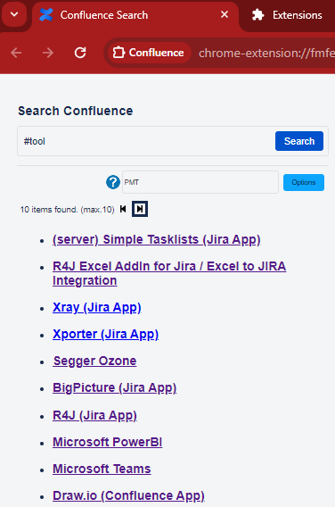
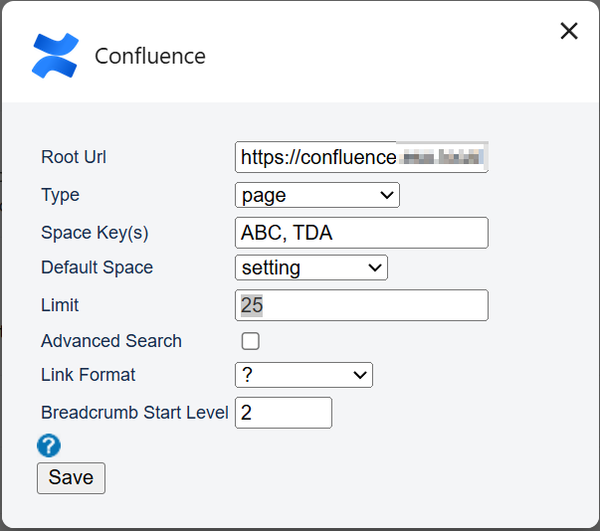
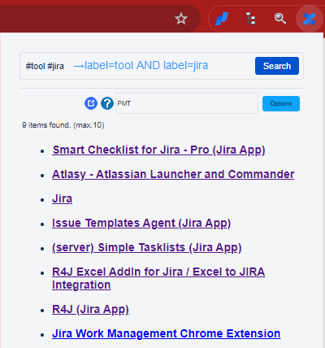

Search from Omnibox
Copy Link feature
Quick Search combining labels
Support Pagination
Search Options for Space, Type, Page Size, Default Space (setting, last accessed or global)
Numbered Headings (context-menu)
Search from Popup
Ctrl+ Submit to open advanced search
Search in New window

