Slide 1


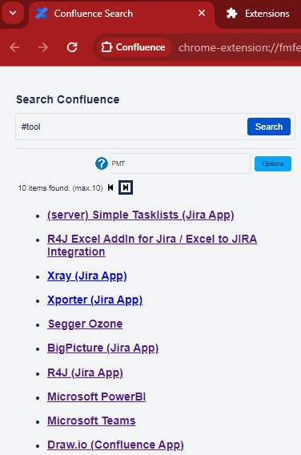
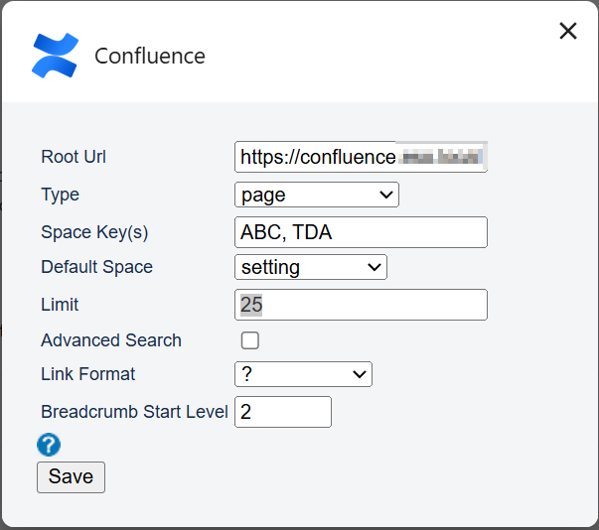
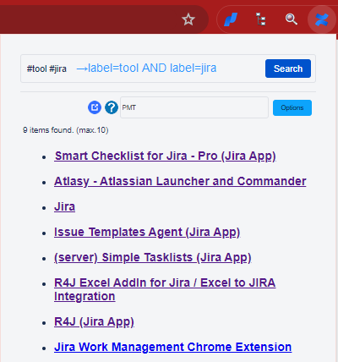

Copy Link and Copy breadcrumb features
Search from Omnibox
Support Pagination
Quick Search combining labels
Search Options for Space, Type, Page Size, Default Space (setting, last accessed or global)
Numbered Headings (context-menu)
Search from Popup
Ctrl+ Submit to open advanced search
Search in New window

