Slide 1
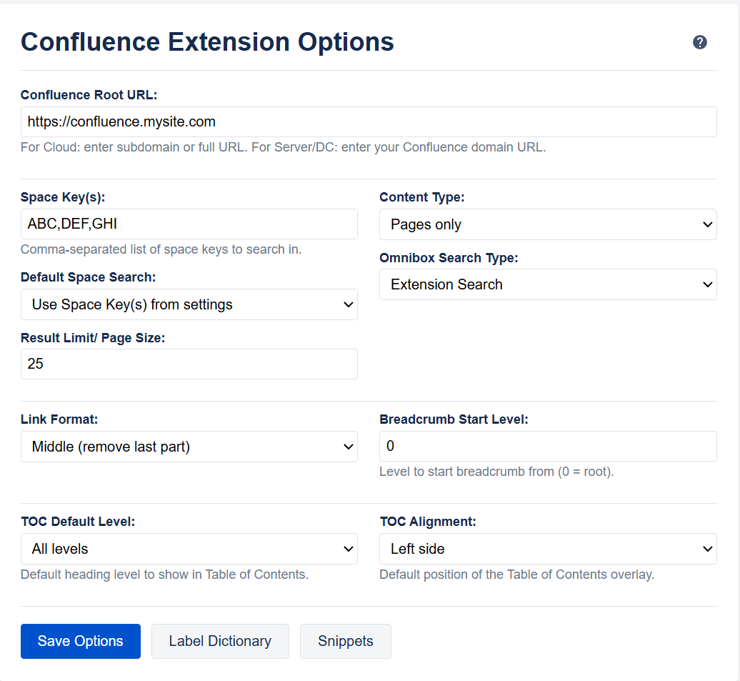
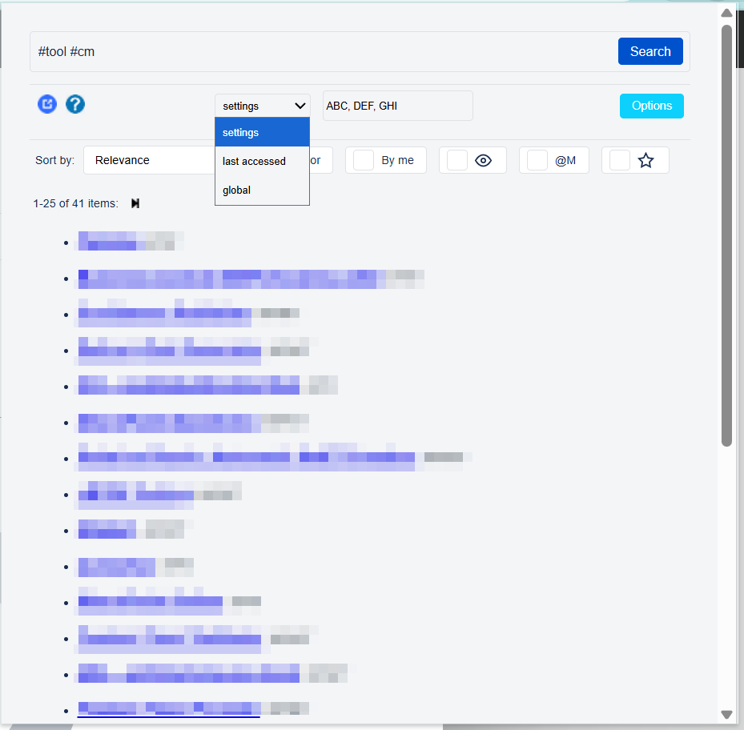
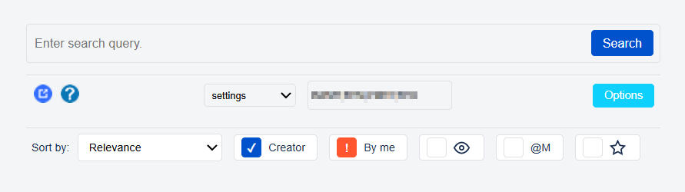
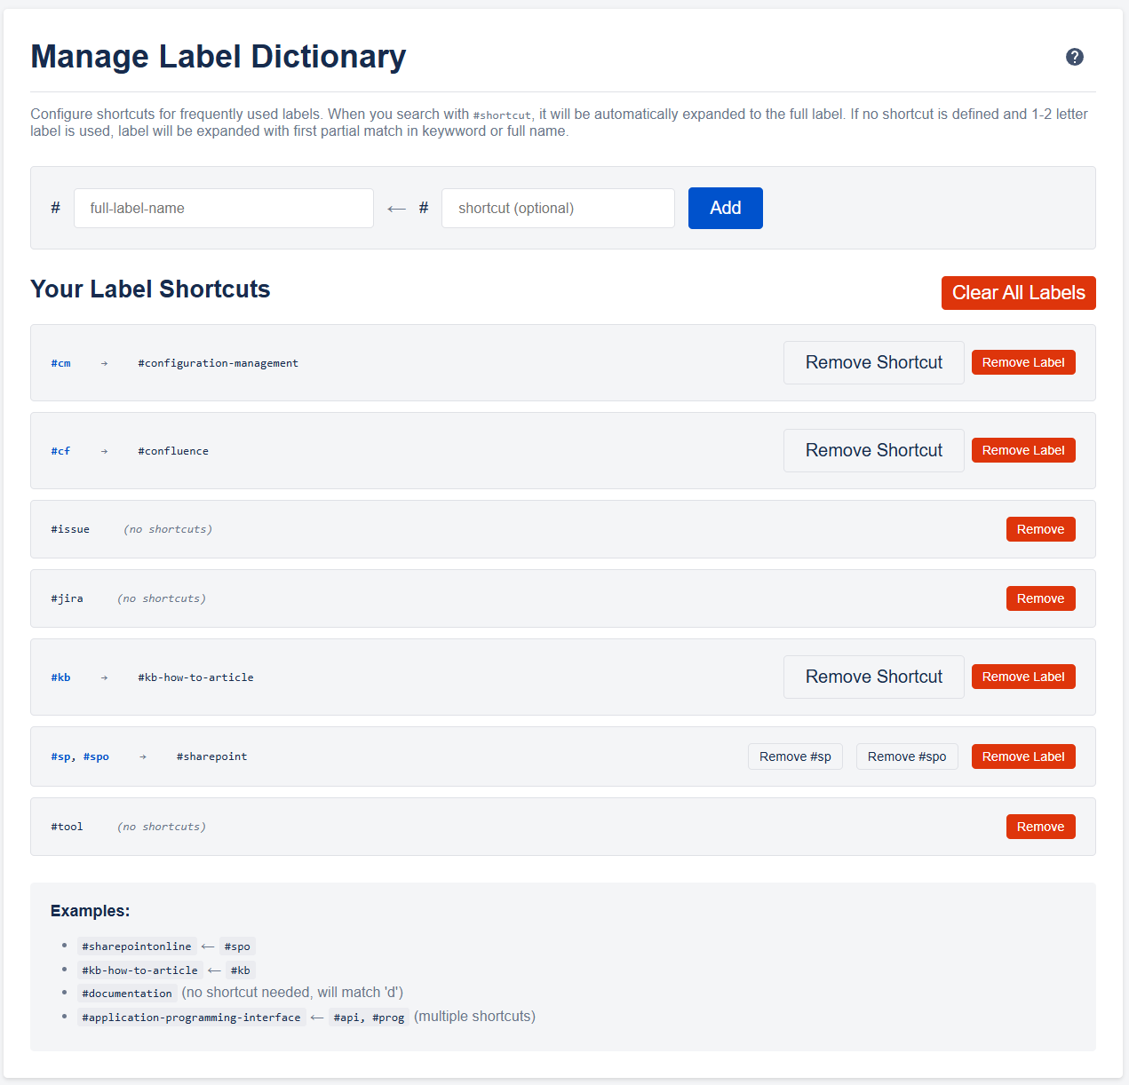

Quick Search combining labels
Support Pagination
Possibility to quick search in predefined spaces included ‘last accessed’ also with keyword overwrite
Search Options for Type, Result Limit, Default Space
Label Dictionary
Quick filters for sorting and ‘not/my pages’ (contributor, creator, favorites, watches)
Open native Confluence advanced Search with Ctrl+Submit or default mode from omnibox
Search from Omnibox with keyword ‘c’
for quick search

Slide 2
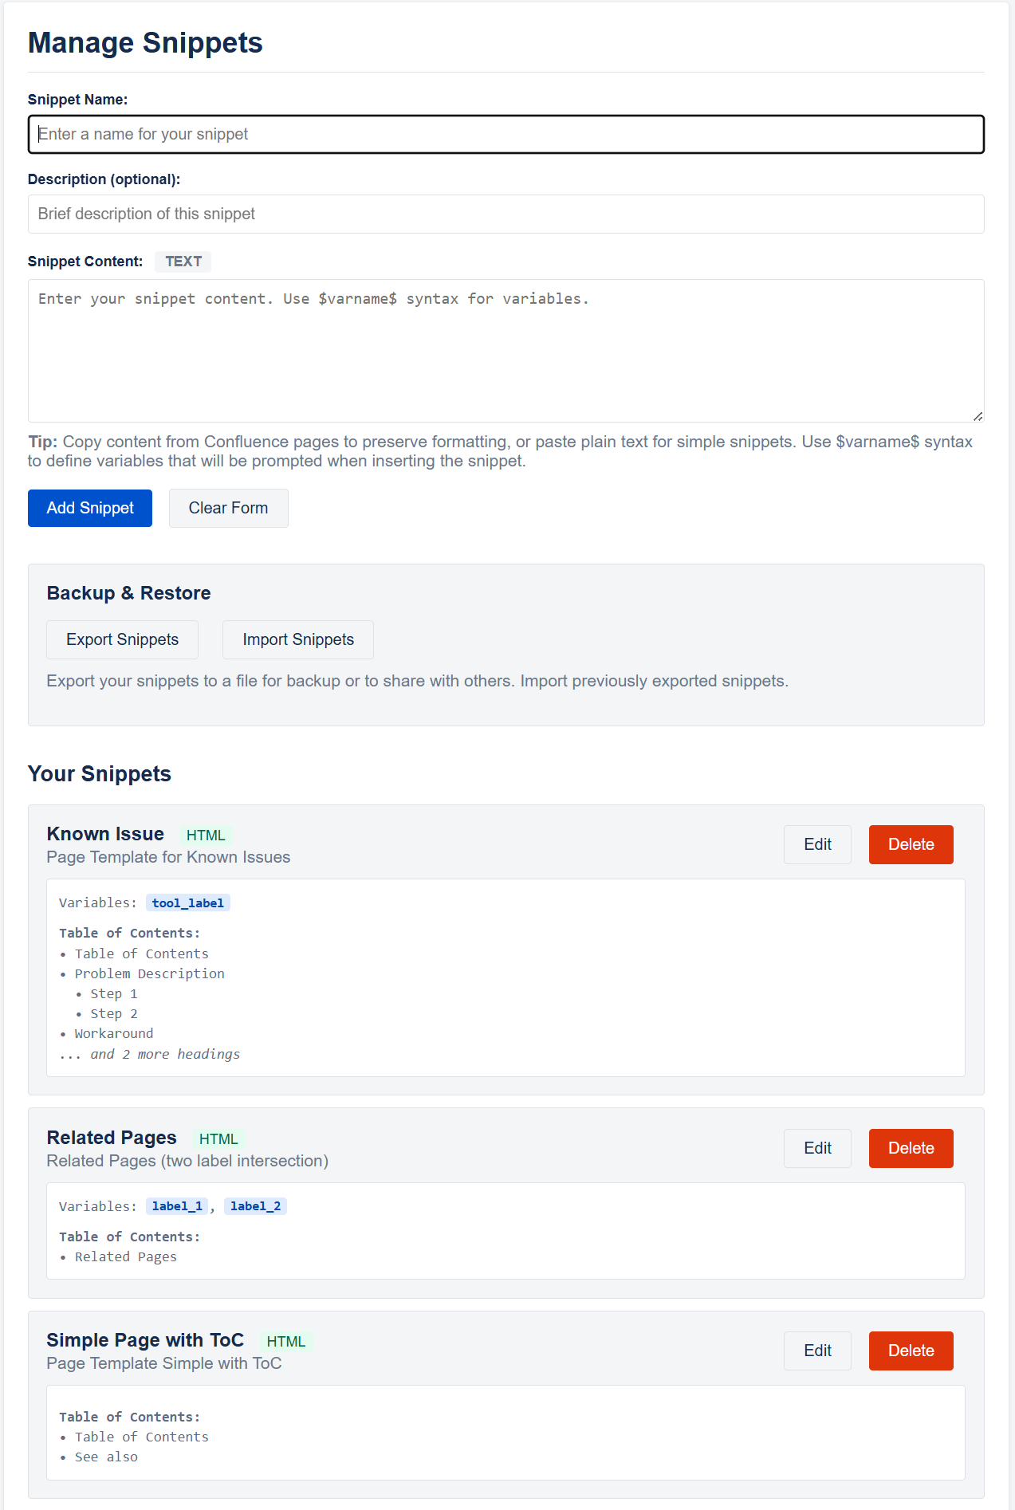
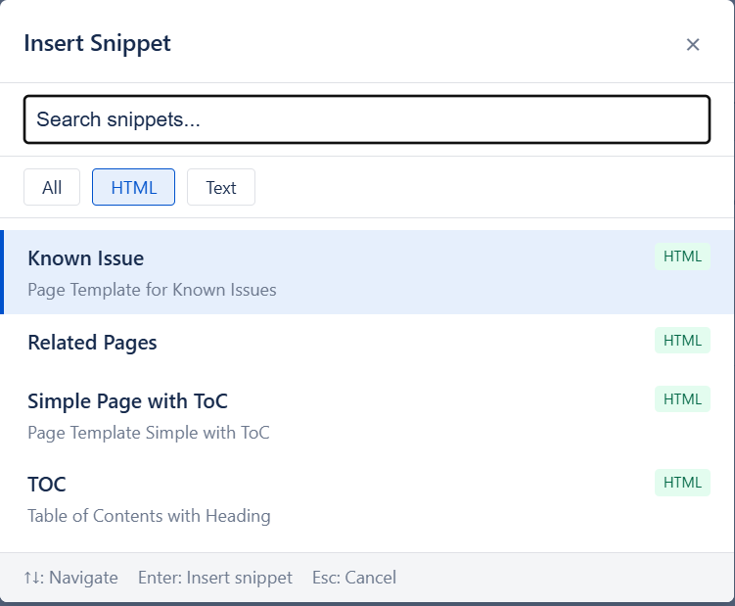
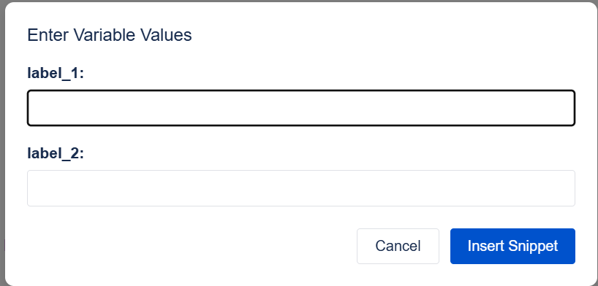
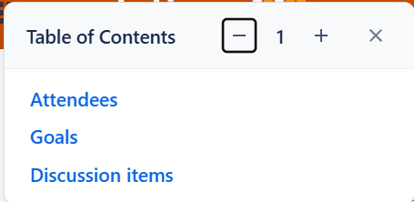
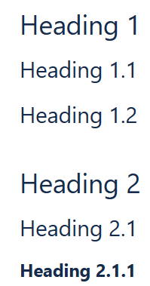
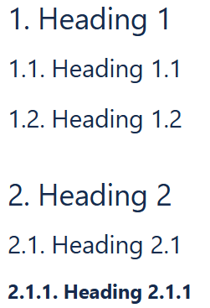
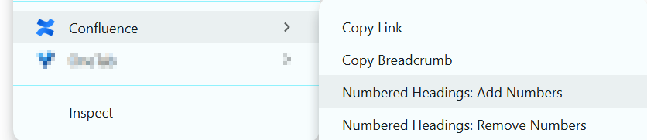
Snippet Management
Local Handling of Templates
Variable expansion
Export/Import for sharing
Source or Rich Editor
Copy Link
Link using PageId (robust to relocation or renaming)
Breadcrumb format
Variable Expansion
Snippet Manager
Snippet Selector for Quick Insert
Table of Contents
Overlay with Left or Right default position
expandable levels
Jump to heading
Draggable
Numbered Headings
Add/Remove Heading Numbering via context menu

Slide 3
