Slide 1
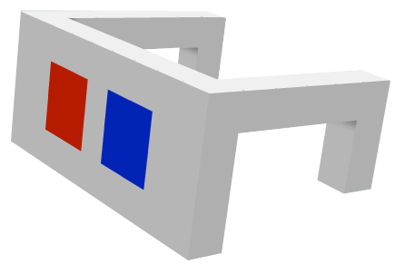
Vectors in 3d 3D
Notes:
Welcome to a session a have chosen to call ”a brief introduction to 3D”. It’s around 100 slides or three hours if listening to me talking about them. I have tried to filter some topics that may be interesting from a flash-developers point of view. If you are a ”online” guest, I have tried to fill in with some comments for you, but this was intended as a discussion base rather than a online guide, so keywords is the main thing.
I also want to give credits for all of you that has contributed to this presentation by publishing papers, tutorials and demos. There is some copy-n-paste going on occasionally and I have lost track of all references and sources. Loads of credits goes out to you all.
Lets start!

Slide 2
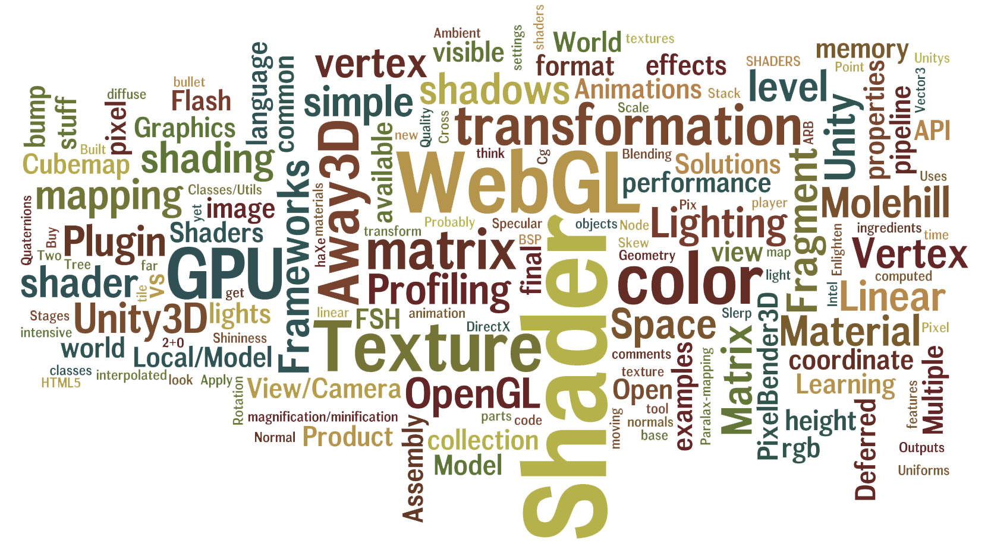
Notes:
Some of the topics of this talk

Slide 3
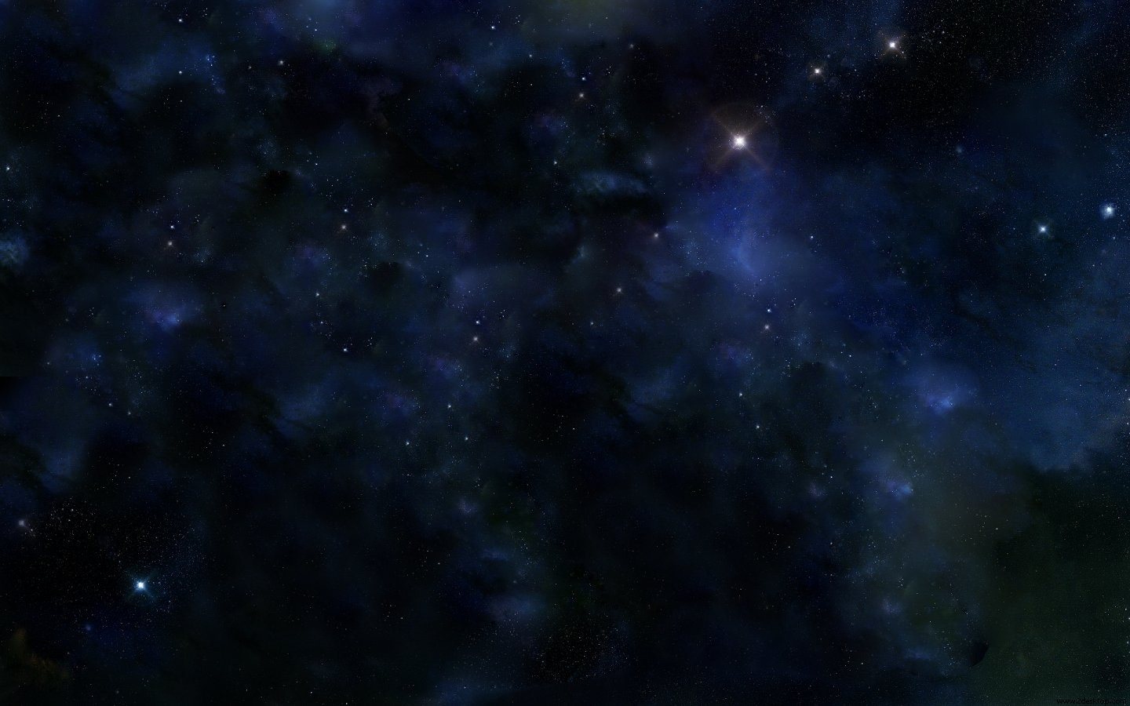
SPACES
Notes:
Feel the space in your 3d world. When thinking on a point or a vector, or when transforming and rotating objects, picturize the space to get an understanding of the directions and how axis is pointing.

Slide 4
Spaces
Euclidean space using Cartesian coordinates. (X, Y and Z)
Local/Model Space
World Space
View/Camera Space (Point-of-view)
Screen space (2D)
Notes:
We are using some different spaces depending on where we looking from.
Object space: Local to an object, an object being a set of polygons. If you want to have multiple instances of the same object, at different locations in the world, you need object space.
World space: This coordinate system is the most important one. This is where all objects are positioned, where you do compute physics, movements and collisions detection. It is also here that lighting is computed. Think of the world space as your game world.
View space: This coordinate system is relative to the camera. Objects in world space are transformed to view space to know what is visible on the screen. This space is also commonly called "eye space" or "camera space".
Screen space (2D): Coordinates representation of the screen. Coordinates are not pixels though. The viewport maps view space to screen space, and the origin in screen space is in the middle of the screen (for perspective projections anyway).

Slide 5
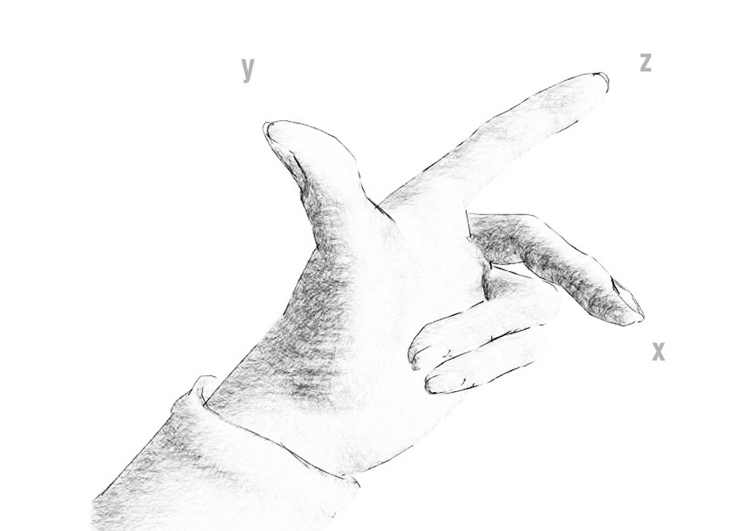
Left- and right-handed systems
Notes:
There is two kinds, the left- or the right-handed system. This can be a little tricky when importing/exporting between softwares. 3DS Max has a left-handed system (Z up Y into the screen and X right) while Maya and Unity for example, uses a right handed. That is because OpenGL and Direct3D vary in axis system.
The picture above representing the left handed one. To use the right-handed one, rotate your right hand 180 degrees around your thumb (y), so that you are pointing at yourself. (inverts z-axis).

Slide 6
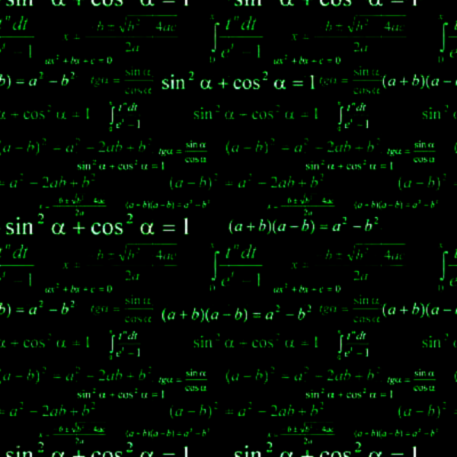
MATH & ALGEBRA
Notes:
Get familiar with the basics. You don’t necessarily have to know the math behind the solutions, but by learning the basics you learn how to formulate the solution and find it quickly.

Slide 7
Length
Pythagorean Formula
|V| = sqrt(x² + y²)
Notes:
The length between two points, or in this case the length of a Vector if you travel from the tail to the head.
To calculate in 3D, just add an extra term.

Slide 8
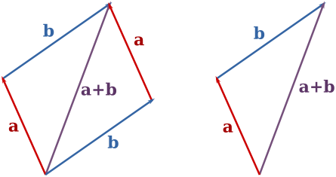
Addition
A = (1, 2)
B = (4, 0)
A + B = (1+4, 2+0) = (5, 2)
Notes:
To find out where the sum of some vector is located.
To add it graphically, you put the tail of one vector at the head of the other.
Just like scalar addition, the order that you add the vectors does not matter.
To calculate in 3d, just add an extra term.

Slide 9
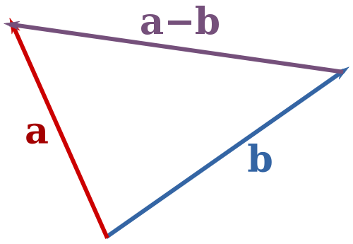
Subtraction
A = (1, 2)
B = (4, 0)
A - B = A + (-B)
A - B = (1-4, 2-0) = (-3, 2)
Notes:
To find the magnitude and direction of the difference between two vectors
Subtracting vectors is very much the same as adding them, except that you do it in the opposite order.
Negating a vector is a simple as rotating it 180 degrees.
To calculate in 3d, just add an extra term.

Slide 10
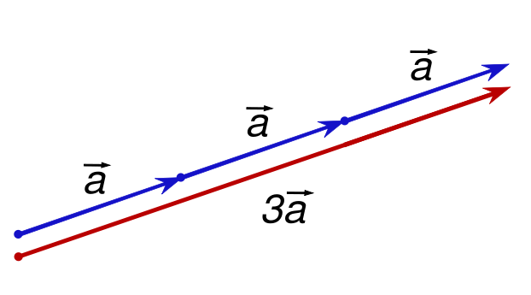
Scalar Multiplication
A*3 = (3*1, 3*2) = (3, 6)
(unit vector = divide the vector by it's length)
(vector length = square root of (x*x+y*y+z*z))
Notes:
This operation scales vectors, like stretching or shrinking a vector.
Scalar = a single real number
unit vector = normalized vector

Slide 11
Vector magnitude & normalization
Multiplication and division, as we just saw, are means by which the length of the vector can be changed without affecting direction.
Notes:
Find the normal vector of a plane. It’s a more advanced operation, but very useful.
Used to calculate the normal vector. The normal vector to a plane is the one that sticks straight out of it. Useful for things like shading the surface and determining visibility.

Slide 12
Vector magnitude & normalization
Perhaps you’re wondering: “OK, so how do I know what the length of a vector is? I know the components, but how long is the actual Vector?”
Understanding how to calculate the length of a vector is incredibly useful and important.
Notes:
Find the normal vector of a plane. It’s a more advanced operation, but very useful.
Used to calculate the normal vector. The normal vector to a plane is the one that sticks straight out of it. Useful for things like shading the surface and determining visibility.

Slide 13
Vector magnitude & normalization
Perhaps you’re wondering: “OK, so how do I know what the length of a vector is? I know the components, but how long is the actual Vector?”
Understanding how to calculate the length of a vector is incredibly useful and important.
Notes:
Find the normal vector of a plane. It’s a more advanced operation, but very useful.
Used to calculate the normal vector. The normal vector to a plane is the one that sticks straight out of it. Useful for things like shading the surface and determining visibility.

Slide 14
Vector magnitude & normalization
Notes:
Find the normal vector of a plane. It’s a more advanced operation, but very useful.
Used to calculate the normal vector. The normal vector to a plane is the one that sticks straight out of it. Useful for things like shading the surface and determining visibility.

Slide 15
Vector magnitude & normalization
Notice in the diagram how the vector, drawn as an arrow and two components(x and y), creates a right triangle.
The sides are the components and the hypotenuse is the arrow itself.
We’re very lucky to have this right triangle, because once upon a time, a Greek mathematician named Pythagoras developed a lovely formula to describe the relationship between the sides and hypotenuse of a right triangle.
Notes:
Find the normal vector of a plane. It’s a more advanced operation, but very useful.
Used to calculate the normal vector. The normal vector to a plane is the one that sticks straight out of it. Useful for things like shading the surface and determining visibility.

Slide 16
Vector magnitude & normalization
The Pythagorean theorem
Notes:
Find the normal vector of a plane. It’s a more advanced operation, but very useful.
Used to calculate the normal vector. The normal vector to a plane is the one that sticks straight out of it. Useful for things like shading the surface and determining visibility.

Slide 17

Vector magnitude & normalization
The Pythagorean theorem
Armed with this formula, we can now compute the magnitude of
Notes:
Find the normal vector of a plane. It’s a more advanced operation, but very useful.
Used to calculate the normal vector. The normal vector to a plane is the one that sticks straight out of it. Useful for things like shading the surface and determining visibility.

Slide 18
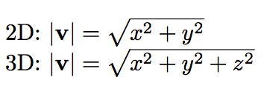
Vector magnitude & normalization
Notes:
Find the normal vector of a plane. It’s a more advanced operation, but very useful.
Used to calculate the normal vector. The normal vector to a plane is the one that sticks straight out of it. Useful for things like shading the surface and determining visibility.

Slide 19
Vector magnitude & normalization
Calculating the magnitude of a vector is only the beginning. The magnitude function opens the door to many possibilities, the first of which is normalization
Notes:
Find the normal vector of a plane. It’s a more advanced operation, but very useful.
Used to calculate the normal vector. The normal vector to a plane is the one that sticks straight out of it. Useful for things like shading the surface and determining visibility.

Slide 20
Vector magnitude & normalization
Normalizing refers to the process of making something “standard” or, well, “normal.”
In the case of vectors, let’s assume for the moment that a standard vector has a length of 1.
To normalize a vector, is to take a vector of any length and, keeping it pointing in the same direction, change its length to 1, turning it into what is called a unit vector.
Notes:
Find the normal vector of a plane. It’s a more advanced operation, but very useful.
Used to calculate the normal vector. The normal vector to a plane is the one that sticks straight out of it. Useful for things like shading the surface and determining visibility.

Slide 21
Vector magnitude & normalization
Notes:
Find the normal vector of a plane. It’s a more advanced operation, but very useful.
Used to calculate the normal vector. The normal vector to a plane is the one that sticks straight out of it. Useful for things like shading the surface and determining visibility.

Slide 22
Vector magnitude & normalization
Since it describes a vector’s direction without regard to its length, it’s useful to have the unit vector readily accessible.
We’ll see this come in handy once we start to work with forces.
Notes:
Find the normal vector of a plane. It’s a more advanced operation, but very useful.
Used to calculate the normal vector. The normal vector to a plane is the one that sticks straight out of it. Useful for things like shading the surface and determining visibility.

Slide 23

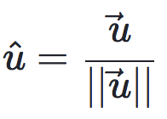
Vector magnitude & normalization
For any given vector V, its unit vector (written as ) is calculated as follows:
Notes:
Find the normal vector of a plane. It’s a more advanced operation, but very useful.
Used to calculate the normal vector. The normal vector to a plane is the one that sticks straight out of it. Useful for things like shading the surface and determining visibility.

Slide 24
Vector magnitude & normalization
In other words, to normalize a vector, simply divide each component by its magnitude.
This is pretty intuitive.
Say a vector is of length 5. Well, 5 divided by 5 is 1.
So, looking at our right triangle, we then need to scale the hypotenuse down by dividing by 5.
In that process the sides shrink, divided by 5 as well.
Notes:
Find the normal vector of a plane. It’s a more advanced operation, but very useful.
Used to calculate the normal vector. The normal vector to a plane is the one that sticks straight out of it. Useful for things like shading the surface and determining visibility.

Slide 25
Vector magnitude & normalization
Notes:
Find the normal vector of a plane. It’s a more advanced operation, but very useful.
Used to calculate the normal vector. The normal vector to a plane is the one that sticks straight out of it. Useful for things like shading the surface and determining visibility.

Slide 26
Vector magnitude & normalization
In other words, to normalize a vector, simply divide each component by its magnitude.
This is pretty intuitive.
Say a vector is of length 5. Well, 5 divided by 5 is 1.
So, looking at our right triangle, we then need to scale the hypotenuse down by dividing by 5.
In that process the sides shrink, divided by 5 as well.
Notes:
Find the normal vector of a plane. It’s a more advanced operation, but very useful.
Used to calculate the normal vector. The normal vector to a plane is the one that sticks straight out of it. Useful for things like shading the surface and determining visibility.

Slide 27
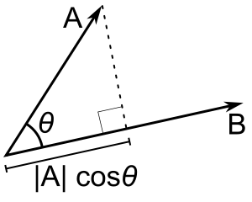
Dot Product
A = (A_{x}, A_{y}, A_{z}) B = (B_{x}, B_{y}, B_{z})
A·B = A_{x}B_{x} + A_{y}B_{y} + A_{z}B_{z} A·B = |A||B|cosθ
Notes:
The Dot Product is a vector operation which will return a scalar value (single number), which for unit vectors is equal to the cosine of the angle between the two input vectors.
Finding the angle between two vectors.
Also called “Inner product”.
Backface culling
Light surfaces
Also with the dot product, you can find the length of a projection of one vector on another.

Slide 28
Dot Product
The dot product takes two vectors and returns a scalar.
This scalar is equal to the magnitudes of the two vectors multiplied together and the result multiplied by the cosine of the angle between the vectors.
When both vectors are normalized, the cosine essentially states how far the first vector extends in the second’s direction (or vice-versa - the order of the parameters doesn’t matter).
Notes:
The Dot Product is a vector operation which will return a scalar value (single number), which for unit vectors is equal to the cosine of the angle between the two input vectors.
Finding the angle between two vectors.
Also called “Inner product”.
Backface culling
Light surfaces
Also with the dot product, you can find the length of a projection of one vector on another.

Slide 29
Dot Product
Notes:
The Dot Product is a vector operation which will return a scalar value (single number), which for unit vectors is equal to the cosine of the angle between the two input vectors.
Finding the angle between two vectors.
Also called “Inner product”.
Backface culling
Light surfaces
Also with the dot product, you can find the length of a projection of one vector on another.

Slide 30
Dot Product
It is easy enough to think in terms of angles and then find the corresponding cosines using a calculator.
However, it is useful to get an intuitive understanding of some of the main cosine values as shown in the diagram.
Notes:
The Dot Product is a vector operation which will return a scalar value (single number), which for unit vectors is equal to the cosine of the angle between the two input vectors.
Finding the angle between two vectors.
Also called “Inner product”.
Backface culling
Light surfaces
Also with the dot product, you can find the length of a projection of one vector on another.

Slide 31
Dot Product
A = (A_{x}, A_{y}, A_{z}) B = (B_{x}, B_{y}, B_{z})
A·B = A_{x}B_{x} + A_{y}B_{y} + A_{z}B_{z} A·B = |A||B|cosθ
Notes:
The Dot Product is a vector operation which will return a scalar value (single number), which for unit vectors is equal to the cosine of the angle between the two input vectors.
Finding the angle between two vectors.
Also called “Inner product”.
Backface culling
Light surfaces
Also with the dot product, you can find the length of a projection of one vector on another.

Slide 32
Dot Product
Note:
The dot product is a very simple operation that can be used in place of the Mathf.Cos function or the vector magnitude operation in some circumstances (it doesn’t do exactly the same thing but sometimes the effect is equivalent).
However, calculating the dot product function takes much less CPU time and so it can be a valuable optimization.
Notes:
The Dot Product is a vector operation which will return a scalar value (single number), which for unit vectors is equal to the cosine of the angle between the two input vectors.
Finding the angle between two vectors.
Also called “Inner product”.
Backface culling
Light surfaces
Also with the dot product, you can find the length of a projection of one vector on another.

Slide 33
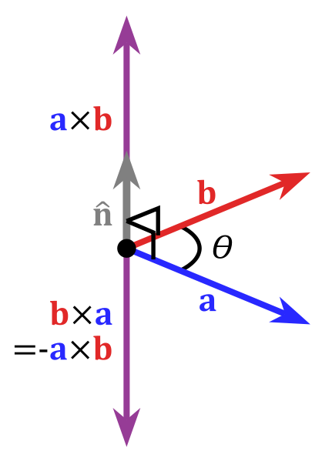
Cross Product
AxB = (A_{y}B_{z} - A_{z}B_{y}, A_{z}B_{x} - A_{x}B_{z}, A_{x}B_{y} - A_{y}B_{x})
Notes:
Find the normal vector of a plane. It’s a more advanced operation, but very useful.
Used to calculate the normal vector. The normal vector to a plane is the one that sticks straight out of it. Useful for things like shading the surface and determining visibility.

Slide 34
Cross Product
The other operations are defined for 2D and 3D vectors and indeed vectors with any number of dimensions.
The cross product, by contrast, is only meaningful for 3D vectors.
It takes two vectors as input and returns another vector as its result.
Notes:
Find the normal vector of a plane. It’s a more advanced operation, but very useful.
Used to calculate the normal vector. The normal vector to a plane is the one that sticks straight out of it. Useful for things like shading the surface and determining visibility.

Slide 35
Cross Product
The other operations are defined for 2D and 3D vectors and indeed vectors with any number of dimensions.
The cross product, by contrast, is only meaningful for 3D vectors.
It takes two vectors as input and returns another vector as its result.
Notes:
Find the normal vector of a plane. It’s a more advanced operation, but very useful.
Used to calculate the normal vector. The normal vector to a plane is the one that sticks straight out of it. Useful for things like shading the surface and determining visibility.

Slide 36
Cross Product
The result vector is perpendicular to the two input vectors.
The “left hand rule” can be used to remember the direction of the output vector from the ordering of the input vectors.
If the first parameter is matched up to the thumb of the hand and the second parameter to the forefinger, then the result will point in the direction of the middle finger.
If the order of the parameters is reversed then the resulting vector will point in the exact opposite direction but will have the same magnitude.
Notes:
Find the normal vector of a plane. It’s a more advanced operation, but very useful.
Used to calculate the normal vector. The normal vector to a plane is the one that sticks straight out of it. Useful for things like shading the surface and determining visibility.

Slide 37
Cross Product
Notes:
Find the normal vector of a plane. It’s a more advanced operation, but very useful.
Used to calculate the normal vector. The normal vector to a plane is the one that sticks straight out of it. Useful for things like shading the surface and determining visibility.

Slide 38
Cross Product
The magnitude of the result is equal to the magnitudes of the input vectors multiplied together and then that value multiplied by the sine of the angle between them.
Some useful values of the sine function are shown
Notes:
Find the normal vector of a plane. It’s a more advanced operation, but very useful.
Used to calculate the normal vector. The normal vector to a plane is the one that sticks straight out of it. Useful for things like shading the surface and determining visibility.

Slide 39
Cross Product
The cross product can seem complicated since it combines several useful pieces of information in its return value.
However, like the dot product, it is very efficient mathematically and can be used to optimize code that would otherwise depend on slow transcendental functions.
Notes:
Find the normal vector of a plane. It’s a more advanced operation, but very useful.
Used to calculate the normal vector. The normal vector to a plane is the one that sticks straight out of it. Useful for things like shading the surface and determining visibility.

Slide 40
Cross Product
AxB = (A_{y}B_{z} - A_{z}B_{y}, A_{z}B_{x} - A_{x}B_{z}, A_{x}B_{y} - A_{y}B_{x})
Notes:
Find the normal vector of a plane. It’s a more advanced operation, but very useful.
Used to calculate the normal vector. The normal vector to a plane is the one that sticks straight out of it. Useful for things like shading the surface and determining visibility.

Slide 41
Real world examples
In which direction should the missile be fired to hit the target?
Is the enemy visible in the field of view?
How far is the bullet from the window?
Notes:
It’s easier to get the concept by formulate real world examples.

Slide 42
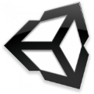
Solutions
Solutions have been done by many before.
Know the basics to find them quicker.
Use utils and classes like:
Vector3
Notes:
Don’t panic. You probably will get away with little knowledge about this, but only to a certain level.

Slide 43
Reading
https://vvvv.org/documentation/3d-vector-mathematics
Vector Math
https://docs.unity3d.com/ScriptReference/Vector3.html
Review all methods and properties of the Unity Vector3 class. follow each link and test the function usage.
Notes:
Don’t panic. You probably will get away with little knowledge about this, but only to a certain level.

