Slide 1
Web 2110 Web Scripting Online Storefront
Tim Daniels
Baker College
12-11-2017

Slide 2
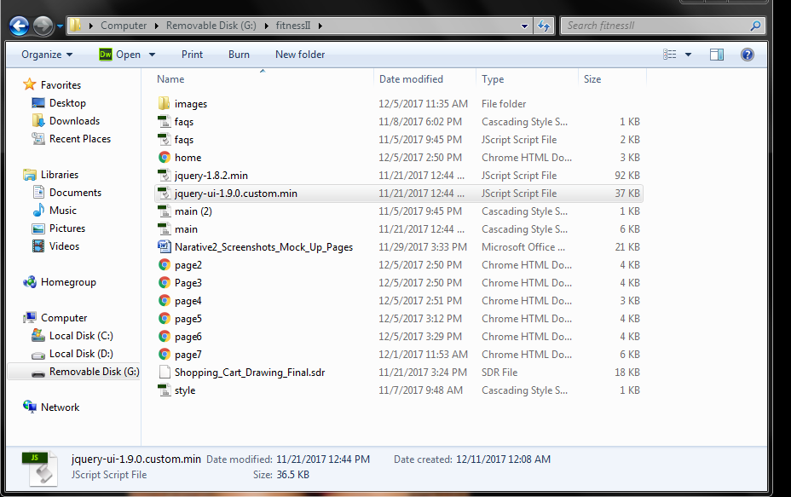
A copy of
images
process/methods
JavaScript pages
One index page used to create each additional page
Used to create this fitness storefront

Slide 3
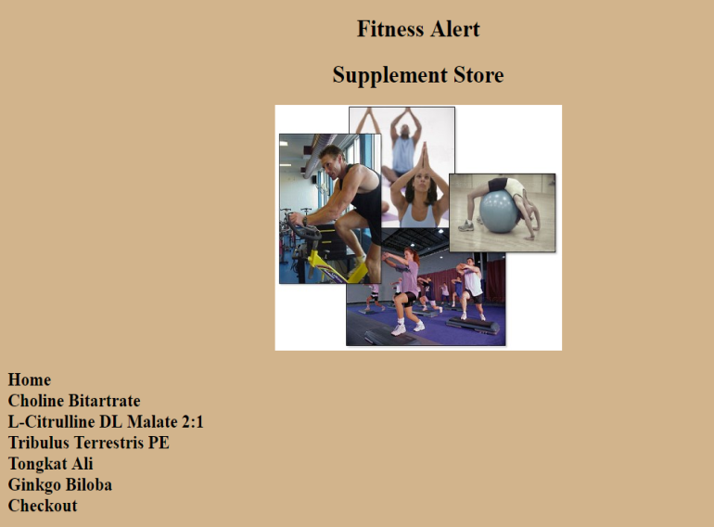
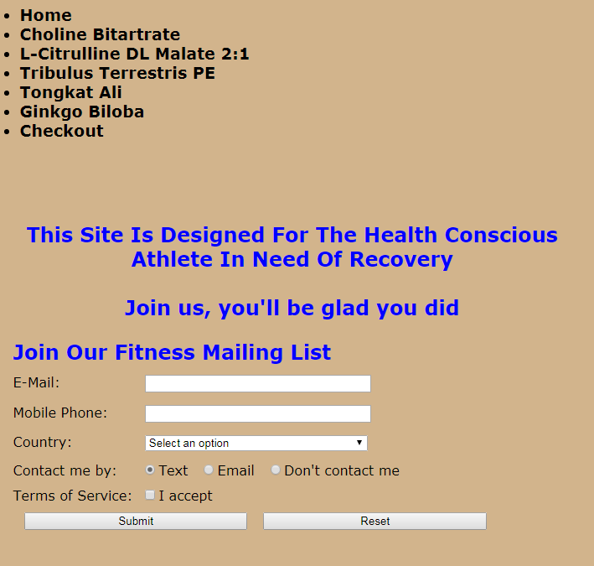
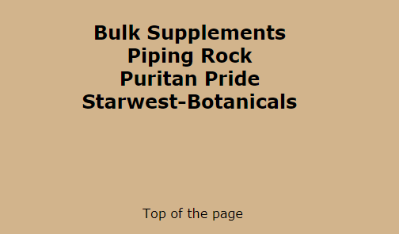
Home: Top
Links To Each Page
Middle
Form Validation/Storage
Bottom
Links To Real Sites
(Click Me)

Slide 4
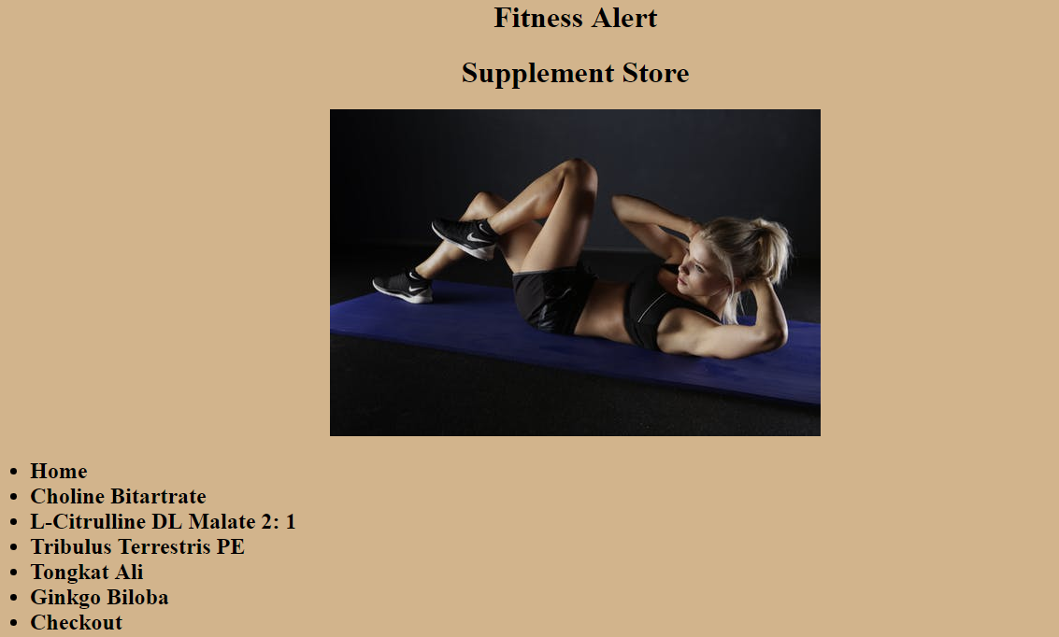
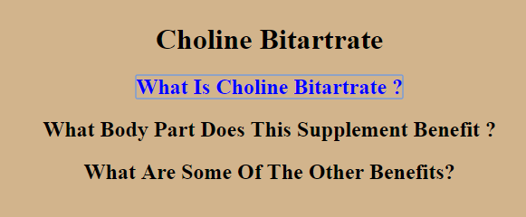
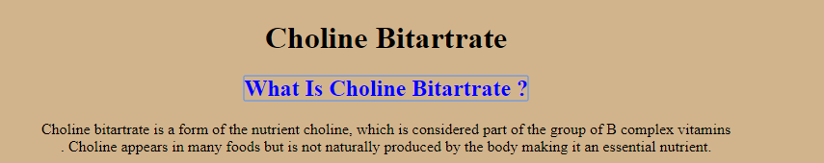
Page 2: Choline Bitartrate
A Question Is Asked (Box 1)
Answer Is Revealed When Clicked (Box 2)

Slide 5
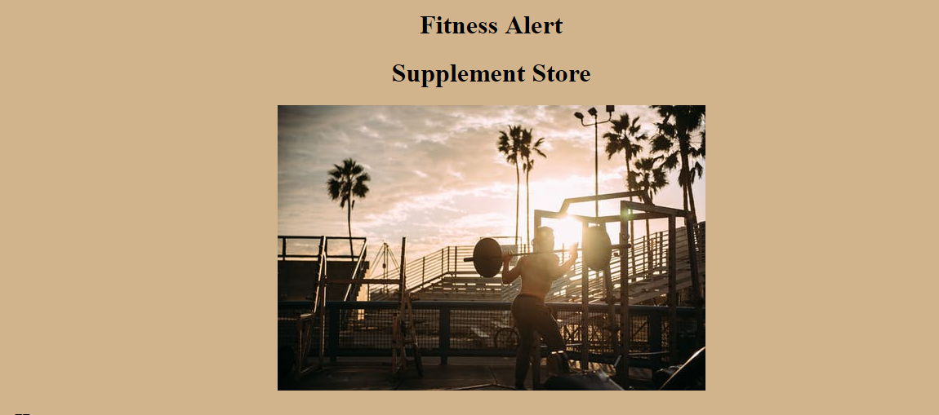
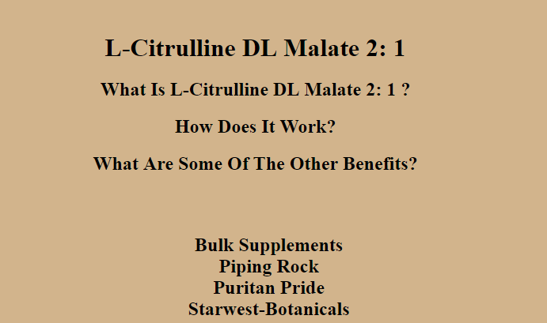
This Is An Effective Supplement For Recovery
L-Citrulline DL Malate 2:1(Click ME)

Slide 6
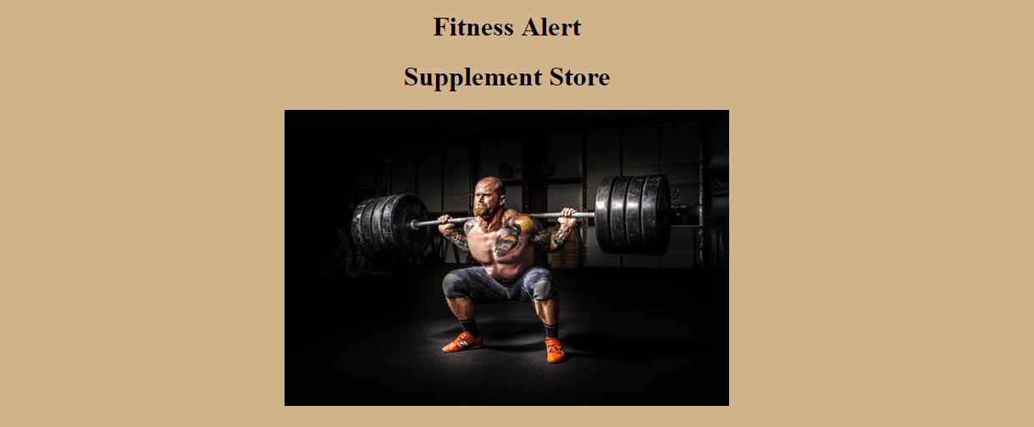
Tribulus Terrestris
An herb used to increase muscle mass
Use Kelp Powder Instead (Starwest Bontanicals)
Question: Click Me For More Info

Slide 7
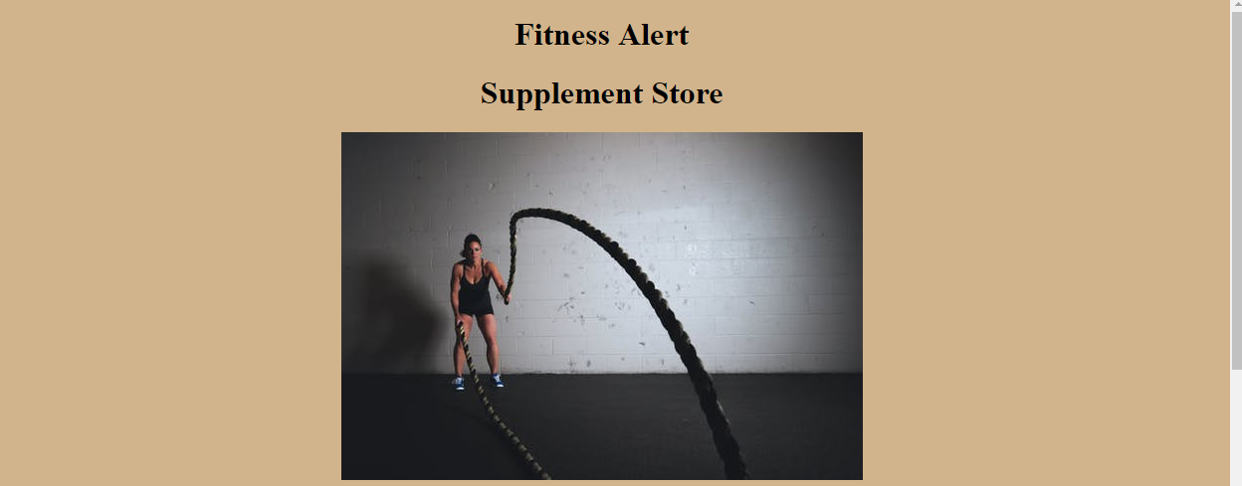
Tongkat Ali
"The Tree That Cures One Hundred Diseases“
Take with a meal or drink; taste is surprisingly unpleasant
Click On Question Area For More Info

Slide 8

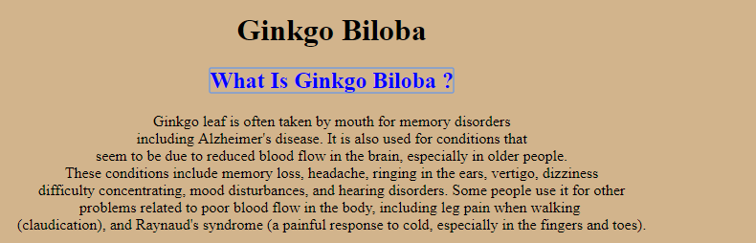
Ginkgo Biloba
Lots Of Benefits

Slide 9
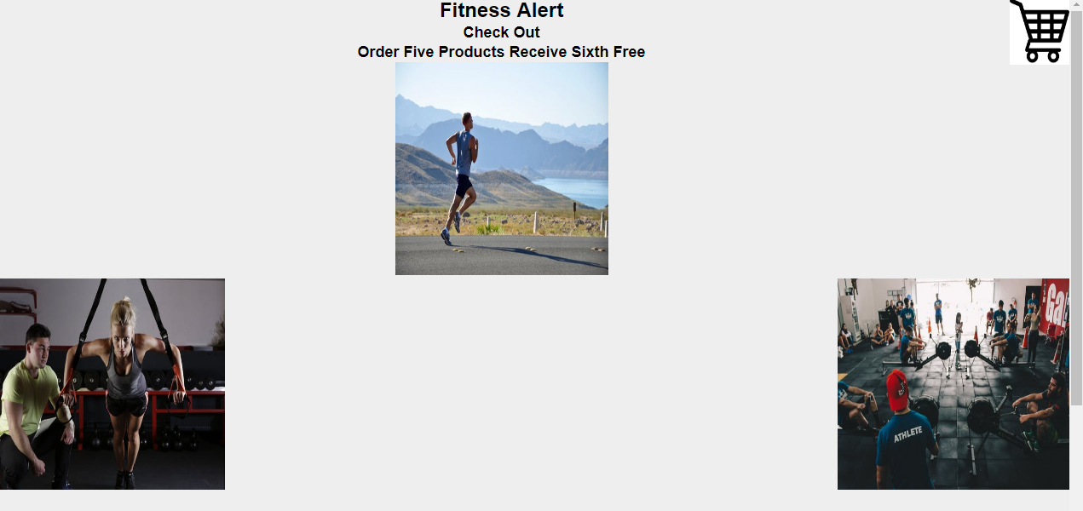
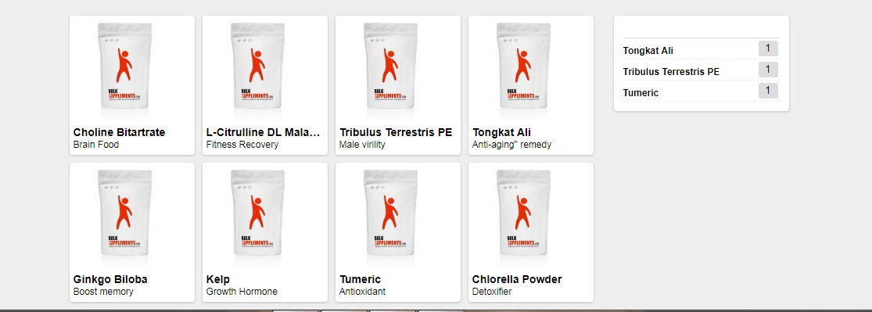
Items Listed
Items Ordered

Slide 10
Fitness Alert Storefront
The End

