Slide 1
FRAGMENTS AND RESPONSIVENESS
Group Members
TINDYEBWA DAN 2015/BCS/076/PS
MOHAMAD OSMAN 2017/BCS/OCC/010/PS

Slide 2
Fragments and responsiveness.
A Fragment represents a behavior or a portion of user interface in an Activity
A Fragment is a piece of an activity which enable more modular activity design.
In simple terms, we can say that a fragment is a kind of sub-activity.

Slide 3
important points about fragment
A fragment has its own layout and its own behavior with its own life cycle callbacks.
You can add or remove fragments in an activity while the activity is running.
Fragment life cycle is closely related to the life cycle of its host activity (activity paused, all the fragments stopped because A fragment must always be embedded in an activity.)
A fragment can implement a behavior that has no user interface component.
Fragments were added to the Android API in Honeycomb version of Android which API version 11.
You can combine multiple fragments in a single activity to build a multi-pane UI and reuse a fragment in multiple activities.

Slide 4
Why were Fragments introduced?
They were introduced primarily to support more dynamic and flexible UI designs on large screens, such as tablets. Because a tablet's screen is much larger than that of a handset, there's more room to combine and interchange UI components. Fragments allow such designs without the need for you to manage complex changes to the view hierarchy. By dividing the layout of an activity into fragments, you become able to modify the activity's appearance at runtime and preserve those changes in a back stack that's managed by the activity.

Slide 5
Important points about fragment
When you add a fragment as a part of your activity layout, it lives in a ViewGroup inside the activity's view hierarchy and the fragment defines its own view layout.
You create fragments by extending Fragment class and You can insert a fragment into your activity layout by declaring the fragment in the activity's layout file, as a <fragment> element.

Slide 6
For example…
<fragment android:layout_width="1dp" android:layout_height="match_parent" android:layout_weight="3" android:name="com.tindyebwa.framentsdanfido.DetailFragment" android:id="@+id/detail" />

Slide 7
Cntd…
A news application can use one fragment to show a list of articles on the left and another fragment to display an article on the right—both fragments appear in one activity, side by side

Slide 8
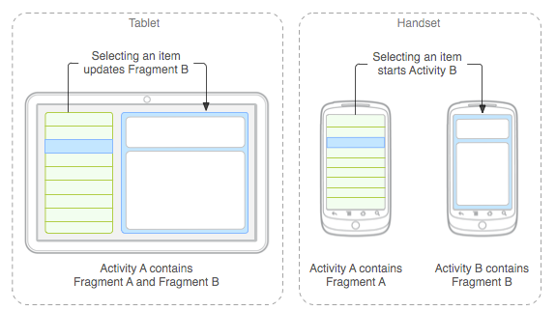
Appearance on different devices

Slide 9
Creating a Fragment
To create a fragment, you must create a subclass of Fragment (or an existing subclass of it).
The Fragment class has code that looks a lot like an Activity.
It contains callback methods similar to an activity, such as onCreate(), onStart(), onPause(), and onStop().
Converting an existing Android application to use fragments, you might simply move code from your activity's callback methods into the respective callback methods of your fragment.

Slide 10
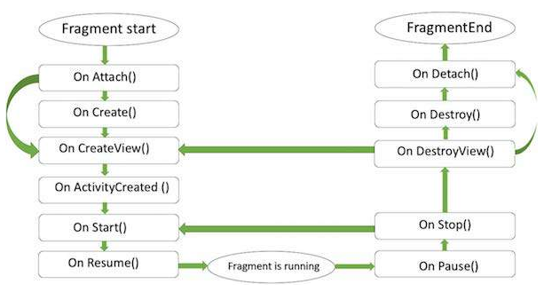
Lifecycle of Fragments
Android fragments have their own life cycle very similar to an android activity. This section briefs different stages of its life cycle.

Slide 11
Methods…
onAttach()
onCreate()
onCreateView()
onActivityCreated()
onStart()
onResume()
onPause()
onStop()
onDestroyView()
onDestroy()

Slide 12
onAttach()
The fragment instance is associated with an activity instance.
The fragment and the activity is not fully initialized.
Typically you get in this method a reference to the activity which uses the fragment for further initialization work.

Slide 13
onCreate()
The system calls this method when creating the fragment.
Essential components of the fragment that need to be retained when the fragment is paused or stopped, then resumed should be initialized.

Slide 14
onCreateView()
The system calls this callback when it's time for the fragment to draw its user interface for the first time.
To draw a UI for your fragment, you must return a View component from this method that is the root of your fragment's layout.
You can return null if the fragment does not provide a UI.

Slide 15
onActivityCreated()
The onActivityCreated() is called after the onCreateView() method when the host activity is created.
Activity and fragment instance have been created as well as the view hierarchy of the activity.
View can be accessed with the findViewById() method.
In this method you can instantiate objects which require a Context object

Slide 16
onStart(), onResume()
The onStart() method is called once the fragment gets visible.
onResume() is called when the Fragment becomes active.

Slide 17
onPause()
The system calls this method as the first indication that the user is leaving the fragment.
This is usually where you should commit any changes that should be persisted beyond the current user session.

Slide 18
onStop(), onDestroyView()
onStop() Fragment going to be stopped by calling onStop()
onDestroyView() Fragment view will destroy after call this method

Slide 19
onDestroy()
onDestroy() is called to do final clean up of the fragment's state but Not guaranteed to be called by the Android platform.

Slide 20
How to use Fragments?
First of all decide how many fragments you want to use in an activity.
Basing on the number of fragments, create classes which will extend the Fragment class. The Fragment class has above mentioned callback functions. You can override any of the functions based on your requirements.
Corresponding to each fragment, you will need to create layout files in XML file. These files will have layout for the defined fragments.
Modify activity file to define the actual logic of replacing fragments based on your requirement.

Slide 21
Types of Fragments
There are basically three types and these are;
Single Frame fragments
List fragments and
Fragment transactions

Slide 22
Single Frame fragments
Single frame fragments are using for hand hold devices like mobiles, here we can show only one fragment as a view.
The device should be above android 3.0 version.

Slide 23
List fragments
fragments having special list view is called as list fragment

Slide 24
Fragment Transition
Using with fragment transaction. we can move one fragment to another fragment.
The transition framework provides a convenient API for animating between different UI states in an application.
The framework is built around two key concepts: scenes and transitions. A scene defines a given state of an application's UI, whereas a transition defines the animated change between two scenes.

