Slide 1
Dynamic pricing
Tom Archer
Code and presentation can be found here: https://github.com/tdarcher/pace_interview.git

Slide 2
Existing dynamic price models
Historical:
Only consider final number of rooms
Same day last year, moving average
Advanced booking
Only consider the number of reservations
Additive, booking curve, time series
Combined:
Weighted average of historical and advanced

Slide 3
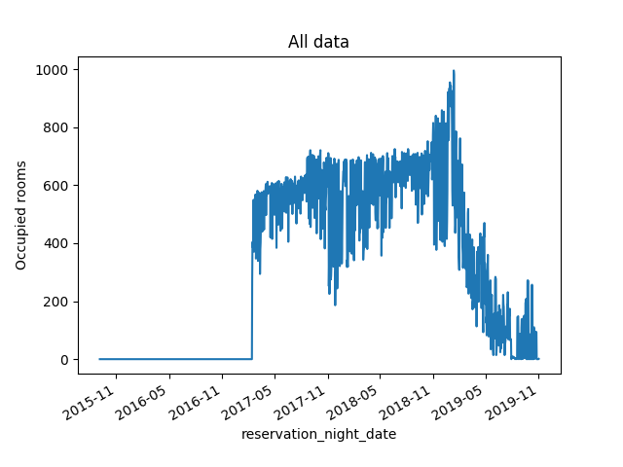

Slide 4
1 Occupancy prediction

Slide 6
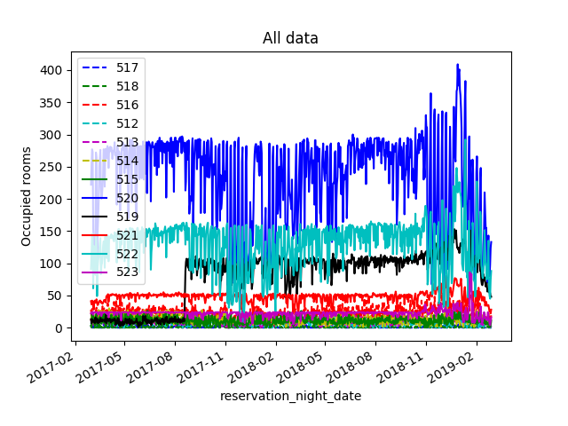

Slide 7
Rooms remaining

Slide 8
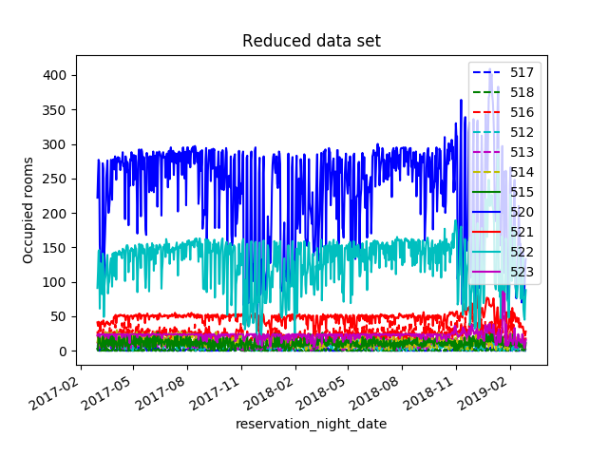

Slide 9
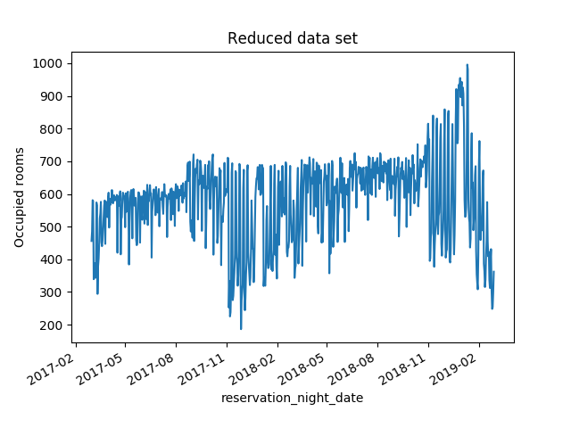

Slide 10
Analysis of Historical trends
Predicting demand

Slide 11
Training
Validation

Slide 12
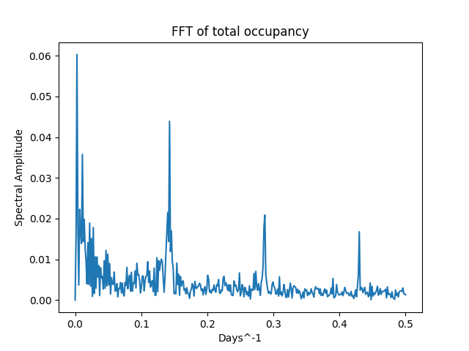
Some structure
Might become
viable with more data
1/7 days =0.143
Weekly occurring trend

Slide 13
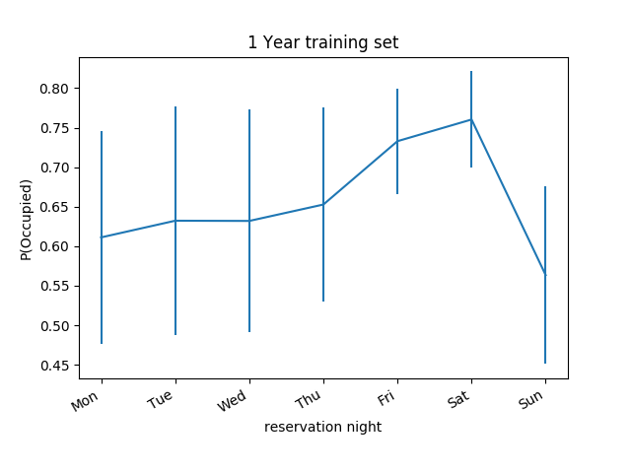

Slide 14
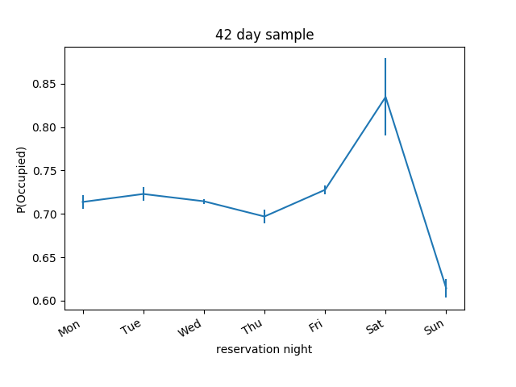
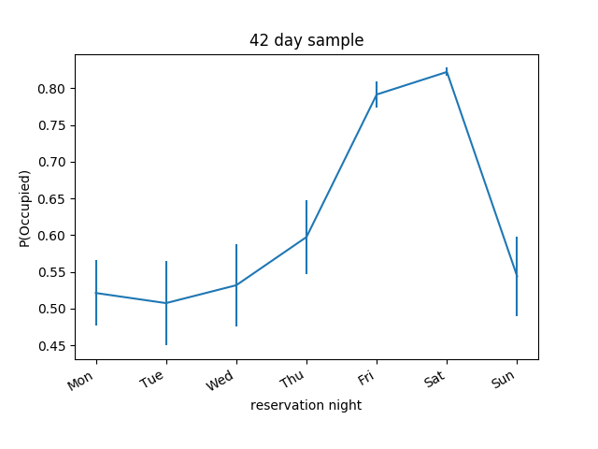

Slide 15
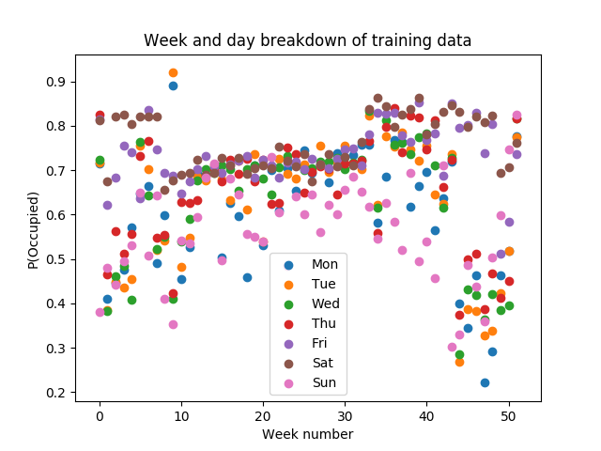
Initial model
Data broken down into week number and day
Demand estimated to be the same as previous year

Slide 16
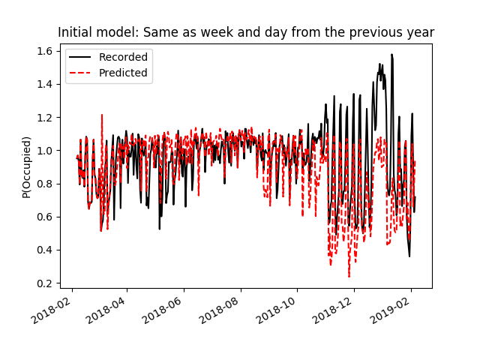
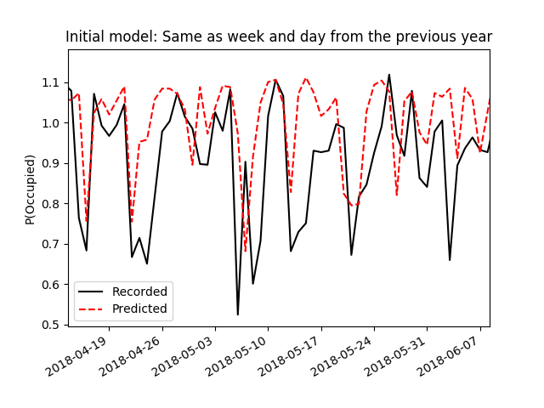
Predict occupancy from historical data
Historical occupancy taken from day and week of previous year.
Works well for the fitted data:
- Need to refit for each hotel
- No variation with improved
performance of the hotel
Over occupancy/more rooms on line?

Slide 17
Can we introduce transferability?

Slide 18
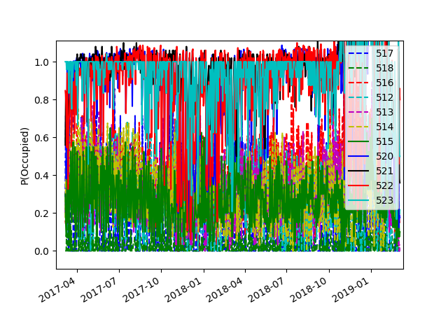
Average occupancy of 523 close to 100%
Average occupancy of 515 only 30%
Similar demand curve for each room id, but a systematic shift present

Slide 19
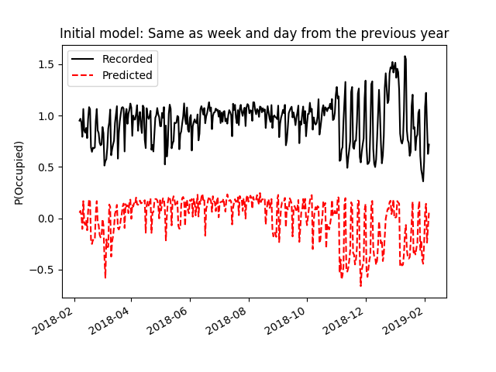
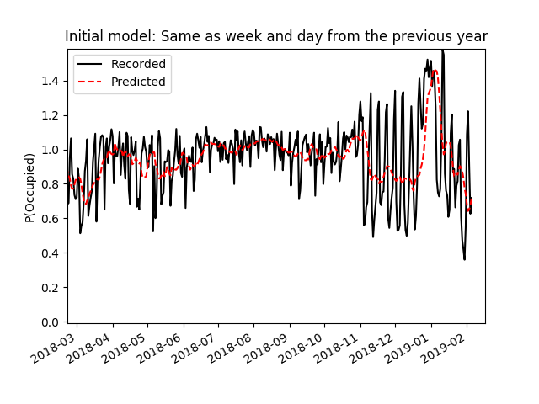
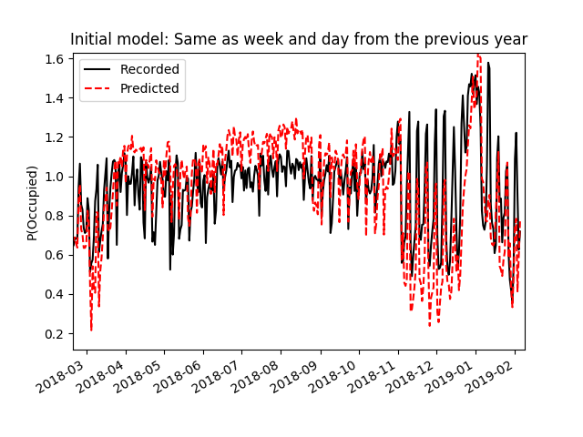
Normalized demand
Hotel performance

Slide 20
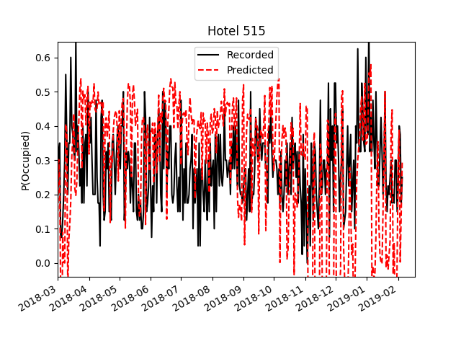
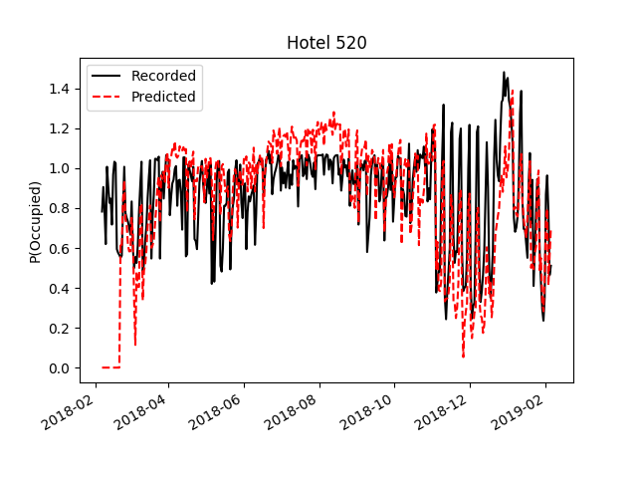
Applying model to different hotels
Residual=0.17
Residual=0.14

Slide 21
2.Revenue

Slide 22
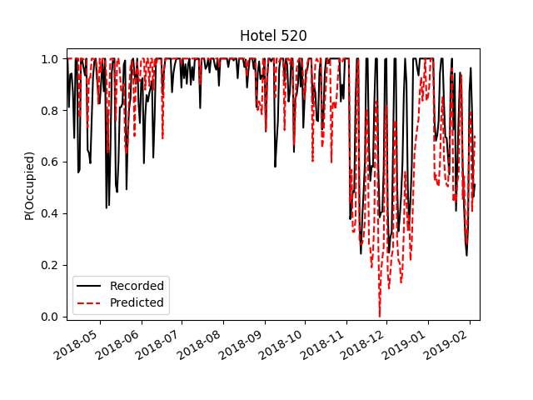
Revenue
P>1 is not a real, the
prediction must be
truncated
However the occupancy probability is a function of price which will create
feedback if the price is changed

Slide 23
3.Price recommendation

Slide 24
Average occupancy of 523 close to 100%
Average occupancy of 515 only 30%
Hotels which are fully occupied most of the year could benefit from a price increase, e.g. 523,520,522
Hotels which have extra capacity could try a price decrease

Slide 25
Considerations
Feedback between changing the price and the occupancy is unknown
Small changes the the price could be made to probe how the occupancy responds.
Rooms could be divided up into price bands to
– promote constant occupation keeping the workload consistent

Slide 26
Conclusion
A simple model based on historical demand and more recent average performance has been implemented. Data is reproduce within 17%
The model can be used to estimate the nightly revenue.
Pricing recommendations need to be implemented slowly to allow deviations to the model to be assessed.

Slide 27
Thank you
Code and presentation can be found here: https://github.com/tdarcher/pace_interview.git

