Slide 1
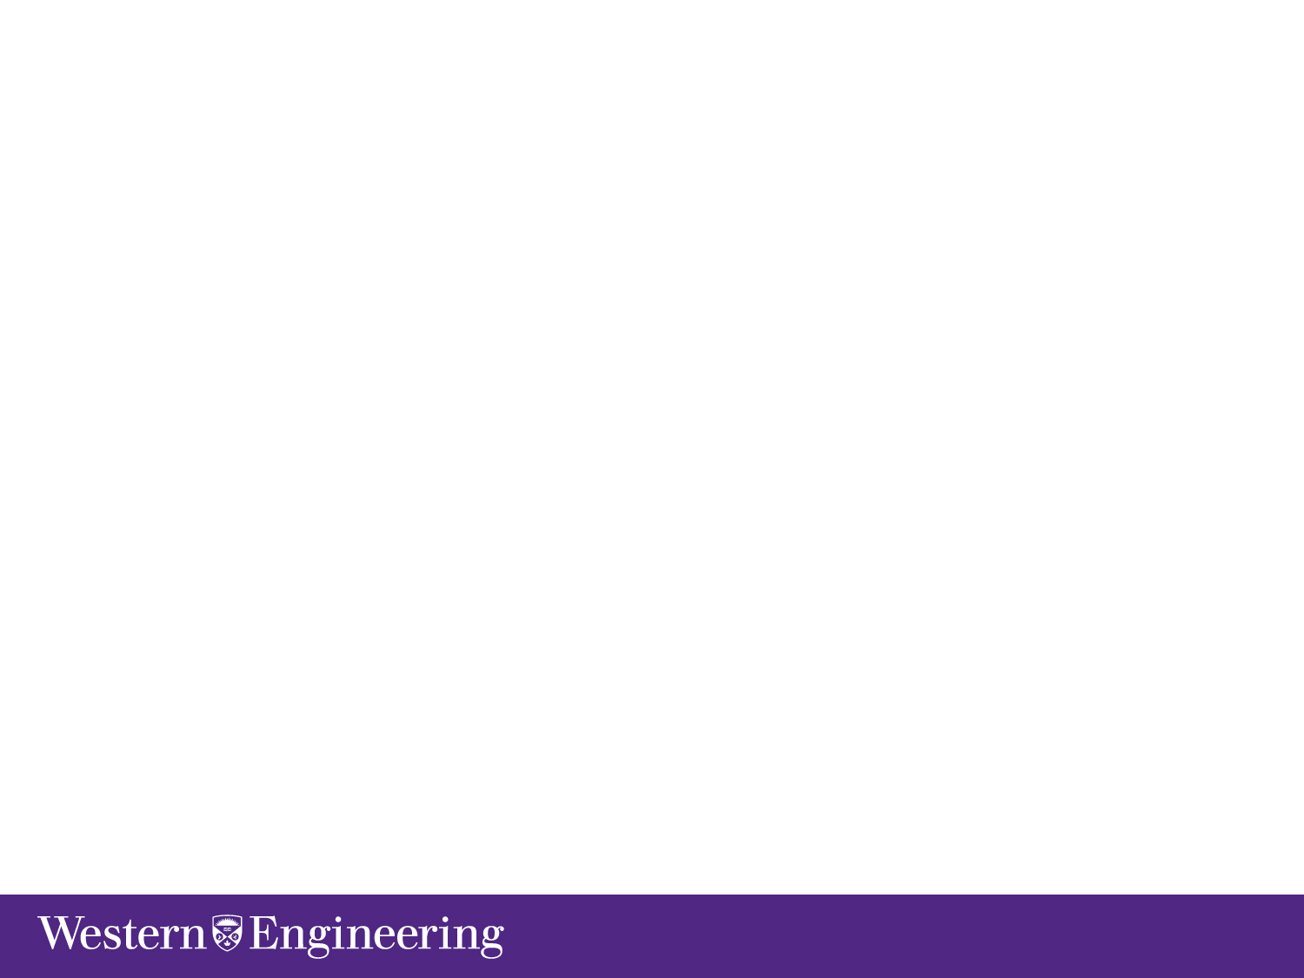


Slide 2
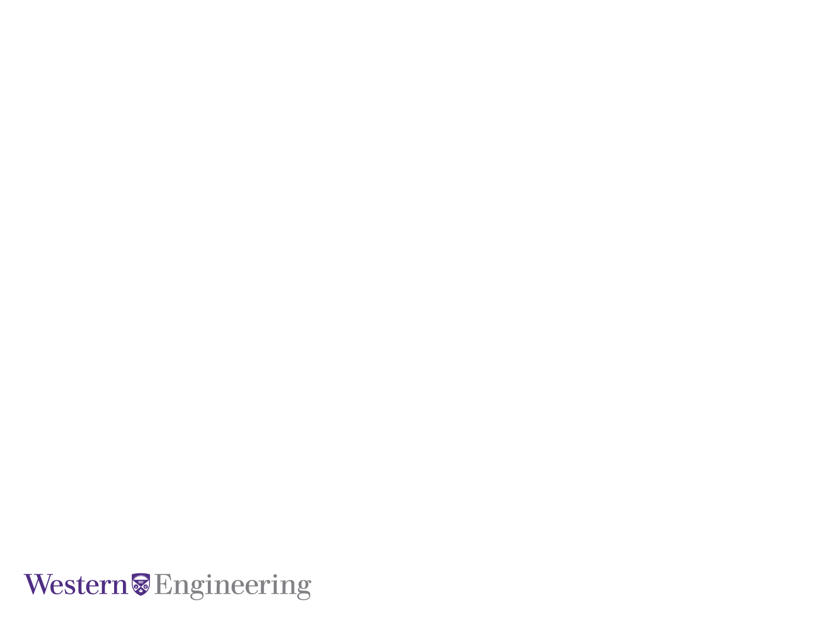
GeoCAPTCHA
Presented By
Tanushree Das
Electrical and Computer Engineering

Slide 3
CAPTCHA
Completely Automated Public Turing test to tell Computers and Humans Apart. It is also known as reverse turing test.
Usability and Security are its two main characteristics.
Prevents automated Computer Programs attacks such as DoS, Botnet etc.
Text-based and Image-based CAPTCHA are two major implementation methods.
GeoCAPTCHA

Slide 4
Failure of traditional CAPTCHA
Text Based CAPTCHA is broken with techniques such as OCR(Optical Character Recognition), Binarization etc.
Variation of text based CAPTCHA with rotations, division are difficult for humans.
CAPTCHA distinguishes between Humans and Computers but not a ‘Human Attacker’.
GeoCAPTCHA

Slide 5

GeoCAPTCHA
Proposal by :
Te-En Wei, Albert B. Jeng, Hahn-Ming Lee
GeoCAPTCHA

Slide 6
GeoCAPTCHA
Personalized Image Based CAPTCHA distinguishing between Human and Computers as well prevent 3rd party human attack.
User needs to remember a geographic scene privately known to him.
GUI used is similar to Google Map UI.
GeoCAPTCHA

Slide 7
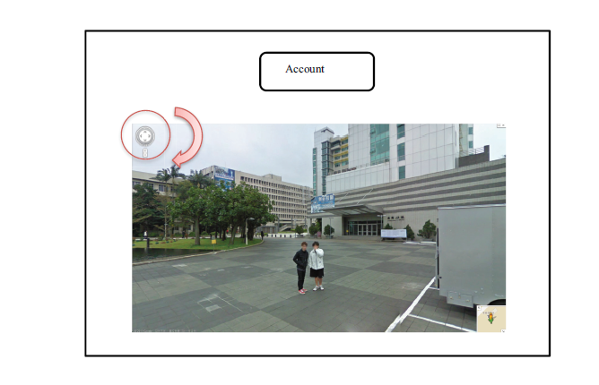
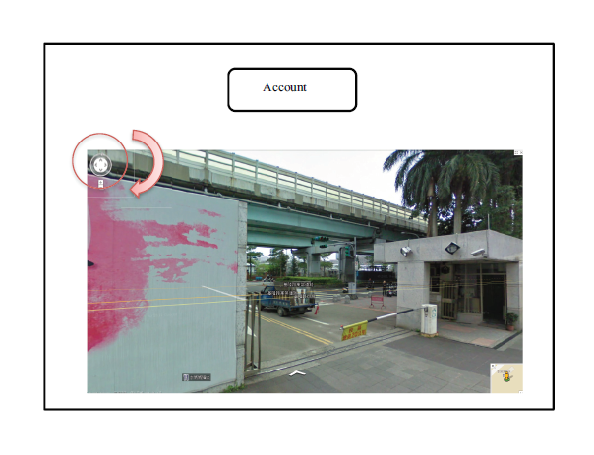
GeoCAPTCHA
Fig 1:The Random Challenge with Any angle street view
Fig 2:The Rotated Solution of Correct Angle Street view

Slide 8
GeoCAPTCHA HIP Test
Compares the Hash Value of preregistered image and Street View challenge image.
Let GH(x) be the function to calculate Hash Value of image ‘x’.
| GH(x)-GH(y) <=T | } HIP Test Pass.
where T : Error Threshold
GeoCAPTCHA

Slide 9
Algorithm for implementing GeoCAPTCHA
GeoCAPTCHA

Slide 10
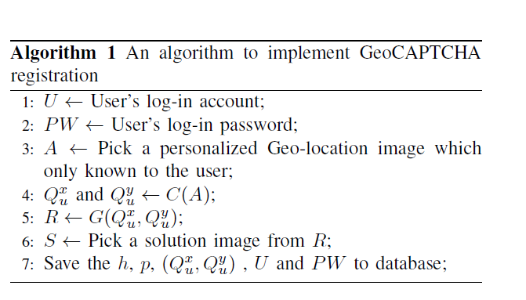
Algorithm 1:
GepCaptcha

Slide 11
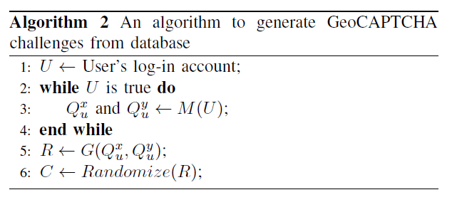
Algorithm 2:
GepCaptcha

Slide 12
Comparison between CAPTCHA, Personalized CAPTCHA and GeoCAPTCHA
 | Challenge Quantity | Challenge can be recorded | Broken by OCR | Automatic Attack | Genuine User (Human) | 3rd Party Human
Typical CAPTCHA | Plenty and Dynamic | No | Text-based: Yes Image-based: No | Fail | Pass | Pass
Personalized Challenge | Fixed and Static | Yes | Yes | Pass | Pass | Fail
GeoCAPTCHA | Fixed and Dynamic | No | No | Fail | Pass | Fail
GeoCAPTCHA

Slide 13
Advantages:
Interface simple as it is similar to Google Map, making it User friendly.
One mouse click is required making it suitable for traditional computers and touch screens.
Non-recordable and OCR cannot break it.
Defeating 3rd party human attack.
GeoCAPTCHA

Slide 14
References
https://developers.google.com/maps/documentation/javascript/streetview#StreetViewLocation
Te-En Wei, Albert B. Jeng, Hahn-Ming Lee, GeoCAPTCHA - A Novel Personalized CAPTCHA Using Geographic Concept to Defend Against 3rd Party Human Attack
GeoCAPTCHA

Slide 15
THANK YOU
GeoCAPTCHA

