Slide 1
Embedded OS/RTOS
Presented by – Tanushree Das
ECE 9047,Western university

Slide 2



What is RTOS ?
A real-time operating system (RTOS) is an operating system (OS) intended to serve real-time application process data as it comes in, typically without buffering delays.
Key characteristics:
Deterministic: It guarantees task completion within a set deadline.
Responsiveness : Minimum interrupt and thread switch latency.
Priority : Tasks must be able to be given a priority. Specially critical tasks.
.

Slide 3
Classification
Hard RTOS : Zero-tolerance for missed deadline.
Soft RTOS : Acceptable, system does not fail.
Deadline
Hard Real-time
Average Case
Worst Case
Average Case
Soft Real-time
Worst Case

Slide 4
RTOS Architecture :
Application
The most important component is Kernel(Monolithic and Microkernel).
RTOS-Kernel
BSP
BSP or Board Support Package makes an RTOS target specific .
Computer Hardware
RTOS Architecture
Notes:
How presentation will benefit audience: Adult learners are more interested in a subject if they know how or why it is important to them.
Presenter’s level of expertise in the subject: Briefly state your credentials in this area, or explain why participants should listen to you.

Slide 5
RTOS Kernel Functions :
Priority-based Scheduler : Most RTOS have between 32 and 256 possible priorities for individual tasks/processes. The scheduler will run the task with the highest priority .
Inter-process Communication : Obtained by message –passing ,POSIX message queues etc.
Memory Allocation : Required memory allocation is generally specified statically at compile time to avoid memory leaks and fragmentation.
Notes:
How presentation will benefit audience: Adult learners are more interested in a subject if they know how or why it is important to them.
Presenter’s level of expertise in the subject: Briefly state your credentials in this area, or explain why participants should listen to you.

Slide 6
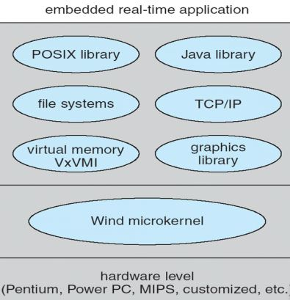
Example : VxWorks
A proprietary software developed by Wind River Classification, CA.
Multitasking kernel with preemtive and round-robin scheduling and fast interrupt response.
Bluetooth, USB, CAN protocols, Firewire IEEE 1394, BLE, L2CAP .
VxWorks microkernel (a full RTOS that can be as small as 20KB) : VxWorks 7
VxWorks Architecture
Notes:
How presentation will benefit audience: Adult learners are more interested in a subject if they know how or why it is important to them.
Presenter’s level of expertise in the subject: Briefly state your credentials in this area, or explain why participants should listen to you.

Slide 7

VX Works in Embedded System :
During the trip to Mars:
VxWorks ran applications dedicated to the navigation and guidance phase of the mission.
Pre-programmed software sequence for handling the complexity of the entry-descent-landing.
Once landed, the applications were replaced with software for driving on the surface and performing scientific activities.
Mars Rover

Slide 8
Conclusion
An RTOS can help make complex applications both predictable and reliable.
The precise control over timing made possible by an RTOS adds a form of reliability that cannot be achieved with a General Purpose Operating System.
The chief design goal is not high throughput, but rather a guarantee of a soft or hard performance category.
Notes:
How presentation will benefit audience: Adult learners are more interested in a subject if they know how or why it is important to them.
Presenter’s level of expertise in the subject: Briefly state your credentials in this area, or explain why participants should listen to you.

Slide 9
References
http://www.embedded.com/design/operating-systems/4006709/Exactly-When-Do-You-Need-Real-Time-
https://en.wikipedia.org/wiki/Mars_Science_Laboratory
https://www.nasa.gov/sites/default/files/482489main_4100_-_RTOS_101.pdf
http://www.ni.com/white-paper/14238/en/
https://stackoverflow.com/questions/536506/how-do-real-time-operating-systems-work
https://en.wikipedia.org/wiki/Real-time_operating_system
Notes:
How presentation will benefit audience: Adult learners are more interested in a subject if they know how or why it is important to them.
Presenter’s level of expertise in the subject: Briefly state your credentials in this area, or explain why participants should listen to you.

Slide 10


