Slide 1
Paper Skeleton
Machine-Learning-Based Market Crash Early Warning Model
and How TDA Can Boost the Performance at High Cut-offs

Slide 2
Content
Abstract
Introduction
Data
Method/Model
Results
Discussion
References

Slide 3
1. Abstract

Slide 4
2. Introduction
Leverage Gidea & Katz papers for TDA motivation on encoding the shape of data and the fact that it’s proved relevant by them
Pointing out the shortcoming on false positives/negatives, as well as lack of rigorous evaluation
Inspired by the Machine Learning approach to tackle the problem of crisis signal/EWS: data-driven, rigorous & explainable (!!!)
ML is also a natural way to incorporate TDA features, where false positives/negatives are visibly improved, esp. at high cutoffs/high confidence levels
→ Our paper’s contributions + references to TDA intro

Slide 5
3. Data
To overcome curse of dimensionality
and maintain high explainability
35 years of weekly price (covering major crashes since 1983)
Asset types covering: Equity, FI, FX, Commodities (& Fama French Factors)
Parsimonious approach to Feature Engineering (→ c. 10 features/dimensions)
Return/Change/Momentum features
Spread features
Volatility features
Meta parameters:
forecast window = 2w
TH = 5% (i.e. Y=1 for chosen index drop > 5%, Y=0 otherwise)
training batch window = 26w
rolling step size = 1w
→ c. 3000 data points in total
A trade-off between data balance
and learning true crash patterns:
Too few positive samples → data imbalance
Too low TH → learning noises vs. signals
Discuss more in the discussion section

Slide 6
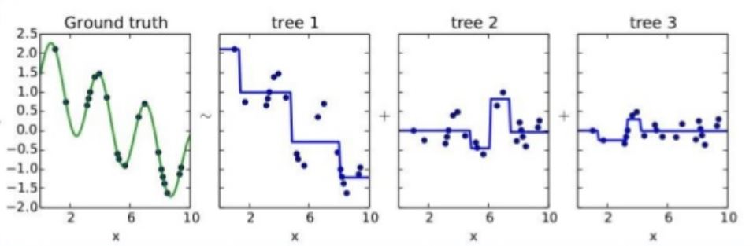
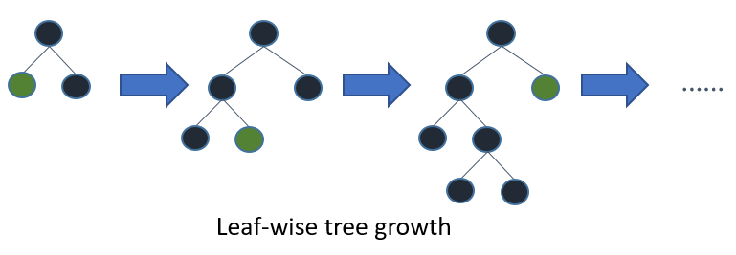
4. Model
Comparable Results (in many problems) vs. SVM vs. CNN vs. Regression
Tree-based
Transparent and whitebox as regression vs. deep neural networks
Free from normalisation/standardisation of the features vs. regression & DNN
Free from parametrization: minimum assumptions for data distribution etc.
Robust vs. common curses e.g. co-linearity and dimensionality
Kagglers’ love (used by 17 out of 29 winners)

Slide 7

4. Model
“Online” Learning:
Roll 2w of data
Return/Change Features
Return/Change Features
XGBoost Model
(Training)
XGBoost Model
(Testing)
Y:
Ground Truth
Spread Features
$Y$:
Prediction
Spread Features
Volatility Features
Volatility Features

Slide 8
4. Model
“Online” Learning:
Roll 2w of data
Return/Change Features
Return/Change Features
Spread Features
Spread Features
XGBoost Model
(Training)
XGBoost Model
(Testing)
Y:
Ground Truth
$Y$:
Prediction
Volatility Features
Volatility Features
TDA Features
TDA Features

Slide 9
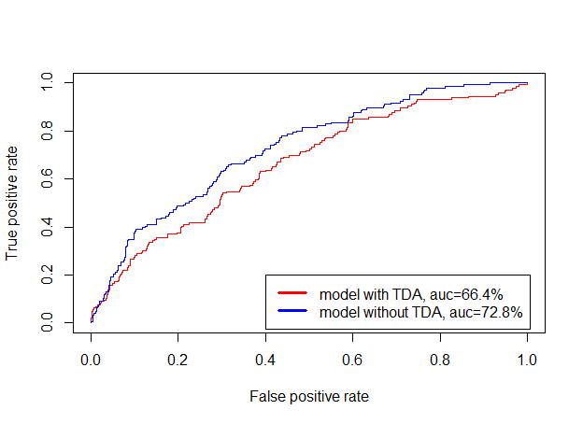
5. Results 1.0
AUC Score (on Hang Seng Index down > 5% in 2w) = 72.8%

Slide 10
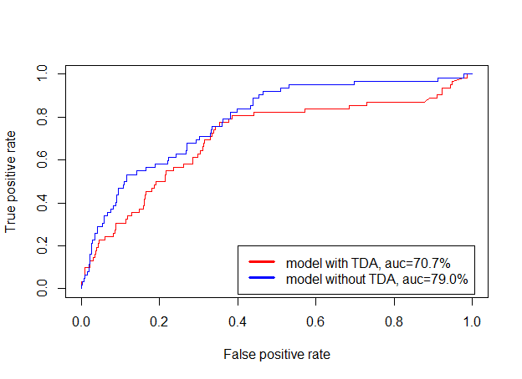
5. Results 1.0
AUC Score (on S&P 500 down > 5% in 2w) = 79.0%

Slide 11
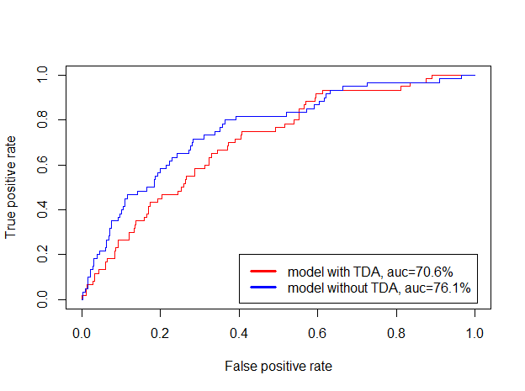
5. Results 1.0
AUC Score (on FSTE 100 down > 5% in 2w) = 76.1%

Slide 12

5. Results 1.0
Comparable to the results in the “Chatzis et al” paper (2nd reference paper above):
However, “Financial Machine Learning” and “Market Crashes” are also biased to false positives at the high cut-offs

Slide 13
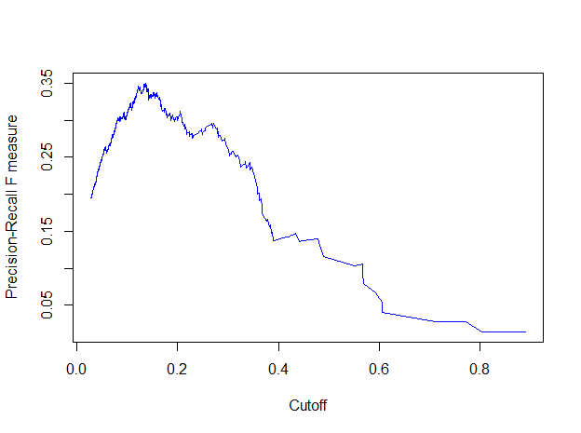
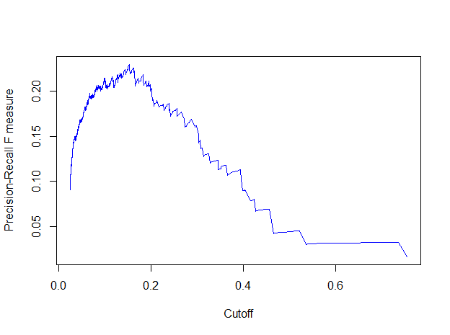
5. Results 1.0
F1 vs. Cutoff (on HSI down > 5% in 2w)
F1 vs. Cutoff (on S&P 500 down > 5% in 2w)

Slide 14
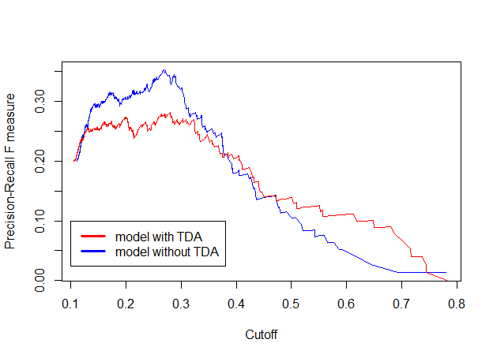
5. Results 2.0 – HSI

Slide 15
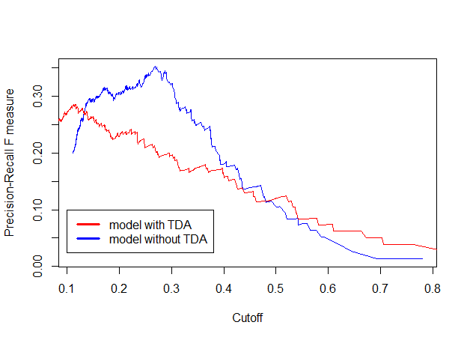

5. Results 2.0 – S&P 500

Slide 16
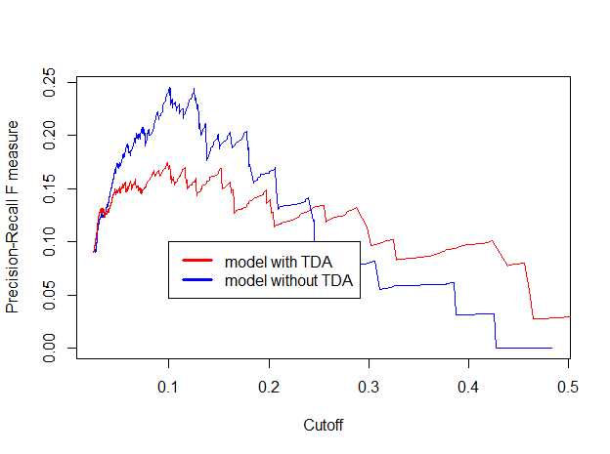
5. Results 2.0 – FTSE 100

Slide 17
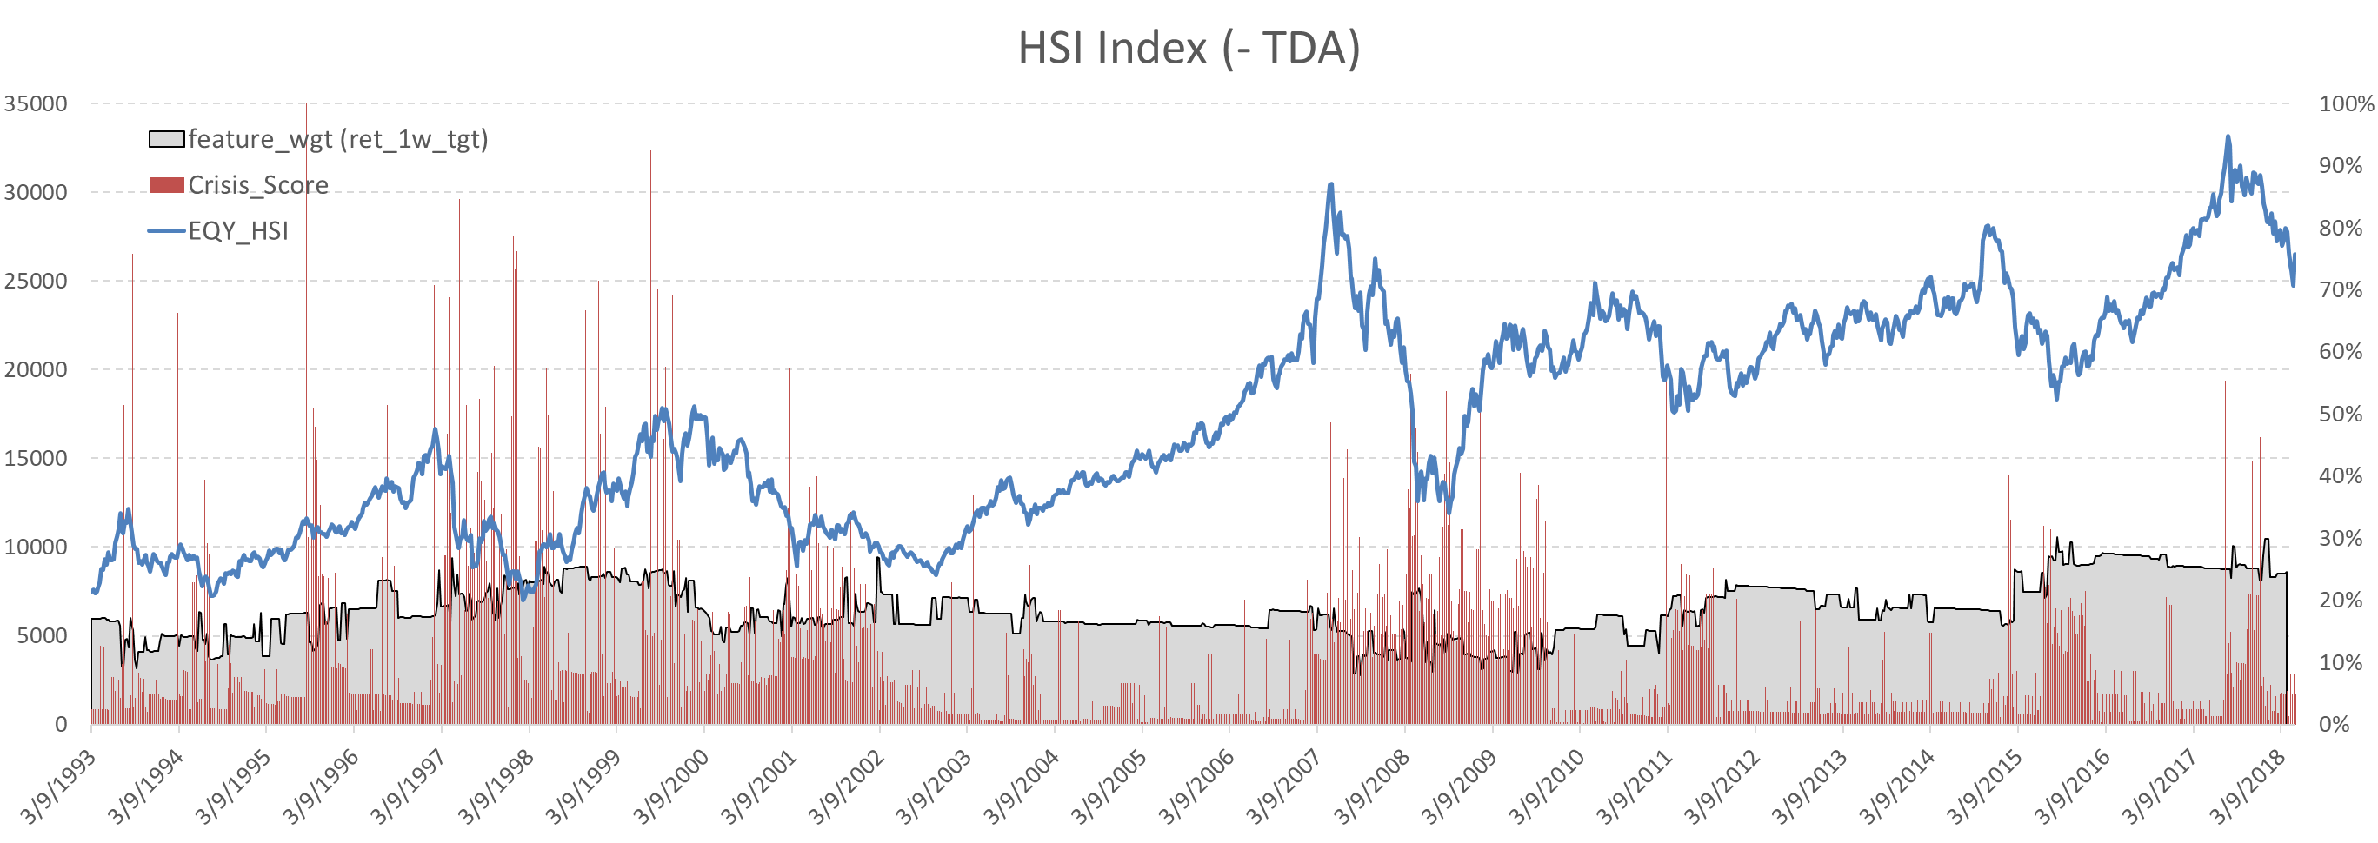
5. Results in Details: HSI (-TDA)

Slide 18
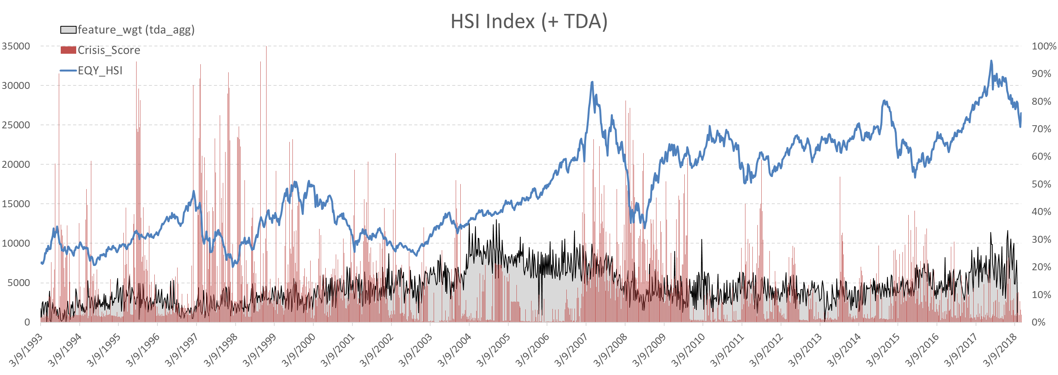
5. Results in Details: HSI (+TDA)

Slide 19
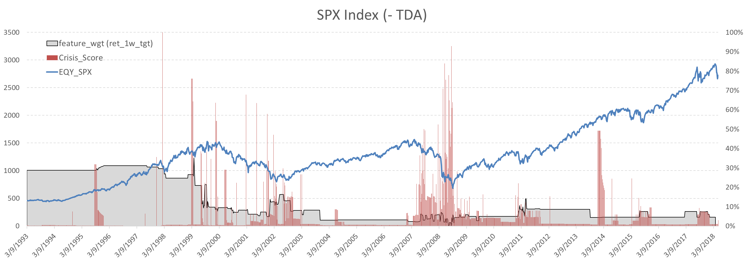
5. Results in Details: S&P 500 (-TDA)

Slide 20
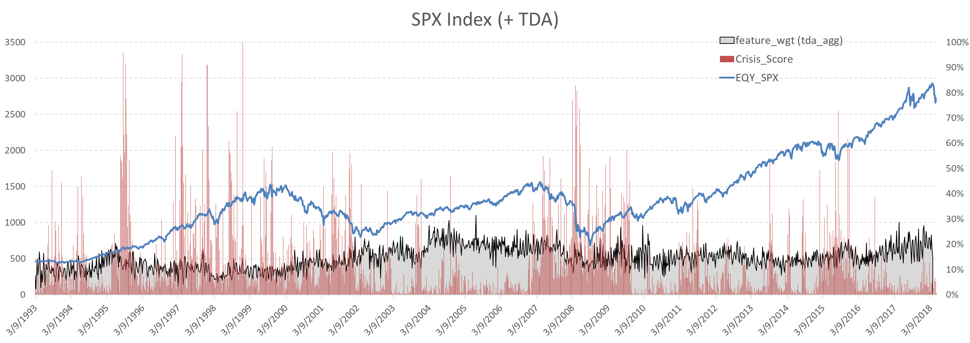
5. Results in Details: S&P 500 (+TDA)

Slide 21
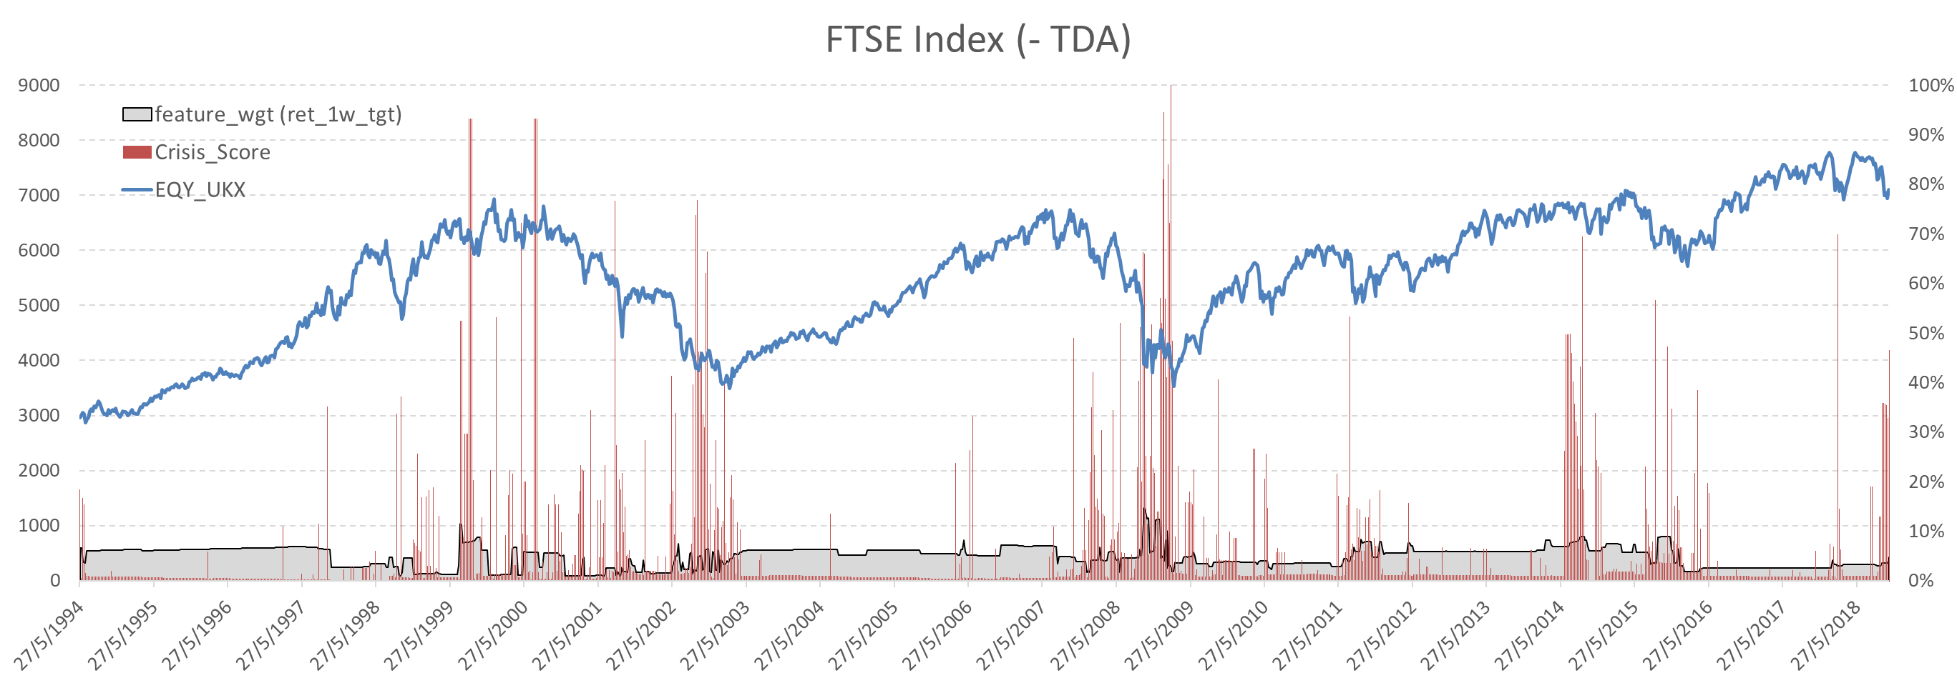
5. Results in Details: FTSE 100 (-TDA)

Slide 22
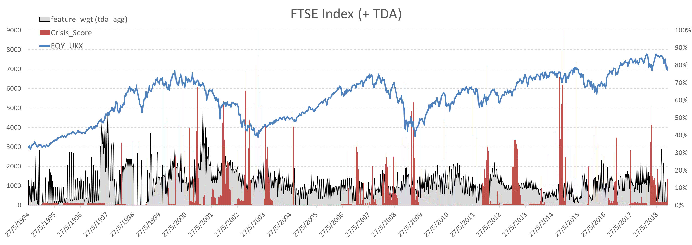
5. Results in Details: FTSE 100 (+TDA)

Slide 23
5. Results in Details – WHY???
To do:
Case-study several successful warning/prediction points in the back-testing window:
Print out the decision trees trained before making the successful prediction
Print out feature importance graphs (confident TDA features are important!!!)
Bring in the market regime and structure at the time
Exact TDA norm values and changes at those points of time
→ establish patterns and rationalise them

Slide 24
6. Discussion
Studies on stock market crashes are challenging and important
Extremely noisy!!!
For practitioners: banks, investment management, asset owners
For policy makers/regulators
Effect of overflow/contagion to other layers/asset classes: economic, banking, fx and commodities
Methods taken here fall into a new and trending-up paradigm: data driven vs. mathematical/physics modelling
Echoing Pawel’s “controversial” point
Lopez de Prado’s leading “revolution” on Financial Machine Learning
More to come:
Further refinement in this project on: feature engineering, parameter fine-tune & model
machine learning approach to credit risk modelling vs. Merton/Reduced-form
ETF investing
Commodity regime studies in the lens of TDA

Slide 25
7. References

