Slide 1
Paper Skeleton
Machine-Learning-Based Market Crash Early Warning Model
and How TDA Can Boost the Performance at High Cut-offs

Slide 2
Content
Abstract
Introduction
Data
Method/Model
Results
Discussion
References

Slide 3
1. Abstract

Slide 4
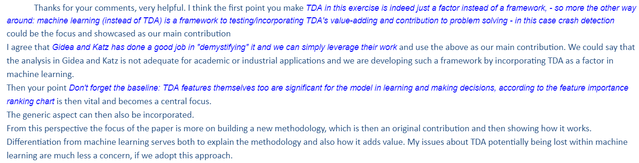
2. Introduction

Slide 5
2. Introduction
At the very technical level, the Gidea&Katz paper computes TDA norm different from our approach:
they use the ball-radius as their epsilon vs. we simply use the top-down height function to construct the filtration complex, inspired in Liu’s preprint https://arxiv.org/pdf/1608.07373.pdf
they use the daily returns to form their data point cloud vs. we simply use the weekly price time series
they compute the PL 1-norms of the above point cloud and normalise it for the window of interest, e.g. dot-com & GFC vs. we compute the change of PL norms against the previous PL 1-norm of the previous week
Difference: Effectively, what their PL detects is a global (of a given time window, e.g. 50d or 100d) breakdown of correlations among the 4 indices, whereas our PL norms change summarise the overall market landscape (drastic) evolutions of the specified time window
Commonality: conceptually, both capture the global structural changes of the market

Slide 6
2. Introduction
There are several considerations why I used the approach we used
Due to the nature of supervised learning, it’s obviously flawed and overfitting to use more than one equity indices to train a model and predict one of them, even the time segregation from the prediction/testing phase is strictly enforced, due to synchronicities between indices, information can leak: e.g. the crash of S&P on a Friday afternoon might only be felt and translated in HSI the week after
That forces us to compute the TDA of the indices alone, instead of constructing a multi-dimensional point cloud from multi-indices
Daily data, in my opinion subjects to too much trading noise and short-term sentiments, on the other hand weekly frequency data is a very common rule-of-thumb choice in market risk modelling
In our exercise, simply using the PL 1-norm value empirically didn’t train the model anything new, instead the power of TDA turns out only significant when transform 1-norm into the change/relative version against the previous 1-norm value

Slide 7
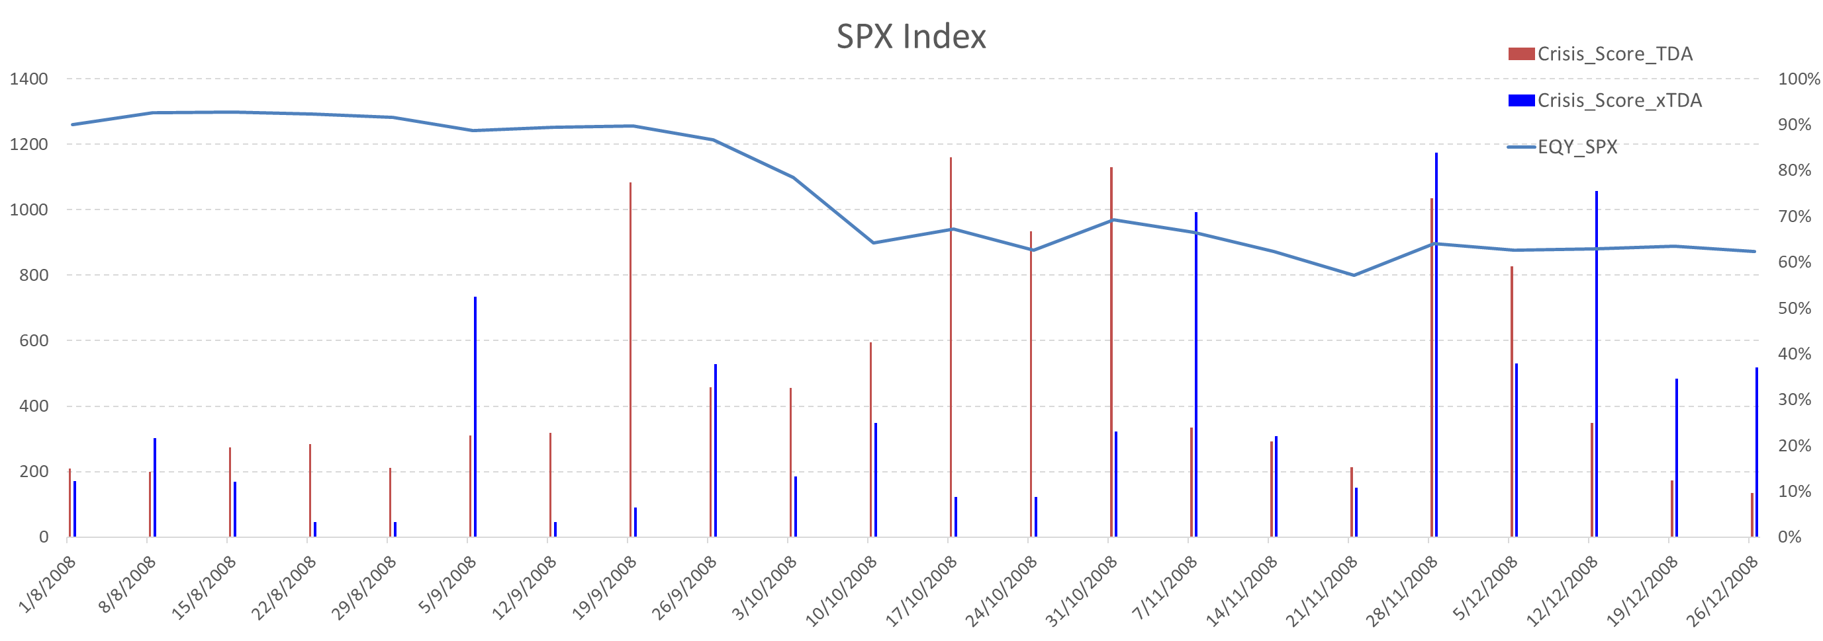
2. Introduction
With all the benefits (we discussed in the emails) to incorporating TDA into a supervised machine learning framework to manifest its potential, for the introduction section, I guess the very intuitive comparisons of the results from models with and without TDA features might speak most effectively to the business/industrial-problem-oriented audience (I can produce a couple of more similar charts if needed):

Slide 8
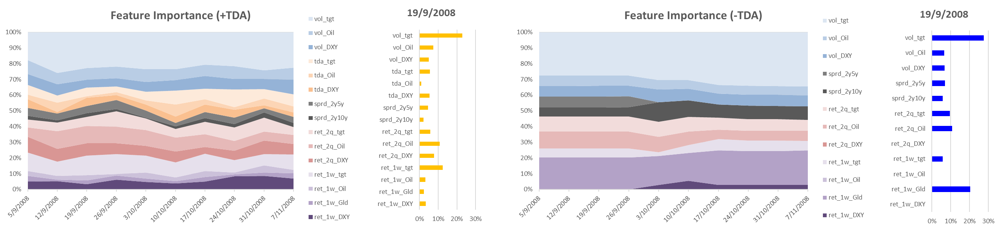
2. Introduction
To further motivate the readers, we can briefly touch the rationales/reasonings by showing the corresponding “feature importance ranking” and a few lines of highlights:

Slide 9
3. Data
To overcome curse of dimensionality
and maintain high explainability
35 years of weekly price (covering major crashes since 1983)
Asset types covering: Equity, FI, FX, Commodities (& Fama French Factors)
Parsimonious approach to Feature Engineering (→ c. 10 features/dimensions)
Return/Change/Momentum features
Spread features
Volatility features
Definitions of market crash:
forecast window = 2w
TH = 5% (i.e. Y=1 for chosen index drop > 5%, Y=0 otherwise)
training batch window = 26w
rolling step size = 1w
→ c. 3000 data points in total
A trade-off between data balance
and learning true crash patterns:
Too few positive samples → data imbalance
Too low TH → learning noises vs. signals
Discuss more in the discussion section

Slide 10
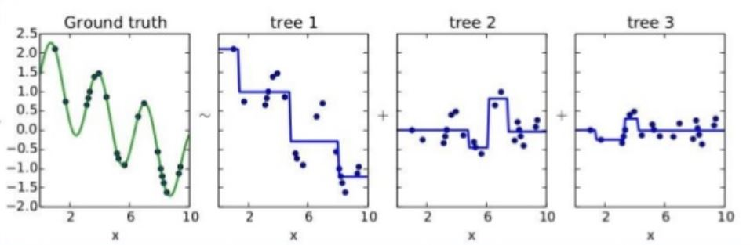
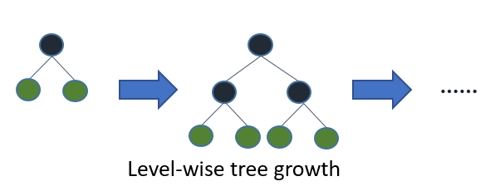
4. Model
Comparable Results (in many problems) vs. SVM vs. CNN vs. Regression
Tree-based
Transparent and whitebox as regression vs. deep neural networks
Free from normalisation/standardisation of the features vs. regression & DNN
Free from parametrization: minimum assumptions for data distribution etc.
Robust vs. common curses e.g. co-linearity and dimensionality
Kagglers’ love (used by 17 out of 29 winners)

Slide 11
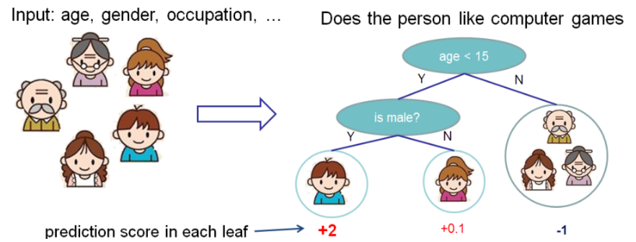
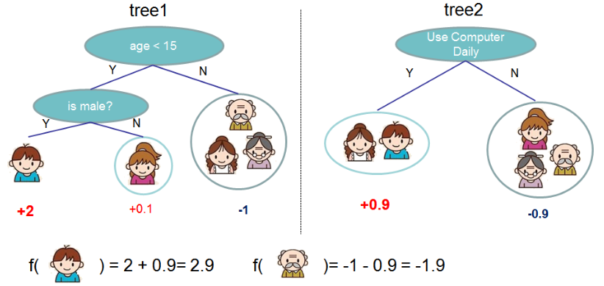
4. Model
Key Hyper Parameters:
Max depth (=2 in the example on the right hand side)
This parameter specifies the number of levels of forks each model can be trained to optimise the performance
Number of Iterations (=2 in the example on the right hand side)
This parameter specifies the number of trees to be ensembled and hence training iterations
For more details ref.
https://xgboost.readthedocs.io/en/latest/tutorials/model.html

Slide 12
4. Model
Key Hyper Parameters:
As the fine-tuning exercise shows, the parameters optimise the performance with the below combination for a general market crash dataset:
Max depth = 3
Number of Iterations = 5
It makes sense and is expected as we have a “small” dataset and more levels and iterations can easily overfit the training and render the performance less-generalised to different market conditions/regimes extrapolated from the training period

Slide 13

4. Model
“Online” Learning:
Roll 1w of data
Return/Change Features
Return/Change Features
XGBoost Model
(Training)
XGBoost Model
(Testing)
Y:
Ground Truth
Spread Features
$Y$:
Prediction
Spread Features
Volatility Features
Volatility Features

Slide 14
4. Model
“Online” Learning:
Roll 1w of data
Return/Change Features
Return/Change Features
Spread Features
Spread Features
XGBoost Model
(Training)
XGBoost Model
(Testing)
Y:
Ground Truth
$Y$:
Prediction
Volatility Features
Volatility Features
TDA Features
TDA Features

Slide 15
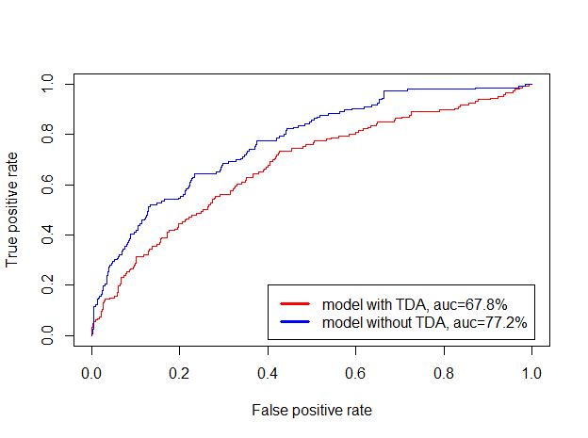
5. Results 1.0
AUC Score (on Hang Seng Index down > 5% in 2w) = 77.2%

Slide 16
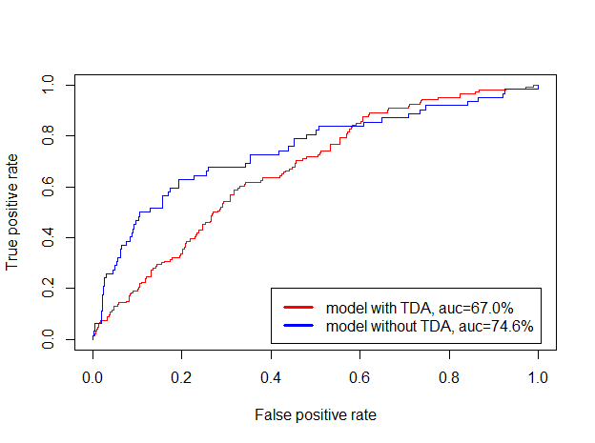
5. Results 1.0
AUC Score (on S&P 500 down > 5% in 2w) = 74.6%

Slide 17
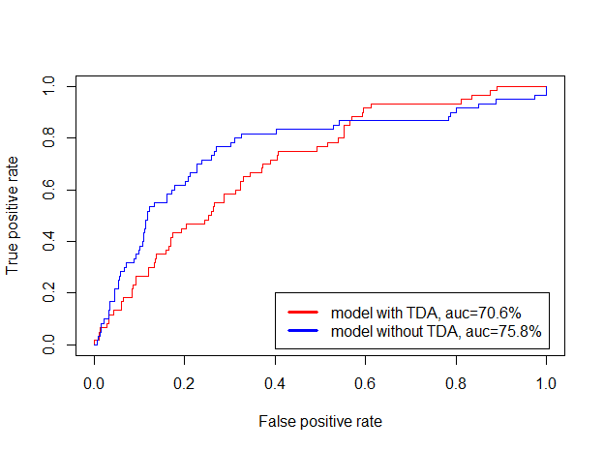
5. Results 1.0
AUC Score (on FSTE 100 down > 5% in 2w) = 75.8%

Slide 18

5. Results 1.0
Comparable to the results in the “Chatzis et al” paper (2nd reference paper above):
However, “Financial Machine Learning” and “Market Crashes” are also biased to false positives at the high cut-offs

Slide 19
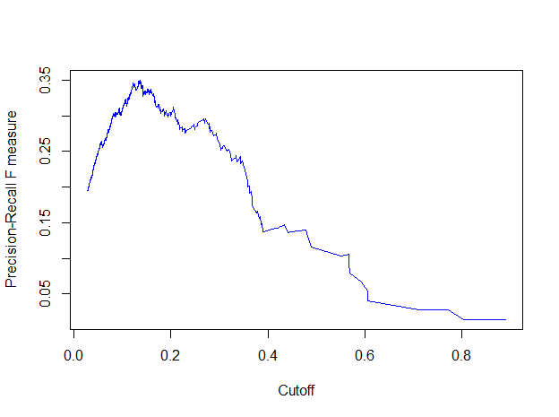
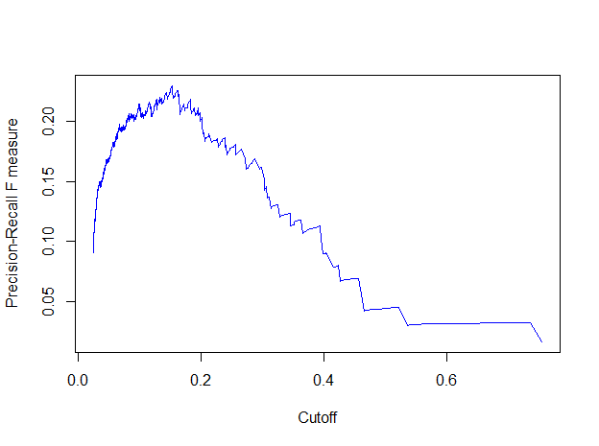
5. Results 1.0
F1 vs. Cutoff (on HSI down > 5% in 2w)
F1 vs. Cutoff (on S&P 500 down > 5% in 2w)

Slide 20
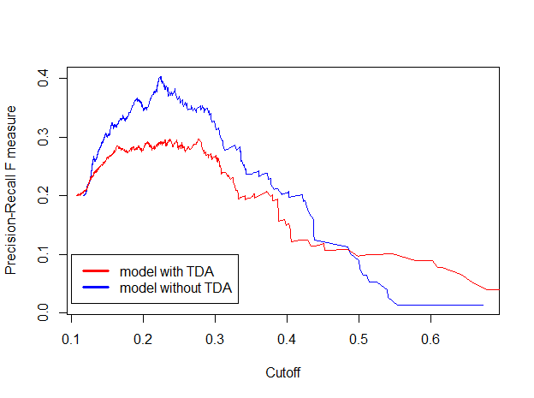
5. Results 2.0 – HSI

Slide 21
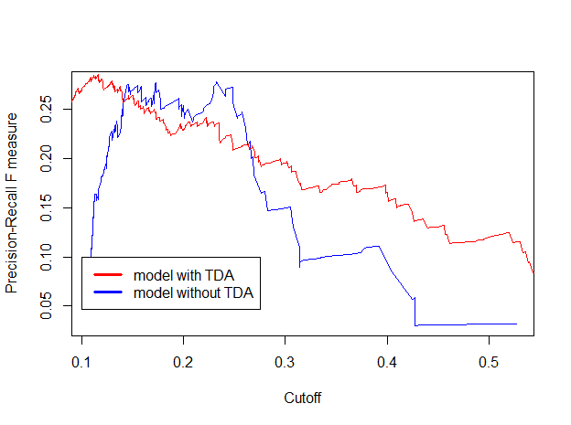
5. Results 2.0 – S&P 500

Slide 22
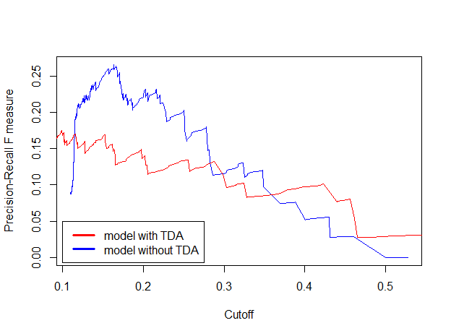
5. Results 2.0 – FTSE 100

Slide 23
5. Results 2.0 – F1
F1 Scores vs. Cutoff: S&P 500 Index
F1 Scores vs. Cutoff: FTSE 100 Index
F1 Scores vs. Cutoff: Hang Seng Index

Slide 24
5. Results 2.0 – AUC for HSI and FTSE 100
Area under Curve: Hang Seng Index
Area under Curve: FTSE 100 Index

Slide 25
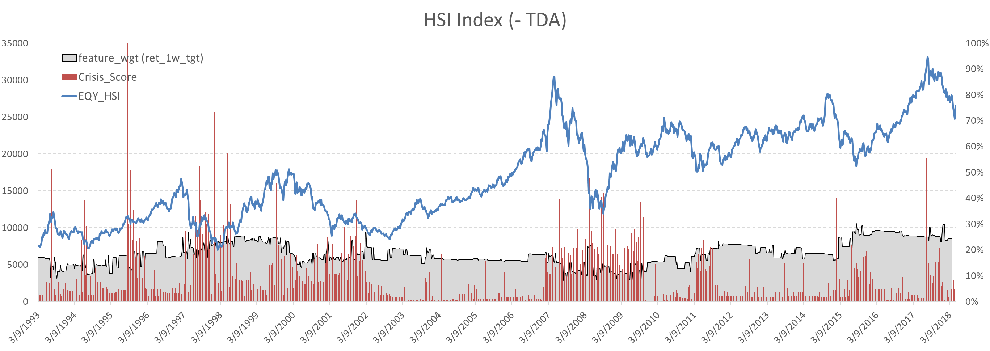
5. Results in Details: HSI (-TDA)

Slide 26
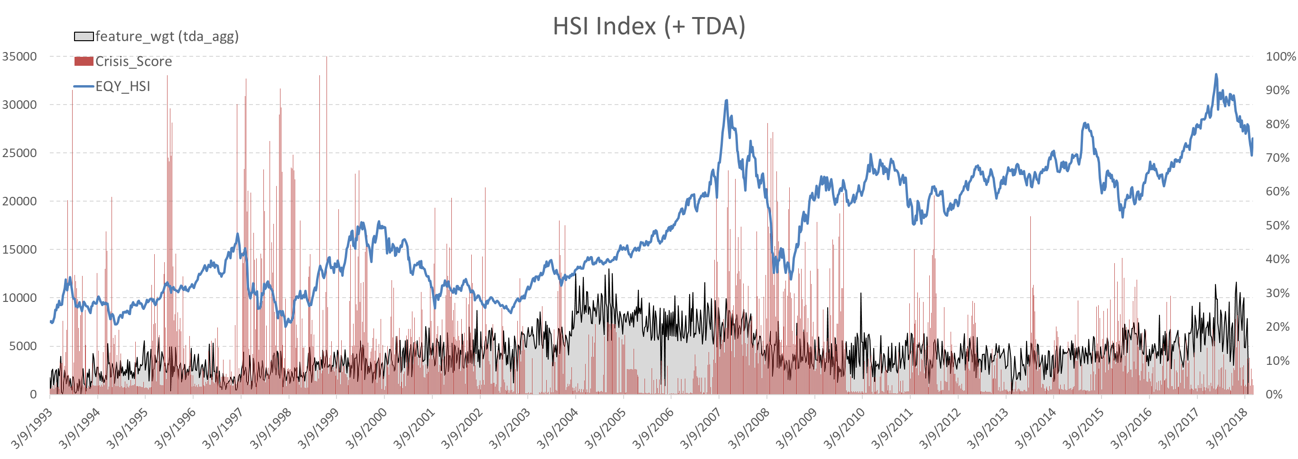
5. Results in Details: HSI (+TDA)

Slide 27
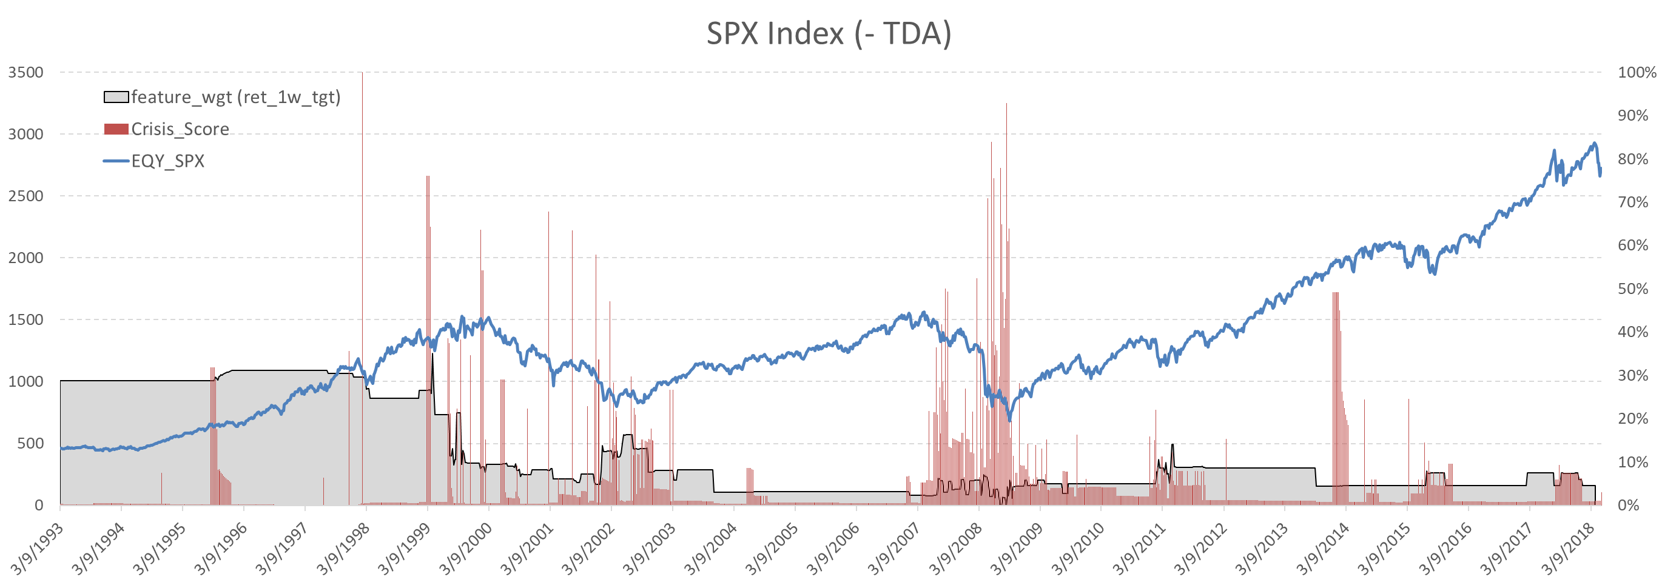
5. Results in Details: S&P 500 (-TDA)

Slide 28
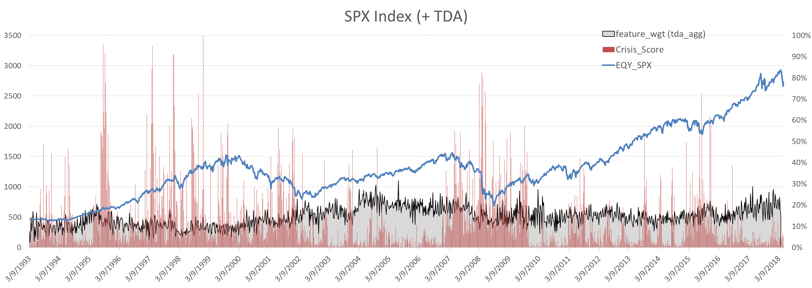
5. Results in Details: S&P 500 (+TDA)

Slide 29
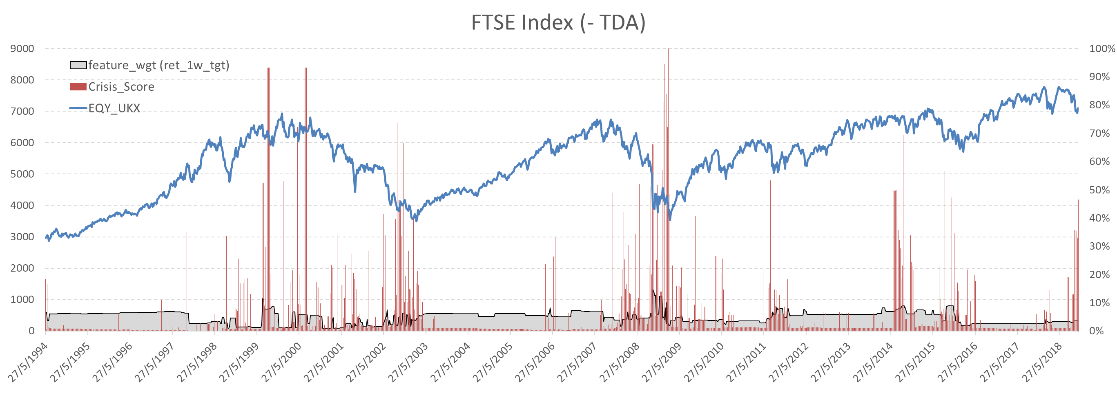
5. Results in Details: FTSE 100 (-TDA)

Slide 30
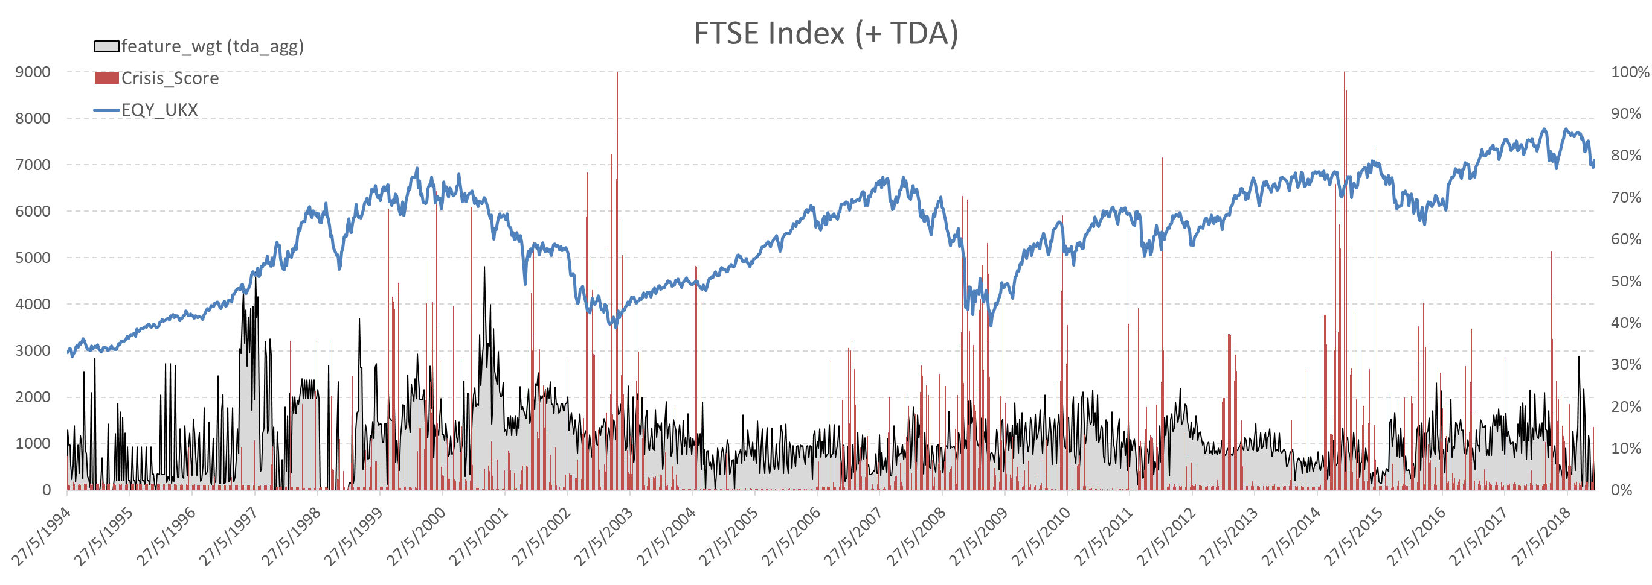
5. Results in Details: FTSE 100 (+TDA)

Slide 31
5. Results in Details – WHY???
To do:
Case-study several successful warning/prediction points in the back-testing window:
Print out the decision trees trained before making the successful prediction
Print out feature importance graphs (confident TDA features are important!!!)
Bring in the market regime and structure at the time
Exact TDA norm values and changes at those points of time
→ establish patterns and rationalise them

Slide 32
6. Discussion
Studies on stock market crashes are challenging and important
Extremely noisy!!!
For practitioners: banks, investment management, asset owners
For policy makers/regulators
Effect of overflow/contagion to other layers/asset classes: economic, banking, fx and commodities
Methods taken here fall into a new and trending-up paradigm: data driven vs. mathematical/physics modelling
Echoing Pawel’s “controversial” point
Lopez de Prado’s leading “revolution” on Financial Machine Learning
More to come:
Further refinement in this project on: feature engineering, parameter fine-tune & model
machine learning approach to credit risk modelling vs. Merton/Reduced-form
ETF investing
Commodity regime studies in the lens of TDA

Slide 33
7. References

