Slide 1
TDA Business Overview
Asia-Pac Region

Slide 2
Content
Intro to TDA
TDA Hubs (Global)
TDA Hubs (Asia-Pac)
Intro to Paishi Tech
Use Case
Pipeline

Slide 3
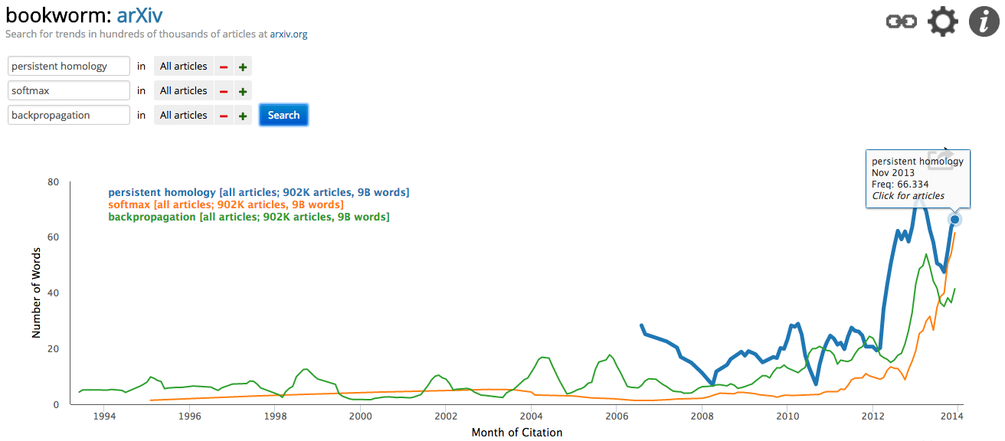
Intro to TDA
Born with the unique ability to quantify the shape of data, TDA has been gathering momentum:

Slide 4
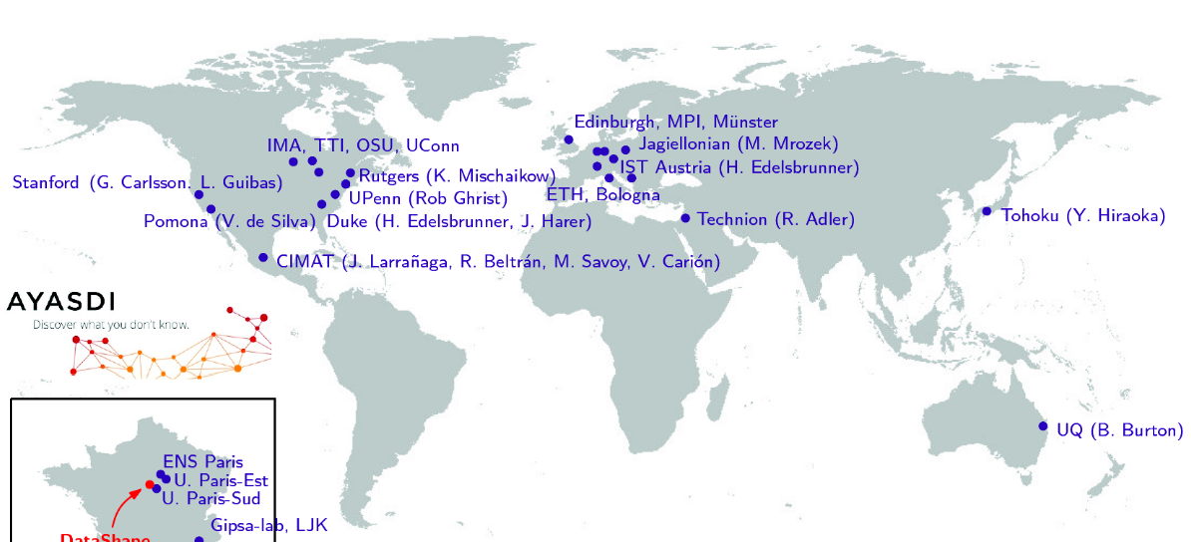
TDA Hubs – Global
Glasgow/Strathclyde
Swansea

Slide 5
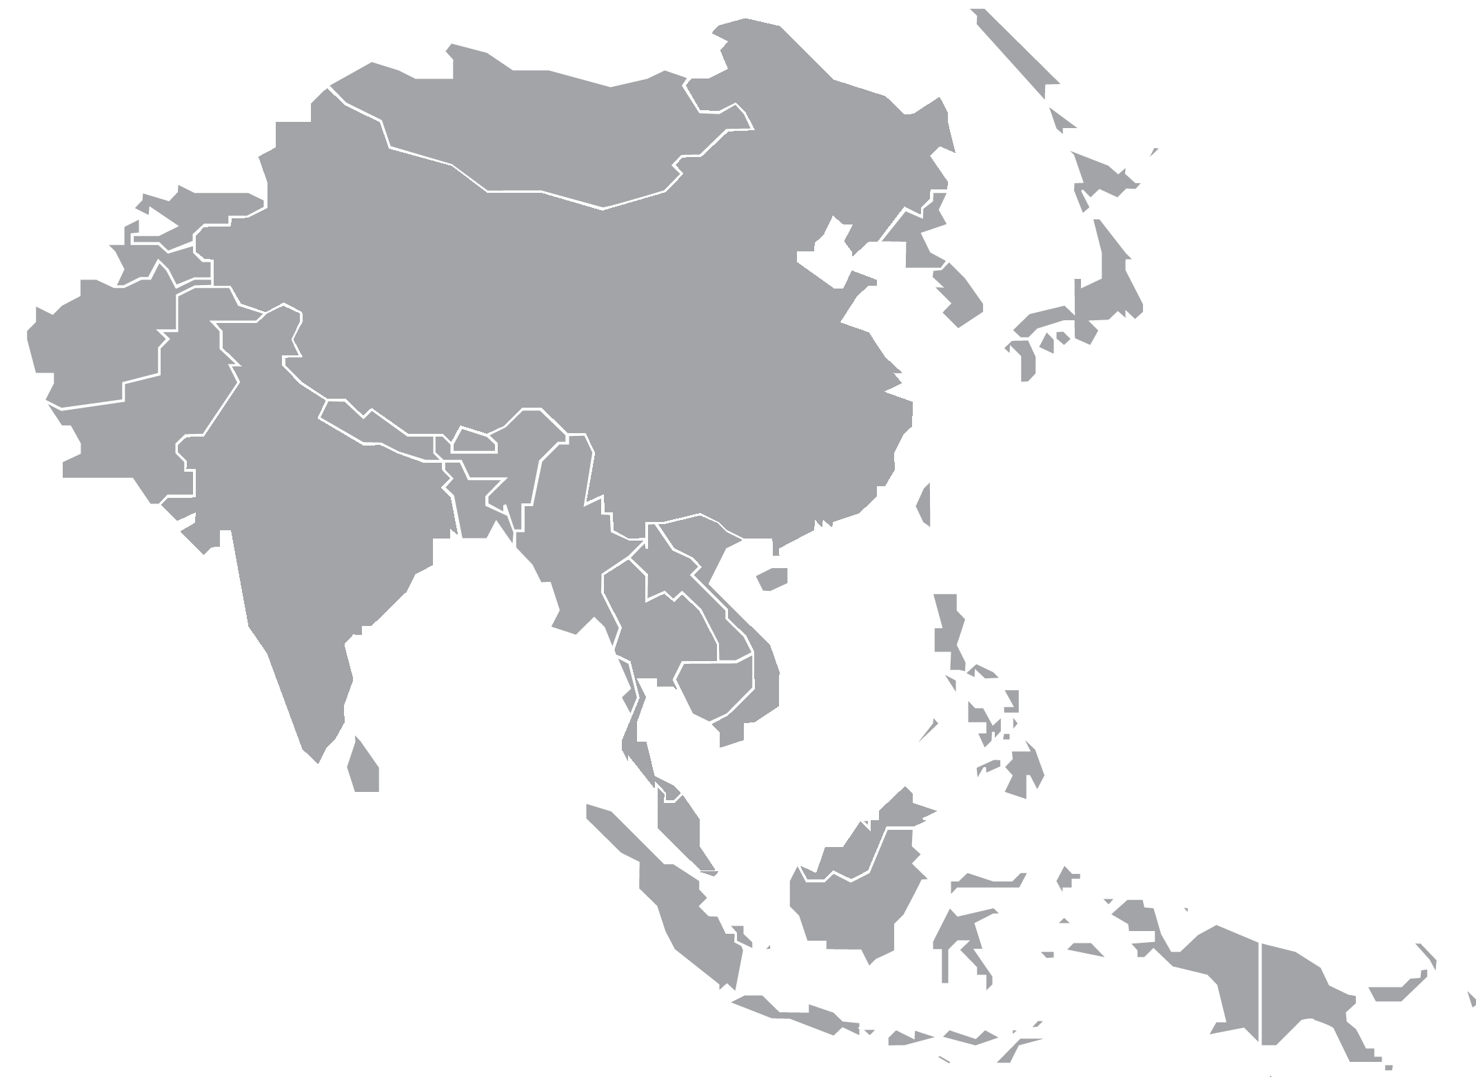
TDA Hubs – Asia Pac
Hiraoka Laboratory
Kyoto Univerisity
湃势科技
Pashi Technologies, Shenzhen/Hong Kong, China
? Molecular Based Mathematical Biology
Nanyang Technological University

Slide 6
About Us
Paishi Technologies has been established since 2015, in Shenzhen China
Dedicated to Data Visualisation and Analytics.
Leveraging TDA Technologies e.g. Mapper

Slide 7
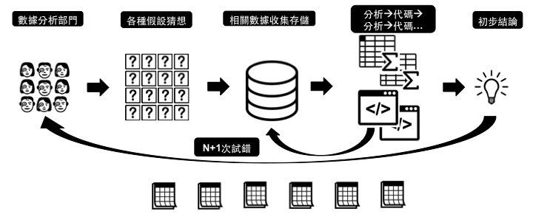
About Us – Our Approach

Slide 8
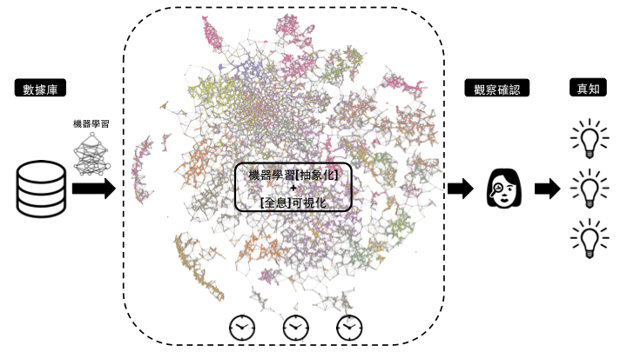
About Us – Our Approach

Slide 9
Use Case: The Problem
Bank X has a growing number of current and saving accounts
Facing industry-wide competition to cross-sell other more profitable services and products, e.g. insurances, investments (eqv. ISA) & loans
Current sales channels (e.g. call centre) suffer from low conversion rate
Looking for data-driven marketing solution

Slide 10
Use Case: The Dataset
Account
Personal Features: e.g. gender, age, employment
Account Features: e.g. ATM records, online banking
Product
Product Features: purchase time, duration, amount
Interest Rate
Execution
Outcome Features: Purchase? Reject
Execution Means: Call Centre? Message? Social Media?
497 Features
497 Dimensions

Slide 11
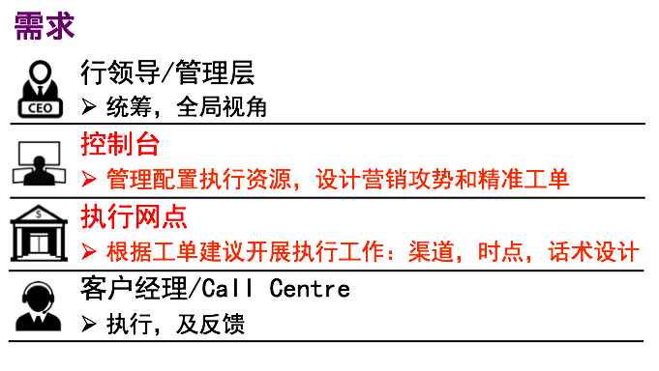
Use Case: The Requirements
Management
Strategic Decision Maker
Control Centre
Coordinate & Facilitate Top-down
Branch
Execution: digital & in person (e.g. Call Centre referral)
Call Centre
Execution: call

Slide 12
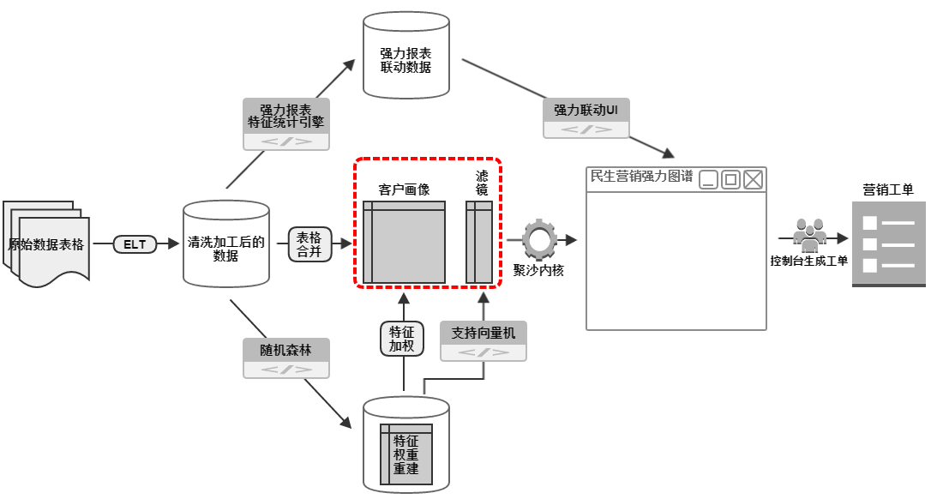
Use Case: The Solution

Slide 13
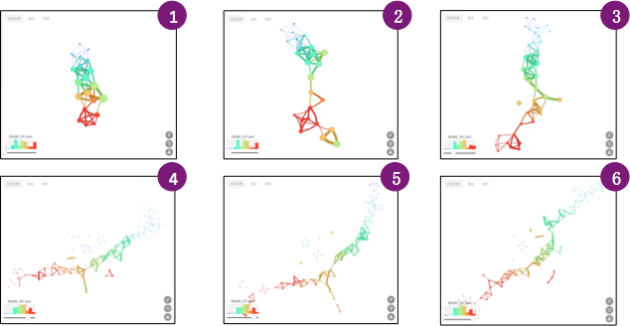
Use Case: The Solution

Slide 14
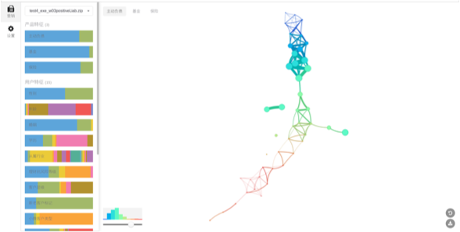
Use Case: The Solution - Front End

Slide 15
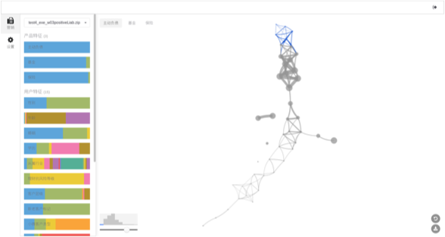
Use Case: The Solution - Front End

Slide 16
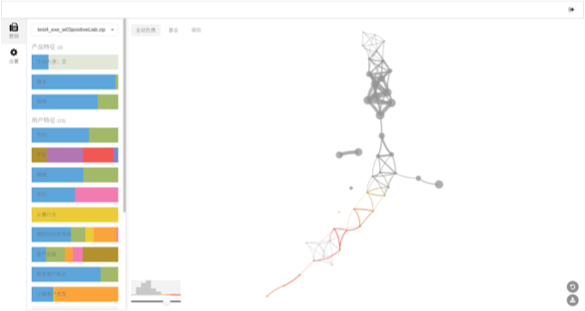
Use Case: The Solution - Front End

Slide 17
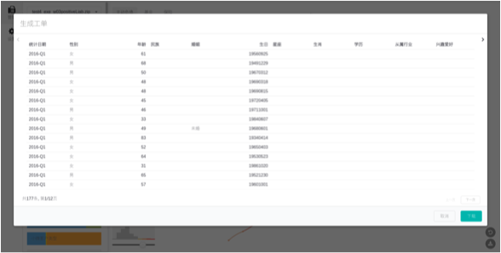
Use Case: The Solution - Front End

Slide 18
Use Case: The Result (1st Round)
Old Model:
22225 Target Accounts
389 Purchases
Conversion Rate = 1.75%
Paishi TDA Model
10000 out of the same 22225 Accounts
Shortlisted 400 Target Accounts
Compared to the known result: 52 names appeared in the list of 389 successful purchases
Conversion Rate = 13%

Slide 19
Use Case: The Result (2nd Round)
Old Model:
22225 Target Accounts
389 Purchases
Conversion Rate = 1.75%
Paishi TDA Model
Latest Account Dataset: 80k accounts with 7k products
Shortlisted 1545 target accounts
122 Confirmed Interests
Conversion Rate = 7.9%

Slide 20
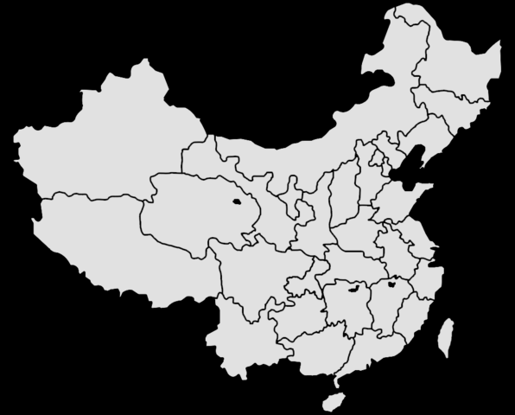









Paishi Tech Pipeline
Done
Start
Next
取经科技

