Slide 1
The Power of Fire
A game modification for
Warcraft III: The Frozen Throne
Tamino Dauth
B. Sc. Hochschule Karlsruhe – Technik und Wirtschaft

Slide 2
History of Warcraft
1994 - Warcraft: Orcs & Humans
1995 - Warcraft II: Tides of Darkness
  1996 - Warcraft II: Beyond the Dark Portal
2002 - Warcraft III: Reign of Chaos
  2003 - Warcraft III: The Frozen Throne
2004 - World of Warcraft

Slide 3
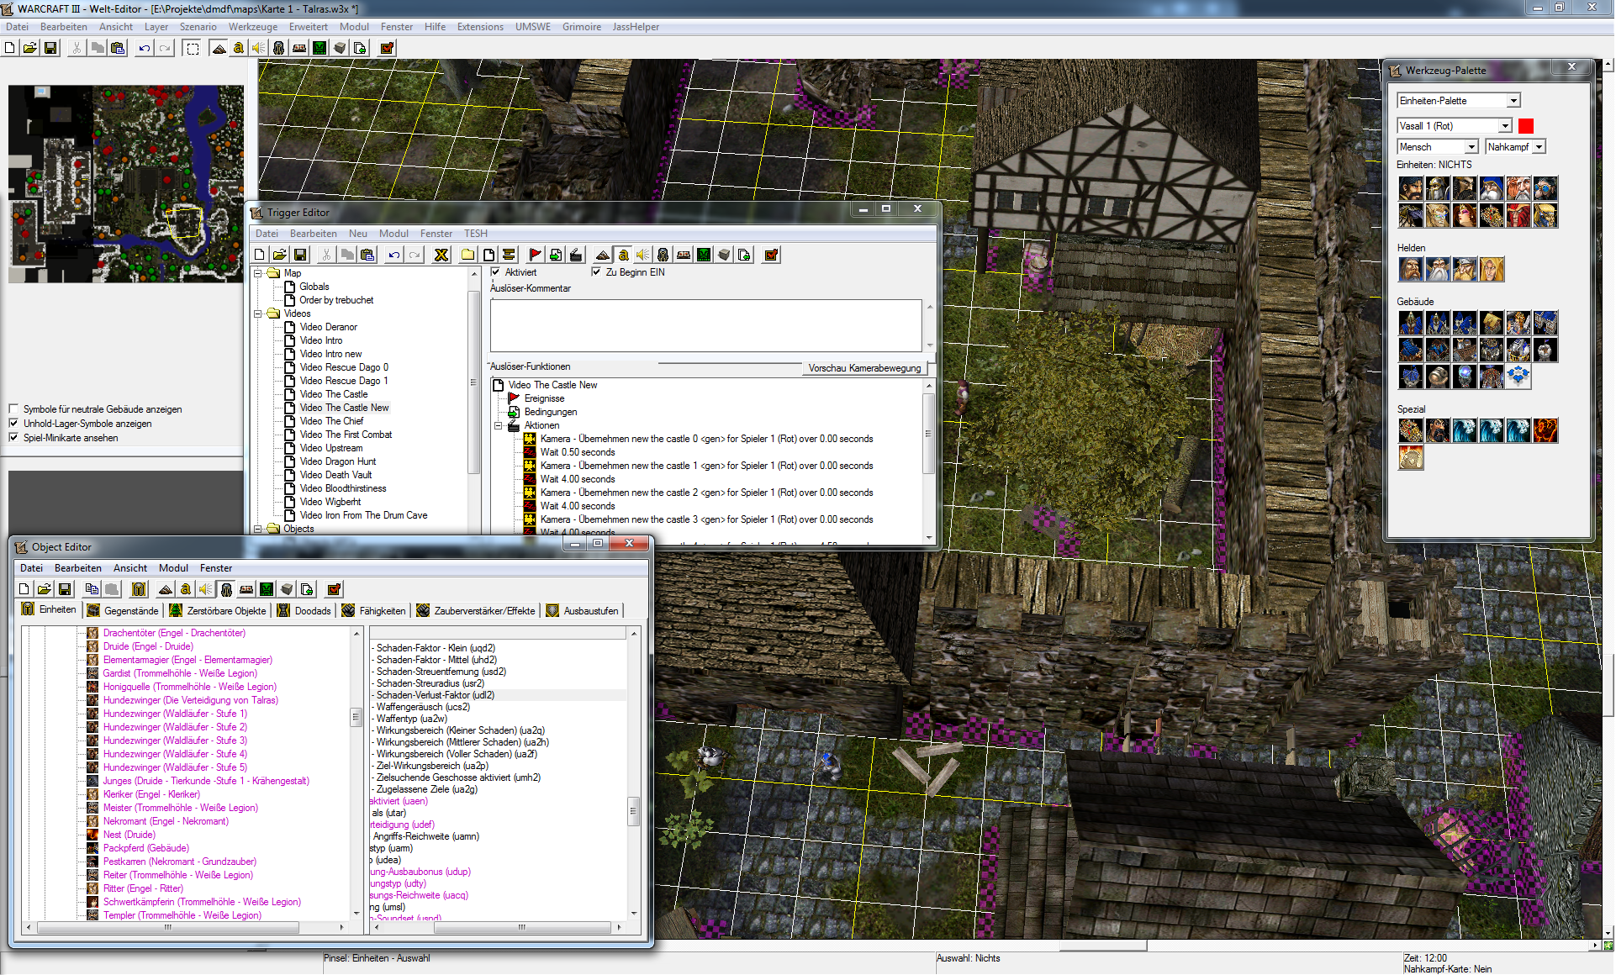
Modification
Change and add content to the game
Possibilities:
  World Editor
  Scripting languages: JASS, vJass, Zinc, Wurst
  Custom resources: Graphics, sounds
  Up to 8 MiByte per map
  Custom MPQs or campaigns with no limit

Slide 4
Custom Game vs Modification
Custom Game:
No limits
Full copyright
Not necessarily commercial requirements
Start from scratch
Requires more time and more manpower
Modification:
Limited possibilities
Limited copyright
Requires the original game
Focus on content
Requires less time

Slide 5
Community
www.hiveworkshop.com
www.wc3c.net
www.inwarcraft.de
http://www.wc3jass.com
http://www.moddb.com/games/warcraft-iii-frozen-throne/mods
Inactive/closed websites:
wc3sear.ch (moved to Hive Workshop)

Slide 6
Existing maps
DotA (origin of DotA 2 and League of Legends)
Footman
X Hero Siege
Hero Line Wars
Battletanks
5520 different maps on Hive Workshop (2015-10-02)
Some popular map types:
  Aoen of Strife
  Arena
  Campaign
  Cinematic
  Defense
  Escape
  Footman
  Melee
  Mini-Game
  Racing
  Role Play Game
  Tagging (Vampirism)
  Tower Defense

Slide 7
The Power of Fire
Modification for Warcraft III: The Frozen Throne
Uses a custom .exe file which has to be started
Attaches a custom .mpq file which has a size of 320 MiBytes (2015-10-02) and contains all data
8 different classes with 15 spells each:
  Cleric
  Necromancer
  Druid
  Knight
  Dragon Slayer
  Ranger
  Elemental Mage
  Wizard
Provided maps:
  Talras (6 players): Cooperative RPG
  Arena (12 players): Player versus Player

Slide 8
Comparison
Original:
Realtime strategy game
Control army, base and multiple heroes
Comic style
Fast multiplayer games
Multiplayer is not story driven
Up to 12 players
Modification:
Realtime COOP RPG
Control one single hero
Realtexture style
Longtime multiplayer games
Storydriven multiplayer
Up to 6 players

Slide 9
Terrain
Realtexture models
More detailed
Less locations but in bigger size
Dungeons separated from the map

Slide 10
Character management
8 different classes
15 spells per class
Up to level 25
Bagpack and equipment system
Automatic revival
Shared bounty and shared XP (distributed equally to all characters)

Slide 11
Inventory
Original Inventory is limited to 6 items
5 different equipments
Rucksack with 30 bags 3 slots each
Items of the same type can be stacked

Slide 12
Conversations
Influenced by Gothic and other RPG games
Interactive decisions of the player can alter the story
Provided choices can depend on previous actions or the character's class

Slide 13
World
NPCs with daily routines
NPC have interactive conversations (influenced by Gothic)

Slide 14
Story
Linear main story
Cooperative main quests
Independent Side quests per character

Slide 15
Download and related projects
Download:
  http://wc3lib.org/mods.html
Related projects:
  Warcraft III Library: C++ programming library for writing modification tools
  Advanced Script Library: vJass library providing systems for custom maps and modifications

