Slide 1
Battle of the Neighborhood
Applied Data Science Capstone Project
November 2020
Trent Dawson

Slide 2
Introduction
Business Objective: A small business owner is looking to open a store somewhere in the Scarborough Borough of Toronto, Canada and is deciding between opening a coffee shop and a gas station.
Analysis Objective: This project will explore the neighborhoods in Scarborough as well as the venues that exist in them, aiming to find the best-fitting neighborhood for the new coffee shop/gas station

Slide 3
Data
Summary of Data Collected:
Postal Code, Borough Name, Neighborhood Name
Longitude/Latitude Coordinates
Venue Name, Venue Coordinates, Venue Category
Links to Data Sources:
https://en.wikipedia.org/wiki/List_of_postal_codes_of_Canada:_M
http://cocl.us/Geospatial_data
https://api.foursquare.com/v2/venues/explore?&client_id={}&client_secret={}&v={}&ll={},{}&radius={}&limit={}

Slide 4
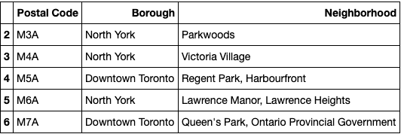
Neighborhood Data Preview

Slide 5
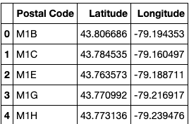
Coordinate Data Preview

Slide 6
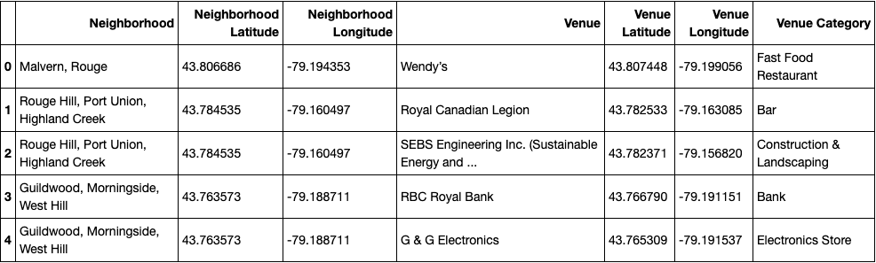
Venue Data Preview

Slide 7
Methodology
Data for neighborhoods in Toronto is gathered from the Wikipedia page and is pre-processed before ultimately
Data is joined with the coordinates csv file and n filtered down to only contain Scarborough neighborhoods.
The venue data is fetched from the Foursquare API. Each venue can then be assigned to a neighborhood and joined with the neighborhood data from Wikipedia.
The venue data is grouped together by venue category, allowing for a good summary of the venues that exist within each neighborhood.
Conclusions are derived from these findings to provide business value for the client.

Slide 8
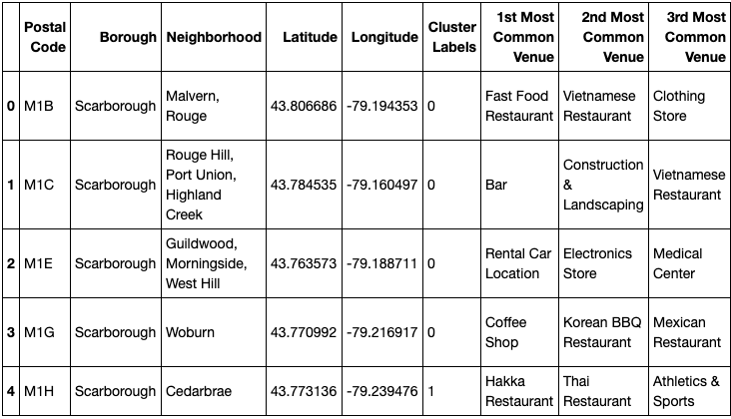
Results
This output table shows the various neighborhoods in the Scarborough borough and the most common venues in each neighborhood. The results are scaled out to the 10 most common venues in each neighborhood.

Slide 9
Recommendation
Recommended Store Type:
Gas station
Less throughout the entire borough
Potential Neighborhoods:
These neighborhoods do not feature a gas station as one oft their top 10 most frequent venues, meaning there is not a high level of competition for business within these neighborhoods.
Golden Mile
Guildwood
Wexfor
Woburn
Final Recommendation:
Guildwood
Low number of grocery stores
High number of intersections

