Slide 1
Schwab System Analysis
Teradata Workload Analysis
Thomas Sluis
Senior Solution Engineer
September 18, 2020

Slide 2
System Analysis
Schwab
Users_Total | 1,865
ObjectCount_Tables | 55,409
ObjectCount_Views | 37,185
ObjectCount_Indices | 29
ObjectCount_Program | 2762
ObjectCount_Other | 27
Query_Day_Count | 213
Query_Total_Count | 1,784,079,399
Query_per_Day | 8,375,960
Query_per_Sec | 96.9
Query_per_Year | 3,057,225,261
Concurrency_Max | 156
Concurrency_Avg | 23
Query_Runtime_Avg | 0.148
DiskSpaceTB_Max | 576
DiskSpaceTB_Used | 300
Summary:
130 Applications connecting to the system
1,865 Active Users, Business & Applications
3.05 Billion Annual Queries
249 M Average Queries per Month
8.3 M Average Queries per Day
97 Queries per second
156 Concurrent Queries (Peak)
0.148 Seconds Average Response Time

Slide 3
Daily Data Transfers

Slide 4
Daily Queries Throughput
Average 8.3 Million Per Day. 97 queries per second.
98.6% of the queries are sub-second

Slide 5
JOIN Frequency
Last 3-Months Queries
Frequent Multi-Table JOINs
Frequent INSERTS/UPDATES/DELETES
Number of JOINS | Total Queries
1 | 447,733,448
2 | 14,308,149
3 | 1,947,385
4 | 647,060
5 | 1,065,741
5+ | 2,287,719
Grand Total | 467,989,502
Statement Type | Total Queries
Insert | 365,900,089
Update | 72,000,567
Select | 22,502,915
Delete | 5,701,982
Collect Statistics | 684,081
Create Table | 376,258
Help | 327,622
Begin Loading | 149,747
Merge Into | 73,854
Execute Mload | 57,995
Begin Mload | 57,264
Mload | 57,221
Null | 45,114
Commit Work | 34,558
Grant | 16,385
Extremely Challenging for BigQuery to handle complex multi-way
JOINs and frequently loaded/updated data.

Slide 6
Applications and Data Extracts
BigQuery 10GB Export Limit applies here
Appl | Total_Queries | Total_FetchedRows | Average Rows Per Query
MSMDSRV:NET:SS:15.11.00.000 | 526 | 13,610,036,438 | 25,874,594
CPU_SCORING:NET:SS:16.20.06.00 | 1,871 | 42,635,290,434 | 22,787,435
EXECUTOR | 924 | 4,684,627,346 | 5,069,943
QUERYCHAMELEON:NET:SS:15.11.00 | 1,002 | 3,746,724,894 | 3,739,246
R | 814 | 2,577,559,525 | 3,166,535
QUERYCHAMELEON:NET:SS:16.20.09 | 927 | 2,202,368,910 | 2,375,802
FDICSWEEP:NET:SS:15.11.00.000 | 90 | 180,256,508 | 2,002,850
MS SQL Server | 13,123 | 25,480,142,600 | 1,941,640
CPU_SCORE:NET:SS:16.20.06.000 | 110 | 155,101,636 | 1,410,015
CPU_SCORING:NET:SS:16.10.01.00 | 116 | 141,734,567 | 1,221,850
CORRECTIONCOMPARER:NET:SS:16.2 | 494 | 271,816,907 | 550,237
QUERYCHAMELEON:NET:SS:16.20.06 | 191 | 70,071,262 | 366,865
SAP BO Web Intelligence | 16 | 4,990,751 | 311,922
TOAD | 1,813,695 | 558,505,377,034 | 307,938
QUERYCHAMELEON | 1,374,601 | 400,196,480,046 | 291,136
FRA:NET:SS:16.20.06.000 | 553 | 149,659,282 | 270,632
TD SQL Assistant | 3,252,136 | 854,777,632,149 | 262,836
SELFSERVICE.EXE:NET:SS:15.11.0 | 20,331 | 2,786,984,670 | 137,081
DATAMIGRATIONANDRECOVERYSERVIC | 242,171 | 32,040,277,483 | 132,304
Python Win | 14,676 | 1,520,981,010 | 103,637
ESMUTILITY:NET:SS:17.00.02.000 | 868 | 87,978,095 | 101,357
REPTGEN:NET:SS:15.11.00.000 | 4,150 | 420,217,274 | 101,257
Unica | 1,228,527 | 115,169,581,342 | 93,746
Tableau | 2,579,510 | 207,850,929,151 | 80,578

Slide 7
Table Size > 10GB
1,456 Tables > 10GB
DataBaseName | NAME | CurrentPerm_GB
IDW_DATA | ACCT_POSTN_T | 20,163.38
IDW_DATA | PAS_ACCT_ACTVY_T | 15,172.45
CAP_DATA | CAP_ACCT_SUMM_NM_MTHLY_T | 10,893.19
OSI_DATA | R_FRL_DRVR_ACCT_T | 8,287.67
IDW_DATA | ITEM_ISS_PRICE_T | 8,082.44
CAP_DATA | CAP_ACTVY_SUMM_NM_MTHLY_T | 7,405.74
IDW_DATA | acct_bal_t | 6,642.51
IDW_DATA | SEG_STK_REC_DETL_T | 6,610.13
OSI_DATA | R_FRL_PROF_SCND_DRVR_ACCT_T | 5,697.84
IDW_DATA | WEB_CHNL_ACTVY_T | 5,024.04
IDW_RPT_DATA | AFLT_ACCT_BAL_T | 4,998.81
IDW_DATA | ACXIOM_INFOBASE_HSHLD_PROFL_T | 4,851.18
IDW_DATA | FI_DEALR_QUOTE_T | 4,070.18
IDW_DATA | CHBS_BD_TP_ACCT_BAL_TRADE_T | 4,066.74
CAP_DATA | CAP_ACTVY_SUBTOTAL_NM_MTHLY_T | 3,485.25
OSI_DATA | f_asset_t | 3,331.06
OSI_DATA | C_HSHLD_DLY_T | 3,324.42
IDW_DATA | ACXIOM_INFOBASE_MKT_INDCS_t | 3,071.84
IDW_ACQ_DATA | BDH_SFDC_HOUSEHOLD__C_L_T | 2,907.38
IDW_DATA | ACCT_TRAN_T | 2,552.49
IDW_DATA | CHBS_CCR_BAL_TRADE_T | 2,532.80
IDW_DATA | EXPEN_MTHLY_T | 2,143.06
CAP_DATA | CAP_ACCT_REVNU_NM_MTHLY_T | 1,968.07
IDW_DATA | DOE_ORD_MSTR_T | 1,795.32
IDW_DATA | ACCT_POSTN_MTHLY_T | 1,727.62
IDW_DATA | SMRT_BANR_RTD_EVNT_T | 1,606.31
IDW_DATA | GSDW_ISS_T | 1,603.76
IDW_DATA | CUST_ACCT_TRAN_T | 1,601.41
IDW_DATA | RTRMT_PLAN_PARTC_POSTN_T | 1,420.66

Slide 8
Number of Tables Having > 1500 Insert/Update/Delete
On an average 225 Tables break the BigQuery limits daily

Slide 9
Databases with Most Frequent INSERTS/UPDATES/DELETES
Row Labels | Average of StatementCountPerTable
ACTIMIZE_DEV_DATA | 623,941
IDW_PRSTNT_STAGE | 479,955
RETL_DEV_DATA | 335,842
IDWSCRSDM_DEV | 258,038
IDW_ADMIN | 239,695
ACTIMIZE_UAT_DATA | 145,833
CSIMBI_DATA | 120,792
MKTG_EFF_SB | 98,837
CSIMBI_DEV_DATA | 92,339
APP_DATA | 84,315
IDW_UAT_DATA | 72,460
OSI_UAT_STAGE | 54,600
CAP_DATA | 48,796
ACTIMIZE_DATA | 41,166
QA_PAS_DATA | 36,803
BANK_UAT_RPT_STAGE | 36,056
COMPL_DEV_DATA | 33,956
IDW_DATA | 33,146
DM_CONTROL | 27,239
TDStats | 22,461
CRS_BETA_STAGE | 21,718
BANKMIS_PROD | 21,477
IDW_RPT_DATA | 18,694
PAS_DATA | 16,248
IDW_DBA_DWA | 14,043
IDW_STAGE | 13,621
PSFT_EXPN_STAGE | 13,295
IDW_UAT_STAGE | 12,934
IDW_SPARKS | 11,202
LCR_DEV_DATA | 10,989
Database Name | Average of StatementCountPerTable
BANK_RPT_DATA | 10,832
FT_DATA | 10,350
IDW_RPT_STAGE | 9,365
TRSRY_TECH_DWA | 8,372
BANK_UAT_RPT_DATA | 8,251
OSI_STAGE | 7,253
OSI_UAT_DATA | 7,242
SB_INTL_BUSN | 7,186
IDW_ITEM_DATA | 5,824
MIS_APPS_DEV_STAGE | 5,205
SB_TGCA | 4,434
AIL_ANLY_DWA | 4,336
SysAdmin | 3,423
OSI_DATA | 3,138
IDW_ACQ_DATA | 3,109
LCR_QA_DATA | 2,822
UNICA_PROD_APPDATA | 2,819
MIS_APPS_PROD_STAGE | 2,709
IDW_DMG | 2,659
EBS_DATA | 2,648
IDWSIDM_DEV | 2,599
IDWOPSDM_DEV | 2,559
BRCH_INCTV_PROD_DATA | 2,559
BANK_RPT_STAGE | 2,428
LCR_UAT_DATA | 1,899
BRCH_INCTV_DEV_DATA | 1,803
IDW_HC_DATA | 1,802
SLR_MRT_PROD_DATA | 1,723
IDWSIDM_PROD | 1,673

Slide 10
Dictionary Analysis – Requirements For A Successful Migration
Column Formatting
Primary Indexes
2,358,570 Column Formats
34,742 UPI/NUPI Defined
01
06
Partitioning & Indexes
Table Structures
1,186 PPI Defined
76,270 total indexes used 24,295,344 times in the workload
29,679 SET tables out of 54,830 (54%)
114 Global Temporary Tables
02
05
Special Data Types
815 INTERVAL
170 PERIOD
1,302 NUMBER
53 BLOB > 8MB
91 CLOB > 16MB
75 XML/JSON
212 Geospatial
Constraints
03
04
608 Primary Key Constraints
Notes:
System database excluded:
DatabaseName NOT IN ('All', 'Crashdumps', 'DBC', 'dbcmngr’, 'Default', 'External_AP', 'EXTUSER', 'LockLogShredder', 'PUBLIC','Sys_Calendar', 'SysAdmin', 'SYSBAR', 'SYSJDBC', 'SYSLIB','SystemFe', 'SYSUDTLIB', 'SYSUIF', 'TD_SERVER_DB', 'TDStats','TD_SYSGPL', 'TD_SYSXML', 'TDMaps', 'TDPUSER', 'TDQCD','tdwm', 'SQLJ', 'TD_SYSFNLIB', 'SYSSPATIAL')

Slide 11


Business Impacts of Gaps
Column Formatting
Primary Indexes
Column Formatting allows you to control data type precision and if not handled properly in the ETL logic can cause reconciliation issues.
Not having PI will require complete remodelling and will dramatically reduce performance especially for tactical queries
01
06
Partitioning & Indexes
Table Structures
Multi-Level partitioning available in Teradata is missing in other databases which will result in significantly worse performance for partitioned queries and queries requiring index.
Table Structures
54% of the tables are SET tables which enforce uniqueness automatically, absence of this capability will require moving this complex logic to ETL.
Global Temporary tables will need to be handled in the ETL as well.
54% of the tables are SET tables which enforce uniqueness automatically, absence of this capability will require moving this complex logic to ETL.
Global Temporary tables will need to be handled in the ETL as well.
02
05
Special Data Types
These data types provide specialized business capabilities such as Time Series, Geospatial, Temporal, Unstructured Data processing. Absence of the data types will make it really difficult to provide these business capabilities.
Constraints
03
04
All the constraints handled by the database would need to be handled by ETL which will significantly increase ETL effort and it can cause reconciliation issues
Notes:
BigQuery simply doesn’t comply with the functional and non-functional features of the current system.
The migration tool from BigQuery will only convert the syntax and most likely the results will be incorrect.
In order to fix the issue you would be forced to rewrite the ETL which will result in Millions of $ of Systems Integrators bill. We have customers who have spent more than 3 years trying to migrate off a Teradata platform, at that point they have spent orders of magnitude more on Systems Integrators billed hours than the platform.
After 3 years you have no net new capability but the same capability which is available to you today already.

Slide 12
Conclusions
The Schwab system has:
Complex workload involving multiple joins running at scale (8.3M Queries Daily)
Low Latency ingestion performed on a regular basis
Sophisticated schema deployed
Multiple applications running large extracts
The above factors need to be considered during migration.
There is an opportunity to run some analytics in-Database.

Slide 13
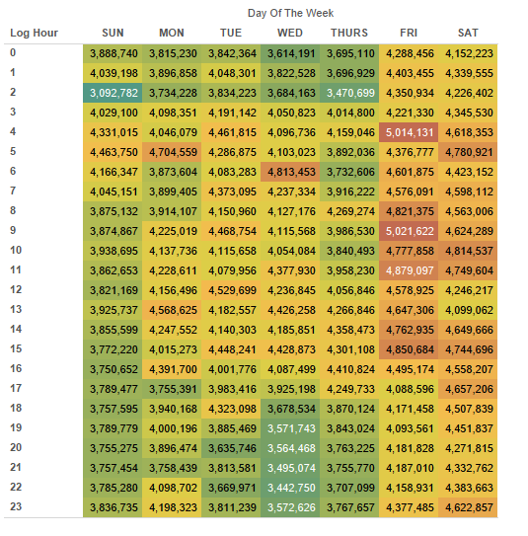
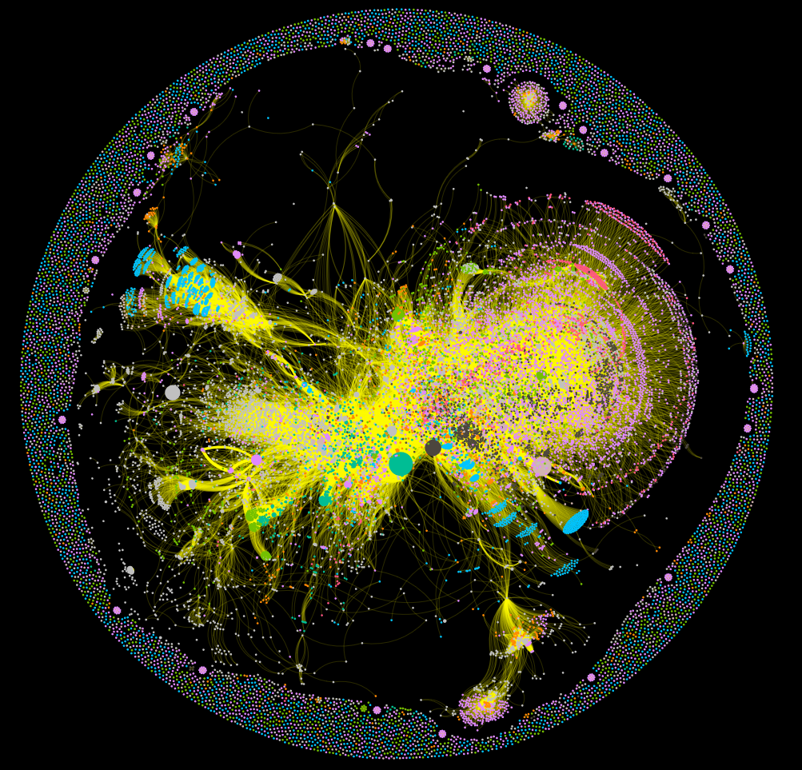
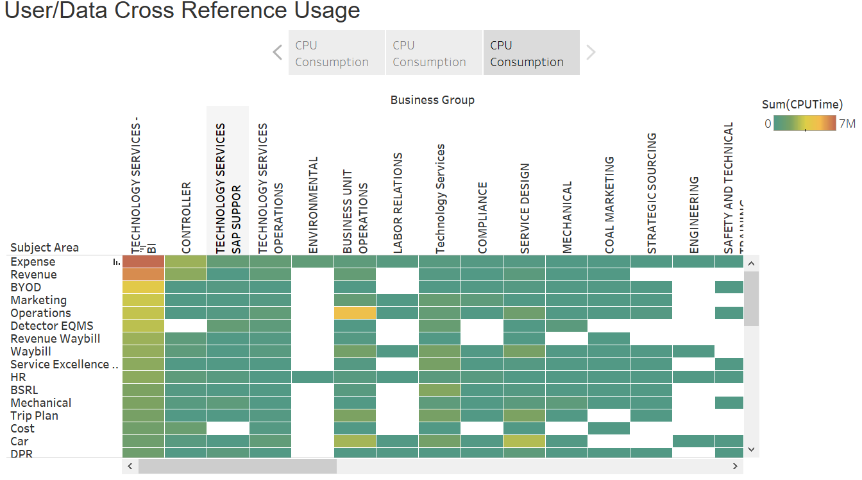
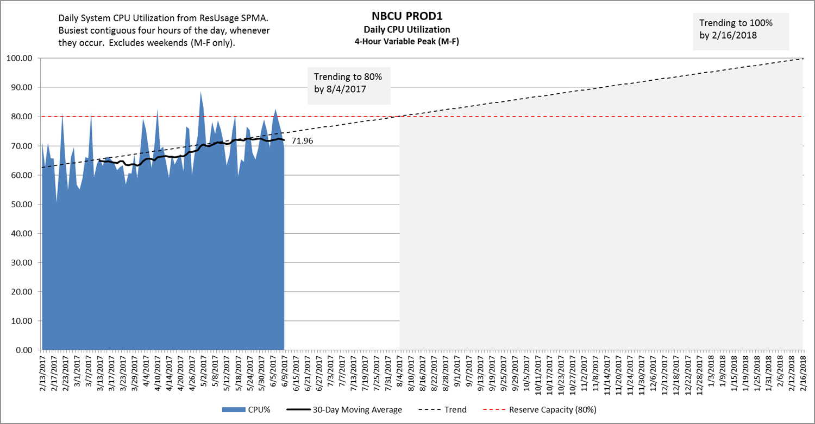
Vantage Workload Assessment
Vantage Health Check
What is it? | Vantage Health Check is a routine service Teradata provides for customers to help them understand their usage of the Vantage platform.
What do I get? | A report detailing the usage of the Vantage Platform along the dimensions of: Resource usage (Compute & Storage) Workload Profile Data Affinity Feature Usage (if on Teradata 16+) User Profile (optional) Data Usage Profile (optional)
What do I need? | The health check requires the following data: ResUsage and Database Query Log (DBQL) DBQL Object logging (for Data Affinity) Feature logging (for Feature Usage) User group mapping (optional, requires customer input) Data subject area mapping (optional, requires customer input) SQL will be supplied to the DBA for execution and extraction of the results for visualization
How long does it take? | Teradata will take 1 week to complete the analysis and produce the report. There is no charge for the Initial Baseline service.
Potentially Sensitive Data
What is extracted? | Username Database name Table name CPU, IO and Diskspace metrics
©2020 Teradata

Slide 14
EDW Utilization Stats
March 2018 – February 2019
PROD2 (Primary EDW) Facts*:
81 Applications on same platform
6,763 Active Users, Business & Applications
5,160 Active Named Business Users
178M Average Queries per Month
0.88 Seconds Average Response Time
71% Business User Adhoc
227 Concurrent Queries on Average
$0.0026970 Cost per Query
99.99% Availability
8M Average Queries per Day
Utilization Breakdown
9% Business Application BI Access
Only 6% ETL during core hours
11% Business Application Analytic ETL
3% DB Admin
* Only includes statistics on PROD2, one of 10 systems at large healthcare firm

Slide 15
Business Usage Decoded (Who & What Data)
Core Consumption
2-3 Weeks Engagement
Automated Consumption Acquisition
Understand platform usage patterns
CPU
IO
Based on SAR reports
Core Database Consumption
Overall system usage
Provides breakdown of user groups
Backlog reporting
Heatmaps
Based on resusage
Core Usage
Maps subject areas to business groups
Based on DBQL
Core
Usage
Core Database Consumption
Core Consumption

