Slide 1


Consistency and Linearizability
CS 4740: Cloud Computing
Fall 2024
Lecture 9
Yue Cheng
Some material taken/derived from:
Princeton COS-418 materials created by Michael Freedman and Wyatt Lloyd.
MIT 6.824 by Robert Morris, Frans Kaashoek, and Nickolai Zeldovich.
@ 2024 released for use under a CC BY-SA license.

Slide 2
Announcement
Lab 2 is out
There will be a Lab 2 tutorial tomorrow at 3pm
Zoom info to be announced via Canvas

Slide 3
Fault tolerance vs. Consistency
Fault-tolerance / durability:
Don’t lose operations
Consistency:
Ordering between (visible) operations
Notes:
Processes may be running on different machines

Slide 4


Correct consistency model?
A
B
Let’s say A and B send an op.
All readers see A → B ?
All readers see B → A ?
Some see A → B and others B → A ?
Notes:
Processes may be running on different machines

Slide 5

Consistency models
Strong consistency
Paxos / Raft
Eventual consistency
Amazon Dynamo

Slide 6
Strong consistency
Provide behavior of a single copy of object:
Read should return the most recent write
Subsequent reads should return same value, until next write
Telephone intuition:
Alice updates Facebook post
Alice calls Bob on phone: “Check my Facebook post!”
Bob read’s Alice’s wall, sees her post

Slide 7

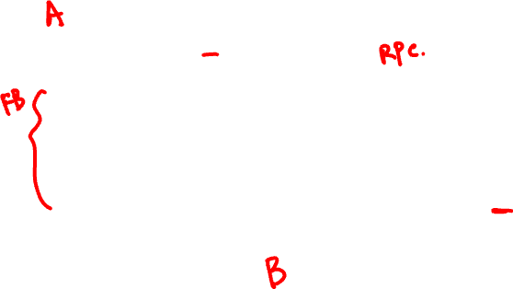
Strong consistency?
write(A,1)
success
1
read(A)
Phone call: Ensures happens-before relationship, even through “out-of-band” communication

Slide 8
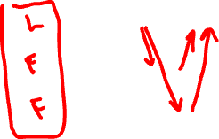
Strong consistency?
write(A,1)
success
1
read(A)
One cool trick: Delay responding to writes/ops until properly committed

Slide 9
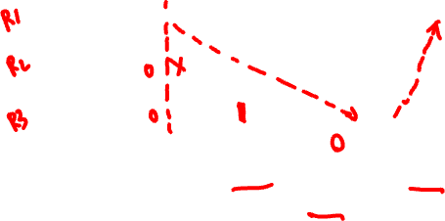
Strong consistency? This is buggy!
write(A,1)
success
1
committed
read(A)
Isn’t sufficient to return value of third node: It doesn’t know precisely when op is “globally” committed
Instead: Need to actually order read operation

Slide 10

Strong consistency!
write(A,1)
success
1
read(A)
Order all operations via (1) leader, (2) consensus

Slide 11

Consistency models
Linearizability
Causal
Eventual
Sequential

Slide 12
Consistency models
Linearizability
Causal
Eventual
Sequential

Slide 13
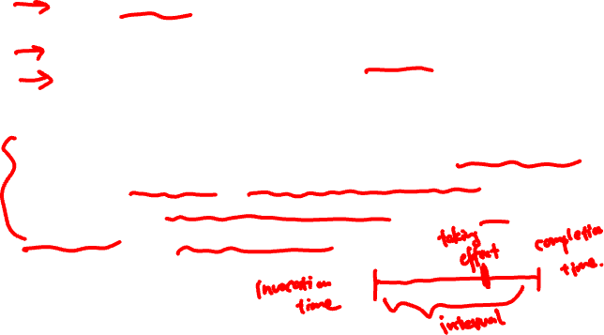
Strong consistency = linearizability
Linearizability (Herlihy and Wing 1991)
All servers execute all ops in some identical sequential order
Global ordering preserves each client’s own local ordering
Global ordering preserves real-time guarantee
Informally, linearizability specifies that each concurrent operation appears to occur instantaneously and exactly once at some point in time between its invocation and its completion.
Notes:
Informally, linearizability specifies that each concurrent op appears to occur instantaneously and exactly once at some point in time between its invocation and its completion.
Linearizability (also known as atomic consistency, strong consistency, immediate consistency) describes reads and writes on a single object (stores a single value). it doesn’t involve multiple objects. It doesn’t involve “transaction”, which groups multiple objects. It treats each operation as an atom, i.e., to take effect in a single time point, rather than a timespan.
Bullet 2: Order of each client’s own local operations (partial order w.r.t. global order) should be strictly preserved in the global ordering.

Slide 14

Strong consistency = linearizability
Linearizability (Herlihy and Wing 1991)
All servers execute all ops in some identical sequential order
Global ordering preserves each client’s own local ordering
Global ordering preserves real-time guarantee
All ops receive global timestamp using a sync’d clock
If ts_{op1}(x) < ts_{op2}(y), OP1(x) precedes OP2(y) in sequence
Notes:
Bullet 3: Global ordering should preserve real-time precedence.

Slide 15
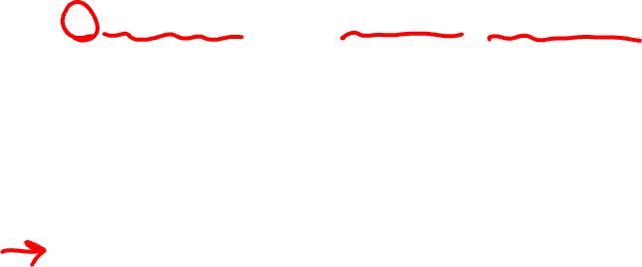

Strong consistency = linearizability
Linearizability (Herlihy and Wing 1991)
All servers execute all ops in some identical sequential order
Global ordering preserves each client’s own local ordering
Global ordering preserves real-time guarantee
All ops receive global timestamp using a sync’d clock
If ts_{op1}(x) < ts_{op2}(y), OP1(x) precedes OP2(y) in sequence
Once write completes, all later reads (by wall-clock start time) should return value of that write or value of later write.
Once read returns particular value, all later reads should return that value or value of later write.
Notes:
Bullet 3: Global ordering should preserve real-time precedence.

Slide 16
Real-time ordering examples

Slide 17
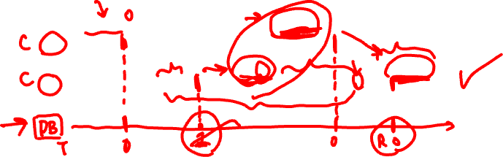
W(0)
W(0)
A:
W(1)
R(0)
B:

Slide 18
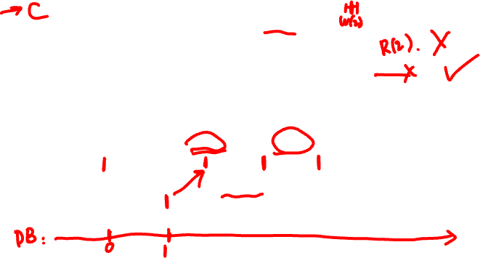

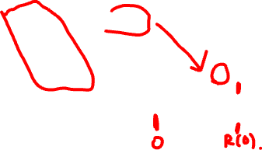
W(0)
W(0)
A:
W(1)
R(0)
B:
W(0)
R(1)
W(0)
A:
W(1)
R(0)
B:

Slide 19
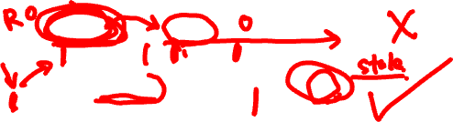

W(0)
W(0)
A:
W(1)
R(0)
B:
W(0)
R(1)
W(0)
A:
W(1)
R(0)
B:
W(0)
R(1)
W(0)
A:
W(1)
R(1)
B:

Slide 20
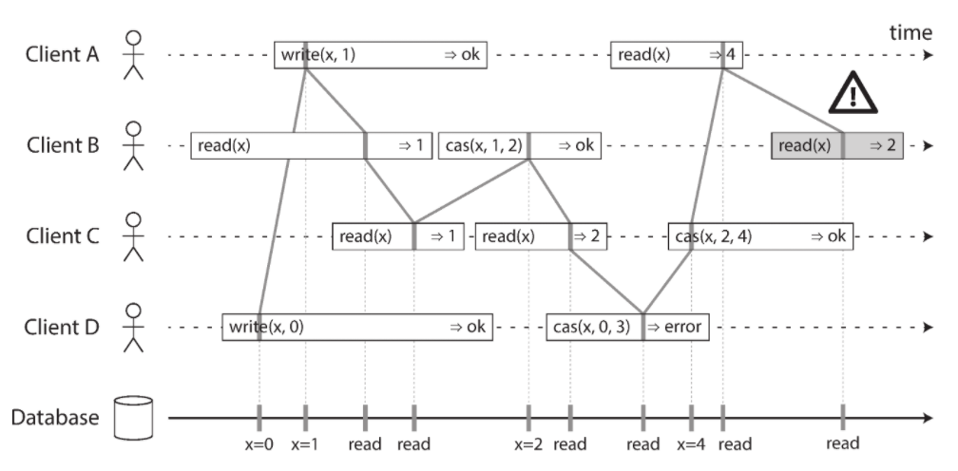
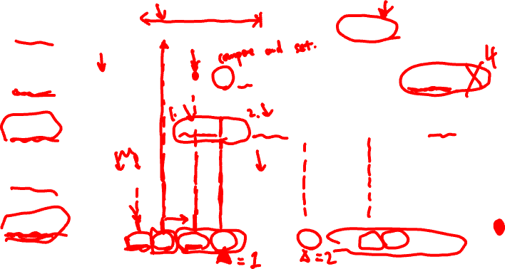
Real-time ordering examples
*: https://www.oreilly.com/library/view/designing-data-intensive-applications/9781491903063/ (Page 328)

Slide 21
Consistency models
Linearizability
Causal
Eventual
Sequential

Slide 22
Weaker: Sequential consistency
Sequential = Linearizability – real-time ordering
All servers execute all ops in some identical sequential order
Global ordering preserves each client’s own local ordering

Slide 23
Weaker: Sequential consistency
Sequential = Linearizability – real-time ordering
All servers execute all ops in some identical sequential order
Global ordering preserves each client’s own local ordering
With concurrent ops, “reordering” of ops (w.r.t. real-time ordering) acceptable, but all servers must see same order
e.g., linearizability cares about time sequential consistency cares about program order

Slide 24
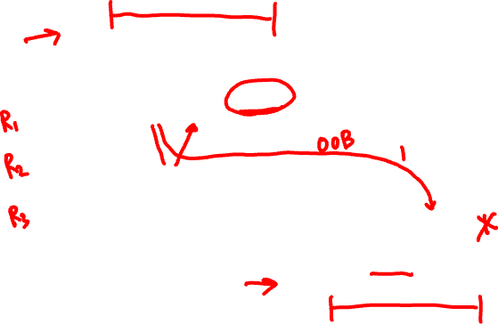
Sequential consistency
write(A,1)
success
0
read(A)
In example, system orders read(A) before write(A,1)

Slide 25
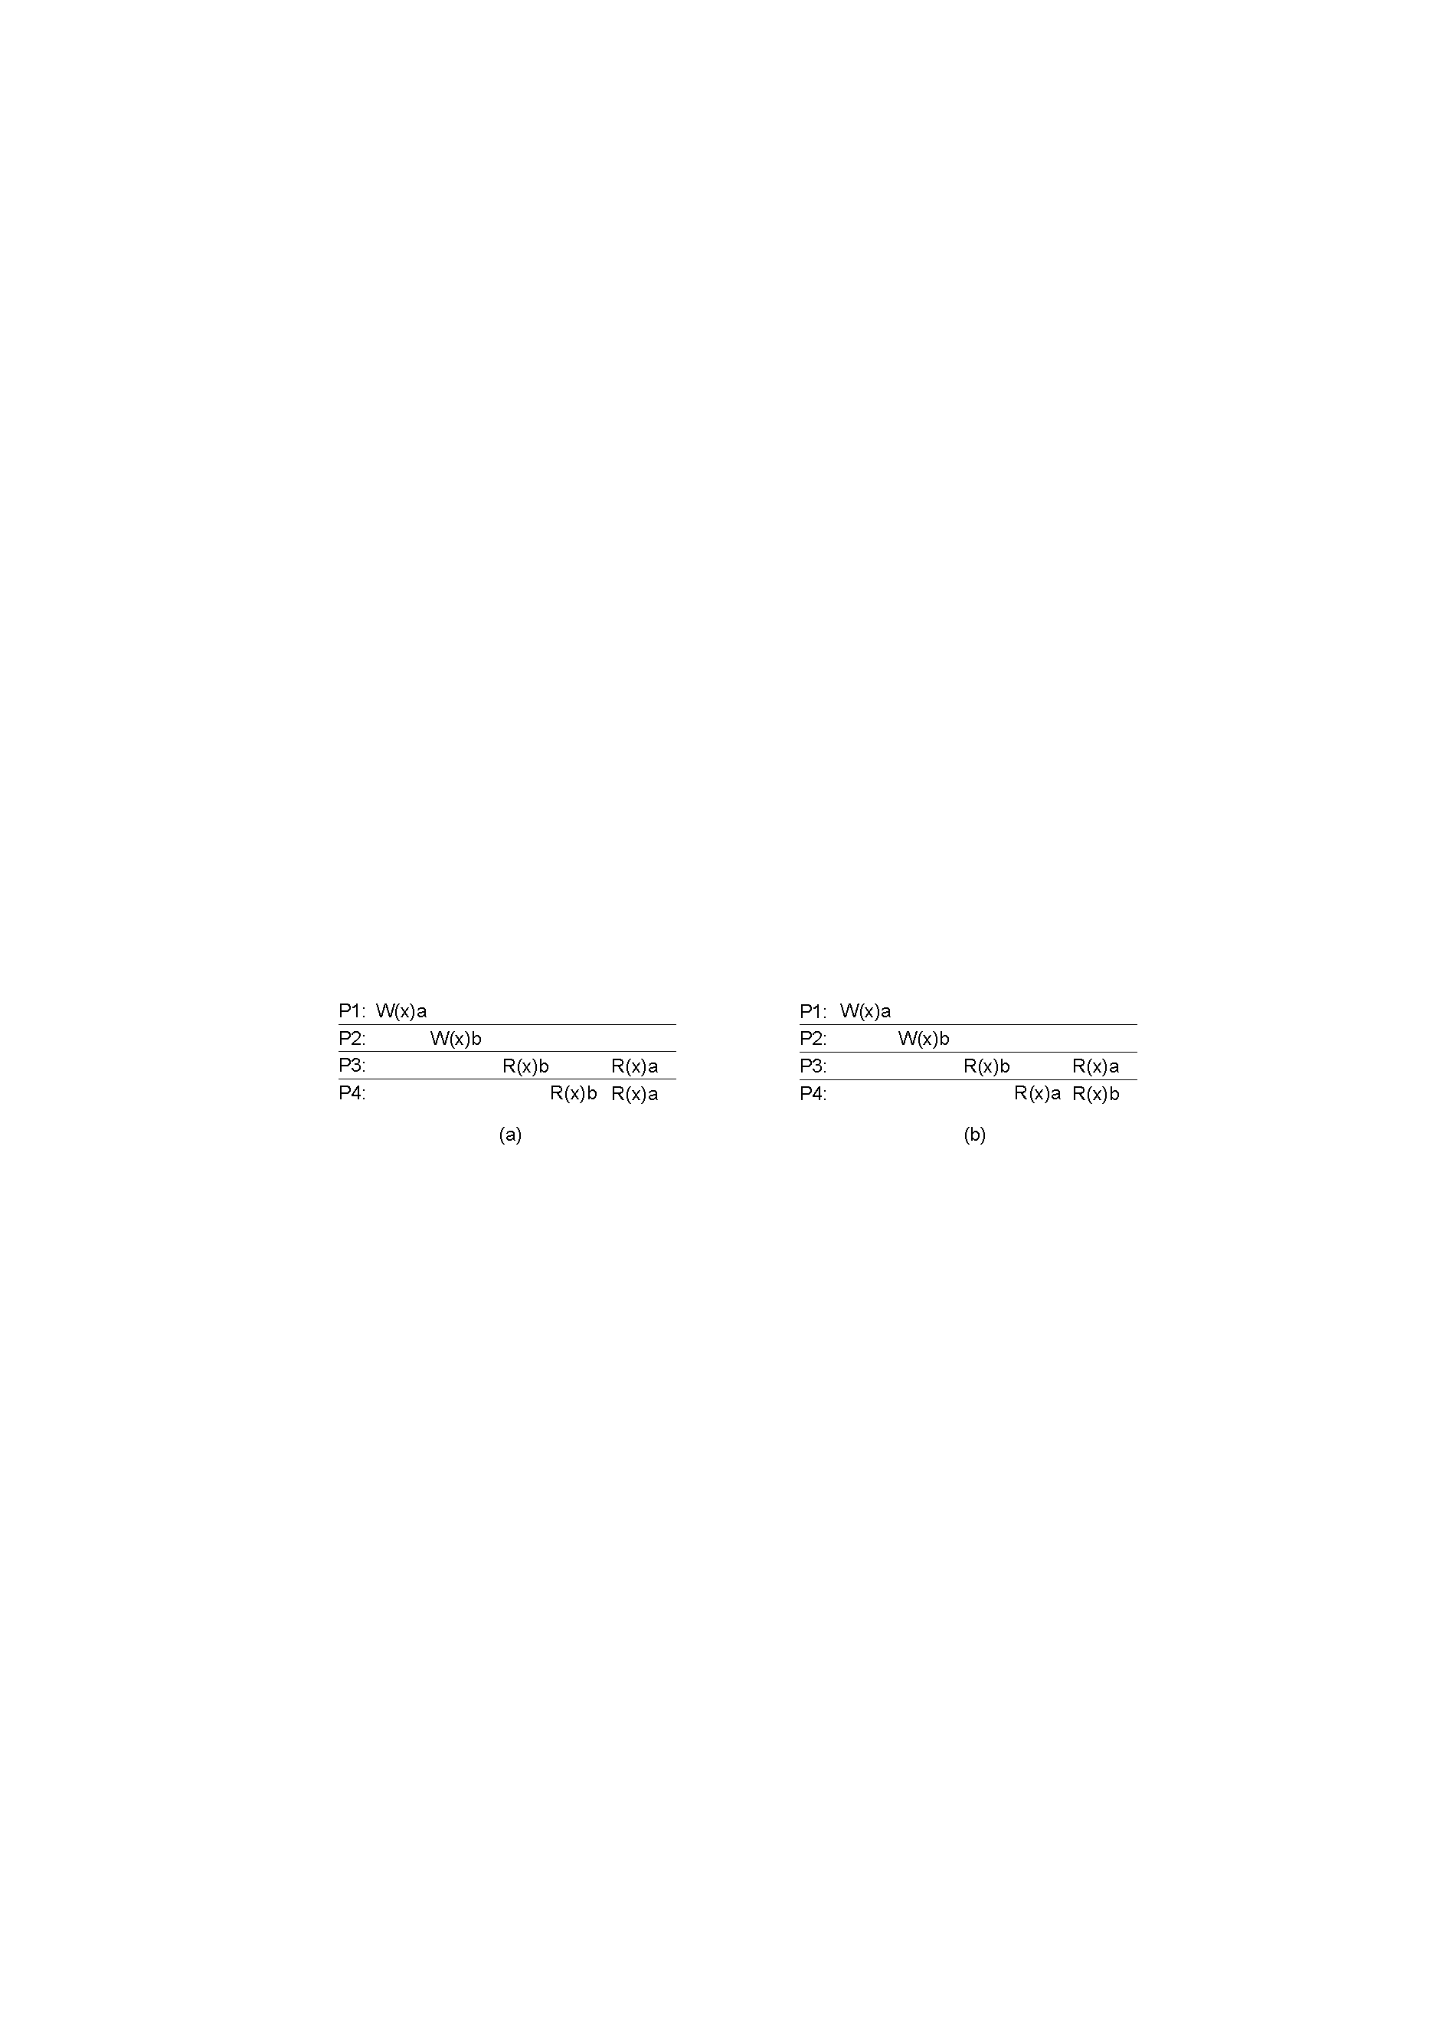
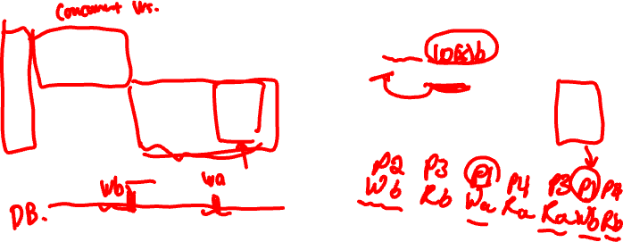
Valid sequential consistency?

Slide 26
Valid sequential consistency?
x
✓

Slide 27
Valid sequential consistency?
x
✓
Why? Because P3 and P4 don’t agree on order of ops. Doesn’t matter when events took place on diff machine, as long as proc’s AGREE on order.

Slide 28
Valid sequential consistency?
x
✓
Why? Because P3 and P4 don’t agree on order of ops. Doesn’t matter when events took place on diff machine, as long as proc’s AGREE on order.
What if P1 did W(x)a and then W(x)b?

Slide 29
Valid sequential consistency?
x
✓
Why? Because P3 and P4 don’t agree on order of ops. Doesn’t matter when events took place on diff machine, as long as proc’s AGREE on order.
What if P1 did W(x)a and then W(x)b?
Neither valid, as (a) doesn’t preserve local ordering

Slide 30
Consistency models
Linearizability
Causal
Eventual
Sequential

Slide 31
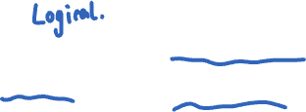
Recall use of logical clocks (lec 8?)
Lamport clocks: C(a) < C(z) Conclusion: None
Vector clocks: V(a) < V(z) Conclusion: a → … → z
Notes:
Users post messages, reply to each others’ messages.

Slide 32
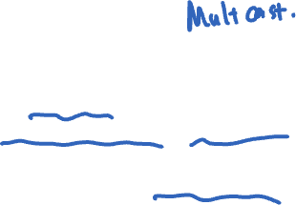
Recall use of logical clocks (lec 8?)
Lamport clocks: C(a) < C(z) Conclusion: None
Vector clocks: V(a) < V(z) Conclusion: a → … → z
Distributed bulletin board application
Each post gets sent to all other users
Consistency goal: No user to see reply before the corresponding original message post
Conclusion: Deliver message only after all messages that causally precede it have been delivered
Notes:
Users post messages, reply to each others’ messages.

Slide 33
Causal consistency

Slide 34
Causal consistency
Writes that are potentially causally related must be seen by all machines in same order.

Slide 35
Causal consistency
Writes that are potentially causally related must be seen by all machines in same order.
Concurrent writes may be seen in a different order on different machines.

Slide 36
Causal consistency
Writes that are potentially causally related must be seen by all machines in same order.
Concurrent writes may be seen in a different order on different machines.
Concurrent: Ops not causally related

Slide 37
Causal consistency
Writes that are potentially causally related must be seen by all machines in same order.
Concurrent writes may be seen in a different order on different machines.
Concurrent: Ops not causally related
P1
P2
P3
a
f
b
c
d
e
g
Physical time ↓

Slide 38
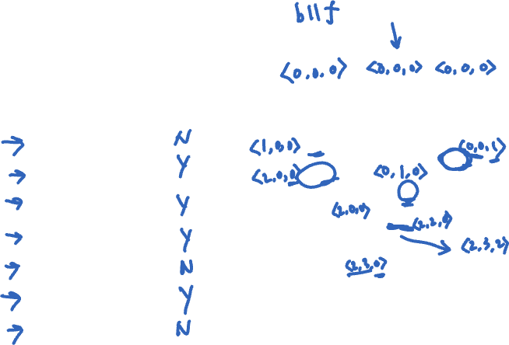
Causal consistency
Operations
a, b
b, f
c, f
e, f
e, g
a, c
a, e
Concurrent?
N
Y
Y
Y
N
Y
N
P1
P2
P3
a
f
b
c
d
e
g
Physical time ↓

Slide 39
Causal consistency
Operations
a, b
b, f
c, f
e, f
e, g
a, c
a, e
Concurrent?
N
Y
Y
Y
N
Y
N
P1
P2
P3
a
f
b
c
d
e
g
Physical time ↓

Slide 40
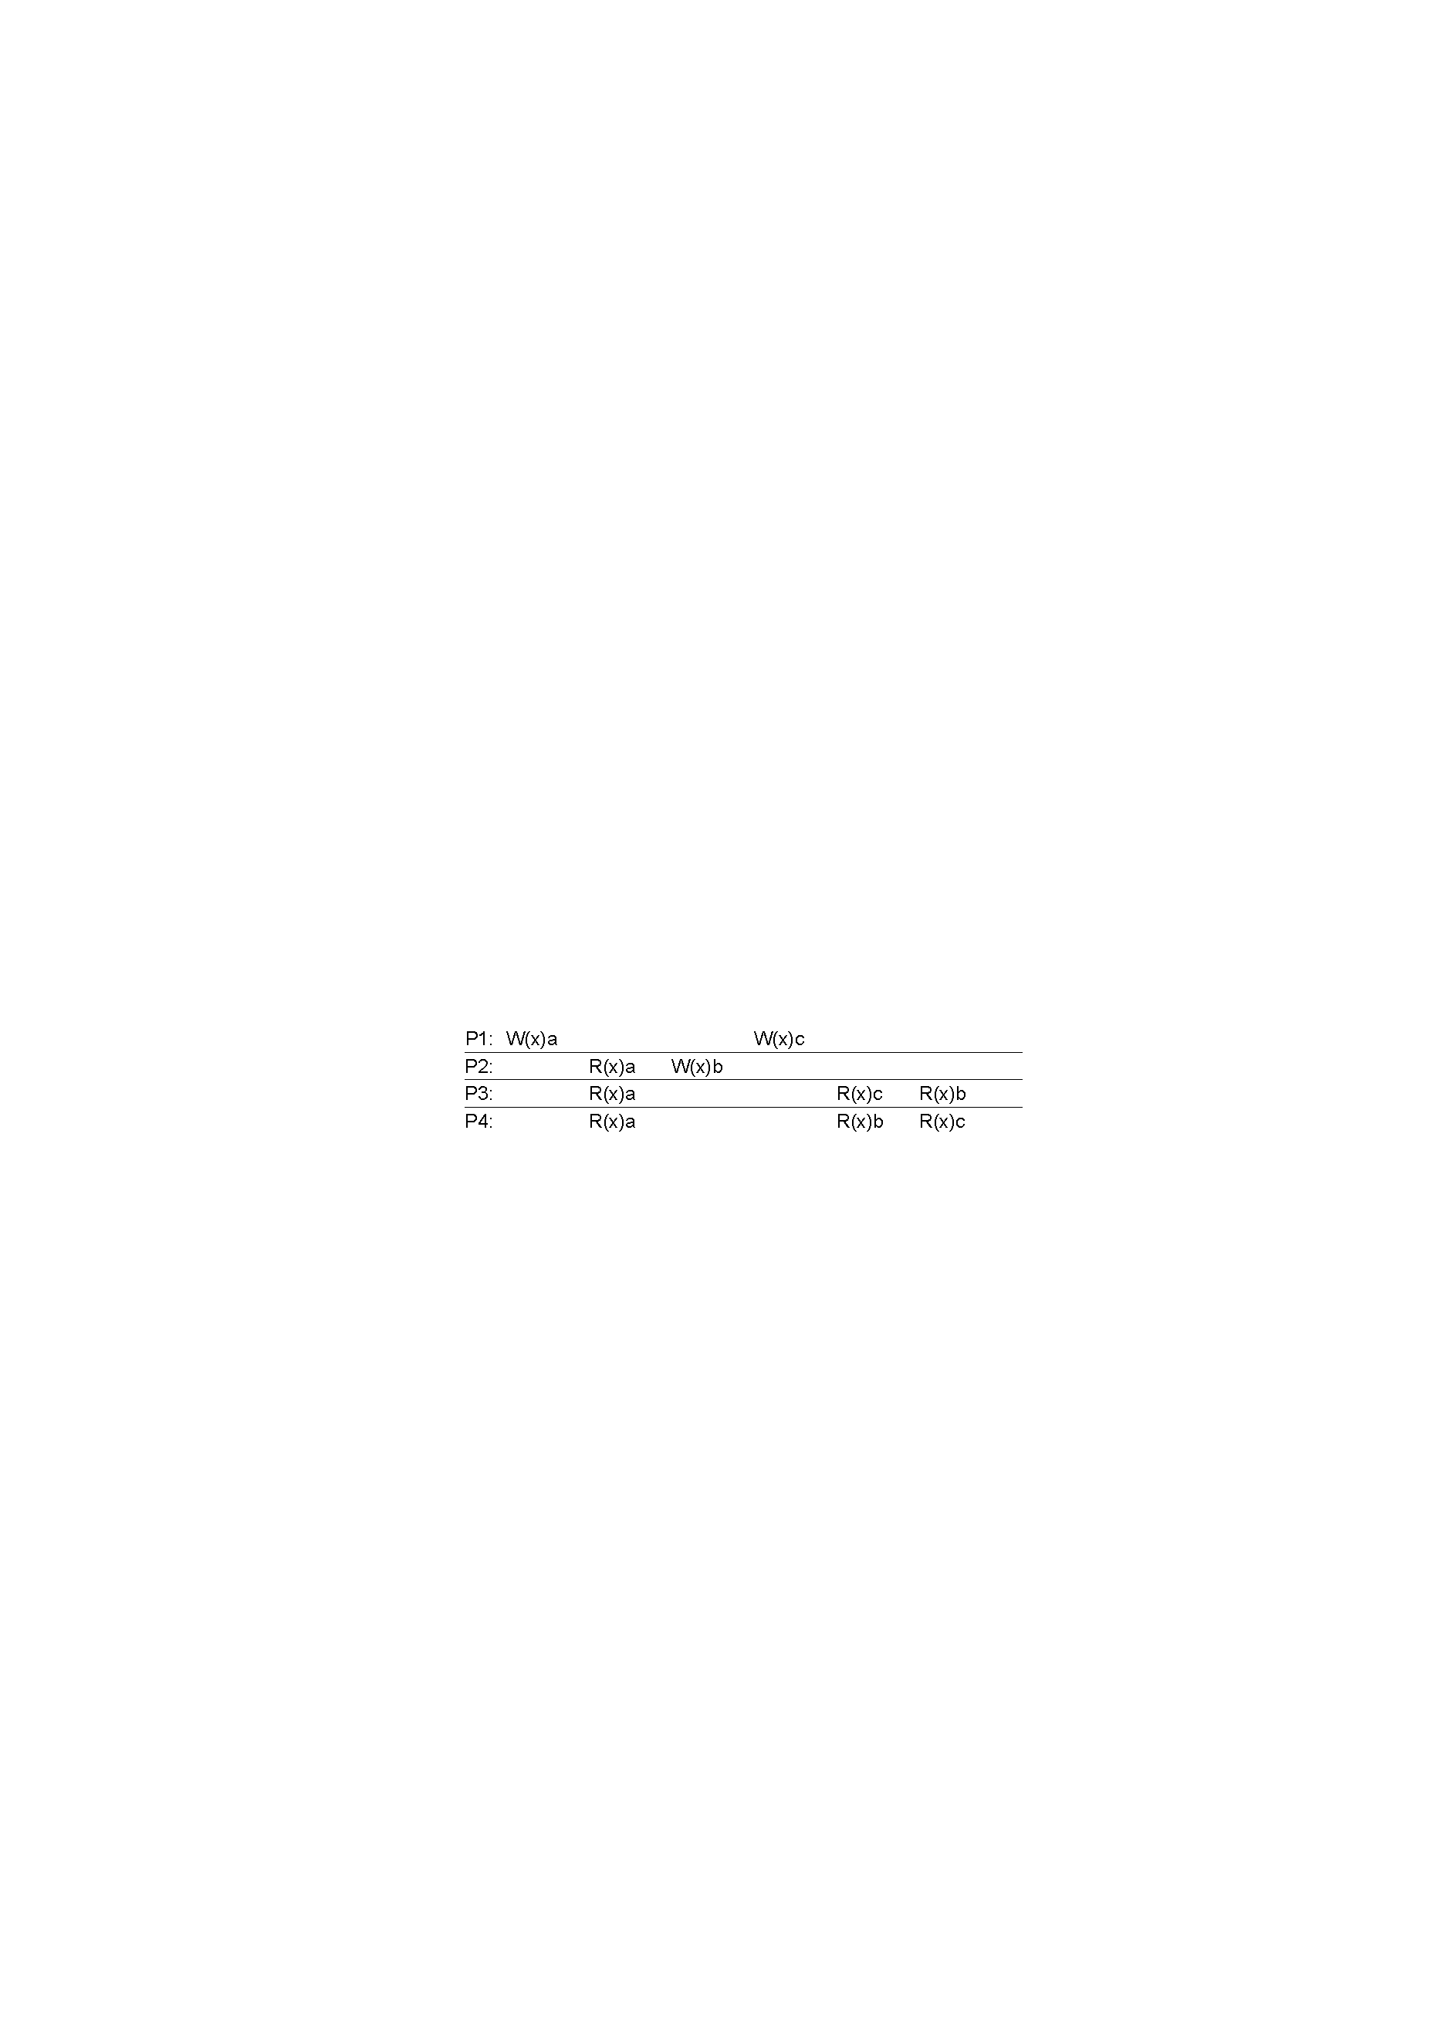
Causal consistency

Slide 41
Causal consistency
Valid under causal consistency
Why? W(x)b and W(x)c are concurrent
So all processes don’t (need to) see them in same order
P3 and P4 read the values ‘a’ and ‘b’ in order as potentially causally related. No ‘causality’ for ‘c’.

Slide 42
Sequential consistency

Slide 43
Sequential consistency
Invalid under sequential consistency
Why? P3 and P4 see b and c in different order
But fine for causal consistency
b and c are not causally dependent
Notes:
Write after write has no dep’s, write after read does
The above statement is a bit tricky. Write after write, if happened between two processes, does not have a causal relationship.
Write after read, if happened at two processes (two issuing read and write independently), does not have a causal relationship.

Slide 44
Consistency models
Strong consistency
Paxos / Raft
Eventual consistency
Amazon Dynamo
Next class

Slide 45
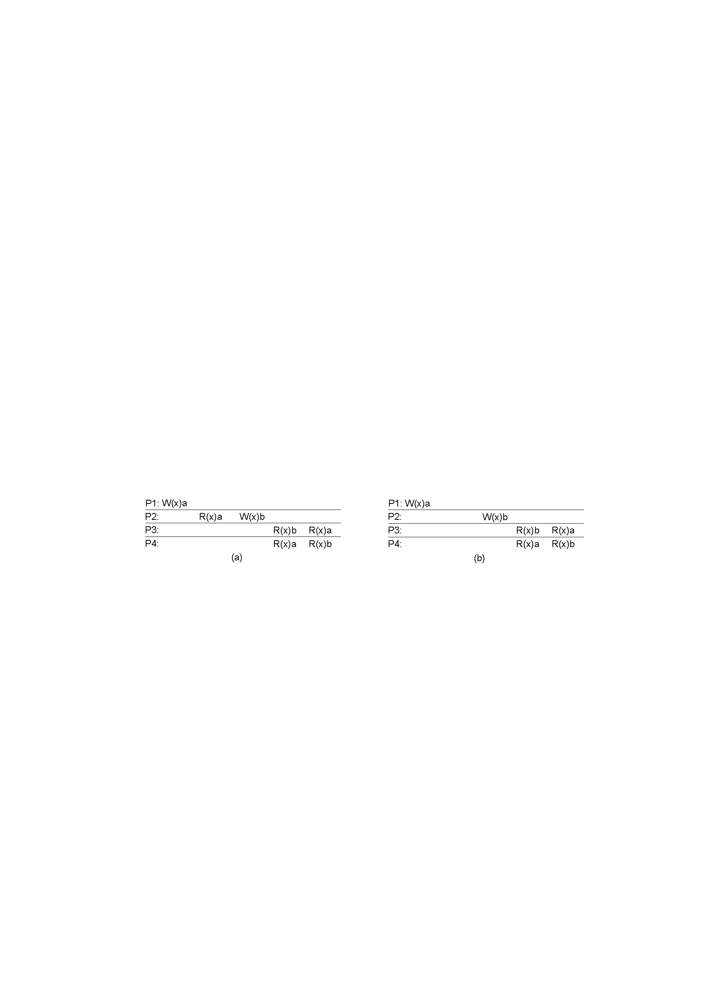
Causal consistency

Slide 46
Causal consistency
x
A: Violation: W(x)b is potentially dep on W(x)a

Slide 47
Causal consistency
x
✓
A: Violation: W(x)b is potentially dep on W(x)a
B: Correct. P2 doesn’t read value of a before W

Slide 48
Quiz 2: Valid Sequential Consistency?
x
✓
Why? Because P3 and P4 don’t agree on order of ops. Doesn’t matter when events took place on diff machine, as long as proc’s AGREE on order.
What if P1 did both W(x)a and W(x)b?
Neither valid, as (a) doesn’t preserve local ordering

Slide 49
Intuition: Real-time ordering
write(A,1)
success
1
committed
read(A)
Once write completes, all later reads (by wall-clock start time) should return value of that write or value of later write.
Once read returns particular value, all later reads should return that value or value of later write.

