Slide 1


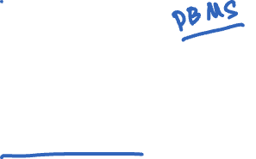
Concurrency Control, Recovery, and Locking
CS 475: Concurrent & Distributed Systems (Fall 2021)
Lecture 14
Yue Cheng
Some material taken/derived from:
Princeton COS-418 materials created by Michael Freedman and Kyle Jamieson.
MIT 6.824 by Robert Morris, Frans Kaashoek, and Nickolai Zeldovich.
Licensed for use under a Creative Commons Attribution-NonCommercial-ShareAlike 3.0 Unported License.

Slide 2

The transaction
Definition: A unit of work:
May consist of multiple data accesses or updates
Must commit or abort as a single atomic unit
Transactions can either commit, or abort
When commit, all updates performed on database are made permanent, visible to other transactions
When abort, database restored to a state such that the aborting transaction never executed

Slide 3
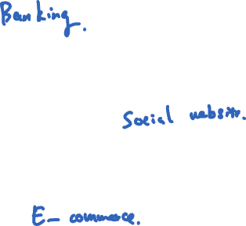
Transaction examples
Bank account transfer
Turing -= $100
Lovelace += $100
Maintaining symmetric relationships
Lovelace FriendOf Turing
Turing FriendOf Lovelace
Order product
Charge customer card
Decrement stock
Ship stock

Slide 4

Relationship with replication
Replication (e.g., Raft) is about doing the same thing in multiple places to provide fault tolerance
Sharding is about doing different things in multiple places for scalability
e.g., using consistent hashing to partition data in distributed storage (Dynamo)
Atomic commit is about doing different things in different places together

Slide 5
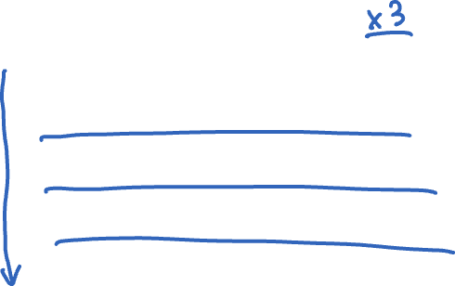
Relationship with replication
Replication Dimension
A-F
A-F
A-F
Sharding Dimension
G-L
G-L
G-L
M-R
M-R
M-R
S-Z
S-Z
S-Z

Slide 6
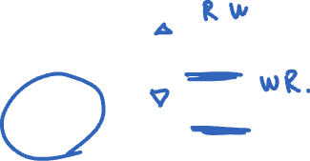
Focus on sharding for today
Replication Dimension
A-F
A-F
A-F
Sharding Dimension
G-L
G-L
G-L
M-R
M-R
M-R
S-Z
S-Z
S-Z

Slide 7
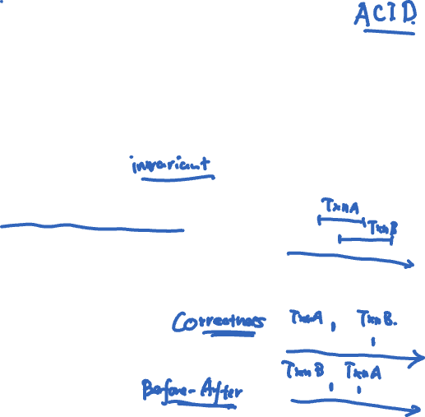
Defining properties of transactions
Atomicity: Either all constituent operations of the transaction complete successfully, or none do
Consistency: Each transaction in isolation preserves a set of integrity constraints on the data
Isolation: Transactions’ behavior not impacted by presence of other concurrent transactions
Durability: The transaction’s effects survive failure of volatile (memory) or non-volatile (disk) storage
Notes:
Consistency: a set of declarative integrity constraints.
Isolation: a txn sees only a state of the DB that could occur if that txn were the only one running against the DB and produces only results that it could produce if it was running alone.
Durability: The effect of committed txn survives failures.
A, C, D address correctness for serial txns, where only a single txn at a time is allowed to be in progress. I property of a txn comes into play when concurrent execution is allowed.

Slide 8

Challenges
High transaction speed requirements
If always fsync() to disk for each result on transaction, yields terrible performance
Atomic and durable writes to disk are difficult
In a manner to handle arbitrary crashes
Hard disks and solid-state storage use write buffers in volatile memory

Slide 9
Outline
Techniques for achieving ACID properties
Write-ahead logging and checkpointing
Serializability and two-phase locking

Slide 10
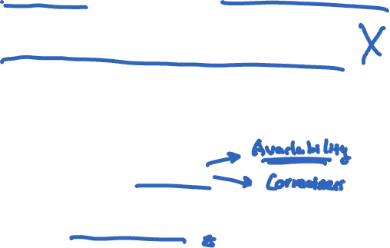
What does the system need to do?
Transaction's properties: ACID
Atomicity, Consistency, Isolation, Durability
Application logic checks consistency (C)
This leaves two main goals for the system:
Handle failures (A, D)
Handle concurrency (I)

Slide 11
Goal #1: Concurrency control
Transaction recovery
Notes:
A + D

Slide 12

Failure model: crash failures
Standard “crash failure” model:
Machines are prone to crashes:
Disk contents (non-volatile storage) okay
Memory contents (volatile storage) lost
Machines don’t misbehave (“Byzantine”)

Slide 13

Account transfer transaction
Transfers $10 from account A to account B
transaction transfer(A, B):
begin_tx
a ← read(A)
if a < 10 then abort_tx
else write(A, a−10)
b ← read(B)
write(B, b+10)
commit_tx

Slide 14
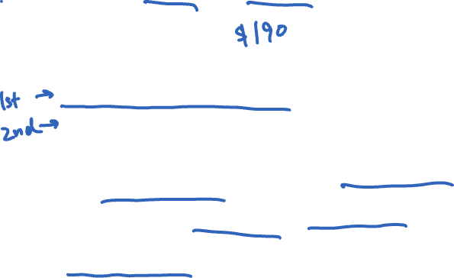
Problem
transaction transfer(A, B):
begin_tx
a ← read(A)
if a < 10 then abort_tx
else write(A, a−10)
b ← read(B)
write(B, b+10)
commit_tx
Suppose $100 in A, $100 in B
commit_tx starts the commit protocol:
write(A, $90) to disk
write(B, $110) to disk
What happens if system crash after first write, but before second write?
After recovery: Partial writes, money is lost
Lack atomicity in the presence of failures

Slide 15
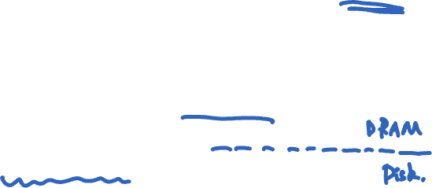
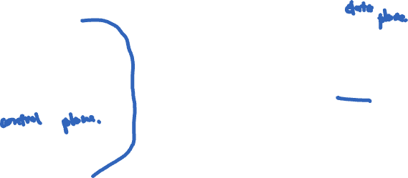
System architecture
Smallest unit of storage that can be atomically written to non-volatile storage is called a page
Buffer manager moves pages between buffer pool (in volatile memory) and disk (in non-volatile storage)
Buffer pool
Page
Buffer manager
Non-volatile storage
Disk

Slide 16

Two design choices
Force all of a transaction’s writes to disk before transaction commits?
Yes: force policy
No: no-force policy
May uncommitted transactions’ writes overwrite committed values on disk?
Yes: steal policy
No: no-steal policy

Slide 17

Performance implications
Force all of a transaction’s writes to disk before transaction commits?
Yes: force policy
May uncommitted transactions’ writes overwrite committed values on disk?
No: no-steal policy
Then slower disk writes appear on the critical path of a committing transaction
Then buffer manager loses write scheduling flexibility

Slide 18


Undo & redo
Force all a transaction’s writes to disk before transaction commits?
Choose no: no-force policy
Need support for redo: complete a committed transaction’s writes on disk
May uncommitted transactions’ writes overwrite committed values on disk?
Choose yes: steal policy
Need support for undo: removing the effects of an uncommitted transaction on disk

Slide 19
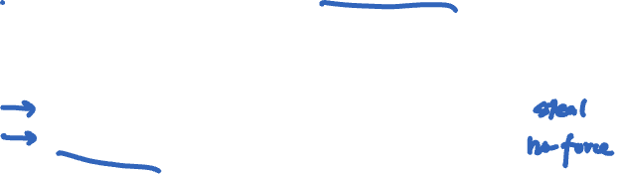
How to implement undo & redo?
Log: A sequential file that stores information about transactions and system state
Resides in separate, non-volatile storage
One entry in the log for each update, commit, abort operation: called a log record
Log record contains:
Monotonic-increasing log sequence number (LSN)
Old value (before image) of the item for undo
New value (after image) of the item for redo

Slide 20
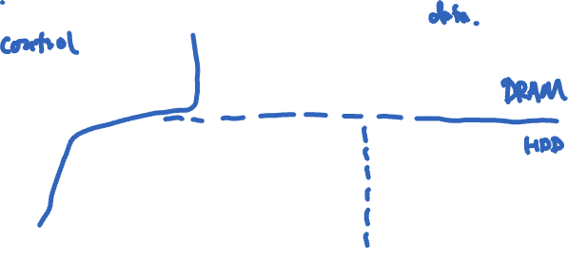
System architecture
Buffer pool (volatile memory) and disk (non-volatile)
The log resides on a separate partition or disk (in non-volatile storage)
Buffer pool
Buffer manager
Page
Non-volatile storage
Disk
Log

Slide 21
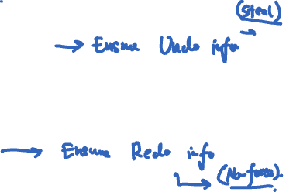
Write-ahead logging (WAL)
Ensures atomicity in the event of system crashes under no-force/steal buffer management
Force all log records pertaining to an updated page into the (non-volatile) log before any (over)-writes to page itself
A transaction is not considered committed until all its log records (including commit record) are forced into the log
Notes:
1st point: ensures UNDO info due to STEAL
2nd point: ensures REDO info due to NO-FORCE

Slide 22
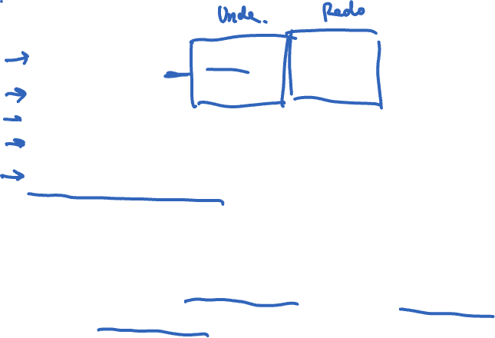
WAL example
force_log_entry(A, old=$100, new=$90)
force_log_entry(B, old=$100, new=$110)
write(A, $90)
write(B, $110)
force_log_entry(commit)
What if the commit log record size > the page size?
How to ensure each log record is written atomically?
Write a checksum of entire log entry
Does not have to flush to disk

Slide 23
Goal #2: Concurrency control
Transaction isolation
Notes:
I

Slide 24
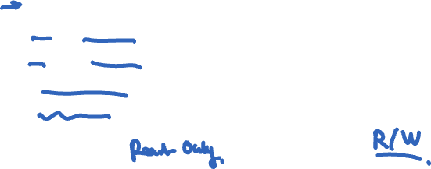
Two concurrent transactions
transaction sum(A, B):
begin_tx
a ← read(A)
b ← read(B)
print a + b
commit_tx
transaction transfer(A, B):
begin_tx
a ← read(A)
if a < 10 then abort_tx
else write(A, a−10)
b ← read(B)
write(B, b+10)
commit_tx

Slide 25
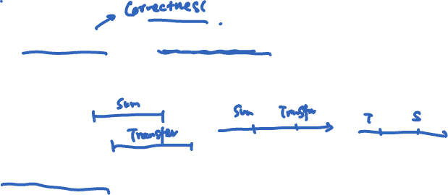
Isolation between transactions
Isolation: sum appears to happen either completely before or completely after transfer
Sometimes called before-after atomicity
Schedule for transactions is an ordering of the operations performed by those transactions

Slide 26
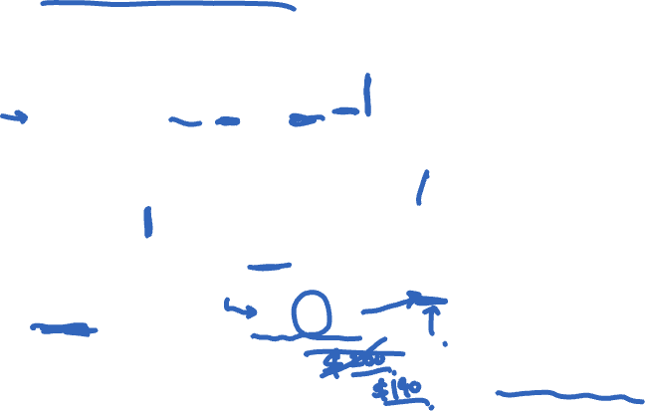
Problem for concurrent execution: Inconsistent retrieval
Serial execution of transactions—transfer then sum:
transfer: r_{A} w_{A} r_{B} w_{B} ©
sum: r_{A} r_{B} ©
Concurrent execution resulting in inconsistent retrieval, result differing from any serial execution:
transfer: r_{A} w_{A} r_{B} w_{B} ©
sum: r_{A} r_{B} ©
Time →
© = commit
debit
credit
debit
credit

Slide 27

Isolation between transactions
Isolation: sum appears to happen either completely before or completely after transfer
Sometimes called before-after atomicity
Given a schedule of operations:
Is that schedule in some way “equivalent” to a serial execution of transactions?

Slide 28
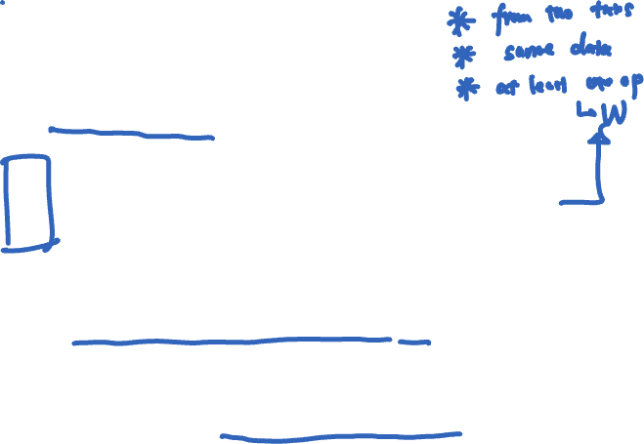
Equivalence of schedules
Two operations from different transactions are conflicting if:
They read and write to the same data item
The write and write to the same data item
Two schedules are equivalent if:
They contain the same transactions and operations
They order all conflicting operations of non-aborting transactions in the same way

Slide 29
Conflict serializability
Ideal isolation semantics: conflict serializability
A schedule is conflict serializable if it is equivalent to some serial schedule
i.e., non-conflicting operations can be reordered to get a serial schedule

Slide 30

A serializable schedule
Ideal isolation semantics: conflict serializability
A schedule is conflict serializable if it is equivalent to some serial schedule
i.e., non-conflicting operations can be reordered to get a serial schedule
transfer: r_{A} w_{A} r_{B} w_{B} ©
sum: r_{A} r_{B} ©
Time →
© = commit
r_{A}
Serial schedule
Conflict-free!

Slide 31
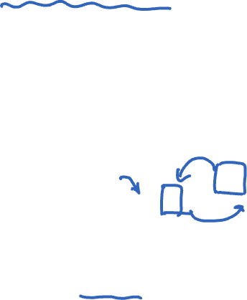
A non-serializable schedule
Ideal isolation semantics: conflict serializability
A schedule is conflict serializable if it is equivalent to some serial schedule
i.e., non-conflicting operations can be reordered to get a serial schedule
transfer: r_{A} w_{A} r_{B} w_{B} ©
sum: r_{A} r_{B} ©
Time →
© = commit
But in a serial schedule, sum’s reads either both before w_{A} or both after w_{B}
Conflicting ops
Conflicting ops

Slide 32
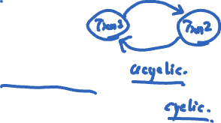
Testing for serializability
Each node t in the precedence graph represents a transaction t
Edge from s to t if some action of s precedes and conflicts with some action of t

Slide 33
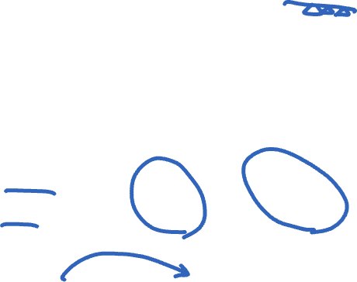
Serializable schedule, acyclic graph
Each node t in the precedence graph represents a transaction t
Edge from s to t if some action of s precedes and conflicts with some action of t
transfer: r_{A} w_{A} r_{B} w_{B} ©
sum: r_{A} r_{B} ©
Time →
© = commit
Serializable
transfer
sum

Slide 34

Non-serializable schedule, cyclic graph
Each node t in the precedence graph represents a transaction t
Edge from s to t if some action of s precedes and conflicts with some action of t
transfer: r_{A} w_{A} r_{B} w_{B} ©
sum: r_{A} r_{B} ©
Time →
© = commit
Non-serializable
transfer
sum

Slide 35
Testing for serializability
Each node t in the precedence graph represents a transaction t
Edge from s to t if some action of s precedes and conflicts with some action of t
In general, a schedule is conflict-serializable if and only if its precedence graph is acyclic

Slide 36
How to ensure a serializable schedule?
Locking-based approaches
Strawman 1: Big global lock
Acquire the lock when transaction starts
Release the lock when transaction ends
Results in a serial transaction schedule at the cost of performance

Slide 37
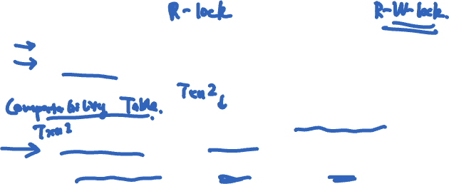
Locking
Locks maintained by transaction manager
Transaction requests lock for a data item
Transaction manager grants or denies lock
Lock types
Shared: Need to have before read object
Exclusive: Need to have before write object
 | Shared (S) | Exclusive (X)
Shared (S) | Yes | No
Exclusive (X) | No | No
Notes:
Compatibility matrix directly models the semantics of conflicts used in the definition of conflict serializability.
I.e., locking can be used to enforce serializability.
Rather than testing for serializability, the blocking txns due to lock conflicts can be used to prevent non-serializable schedules from ever being produced.

Slide 38
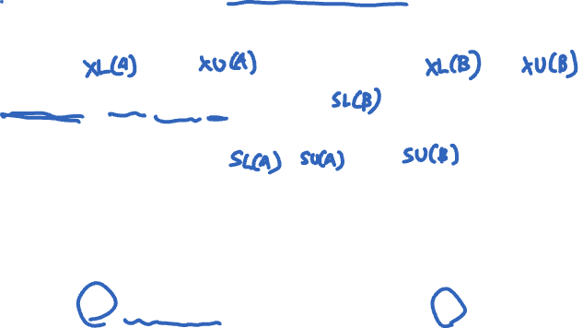
How to ensure a serializable schedule?
Strawman 2: Grab (fine-grained) locks independently, for each data item (e.g., bank accounts A and B)
transfer: ◢_{A} r_{A} w_{A} ◣_{A} ◢_{B} r_{B} w_{B} ◣_{B} ©
sum: ◿_{A} r_{A} ◺_{A} ◿_{B} r_{B} ◺_{B} ©
Time →
© = commit
◢ /◿ = eXclusive- / Shared-lock; ◣ / ◺ = X- / S-unlock
Permits this non-serializable interleaving

Slide 39
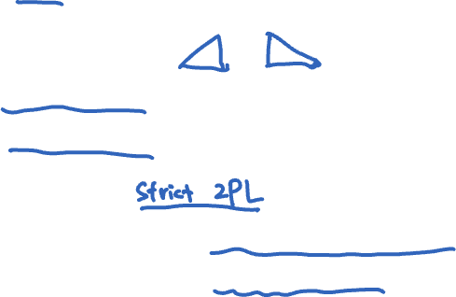
Two-phase locking (2PL)
2PL rule: Once a transaction has released a lock it is not allowed to obtain any other locks
A growing phase when txn acquires locks
A shrinking phase when txn releases locks
In practice:
Growing phase is the entire transaction
Shrinking phase is during commit

Slide 40
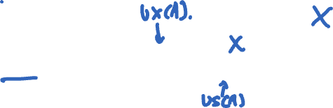
2PL allows only serializable schedules
2PL rule: Once a transaction has released a lock it is not allowed to obtain any other locks
transfer: ◢_{A} r_{A} w_{A} ◣_{A} ◢_{B} r_{B} w_{B} ◣_{B} ©
sum: ◿_{A} r_{A} ◺_{A} ◿_{B} r_{B} ◺_{B} ©
Time →
© = commit
◢ /◿ = X- / S-lock; ◣ / ◺ = X- / S-unlock
2PL precludes this non-serializable interleaving

Slide 41
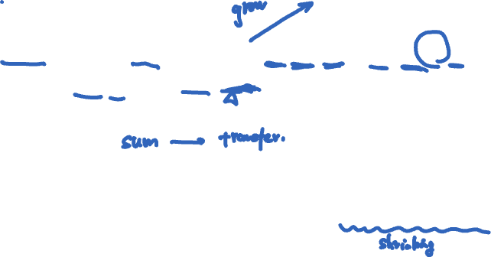
2PL and transaction concurrency
2PL rule: Once a transaction has released a lock it is not allowed to obtain any other locks
transfer: ◿_{A} r_{A} ◢_{A} w_{A} ◿_{B} r_{B} ◢_{B} w_{B}✻©
sum: ◿_{A} r_{A} ◿_{B} r_{B}✻©
Time →
© = commit
◢ /◿ = X- / S-lock; ◣ / ◺ = X- / S-unlock; ✻ = release all locks
2PL permits this serializable, interleaved schedule

Slide 42
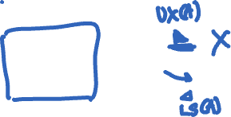
2PL doesn’t exploit all opportunities for concurrency
2PL rule: Once a transaction has released a lock it is not allowed to obtain any other locks
transfer: r_{A} w_{A} r_{B} w_{B} ©
sum: r_{A} r_{B} ©
Time →
© = commit
(locking not shown)
2PL precludes this serializable, interleaved schedule
Notes:
Note that 2PL is sufficient but not necessary for implementing serializability.
There are schedules that are serializable but would not be allowed (naturally precluded) by 2PL.

Slide 43

Issues with 2PL
What if a lock is unavailable? Is deadlock possible?
Yes; but a central controller can detect deadlock cycles and abort involved transactions
The phantom problem
Database has fancier ops than key-value store
T1: begin_tx; update employee (set salary = 1.1×salary) where dept = “CS”; commit_tx
T2: insert into employee (“carol”, “CS”)
Even if they lock individual data items, could result in non-serializable execution

Slide 44
Linearizability vs. Serializability
Linearizability: a guarantee about single operations on single objects
Once write completes, all later reads (by wall clock) should reflect that write
Serializability is a guarantee about transactions over one or more objects
Doesn’t impose real-time constraints
Linearizability + serializability = strict serializability
Transaction behavior equivalent to some serial execution
And that serial execution agrees with real-time

Slide 45
Summary
Techniques for achieving ACID properties
Write-ahead logging and check-pointing → A, D
Serializability and two-phase locking → I

