Slide 1


2PL and OCC
CS 475: Concurrent & Distributed Systems (Fall 2021)
Lecture 15
Yue Cheng
Some material taken/derived from:
Princeton COS-418 materials created by Michael Freedman and Kyle Jamieson.
MIT 6.824 by Robert Morris, Frans Kaashoek, and Nickolai Zeldovich.
Licensed for use under a Creative Commons Attribution-NonCommercial-ShareAlike 3.0 Unported License.

Slide 2
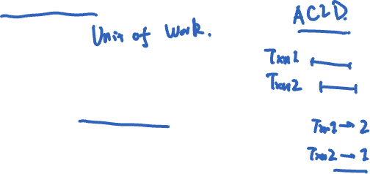
Recap: Transaction serializability
Serializability:
Execution of a set of transactions over multiple items is equivalent to some serial execution of transactions

Slide 3
Q: How to ensure correctness when running concurrent transactions?
Notes:
Recall: strict serializability = real time + total order + multiple objects

Slide 4
What does correctness mean?
Transactions should have property of isolation, i.e., all operations in a transaction appear to happen together at the same time

Slide 5
What does correctness mean?
Transactions should have property of isolation, i.e., all operations in a transaction appear to happen together at the same time
We need serializability

Slide 6
Fixing concurrency problems
Strawman: Just run transactions serially — prohibitively bad performance

Slide 7

Fixing concurrency problems
Strawman: Just run transactions serially — prohibitively bad performance
Observation: Problems only arise when:
Two transactions touch the same data
At least one of these transactions involves a write to the data

Slide 8
Fixing concurrency problems
Strawman: Just run transactions serially — prohibitively bad performance
Observation: Problems only arise when:
Two transactions touch the same data
At least one of these transactions involves a write to the data
Key idea: Only permit schedules whose effects are guaranteed to be equivalent to serial schedules

Slide 9
Serializability of schedules
Two operations conflict if
They belong to different transactions
They operate on the same data
One of them is a write
Notes:
In a serializable schedule, non-conflicting operations can be re-ordered to get a serial schedule

Slide 10
Serializability of schedules
Two operations conflict if
They belong to different transactions
They operate on the same data
One of them is a write
Two schedules are equivalent if
They involve the same transactions and operations
All conflicting operations are ordered the same way
Notes:
In a serializable schedule, non-conflicting operations can be re-ordered to get a serial schedule

Slide 11
Serializability of schedules
Two operations conflict if
They belong to different transactions
They operate on the same data
One of them is a write
Two schedules are equivalent if
They involve the same transactions and operations
All conflicting operations are ordered the same way
A schedule is serializable if it is equivalent to a serial schedule
Notes:
In a serializable schedule, non-conflicting operations can be re-ordered to get a serial schedule

Slide 12
Testing for serializability
Intuition: Swap non-conflicting operations until you reach a serial schedule

Slide 13

Testing for serializability
Intuition: Swap non-conflicting operations until you reach a serial schedule
T1: R(A), W(A), Commit
T2: R(A), R(B), W(B), Commit
time

Slide 14
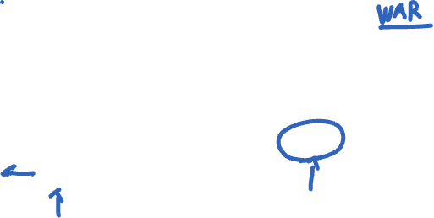
Testing for serializability
Intuition: Swap non-conflicting operations until you reach a serial schedule
T1: R(A), W(A), Commit
T2: R(A), R(B), W(B), Commit
time

Slide 15
Testing for serializability
Intuition: Swap non-conflicting operations until you reach a serial schedule
Intuition: Swap non-conflicting operations until you reach a serial schedule
T1: R(A), W(A), Commit
T2: R(A), R(B), W(B), Commit
time

Slide 16
Testing for serializability
Intuition: Swap non-conflicting operations until you reach a serial schedule
Intuition: Swap non-conflicting operations until you reach a serial schedule
T1: R(A), W(A), Commit
T2: R(A), R(B), W(B) Commit
time
Serializable

Slide 17

Testing for serializability
Intuition: Swap non-conflicting operations until you reach a serial schedule
Intuition: Swap non-conflicting operations until you reach a serial schedule
T1: R(A), W(A), W(B), Commit
T2: R(B), W(B), R(A), Commit
time

Slide 18

Testing for serializability
Intuition: Swap non-conflicting operations until you reach a serial schedule
Intuition: Swap non-conflicting operations until you reach a serial schedule
T1: R(A), W(A), W(B), Commit
T2: R(B), W(B), R(A), Commit
time

Slide 19

Testing for serializability
Intuition: Swap non-conflicting operations until you reach a serial schedule
Intuition: Swap non-conflicting operations until you reach a serial schedule
T1: R(A), W(A) W(B), Commit
T2: R(B), W(B), R(A), Commit
time

Slide 20
Testing for serializability
Intuition: Swap non-conflicting operations until you reach a serial schedule
Intuition: Swap non-conflicting operations until you reach a serial schedule
T1: R(A), W(A), W(B), Commit
T2: R(B), W(B), R(A), Commit
time
NOT serializable

Slide 21
Testing for serializability
Another way to test serializability
Draw arrows between conflicting operations
Arrow points in the direction of time
If no cycles between transactions, the schedule is serializable

Slide 22
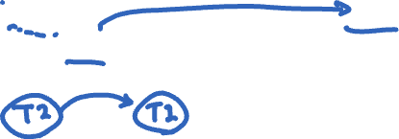
Testing for serializability
Another way to test serializability
Draw arrows between conflicting operations
Arrow points in the direction of time
If no cycles between transactions, the schedule is serializable
T1: R(A), W(A), Commit
T2: R(A), R(B), W(B), Commit
time

Slide 23
Testing for serializability
Another way to test serializability
Draw arrows between conflicting operations
Arrow points in the direction of time
If no cycles between transactions, the schedule is serializable
T1: R(A), W(A), Commit
T2: R(A), R(B), W(B), Commit
time

Slide 24
Testing for serializability
Another way to test serializability
Draw arrows between conflicting operations
Arrow points in the direction of time
If no cycles between transactions, the schedule is serializable
T1: R(A), W(A), Commit
T2: R(A), R(B), W(B), Commit
time

Slide 25
Testing for serializability
Another way to test serializability
Draw arrows between conflicting operations
Arrow points in the direction of time
If no cycles between transactions, the schedule is serializable
T1: R(A), W(A), Commit
T2: R(A), R(B), W(B), Commit
No cycles,
serializable
time

Slide 26

Testing for serializability
Another way to test serializability
Draw arrows between conflicting operations
Arrow points in the direction of time
If no cycles between transactions, the schedule is serializable
T1: R(A), W(A), W(B), Commit
T2: R(B), W(B), R(A), Commit
time

Slide 27
Testing for serializability
Another way to test serializability
Draw arrows between conflicting operations
Arrow points in the direction of time
If no cycles between transactions, the schedule is serializable
T1: R(A), W(A), W(B), Commit
T2: R(B), W(B), R(A), Commit
time

Slide 28
Testing for serializability
Another way to test serializability
Draw arrows between conflicting operations
Arrow points in the direction of time
If no cycles between transactions, the schedule is serializable
T1: R(A), W(A), W(B), Commit
T2: R(B), W(B), R(A), Commit
time

Slide 29

Testing for serializability
Another way to test serializability
Draw arrows between conflicting operations
Arrow points in the direction of time
If no cycles between transactions, the schedule is serializable
T1: R(A), W(A), W(B), Commit
T2: R(B), W(B), R(A), Commit
Cycle exists
(T1 ⇄ T2),
NOT serializable
time

Slide 30
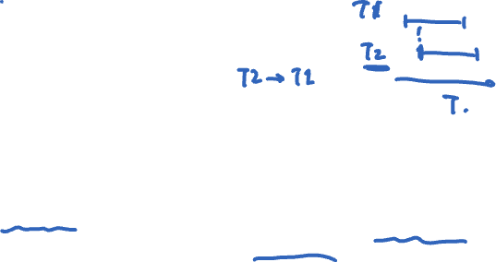
Linearizability vs. Serializability
Linearizability: a guarantee about single operations on single objects
Once write completes, all later reads (by wall clock) should reflect that write
Serializability is a guarantee about transactions over one or more objects
Doesn’t impose real-time constraints
Linearizability + serializability = strict serializability
Transaction behavior equivalent to some serial execution
And that serial execution agrees with real-time
Notes:
Recall: strict serializability = real time + total order + multiple objects

Slide 31
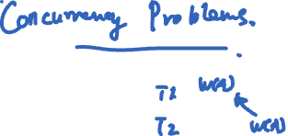
Some new terms
Lost update: the result of a transaction is overwritten by another transaction

Slide 32

Some new terms
Lost update: the result of a transaction is overwritten by another transaction
Dirty read: uncommitted results are read by a transaction

Slide 33

Some new terms
Lost update: the result of a transaction is overwritten by another transaction
Dirty read: uncommitted results are read by a transaction
Non-repeatable read: two reads in the same transaction return different results

Slide 34
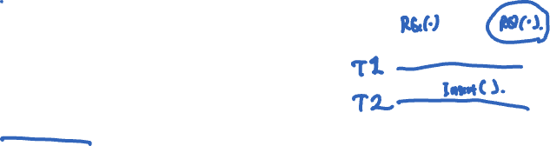
Some new terms
Lost update: the result of a transaction is overwritten by another transaction
Dirty read: uncommitted results are read by a transaction
Non-repeatable read: two reads in the same transaction return different results
Phantom read: later reads in the same transaction return extra rows

Slide 35
Serial schedule – No problem
T1: R(A), W(A), R(B), W(B), Abort
T2: R(A), W(A), Commit
time

Slide 36

Quiz: Which concurrency problem is this?
Quiz: Which concurrency problem is this?
T1: R(A), W(A) R(B), W(B), Abort
T2: R(A), W(A), Commit
time
Lost update
Dirty read
Non-repeatable read
Phantom read
??
Notes:
DR

Slide 37
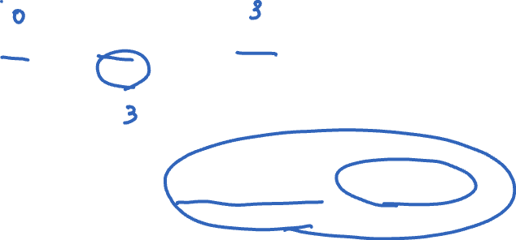
Quiz: Which concurrency problem is this?
Quiz: Which concurrency problem is this?
T1: R(A) R(A), W(A), Commit
T2: R(A), W(A), Commit
time
Lost update
Dirty read
Non-repeatable read
Phantom read
??
Notes:
NRR

Slide 38

Quiz: Which concurrency problem is this?
Quiz: Which concurrency problem is this?
T1: R(A), W(A) W(B), Commit
T2: R(A) W(A), W(B), Commit
time
Lost update
Dirty read
Non-repeatable read
Phantom read
??
Notes:
LU

Slide 39
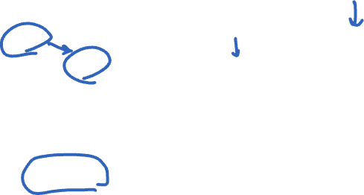
Quiz: Which concurrency problem is this?
Quiz: Which concurrency problem is this?
T1: R(A), W(A) W(A), Commit
T2: R(A), R(B), W(B), Commit
time
Lost update
Dirty read
Non-repeatable read
Phantom read
??
Notes:
DR

Slide 40
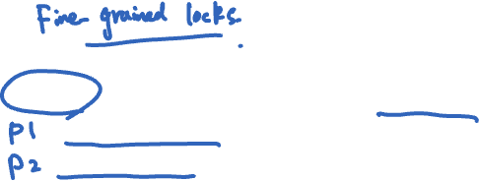
Lock-based concurrency control
Big Global Lock: Results in a serial transaction schedule at the cost of performance
2PL: Two-phase locking with finer-grain locks:
Growing phase when txn acquires locks
Shrinking phase when txn releases locks (typically commit)
Allows txns to execute concurrently, improving performance
Notes:
So that motivates the 2PL algorithm.

Slide 41
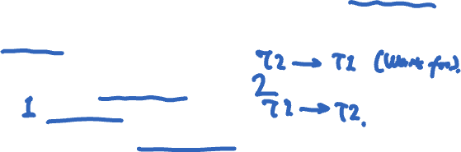
2PL
2PL guarantees serializability by disallowing cycles between txns
There could be dependencies in the waits-for graph among txns waiting for locks:
Edge from T2 to T1 means T1 acquired lock first and T2 has to wait
Edge from T1 to T2 means T1 acquired lock first and T2 has to wait
Cycles mean DEADLOCK, and in that case 2PL won’t proceed

Slide 42
2PL
T1: R(A), W(A), W(B), Commit
T2: R(B), W(B), R(A) Commit
time

Slide 43
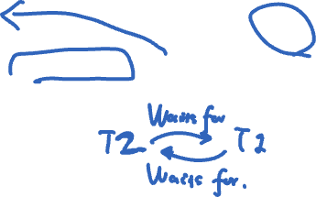
2PL
T1: R(A), W(A), W(B), Commit
T2: R(B), W(B), R(A) Commit
time

Slide 44
2PL
Lock_X(A)
T1: R(A), W(A), W(B), Commit
T2: R(B), W(B), R(A) Commit
time

Slide 45
2PL
Lock_X(A)
T1: R(A), W(A), W(B), Commit
T2: R(B), W(B), R(A) Commit
Lock_X(B)
time

Slide 46

2PL
Lock_X(A)
T1: R(A), W(A), W(B), Commit
T2: R(B), W(B), R(A) Commit
Lock_X(B)
Lock_S(A)
time

Slide 47

2PL
Lock_X(A)
Lock_X(B)
T1: R(A), W(A), W(B), Commit
T2: R(B), W(B), R(A) Commit
Lock_X(B)
Lock_S(A)
time

Slide 48
2PL
Lock_X(A)
Lock_X(B)
T1: R(A), W(A), W(B), Commit
T2: R(B), W(B), R(A) Commit
DEADLOCK!
Lock_X(B)
Lock_S(A)
time

Slide 49
2PL
Lock_X(A)
Lock_X(B)
T1: R(A), W(A), W(B), Commit
T2: R(B), W(B), R(A) Commit
DEADLOCK!
Lock_X(B)
Lock_S(A)
time
Deal with deadlocks by aborting one of the two txns (e.g., detect with timeout)

Slide 50
2PL: Releasing locks too soon?
What if we release the lock as soon as we can?

Slide 51
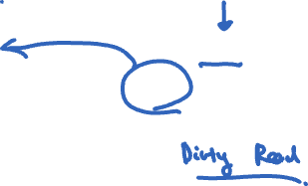
2PL: Releasing locks too soon?
What if we release the lock as soon as we can?
T1: R(A), W(A), Abort
T2: R(B), W(B), R(A) Abort Abort
time

Slide 52
2PL: Releasing locks too soon?
What if we release the lock as soon as we can?
Lock_X(A)
T1: R(A), W(A), Abort
T2: R(B), W(B), R(A) Abort Abort
time

Slide 53
2PL: Releasing locks too soon?
What if we release the lock as soon as we can?
Lock_X(A)
Unlock_X(A)
T1: R(A), W(A), Abort
T2: R(B), W(B), R(A) Abort Abort
time

Slide 54
2PL: Releasing locks too soon?
What if we release the lock as soon as we can?
Lock_X(A)
Unlock_X(A)
T1: R(A), W(A), Abort
T2: R(B), W(B), R(A) Abort Abort
Lock_X(B)
time

Slide 55
2PL: Releasing locks too soon?
What if we release the lock as soon as we can?
Lock_X(A)
Unlock_X(A)
T1: R(A), W(A), Abort
T2: R(B), W(B), R(A) Abort Abort
Lock_X(B)
Lock_S(A)
time

Slide 56

2PL: Releasing locks too soon?
What if we release the lock as soon as we can?
Lock_X(A)
Unlock_X(A)
T1: R(A), W(A), Abort
T2: R(B), W(B), R(A) Abort Abort
Lock_X(B)
Lock_S(A)
time
Rollback of T1 requires rollback of T2, since T2 reads a value written by T1

Slide 57
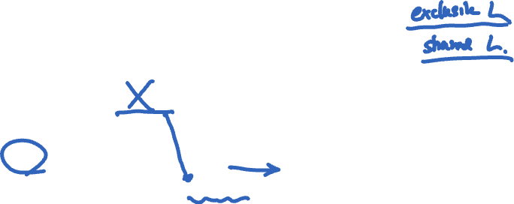
2PL: Releasing locks too soon?
What if we release the lock as soon as we can?
Lock_X(A)
Unlock_X(A)
T1: R(A), W(A), Abort
T2: R(B), W(B), R(A) Abort Abort
Lock_X(B)
Lock_S(A)
time
Rollback of T1 requires rollback of T2, since T2 reads a value written by T1
Cascading aborts: the rollback of one txn causes rollback of another

Slide 58
Strict 2PL
Release locks at the end of the transaction
Variant of 2PL implemented by most DBs in practice

Slide 59
Q: What if access patterns rarely, if ever, conflict?

Slide 60
Today
Optimistic concurrency control (OCC)
Be optimistic, or opportunistic, that conflicts rarely happen

Slide 61

Be optimistic!
Goal: Low overhead for non-conflicting txns
Assume success!
Process transaction as if would succeed
Check for serializability only at commit time
If fails, abort transaction
Optimistic Concurrency Control (OCC)
Higher performance when few conflicts vs. locking
Lower performance when many conflicts vs. locking

Slide 62
OCC: Three-phase approach
Begin: Record timestamp marking the transaction’s beginning
Notes:
Time-to-check to Time-to-use

Slide 63
OCC: Three-phase approach
Begin: Record timestamp marking the transaction’s beginning
Modify phase:
Txn can read values of committed data items
Updates only to local copies (versions) of items (in DB cache)
Notes:
Time-to-check to Time-to-use

Slide 64
OCC: Three-phase approach
Begin: Record timestamp marking the transaction’s beginning
Modify phase:
Txn can read values of committed data items
Updates only to local copies (versions) of items (in DB cache)
Validate phase
Notes:
Time-to-check to Time-to-use

Slide 65
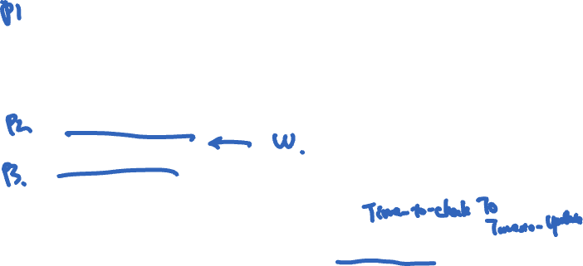
OCC: Three-phase approach
Begin: Record timestamp marking the transaction’s beginning
Modify phase:
Txn can read values of committed data items
Updates only to local copies (versions) of items (in DB cache)
Validate phase
Commit phase
If validates, transaction’s updates applied to DB
Otherwise, transaction restarted
Care must be taken to avoid “TOCTTOU” issues
Notes:
Time-to-check to Time-to-use

Slide 66
OCC: Three-phase approach
Begin: Record timestamp marking the transaction’s beginning
Modify phase:
Txn can read values of committed data items
Updates only to local copies (versions) of items (in DB cache)
Validate phase
Commit phase
If validates, transaction’s updates applied to DB
Otherwise, transaction restarted
Care must be taken to avoid “TOCTTOU” issues
Execute optimistically!
Notes:
Time-to-check to Time-to-use

Slide 67

OCC: Three-phase approach
Begin: Record timestamp marking the transaction’s beginning
Modify phase:
Txn can read values of committed data items
Updates only to local copies (versions) of items (in DB cache)
Validate phase
Commit phase
If validates, transaction’s updates applied to DB
Otherwise, transaction restarted
Care must be taken to avoid “TOCTTOU” issues
Execute optimistically!
These should happen together!
Notes:
Time-to-check to Time-to-use

Slide 68
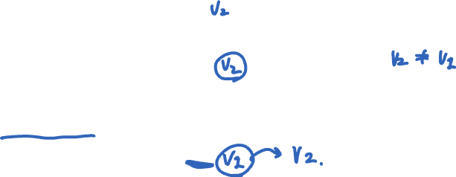
OCC: Why validation is necessary!
New txn creates shadow copies of P and Q
P and Q’s copies at inconsistent state
txn coordinator
O
P
txn coordinator
When commits txn updates,
create new versions at some timestamp t
Q

Slide 69
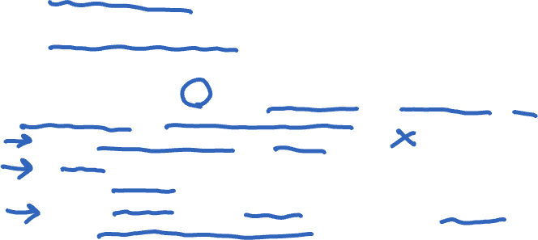

OCC: Validate phase
Transaction is about to commit. System must ensure:
Initial consistency: Versions of accessed objects at start consistent
No conflicting concurrency: No other txn has committed an operation at object that conflicts with one of this txn’s invocations
Consider transaction T: For all other txns O either committed or in validation phase, one of the following holds:
O completes commit before T starts modify
T starts commit after O completes commit, and ReadSet T and WriteSet O are disjoint
Both ReadSet T and WriteSet T are disjoint from WriteSet O, and O completes modify phase
When validating T, first check (A), then (B), then (C). If all fail, validation fails and T aborted

Slide 70
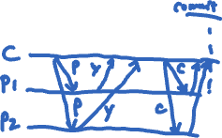
Atomic commit for OCC
Use two-phase commit (2PC) to achieve atomic commit (validate + commit writes)
Recall 2PC protocol:
Coordinator sends prepare messages to all nodes, other nodes vote yes or no
If all nodes accept, proceed
If any node declines, abort
Coordinator sends commit or abort messages to all nodes, and all nodes act accordingly

Slide 71

Atomic commit for OCC
Execute optimistically: Read committed values, write changes locally
Validate: Check if data has changed since original read
Commit (Write): Commit if no change, else abort
Phase 1: send prepare to each shard: include buffered write + original reads for that shard
Shards validate reads and acquire locks (exclusive for write locations, shared for read locations)
If this succeeds, respond with yes; else respond with no
Phase 2: collect votes, send result (abort or commit) to all shards
If commit, shards apply buffered writes
All shards release locks
Phase 1
Phase 2

Slide 72
Atomic commit for OCC
Execute optimistically: Read committed values, write changes locally
Validate: Check if data has changed since original read
Commit (Write): Commit if no change, else abort
Phase 1: send prepare to each shard: include buffered write + original reads for that shard
Shards acquire locks and validate reads (exclusive for write locations, shared for read locations)
If this succeeds, respond with yes; else respond with no
Phase 2: collect votes, send result (abort or commit) to all shards
If commit, shards apply buffered writes
All shards release locks
Phase 1
Phase 2

Slide 73

Atomic commit for OCC
Execute optimistically: Read committed values, write changes locally
Validate: Check if data has changed since original read
Commit (Write): Commit if no change, else abort
Phase 1: send prepare to each shard: include buffered write + original reads for that shard
Shards acquire locks and validate reads (exclusive for write locations, shared for read locations)
If this succeeds, respond with yes; else respond with no
Phase 2: collect votes, send result (abort or commit) to all shards
If commit, shards apply buffered writes
All shards release locks
Phase 1
Phase 2

Slide 74
Two ways of implementing serializability: 2PL, OCC
2PL (pessimistic):
Assume conflict, always lock
High overhead for non-conflicting txn
Must check for deadlock
OCC (optimistic):
Assume no conflict
Low overhead for low-conflict workloads (but high for high-conflict workloads)
Ensure correctness by aborting txns if conflict occurs

Slide 75
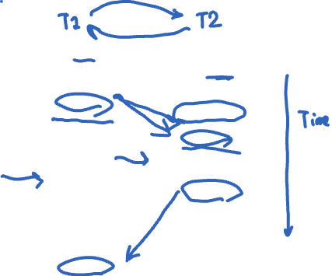
Lock_X(A) <granted>
Read(A) | Lock_S(A)
A := A-50
Write(A)
Unlock(A) | <granted>
 | Read(A)
 | Unlock(A)
 | Lock_S(B) <granted>
Lock_X(B)
 | Read(B)
<granted> | Unlock(B)
Read(B)
B := B +50
Write(B)
Unlock(B)
Is this a 2PL schedule?
No Is this a serializable schedule?
No
Notes:
Explain:
Time goes downward, things on same row occur at the same time
Two transactions, left and right
Lock_*(Y) means (exclusive, shared) lock was requested on object Y; may have to wait until lock is granted
Why not 2PL: lock is acquired by T1 for A, then released; T1 then acquires a lock for B, this is not 2PL!
Why not serializable: draw arrows

Slide 76
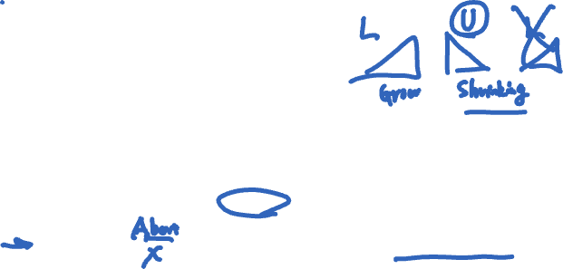
Lock_X(A) <granted>
Read(A) | Lock_S(A)
A := A-50
Write(A)
Lock_X(B) <granted>
Unlock(A) | <granted>
 | Read(A)
 | Lock_S(B)
Read(B)
B := B +50
Write(B)
Unlock(B) | <granted>
 | Unlock(A)
 | Read(B)
 | Unlock(B)
Is this a 2PL schedule?
Yes, and it is serializable
Is this a Strict 2PL schedule?
No, cascading aborts possible

Slide 77
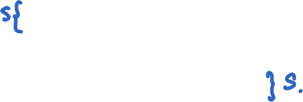
Lock_X(A) <granted>
Read(A) | Lock_S(A)
A := A-50
Write(A)
Lock_X(B) <granted>
Read(B)
B := B +50
Write(B)
Unlock(A)
Unlock(B) | <granted>
 | Read(A)
 | Lock_S(B) <granted>
 | Read(B)
 | Unlock(A)
 | Unlock(B)
Is this a 2PL schedule?
Yes, and it is serializable
Is this a Strict 2PL schedule?
Yes, cascading aborts not possible

