Slide 1



Amazon Dynamo
CS 475: Concurrent & Distributed Systems (Fall 2021)
Lecture 13
Yue Cheng
Some material taken/derived from:
Princeton COS-418 materials created by Michael Freedman.
MIT 6.824 by Robert Morris, Frans Kaashoek, and Nickolai Zeldovich.
Licensed for use under a Creative Commons Attribution-NonCommercial-ShareAlike 3.0 Unported License.

Slide 2




Horizontal or vertical scalability
Vertical scaling
(Scaling-up)

Slide 3
Horizontal or vertical scalability
Vertical scaling
(Scaling-up)
Horizontal scaling
(Scaling-out)

Slide 4
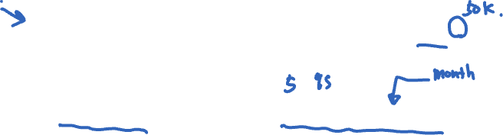
Horizontal scaling is challenging
Probability of any failure in given period = 1−(1−p)^{n}
p = probability a machine fails in given period
n = number of machines
For 50K machines, each with 99.99966% available
16% of the time, data center experiences failures
For 100K machines, failures 30% of the time!

Slide 5
Horizontal scaling is challenging
Probability of any failure in given period = 1−(1−p)^{n}
p = probability a machine fails in given period
n = number of machines
For 50K machines, each with 99.99966% available
16% of the time, data center experiences failures
For 100K machines, failures 30% of the time!
Main challenge: Coping with constant failures

Slide 6
Outline
Techniques for partitioning data
Metrics for success
Case study
Amazon Dynamo key-value store

Slide 7
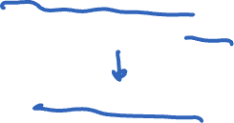
Scaling out: Placement
You have key-value pairs to be partitioned across nodes based on an ID
Problem 1: Data placement
On which node(s) to place each key-value pair?
Maintain mapping from data object to node(s)
Evenly distribute data/load

Slide 8
Scaling out: Partition management
Problem 2: Partition management
How to recover from node failure
e.g., bringing another node into partition group
Changes in system size, i.e., nodes joining/leaving
Heterogeneous nodes

Slide 9

Scaling out: Partition management
Problem 2: Partition management
How to recover from node failure
e.g., bringing another node into partition group
Changes in system size, i.e., nodes joining/leaving
Heterogeneous nodes
Centralized: Cluster manager
Decentralized: Deterministic hashing and algorithms

Slide 10
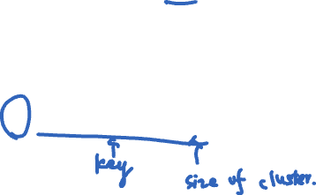
Modulo hashing
First consider problem of data partition:
Given object id X, choose one of k servers to use
Suppose we use modulo hashing:
Place X on server i = hash(X) mod k

Slide 11

Modulo hashing
First consider problem of data partition:
Given object id X, choose one of k servers to use
Suppose we use modulo hashing:
Place X on server i = hash(X) mod k
What happens if a server fails or joins (k ← k±1)?
or different clients have different estimate of k?

Slide 12
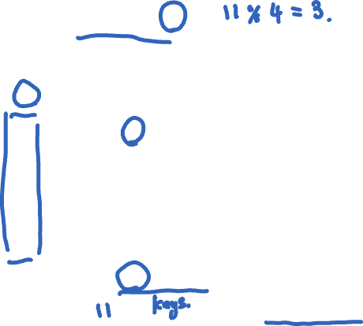
Problem for modulo hashing: Changing number of servers
i = h(x) mod 4
Server
4
3
2
1
0
5
7
10
11
27
29
36
38
40
h(x) = x + 1

Slide 13
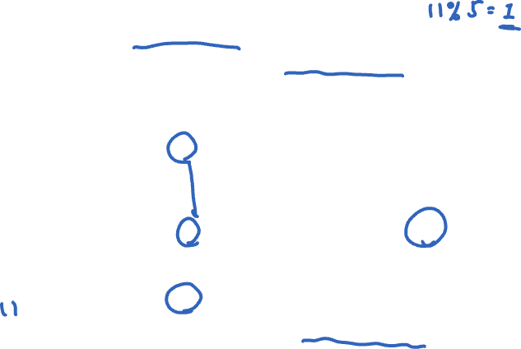
Problem for modulo hashing: Changing number of servers
i = h(x) mod 4
Add one machine: i = h(x) mod 5
Server
4
3
2
1
0
5
7
10
11
27
29
36
38
40
h(x) = x + 1

Slide 14
Problem for modulo hashing: Changing number of servers
i = h(x) mod 4
Add one machine: i = h(x) mod 5
Server
4
3
Many entries get remapped to new nodes!
→ Need to move objects over the network
2
1
0
5
7
10
11
27
29
36
38
40
h(x) = x + 1

Slide 15
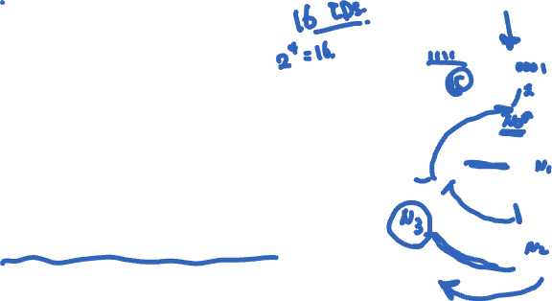
Consistent hashing
Assign n tokens to random points on mod 2^{k} circle; hash key size = k
Hash object to random circle position
Put object to closest clockwise bucket
successor (key) → bucket
0
14
Token
12
4
Bucket
8

Slide 16
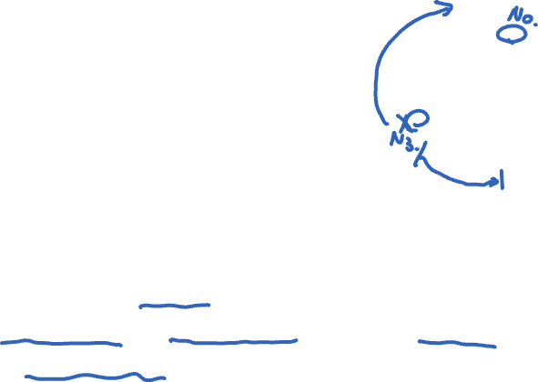
Consistent hashing
Assign n tokens to random points on mod 2^{k} circle; hash key size = k
Hash object to random circle position
Put object to closest clockwise bucket
successor (key) → bucket
0
14
Token
12
4
Bucket
8
Desirable features:
Balance: No bucket has “too many” objects; E(bucket size)=1/ n^{th}
Smoothness: Addition/removal of token minimizes object movements for other buckets

Slide 17

Consistent hashing’s load balancing problem
Each node owns 1/n^{th} of the ID space in expectation
Hot keys → some buckets have higher request rate
0
14
Token
4
Bucket
8

Slide 18

Consistent hashing’s load balancing problem
Each node owns 1/n^{th} of the ID space in expectation
Hot keys → some buckets have higher request rate
If a node fails, its successor takes over bucket
Smoothness goal ✔: Only localized shift, not O(n)
But now successor owns two buckets: 2/n^{th} of key space
The failure has upset the load balance
0
14
Token
4
Bucket
8

Slide 19
Consistent hashing’s load balancing problem
Each node owns 1/n^{th} of the ID space in expectation
Hot keys → some buckets have higher request rate
If a node fails, its successor takes over bucket
Smoothness goal ✔: Only localized shift, not O(n)
But now successor owns two buckets: 2/n^{th} of key space
The failure has upset the load balance
0
14
4
Bucket
8

Slide 20

Virtual nodes
Idea: Each physical node implements v virtual nodes
Each physical node maintains v > 1 token ids
Each token id corresponds to a virtual node
Each physical node can have a different v based on strength of node (heterogeneity)
Each virtual node owns an expected 1/(vn)^{th} of ID space

Slide 21
Virtual nodes
Idea: Each physical node implements v virtual nodes
Each physical node maintains v > 1 token ids
Each token id corresponds to a virtual node
Each physical node can have a different v based on strength of node (heterogeneity)
Each virtual node owns an expected 1/(vn)^{th} of ID space
Upon a physical node’s failure, v virtual nodes fail
Each of their successors takes over 1/(vn)^{th} more
Expected to be distributed across physical nodes

Slide 22
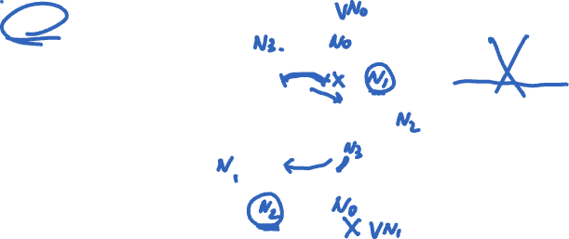
Virtual nodes: Example
4 Physical Nodes
V=2
0
14
Same physical node
4
8

Slide 23
Virtual nodes: Example
4 Physical Nodes
V=2
0
14
Same physical node
4
8
Result: Better load balance with larger v

Slide 24
Outline
Techniques for partitioning data
Metrics for success
Case study
Amazon Dynamo key-value store

Slide 25
Dynamo: The P2P context
Chord and DHash intended for wide-area P2P systems
Individual nodes at Internet’s edge, file sharing

Slide 26
Dynamo: The P2P context
Chord and DHash intended for wide-area P2P systems
Individual nodes at Internet’s edge, file sharing
Central challenge: low-latency key lookup with high availability
Trades off consistency for availability and latency

Slide 27

Dynamo: The P2P context
Chord and DHash intended for wide-area P2P systems
Individual nodes at Internet’s edge, file sharing
Central challenge: low-latency key lookup with high availability
Trades off consistency for availability and latency
Techniques:
Consistent hashing to map keys to nodes
Vector clocks for conflict resolution
Gossip for node membership
Replication at successors for availability under failure

Slide 28

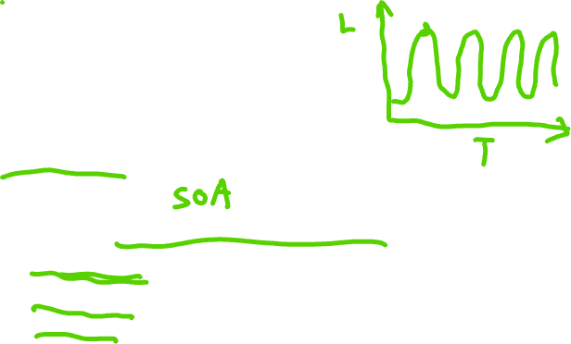
Amazon’s workload (in 2007)
Tens of thousands of servers in globally-distributed data centers
Peak load: Tens of millions of customers
Tiered service-oriented architecture
Stateless web page rendering servers, atop
Stateless aggregator servers, atop
Stateful data stores (e.g. Dynamo)
put(), get(): values “usually less than 1 MB”

Slide 29
How does Amazon use Dynamo?
Shopping cart
Session info
Maybe “recently visited products” etc.?
Product list
Mostly read-only, replication for high read throughput

Slide 30
How does Amazon use Dynamo?
Shopping cart
Session info
Maybe “recently visited products” etc.?
Product list
Mostly read-only, replication for high read throughput
Each instance contains a few hundred servers

Slide 31
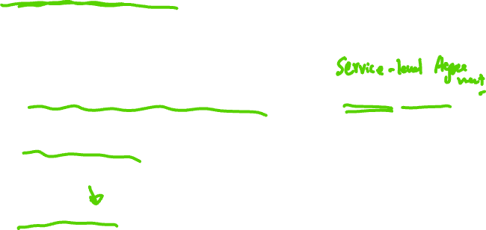
Dynamo requirements
Highly available writes despite failures
Despite disks failing, network routes flapping, “data centers destroyed by tornadoes”
Always respond quickly, even during failures → replication
Low request-response latency: focus on 99.9% SLA
Incrementally scalable as servers grow to workload
Adding “nodes” should be seamless
Comprehensible conflict resolution
High availability in above sense implies conflicts
Notes:
Highly available writes: Writes won’t fail…

Slide 32
Design questions
How is data placed and replicated?
How are requests routed and handled in a replicated system?
How to cope with temporary and permanent node failures?

Slide 33

Dynamo’s system interface
Basic interface is a key-value store
get(k) and put(k, v)
Keys and values opaque to Dynamo
get(key) → value, context
Returns one value or multiple conflicting values
Context describes version(s) of value(s)
put(key, context, value) → “OK”
Context indicates which versions this version supersedes or merges

Slide 34

Dynamo’s techniques
Place replicated data on nodes with consistent hashing
Maintain consistency of replicated data with vector clocks
Eventual consistency for replicated data: prioritize success and low latency of writes over reads
And availability over consistency (unlike DBs)
Efficiently synchronize replicas using Merkle trees

Slide 35
Dynamo’s techniques
Place replicated data on nodes with consistent hashing
Maintain consistency of replicated data with vector clocks
Eventual consistency for replicated data: prioritize success and low latency of writes over reads
And availability over consistency (unlike DBs)
Efficiently synchronize replicas using Merkle trees
Key tradeoffs: Response time vs. consistency vs. durability

Slide 36
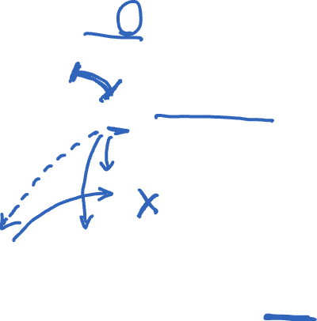
Data placement
Key K
put(K,…), get(K) requests go to me
Coordinator node
Each data item is replicated at N virtual nodes (e.g., N = 3)

Slide 37
Data replication
A key-value pair → key’s N successors (preference list)
Coordinator receives a put for some key
Coordinator then replicates data onto nodes in the key’s preference list

Slide 38
Data replication
A key-value pair → key’s N successors (preference list)
Coordinator receives a put for some key
Coordinator then replicates data onto nodes in the key’s preference list
Writes to more than just N successors in case of failure

Slide 39
Data replication
A key-value pair → key’s N successors (preference list)
Coordinator receives a put for some key
Coordinator then replicates data onto nodes in the key’s preference list
Writes to more than just N successors in case of failure
For robustness, the preference list skips tokens to ensure distinct physical nodes
Notes:
tokens: virtual nodes in the consistent hash ring…

Slide 40
Gossip and lookup
Gossip: Once per second, each node contacts a randomly chosen other node
They exchange their lists of known nodes (including virtual node IDs)
Assumes all nodes will come back eventually, doesn’t repartition
Each node learns which others handle all key ranges

Slide 41
Gossip and lookup
Gossip: Once per second, each node contacts a randomly chosen other node
They exchange their lists of known nodes (including virtual node IDs)
Assumes all nodes will come back eventually, doesn’t repartition
Each node learns which others handle all key ranges
Result: All nodes can send directly to any key’s coordinator (“zero-hop DHT”)
Reduces variability in response times

Slide 42

Partitions force a choice between availability and consistency
Suppose three replicas are partitioned into two and one
If one replica fixed as master, no client in other partition can write
Traditional distributed databases emphasize consistency over availability when there are partitions

Slide 43
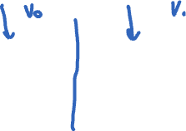
Alternative: Eventual consistency
Dynamo emphasizes availability over consistency when there are partitions
Tell client write complete when only some replicas have stored it
Propagate to other replicas in background
Allows writes in both partitions…but risks:
Returning stale data
Write conflicts when partition heals:
put(k,v₀)
put(k,v₁)
?@%$!!

Slide 44
Mechanism: Sloppy quorums
If no failure, reap “consistency” benefits of single master
Else sacrifice “consistency” to allow progress
Dynamo tries to store all values put() under a key on first N live nodes of coordinator’s preference list

Slide 45
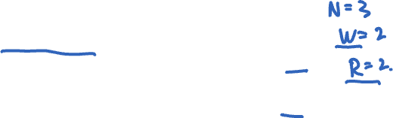
Mechanism: Sloppy quorums
If no failure, reap “consistency” benefits of single master
Else sacrifice “consistency” to allow progress
Dynamo tries to store all values put() under a key on first N live nodes of coordinator’s preference list
BUT to speed up get() and put():
Coordinator returns “success” for put when W < N replicas have completed write
Coordinator returns “success” for get when R < N replicas have completed read

Slide 46
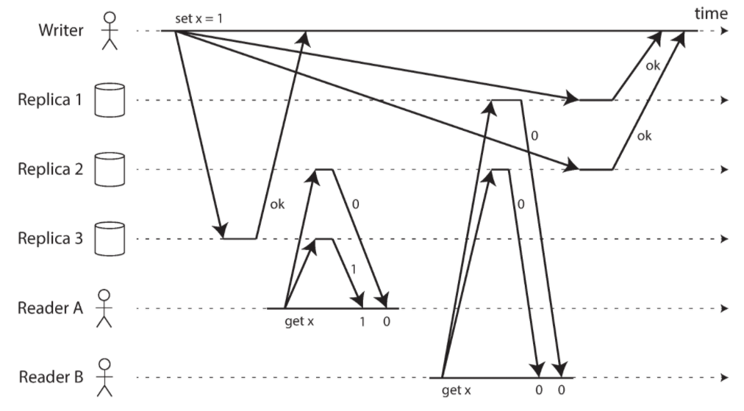
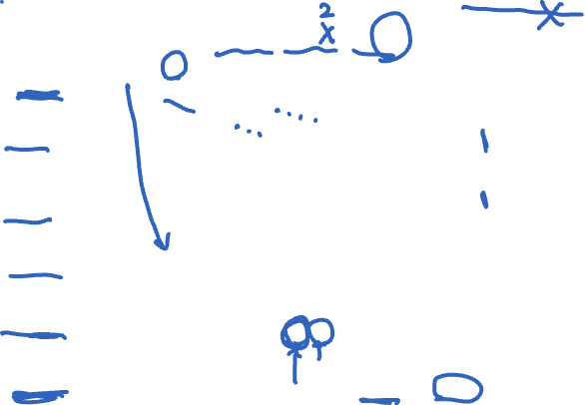
Consistency under sloppy quorums != linearizability
Sloppy quorum of (N=3, W=3, R=2)
*: https://www.oreilly.com/library/view/designing-data-intensive-applications/9781491903063/ (Page 334)

Slide 47
Sloppy quorums: Hinted handoff
Suppose coordinator doesn’t receive W replies when replicating a put()
Could return failure, but remember goal of high availability for writes…

Slide 48

Sloppy quorums: Hinted handoff
Suppose coordinator doesn’t receive W replies when replicating a put()
Could return failure, but remember goal of high availability for writes…
Hinted handoff: Coordinator tries further nodes in preference list (beyond first N) if necessary
Indicates the intended replica node to recipient
Recipient will periodically try to forward to the intended replica node

Slide 49
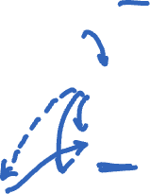
Hinted handoff: Example
Suppose C fails
Node E is in preference list
Needs to receive replica of the data
Hinted Handoff: replica at E points to node C; E periodically forwards to C
Key K
Coordinator

Slide 50
Hinted handoff: Example
Suppose C fails
Node E is in preference list
Needs to receive replica of the data
Hinted Handoff: replica at E points to node C; E periodically forwards to C
When C comes back
E forwards the replicated data back to C
Key K
Coordinator

Slide 51
Wide-area replication
Last ¶,§4.6: Preference lists always contain nodes from more than one data center
Consequence: Data likely to survive failure of entire data center

Slide 52

Wide-area replication
Last ¶,§4.6: Preference lists always contain nodes from more than one data center
Consequence: Data likely to survive failure of entire data center
Blocking on writes to a remote data center would incur unacceptably high latency
Compromise: W < N, eventual consistency
Better durability, latency but worse consistency

Slide 53
Sloppy quorums and get()s
Suppose coordinator doesn’t receive R replies when processing a get()
Penultimate ¶,§4.5: “R is the min. number of nodes that must participate in a successful read operation.”
Sounds like these get()s fail
Why not return whatever data was found, though?
As we will see, consistency not guaranteed anyway…

Slide 54
Sloppy quorums and freshness
Common case given in paper: N = 3; R = W = 2
With these values, do sloppy quorums guarantee a get() sees all prior put()s?

Slide 55

Sloppy quorums and freshness
Common case given in paper: N = 3; R = W = 2
With these values, do sloppy quorums guarantee a get() sees all prior put()s?
If no failures, yes:
Two writers saw each put()
Two readers responded to each get()

Slide 56
Sloppy quorums and freshness
Common case given in paper: N = 3; R = W = 2
With these values, do sloppy quorums guarantee a get() sees all prior put()s?
If no failures, yes:
Two writers saw each put()
Two readers responded to each get()
Write and read quorums must overlap!

Slide 57
Sloppy quorums and freshness
Common case given in paper: N = 3; R = W = 2
With these values, do sloppy quorums guarantee a get() sees all prior put()s?
With node failures, no:
Two nodes in preference list go down
put() replicated outside preference list; Hinted handoff nodes have data
Two nodes in preference list come back up
get() occurs before they receive prior put()

Slide 58

Conflicts
Suppose N = 3, W = R = 2, nodes are named A, B, C
1st put(k, …) completes on A and B
2nd put(k, …) completes on B and C
Now get(k) arrives, completes first at A and C

Slide 59

Conflicts
Suppose N = 3, W = R = 2, nodes are named A, B, C
1st put(k, …) completes on A and B
2nd put(k, …) completes on B and C
Now get(k) arrives, completes first at A and C
Conflicting results from A and C
Each has seen a different put(k, …)

Slide 60
Conflicts
Suppose N = 3, W = R = 2, nodes are named A, B, C
1st put(k, …) completes on A and B
2nd put(k, …) completes on B and C
Now get(k) arrives, completes first at A and C
Conflicting results from A and C
Each has seen a different put(k, …)
Dynamo returns both results; what does client do now?

Slide 61
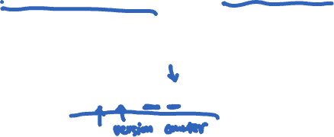
Version vectors (vector clocks)
Version vectors: List of (coordinator node, counter) pairs
e.g., [(A, 1), (B, 3), …]
Dynamo stores a version vector with each stored key-value pair
Tracks causal relationship between different versions of data stored under the same key k

Slide 62
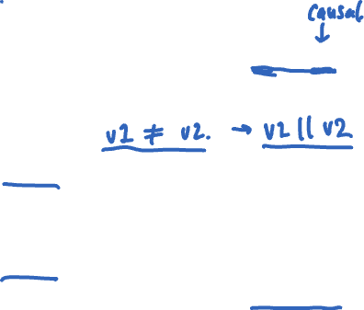

Version vectors (VV) in Dynamo
Rule: If vector clock comparison of v1 < v2, then the first is an ancestor of the second – Dynamo can forget v1
Each time a put() occurs, Dynamo increments the counter in the V.V. for the coordinator node
Each time a get() occurs, Dynamo returns the V.V. for the value(s) returned (in the “context”)
Then users must supply that context to put()s that modify the same key

Slide 63
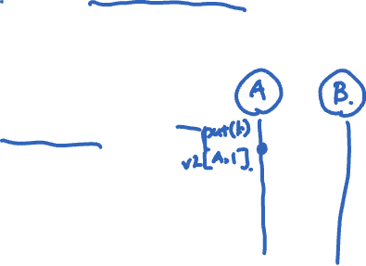
Version vectors (auto-resolving case)
put handled by node A
v1 [(A,1)]

Slide 64
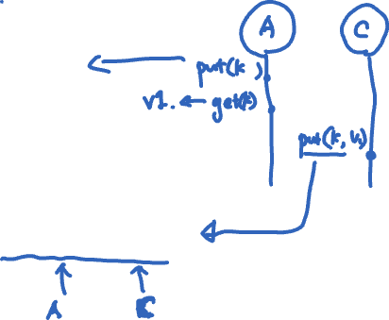

Version vectors (auto-resolving case)
put handled by node A
v1 [(A,1)]
put handled by node C
v2 [(A,1), (C,1)]

Slide 65
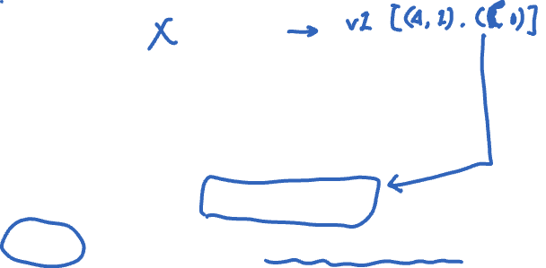
Version vectors (auto-resolving case)
put handled by node A
v1 [(A,1)]
put handled by node C
v2 [(A,1), (C,1)]
v2 > v1, so Dynamo nodes automatically drop v1, for v2

Slide 66
Version vectors (app-resolving case)
put handled by node A
v1 [(A,1)]
put handled by node B
v2 [(A,1), (B,1)]

Slide 67
Version vectors (app-resolving case)
put handled by node A
v1 [(A,1)]
put handled by node B
put handled by node C
v2 [(A,1), (B,1)]
v3 [(A,1), (C,1)]

Slide 68
Version vectors (app-resolving case)
put handled by node A
v1 [(A,1)]
put handled by node B
put handled by node C
v2 [(A,1), (B,1)]
v3 [(A,1), (C,1)]
v2 || v3, so a client must perform semantic reconciliation

Slide 69
Version vectors (app-resolving case)
put handled by node A
v1 [(A,1)]
put handled by node B
put handled by node C
v2 [(A,1), (B,1)]
v3 [(A,1), (C,1)]
v2 || v3, so a client must perform semantic reconciliation
Client reads v2, v3; context: [(A,1), (B,1), (C,1)]
v4 [(A,2), (B,1), (C,1)]

Slide 70
Version vectors (app-resolving case)
put handled by node A
v1 [(A,1)]
put handled by node B
put handled by node C
v2 [(A,1), (B,1)]
v3 [(A,1), (C,1)]
v2 || v3, so a client must perform semantic reconciliation
Client reads v2, v3; context: [(A,1), (B,1), (C,1)]
v4 [(A,2), (B,1), (C,1)]
Client reconciles v2 and v3; node A handles the put

Slide 71
Trimming version vectors
Many nodes may process a series of put()s to same key
Version vectors may get long – do they grow forever?

Slide 72
Trimming version vectors
Many nodes may process a series of put()s to same key
Version vectors may get long – do they grow forever?
In practice, unlikely: unless failures, upper limit of N

Slide 73

Trimming version vectors
Many nodes may process a series of put()s to same key
Version vectors may get long – do they grow forever?
In practice, unlikely: unless failures, upper limit of N
Dynamo also uses a clock truncation scheme
Stores time of modification with each V.V. entry
When V.V. > 10 nodes long, V.V. drops the timestamp of the node that least recently processed that key

Slide 74
Impact of deleting a VV entry
put handled by node A
v1 [(A,1)]

Slide 75
Impact of deleting a VV entry
put handled by node A
v1 [(A,1)]
put handled by node C
v2 [(A,1), (C,1)]

Slide 76
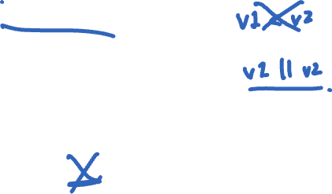
Impact of deleting a VV entry
put handled by node A
v1 [(A,1)]
put handled by node C
v2 [(A,1), (C,1)]
v2 || v1, so looks like application resolution is required

Slide 77

Concurrent writes
What if two clients concurrently write w/o failure?
e.g. add different items to same cart at same time
Each does get-modify-put
They both see the same initial version
And they both send put() to same coordinator
Will coordinator create two versions with conflicting VVs?

Slide 78
Concurrent writes
What if two clients concurrently write w/o failure?
e.g. add different items to same cart at same time
Each does get-modify-put
They both see the same initial version
And they both send put() to same coordinator
Will coordinator create two versions with conflicting VVs?
We want that outcome, otherwise one was thrown away
Paper doesn't say, but coordinator could detect problem via put() context

Slide 79
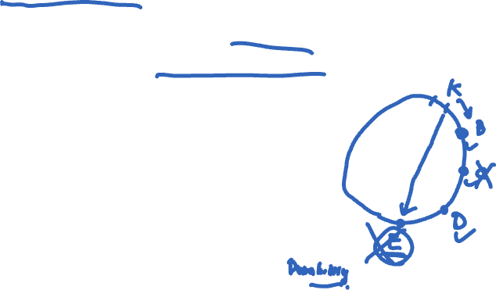
Removing threats to durability
Hinted handoff node crashes before it can replicate data to node in preference list
Need another way to ensure that each key-value pair is replicated N times

Slide 80
Removing threats to durability
Hinted handoff node crashes before it can replicate data to node in preference list
Need another way to ensure that each key-value pair is replicated N times
Mechanism: replica synchronization
Nodes nearby on ring periodically gossip
Compare the (k, v) pairs they hold
Copy any missing keys the other has

Slide 81
Removing threats to durability
Hinted handoff node crashes before it can replicate data to node in preference list
Need another way to ensure that each key-value pair is replicated N times
Mechanism: replica synchronization
Nodes nearby on ring periodically gossip
Compare the (k, v) pairs they hold
Copy any missing keys the other has
How to compare and copy replica state quickly and efficiently?

Slide 82
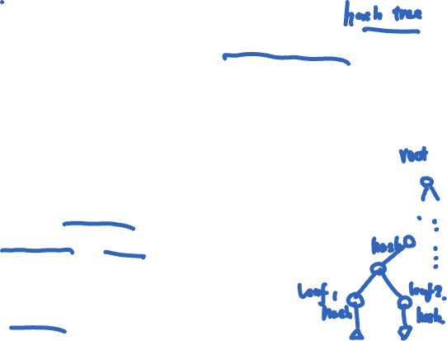
Efficient synchronization with Merkle trees
Merkle trees hierarchically summarize the key-value pairs a node holds
One Merkle tree for each virtual node key range
Leaf node = hash of one key’s value
Internal node = hash of concatenation of children
Compare roots; if match, values match
If they don’t match, compare children
Iterate this process down the tree

Slide 83
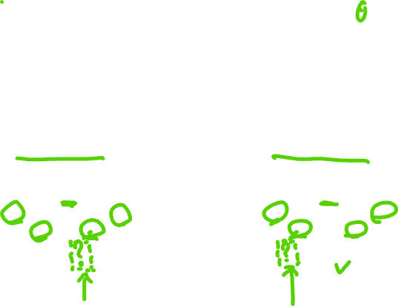
Merkle tree reconciliation
B is missing orange key; A is missing green one
Exchange and compare hash nodes from root downwards, pruning when hashes match
A’s values:
B’s values:
[0, 2¹²⁸)
[0, 2¹²⁸)
[0, 2¹²⁷)
[2¹²⁷, 2¹²⁸)
[0, 2¹²⁷)
[2¹²⁷, 2¹²⁸)
Finds differing keys quickly and with minimum information exchange

Slide 84
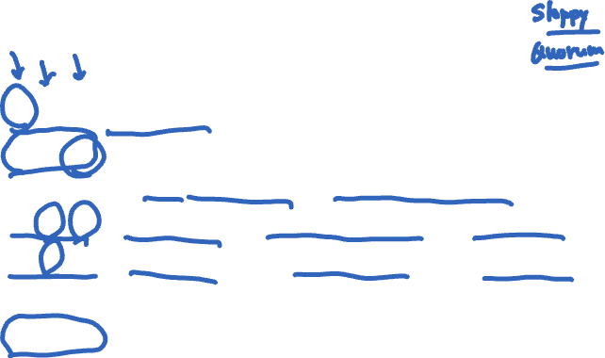
How useful is it to vary N, R, W?
N | R | W | Behavior
3 | 2 | 2 | Parameters from paper: Good durability, good R/W latency
3 | 3 | 1 | Slow reads, weak durability, fast writes
3 | 1 | 3 | Slow writes, strong durability, fast reads
3 | 3 | 3 | More likely that reads see all prior writes?
3 | 1 | 1 | Read quorum doesn’t overlap write quorum

Slide 85
Dynamo: Take-aways
Consistent hashing broadly useful for replication—not only in P2P systems
Extreme emphasis on availability and low latency, unusually, at the cost of some inconsistency
Eventual consistency lets writes and reads return quickly, even when partitions and failures
Version vectors allow some conflicts to be resolved automatically; others left to application

