Slide 1


Strong Consistency
CS 475: Concurrent & Distributed Systems (Fall 2021)
Lecture 11
Yue Cheng
Some material taken/derived from:
Princeton COS-418 materials created by Michael Freedman.
MIT 6.824 by Robert Morris, Frans Kaashoek, and Nickolai Zeldovich.
Licensed for use under a Creative Commons Attribution-NonCommercial-ShareAlike 3.0 Unported License.

Slide 2

Consistency models
2PC / Consensus
Paxos / Raft
Eventual consistency
Dynamo

Slide 3

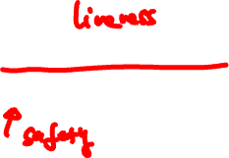
Consistency in Paxos/Raft
shl
Consensus Module
State Machine
Consensus Module
State Machine
Consensus Module
State Machine
Log
Log
Log
add
jmp
mov
shl
add
jmp
mov
shl
add
jmp
mov
shl
Fault-tolerance / durability: Don’t lose operations
Consistency: Ordering between (visible) operations
Notes:
Processes may be running on different machines

Slide 4

Correct consistency model?
A
B
Let’s say A and B send an op.
All readers see A → B ?
All readers see B → A ?
Some see A → B and others B → A ?
Notes:
Processes may be running on different machines

Slide 5
Paxos/Raft has strong consistency

Slide 6
Paxos/Raft has strong consistency
Provide behavior of a single copy of object:
Read should return the most recent write
Subsequent reads should return same value, until next write

Slide 7
Paxos/Raft has strong consistency
Provide behavior of a single copy of object:
Read should return the most recent write
Subsequent reads should return same value, until next write
Telephone intuition:
Alice updates Facebook post
Alice calls Bob on phone: “Check my Facebook post!”
Bob read’s Alice’s wall, sees her post

Slide 8

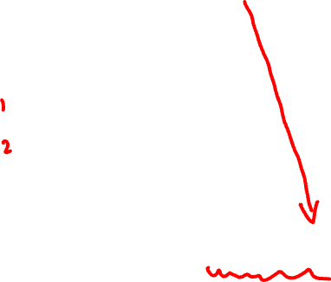
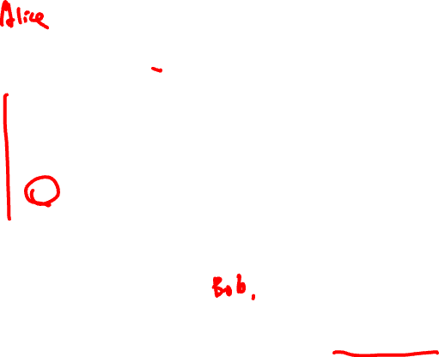
Strong Consistency?
write(A,1)
success
1
read(A)
Phone call: Ensures happens-before relationship, even through “out-of-band” communication

Slide 9

Strong Consistency?
write(A,1)
success
1
read(A)
One cool trick: Delay responding to writes/ops until properly committed

Slide 10
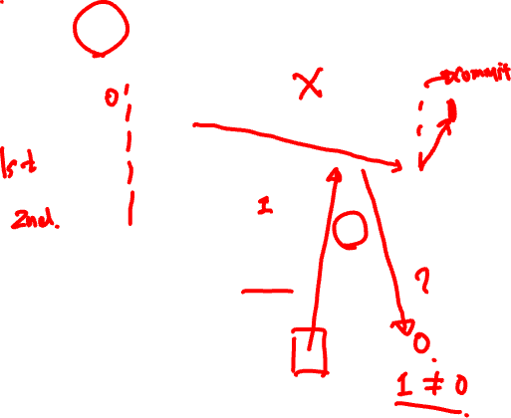
Strong Consistency? This is buggy!
write(A,1)
success
1
committed
read(A)
Isn’t sufficient to return value of third node: It doesn’t know precisely when op is “globally” committed
Instead: Need to actually order read operation

Slide 11

Strong Consistency!
write(A,1)
success
1
read(A)
Order all operations via (1) leader, (2) consensus

Slide 12
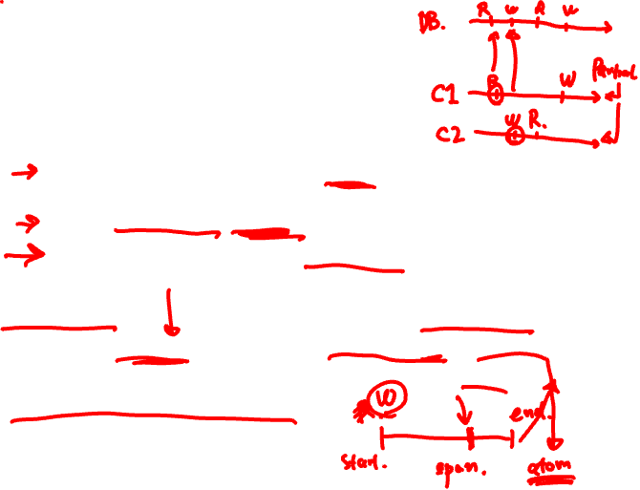
Strong consistency = linearizability
Linearizability (Herlihy and Wing 1991)
All servers execute all ops in some identical sequential order
Global ordering preserves each client’s own local ordering
Global ordering preserves real-time guarantee
Informally, linearizability specifies that each concurrent operation appears to occur instantaneously and exactly once at some point in time between its invocation and its completion.
Notes:
Informally, linearizability specifies that each concurrent op appears to occur instantaneously and exactly once at some point in time between its invocation and its completion.
Linearizability (also known as atomic consistency, strong consistency, immediate consistency) describes reads and writes on a single object (stores a single value). it doesn’t involve multiple objects. It doesn’t involve “transaction”, which groups multiple objects. It treats each operation as an atom, i.e., to take effect in a single time point, rather than a timespan.
Bullet 2: Order of each client’s own local operations (partial order w.r.t. global order) should be strictly preserved in the global ordering.

Slide 13

Strong consistency = linearizability
Linearizability (Herlihy and Wing 1991)
All servers execute all ops in some identical sequential order
Global ordering preserves each client’s own local ordering
Global ordering preserves real-time guarantee
All ops receive global time-stamp using a sync’d clock
If ts_{op1}(x) < ts_{op2}(y), OP1(x) precedes OP2(y) in sequence
Notes:
Bullet 3: Global ordering should preserve real-time precedence.

Slide 14

Strong consistency = linearizability
Linearizability (Herlihy and Wing 1991)
All servers execute all ops in some identical sequential order
Global ordering preserves each client’s own local ordering
Global ordering preserves real-time guarantee
All ops receive global time-stamp using a sync’d clock
If ts_{op1}(x) < ts_{op2}(y), OP1(x) precedes OP2(y) in sequence
Once write completes, all later reads (by wall-clock start time) should return value of that write or value of later write.
Once read returns particular value, all later reads should return that value or value of later write.
Notes:
Bullet 3: Global ordering should preserve real-time precedence.

Slide 15

Intuition: Real-time ordering
write(A,1)
success
1
committed
read(A)
Once write completes, all later reads (by wall-clock start time) should return value of that write or value of later write.
Once read returns particular value, all later reads should return that value or value of later write.

Slide 16
Real-time ordering examples

Slide 17
W(0)
W(0)
A:
W(1)
R(0)
B:

Slide 18
W(0)
W(0)
A:
W(1)
R(0)
B:
W(0)
R(1)
W(0)
A:
W(1)
R(0)
B:

Slide 19
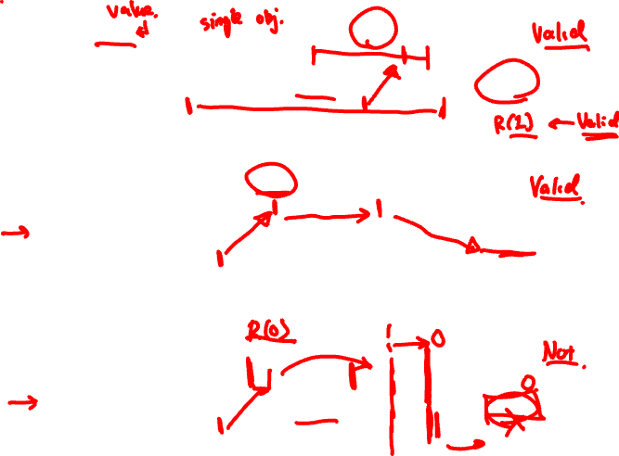
W(0)
W(0)
A:
W(1)
R(0)
B:
W(0)
R(1)
W(0)
A:
W(1)
R(0)
B:
W(0)
R(1)
W(0)
A:
W(1)
R(1)
B:

Slide 20
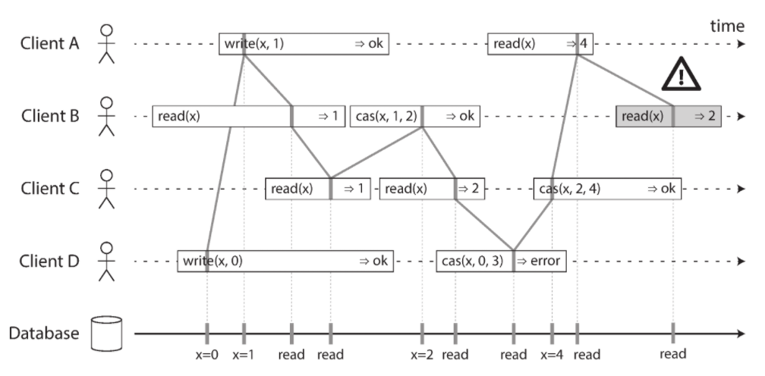
Real-time ordering examples
*: https://www.oreilly.com/library/view/designing-data-intensive-applications/9781491903063/ (Page 328)

Slide 21

Weaker: Sequential consistency
Sequential = Linearizability – real-time ordering
All servers execute all ops in some identical sequential order
Global ordering preserves each client’s own local ordering

Slide 22

Weaker: Sequential consistency
Sequential = Linearizability – real-time ordering
All servers execute all ops in some identical sequential order
Global ordering preserves each client’s own local ordering
With concurrent ops, “reordering” of ops (w.r.t. real-time ordering) acceptable, but all servers must see same order
e.g., linearizability cares about time sequential consistency cares about program order

Slide 23

Sequential Consistency
write(A,1)
success
0
read(A)
In example, system orders read(A) before write(A,1)

Slide 24

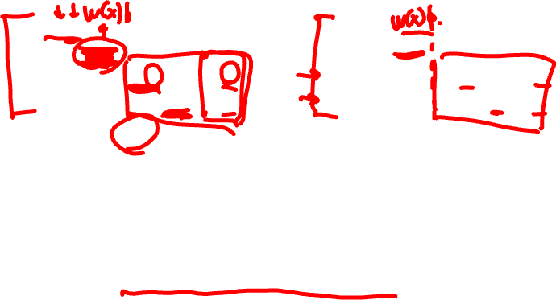
Valid Sequential Consistency?
x
✓
Why? Because P3 and P4 don’t agree on order of ops. Doesn’t matter when events took place on diff machine, as long as proc’s AGREE on order.
What if P1 did both W(x)a and W(x)b?
Neither valid, as (a) doesn’t preserve local ordering

