Slide 1


CAP Theorem & Causal Consistency
CS 475: Concurrent & Distributed Systems (Fall 2021)
Lecture 12
Yue Cheng
Some material taken/derived from:
Princeton COS-418 materials created by Michael Freedman.
MIT 6.824 by Robert Morris, Frans Kaashoek, and Nickolai Zeldovich.
Licensed for use under a Creative Commons Attribution-NonCommercial-ShareAlike 3.0 Unported License.

Slide 2

Tradeoffs are fundamental?
2PC / Consensus
Paxos / Raft
Eventual consistency
Dynamo

Slide 3

“CAP” conjecture for distributed systems
From keynote lecture by Eric Brewer (2000)
History: Eric started Inktomi, early Internet search site based around “commodity” clusters of computers
Using CAP to justify “BASE” model: Basically Available, Soft-state services with Eventual consistency

Slide 4

“CAP” conjecture for distributed systems
From keynote lecture by Eric Brewer (2000)
History: Eric started Inktomi, early Internet search site based around “commodity” clusters of computers
Using CAP to justify “BASE” model: Basically Available, Soft-state services with Eventual consistency
Popular interpretation: 2-out-of-3
Consistency (Linearizability)
Availability
Partition Tolerance: Arbitrary crash/network failures

Slide 5

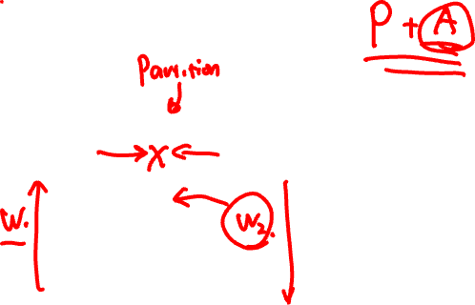
CAP Theorem: Proof
Not
consistent
Gilbert, Seth, and Nancy Lynch. "Brewer's conjecture and the feasibility of consistent, available, partition-tolerant web services." ACM SIGACT News 33.2 (2002): 51-59.
Notes:
AP

Slide 6
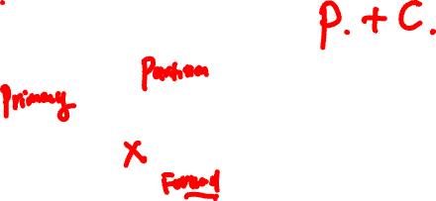
CAP Theorem: Proof
Not
available
Gilbert, Seth, and Nancy Lynch. "Brewer's conjecture and the feasibility of consistent, available, partition-tolerant web services." ACM SIGACT News 33.2 (2002): 51-59.
Notes:
CP

Slide 7
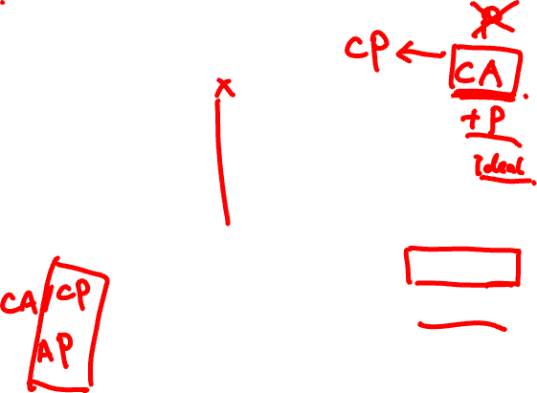
CAP Theorem: Proof
Not
partition
tolerant
Gilbert, Seth, and Nancy Lynch. "Brewer's conjecture and the feasibility of consistent, available, partition-tolerant web services." ACM SIGACT News 33.2 (2002): 51-59.
Notes:
CA

Slide 8
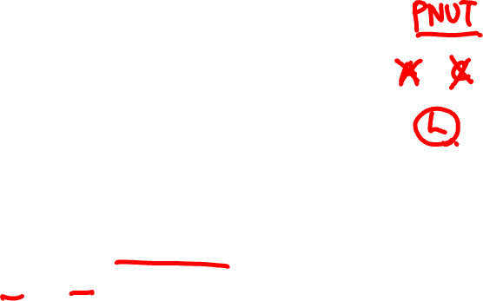
CAP Theorem: AP or CP
Not
partition
tolerant
Criticism: It’s not 2-out-of-3
Can’t “choose” no partitions
So: AP or CP

Slide 9

More tradeoffs L vs. C
L: Low-latency: Speak to fewer than quorum of nodes?
2PC: write N, read 1
Raft: write ⌊N/2⌋ + 1, read ⌊N/2⌋ + 1
General: |W| + |R| > N

Slide 10

More tradeoffs L vs. C
L: Low-latency: Speak to fewer than quorum of nodes?
2PC: write N, read 1
Raft: write ⌊N/2⌋ + 1, read ⌊N/2⌋ + 1
General: |W| + |R| > N
L and C are fundamentally at odds
“C” = linearizability, sequential, serializability (more later)

Slide 11
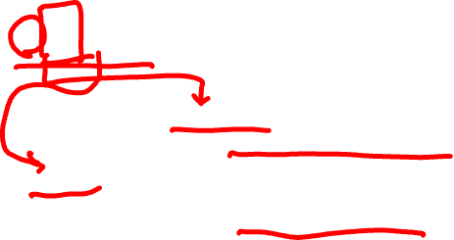
PACELC
If there is a partition (P):
How does system tradeoff A and C?
Else (no partition)
How does system tradeoff L and C?

Slide 12

PACELC
If there is a partition (P):
How does system tradeoff A and C?
Else (no partition)
How does system tradeoff L and C?
Is there a useful system that switches?
Dynamo: PA/EL
“ACID” DBs: PC/EC

Slide 13

PACELC
If there is a partition (P):
How does system tradeoff A and C?
Else (no partition)
How does system tradeoff L and C?
Is there a useful system that switches?
Dynamo: PA/EL
“ACID” DBs: PC/EC
http://dbmsmusings.blogspot.com/2010/04/problems-with-cap-and-yahoos-little.html

Slide 14

Consistency models
Linearizability
Causal
Eventual
Sequential

Slide 15

Recall use of logical clocks (lec N?)
Lamport clocks: C(a) < C(z) Conclusion: None
Vector clocks: V(a) < V(z) Conclusion: a → … → z
Notes:
Users post messages, reply to each others’ messages.

Slide 16

Recall use of logical clocks (lec N?)
Lamport clocks: C(a) < C(z) Conclusion: None
Vector clocks: V(a) < V(z) Conclusion: a → … → z
Distributed bulletin board application
Each post gets sent to all other users
Consistency goal: No user to see reply before the corresponding original message post
Conclusion: Deliver message only after all messages that causally precede it have been delivered
Notes:
Users post messages, reply to each others’ messages.

Slide 17
Causal Consistency

Slide 18

Causal Consistency
Writes that are potentially causally related must be seen by all machines in same order.

Slide 19
Causal Consistency
Writes that are potentially causally related must be seen by all machines in same order.
Concurrent writes may be seen in a different order on different machines.

Slide 20
Causal Consistency
Writes that are potentially causally related must be seen by all machines in same order.
Concurrent writes may be seen in a different order on different machines.
Concurrent: Ops not causally related

Slide 21
Causal Consistency
Writes that are potentially causally related must be seen by all machines in same order.
Concurrent writes may be seen in a different order on different machines.
Concurrent: Ops not causally related
P1
P2
P3
a
f
b
c
d
e
g
Physical time ↓

Slide 22
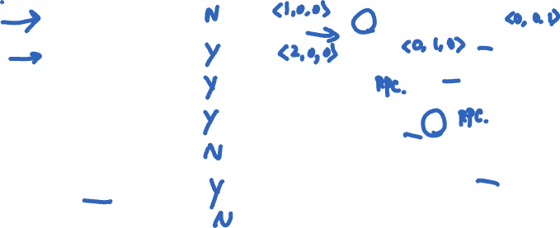
Causal Consistency
Operations
a, b
b, f
c, f
e, f
e, g
a, c
a, e
Concurrent?
N
Y
Y
Y
N
Y
N
P1
P2
P3
a
f
b
c
d
e
g
Physical time ↓

Slide 23
Causal Consistency
Operations
a, b
b, f
c, f
e, f
e, g
a, c
a, e
Concurrent?
N
Y
Y
Y
N
Y
N
P1
P2
P3
a
f
b
c
d
e
g
Physical time ↓

Slide 24

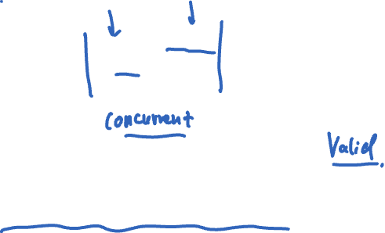
Causal Consistency: Quiz
Valid under causal consistency
Why? W(x)b and W(x)c are concurrent
So all processes don’t (need to) see them in same order
P3 and P4 read the values ‘a’ and ‘b’ in order as potentially causally related. No ‘causality’ for ‘c’.

Slide 25
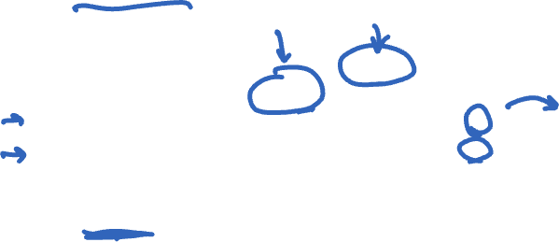
Sequential Consistency: Quiz
Invalid under sequential consistency
Why? P3 and P4 see b and c in different order
But fine for causal consistency
B and C are not causually dependent
Write after write has no dep’s, write after read does

Slide 26
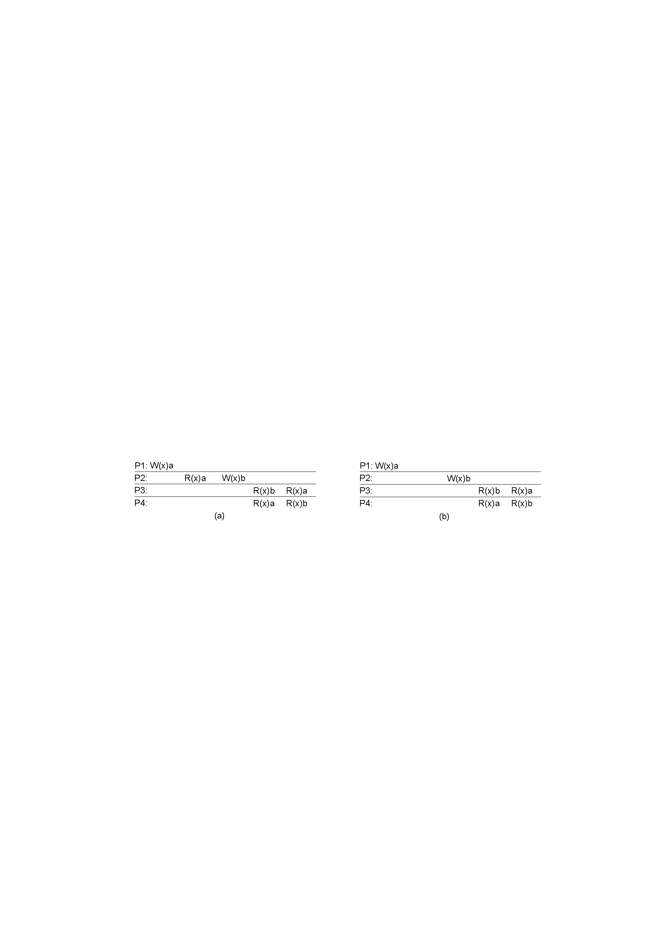
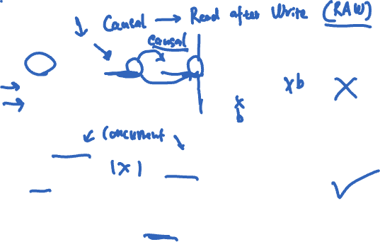
Causal Consistency
x
✓
A: Violation: W(x)b is potentially dep on W(x)a
B: Correct. P2 doesn’t read value of a before W

