Slide 1


Resilient Distributed Datasets: Spark
CS 475: Concurrent & Distributed Systems (Fall 2021)
Lecture 16
Yue Cheng
Some material taken/derived from:
Matei Zarahia’s NSDI’12 talk slides.
Utah CS6450 by Ryan Stutsman.
Licensed for use under a Creative Commons Attribution-NonCommercial-ShareAlike 3.0 Unported License.

Slide 2
What’s good with MapReduce
Scaled analytics to thousands of machines
Eliminated fault-tolerance as a concern

Slide 3
Problems with MapReduce
Scaled analytics to thousands of machines
Eliminated fault-tolerance as a concern
Not very expressive
Iterative algorithms
(PageRank, Logistic Regression, Transitive Closure)
Interactive and ad-hoc queries
(Interactive Log Debugging)
Lots of specialized frameworks
Pregel, GraphLab, PowerGraph, DryadLINQ, HaLoop…

Slide 4
Sharing data between iterations/ops
Only way to share data between iterations / phases is through shared storage
Slow!
Allow operations to feed data to one another
Ideally, through memory instead of disk-based storage

Slide 5
Sharing data between iterations/ops
Only way to share data between iterations / phases is through shared storage
Slow!
Allow operations to feed data to one another
Ideally, through memory instead of disk-based storage
Need the “chain” of operations to be exposed to make this work
Problem to solve: Would this break the MR fault-tolerance scheme?
Retry and Map or Reduce task since idempotent

Slide 6
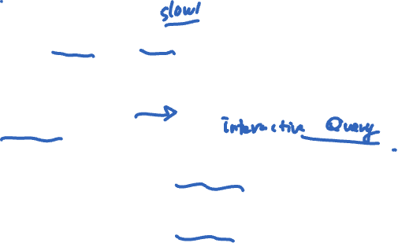
Examples
HDFS read
HDFS write
HDFS read
HDFS write
iter. 1
iter. 2
. . .
Input
HDFS read
query 1
result 1
query 2
result 2
query 3
result 3
Input
. . .
Notes:
Emphasize that the overhead of replication and disk IO from HDFS comes from FT

Slide 7
Examples
HDFS read
HDFS write
HDFS read
HDFS write
iter. 1
iter. 2
. . .
Input
HDFS read
query 1
result 1
query 2
result 2
query 3
result 3
Input
. . .
Slow due to replication and disk I/O, but necessary for fault tolerance
Notes:
Emphasize that the overhead of replication and disk IO from HDFS comes from FT

Slide 8
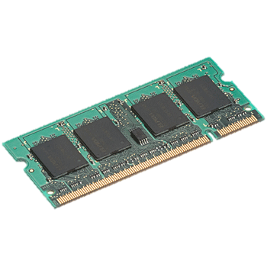
Goal: In-memory data sharing
iter. 1
iter. 2
. . .
Input
query 1
one-time processing
query 2
query 3
Input
. . .

Slide 9
Goal: In-memory data sharing
iter. 1
iter. 2
. . .
Input
query 1
one-time processing
query 2
query 3
Input
. . .
10-100× faster than network/disk, but how to get FT?

Slide 10
Challenges
How to design a distributed memory abstraction that is both fault-tolerant and efficient?

Slide 11
Challenges
How to design a distributed memory abstraction that is both fault-tolerant and efficient?
Existing storage systems allow fine-grained mutation to state
In-memory key-value stores
Requires replicating data or logs across nodes for fault tolerance
Costly for data-intensive apps
10-100x slower than memory write
They also require costly on-the-fly replication for mutations

Slide 12
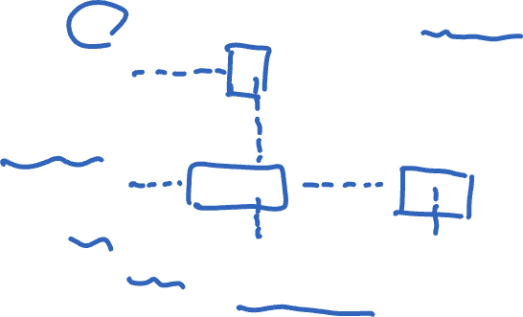
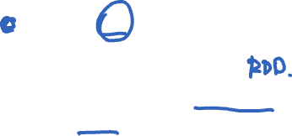
Tradeoff space
Network
bandwidth
Memory
bandwidth
Fine
K-V stores (Dynamo),
Database,
RAMCloud
Best for
transactional
workloads
Granularity
of updates
Best for batch
workloads
A new abstraction??
HDFS
Coarse
Low
High
Write throughput

Slide 13
Challenges
How to design a distributed memory abstraction that is both fault-tolerant and efficient?
Existing storage systems allow fine-grained mutation to state
In-memory key-value stores
Requires replicating data or logs across nodes for fault tolerance
Costly for data-intensive apps
10-100x slower than memory write
They also require costly on-the-fly replication for mutations
Insight: leverage similar coarse-grained approach that transforms whole dataset per operation, like MapReduce (batch processing)

Slide 14
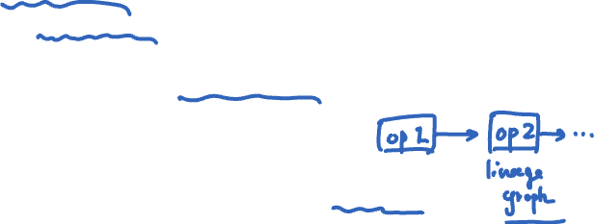
Solution: Resilient Distributed Datasets (RDDs)
Restricted form of distributed shared memory
Immutable, partitioned collections of records
Can only be built through coarse-grained, deterministic transformations (map, filter, join, …)
Efficient fault recovery using lineage
Log one operation to apply to many elements
Recompute lost partitions on failure
No cost if nothing fails

Slide 15

Spark programming interface
Scala API, exposed within interpreter as well
Managing RDDs
Transformations on RDDs (RDD₁ → RDD₂)
Actions on RDDs (RDD → output)
Control over RDD partitioning (how items are split over nodes)
Control over RDD persistence (in memory, on disk, or recompute on loss)

Slide 16
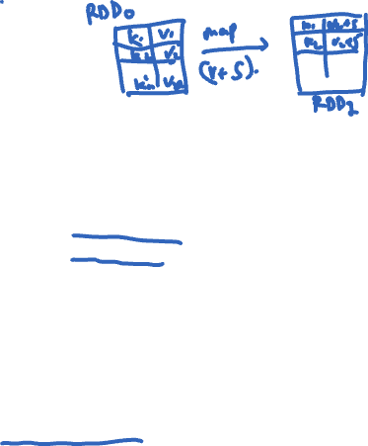
Transformations
Transformations (define a new RDD) | map filter sample groupByKey reduceByKey sortByKey | flatMap union join cogroup cross mapValues
Actions (return a result to driver program) | collect reduce count save lookupKey
RDDs in terms of Scala types → Scala semantics at workers
Transformations are lazy “thunks”; cause no cluster action

Slide 17


Actions
Actions (return a result to driver program) | collect reduce count save lookupKey
Consumes an RDD to produce output
either to storage (save), or
to interpreter/Scala (count, collect, reduce)
Causes RDD lineage chain to get executed on the cluster to produce the output
(for any missing pieces of the computation)

Slide 18


Interactive debugging
lines = textFile(“hdfs://foo.log”)
errors = lines.filter(
_.startsWith(“ERROR”)
errors.persist()

Slide 19
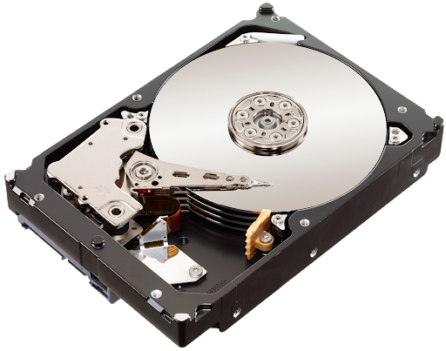
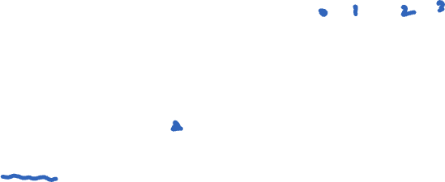
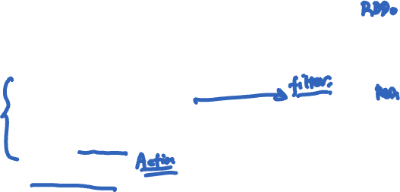
Interactive debugging
lines
lines = textFile(“hdfs://foo.log”)
errors = lines.filter(
_.startsWith(“ERROR”)
errors.persist()
errors.count()
errors

Slide 20
Interactive debugging
lines
lines = textFile(“hdfs://foo.log”)
errors = lines.filter(
_.startsWith(“ERROR”)
errors.persist()
errors.count()
errors
count()

Slide 21

Interactive debugging
lines
lines = textFile(“hdfs://foo.log”)
errors = lines.filter(
_.startsWith(“ERROR”)
errors.persist()
errors.count()
errors.filter(
_.contains(“MySQL”))
errors
count()

Slide 22
Interactive debugging
lines
lines = textFile(“hdfs://foo.log”)
errors = lines.filter(
_.startsWith(“ERROR”)
errors.persist()
errors.count()
errors.filter(
_.contains(“MySQL”)).count()
errors
count()

Slide 23
Interactive debugging
lines
lines = textFile(“hdfs://foo.log”)
errors = lines.filter(
_.startsWith(“ERROR”)
errors.persist()
errors.count()
errors.filter(
_.contains(“MySQL”)).count()
errors
count()

Slide 24
Interactive debugging
lines
lines = textFile(“hdfs://foo.log”)
errors = lines.filter(
_.startsWith(“ERROR”)
errors.persist()
errors.count()
errors.filter(
_.contains(“MySQL”)).count()
errors
count()
count()

Slide 25
Interactive debugging
lines
lines = textFile(“hdfs://foo.log”)
errors = lines.filter(
_.startsWith(“ERROR”)
errors.persist()
errors.count()
errors.filter(
_.contains(“MySQL”)).count()
errors.filter(
_.contains(“HDFS”))
errors
count()
count()

Slide 26

Interactive debugging
lines
lines = textFile(“hdfs://foo.log”)
errors = lines.filter(
_.startsWith(“ERROR”)
errors.persist()
errors.count()
errors.filter(
_.contains(“MySQL”)).count()
errors.filter(
_.contains(“HDFS”))
_.map(_.split(“\t”)(3))
errors
count()
count()

Slide 27
Interactive debugging
lines
lines = textFile(“hdfs://foo.log”)
errors = lines.filter(
_.startsWith(“ERROR”)
errors.persist()
errors.count()
errors.filter(
_.contains(“MySQL”)).count()
errors.filter(
_.contains(“HDFS”))
_.map(_.split(“\t”)(3))
.collect()
errors
count()
count()

Slide 28

Interactive debugging
lines
lines = textFile(“hdfs://foo.log”)
errors = lines.filter(
_.startsWith(“ERROR”)
errors.persist()
errors.count()
errors.filter(
_.contains(“MySQL”)).count()
errors.filter(
_.contains(“HDFS”))
_.map(_.split(“\t”)(3))
.collect()
errors
count()
count()

Slide 29
Interactive debugging
lines
lines = textFile(“hdfs://foo.log”)
errors = lines.filter(
_.startsWith(“ERROR”)
errors.persist()
errors.count()
errors.filter(
_.contains(“MySQL”)).count()
errors.filter(
_.contains(“HDFS”))
_.map(_.split(“\t”)(3))
.collect()
errors
count()
count()

Slide 30
Interactive debugging
lines
lines = textFile(“hdfs://foo.log”)
errors = lines.filter(
_.startsWith(“ERROR”)
errors.persist()
errors.count()
errors.filter(
_.contains(“MySQL”)).count()
errors.filter(
_.contains(“HDFS”))
_.map(_.split(“\t”)(3))
.collect()
errors
count()
count()
collect()
Notes:
.split(“\t”)(3) returns the 3rd field after getting delimited …

Slide 31
persist()
Not an action nor a transformation
A scheduler hint
Tells which RDDs the Spark schedule should materialize and whether in memory or storage
Gives the user control over reuse/recompute/recovery tradeoffs

Slide 32
Lineage graph of RDDs
lines
lines

Slide 33
Lineage graph of RDDs
lines
lines
filter(_.startsWith(“ERROR”))
errors
errors

Slide 34
Lineage graph of RDDs
lines
lines
filter(_.startsWith(“ERROR”))
errors
errors
filter(_.contains(“HDFS”))
HDFS errors
HDFS errors

Slide 35
Lineage graph of RDDs
lines
lines
filter(_.startsWith(“ERROR”))
errors
errors
filter(_.contains(“HDFS”))
HDFS errors
HDFS errors
map(_.split(‘\t’)(3))
time fields
time fields

Slide 36
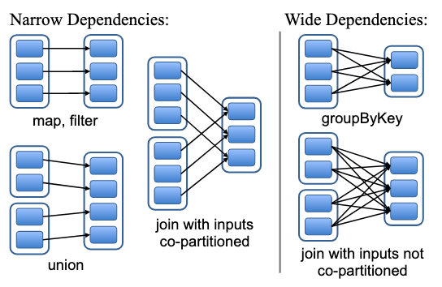
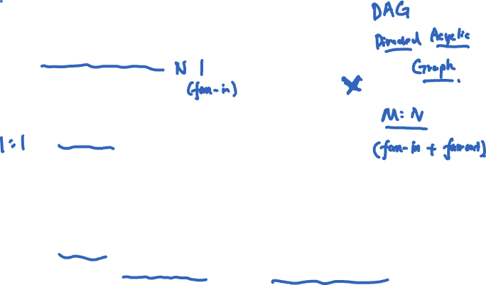
Narrow & wide dependencies
Narrow: each parent partition used by at most one child partition (can partition on one machine)
Wide: multiple child partitions depend on one parent partition
Must stall for all parent data, loss of child requires whole parent RDD (not just a small # of partitions)

Slide 37
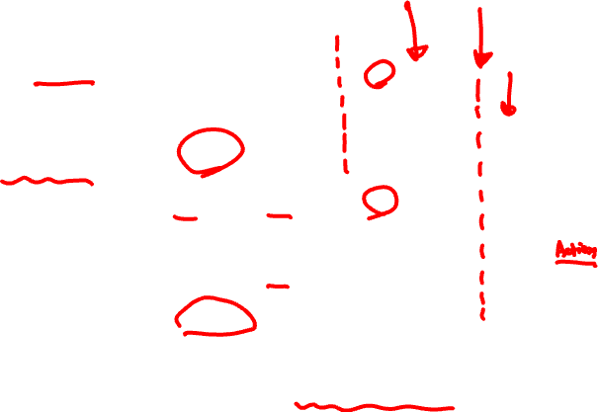
Task scheduler
Dryad-like DAGs
Pipelines functions within a stage
Locality & data reuse aware
Partitioning-aware to avoid shuffles
A:
B:
G:
Stage 1
groupBy
C:
D:
F:
map
E:
join
Stage 2
union
Stage 3
= cached data partition
Notes:
Boundary of a stage is the shuffle operation required for wide dependencies (fan-outs from parent)…

Slide 38

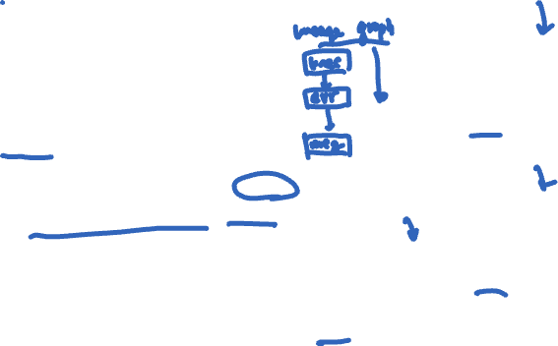
Interactive debugging (control and data flow)
Load error messages from a log into memory, then interactively search for various patterns
Base RDD
Msgs. 1
lines = spark.textFile(“hdfs://...”)
errors = lines.filter(_.startsWith(“ERROR”))
messages = errors.map(_.split(‘\t’)(2))
messages.persist()
Transformed RDD
Worker
results
tasks
Block 1
Driver
Action
messages.filter(_.contains(“MySQL”)).count
messages.filter(_.contains(“HDFS”)).count
Msgs. 2
Worker
Msgs. 3
Worker
Block 2
Result: full-text search of Wikipedia in <1 sec (vs 20 sec for on-disk data)
Result: scaled to 1 TB data in 5-7 sec (vs 170 sec for on-disk data)
Block 3
Notes:
Key idea: add “variables” to the “functions” in functional programming

Slide 39

Fault recovery
RDDs track the graph of transformations that built them (their lineage) to rebuild lost data
E.g.:
messages = textFile(...).filter(_.contains(“error”))
.map(_.split(‘\t’)(2))
HadoopRDD
path = hdfs://…
FilteredRDD
func = _.contains(...)
MappedRDD
func = _.split(…)

Slide 40
Fault recovery
RDDs track the graph of transformations that built them (their lineage) to rebuild lost data
E.g.:
messages = textFile(...).filter(_.contains(“error”))
.map(_.split(‘\t’)(2))
HadoopRDD
FilteredRDD
MappedRDD
HadoopRDD
path = hdfs://…
FilteredRDD
func = _.contains(...)
MappedRDD
func = _.split(…)

Slide 41
Fault recovery
RDDs track the graph of transformations that built them (their lineage) to rebuild lost data
E.g.:
messages = textFile(...).filter(_.contains(“error”))
.map(_.split(‘\t’)(2))
HadoopRDD
FilteredRDD
MappedRDD
HadoopRDD
path = hdfs://…
FilteredRDD
func = _.contains(...)
MappedRDD
func = _.split(…)

Slide 42

Fault recovery results
Failure happens

Slide 43
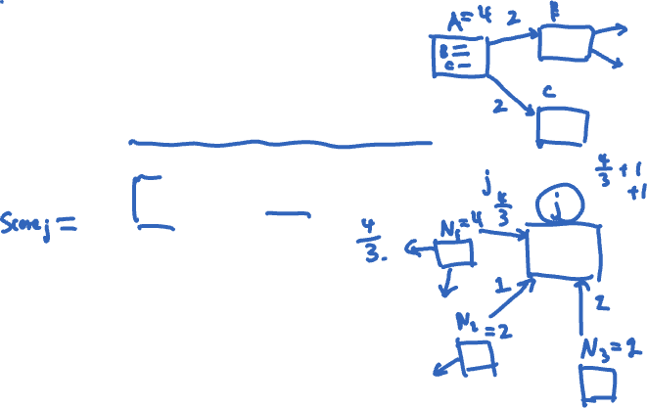
Example: PageRank
1. Start each page with a rank of 1
2. On each iteration, update each page’s rank to
Σ_{i∈neighbors} rank_{i} / |neighbors_{i}|
links = // RDD of (url, neighbors) pairs
ranks = // RDD of (url, rank) pairs
for (i <- 1 to ITERATIONS) {
ranks = links.join(ranks).flatMap {
(url, (links, rank)) =>
links.map(dest => (dest, rank/links.size))
}.reduceByKey(_ + _)
}
Notes:
Name of Page Rank: A name that might reasonably be interpreted as referring to more than one possible meanings (Larry Page)

Slide 44

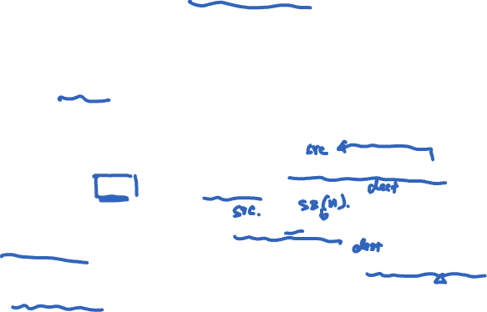
Example: PageRank
1. Start each page with a rank of 1
2. On each iteration, update each page’s rank to
Σ_{i∈neighbors} rank_{i} / |neighbors_{i}|
RDD[(URL, Seq[URL])]
links = // RDD of (url, neighbors) pairs
ranks = // RDD of (url, rank) pairs
for (i <- 1 to ITERATIONS) {
ranks = links.join(ranks).flatMap {
(url, (links, rank)) =>
links.map(dest => (dest, rank/links.size))
}.reduceByKey(_ + _)
}
RDD[(URL, Rank)]
RDD[(URL, (Seq[URL],Rank))]
For each neighbor in links emits (URL, RankContrib)
Reduce to RDD[(URL, Rank)]

Slide 45
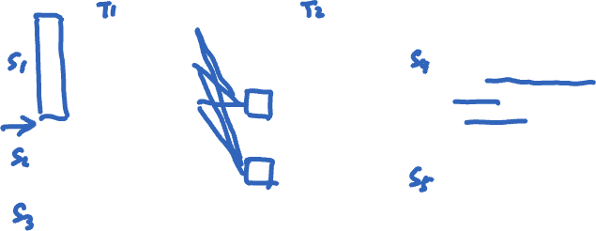
Join (⨝)
Alice | 5
Bob | 6
Claire | 4
Alice | F
Bob | M
Claire | F
Alice | 5 | F
Bob | 6 | M
Claire | 4 | F
⨝
=
A | 5
A | 2
A | 3
B | 4
B | 1
C | 6
C | 8
C | 5
B | 2
A | 3
B | 4
A | 1
B | 6
C | 8
If partitioning doesn’t match, then need to reshuffle to match pairs. Same problem in reduce() for MapReduce.
⨝

Slide 46

Optimizing placement
Links
(url, neighbors)
Ranks₀
(url, rank)
links & ranks repeatedly joined
Can co-partition them (e.g. hash both on URL) to avoid shuffles
Can also use app knowledge, e.g., hash on DNS name
links = links.partitionBy( new URLPartitioner())
join
Contribs₀
reduce
Ranks₁
join
Contribs₂
reduce
Ranks₂
. . .

Slide 47

Optimizing placement
Links
(url, neighbors)
Ranks₀
(url, rank)
links & ranks repeatedly joined
Can co-partition them (e.g. hash both on URL) to avoid shuffles
Can also use app knowledge, e.g., hash on DNS name
links = links.partitionBy( new URLPartitioner())
join
Contribs₀
reduce
Ranks₁
join
Contribs₂
reduce
Ranks₂
. . .
Q: Where might we have placed persist()?

Slide 48
Co-partitioning example
Co-partitioning can avoid shuffle on join
But, fundamentally a shuffle on reduceByKey
Optimization: custom partitioner on domain
Notes:
co-partitioning can avoid shuffle on join
there is a shuffle on reduceByKey
optimization: custom partitioner on domain…

Slide 49

PageRank performance
* Figure 10a: 30 machines on 54 GB of Wikipedia data computing PageRank

Slide 50

Tradeoff space
Network
bandwidth
Memory
bandwidth
Fine
K-V stores (Dynamo),
Database,
RAMCloud
Best for
transactional
workloads
Granularity
of updates
Best for batch
workloads
HDFS
RDDs
Coarse
Low
High
Write throughput

