Slide 1


Byzantine Fault Tolerance
CS 475: Concurrent & Distributed Systems (Fall 2021)
Lecture 10
Yue Cheng
Some material taken/derived from:
Princeton COS-418 materials created by Kyle Jamieson.
MIT 6.824 by Robert Morris, Frans Kaashoek, and Nickolai Zeldovich.
Licensed for use under a Creative Commons Attribution-NonCommercial-ShareAlike 3.0 Unported License.

Slide 2
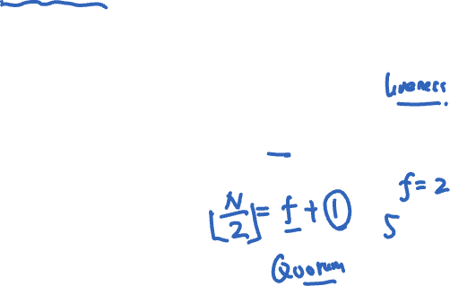
So far: Fail-stop failures
Traditional state machine replication tolerates fail-stop failures:
Node crashes
Network breaks or partitions
State machine replication with N = 2f+1 replicas can tolerate f simultaneous fail-stop failures
Two algorithms: Paxos, Raft

Slide 3
Byzantine faults
Byzantine fault: Node/component fails arbitrarily
Might perform incorrect computation
Might give conflicting information to different parts of the system
Might collude with other failed nodes

Slide 4

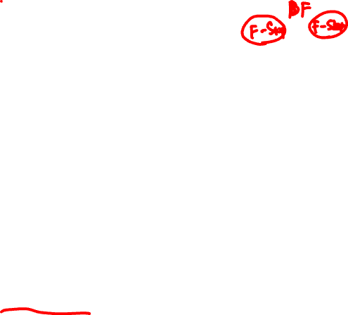
Byzantine faults
Byzantine fault: Node/component fails arbitrarily
Might perform incorrect computation
Might give conflicting information to different parts of the system
Might collude with other failed nodes
Why might nodes or components fail arbitrarily?
Software bug present in code
Hardware failure occurs
Hack attack on system

Slide 5
Today: Byzantine fault tolerance
Can we provide state machine replication for a service in the presence of Byzantine faults?
Such a service is called a Byzantine Fault Tolerant (BFT) service
Why might we care about this level of reliability?

Slide 6
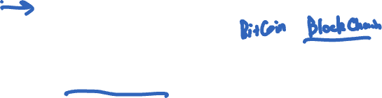
Motivation for BFT
The ideas surrounding Byzantine fault tolerance have found numerous applications:
Commercial airliner flight control computer systems
Digital currency systems
Some limitations, but...
Inspired much follow-on research to address these limitations

Slide 7
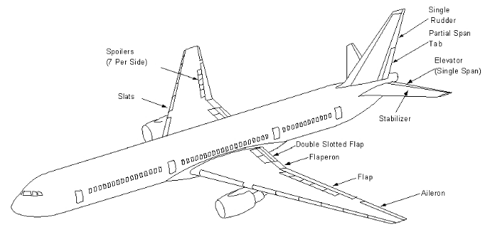
Mini-case-study: Boeing 777 fly-by-wire primary flight control system
Triple-redundant, dissimilar processor hardware:
Intel 80486
Motorola
AMD
Each processor runs code from a different compiler
Key techniques:
Hardware and software diversity,
Voting between components
Simplified design:
Pilot inputs → three processors
Processors vote → control surface

Slide 8
Today
Traditional state-machine replication for BFT?
Practical BFT replication algorithm

Slide 9
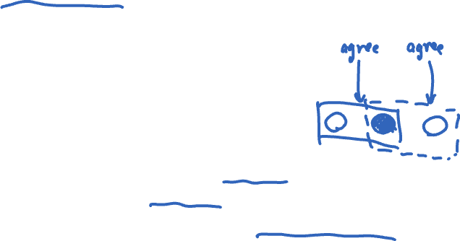
Review: Tolerating one fail-stop failure
Traditional state machine replication (Paxos) requires, e.g., 2f + 1 = three replicas, if f = 1
Operations are totally ordered → correctness
A two-phase protocol
Each operation uses ≥ f + 1 = 2 of them
Overlapping quorums
So at least one replica “remembers”

Slide 10

Use Paxos for BFT?
Can’t rely on the primary to assign seqno
Could assign same seqno to different requests
Can’t use Paxos for view change
Under Byzantine faults, the intersection of two majority (f + 1 node) quorums may be bad node
Bad node tells different quorums different things!
e.g. tells N0 accept val1, but N1 accept val2

Slide 11


Paxos under Byzantine faults (f = 1)
Prepare(N0:1)
OK(val=null)
N2
Prepare(N0:1)
OK
N0
OK(val=null)
N1
n_{h}=N0:1
n_{h}=N0:1

Slide 12

Paxos under Byzantine faults (f = 1)
f +1 ✓
OK
Accept(N0:1, val=xyz)
N2
Accept(N0:1, val=xyz)
OK
N0
Decide
xyz
N1
n_{h}=N0:1
n_{h}=N0:1

Slide 13

Paxos under Byzantine faults (f = 1)
Prepare(N2:1)
N2
OK
N0
Decide
xyz
N1
n_{h}=N0:1
n_{h}=N2:1

Slide 14

Paxos under Byzantine faults (f = 1)
Accept(N1:1, val=abc)
N2
OK
f +1 ✓
N0
Decide
xyz
Decide abc
N1
n_{h}=N0:1
n_{h}=N2:1
Conflicting decisions!

Slide 15



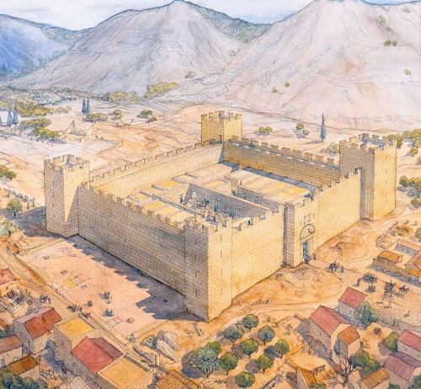


Theoretical fundamentals: Byzantine Generals
General #2
Unreliable messenger
General #3
General #1

Slide 16
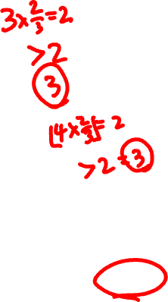
Theoretical fundamentals: Byzantine Generals
General #2
Unreliable messenger
General #3
General #1
Result: Using messengers, problem solvable iff > ⅔ of the generals are loyal

Slide 17
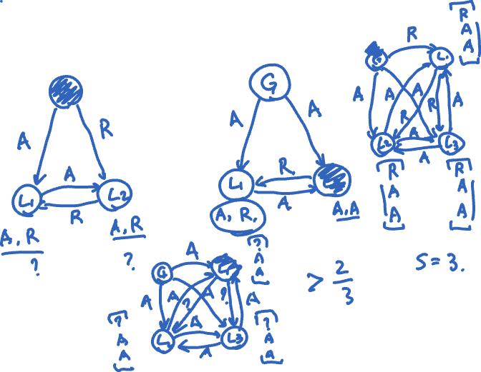


Slide 18
Put burden on client instead?
Clients sign input data before storing it, then verify signatures on data retrieved from service
Example: Store signed file f1=“aaa” with server
Verify that returned f1 is correctly signed
But a Byzantine node can replay stale, signed data in its response
Inefficient: Clients have to perform computations and sign data

Slide 19

Today
Traditional state-machine replication for BFT?
Practical BFT replication algorithm
[Castro & Liskov, 1999]

Slide 20

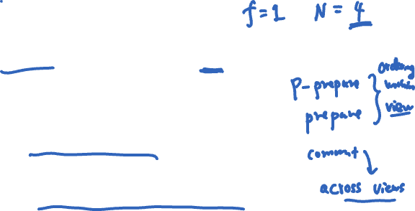
Practical BFT: Overview
Uses 3f+1 replicas to survive f failures
Shown to be minimal (Lamport)
Requires three phases (not two)
Provides state machine replication
Arbitrary service accessed by operations, e.g.,
File system ops read and write files and directories
Tolerates Byzantine-faulty clients

Slide 21


Correctness argument
Assume
Operations are deterministic
Replicas start in same state
Then if replicas execute the same requests in the same order:
Correct replicas will produce identical results
Client
Replicas

Slide 22

Non-problem: Client failures
Clients can’t cause internal inconsistencies of the data in servers
State machine replication property
Clients can write bogus data to the system
Sol’n: Authenticate clients and separate their data
This is a separate problem
Client
Replicas

Slide 23

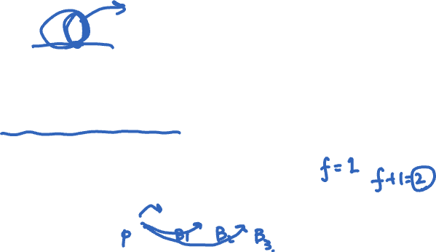
What clients do
Send requests to the primary replica
Wait for f+1 identical replies
Note: The replies may be deceptive
i.e., replica returns “correct” answer, but locally does otherwise!
But at least one reply is from a non-faulty replica
f+1 matching replies
Client
3f+1 replicas

Slide 24

What replicas do
Carry out a protocol that ensures that
Replies from honest replicas are correct
Enough replicas process each request to ensure that
The non-faulty replicas process the same requests
In the same order
Non-faulty replicas obey the protocol

Slide 25

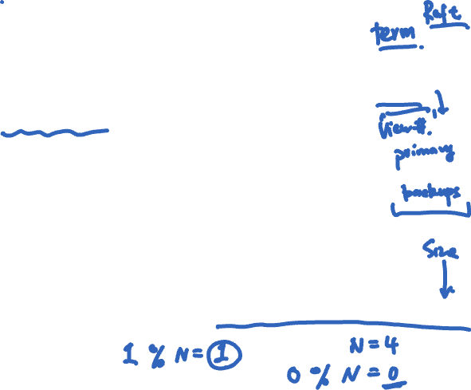
Primary-Backup protocol
Primary-Backup protocol: Group runs in a view
View number designates the primary replica
Primary is the node whose id == view# (modulo N)
Client
Primary
Backups
View
Notes:
View: term concept in Raft

Slide 26

Ordering requests
Primary picks the ordering of requests
But the primary might be a liar!
Backups ensure primary behaves correctly
Check and certify correct ordering
Trigger view changes to replace faulty primary
Client
Primary
Backups
View

Slide 27
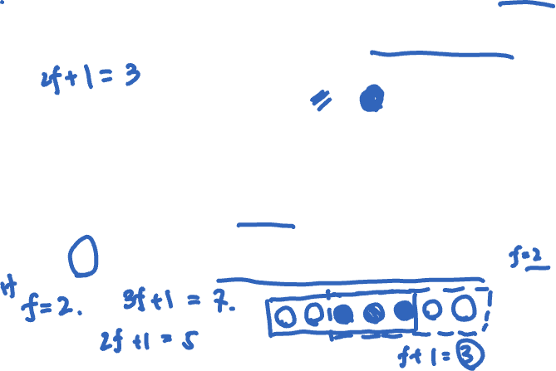
Byzantine quorums (f = 1)
A Byzantine quorum contains ≥ 2f+1 replicas
One op’s quorum overlaps with next op’s quorum
There are 3f+1 replicas, in total
So overlap is ≥ f+1 replicas
f+1 replicas must contain ≥ 1 non-faulty replica

Slide 28
Quorum certificates
A Byzantine quorum contains ≥ 2f+1 replicas
Quorum certificate: a collection of 2f + 1 signed, identical messages from a Byzantine quorum
All messages agree on the same statement

Slide 29

Keys
Each client and replica has a private-public keypair
Secret keys: symmetric cryptography
Key is known only to the two communicating parties
Bootstrapped using the public keys
Each client, replica has the following secret keys:
One key per replica for sending messages
One key per replica for receiving messages
Notes:
Secret keys:
Private keys for encrypting messages to send
Public keys for decrypting messages received.

Slide 30
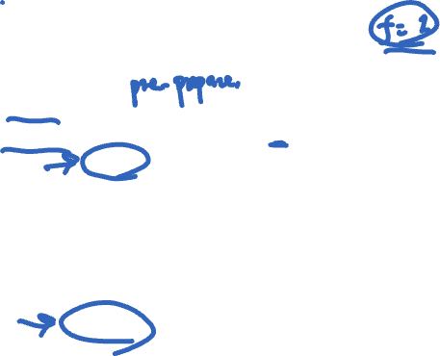
Ordering requests
request:
m_{Signed,Client}
Let seq(m)=n_{Signed, Primary}
Primary
Primary could be lying, sending a different message to each backup!
Backup 1
Backup 2
Backup 3
Primary chooses the request’s sequence number (n)
Sequence number determines order of execution

Slide 31

Checking the primary’s message
request:
m_{Signed,Client}
Let seq(m)=n_{Signed, Primary}
Primary
I accept seq(m)=n_{Signed, Backup 1}
Backup 1
I accept seq(m)=n_{Signed, Backup 2}
Backup 2
Backup 3
Backups locally verify they’ve seen ≤ one client request for sequence number n
If local check passes, replica broadcasts accept message
Each replica makes this decision independently

Slide 32
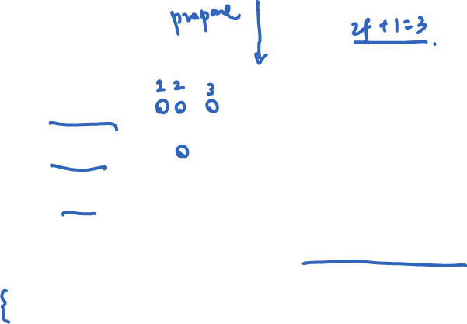
Collecting a prepared certificate (f = 1)
request:
m_{Signed,Client}
Let seq(m)=n_{Signed, Primary}
Primary
P
I accept seq(m)=n_{Signed, Backup 1}
Backup 1
P
I accept seq(m)=n_{Signed, Backup 2}
Backup 2
P
Backup 3
Each correct node has a prepared certificate locally, but does not know whether the other correct
nodes do too! So, we can’t commit yet!
Backups wait to collect a prepared quorum certificate
Message is prepared (P) at a replica when it has:
A message from the primary proposing the seqno
2f messages from itself and others accepting the seqno

Slide 33
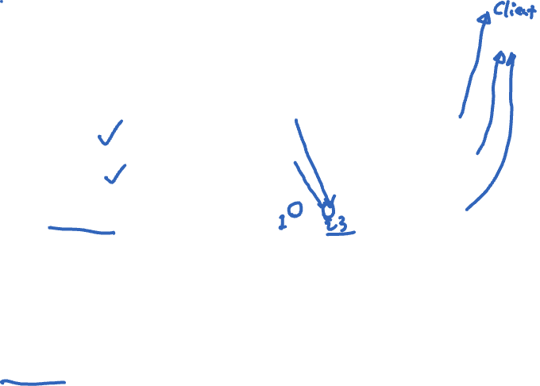
Collecting a committed certificate (f = 1)
request: m
Let seq(m)=n
Have cert for seq(m)=n_{Signed, Primary}
Primary
P
C
—”—_{Signed, Backup 1}
Backup 1
P
C
accept
—”—_{Signed, Backup 2}
Backup 2
P
C
Backup 3
Once the request is committed, replicas execute the operation and send a reply
directly back to the client.
Prepared replicas announce: they know a quorum accepts
Replicas wait for a committed quorum certificate C: 2f+1 different statements that a replica is prepared

Slide 34
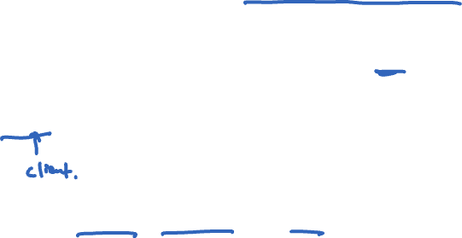
Byzantine primary: replaying old requests
The client assigns each request a unique, monotonically increasing timestamp t
Servers track greatest t executed for each client c, T(c), and their corresponding reply
On receiving request to execute with timestamp t:
If t < T(c), skip the request execution
If t = T(c), resend the reply but skip execution.
If t > T(c), execute request, set T(c) ← t, remember reply
Malicious primary can invoke t = T(c) case but cannot compromise safety

Slide 35
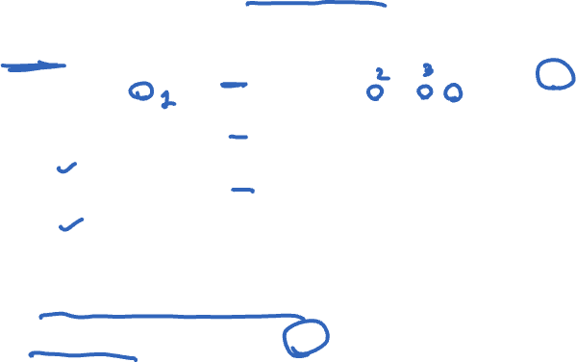
Byzantine primary: Splitting replicas (f = 1)
request: m
Replayed request, signed by client
Primary
Let seq(m’)=n
accept m’
Backup 1
Let seq(m)=n
Backup 2
Let seq(m)=n
Backup 3
accept m
Recall: To prepare, need primary message and 2f accepts
Backup 1: Won’t prepare m’
Backups 2, 3: Will prepare m

Slide 36

Byzantine primary: Splitting replicas
In general, backups won’t prepare two different requests with the same seqno if primary lies
Suppose they did: two distinct requests m and m′ for the same sequence number n
Then prepared quorum certificates (each of size 2f+1) would intersect at an honest replica
So that honest replica would have sent an accept message for both m and m′
So m = m′

Slide 37

View change
Client
Primary
Backups
View
If a replica suspects the primary is faulty, it requests a view change
Sends a viewchange request to all replicas
Everyone acks the view change request
New primary collects a quorum (2f+1) of responses
Sends a new-view message with this certificate

Slide 38

Considerations for view change
Need committed operations to survive into next view
Client may have gotten answer
Need to preserve liveness
If replicas are too fast to do view change, but really primary is okay – then performance problem
Or malicious replica tries to subvert the system by proposing a bogus view change

Slide 39
Garbage collection
Storing all messages and certificates into a log
Can’t let log grow without bound
Protocol to shrink the log when it gets too big
Discard messages, certificates on commit?
No! Need them for view change
Replicas have to agree to shrink the log

Slide 40
Back to theoretical fundamentals: Byzantine generals
Generals camped outside a city, waiting to attack
Must agree on common battle plan
Attack or wait together → success
However, one or more of them may be traitors who will try to confuse the others
Problem: Find an algorithm to ensure loyal generals agree on plan
Using messengers, problem solvable if and only if more than two-thirds of the generals are loyal

Slide 41
Byzantine primary (f = 1)
request: m
Primary
Let seq(m)=n
accept m
Backup 1
Let seq(m′)=n
Backup 2
Let seq(m′)=n
Backup 3
accept m′
Recall: To prepare, need primary message and 2f accepts
Backup 1: Has primary message for m, accepts for m′
Backups 2, 3: Have primary message + one matching accept
No one has accumulated enough messages to prepare → time for a view change

