Slide 1
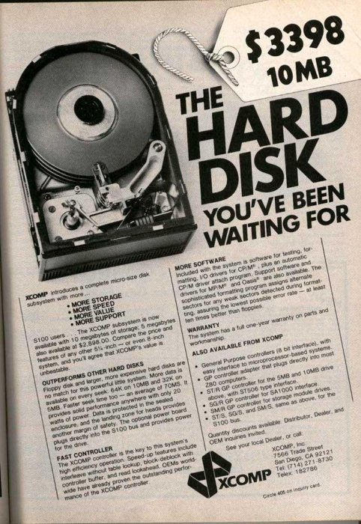
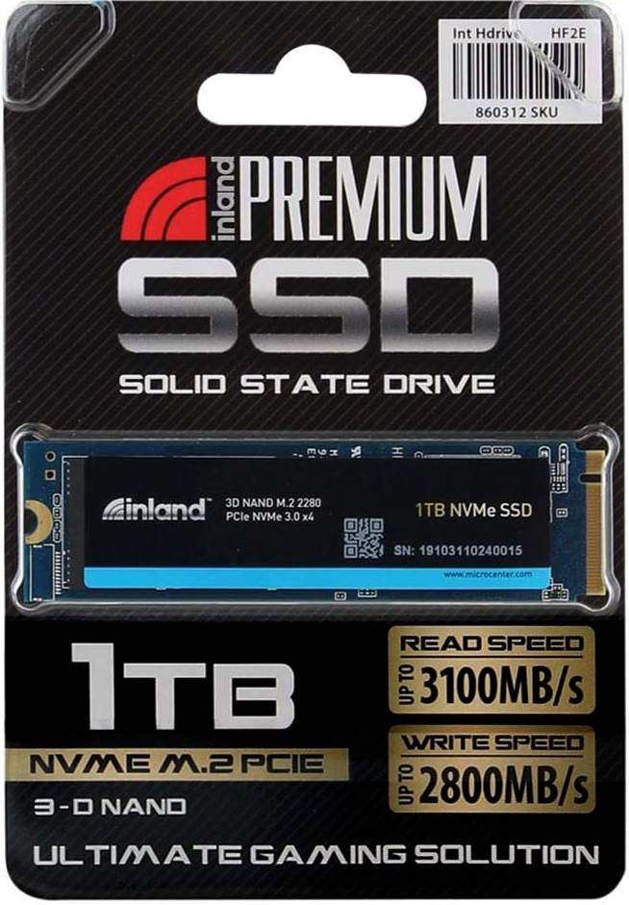

Persistence: HDDs and SSDs
CS 571: Operating Systems (Spring 2021)
Lecture 9
Yue Cheng
Some material taken/derived from:
Wisconsin CS-537 materials by Remzi Arpaci-Dusseau + Harvard CS-161 materials by James Mickens.
Licensed for use under a Creative Commons Attribution-NonCommercial-ShareAlike 3.0 Unported License.

Slide 2
Hard Disk Drives (HDDs)

Slide 3
Basic Interface
A magnetic disk has a sector-addressable address space
You can think of a disk as an array of sectors
Each sector (logical block) is the smallest unit of transfer
Sectors are typically 512 or 4096 bytes
Main operations
Read from sectors (blocks)
Write to sectors (blocks)
Notes:
Magnetization: magnetizable material (magnetic film)
Longitudinal recording vs. perpendicular recording: only needs two stable magnetic states

Slide 4
Disk Structure
The 1-dimensional array of logical blocks is mapped into the sectors of the disk sequentially
Sector 0 is the first sector of the first track on the outermost cylinder
Mapping proceeds in order through that track, then the rest of the tracks in that cylinder, and then through the rest of the cylinders from outermost to innermost
Logical to physical address should be easy
Except for bad sectors

Slide 5
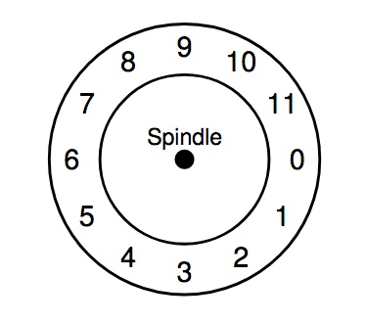
Internals of Hard Disk Drive (HDD)

Slide 6
Internals of Hard Disk Drive (HDD)
Platter
Covered with a magnetic film

Slide 7
Internals of Hard Disk Drive (HDD)
A single track example
Notes:
single track contains sectors in clock wise direction from sec 0 to sec 11. a total of 12 sectors

Slide 8
Internals of Hard Disk Drive (HDD)
Spindle in the center of the surface

Slide 9
Internals of Hard Disk Drive (HDD)
The track is divided into numbered sectors

Slide 10
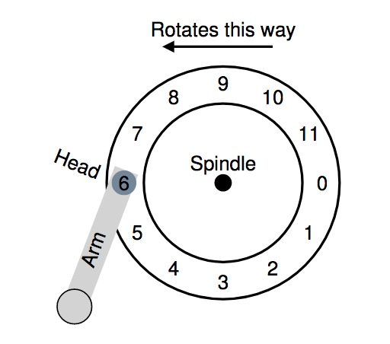
Internals of Hard Disk Drive (HDD)
A single track + an arm +
a head

Slide 11
HDD Mechanism (3D view)

Slide 12
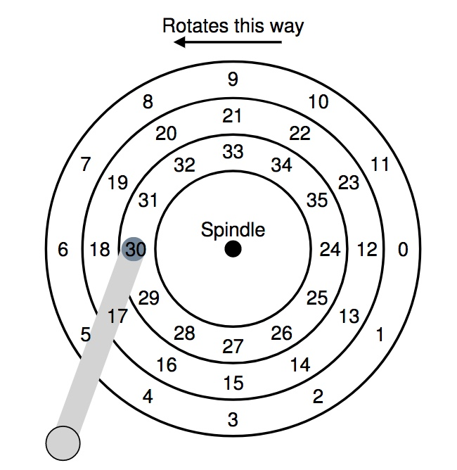
Let’s Read Sector 0

Slide 13
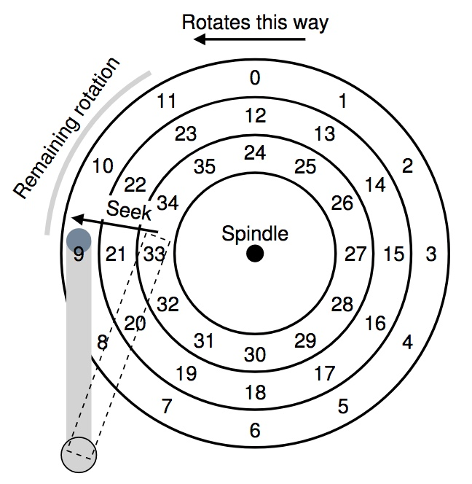
Let’s Read Sector 0
1. Seek for right track
2. Rotate (sector 9 → 0)
3. Transfer data (sector 0)

Slide 14
Don’t Try This at Home!
https://www.youtube.com/watch?v=9eMWG3fwiEU&feature=youtu.be&t=30s

Slide 15
Disk Performance
I/O latency of disks
L_{I/O} = L_{seek} + L_{rotate} + L_{transfer}
Disk access latency at millisecond level

Slide 16
Seek, Rotate, Transfer
Seek may take several milliseconds (ms)
Settling along can take 0.5 - 2ms
Entire seek often takes 4 - 10ms

Slide 17
Seek, Rotate, Transfer
Rotation per minute (RPM)
7200 RPM is common nowadays
15000 RPM is high end
Old computers may have 5400 RPM disks
1 / 7200 RPM = 1 minute / 7200 rotations =
1 second / 120 rotations = 8.3 ms / rotation

Slide 18
Seek, Rotate, Transfer
Rotation per minute (RPM)
7200 RPM is common nowadays
15000 RPM is high end
Old computers may have 5400 RPM disks
1 / 7200 RPM = 1 minute / 7200 rotations =
1 second / 120 rotations = 8.3 ms / rotation
So it may take 4.2 ms on average to rotate to target (0.5 * 8.3 ms)
Notes:
a good rule of thumb when calculating avg rotate time is by dividing the single track rotation time by half

Slide 19
Seek, Rotate, Transfer
Relatively fast
Depends on RPM and sector density
100+ MB/s is typical for SATA I (1.5Gb/s max)
Up to 600MB/s for SATA III (6.0Gb/s)
1s / 100MB = 10ms / MB = 4.9us/sector
Assuming 512-byte sector

Slide 20
Workloads
Seeks and rotations are slow while transfer is relatively fast
What kind of workload is best suited for disks?

Slide 21
Workloads
Seeks and rotations are slow while transfer is relatively fast
What kind of workload is best suited for disks?
Sequential I/O: access sectors in order (transfer dominated)
Random workloads access sectors in a random order (seek+rotation dominated)
Typically slow on disks
Never do random I/O unless you must! E.g., Quicksort is a terrible algorithm for disk!
Notes:
avoid random io as much as you can unless you have to.
quick sort if dataset is huge and cannot fit in mem; its terribly slow.

Slide 22

Disk Performance Calculation
Seagate Enterprise SATA III HDD
How long does an average 4KB read take?
Metric | Perf
RPM | 7200
Avg seek | 4.16ms
Max transfer | 500MB/s

Slide 23
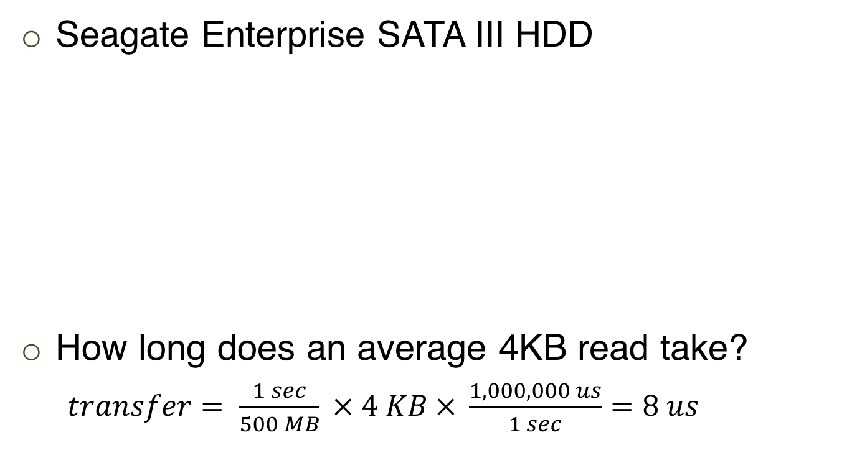
Disk Performance Calculation
Seagate Enterprise SATA III HDD
How long does an average 4KB read take?
$transfer= \frac{1 sec}{500 MB} × 4 KB × \frac{1,000,000 us}{1 sec}=8 us$
Metric | Perf
RPM | 7200
Avg seek | 4.16ms
Max transfer | 500MB/s

Slide 24

Disk Performance Calculation
Seagate Enterprise SATA III HDD
How long does an average 4KB read take?
$transfer= \frac{1 sec}{500 MB} × 4 KB × \frac{1,000,000 us}{1 sec}=8 us$
Latency = 4.16 ms + 4.2 ms + 8 us = 8.368 ms
Metric | Perf
RPM | 7200
Avg seek | 4.16ms
Max transfer | 500MB/s
Avg Seek
Avg Rotate

Slide 25
Q: Given a stream of I/O requests, in what order should they be served?

Slide 26
Disk Scheduling

Slide 27
Disk Scheduling
OS is responsible for using hardware efficiently — for the disk drives, this means having a fast access time and high disk bandwidth utilization
Strategy: reorder requests to meet some goal
Performance (e.g., by making I/O sequential)
Fairness
Consistent latency
Usually implemented in both OS and hardware

Slide 28
Disk Scheduling
Performance objective: minimize seek+rotation time
Minimize the distance the head needs to go
Disk bandwidth:
The total number of bytes transferred, divided by the total time between the first request for service and the completion of the last transfer

Slide 29
Disk Scheduling
There are many sources of disk I/O requests:
OS
System processes
User processes
I/O request:
Read/write mode, disk address, memory address, number of sectors to transfer
OS maintains queue of requests, per disk or device
Idle disk can immediately work on I/O request, busy disk means work must queue
Optimization algorithms make sense only when a queue exists
Notes:
io req is a complicated combination of all these stuff: …
os maintains a Q of io req at per device level.
so far we’ve covered two big classes of scheduling algos: cpu sched and disk sched;

Slide 30
Disk Scheduling
Note that drive controllers have small buffers and can manage a queue of I/O requests (of varying “depth”)
Disk scheduling algorithms:
Algorithms that schedule the orders of disk I/O requests
Notes:
two level io sched is a bit out of our current scope too complex; so we are simply focusing on the os part

Slide 31
Disk Scheduling
Disk scheduling algorithms:
Algorithms that schedule the orders of disk I/O requests
The analysis is true for one or many platters
We illustrate scheduling algorithms with an example request queue (0-199)
98, 183, 37, 122, 14, 124, 65, 67
Initially, head pointer pointing to 53
Notes:
with an exmaple IO workload that spans a cylinder range of 0-199
you can think of each cylinder number touched in this workload as a disk addr requested by the app

Slide 32
FIFO
Idea: Serve the I/O request in the order they arrive

Slide 33
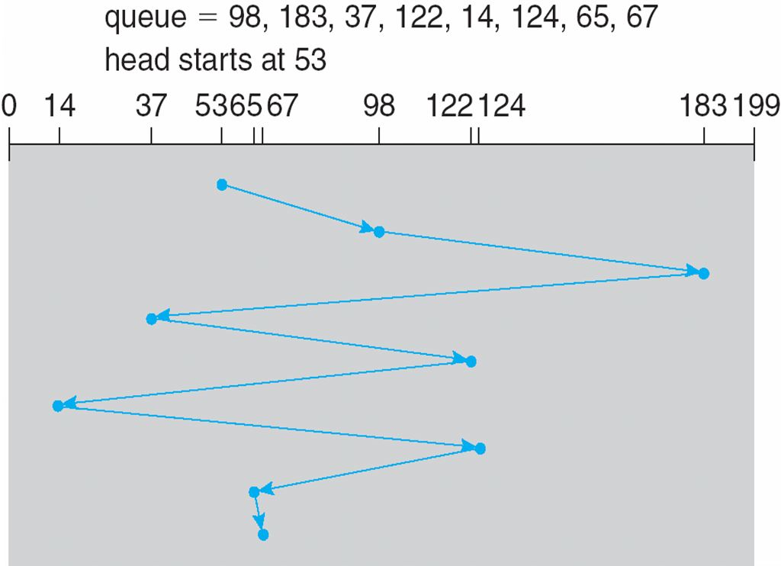
FIFO
Idea: Serve the I/O request in the order they arrive
Notes:
visualization of FIFO
zig zag kind of flow

Slide 34
FIFO
Idea: Serve the I/O request in the order they arrive
Illustration shows total head movement of 640 cylinders
Notes:
Performance is so bad
98-53+183-98+183-37+122-37+122-14+124-14+124-65+2 = 640

Slide 35
Shortest Positioning Time First (SPTF)
Idea: Selects the request that will take the least time for seeking and rotating
Also called Shortest Seek Time First (SSTF) if rotational positioning is not considered

Slide 36
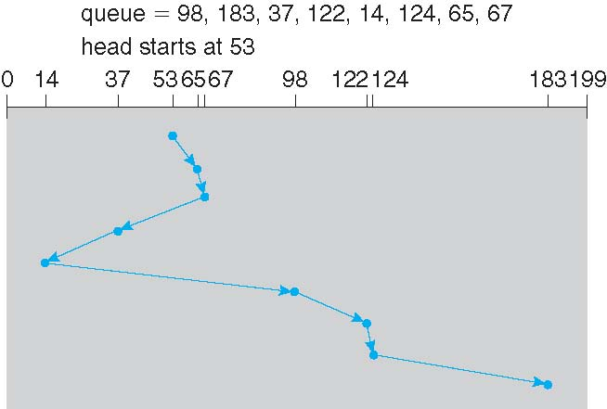
Shortest Positioning Time First (SPTF)
Idea: Selects the request that will take the least time for seeking and rotating
Illustration shows total head movement of 236 cylinders
Greedy algorithm: Similar to SJF: may cause starvation of some requests!
Notes:
kind of like a greedy algo – out of order scheduling…
65-53+67-65+67-37+37-14+98-14+122-98+124-122+183-124 = 236
67-53+67-14+183-14

Slide 37
SCAN
Idea: Sweep back and forth, from one end of disk to the other, serving requests as you go
The disk arm starts at one end of the disk, and moves toward the other end, servicing requests until it gets to the other end of the disk, where the head movement is reversed and servicing continues
AKA Elevator Algorithm

Slide 38
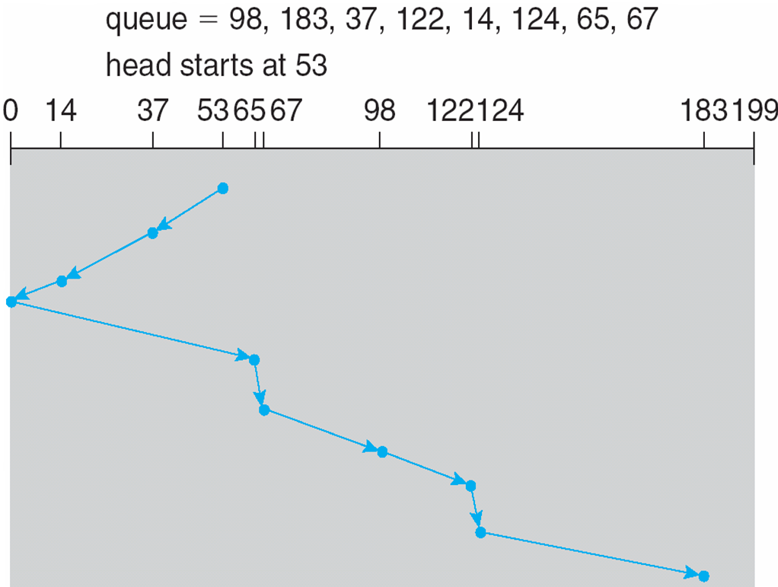
SCAN
Illustration shows total head movement of 236 cylinders
Issue: Cylinders in the middle get better service; Requests at the other end wait the longest!
Notes:
53-37+37-14+14+65+67-65+98-67+122-98+124-122+183-124 =
53+183 = 236

Slide 39
C-SCAN (Circular-SCAN)
Idea: Only sweep in ONE direction
When it reaches the other end, however, it immediately returns to the beginning of the disk, without servicing any requests on the return trip
Provides a more uniform wait time than SCAN
Treats the cylinders as a circular list that wraps around from the last cylinder to the first one

Slide 40
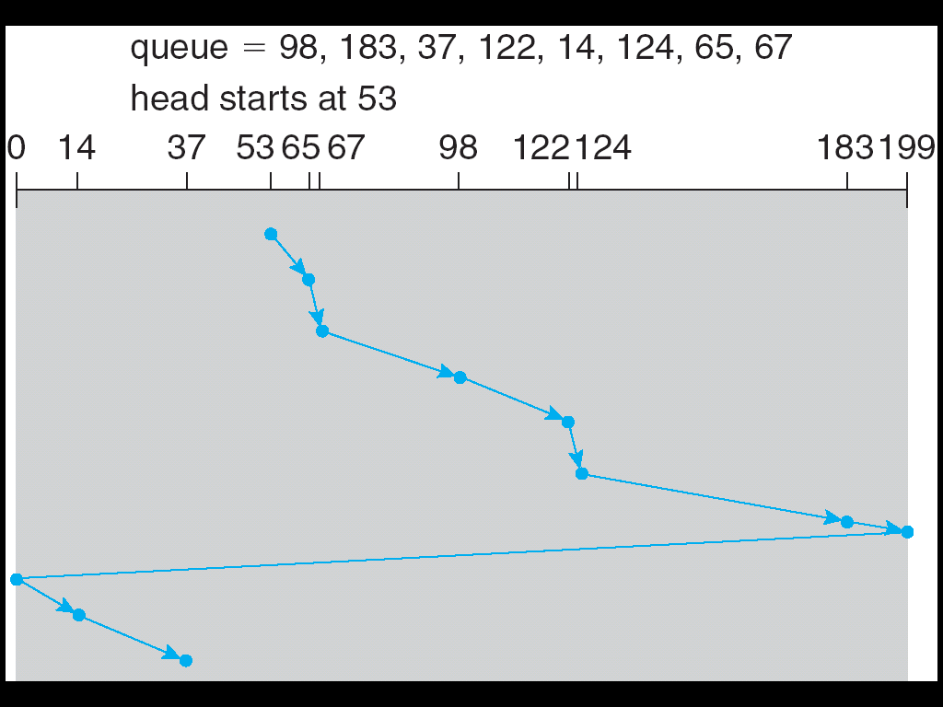
C-SCAN
Total number of cylinders?
Notes:
65-53+67-65+98-67+122-98+124-122+183-124+199-183+199+14+37-14 = 382
199-53+199+37

Slide 41
C-LOOK
Idea: Arm only goes as far as the last request in each direction, then reverses direction immediately, without first going all the way to the end of the disk
LOOK: A version of SCAN
C-LOOK: A version of C-SCAN
Notes:
w/o bouncing at the boundary

Slide 42
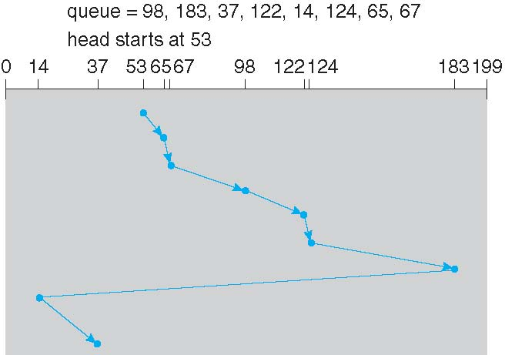
C-LOOK
Total number of cylinders?
Notes:
65-53+67-65+98-67+122-98+124-122+183-124+183-14+37-14 = 322
183-53+183-14+37-14 = 322

Slide 43
Work Conservation
Work conserving schedulers always try to do I/O if there’s I/O to be done
Sometimes, it’s better to wait (delay) instead if you anticipate another request will appear nearby
Such non-work-conserving schedulers are called anticipatory schedulers
Notes:
so far all sched we’ve discussed are work conserving sched

Slide 44
Selecting A Disk Scheduling Algorithm
SPTF is common and has a natural appeal
Starvation
SCAN and C-SCAN perform better for systems that place a heavy load on the disk
Less starvation
Performance depends on the workload (i.e., number and types of requests)
The disk scheduling algorithm should be written as a separate OS module, allowing it to be replaced with a different algorithm if necessary
Requests for disk service can be impacted by the file-allocation method/pattern
as well as metadata layout – topic of file systems
Next lecture

Slide 45
Solid State Drives (SSDs)
Notes:
In the last few lectures, we’ve covered topics related to mechanical hard disk drives. Today we are going to discuss flash: a faster storage medium which is also commonly used everywhere

Slide 46
Disk Recap
I/O requires: seek, rotate, transfer
Inherently:
Not parallel (only one head)
Slow (mechanical)
Poor random I/O (locality around disk head)
Random requests each taking ~10+ ms
Notes:
first a brief overview about hdd:
consists of three parts:
[draw surface 1D… ]
Mechanical, bad random IO perf: a random io workload with requests randomly scattered across the surface. arms seeking back force; surface rotate back and force. each random io comes with a cost associated with the moving mechanical parts:

Slide 47
SSD Overview
Hold charge in cells. No moving (mechanical) parts (no seeks)!
SSDs use transistors (just like DRAM), but SSD data persists when the power goes out
NAND-based flash is the most popular technology, so we’ll focus on it
SSD is Inherently parallel!
Notes:
flash is a completely different story. flash is one type of electronic storage medium.
there is no mechanical moving parts; instead, it holds charge in cells. There is no mechanical moving parts, there is no back and force seek. Also, its inherently parallel, where multiple reads can be served simultaneously by the device.

Slide 48
SSD Overview
Hold charge in cells. No moving (mechanical) parts (no seeks)!
SSDs use transistors (just like DRAM), but SSD data persists when the power goes out
NAND-based flash is the most popular technology, so we’ll focus on it
SSD is Inherently parallel!
High-level takeaways
SSDs have a higher $/bit than HDDs, but better performance
SSDs handle writes in a strange way; this has implications for file system design
Notes:
flash is a completely different story. flash is one type of electronic storage medium.
there is no mechanical moving parts; instead, it holds charge in cells. There is no mechanical moving parts, there is no back and force seek. Also, its inherently parallel, where multiple reads can be served simultaneously by the device.

Slide 49
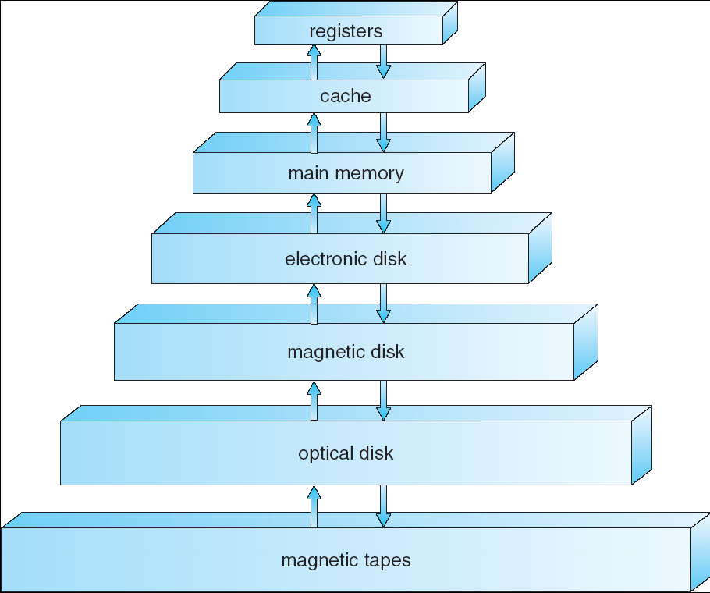
Storage Hierarchy Overview
SSD:
Smaller capacity
Higher $/bit
Faster accesses
HDD:
Larger capacity
Lower $/bit
Way slower accesses
Notes:
this storage hierarchy graph shows where we are right now.
now we are talking about flash, which is one type of electronic disks. it is one level above the magnetic mechanical disk.
flash has relatively smaller capacity but faster performance, as compared to hdds.

Slide 50
Disk vs. SSD: Performance
Throughput
Disk: ~130MB/s (sequential)
Flash: ~400MB/s
Latency
Disk: ~10ms (one op)
Flash:
Read: 10-50us
Program: 200-500us
Erase: 2ms
Notes:
Lets first take a look at perf comparison.
Regarding throughput, disks can at most achieve 130mb/s for sequential io, whereas flash can easily achieve 400+mb/s
Regarding latency: for each random io operation, disk would take around 10ms. whereas for flash, the read latency is at micro second level, which is 3 orders of magnitude difference.
Due to its unique internal logic, flash latency can be categorized into three classes:
pure read is super fast: 10-50us;

Slide 51
Disk vs. SSD: Performance
Throughput
Disk: ~130MB/s (sequential)
Flash: ~400MB/s
Latency
Disk: ~10ms (one op)
Flash:
Read: 10-50us
Program: 200-500us
Erase: 2ms
Types of write, more later…
Notes:
program and erase can be treated as write: at 200-500us level;
besides read and write, flash has a unique op, which is called erase, flash can only be written new data after old data has been erased, flash does not support overwrite. and this erase op is the most expensive, which is at ms level. we will talk about the detail of erase later.

Slide 52
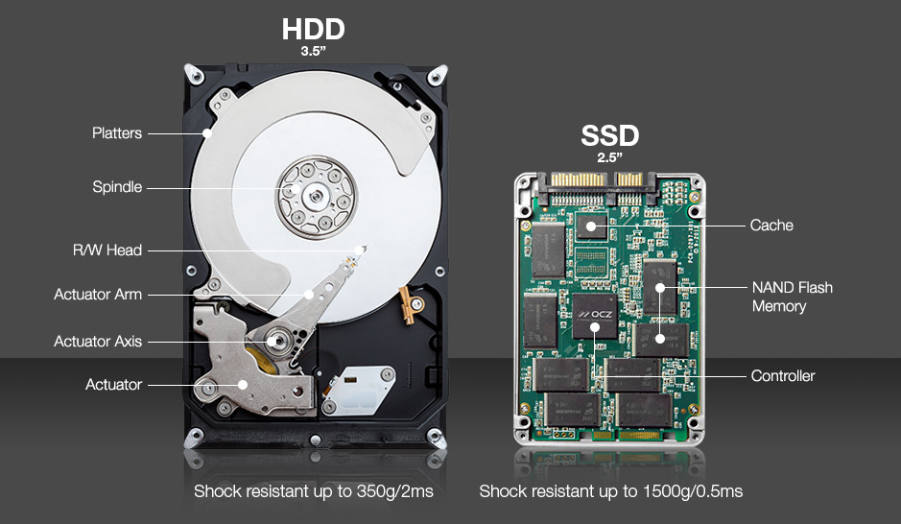
Disk vs. SSD: Internal
* https://www.enterprisestorageforum.com/storage-hardware/ssd-vs-hdd.html
Notes:
HDD is apparently not as shock resistant as SSDs – ability to sustain minor impact without damage to the internal mechanism…
SSD – PCB board which electrically connects electronic componnets using conductive tracks, pads, other features, etc.

Slide 53


Disk vs. SSD: Capacity
“An obvious question is why are we talking about spinning disks at all, rather than SSDs, which have higher IOPS and are the “future” of storage. The root reason is that the cost per GB remains too high, and more importantly that the growth rates in capacity/$ between disks and SSDs are relatively close (at least for SSDs that have sufficient numbers of program-erase cycles to use in data centers), so that cost will not change enough in the coming decade. We do make extensive use of SSDs, but primarily for high performance workloads and caching, and this helps disks by shifting seeks to SSDs.
~ Eric Brewer et al.
Source: https://static.googleusercontent.com/media/research.google.com/en//pubs/archive/44830.pdf
Notes:
This is an excerpt from eric brewer’s white paper that was published in FAST’16.
Basically what he discussed in this paragraph is that though flash is super fast compared to traditional hdd, hdd is still the main stream storage medium. why? because hdd has way higher density, and much cheaper cost per GB price. Where ssd can be used? SSDs can be used as a hdd cache to accelerate random io workloads, because its super fast for random read, it is expensive, and hence its small capacity has to be used cautiously.

Slide 54
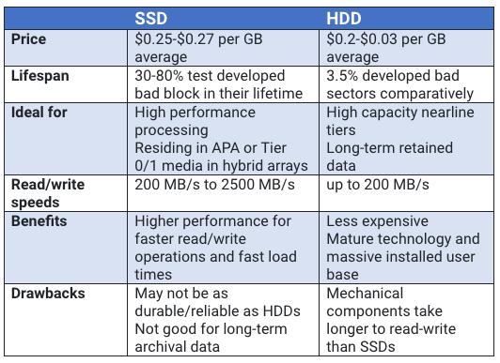
Disk vs. SSD: Summary
* https://www.enterprisestorageforum.com/storage-hardware/ssd-vs-hdd.html
Notes:
Nearline storage: https://en.wikipedia.org/wiki/Nearline_storage

Slide 55
SSD Architecture
Notes:
next lets zoom in and take a look at the internal architecture of flash

Slide 56
SLC: Single-Level Cell
charge
NAND Cell
Notes:
this graph shows an empty nand cell within a flash. a flash may have thousands of millions of cells. each cell represents one single bit.
Y-axis is the electricity charge level.
NAND := NOT-AND (In digital electronics, a NAND gate (NOT-AND) is a logic gate which produces an output which is false only if all its inputs are true)
NAND flash also uses floating-gate transistors, but they are connected in a way that resembles a NAND gate:

Slide 57
SLC: Single-Level Cell
1
charge
NAND Cell
Notes:
For SLC, which is single level cell, it has a single level threshold. charge above this level represents 1

Slide 58
SLC: Single-Level Cell
0
charge
NAND Cell
Notes:
whereas charge below this level represents 0

Slide 59
MLC: Multi-Level Cell
00
charge
NAND Cell
Notes:
a counterpart of single level cell is the multi level cell;
MLC can be used to represent two bits rather than one single binary bit

Slide 60
MLC: Multi-Level Cell
01
charge
NAND Cell

Slide 61
MLC: Multi-Level Cell
10
charge
NAND Cell
Notes:
above the mid level but slightly below the upmost level : 10

Slide 62
MLC: Multi-Level Cell
11
charge
NAND Cell
Notes:
a full charge represents 11

Slide 63
Single- vs. Multi-Level Cell
SLC
MLC
charge
charge
Notes:
3D NAND, as the name implies, involves cutting multiple layers into the silicon, stacking memory cells to increase storage density. By stacking cells in 32 layers, we can reach much higher storage density in each die, as well as allowing the cells to space out more on each plane, helping reduce interference issues between the cells.

Slide 64
Single- vs. Multi-Level Cell
SLC
MLC
charge
charge
expensive
robust
1 cell: 1 bit
cheap
sensitive
1 cell: multi-bit
Notes:
single level cell is more expensive but provides better robustness, compared to multi level cell.
To explain why MLC is cheaper and more sensitive, we need to understand the wearout issue of flash devices.
[why multi level cell is more sensitive simply because its more error prone, and the when writing many times, it may be wornout within a short time.]

Slide 65
Wearout
Problem: flash cells wear out after being erased too many times
MLC: ~10K times
SLC: ~100K times
Usage strategy: ???
Notes:
might be faced with risk of not working properly after this many times of erasures.
it might stop working correctly and start give errors after this lifespan limit

Slide 66
Wearout
Problem: flash cells wear out after being erased too many times
MLC: ~10K times
SLC: ~100K times
Usage strategy: wear leveling
Prevents some cells from being wornout while others still fresh
Notes:
the core idea of flash wear leveling is to provide write balancing across all cells. to prevent some cells from being worn out while others still fresh

Slide 67
Banks
SSD devices are divided into banks (aka. planes)
Banks can be accessed in parallel
Bank 0
Bank 1
Bank 2
Bank 3
Notes:
flash devices can be divided into multiple banks, multiple banks can be accessed in parallel;
this further improves the flash performance

Slide 68
Banks
SSD devices are divided into banks (aka. planes)
Banks can be accessed in parallel
read
read
Bank 0
Bank 1
Bank 2
Bank 3

Slide 69
Banks
SSD devices are divided into banks (aka. planes)
Banks can be accessed in parallel
data
data
Bank 0
Bank 1
Bank 2
Bank 3

Slide 70
SSD Writes
Writing 0’s
Fast, fine-grained
Writing 1’s
Slow, coarse-grained
Notes:
now lets talk about how flash handles writes
like other storage medium, flash represents data in binary form. but flash distinguishes 0 based writes from 1-based writes.
writing 0’s can be fast and fine-grained, whereas writing 1’s can be slow and coarse grained.

Slide 71
SSD Writes
Writing 0’s
Fast, fine-grained
called “program”
Writing 1’s
Slow, coarse-grained
called “erase”
Notes:
writing 0– called program phase, which can be treated as disk write
writing 1 called erase phase, which is used by flash to clean up old data before accepting new writes
there is a mismatch interms of granulary for program and erase

Slide 72
SSD Writes
Writing 0’s
Fast, fine-grained [page-level]
called “program”
Writing 1’s
Slow, coarse-grained [block-level]
called “erase”
Notes:
program phase is in finer granularity, which is at page level
while erasue is at coarse granulariy which is at block level
blocks contain multiple pages. pages are basic units of flash reads and writes

Slide 73
SSD Writes
Writing 0’s
Fast, fine-grained [page-level]
called “program”
Writing 1’s
Slow, coarse-grained [block-level]
called “erase”
Flash can only “write” (program) into clean pages
“clean”: pages containing all 1’s (pages that have been erased)
Flash does not support in-place overwrite!
Notes:
again, flash can only write new data into clean pages, clean page contains all 1’s. which are the pages that have been erased.
one important attribute of flash is that flash does not support in-place overwrite. it always has to erase the old data if the page is not clean, then program or write new data in.

Slide 74
Banks and Blocks
Bank 0
Bank 1
Bank 2
Bank 3

Slide 75
Banks and Blocks
Each bank contains many “blocks”
Bank 0
Bank 2
Bank 3

Slide 76
Block and Pages
1111
1111
1111
1111
1111
1111
1111
1111
1111
1111
1111
1111
1111
1111
1111
1111
One block

Slide 77
Block and Pages
1111
1111
1111
1111
1111
1111
1111
1111
1111
1111
1111
1111
1111
1111
1111
1111
One page

Slide 78
Block and Pages
1111
1111
1111
1111
1111
1111
1111
1111
1111
1111
1111
1111
1111
1111
1111
1111
All pages are clean (“programmable”)

Slide 79
Block
program
1011
1000
1111
1111
1111
1111
1111
1111
1111
1111
1111
1111
1111
1111
1111
1111

Slide 80
Block
1011
1000
1111
1111
1111
1111
1111
1111
1111
1111
0110
1010
1111
1111
1111
1111
program

Slide 81
Block
1011
1000
1111
1111
1111
1111
1111
1111
1111
1111
0110
1010
1111
1111
1111
1111
Two pages hold data (cannot be overwritten)

Slide 82
Block
still want to write data into this page???
1011
1000
1111
1111
1111
1111
1111
1111
1111
1111
0110
1010
1111
1111
1111
1111
Two pages hold data (cannot be overwritten)

Slide 83
Block
1011
1000
1111
1111
1111
1111
1111
1111
1111
1111
0110
1010
1111
1111
1111
1111
erase

Slide 84
Block
1111
1111
1111
1111
1111
1111
1111
1111
1111
1111
1111
1111
1111
1111
1111
1111
erase
(the whole block)
Notes:
erase all pages in this block

Slide 85
Block
1111
1111
1111
1111
1111
1111
1111
1111
1111
1111
1111
1111
1111
1111
1111
1111
After erase, again, free state
(can write new data in any page)

Slide 86
Block
1011
0001
1111
1111
1111
1111
1111
1111
1111
1111
1111
1111
1111
1111
1111
1111
This dark blue page holds data

Slide 87
SSD vs. Disk: APIs
disk
flash
read
write

Slide 88
SSD vs. Disk: APIs
disk
flash
read
read sector
read page
write

Slide 89
SSD vs. Disk: APIs
disk
flash
read
read sector
read page
program page
(0’s)
erase block
(1’s)
write
write sector

Slide 90
SSD Architecture
Bank/plane: 1024 to 4096 blocks
Banks accessed in parallel
Block: 64 to 256 pages
Unit of erase
Page: 2 to 8 KB
Unit of read and program

Slide 91
Disk vs. SSD: Performance
Throughput
Disk: ~130MB/s (sequential)
Flash: ~400MB/s
Latency
Disk: ~10ms (one op)
Flash:
Read: 10-50us
Program: 200-500us
Erase: 2ms
Notes:
Now that you have a better idea how it works internally, lets revisit flash perf

Slide 92
Working with File System
Notes:
How to use flash

Slide 93
Traditional File Systems
File System
Traditional API:
read sector
write sector
Storage Device
Notes:
traditional file system exposes apis to read and write sectors
which is under the assumption that the storage medium is hdds

Slide 94
Traditional File Systems
File System
Traditional API:
read sector
write sector
Storage Device
Mismatch with SSD!
Notes:
there is a clear mismatch for fs apis bw hdd and flash devices

Slide 95
Traditional APIs wrapping around SSD APIs
read(addr):
return ssd_read(addr)
write(addr, data):
block_copy = ssd_read(all pages of block)
modify block_copy with data
ssd_erase(block of addr)
ssd_program(all pages of block_copy)
Notes:
One naïve approach for solving this mismatch is by providing a traditional api wrapper around flash apis
[whiteboard: list traditional apis, list flash apis]
traditional apis are read and write, which are oblivious of the flash device.

Slide 96
Awkward SSD Write
Memory
00
00
00
11
11
01
11
11
00
01
11
11
SSD
01
10
11
11
11
10
11
11
11
11
10
11
block 0
block 1
block 2

Slide 97
Awkward SSD Write
Memory
File system wants
to write 0001
00
00
00
11
11
01
11
11
00
01
11
11
SSD
01
10
11
11
11
10
11
11
11
11
10
11
block 0
block 1
block 2

Slide 98
Awkward SSD Write
Memory
00
00
00
11
11
01
11
11
00
01
11
11
SSD
01
10
11
11
11
10
11
11
11
11
10
11
block 0
block 1
block 2

Slide 99
Awkward SSD Write
00
00
00
11
Memory
01
10
11
11
Read all pages in block
00
00
00
11
11
01
11
11
00
01
11
11
SSD
01
10
11
11
11
10
11
11
11
11
10
11
block 0
block 1
block 2

Slide 100
Awkward SSD Write
00
00
00
11
Memory
01
10
11
11
00
00
00
11
11
01
11
11
00
01
11
11
SSD
01
10
11
11
11
10
11
11
11
11
10
11
block 0
block 1
block 2

Slide 101
Awkward SSD Write
Modify target page
in memory
00
01
00
11
Memory
01
10
11
11
00
00
00
11
11
01
11
11
00
01
11
11
SSD
01
10
11
11
11
10
11
11
11
11
10
11
block 0
block 1
block 2

Slide 102
Awkward SSD Write
00
01
00
11
Memory
01
10
11
11
00
00
00
11
11
01
11
11
00
01
11
11
SSD
01
10
11
11
11
10
11
11
11
11
10
11
block 0
block 1
block 2

Slide 103
Awkward SSD Write
00
01
00
11
Memory
01
10
11
11
Erase whole block
11
11
11
11
11
01
11
11
00
01
11
11
SSD
11
11
11
11
11
10
11
11
11
11
10
11
block 0
block 1
block 2

Slide 104
Awkward SSD Write
00
01
00
11
Memory
01
10
11
11
11
11
11
11
11
01
11
11
00
01
11
11
SSD
11
11
11
11
11
10
11
11
11
11
10
11
block 0
block 1
block 2

Slide 105
Awkward SSD Write
00
01
00
11
Memory
01
10
11
11
Program all pages
in block
00
01
00
11
11
01
11
11
00
01
11
11
SSD
01
10
11
11
11
10
11
11
11
11
10
11
block 0
block 1
block 2

Slide 106
Awkward SSD Write
Memory
00
01
00
11
11
01
11
11
00
01
11
11
SSD
01
10
11
11
11
10
11
11
11
11
10
11
block 0
block 1
block 2
Notes:
whats the problem with this naïve api wrapper based approach?

Slide 107
Issue: Write Amplification
Random writes are expensive for flash!
Writing one 4KB page may cause:
read, erase, and program of the whole 256KB block
Notes:
the issue is the write amplification.
in our example, we want to write to a single page of 4KB. you have to bring the whole block of 256kb into memory, modify the single page that you target, and then erase the whole block before you can write new data into device.
By write amplification, it means the a small random write can get dramatically amplified to a huge write which touches all data within this particular block.

Slide 108
Flash Translation Layer (FTL)
Notes:
to solve this issue, ppl propose a scheme called flash translation layer or ftl

Slide 109
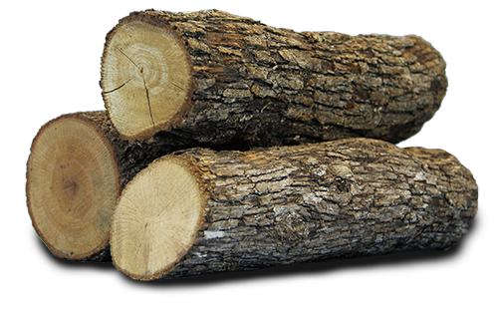
Flash Translation Layer (FTL)
Add an address translation layer between upper-level file system and lower-level flash
Translate logical device addresses to physical addresses
Convert in-place write into append-write (log-structured)
Essentially, a virtualization & optimization layer
Notes:
the core idea of ftl is adding one address translation layer to map the logical disk addr into the physical flash addr, and to convert random in-place writes into append based writes

Slide 110
Flash Translation Layer (FTL)
Usually implemented in SSD device’s firmware (hardware)
But is also implemented in software for some SSDs
Where to store mapping?
SRAM
Physical pages can be in three states
uninitialized, valid, invalid

Slide 111
SSD Architecture with FTL
SSD provides disk-like interface
FTL
SRAM:
Mapping table
Notes:
ssd provides disk like interfaces for fs to interact with flash device.
fs uses logical addr which gets translated into physical addr using ftl. ftl refers to the mapping table structure stored in device’s sram for doing locating, etc

Slide 112
Logical-to-physical map
Log head
Uninitialized
. . .
Valid
Page
0
1
2
3
4
5
6
7
8
9
10
11
Block
0
1
2

Slide 113
write(page=92, data=w0)
Logical-to-physical map
92 --> 0
erase(block0)
program(page0, w0)
logHead++
Log head
Log head
Uninitialized
w0
. . .
1*
1*
1*
1*
Valid
Page
0
1
2
3
4
5
6
7
8
9
10
11
Block
0
1
2

Slide 114
write(page=92, data=w0)
Logical-to-physical map
92 --> 0
17 --> 1
erase(block0)
program(page0, w0)
logHead++
write(page=17, data=w1)
program(page1, w1)
logHead++
Log head
Log head
Uninitialized
w0
w1
1*
1*
. . .
1*
Valid
Page
0
1
2
3
4
5
6
7
8
9
10
11
Block
0
1
2

Slide 115
write(page=92, data=w0)
Logical-to-physical map
92 --> 0
17 --> 1
erase(block0)
program(page0, w0)
logHead++
Advantages w.r.t. direct mapping
Avoids expensive read-modify-write behavior
Better wear levelling: writes get spread across pages, even if there is spatial locality in writes at logical level
write(page=17, data=w1)
program(page1, w1)
logHead++
Log head
Uninitialized
w0
w1
1*
1*
. . .
Valid
Page
0
1
2
3
4
5
6
7
8
9
10
11
Block
0
1
2

Slide 116
write(page=92, data=w4)
Logical-to-physical map
92 --> 0
17 --> 1
33 --> 2
68 --> 3
erase(block1)
92 --> 4
program(page4, w4)
logHead++
Garbage version of logical block 92!
Log head
Log head
Uninitialized
w0
w1
w4
. . .
w2
w3
1*
1*
1*
1*
Valid
Page
0
1
2
3
4
5
6
7
8
9
10
11
Block
0
1
2

Slide 117
At some point, FTL must:
Logical-to-physical map
92 --> 0
17 --> 1
33 --> 2
68 --> 3
Read all pages in physical block 0
92 --> 4
Write out the second, third, and fourth pages to the end of the log
Update logical-to-physical map
Garbage version of logical block 92!
Log head
Uninitialized
w0
w1
w2
w3
w4
1*
1*
1*
. . .
Valid
Page
0
1
2
3
4
5
6
7
8
9
10
11
Block
0
1
2

Slide 118
Trash Day is the Worst Day
Garbage collection requires extra read+write traffic
Overprovisioning makes GC less painful
SSD exposes a logical page space that is smaller than the physical page space
By keeping extra, “hidden” pages around, the SSD tries to defer GC to a background task (thus removing GC from critical path of a write)
SSD will occasionally shuffle live (i.e., non-garbage) blocks that never get overwritten
Enforces wear leveling

Slide 119
Flash Translation Layer (FTL)
0
1
2
3
4
5
6
7
Logical
00
11
01
10
11
11
00
10
11
01
11
11
11
11
11
11
Physical
block 0
block 1
Notes:
use this example to illustrate how ftl works.
logical page numbers mapped to physical page number on flash

Slide 120
Flash Translation Layer (FTL)
Write 0011
0
1
2
3
4
5
6
7
Logical
00
11
01
10
11
11
00
10
11
01
11
11
11
11
11
11
Physical
block 0
block 1
Notes:
if app wants to write 0011 to the 2nd logical page, flash tries to find a clean page

Slide 121
Flash Translation Layer (FTL)
Write 0011
0
1
2
3
4
5
6
7
Logical
00
11
01
10
11
11
00
10
11
01
00
11
11
11
11
11
Physical
block 0
block 1
Notes:
in this example ,the first clean page is the 2nd page in block 1. so you write 0011 into this page.

Slide 122
Flash Translation Layer (FTL)
Write 0011
0
1
2
3
4
5
6
7
Logical
Change address
mapping
00
11
01
10
11
11
00
10
11
01
00
11
11
11
11
11
Physical
block 0
block 1
Notes:
then you change the mapping of logical page 1 from previously pointing to page 2 of block 0 to the newly written page in block 1

Slide 123
Flash Translation Layer (FTL)
Write 0011
0
1
2
3
4
5
6
7
Logical
Marked as invalid
and will be garbage collected
Change address
mapping
00
11
01
10
11
11
00
10
11
01
00
11
11
11
11
11
Physical
block 0
block 1
Notes:
correspondingly, you invalid the old page in block 0 which holds the stale data; invalid pages will be eventually garbage collected to make new room for new data.

Slide 124
State Transition of Physical Pages
Free
Valid
Invalid

Slide 125
State Transition of Physical Pages
Free
Program
Valid
Invalid

Slide 126
State Transition of Physical Pages
Free
Program
Valid
Relocate
(overwrite)
Invalid

Slide 127
State Transition of Physical Pages
Free
Program
Valid
Erase
Relocate
(overwrite)
Invalid

