Slide 1
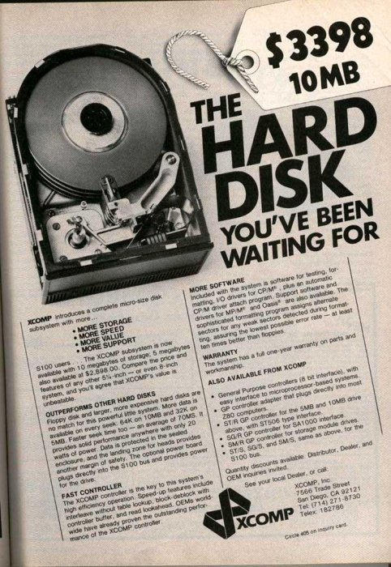
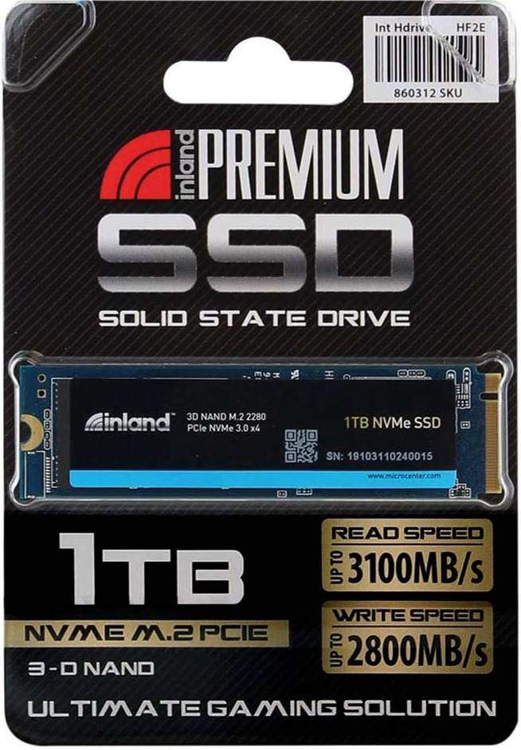

Persistence: HDDs, SSDs, and File System Abstraction
CS 571: Operating Systems (Spring 2022)
Lecture 8
Yue Cheng
Some material taken/derived from:
Wisconsin CS-537 materials by Remzi Arpaci-Dusseau + Harvard CS-161 materials by James Mickens.
Licensed for use under a Creative Commons Attribution-NonCommercial-ShareAlike 3.0 Unported License.

Slide 2
Hard Disk Drives (HDDs)

Slide 3
Basic Interface
A magnetic disk has a sector-addressable address space
You can think of a disk as an array of sectors
Each sector (logical block) is the smallest unit of transfer
Sectors are typically 512 or 4096 bytes
Main operations
Read from sectors (blocks)
Write to sectors (blocks)
Notes:
Magnetization: magnetizable material (magnetic film)
Longitudinal recording vs. perpendicular recording: only needs two stable magnetic states

Slide 4
Disk Structure
The 1-dimensional array of logical blocks is mapped into the sectors of the disk sequentially
Sector 0 is the first sector of the first track on the outermost cylinder
Mapping proceeds in order through that track, then the rest of the tracks in that cylinder, and then through the rest of the cylinders from outermost to innermost
Logical to physical address should be easy
Except for bad sectors

Slide 5
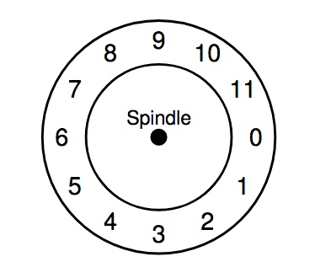
Internals of Hard Disk Drive (HDD)

Slide 6
Internals of Hard Disk Drive (HDD)
Platter
Covered with a magnetic film

Slide 7
Internals of Hard Disk Drive (HDD)
A single track example
Notes:
single track contains sectors in clock wise direction from sec 0 to sec 11. a total of 12 sectors

Slide 8
Internals of Hard Disk Drive (HDD)
Spindle in the center of the surface

Slide 9
Internals of Hard Disk Drive (HDD)
The track is divided into numbered sectors

Slide 10
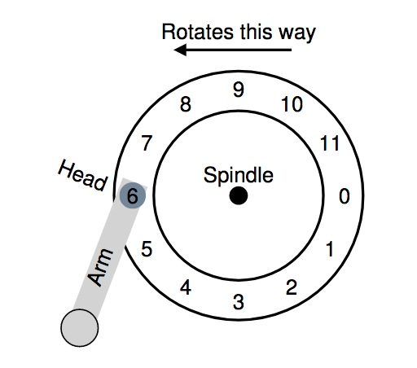
Internals of Hard Disk Drive (HDD)
A single track + an arm +
a head

Slide 11
HDD Mechanism (3D view)

Slide 12
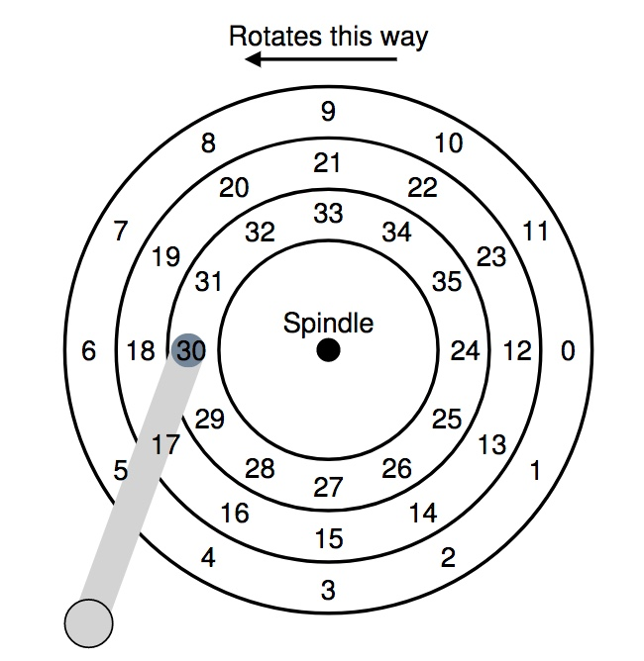

Let’s Read Sector 0

Slide 13
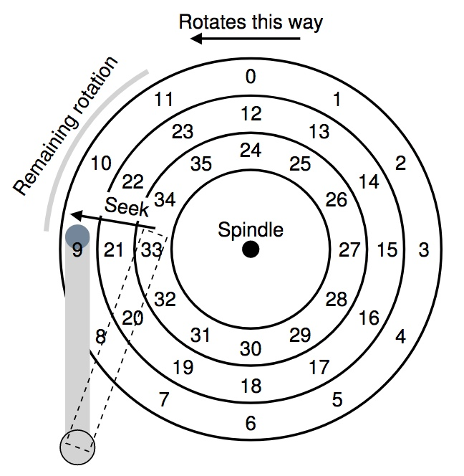
Let’s Read Sector 0
1. Seek for right track
2. Rotate (sector 9 → 0)
3. Transfer data (sector 0)

Slide 14
Don’t Try This at Home!
https://www.youtube.com/watch?v=9eMWG3fwiEU&feature=youtu.be&t=30s

Slide 15
Disk Performance
I/O latency of disks
L_{I/O} = L_{seek} + L_{rotate} + L_{transfer}
Disk access latency at millisecond level

Slide 16
Seek, Rotate, Transfer
Seek may take several milliseconds (ms)
Settling along can take 0.5 - 2ms
Entire seek often takes 4 - 10ms

Slide 17
Seek, Rotate, Transfer
Rotation per minute (RPM)
7200 RPM is common nowadays
15000 RPM is high end
Old computers may have 5400 RPM disks
1 / 7200 RPM = 1 minute / 7200 rotations =
1 second / 120 rotations = 8.3 ms / rotation

Slide 18
Seek, Rotate, Transfer
Rotation per minute (RPM)
7200 RPM is common nowadays
15000 RPM is high end
Old computers may have 5400 RPM disks
1 / 7200 RPM = 1 minute / 7200 rotations =
1 second / 120 rotations = 8.3 ms / rotation
So it may take 4.2 ms on average to rotate to target (0.5 * 8.3 ms)
Notes:
a good rule of thumb when calculating avg rotate time is by dividing the single track rotation time by half

Slide 19
Seek, Rotate, Transfer
Relatively fast
Depends on RPM and sector density
100+ MB/s is typical for SATA I (1.5Gb/s max)
Up to 600MB/s for SATA III (6.0Gb/s)
1s / 100MB = 10ms / MB = 4.9us/sector
Assuming 512-byte sector

Slide 20
Workloads
Seeks and rotations are slow while transfer is relatively fast
What kind of workload is best suited for disks?

Slide 21
Workloads
Seeks and rotations are slow while transfer is relatively fast
What kind of workload is best suited for disks?
Sequential I/O: access sectors in order (transfer dominated)
Random workloads access sectors in a random order (seek+rotation dominated)
Typically slow on disks
Never do random I/O unless you must! E.g., Quicksort is a terrible algorithm for disk!
Notes:
avoid random io as much as you can unless you have to.
quick sort if dataset is huge and cannot fit in mem; its terribly slow.

Slide 22
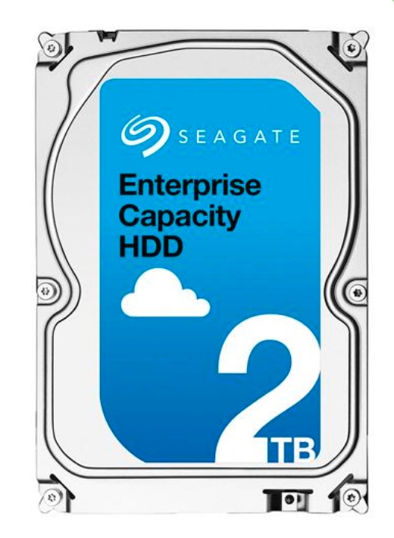
Disk Performance Calculation
Seagate Enterprise SATA III HDD
How long does an average 4KB read take?
Metric | Perf
RPM | 7200
Avg seek | 4.16ms
Max transfer | 500MB/s

Slide 23
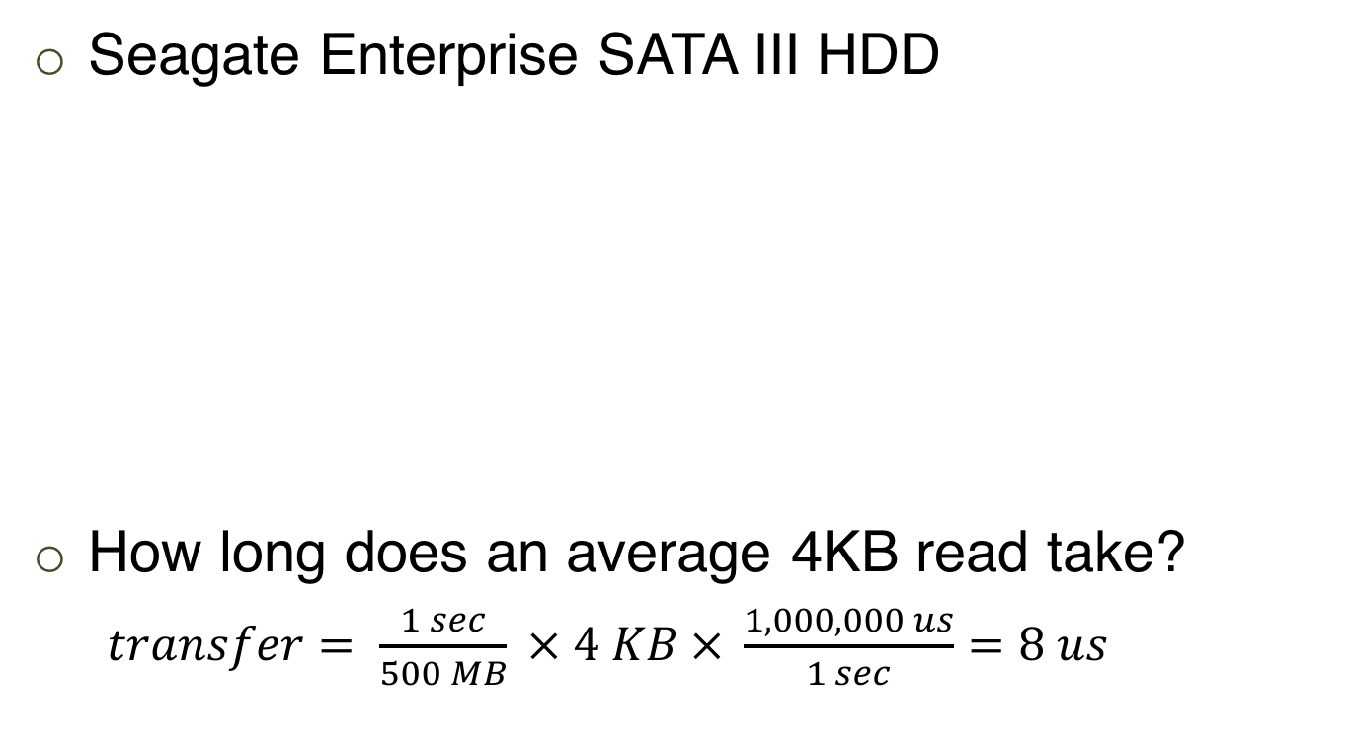

Disk Performance Calculation
Seagate Enterprise SATA III HDD
How long does an average 4KB read take?
$transfer= \frac{1 sec}{500 MB} × 4 KB × \frac{1,000,000 us}{1 sec}=8 us$
Metric | Perf
RPM | 7200
Avg seek | 4.16ms
Max transfer | 500MB/s

Slide 24


Disk Performance Calculation
Seagate Enterprise SATA III HDD
How long does an average 4KB read take?
$transfer= \frac{1 sec}{500 MB} × 4 KB × \frac{1,000,000 us}{1 sec}=8 us$
Latency = 4.16 ms + 4.2 ms + 8 us = 8.368 ms
Metric | Perf
RPM | 7200
Avg seek | 4.16ms
Max transfer | 500MB/s
Avg Seek
Avg Rotate

Slide 25
Solid State Drives (SSDs)
Notes:
In the last few lectures, we’ve covered topics related to mechanical hard disk drives. Today we are going to discuss flash: a faster storage medium which is also commonly used everywhere

Slide 26
Disk Recap
I/O requires: seek, rotate, transfer
Inherently:
Not parallel (only one head)
Slow (mechanical)
Poor random I/O (locality around disk head)
Random requests each taking ~10+ ms
Notes:
first a brief overview about hdd:
consists of three parts:
[draw surface 1D… ]
Mechanical, bad random IO perf: a random io workload with requests randomly scattered across the surface. arms seeking back force; surface rotate back and force. each random io comes with a cost associated with the moving mechanical parts:

Slide 27
SSD Overview
Hold charge in cells. No moving (mechanical) parts (no seeks)!
SSDs use transistors (just like DRAM), but SSD data persists when the power goes out
NAND-based flash is the most popular technology, so we’ll focus on it
SSD is Inherently parallel!
Notes:
flash is a completely different story. flash is one type of electronic storage medium.
there is no mechanical moving parts; instead, it holds charge in cells. There is no mechanical moving parts, there is no back and force seek. Also, its inherently parallel, where multiple reads can be served simultaneously by the device.

Slide 28
SSD Overview
Hold charge in cells. No moving (mechanical) parts (no seeks)!
SSDs use transistors (just like DRAM), but SSD data persists when the power goes out
NAND-based flash is the most popular technology, so we’ll focus on it
SSD is Inherently parallel!
High-level takeaways
SSDs have a higher $/bit than HDDs, but better performance
SSDs handle writes in a strange way; this has implications for file system design
Notes:
flash is a completely different story. flash is one type of electronic storage medium.
there is no mechanical moving parts; instead, it holds charge in cells. There is no mechanical moving parts, there is no back and force seek. Also, its inherently parallel, where multiple reads can be served simultaneously by the device.

Slide 29
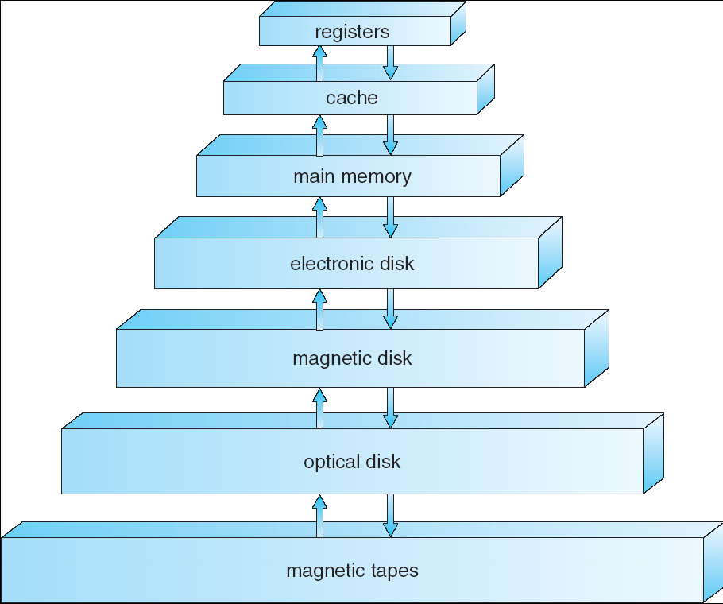
Storage Hierarchy Overview
SSD:
Smaller capacity
Higher $/bit
Faster accesses
HDD:
Larger capacity
Lower $/bit
Way slower accesses
Notes:
this storage hierarchy graph shows where we are right now.
now we are talking about flash, which is one type of electronic disks. it is one level above the magnetic mechanical disk.
flash has relatively smaller capacity but faster performance, as compared to hdds.

Slide 30

Disk vs. SSD: Performance
Throughput
Disk: ~130MB/s 500-600MB/s(sequential)
SSD: ~400MB/s 500-3000+MB/s
Latency
Disk: ~10ms (one op)
SSD:
Read: 10-50us
Program: 200-500us
Erase: 2ms
Notes:
Lets first take a look at perf comparison.
Regarding throughput, disks can at most achieve 130mb/s for sequential io, whereas flash can easily achieve 400+mb/s
Regarding latency: for each random io operation, disk would take around 10ms. whereas for flash, the read latency is at micro second level, which is 3 orders of magnitude difference.
Due to its unique internal logic, flash latency can be categorized into three classes:
pure read is super fast: 10-50us;

Slide 31
Disk vs. SSD: Performance
Throughput
Disk: ~130MB/s 500-600MB/s(sequential)
SSD: ~400MB/s 500-3000+MB/s
Latency
Disk: ~10ms (one op)
SSD:
Read: 10-50us
Program: 200-500us
Erase: 2ms
Types of write, more later…
Notes:
program and erase can be treated as write: at 200-500us level;
besides read and write, flash has a unique op, which is called erase, flash can only be written new data after old data has been erased, flash does not support overwrite. and this erase op is the most expensive, which is at ms level. we will talk about the detail of erase later.

Slide 32
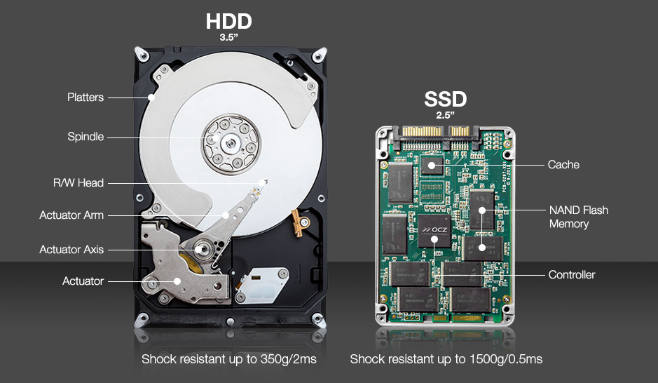

Disk vs. SSD: Internal
* https://www.enterprisestorageforum.com/storage-hardware/ssd-vs-hdd.html
Notes:
HDD is apparently not as shock resistant as SSDs – ability to sustain minor impact without damage to the internal mechanism…
SSD – PCB board which electrically connects electronic componnets using conductive tracks, pads, other features, etc.

Slide 33


Disk vs. SSD: Capacity & Price
“An obvious question is why are we talking about spinning disks at all, rather than SSDs, which have higher IOPS and are the “future” of storage. The root reason is that the cost per GB remains too high, and more importantly that the growth rates in capacity/$ between disks and SSDs are relatively close (at least for SSDs that have sufficient numbers of program-erase cycles to use in data centers), so that cost will not change enough in the coming decade. We do make extensive use of SSDs, but primarily for high performance workloads and caching, and this helps disks by shifting seeks to SSDs.
~ Eric Brewer et al.
Source: https://static.googleusercontent.com/media/research.google.com/en//pubs/archive/44830.pdf
Notes:
This is an excerpt from eric brewer’s white paper that was published in FAST’16.
Basically what he discussed in this paragraph is that though flash is super fast compared to traditional hdd, hdd is still the main stream storage medium. why? because hdd has way higher density, and much cheaper cost per GB price. Where ssd can be used? SSDs can be used as a hdd cache to accelerate random io workloads, because its super fast for random read, it is expensive, and hence its small capacity has to be used cautiously.

Slide 34
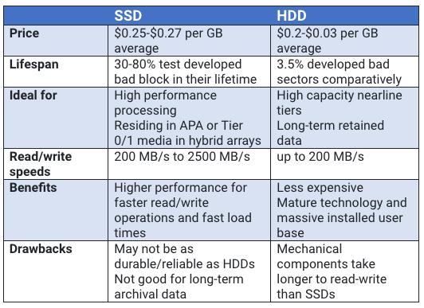

Disk vs. SSD: Summary
* https://www.enterprisestorageforum.com/storage-hardware/ssd-vs-hdd.html
Notes:
Nearline storage: https://en.wikipedia.org/wiki/Nearline_storage

Slide 35
SSD Architecture
Notes:
next lets zoom in and take a look at the internal architecture of flash

Slide 36
SLC: Single-Level Cell
charge
NAND Cell
Notes:
this graph shows an empty nand cell within a flash. a flash may have thousands of millions of cells. each cell represents one single bit.
Y-axis is the electricity charge level.
NAND := NOT-AND (In digital electronics, a NAND gate (NOT-AND) is a logic gate which produces an output which is false only if all its inputs are true)
NAND flash also uses floating-gate transistors, but they are connected in a way that resembles a NAND gate:

Slide 37
SLC: Single-Level Cell
1
charge
NAND Cell
Notes:
For SLC, which is single level cell, it has a single level threshold. charge above this level represents 1

Slide 38
SLC: Single-Level Cell
0
charge
NAND Cell
Notes:
whereas charge below this level represents 0

Slide 39
MLC: Multi-Level Cell
00
charge
NAND Cell
Notes:
a counterpart of single level cell is the multi level cell;
MLC can be used to represent two bits rather than one single binary bit

Slide 40
MLC: Multi-Level Cell
01
charge
NAND Cell

Slide 41
MLC: Multi-Level Cell
10
charge
NAND Cell
Notes:
above the mid level but slightly below the upmost level : 10

Slide 42

MLC: Multi-Level Cell
11
charge
NAND Cell
Notes:
a full charge represents 11

Slide 43
Single- vs. Multi-Level Cell
SLC
MLC
charge
charge
Notes:
3D NAND, as the name implies, involves cutting multiple layers into the silicon, stacking memory cells to increase storage density. By stacking cells in 32 layers, we can reach much higher storage density in each die, as well as allowing the cells to space out more on each plane, helping reduce interference issues between the cells.

Slide 44
Single- vs. Multi-Level Cell
SLC
MLC
charge
charge
expensive
robust
1 cell: 1 bit
cheap
sensitive
1 cell: multi-bit
Notes:
single level cell is more expensive but provides better robustness, compared to multi level cell.
To explain why MLC is cheaper and more sensitive, we need to understand the wearout issue of flash devices.
[why multi level cell is more sensitive simply because its more error prone, and the when writing many times, it may be wornout within a short time.]

Slide 45
Wearout
Problem: flash cells wear out after being erased too many times
MLC: ~10K times
SLC: ~100K times
Usage strategy: ???
Notes:
might be faced with risk of not working properly after this many times of erasures.
it might stop working correctly and start give errors after this lifespan limit

Slide 46
Wearout
Problem: flash cells wear out after being erased too many times
MLC: ~10K times
SLC: ~100K times
Usage strategy: wear leveling
Prevents some cells from being wornout while others still fresh
Notes:
the core idea of flash wear leveling is to provide write balancing across all cells. to prevent some cells from being worn out while others still fresh

Slide 47
Banks
SSD devices are divided into banks (aka. planes)
Banks can be accessed in parallel
Bank 0
Bank 1
Bank 2
Bank 3
Notes:
flash devices can be divided into multiple banks, multiple banks can be accessed in parallel;
this further improves the flash performance

Slide 48
Banks
SSD devices are divided into banks (aka. planes)
Banks can be accessed in parallel
read
read
Bank 0
Bank 1
Bank 2
Bank 3

Slide 49
Banks
SSD devices are divided into banks (aka. planes)
Banks can be accessed in parallel
data
data
Bank 0
Bank 1
Bank 2
Bank 3

Slide 50
SSD Writes
Writing 0’s
Fast, fine-grained
Writing 1’s
Slow, coarse-grained
Notes:
now lets talk about how flash handles writes
like other storage medium, flash represents data in binary form. but flash distinguishes 0 based writes from 1-based writes.
writing 0’s can be fast and fine-grained, whereas writing 1’s can be slow and coarse grained.

Slide 51
SSD Writes
Writing 0’s
Fast, fine-grained
called “program”
Writing 1’s
Slow, coarse-grained
called “erase”
Notes:
writing 0– called program phase, which can be treated as disk write
writing 1 called erase phase, which is used by flash to clean up old data before accepting new writes
there is a mismatch interms of granulary for program and erase

Slide 52
SSD Writes
Writing 0’s
Fast, fine-grained [page-level]
called “program”
Writing 1’s
Slow, coarse-grained [block-level]
called “erase”
Notes:
program phase is in finer granularity, which is at page level
while erasue is at coarse granulariy which is at block level
blocks contain multiple pages. pages are basic units of flash reads and writes

Slide 53
SSD Writes
Writing 0’s
Fast, fine-grained [page-level]
called “program”
Writing 1’s
Slow, coarse-grained [block-level]
called “erase”
SSD can only “write” (program) into clean pages
“clean”: pages containing all 1’s (pages that have been erased)
SSD does not support in-place overwrite!
Notes:
again, flash can only write new data into clean pages, clean page contains all 1’s. which are the pages that have been erased.
one important attribute of flash is that flash does not support in-place overwrite. it always has to erase the old data if the page is not clean, then program or write new data in.

Slide 54
Banks and Blocks
Bank 0
Bank 1
Bank 2
Bank 3

Slide 55
Banks and Blocks
Each bank contains many “blocks”
Bank 0
Bank 2
Bank 3

Slide 56
Block and Pages
1111
1111
1111
1111
1111
1111
1111
1111
1111
1111
1111
1111
1111
1111
1111
1111
One block

Slide 57
Block and Pages
1111
1111
1111
1111
1111
1111
1111
1111
1111
1111
1111
1111
1111
1111
1111
1111
One page

Slide 58
Block and Pages
1111
1111
1111
1111
1111
1111
1111
1111
1111
1111
1111
1111
1111
1111
1111
1111
All pages are clean (“programmable”)

Slide 59
Block
program
1011
1000
1111
1111
1111
1111
1111
1111
1111
1111
1111
1111
1111
1111
1111
1111

Slide 60
Block
1011
1000
1111
1111
1111
1111
1111
1111
1111
1111
0110
1010
1111
1111
1111
1111
program

Slide 61
Block
1011
1000
1111
1111
1111
1111
1111
1111
1111
1111
0110
1010
1111
1111
1111
1111
Two pages hold data (cannot be overwritten)

Slide 62
Block
still want to write data into this page???
1011
1000
1111
1111
1111
1111
1111
1111
1111
1111
0110
1010
1111
1111
1111
1111
Two pages hold data (cannot be overwritten)

Slide 63
Block
1011
1000
1111
1111
1111
1111
1111
1111
1111
1111
0110
1010
1111
1111
1111
1111
erase

Slide 64
Block
1111
1111
1111
1111
1111
1111
1111
1111
1111
1111
1111
1111
1111
1111
1111
1111
erase
(the whole block)
Notes:
erase all pages in this block

Slide 65
Block
1111
1111
1111
1111
1111
1111
1111
1111
1111
1111
1111
1111
1111
1111
1111
1111
After erase, again, free state
(can write new data in any page)

Slide 66
Block
1011
0001
1111
1111
1111
1111
1111
1111
1111
1111
1111
1111
1111
1111
1111
1111
This dark blue page holds data

Slide 67
SSD vs. Disk: APIs
disk
flash
read
write

Slide 68
SSD vs. Disk: APIs
disk
flash
read
read sector
read page
write

Slide 69
SSD vs. Disk: APIs
disk
flash
read
read sector
read page
program page
(0’s)
erase block
(1’s)
write
write sector

Slide 70
SSD Architecture
Bank/plane: 1024 to 4096 blocks
Banks accessed in parallel
Block: 64 to 256 pages
Unit of erase
Page: 2 to 8 KB
Unit of read and program

Slide 71
Disk vs. SSD: Performance
Throughput
Disk: ~130MB/s (sequential)
Flash: ~400MB/s
Latency
Disk: ~10ms (one op)
Flash:
Read: 10-50us
Program: 200-500us
Erase: 2ms
Notes:
Now that you have a better idea how it works internally, lets revisit flash perf

Slide 72
SSDs Working with File System
Notes:
How to use flash

Slide 73
Traditional File Systems
File System
Traditional API:
read sector
write sector
Storage Device
Notes:
traditional file system exposes apis to read and write sectors
which is under the assumption that the storage medium is hdds

Slide 74
Traditional File Systems
File System
Traditional API:
read sector
write sector
Storage Device
Mismatch with SSD!
Notes:
there is a clear mismatch for fs apis bw hdd and flash devices

Slide 75

Traditional APIs wrapping around SSD APIs
read(addr):
return ssd_read(addr)
write(addr, data):
block_copy = ssd_read(all pages of block)
modify block_copy with data
ssd_erase(block of addr)
ssd_program(all pages of block_copy)
Notes:
One naïve approach for solving this mismatch is by providing a traditional api wrapper around flash apis
[whiteboard: list traditional apis, list flash apis]
traditional apis are read and write, which are oblivious of the flash device.

Slide 76
Awkward SSD Write
Memory
00
00
00
11
11
01
11
11
00
01
11
11
SSD
01
10
11
11
11
10
11
11
11
11
10
11
block 0
block 1
block 2

Slide 77

Awkward SSD Write
Memory
File system wants
to write 0001
00
00
00
11
11
01
11
11
00
01
11
11
SSD
01
10
11
11
11
10
11
11
11
11
10
11
block 0
block 1
block 2

Slide 78
Awkward SSD Write
Memory
00
00
00
11
11
01
11
11
00
01
11
11
SSD
01
10
11
11
11
10
11
11
11
11
10
11
block 0
block 1
block 2

Slide 79
Awkward SSD Write
00
00
00
11
Memory
01
10
11
11
Read all pages in block
00
00
00
11
11
01
11
11
00
01
11
11
SSD
01
10
11
11
11
10
11
11
11
11
10
11
block 0
block 1
block 2

Slide 80
Awkward SSD Write
00
00
00
11
Memory
01
10
11
11
00
00
00
11
11
01
11
11
00
01
11
11
SSD
01
10
11
11
11
10
11
11
11
11
10
11
block 0
block 1
block 2

Slide 81

Awkward SSD Write
Modify target page
in memory
00
01
00
11
Memory
01
10
11
11
00
00
00
11
11
01
11
11
00
01
11
11
SSD
01
10
11
11
11
10
11
11
11
11
10
11
block 0
block 1
block 2

Slide 82
Awkward SSD Write
00
01
00
11
Memory
01
10
11
11
00
00
00
11
11
01
11
11
00
01
11
11
SSD
01
10
11
11
11
10
11
11
11
11
10
11
block 0
block 1
block 2

Slide 83
Awkward SSD Write
00
01
00
11
Memory
01
10
11
11
Erase whole block
11
11
11
11
11
01
11
11
00
01
11
11
SSD
11
11
11
11
11
10
11
11
11
11
10
11
block 0
block 1
block 2

Slide 84
Awkward SSD Write
00
01
00
11
Memory
01
10
11
11
11
11
11
11
11
01
11
11
00
01
11
11
SSD
11
11
11
11
11
10
11
11
11
11
10
11
block 0
block 1
block 2

Slide 85
Awkward SSD Write
00
01
00
11
Memory
01
10
11
11
Program all pages
in block
00
01
00
11
11
01
11
11
00
01
11
11
SSD
01
10
11
11
11
10
11
11
11
11
10
11
block 0
block 1
block 2

Slide 86
Awkward SSD Write
Memory
00
01
00
11
11
01
11
11
00
01
11
11
SSD
01
10
11
11
11
10
11
11
11
11
10
11
block 0
block 1
block 2
Notes:
whats the problem with this naïve api wrapper based approach?

Slide 87
Issue: Write Amplification
Random writes are expensive for flash!
Writing one 4KB page may cause:
read, erase, and program of the whole 256KB block
Notes:
the issue is the write amplification.
in our example, we want to write to a single page of 4KB. you have to bring the whole block of 256kb into memory, modify the single page that you target, and then erase the whole block before you can write new data into device.
By write amplification, it means the a small random write can get dramatically amplified to a huge write which touches all data within this particular block.

Slide 88
Flash Translation Layer (FTL)
Notes:
to solve this issue, ppl propose a scheme called flash translation layer or ftl

Slide 89
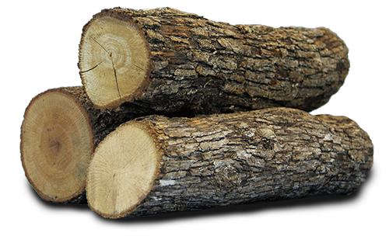
Flash Translation Layer (FTL)
Add an address translation layer between upper-level file system and lower-level flash
Translate logical device addresses to physical addresses
Convert in-place write into append-write (log-structured)
Essentially, a virtualization & optimization layer
Notes:
the core idea of ftl is adding one address translation layer to map the logical disk addr into the physical flash addr, and to convert random in-place writes into append based writes

Slide 90
Flash Translation Layer (FTL)
Usually implemented in SSD device’s firmware (hardware)
But is also implemented in software for some SSDs
Where to store mapping?
SRAM
Physical pages can be in three states
uninitialized, valid, invalid

Slide 91
SSD Architecture with FTL
SSD provides disk-like interface
FTL
SRAM:
Mapping table
Notes:
ssd provides disk like interfaces for fs to interact with flash device.
fs uses logical addr which gets translated into physical addr using ftl. ftl refers to the mapping table structure stored in device’s sram for doing locating, etc

Slide 92

Logical-to-physical map
Log head
Uninitialized
. . .
Valid
Page
0
1
2
3
4
5
6
7
8
9
10
11
Block
0
1
2

Slide 93

write(page=92, data=w0)
Logical-to-physical map
92 --> 0
erase(block0)
program(page0, w0)
logHead++
Log head
Log head
Uninitialized
w0
. . .
1*
1*
1*
1*
Valid
Page
0
1
2
3
4
5
6
7
8
9
10
11
Block
0
1
2

Slide 94
write(page=92, data=w0)
Logical-to-physical map
92 --> 0
17 --> 1
erase(block0)
program(page0, w0)
logHead++
write(page=17, data=w1)
program(page1, w1)
logHead++
Log head
Log head
Uninitialized
w0
w1
1*
1*
. . .
1*
Valid
Page
0
1
2
3
4
5
6
7
8
9
10
11
Block
0
1
2

Slide 95
write(page=92, data=w0)
Logical-to-physical map
92 --> 0
17 --> 1
erase(block0)
program(page0, w0)
logHead++
Advantages w.r.t. direct mapping
Avoids expensive read-modify-write behavior
Better wear levelling: writes get spread across pages, even if there is spatial locality in writes at logical level
write(page=17, data=w1)
program(page1, w1)
logHead++
Log head
Uninitialized
w0
w1
1*
1*
. . .
Valid
Page
0
1
2
3
4
5
6
7
8
9
10
11
Block
0
1
2

Slide 96

write(page=92, data=w4)
Logical-to-physical map
92 --> 0
17 --> 1
33 --> 2
68 --> 3
erase(block1)
92 --> 4
program(page4, w4)
logHead++
Garbage version of logical block 92!
Log head
Log head
Uninitialized
w0
w1
w4
. . .
w2
w3
1*
1*
1*
1*
Valid
Page
0
1
2
3
4
5
6
7
8
9
10
11
Block
0
1
2

Slide 97
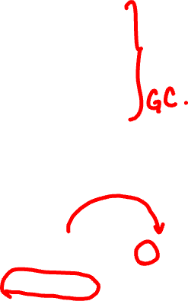
At some point, FTL must:
Logical-to-physical map
92 --> 0
17 --> 1
33 --> 2
68 --> 3
Read all pages in physical block 0
92 --> 4
Write out the second, third, and fourth pages to the end of the log
Update logical-to-physical map
Garbage version of logical block 92!
Log head
Uninitialized
w0
w1
w2
w3
w4
1*
1*
1*
. . .
Valid
Page
0
1
2
3
4
5
6
7
8
9
10
11
Block
0
1
2

Slide 98
Trash Day is the Worst Day
Garbage collection requires extra read+write traffic
Overprovisioning makes GC less painful
SSD exposes a logical page space that is smaller than the physical page space
By keeping extra, “hidden” pages around, the SSD tries to defer GC to a background task (thus removing GC from critical path of a write)
SSD will occasionally shuffle live (i.e., non-garbage) blocks that never get overwritten
Enforces wear leveling

Slide 99
File System Abstraction

Slide 100
What is a File?
File: Array of bytes
Ranges of bytes can be read/written
File system (FS) consists of many files
Files need names so programs can choose the right one
Notes:
first of all whats a file? a file is an array of bytes stored on disk.
all data are essentially files, music, video, images, source code, disk images, etc.
when we are talking about a file, we need to know its name; each and every file has its name.

Slide 101

File Names
Three types of names (abstractions)
inode (low-level names)
path (human readable)
file descriptor (runtime state)
Notes:
basically, a file has three types of names;
1st, inode, or some low level name that only machine can understand;
2nd, path, which is human readable; path consists of multiple directories each of which is essentially a file (a good analogy here is that you can think of an inode as some sort of binary machine code which can be understood by machine, whereas the directory is like high level programming language such as C or Java, which is written by human)
3rd, file descriptor, which is used to represent the runtime status of an open file

Slide 102
Inodes
Each file has exactly one inode number
Inodes are unique (at a given time) within a FS
Numbers may be recycled after deletes
Notes:
lets first talk about inodes within a fs.
inode is unique across files; each file has exactly one inode #.
this inode # can be recycled and reused after that particular file is deleted.
[example on whiteboard] inode # are reusable resources of fs.

Slide 103
Inodes
Each file has exactly one inode number
Inodes are unique (at a given time) within a FS
Numbers may be recycled after deletes
Show inodes via stat
$ stat <file or dir>

Slide 104

‘stat’ Example
PROMPT>: stat test.dat
File: ‘test.dat’ Size: 5 Blocks: 8 IO Block: 4096 regular file
Device: 803h/2051d Inode: 119341128 Links: 1
Access: (0664/-rw-rw-r--) Uid: ( 1001/ yue) Gid: ( 1001/ yue)
Context: unconfined_u:object_r:user_home_t:s0
Access: 2015-12-17 04:12:47.935716294 -0500
Modify: 2014-12-12 19:25:32.669625220 -0500
Change: 2014-12-12 19:25:32.669625220 -0500
Birth: -
Notes:
here is a snapshot of a terminal showing ‘stat’ result;
in this example, we want check status of a file called test.dat; on line # 2, it shows the inode number 119341128.

Slide 105
Path (multiple directories)
A directory is a file
Associated with an inode
Contains a list of <user-readable name, low-level name> pairs
Notes:
the 2nd type of file name is what is called a path.
a path consists of multiple directories, where each directory is essentially a file associated with on inode

Slide 106
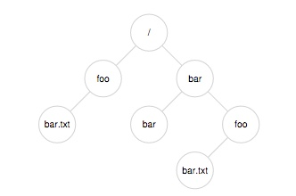
Path (multiple directories)
A directory is a file
Associated with an inode
Contains a list of <user-readable name, low-level name> pairs

Slide 107
Path (multiple directories)
<“foo”, “10”>
<“bar”, “12”>
A directory is a file
Associated with an inode
Contains a list of <user-readable name, low-level name> pairs
Notes:
user readable name is the directory name, and the low level name is the inode number associated with it

Slide 108

Path (multiple directories)
A directory is a file
Associated with an inode
Contains a list of <user-readable name, low-level name> pairs
Directory tree: reads for getting final inode called traversal
[traverse /bar/foo/bar.txt]
Notes:
directories organized as some sort of tree based hierarchical structure.
[whiteboard example]

Slide 109
File Naming
Directories and files can have the same name as long as they are in different locations of the file-system tree
.txt, .c, etc.
Naming convention
In UNIX-like OS, no enforcement for extension name
Notes:
two things you need to note here: 1. same name
2. extension names:
[do a demo of naming convention]

Slide 110
Special Directory Entries
prompt> ls –al
total 216
drwxr-xr-x 19 yue staff 646 Nov 23 16:28 .
drwxr-xr-x+ 40 yue staff 1360 Nov 15 01:41 ..
-rw-r--r--@ 1 yue staff 1064 Aug 29 21:48 common.h
-rwxr-xr-x 1 yue staff 9356 Aug 30 14:03 cpu
-rw-r--r--@ 1 yue staff 258 Aug 29 21:48 cpu.c
-rwxr-xr-x 1 yue staff 9348 Sep 6 12:12 cpu_bound
-rw-r--r-- 1 yue staff 245 Sep 5 13:10 cpu_bound.c
…
Notes:
dot: current working dir
dotdot: parent dir

Slide 111
File System Interfaces
Notes:
next im gonna talk about some of the fs interfaces that are commonly used in unix like os

Slide 112
Creating Files
UNIX system call: open()
int fd = open(char *path, int flag, mode_t mode);
-OR-
int fd = open(char *path, int flag);
Notes:
1st api you need to know is the interface used to create a new file
in unix like os, you can do this by calling open() syscall
Flag: A bitwise 'or' separated list of values that determine the method in which the file is to be opened (whether it should be read only, read/write, whether it should be cleared when opened, etc). See a list of legal values for this field at the end.
Mode: A bitwise 'or' separated list of values that determine the permissions of the file if it is created. See a list of legal values at the end.
two formats: returns an int typed fd

Slide 113
File Descriptor (fd)
open() returns a file descriptor (fd)
A fd is an integer
Private per process
An opaque handle that gives caller the power to perform certain operations
Think of a fd as a pointer to an object of the file
By owning such an object, you can call other “methods” to access the file
Notes:
a fd is an integer; each fd is a private resource of a process; the fd managed and owned by a process is not visible to other processes.

Slide 114

open() Example
int fd1 = open(“file.txt”, O_CREAT); // return 3
read(fd1, buf, 8);
int fd2 = open(“file.txt”, O_WRONLY); // return 4
int fd3 = dup(fd2); // return 5
Notes:
lets take a look at one example;
in this example, this process performs 4 operations on a single file named file.txt
… dup duplicates a fd

Slide 115
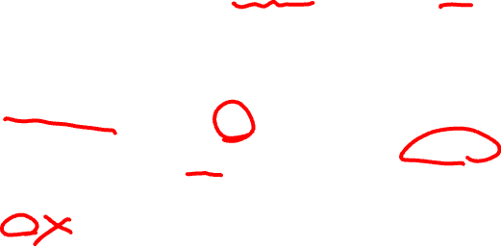
open() Example
int fd1 = open(“file.txt”, O_CREAT); // return 3
read(fd1, buf, 8);
int fd2 = open(“file.txt”, O_WRONLY); // return 3
int fd3 = dup(fd2); // return 4
fd table
fd
0
inode
1
offset = 0
inode = …
location = …
size = …
2
3
4
5
Notes:
use animation to illustrate the whole process
the array data struc on the right hand side is a fd table which is owned by this particular process; used to keep track of all open files

Slide 116
open() Example
int fd1 = open(“file.txt”, O_CREAT); // return 3
read(fd1, buf, 8);
int fd2 = open(“file.txt”, O_WRONLY); // return 3
int fd3 = dup(fd2); // return 4
fd table
fd
0
inode
1
offset = 8
inode = …
location = …
size = …
2
3
4
5
Notes:
reads a number of bytes into the string buffer, and change the file offset from 0 to 8.

Slide 117

open() Example
int fd1 = open(“file.txt”, O_CREAT); // return 3
read(fd1, buf, 8);
int fd2 = open(“file.txt”, O_WRONLY); // return 4
int fd3 = dup(fd2); // return 4
fd table
fd
0
inode
1
offset = 8
inode = …
location = …
size = …
2
3
offset = 0
inode = …
4
5
Notes:
calls open again, correspondingly the process populates the array item under index 4.
this new array item is pointing to this newly created fd data structure

Slide 118
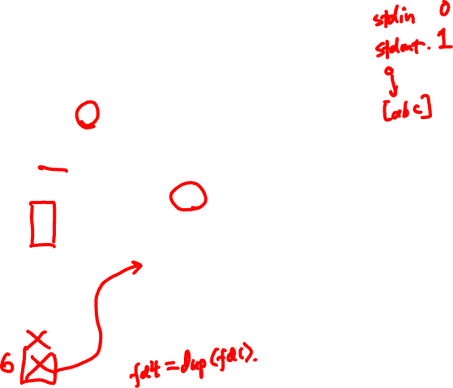
open() Example
int fd1 = open(“file.txt”, O_CREAT); // return 3
read(fd1, buf, 8);
int fd2 = open(“file.txt”, O_WRONLY); // return 4
int fd3 = dup(fd2); // return 5
fd table
fd
0
inode
1
offset = 8
inode = …
location = …
size = …
2
3
offset = 0
inode = …
4
5
Notes:
by calling dup you basically duplicates an pointer in the array, which points to an existing fd struct.
dup returns a new fd fd3 w/ a new value of 5 which is exactly the index number of the newly created pointer element in the array.

Slide 119
UNIX File Read and Write APIs
int fd = open(char *path, int flag, mode_t mode);
-OR-
int fd = open(char *path, int flag);
ssize_t sz = read(int fd, void *buf, size_t count);
ssize_t sz = write(int fd, void *buf, size_t count);
int ret = close(int fd);
Notes:
for read and write, you pass in 1st parameter which is the fd of the target file; 2nd parameter is the buffer. in case of read, buf will be used to store the data you read from the file specificed as fd. reading how many bytes is determined by 3rd parameter count.

Slide 120

Reading and Writing Files
prompt> echo hello > file.txt
prompt> cat file.txt
hello
prompt>
Notes:
here in this example, we wanna store a string ‘hello’ into a new file named file.txt; and then display the content of the file by using the command cat.

Slide 121

Reading and Writing Files
prompt> strace cat file.txt
...
open("file.txt", O_RDONLY) = 3
read(3, "hello\n", 65536) = 6
write(1, "hello\n", 6) = 6
read(3, "", 65536) = 0
close(3) = 0
...
prompt>
Notes:
lets trace the syscall involved in this ‘cat’ process by using strace. here the only syscalls that we are interested in are those related to reading and writing files.

Slide 122
Reading and Writing Files
Open the file with read only mode
prompt> strace cat file.txt
...
open("file.txt", O_RDONLY) = 3
read(3, "hello\n", 65536) = 6
write(1, "hello\n", 6) = 6
read(3, "", 65536) = 0
close(3) = 0
...
prompt>
Notes:
read only, it returns fd 3

Slide 123

Reading and Writing Files
Open the file with read only mode
prompt> strace cat file.txt
...
open("file.txt", O_RDONLY) = 3
read(3, "hello\n", 65536) = 6
write(1, "hello\n", 6) = 6
read(3, "", 65536) = 0
close(3) = 0
...
prompt>
Read content from file
Notes:
read which file, specified as fd, which is 3.
read the content of file into the 2nd parameter

Slide 124
Reading and Writing Files
Open the file with read only mode
prompt> strace cat file.txt
...
open("file.txt", O_RDONLY) = 3
read(3, "hello\n", 65536) = 6
write(1, "hello\n", 6) = 6
read(3, "", 65536) = 0
close(3) = 0
...
prompt>
Read content from file
Write string to std output fd 1
Notes:
write the string to fd 1, which is standard output. the size of the write is 6 bytes.
a typical race condition situation: two processes: strace and cat;

Slide 125

Reading and Writing Files
Open the file with read only mode
prompt> strace cat file.txt
...
open("file.txt", O_RDONLY) = 3
read(3, "hello\n", 65536) = 6
write(1, "hello\n", 6) = 6
read(3, "", 65536) = 0
close(3) = 0
...
prompt>
Read content from file
Write string to std output fd 1
cat tries to read more but reaches EOF
Notes:
cat reaches a new line \n and wants to read more, but reaches eof end of file, so it stops there

Slide 126
Reading and Writing Files
Open the file with read only mode
prompt> strace cat file.txt
...
open("file.txt", O_RDONLY) = 3
read(3, "hello\n", 65536) = 6
write(1, "hello\n", 6) = 6
read(3, "", 65536) = 0
close(3) = 0
...
prompt>
Read content from file
Write string to std output fd 1
cat tries to read more but reaches EOF
cat done with file ops and closes the file
Notes:
and close the file specified using fd 3

Slide 127
Non-Sequential File Operations
off_t offset = lseek(int fd, off_t offset, int whence);

Slide 128
Non-Sequential File Operations
off_t offset = lseek(int fd, off_t offset, int whence);
whence:
If whence is SEEK_SET, the offset is set to offset bytes
If whence is SEEK_CUR, the offset is set to its current location plus offset bytes
If whence is SEEK_END, the offset is set to the size of the file plus offset bytes

Slide 129
Non-Sequential File Operations
off_t offset = lseek(int fd, off_t offset, int whence);
whence:
If whence is SEEK_SET, the offset is set to offset bytes
If whence is SEEK_CUR, the offset is set to its current location plus offset bytes
If whence is SEEK_END, the offset is set to the size of the file plus offset bytes
Note: Calling lseek() does not perform a disk seek!
Notes:
note that calling lseek does not necessarily perofrm a disk seek; it simply changes the fd status by shifting the offset to a new location. whenever there is a new read or write, this new read or write will follow this newly set offset.

Slide 130
Writing Immediately with fsync()
int fd = fsync(int fd);
fsync(fd) forces buffers to flush to disk, and (usually) tells the disk to flush its write cache too
To make the data durable and persistent
Write buffering improves performance
Notes:
most of the time for performance consideration fs does not immediately flush written data to the disk.
if you want instant reflection of writes on disk data, you can use fsync() syscall.

Slide 131
Renaming Files
prompt> mv file.txt new_name.txt

Slide 132
Renaming Files
prompt> strace mv file.txt new_name.txt
...
rename("file.txt", "new_name.txt") = 0
...
prompt>

Slide 133
Renaming Files
prompt> strace mv file.txt new_name.txt
...
rename("file.txt", "new_name.txt") = 0
...
prompt>
System call rename() atomically renames a file

Slide 134
File Renaming Example
prompt> vim file.txt
int fd = open(“.file.txt.swp”,O_WRONLY|O_CREAT|O_TRUNC,S_IRUSR|S_IWUSR);
Using vim to edit a file and then save it
Notes:
rename() syscall is commonly used in real world apps;
a typical example is the vim editor;
when you open up a file using vim editor, perform some edits, and save and quit using colon w and q

Slide 135
File Renaming Example
prompt> vim file.txt
… vim editing session …
int fd = open(“.file.txt.swp”,O_WRONLY|O_CREAT|O_TRUNC,S_IRUSR|S_IWUSR);
write(fd, buffer, size); // write out new version of file (editing…)
Using vim to edit a file and then save it
Notes:
rename() syscall is commonly used in real world apps;
a typical example is the vim editor;
when you open up a file using vim editor, perform some edits, and save and quit using colon w and q

Slide 136
File Renaming Example
prompt> vim file.txt
… vim editing session …
prompt>
:wq
int fd = open(“.file.txt.swp”,O_WRONLY|O_CREAT|O_TRUNC,S_IRUSR|S_IWUSR);
write(fd, buffer, size); // write out new version of file
fsync(fd); // make data durable
close(fd); // close tmp file
rename(“.file.txt.swp”, “file.txt”);// change name and replacing old file
Using vim to edit a file and then save it
Notes:
here is what is happening under the hood:
you would see something like a tmp file named with dot and some weird extension name;
essentially how vim works is it opens up a tmp file and write all updates in this tmp file; whenever vim is quitted, it lfushes data using fsync and close the tmp file; last step is rename tmp file and replaces old file with this new tmp file.

Slide 137
Deleting Files
prompt> rm file.txt

Slide 138
Deleting Files
prompt> strace rm file.txt
...
unlink("file.txt") = 0
...
prompt>

Slide 139
Deleting Files
prompt> strace rm file.txt
...
unlink("file.txt") = 0
...
prompt>
System call unlink() is called to delete a file

Slide 140
Deleting Files
prompt> strace rm file.txt
...
unlink("file.txt") = 0
...
prompt>
System call unlink() is called to delete a file
Directories are deleted when unlink() is called
Q: File descriptors are deleted when ???

Slide 141
Demo: Hard Links vs. Symbolic Links

Slide 142
State Transition of Physical Pages
Free
Valid
Invalid

Slide 143
State Transition of Physical Pages
Free
Program
Valid
Invalid

Slide 144
State Transition of Physical Pages
Free
Program
Valid
Relocate
(overwrite)
Invalid

Slide 145
State Transition of Physical Pages
Free
Program
Valid
Erase
Relocate
(overwrite)
Invalid

