Slide 1


Ray: A Unified Distributed Framework for Emerging AI Applications
CS675: Distributed Systems (Spring 2020)
Lecture 11
Yue Cheng
Some material taken/derived from:
Princeton COS-418 materials created by Michael Freedman and Wyatt Lloyd.
MIT 6.824 by Robert Morris, Frans Kaashoek, and Nickolai Zeldovich.
Licensed for use under a Creative Commons Attribution-NonCommercial-ShareAlike 3.0 Unported License.
Notes:
TODO: add summary slide and takeaway slide…

Slide 2
Supervised Learning → Reinforcement Learning (RL)
One prediction
Static environment
Immediate feedback
Sequences of actions
Dynamic environments
Delayed rewards

Slide 3
Reinforcement learning
Atari breakout
Pong: after 30 mins of training
Pong: DQN wins like a boss
*: Playing Atari with Deep Reinforcement Learning: https://arxiv.org/abs/1312.5602

Slide 4
RL application pattern
Process inputs from different sensors in parallel & real-time
Execute large number of simulations, e.g., up to 100s of millions

Slide 5

RL setup
Agent
Environment
action
Policy:
state → action
state/reward

Slide 6
RL setup in more detail
Agent
Environment
Simulation
policy
action
Training
Policy improvement (e.g., SGD)
Serving
Policy evaluation
state/reward
samples

Slide 7
RL application pattern
Process inputs from different sensors in parallel & real-time
Execute large number of simulations, e.g., up to 100s of millions
Rollouts outcomes are used to update policy (e.g., SGD)
Notes:
Often policies implemented using DNNs: Observations (or states) as input to DNN, and actions generated by DNN as output

Slide 8
RL application requirements
Need to handle dynamic task graphs, where tasks have
Heterogeneous durations
Heterogenous computations
Schedule millions of tasks / sec
Make it easy to parallelize ML algorithms (often written in Python)

Slide 9
The ML/AI ecosystems today
Distributed systems
Distributed systems
Distributed training
Model serving
TensorFlow, PyTorch, MXNet
Clipper, TensorFlow serving
Distributed systems
Data streaming
Distributed systems
Distributed systems
Flink, many others
Data processing
Simulation
Spark, Hadoop, Dask
MPI, simulators, custom tools

Slide 10
Ad hoc integrations are difficult to manage and program!
Emerging AI applications require stitching together multiple disparate systems

Slide 11
Ray API
Tasks
futures = f.remote(args)
Actors
actor = Class.remote(args)
futures = actor.method.remote(args)
objects = ray.get(futures)
ready_futures = ray.wait(futures, k, timeout)

Slide 12
Ray API examples
See separate notes

Slide 13
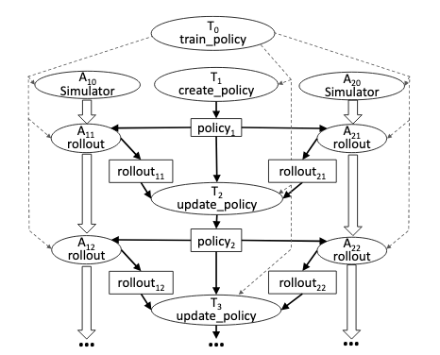
Computation model

Slide 14
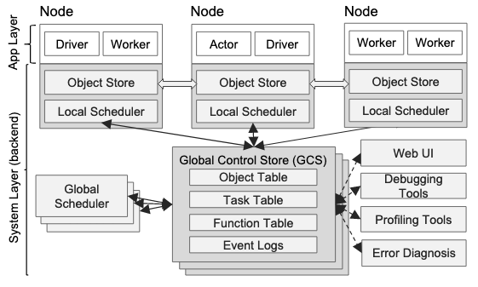
Ray architecture

Slide 15
Global control store (GCS)
Object table
Task table
Function table

Slide 16
Ray scheduler

Slide 17
Fault tolerance
Tasks
Actors
GCS
Scheduler

Slide 18
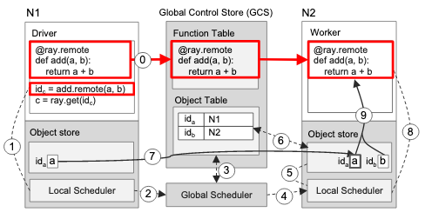
Executing a task remotely

Slide 19
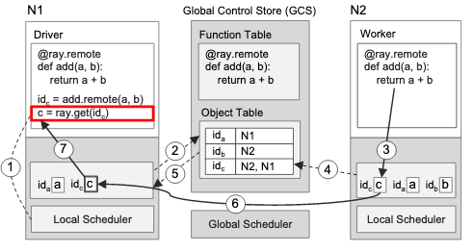
Returning the results of a remote task

Slide 20
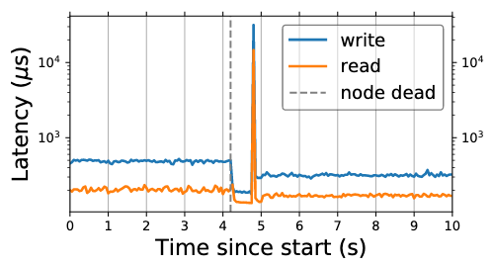
GCS fault tolerance

Slide 21
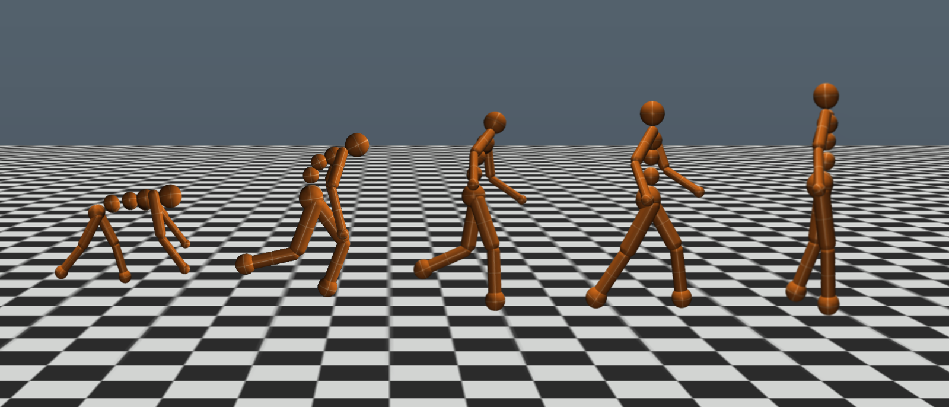
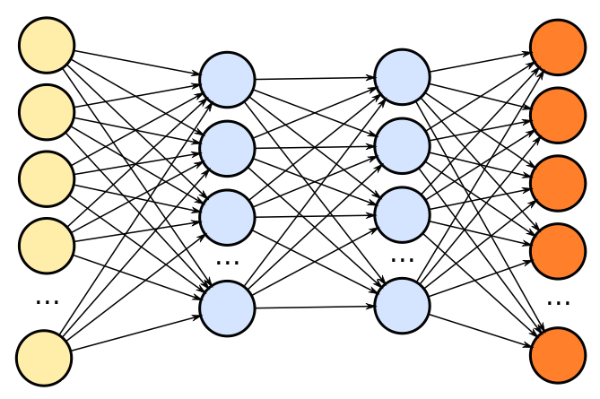
Evolution strategies (ES)
Simulator
actions
state/rewards
Policy
Try lots of different policies and see which one works best!

Slide 22
Pseudocode
class Worker(object):
def do_simulation(policy, seed):
# perform simulation and return reward
workers = [Worker() for i in range(20)]
policy = initial_policy()
for i in range(200):
seeds = generate_seeds(i)
rewards = [workers[j].do_simulation(policy, seeds[j])
for j in range(20)]
policy = compute_update(policy, rewards, seeds)

Slide 23
Pseudocode
@ray.remote
class Worker(object):
def do_simulation(policy, seed):
# perform simulation and return reward
workers = [Worker.remote() for i in range(20)]
policy = initial_policy()
for i in range(200):
seeds = generate_seeds(i)
rewards = [workers[j].do_simulation.remote(policy, seeds[j])
for j in range(20)]
policy = compute_update(policy, ray.get(rewards), seeds)

Slide 24
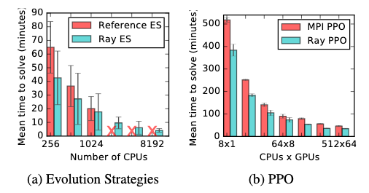
Performance of RL applications

