Slide 1


Ray: A Unified Distributed Framework for Emerging AI Applications
CS675: Distributed Systems (Spring 2020)
Lecture 11
Yue Cheng
Some material taken/derived from:
Princeton COS-418 materials created by Michael Freedman and Wyatt Lloyd.
MIT 6.824 by Robert Morris, Frans Kaashoek, and Nickolai Zeldovich.
Licensed for use under a Creative Commons Attribution-NonCommercial-ShareAlike 3.0 Unported License.
Notes:
TODO: add summary slide and takeaway slide…

Slide 2
Supervised Learning
One prediction
Static environment
Immediate feedback

Slide 3
Supervised Learning → Reinforcement Learning (RL)
One prediction
Static environment
Immediate feedback
Sequences of actions
Dynamic environments
Delayed rewards

Slide 4

Reinforcement learning
Atari breakout
Pong: after 30 mins of training
Pong: DQN wins like a boss
*: Playing Atari with Deep Reinforcement Learning: https://arxiv.org/abs/1312.5602
Notes:
Deep mind..
Deeq Q network…

Slide 5
RL application pattern
Process inputs from different sensors in parallel & real-time
Execute large number of simulations, e.g., up to 100s of millions

Slide 6
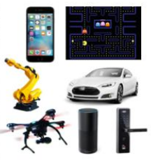
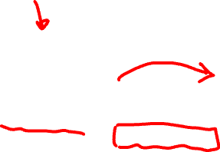
RL setup
Agent
Environment
action
Policy:
state → action
state/reward

Slide 7
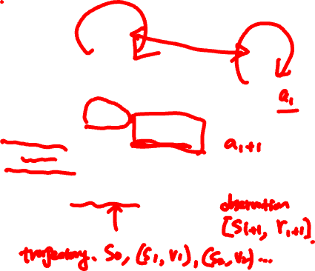
RL setup in more detail
Agent
Environment
Simulation
policy
action
Training
Policy improvement (e.g., SGD)
Serving
Policy evaluation
state/reward
samples

Slide 8
RL application pattern
Process inputs from different sensors in parallel & real-time
Execute large number of simulations, e.g., up to 100s of millions
Rollouts outcomes are used to update policy (e.g., SGD)
Notes:
Often policies implemented using DNNs: Observations (or states) as input to DNN, and actions generated by DNN as output

Slide 9
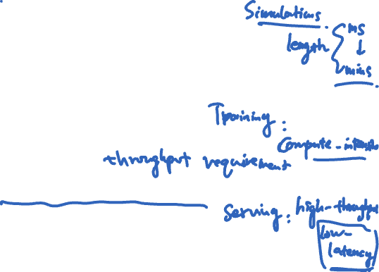
RL application requirements
Need to handle dynamic task graphs, where tasks have
Heterogeneous durations
Heterogenous computations
Schedule millions of tasks / sec
Make it easy to parallelize ML algorithms (often written in Python)

Slide 10
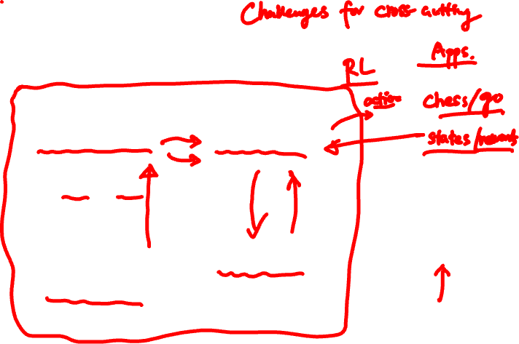
The ML/AI ecosystems today
Distributed systems
Distributed systems
Distributed training
Model serving
TensorFlow, PyTorch, MXNet
Clipper, TensorFlow serving
Distributed systems
Data streaming
Distributed systems
Distributed systems
Flink, many others
Data processing
Simulation
Spark, Hadoop, Dask
MPI, simulators, custom tools

Slide 11
Ad hoc integrations are difficult to manage and program!
Emerging AI applications require stitching together multiple disparate systems

Slide 12
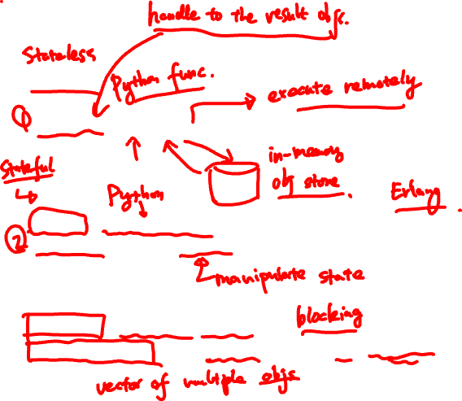
Ray API
Tasks
futures = f.remote(args)
Actors
actor = Class.remote(args)
futures = actor.method.remote(args)
objects = ray.get(futures)
ready_futures = ray.wait(futures, k, timeout)

Slide 13
Ray API examples
See separate notes

Slide 14
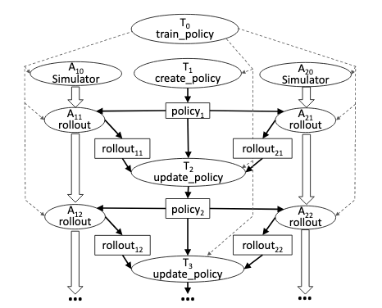
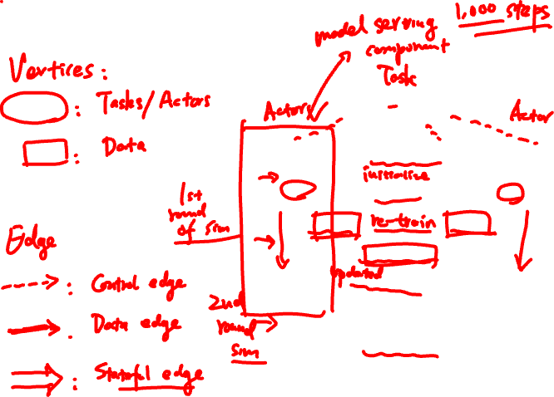
Computation model

Slide 15
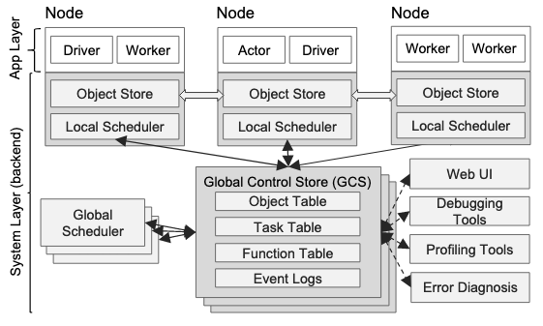
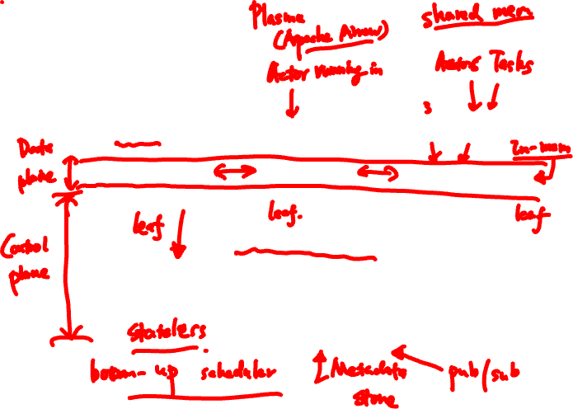
Ray architecture

Slide 16
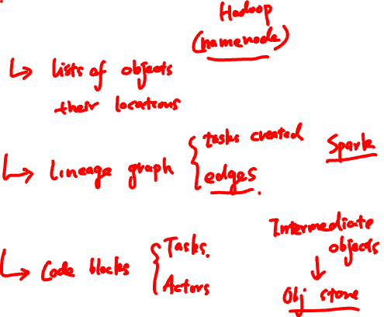
Global control store (GCS)
Object table
Task table
Function table

Slide 17
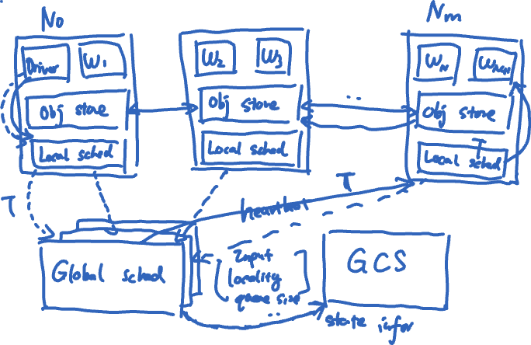
Ray scheduler

Slide 18
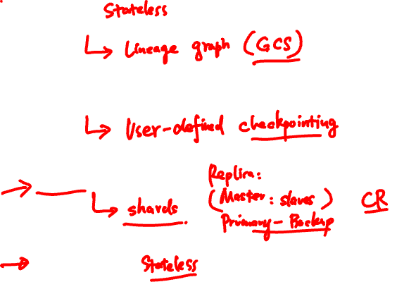
Fault tolerance
Tasks
Actors
GCS
Scheduler

Slide 19
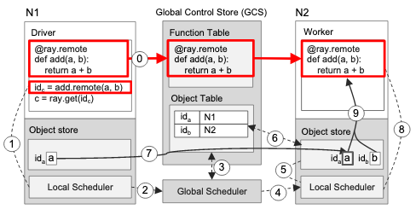
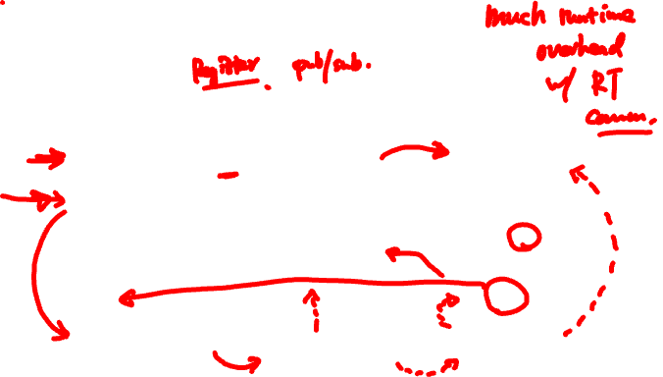
Executing a task remotely

Slide 20
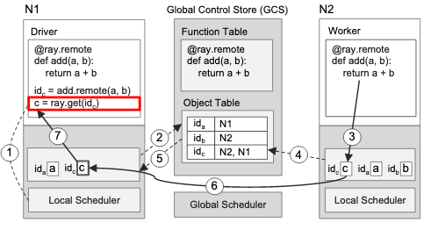
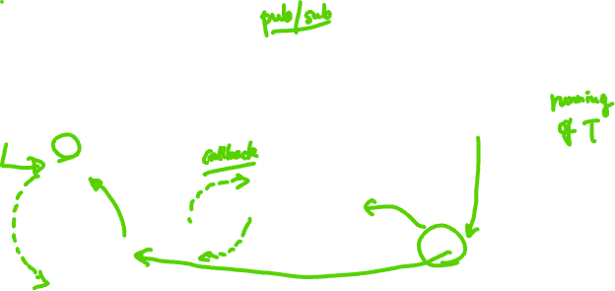
Returning the results of a remote task

Slide 21
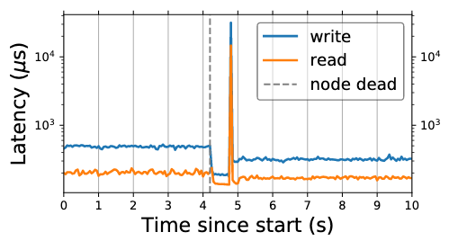
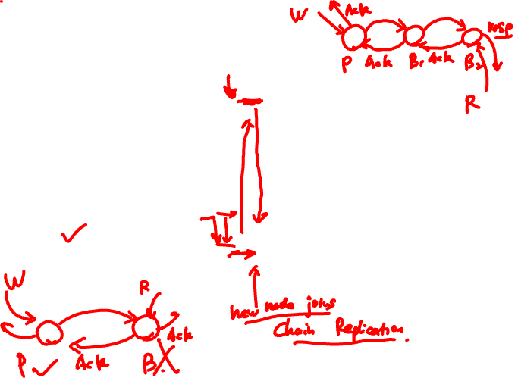
GCS fault tolerance

Slide 22
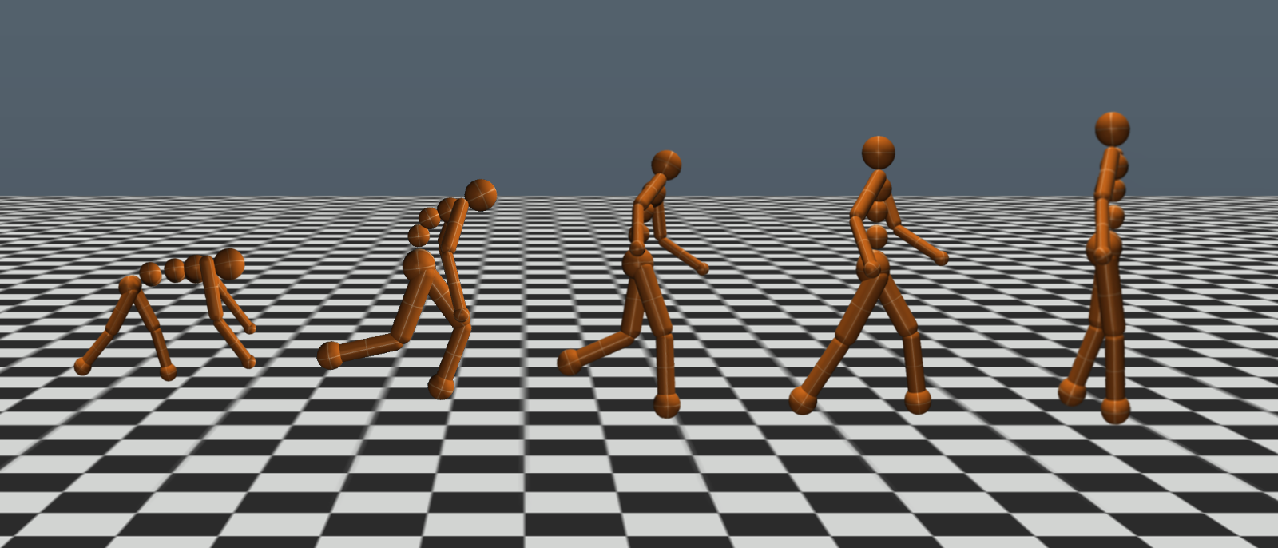
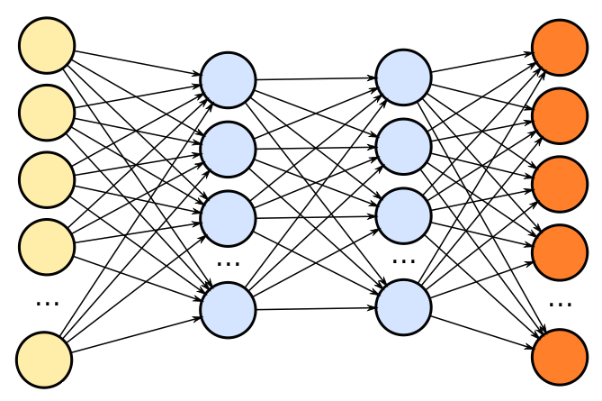
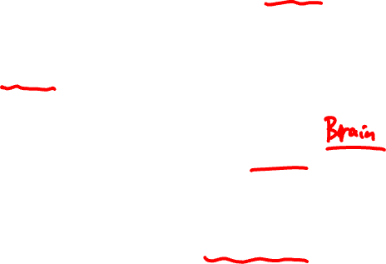
Evolution strategies (ES)
Simulator
actions
state/rewards
Policy
Try lots of different policies and see which one works best!

Slide 23
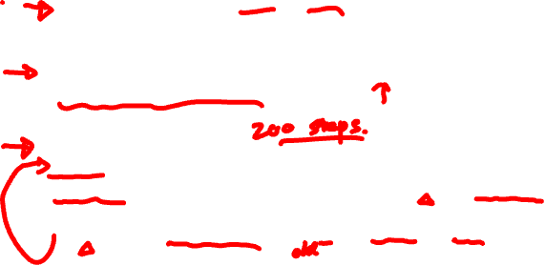
Pseudocode
class Worker(object):
def do_simulation(policy, seed):
# perform simulation and return reward
workers = [Worker() for i in range(20)]
policy = initial_policy()
for i in range(200):
seeds = generate_seeds(i)
rewards = [workers[j].do_simulation(policy, seeds[j])
for j in range(20)]
policy = compute_update(policy, rewards, seeds)

Slide 24
Pseudocode
@ray.remote
class Worker(object):
def do_simulation(policy, seed):
# perform simulation and return reward
workers = [Worker.remote() for i in range(20)]
policy = initial_policy()
for i in range(200):
seeds = generate_seeds(i)
rewards = [workers[j].do_simulation.remote(policy, seeds[j])
for j in range(20)]
policy = compute_update(policy, ray.get(rewards), seeds)

Slide 25
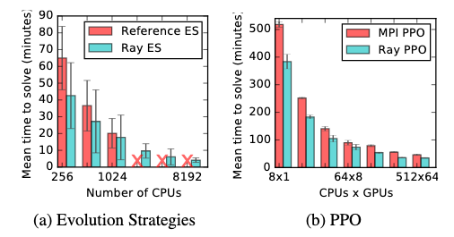
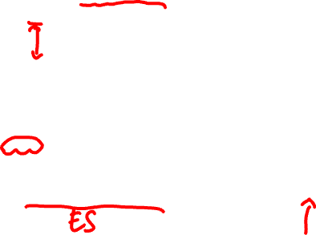
Performance of RL applications

Slide 26
Further discussion
What part of the Ray paper excites you and disappoints you the most?

