Slide 1
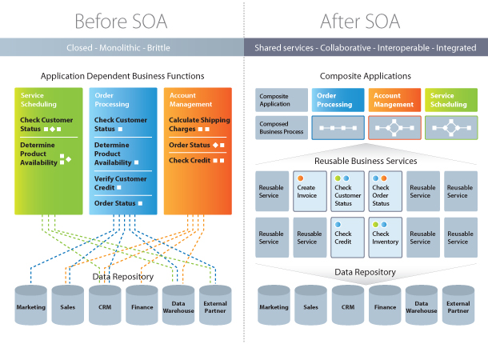
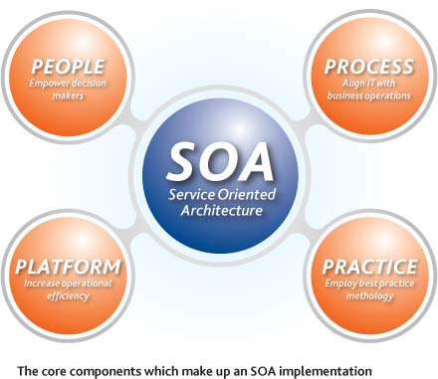
Web Services and SOA
Take the code to the Server
Web Services and Cloud
Telerik Software Academy
http://academy.telerik.com

Slide 2

Table of Contents
The Need for Service-Oriented Applications
Service-Oriented Architecture (SOA)
SOA and Web 2.0
Classical Web Services and Protocols
SOAP, WSDL, HTTP, XML
WS-MetadataExchange
RESTful Web Services

Slide 3


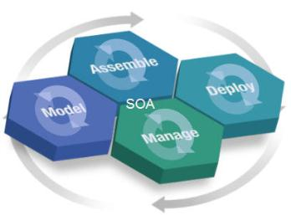
The Need for Service-Oriented (SOA) Applications

Slide 4
Distributed Applications
Most of the modern applications are distributed
Several components which interact with each other
Distributed application models
"Client-Server" model
socket / WebSocket
"Distributed objects" model
DCOM – used in Microsoft Windows
CORBA – open standard, very complex
Java RMI – based on the Java technology
.NET Remoting – used in early .NET Framework
"Web services" / "RESTful Web services" model
RESTful (HTTP, REST, JSON)
Heavy services (SOAP, WSDL, XML, WS-*)

Slide 5
What is a Service?
In the real world a "service" is:
A piece of work performed by a service provider
Takes some input and provides desired results
E.g. a supermarket: pay money and get food
Has quality characteristics (price, execution time, constraints, availability, etc.)
In the software world a "service" is:
Takes some input, performs some work, produces some output
Request-response model (client-server)

Slide 6
Service-Oriented Applications
Service-oriented applications resemble the service-consumer model in the real world
Consist of service provider (server side) and service consumer (client part)
Typical examples are the RIA
Service providers provide some service
Service consumers access the services
Standard protocols are used like XML, JSON, SOAP, WSDL, RSS, HTTP, …

Slide 7
Service-Oriented Architecture (SOA)

Slide 8
What is SOA?
SOA (Service-Oriented Architecture) is a concept for development of software systems
Using reusable building blocks (components) called "services“
SOA = decouple the monolithic software to reusable services
Services in SOA are:
Autonomous, stateless business functions
Accept requests and return responses
Use well-defined, standard interface (protocols)

Slide 9
SOA Services
Autonomous
Each service operates autonomously
Without any awareness that other services exist
Stateless
Do not remember a durable state between requests
Can store state in a database and reference it by ID
Easy to scale -> just add more nodes
Request-response model
Client asks, server returns an answer
Server never sends requests to the client

Slide 10
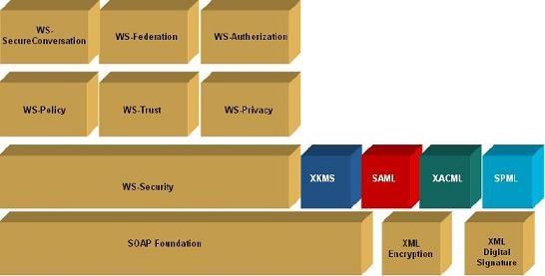
SOA Services (2)
Communication through standard protocols
HTTP, FTP, SMTP, RPC, MSMQ, ...
JSON, XML, SOAP, RSS, WS-*, ..., and more
Platform independent
Not dependent on OS, platforms, languages
Discoverable
Service registries and brokers

Slide 11
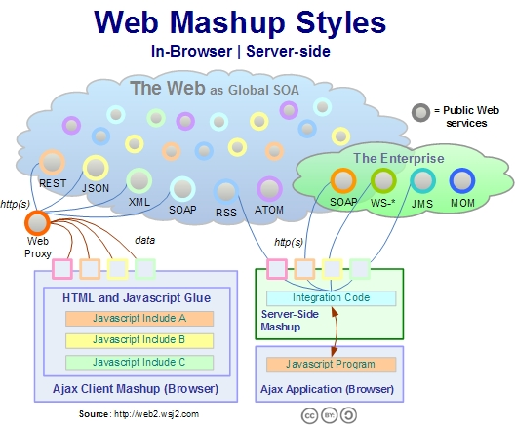
SOA and Web 2.0

Slide 12
SOA and Web 2.0
Moving to a "services model" – global IT trend for both:
Internet business
Inside an enterprise
Two main SOA scenarios
SOA in Internet
Software as service, Web 2.0, RIA, ...
SOA inside an enterprise
Heavy SOA stacks: WS-*, BPM, BPEL, ESB, ...

Slide 13
SOA in Internet
Internet companies implement lightweight SOA in Internet (RESTful)
User simple HTTP requests and simple JSON responses
Also called WOA (Web-Oriented Architecture)
Examples:
Google, Amazon, Facebook, Twitter, Parse.com
Based on lightweight Web standards:
AJAX and Rich Internet Applications (RIA)
REST, XML, RSS, JSON, proprietary APIs

Slide 14
SOA in Enterprises
Heavyweight SOA stacks
Driven by business processes: BPM, BPMN, BPEL, ...
Enterprise application integration (EAI)
B2B integration and SOA based portals
Unified Frameworks: SCA and WCF
Enterprise Service Bus (ESB)
SOA governance (control)
Many public standards like WS-*

Slide 15
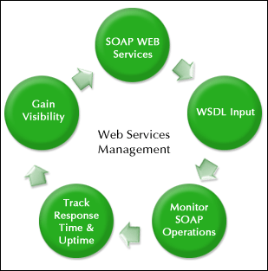
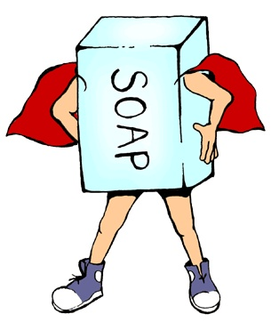
Web Services Infrastructure
SOAP / WSDL / HTTP / XML

Slide 16
Web Services Infrastructure
Heavyweight (classical) web service infrastructure components:
Description
WSDL – Web Server Definition Language
Metadata
DISCO and WS-MetadataExchange (WS-MEX)
Wire format
SOAP, XML, XSD
HTTP

Slide 17
WSDL Service Description
WSDL (Web Services Description Language)
Describes what a Web service can do
Names of the available methods
Input and output parameters, returned value
Data types used for parameters or result
Endpoints: ports and binding
XML based, open standard of W3C
ASP.NET Web services return their WSDL when called with ?wsdl suffix
http://localhost/MyService.asmx?wsdl

Slide 18
WSDL – Example
<?xml version="1.0" encoding="utf-8"?>
<definitions
xmlns:http="http://schemas.xmlsoap.org/wsdl/http/"
xmlns:soap="http://schemas.xmlsoap.org/wsdl/soap/"
xmlns:s="http://www.w3.org/2001/XMLSchema"
xmlns:s0="http://www.devbg.org/ws/MathService"
xmlns:soapenc="http://schemas.xmlsoap.org/soap/encoding/"
xmlns:tm="http://microsoft.com/wsdl/mime/textMatching/"
xmlns:mime="http://schemas.xmlsoap.org/wsdl/mime/"
targetNamespace="http://www.devbg.org/ws/MathService"
xmlns="http://schemas.xmlsoap.org/wsdl/">
<types> … </types>
<message name="AddSoapIn"> … </message>
<portType name="MathServiceSoap"> … </portType>
<binding name="MathServiceSoap" … > … </binding>
<service name="MathService"> … </service>
</definitions>

Slide 19
Discovery of Web Service
The process of getting the service metadata (description)
Usually a URL is interrogated to retrieve the metadata
Two protocols for interrogation
WS-MetadataExchange
standardized protocol developed by Microsoft, Sun, SAP, …
DISCO
old Microsoft protocol to use with the UDDI registries

Slide 20
SOAP – Request/Result Format
SOAP (Simple Object Access Protocol)
Open XML based format for sending messages
Open standard of W3C
A SOAP message consists of:
SOAP header – describes the parameters of the message (metadata)
SOAP body – contains the message (data – the request or the result (response))
Typically SOAP messages are sent over HTTP
Optionally TCP / MQ / Other channels

Slide 21
SOAP Request – Example
<?xml version="1.0" encoding="utf-8"?>
<soap:Envelope
xmlns:xsi="http://www.w3.org/2001/XMLSchema-instance"
xmlns:xsd="http://www.w3.org/2001/XMLSchema"
xmlns:soap="http://schemas.xmlsoap.org/soap/envelope/">
<soap:Body>
<CalcDistance xmlns="http://www.telerik.com/Calc">
<startPoint>
<x>4</x>
<y>5</y>
</startPoint>
<endPoint>
<x>7</x>
<y>-3</y>
</endPoint>
</CalcDistance>
</soap:Body>
</soap:Envelope>

Slide 22
SOAP Result – Example (2)
<?xml version="1.0" encoding="utf-8"?>
<soap:Envelope
xmlns:xsi="http://www.w3.org/2001/XMLSchema-instance"
xmlns:xsd="http://www.w3.org/2001/XMLSchema"
xmlns:soap="http://schemas.xmlsoap.org/soap/envelope/">
<soap:Body>
<CalcDistanceResponse
xmlns="http://www.telerik.com/Calc/">
<CalcDistanceResult>
8,54400374531753
</CalcDistanceResult>
</CalcDistanceResponse>
</soap:Body>
</soap:Envelope>

Slide 23
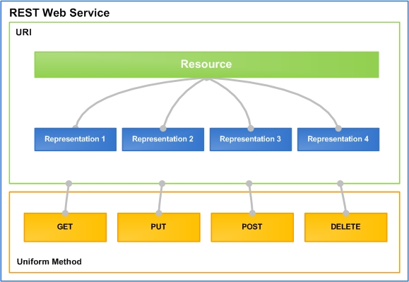
RESTful Web Services
Lightweight Architecture for Web Services

Slide 24
What is REST?
“Representational state transfer (REST) is a style of software architecture for distributed hypermedia systems such as the World Wide Web.”
http://en.wikipedia.org/wiki/Representational_State_Transfer
Application state and functionality are resources
Every resource has an URI
Each resource supports standard operations (CRUD)
This natively maps to the HTTP protocol
HTTP methods: GET (read), POST (create), PUT (update), DELETE (delete), HEAD (meta data), etc.

Slide 25
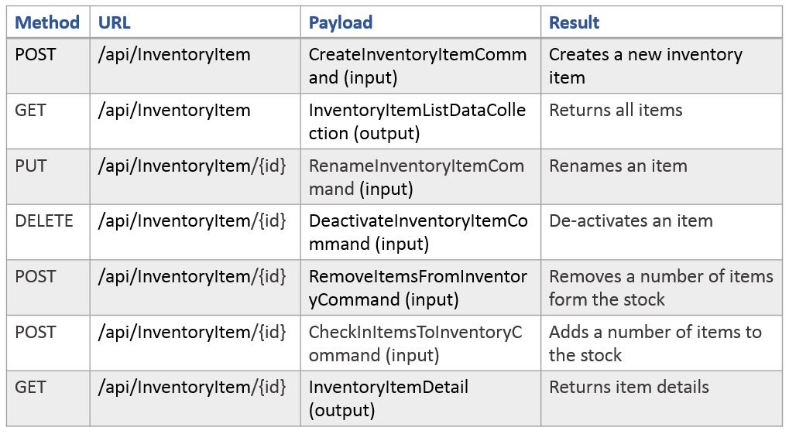
RESTful Services Example
Standard methods and results

Slide 26
RESTful Services Example (2)
One URI for a resource, multiple operations
Add a new document "RestTalk" in category "Code"
POST http://myservice.com/docs/Code/Cats
Get the document / some page
GET http://myservice.com/docs/Code/Cats/2
GET http://myservice.com/docs/Code/Cats/pages/3
Remove the document
DELETE http://myservice.com/docs/Code/Cats/2
Retrieve metadata
HEAD http://myservice.com/docs/Code/Cats

Slide 27
Service-oriented Architecture (3)
Server
Web Client
$.post("server/register", credentials, 'json');
Auth
Register
$.post("server/login", credentials, 'json');
Login
$.getJSON("server/users");
Operations
Desktop client
Users
httpRequest =
HttpRequest.create("server/users");
response = httpRequest.getResponse();
//parse response to C# objects
Add User
Remove User

Slide 28
Web Services and SOA
?
?
?
?
?
Questions?
?
?
?
?
?

