Slide 1
Introduction to Kafka Stream Processing
Travis Deason and Michael Landrum
https://github.com/tdeason416/esports
DS7330 April 25th 2018

Slide 2
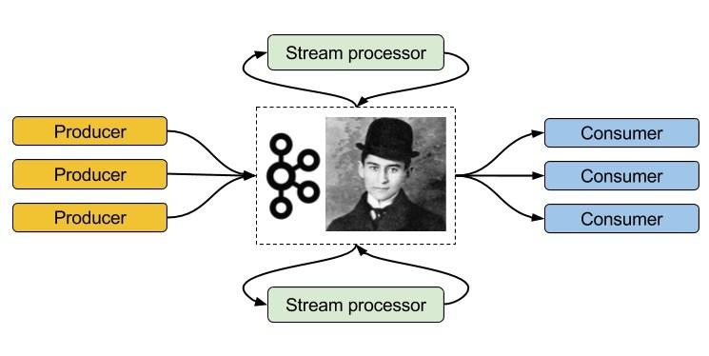
What is Kafka
Kafka is a message system
  Acts like a database where the only indices for the data are sequential integers
Messages are sent to Kafka via one or many producers
Messages are read from Kafka via one or many consumers
Photo ref:
https://i1.wp.com/codeblog.dotsandbrackets.com/wp-content/uploads/2016/11/kafka-1.jpg?resize=745%2C374
Shows a basic concept of what Kafka is used for, and also has a photo of its German philosopher namesake, Franz Kafka

Slide 3
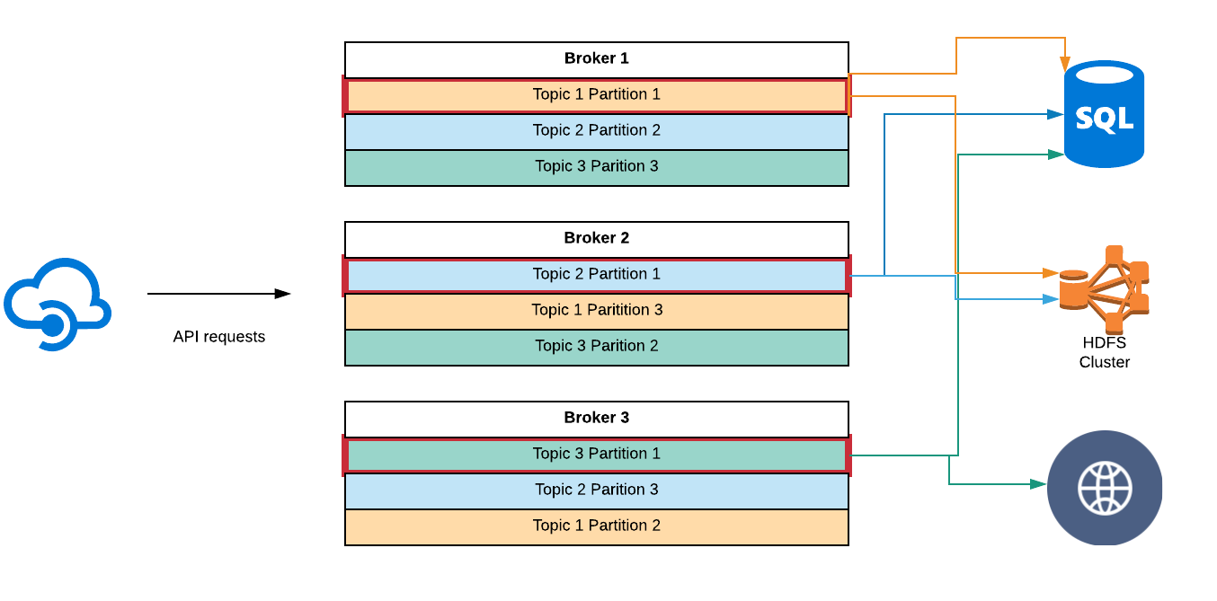
How Does Kafka Work

Slide 4
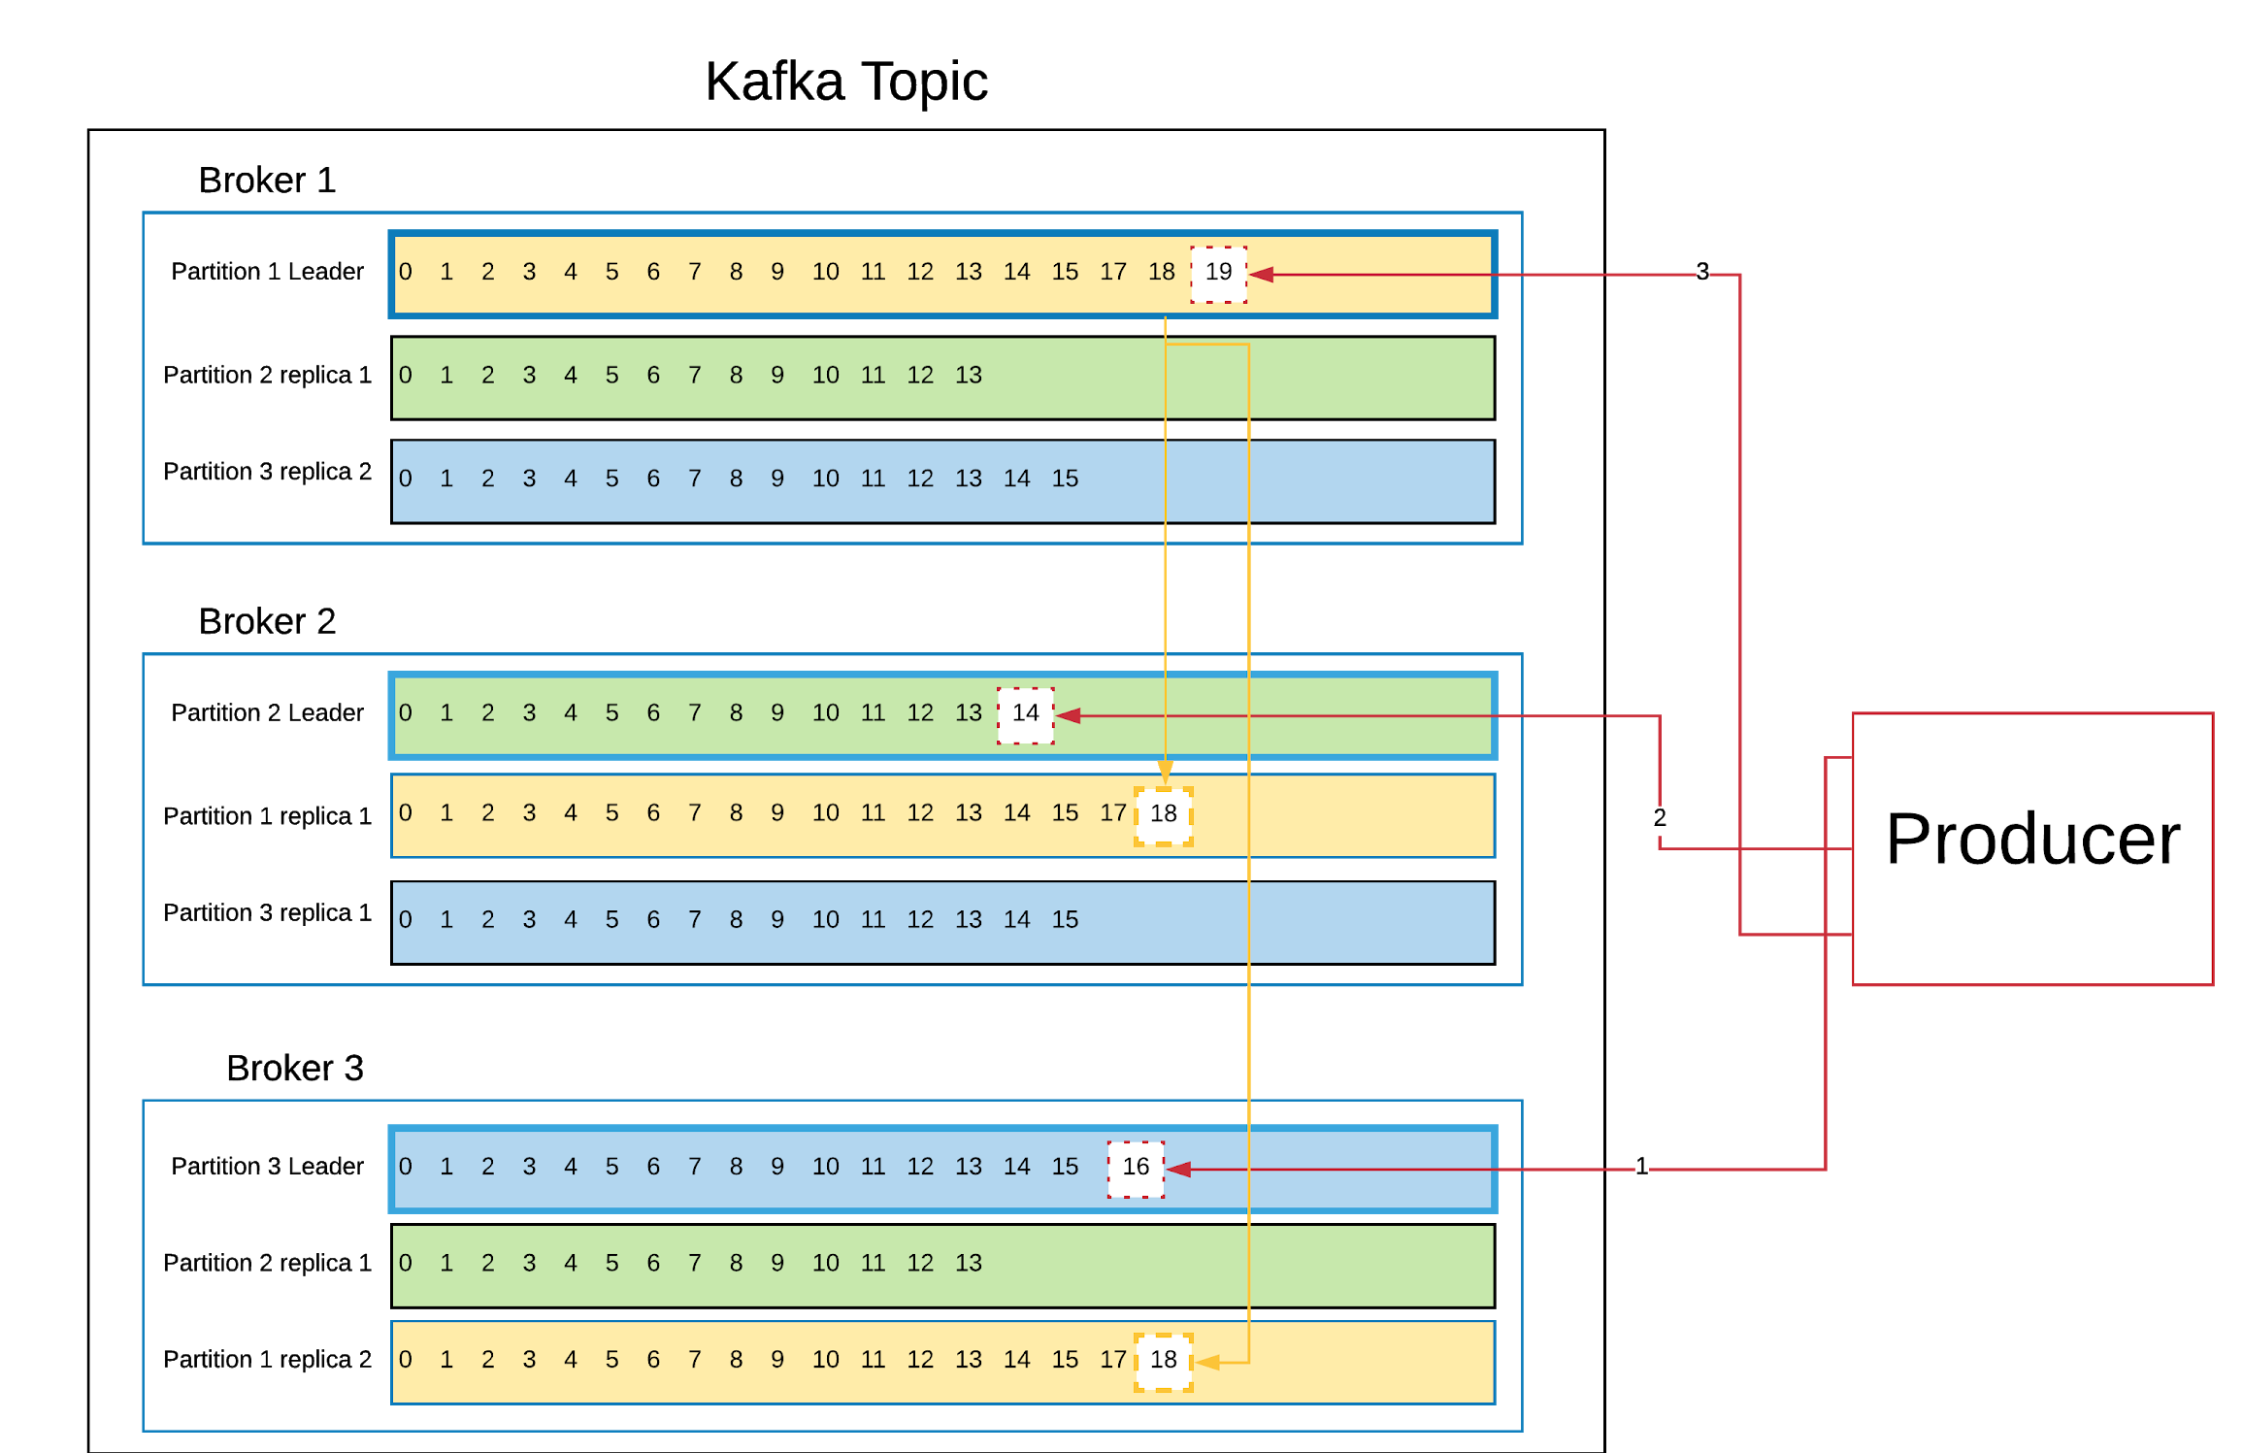
Topics Partitions Offsets and Replicas
A Kafka topic can be split into multiple partitions
  Each partition will contain data unique to that partition
  Each piece of data in the partition can be identified using an integer value called an offset
Partitions can be duplicated by the broker for durability

Slide 5
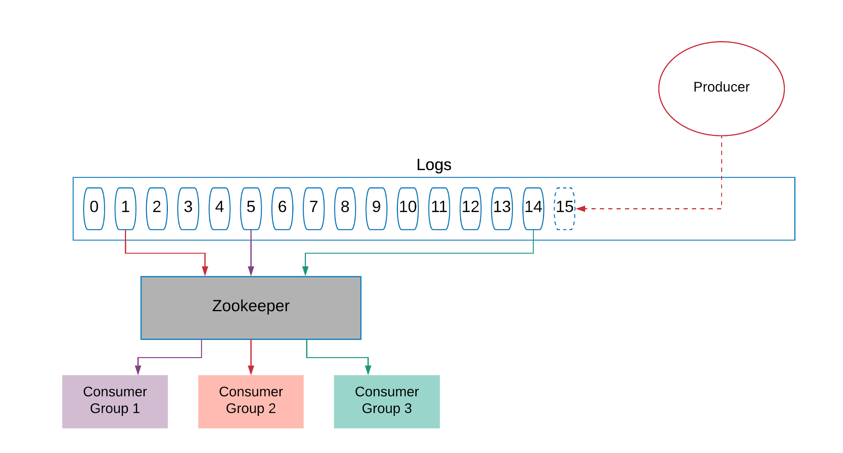
Logs
Kafka Zookeeper keeps a log of which consumers have consumed which offsets
  If a consumer is multiple machines, these can be grouped into a consumer group
Logs allow each consumer to read each message exactly once
  So long as each offset is consumed by only one consumer within a consumer group

Slide 6
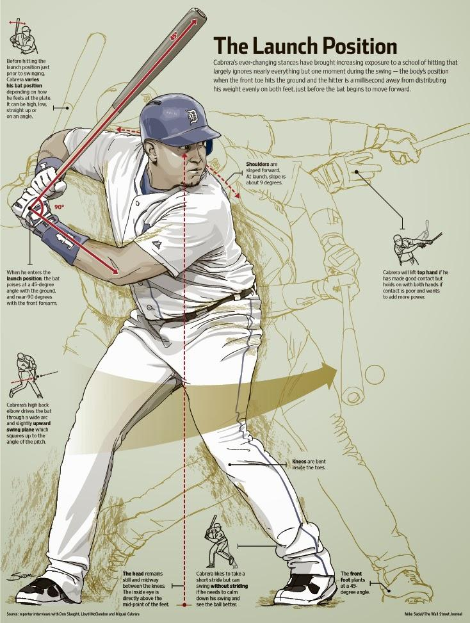
Baseball Streaming Project
To demonstrate a practical application of Kafka, we built a streaming application based which taps into the Major League baseball streaming API available on Sportradar
Source code for this project is at
  https://github.com/tdeason416/esports
Photo ref:
https://www.pinterest.com/pin/42291683975309936/

Slide 7
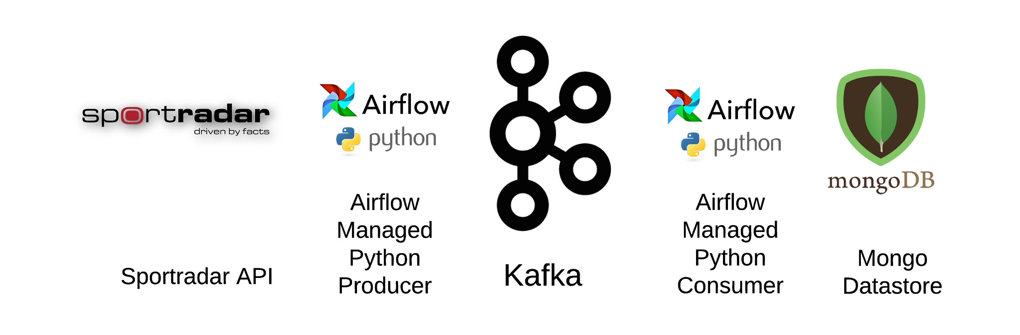
Project Technology

Slide 8
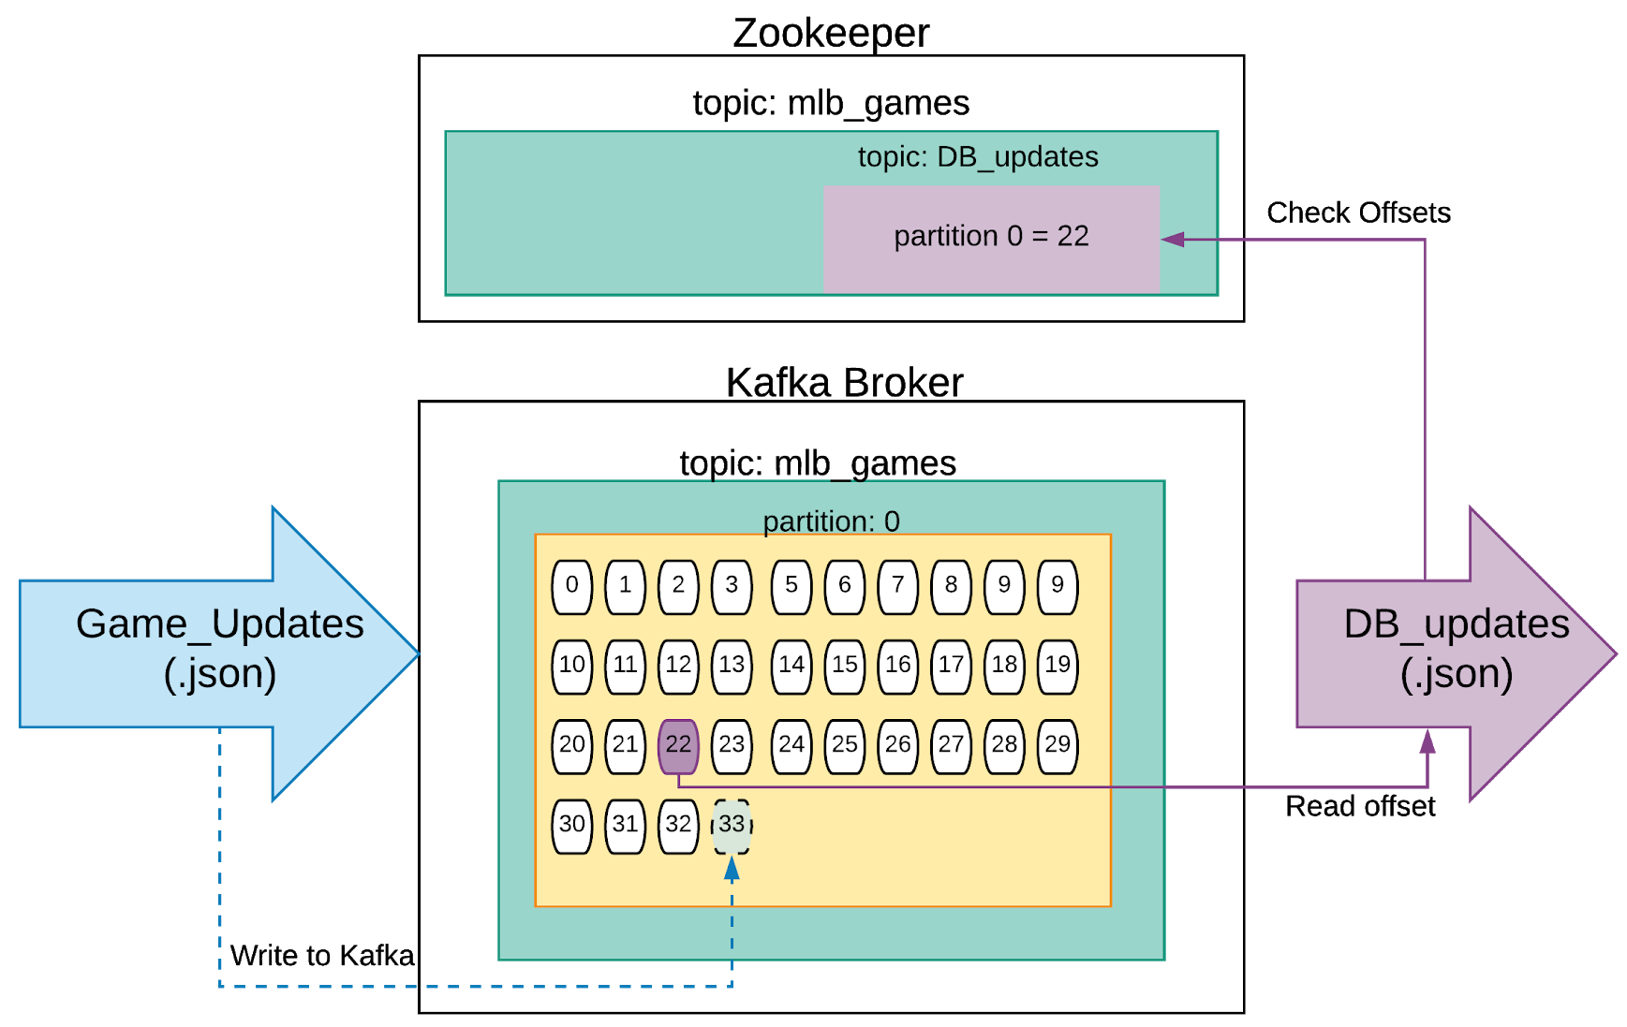
MLB Kafka Architecture
The Kafka cluster consists of a single node which runs both Zookeeper and the Broker
Mlb_games is the only topic
There is only one partition

Slide 9
Questions

