Slide 1
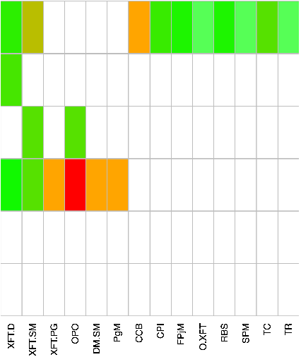

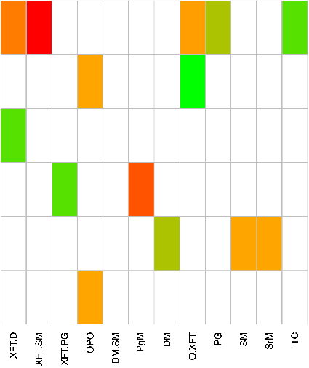
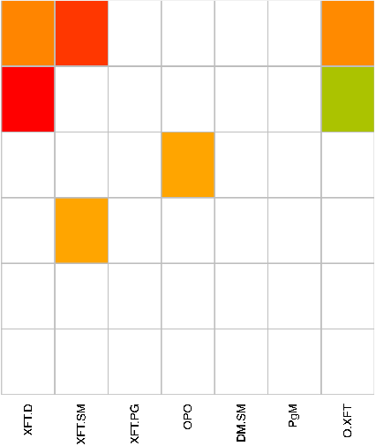

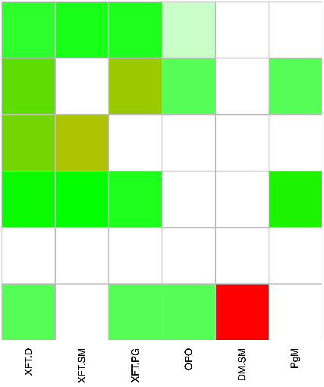


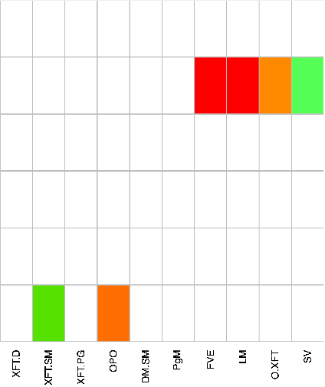

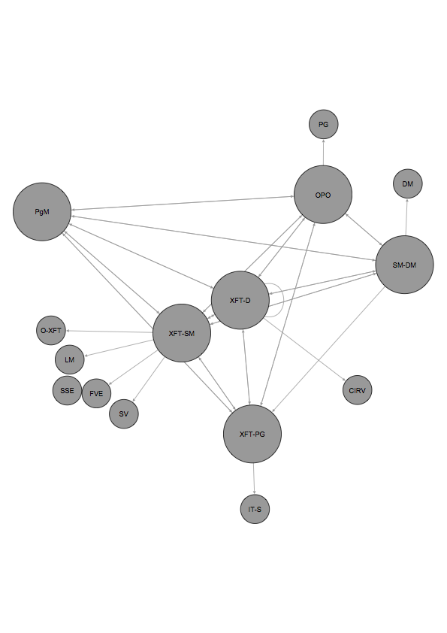
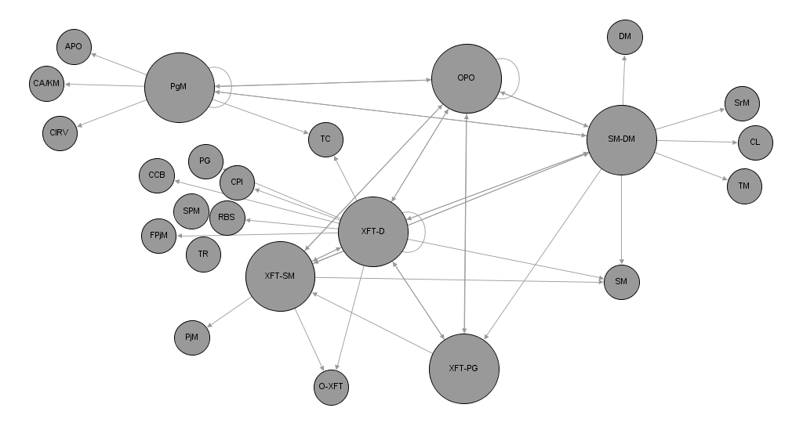
Backlog work on planned sprint goals
Decision Coordination
Exchange of missing knowledge
Resolving technical dependencies
Unexpected change or interruption
XFT-D
XFT-SM
XFT-PG
XFT - 1
OPO
DM-SM
PgM
XFT-D
XFT-SM
XFT-PG
XFT - 2
OPO
DM-SM
PgM
XFT-1
XFT-2
Legend
Abbreviation | Role | Abbreviation | Role
XFT-D | XFT Developer | IT-S | IT Support
XFT-SM | XFT Scrum Master | LM | Line Manager
XFT-PG | XFT Product Guardian | O-XFT | Member of other XFT
OPO | Operative Product Owner | PG | Product Guardian (other)
DM-SM | Department Manager (acting Section Manager) | PjM | Project Manager
PgM | Program Manager | RBS | Radio Base Station
APO | Area Product Owner | SM | Section Manager
DM | Department Manager | SPM | Strategic Product Manager
CA/KM | CA Kanban Master | SrM | Sector Manager
CCB | Change Control Board | SSE | Senior Software Expert
CIRV | Continuous Integration & Release Verification | SV | System Verification
CL | Change Management | TC | Technical Coordinator
CPI | Customer Product Information | TM | Technical Management
FPjM | Feature Project Manager | TR | Trouble Reports
FVE | Functional Verification Engineer

