Slide 1
Post-adoption of agile in large scale organisations: a case study investigating their interrelation
MSc Thesis at Chalmers
Anna Averianova & Tobias Deekens

Slide 2
Problem Statement
Incompatibilities with agile and organisational structures
Organisational structures, information blockages and flow problems
Blurred perception of responsibilities and role descriptions

Slide 3
Purpose Statement
Shed light on communication problems and hot spots
Find reasons and roles involved
Point out mismatches within organisation and agile
Point out mismatches within organisation and agile development

Slide 4
Research Instruments
Daily communication survey
Interviews
Reasons for unusually high intensities
Nature according to roles (islands)
Proof for weak communication paths
Comparison to intended communications
Thoroughness of role definitions
Organisational structure’s impacts on ways of working
Agility of different parts within the organization
Information sharing between different roles
Flow and interruption of work

Slide 5
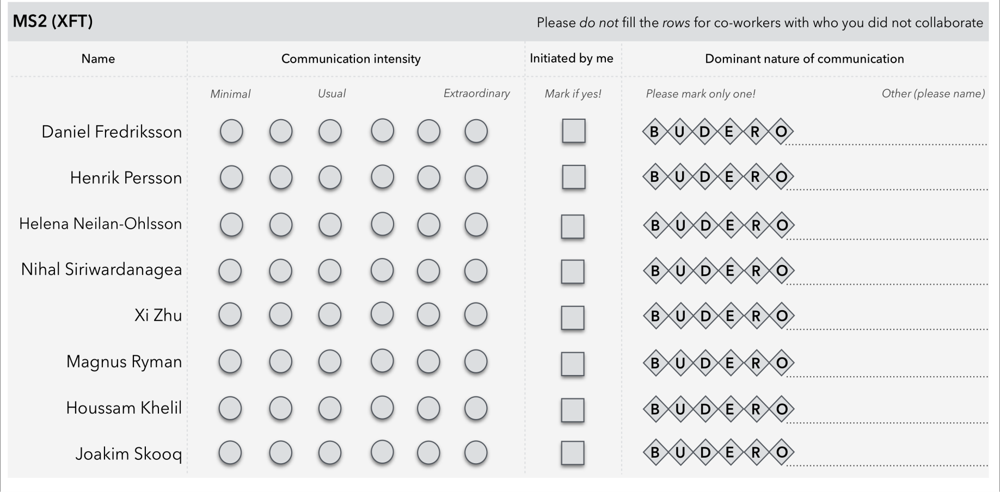
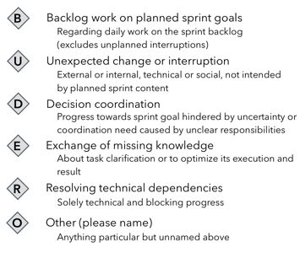
Survey Design

Slide 6
Heat maps

Slide 7
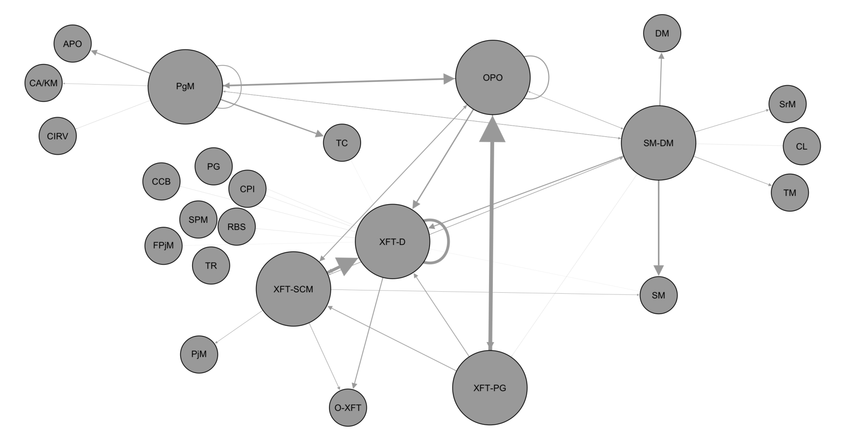
Social Networks

Slide 8
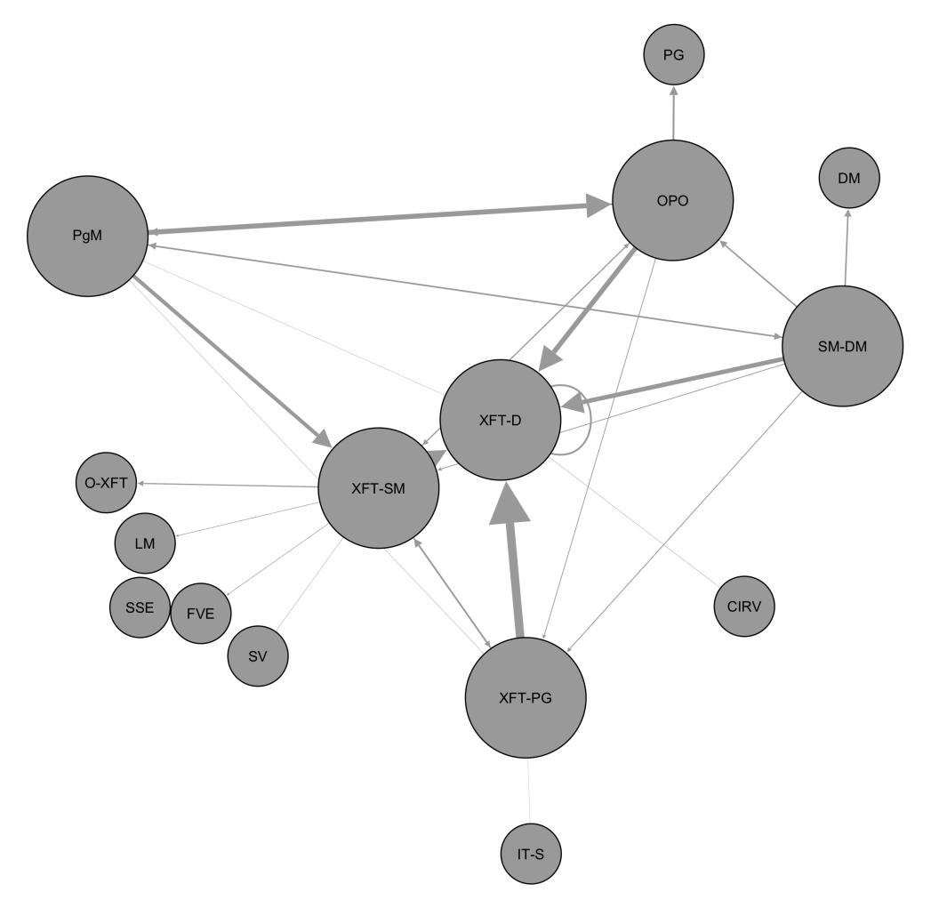
Social Networks

Slide 9
Preliminary results
Survey
Interviews
Scrum master as communication hub
PgMs may be detached from XFT
Technical dependencies cause high intensities
Backlog work results in low intensities
Void of responsibilities
Responsibility overhead for an XFT
Information overflow
Unnatural communication
Lack of vision

