Slide 1
Information and Communication in an Agile Environment
Master’s Thesis
Notes:
Anya

Slide 2
Who are we?
MSc Software Engineering students from Chalmers and GU
Notes:
Anya

Slide 3
What did we do?
Investigation of agile at scale application with respect to information and communication flow challenges and their effect on productivity determinants related to the empowerment of XFTs
Notes:
Anya

Slide 4
Study Concepts
Communication as a form of humans dynamically exchanging information through various channels
Information as a single manifestation of the contents of a message
Notes:
Anya

Slide 5
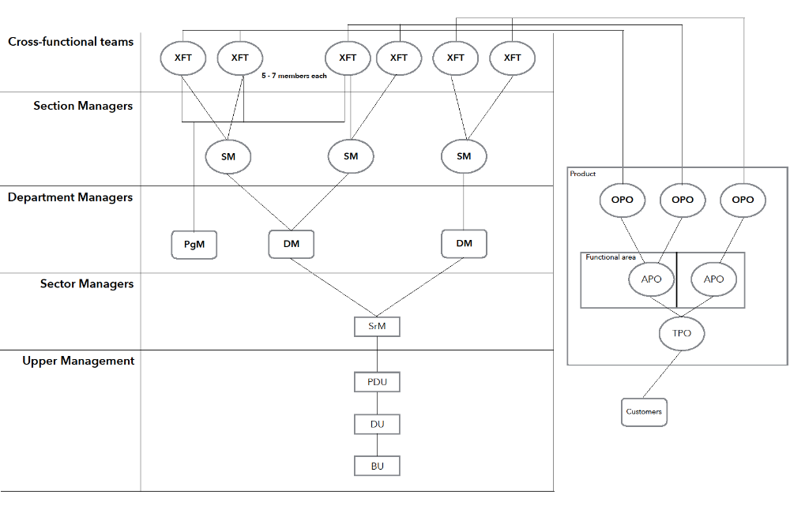
PDU LMR
Notes:
Anya

Slide 6
Research Methods
20 people from 2 XFTs and roles related to them participated in
Surveys (20 people)
Interviews (13 people)
Notes:
Tobi

Slide 7
Participants and Their Roles
Role | Survey | Interview | Survey | Interview
 | XFT 1 |  | XFT 2
XFT Scrum Master | 1 | 1 | 1 | 1
XFT Developer | 5 | 2 | 5 | 2
XFT PG | 1 | 0 | 1 | 1
OPO | 1 | 1 | 1 | 1
DM (acting SM) | 1 | 1 | 1 | 1
Program Manager | 1 | 1 | 1 | 1
Total: | 10 | 6 | 10 | 7
Notes:
Tobi

Slide 8
Surveys
Daily paper hand-out for 1 week with each XFT
Purpose:
  Investigate communication intensisites according to topics
    Visualise through heatmaps
  Construct social networks
Notes:
Tobi

Slide 9
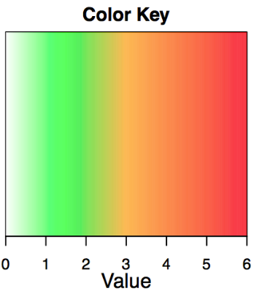
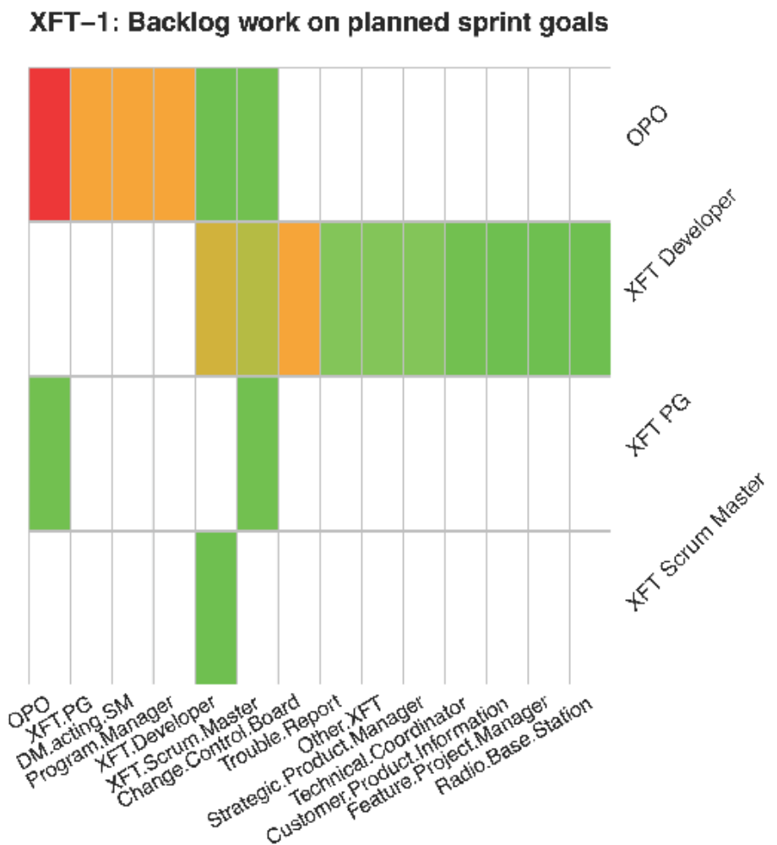
Notes:
Tobi

Slide 10
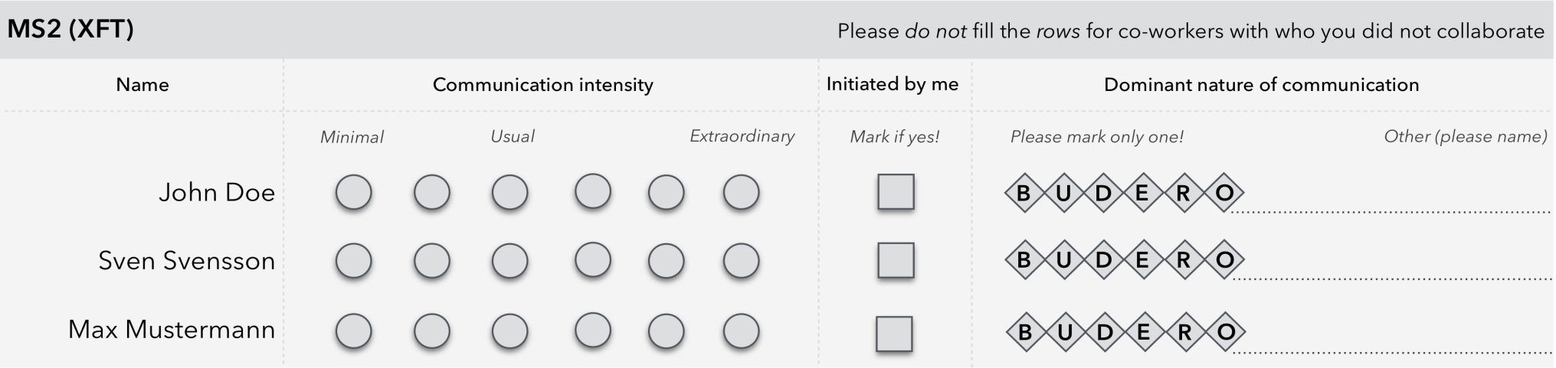
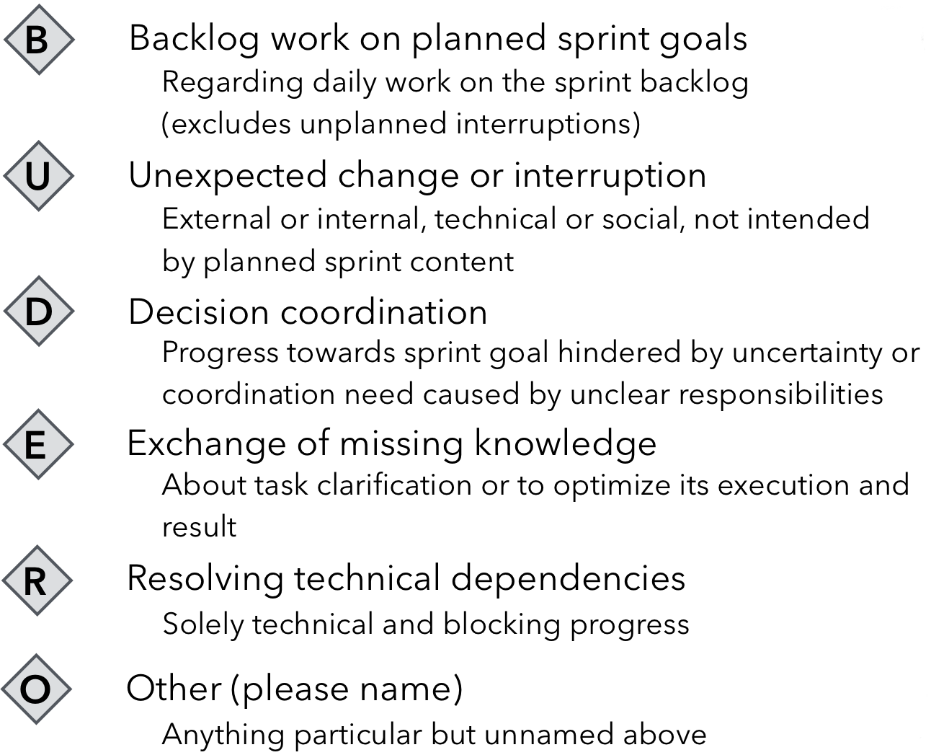
Notes:
Tobi

Slide 11
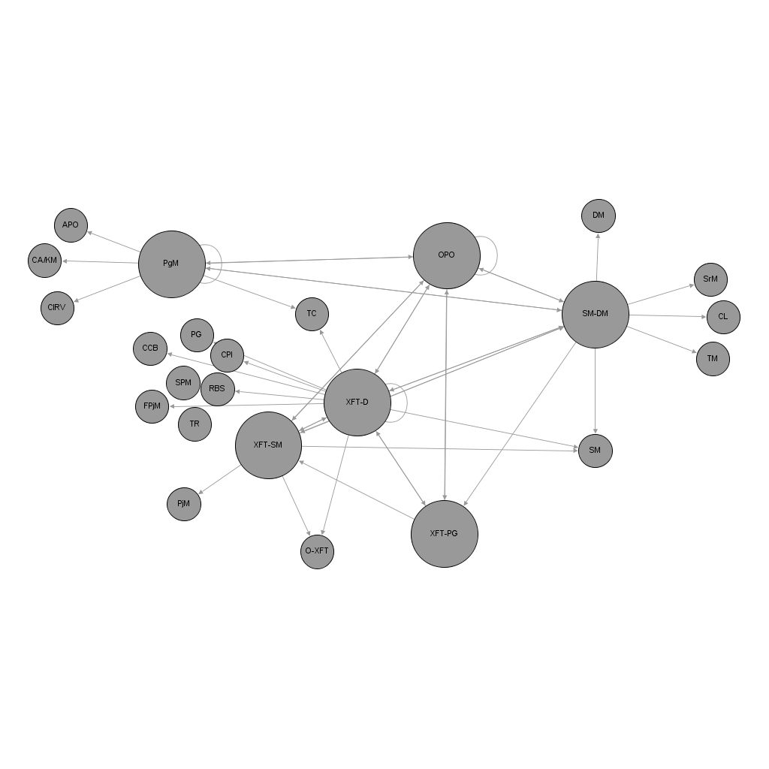
XFT-1: Social Network
Notes:
Tobi

Slide 12
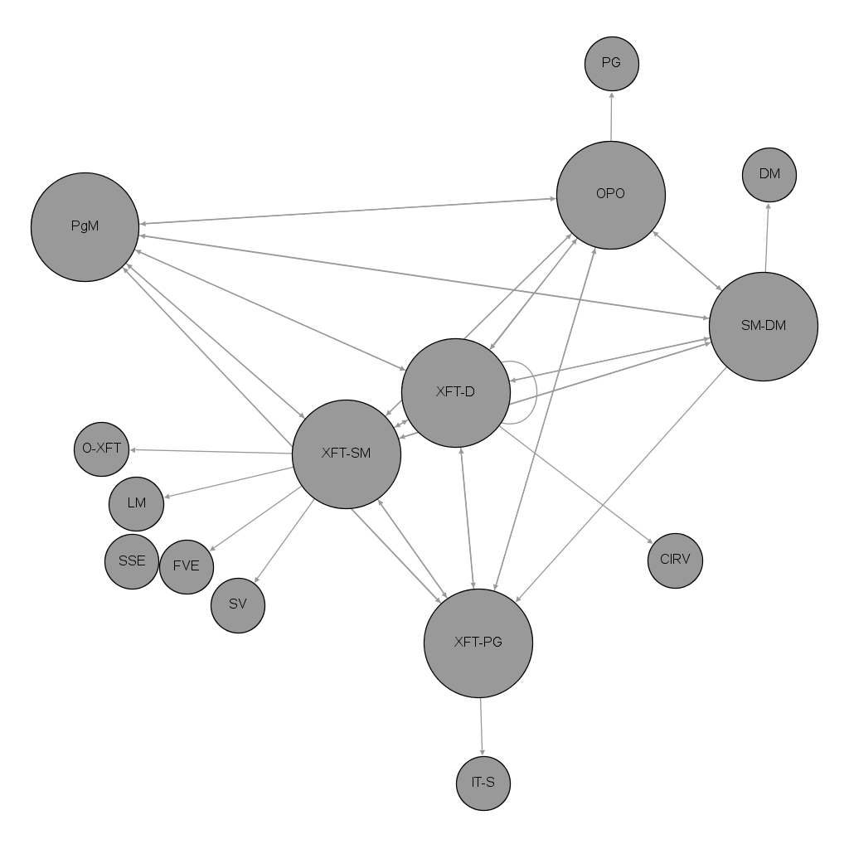
XFT-2: Social Network
Notes:
Tobi

Slide 13
Interviews
Semi-structured 30-60 minutes long interviews
Purpose:
  Investigate challenges related to communication and information flow
    Study their influence on the productivity determinants of XFTs
Notes:
Anya

Slide 14
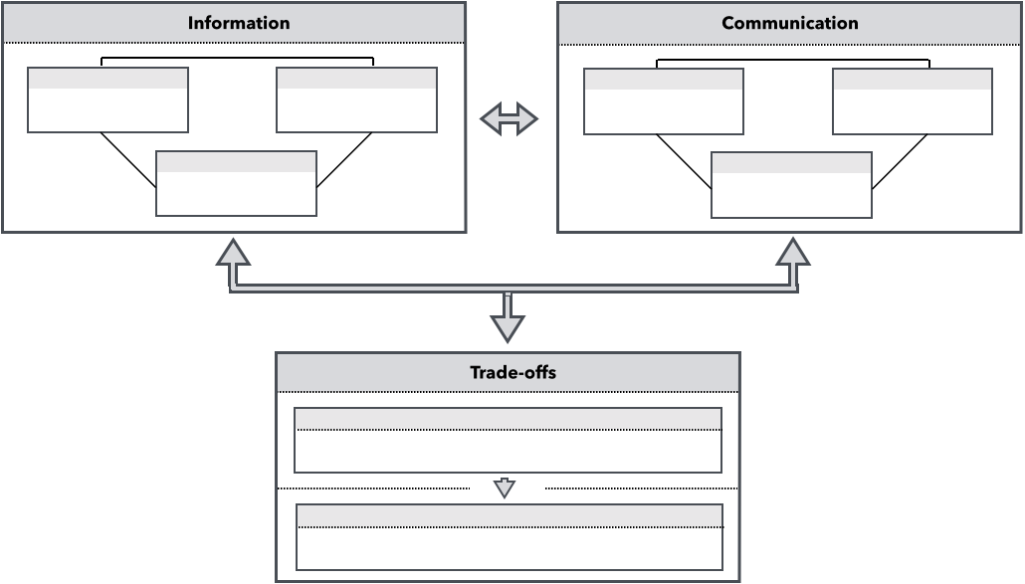
Overview
Notes:
Anya
We analysed the data obtained from the interviews and structured it in a way you can observe from this diagram. I & C, as mentioned, have been analysed separately yet there is mutual influence between the two. Inside each topic we have Challenges, Potential Improvements, Benefits.
Their interplay, in turn, influences the organisational trade-offs on which we will elaborate later. As for now, we will start with the top two boxes.

Slide 15
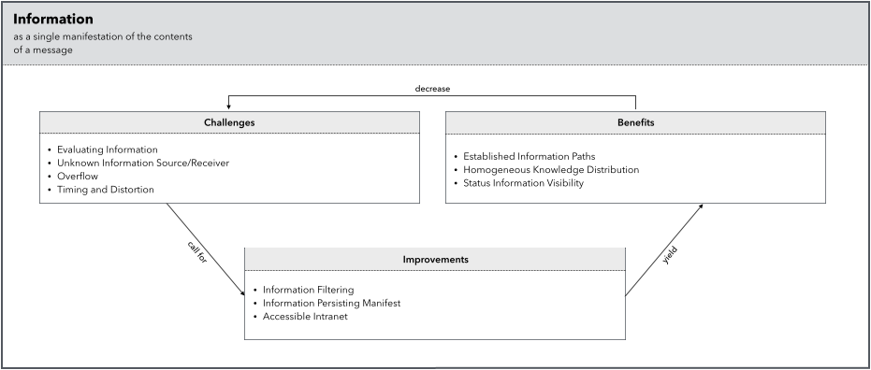
Information
Notes:
Evaluating info: info - no evaluation process -> same issue described differently -> which on is valid/approved?
Uknown S/R: 1) Broadcast to everyone ”so that you know”; 2) Wikis hard to find; 3) Unknown domain – where to start searching? 4) Who to ask? 5) Reliant on personal contacts rather than info flow.
Overflow: Emails (work-related, newsletters etc), demo, syncs => physical limitations, potentially loosing
T & D: meeting parted by days -> info travel, rumors start -> teams have different info = who to trust?

Slide 16
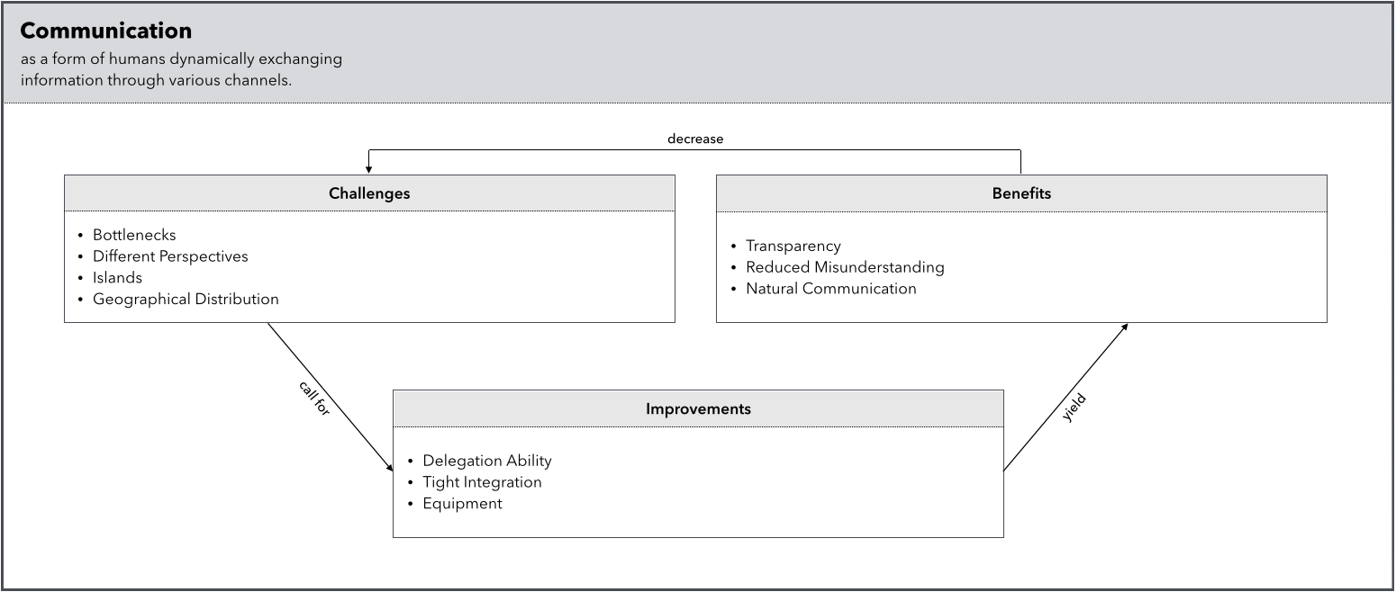
Communication
Notes:
Tobi

Slide 17
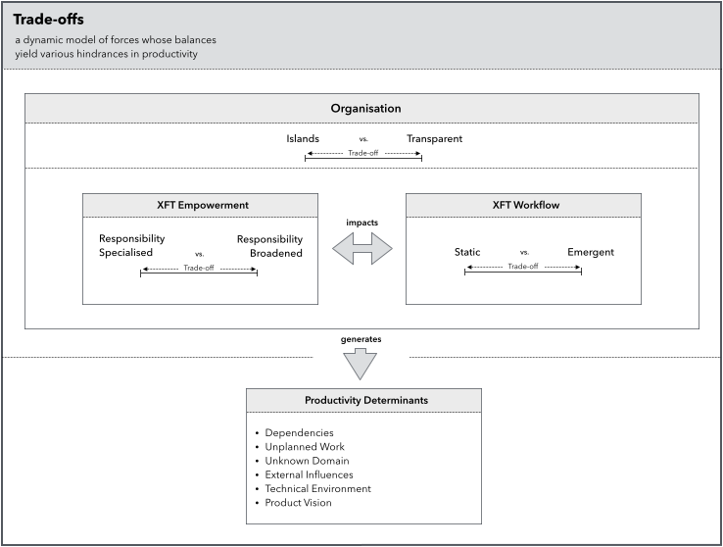
Notes:
Tobi

Slide 18
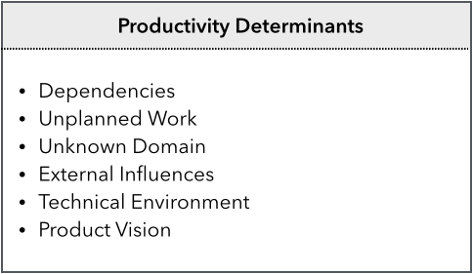
Notes:
Anya
Dependencies: 1) US – book a meeting, discuss, start working; 2) progress of others (delivery delayed); 3) hidden – work invalidated.
Heat Map next!!!

Slide 19
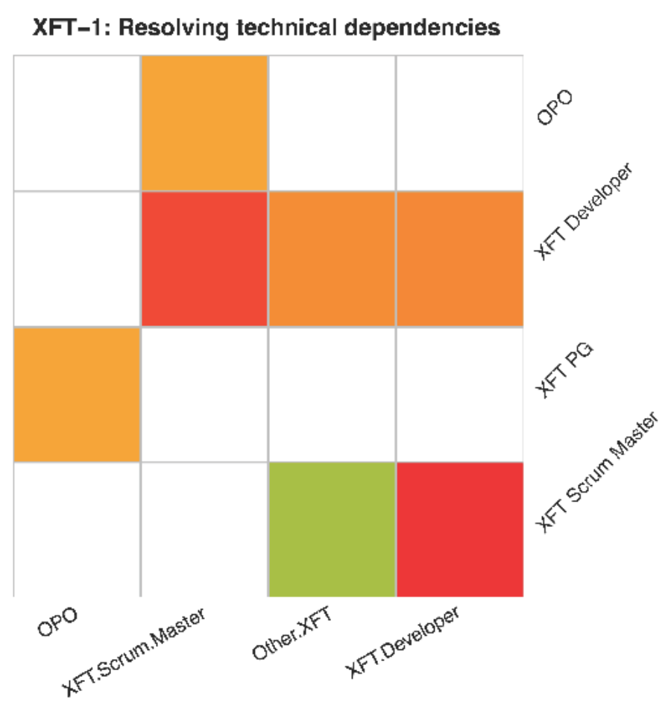
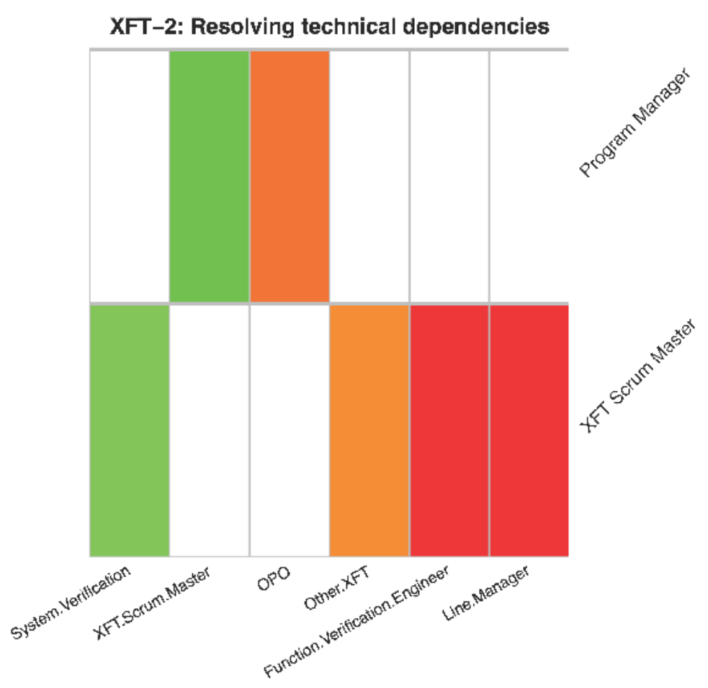
Notes:
Anya
However, dependencies are readily discussed.
Something usual. Or worse. High intensity (red wins over green).
XFT-D accumulates 5 responses

Slide 20
Notes:
Anya
UW TR -> concentrate on reports; affects velocity (people: us -> tr)
HEAT MAP

Slide 21
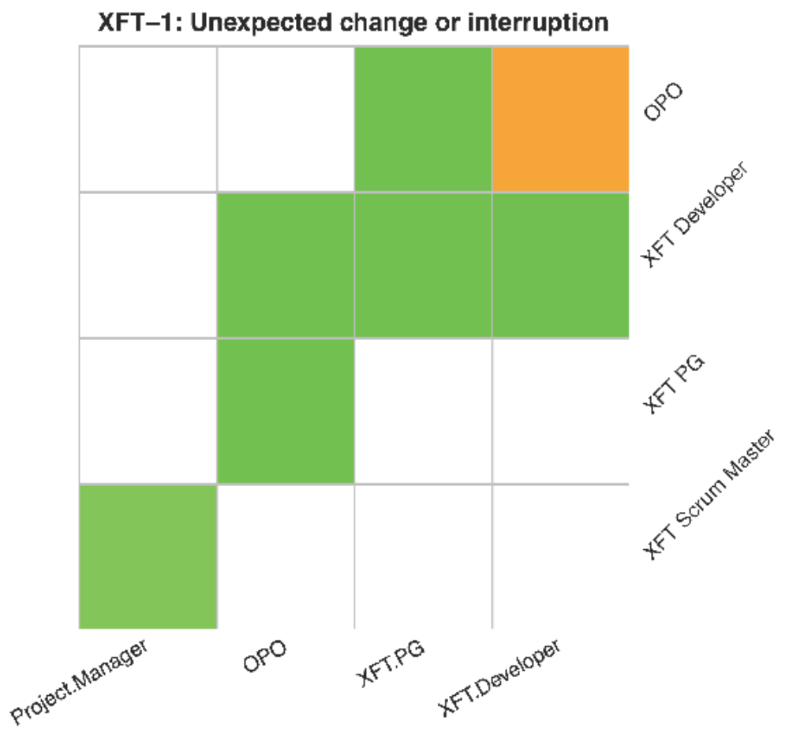
Notes:
Anya
XFT-1
Doesn’t create extra disturbance compared to normal work. See green for XFT mostly (some yellow in B)

Slide 22
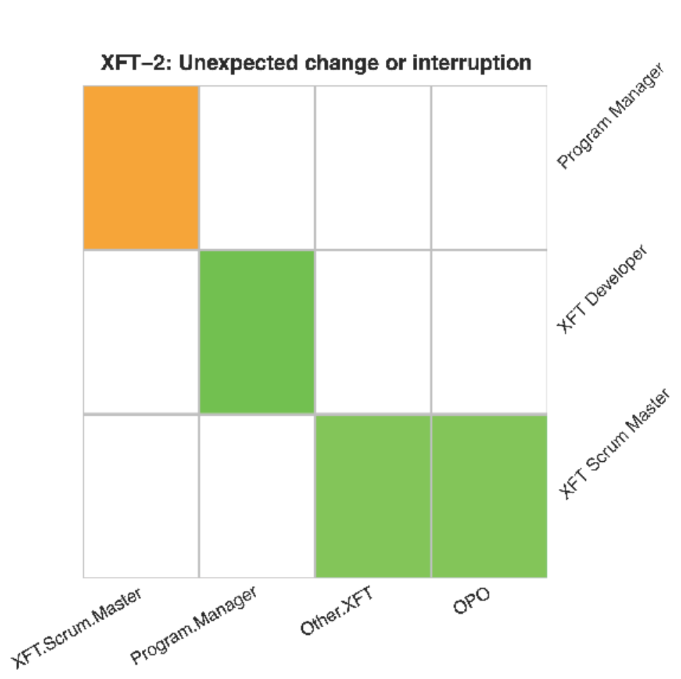
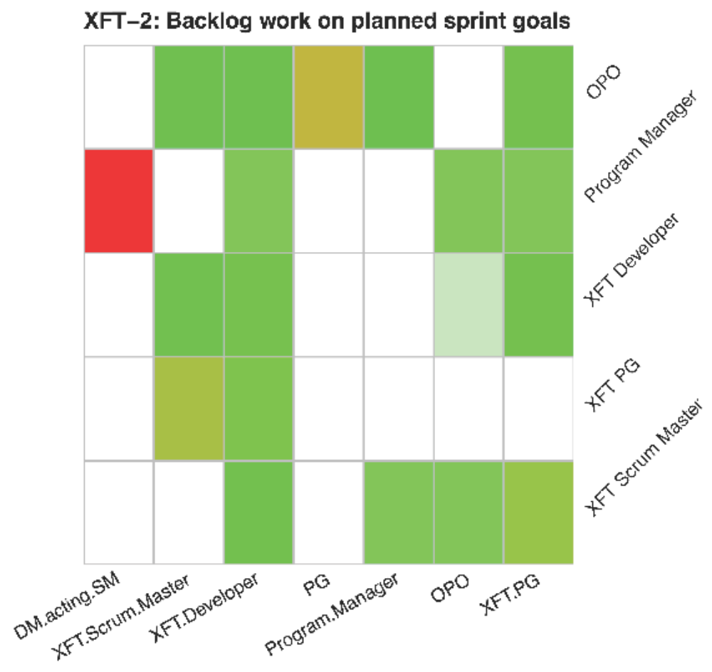
Notes:
Anya
XFT-2
Similar, green for the XFT

Slide 23
Notes:
Anya
UD: 1) long time to familiarise; 2) disrupts sense of single purpose
EI: 1) Urgent reprio; 2) Forced participation in meetings not affecting the team; 3) Affecting but far ahead
TE: empowered, but competence is not there (to solve the problem you need to own it). Affected by factors outside their responsibility or competence.
PV: closer to customer, motivation, higher quality.
- not enough/different perspectives
- carrier: don’t see useful as will change
- not inteseted
- SOCIAL NETWORK

Slide 24
XFT-1: Social Network
Notes:
Anya
APO <-> XFT through OPO and PgM

Slide 25
Conclusions
We touched the base, what is next?
More surveys with more XFTs – more profound and diverse findings
Relation of productivity determinants to different trade-offs positioning
Notes:
Tobi

Slide 26
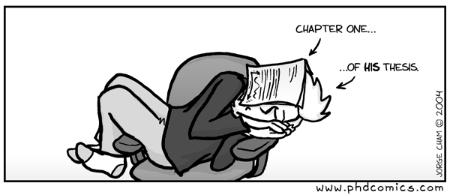
Questions?
Notes:
Tobi

