Slide 1
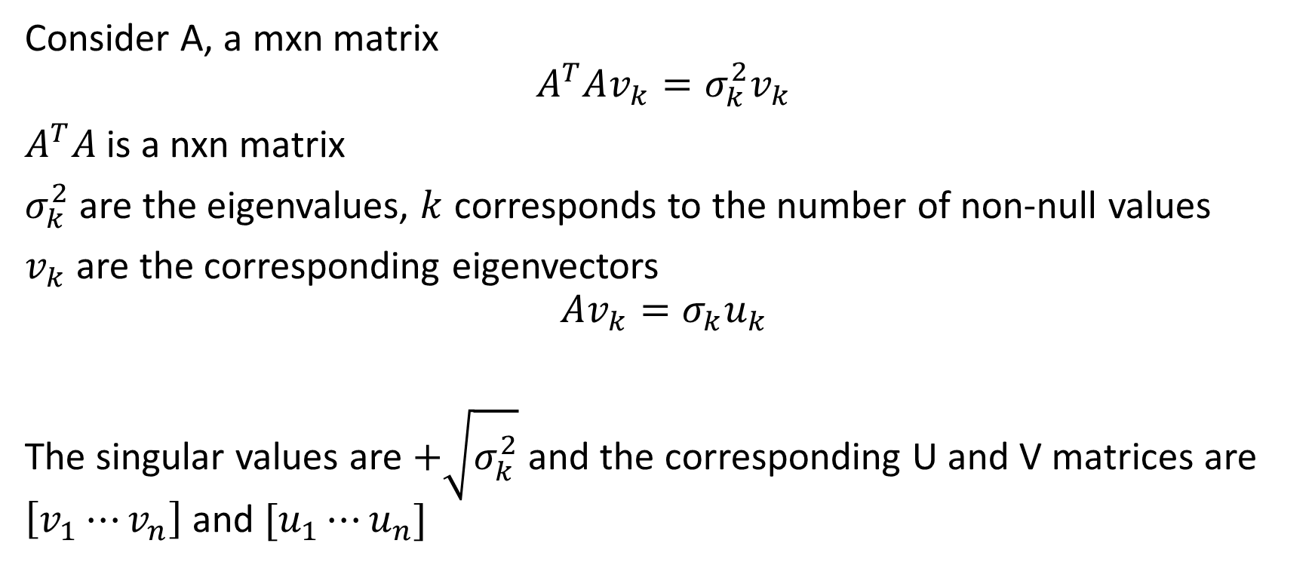
Definition of SVD
Consider A, a mxn matrix
$$A^{T}Av_{k}=σ_{k}^{2}v_{k}$$
$A^{T}A$ is a nxn matrix
$σ_{k}^{2}$ are the eigenvalues, $k$ corresponds to the number of non-null values
$v_{k}$ are the corresponding eigenvectors
$$Av_{k}=σ_{k}u_{k}$$
The singular values are $+\sqrt{σ_{k}^{2}}$ and the corresponding U and V matrices are $\left[v_{1}⋯v_{n}\right]$ and $[u_{1}⋯u_{n}]$

Slide 2
Matlab function svd vs. definition

Slide 3

Value in latex printf
C’est trop moche même quand j’utilise des real et positive symbolic values

Slide 4
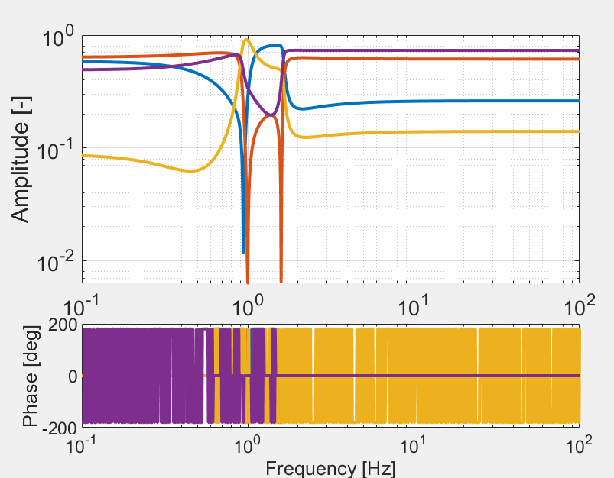
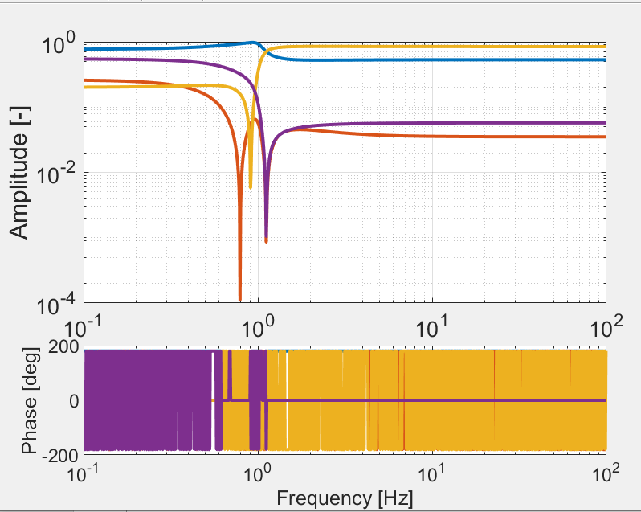
Try to see if plotting the U and V matrix depending on the frequency is relevant
U(1:4,2)
NO
NO
U(1:4,3)

Slide 5
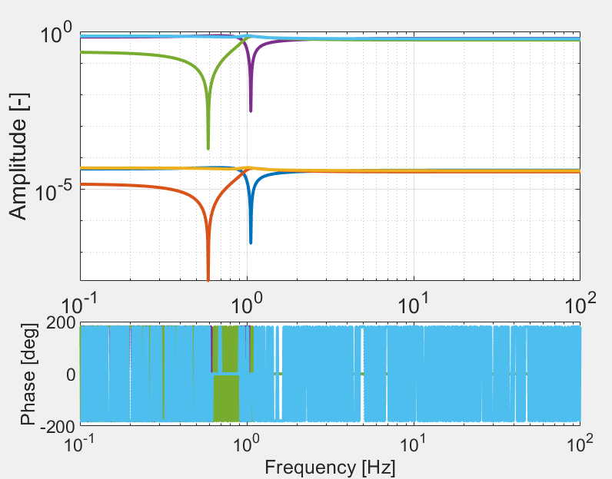
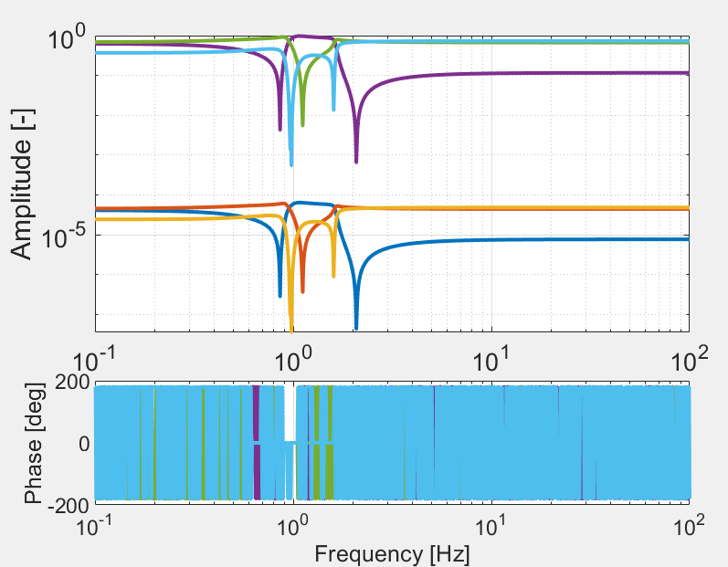
V(1:6,3)
V(1:6,2)

