Slide 1
safety -> safe.ly

Slide 2
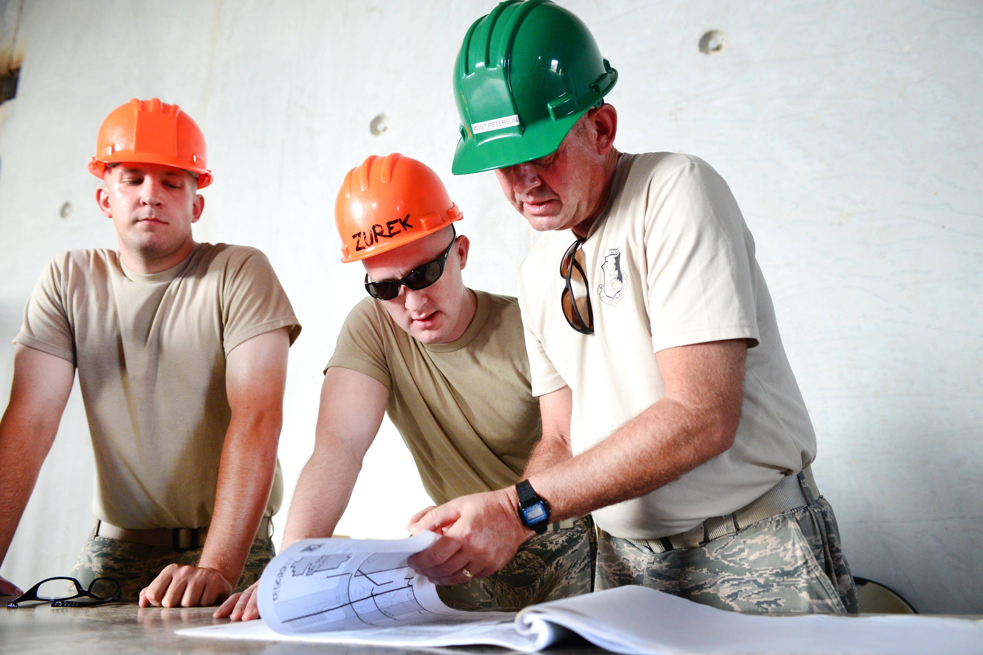
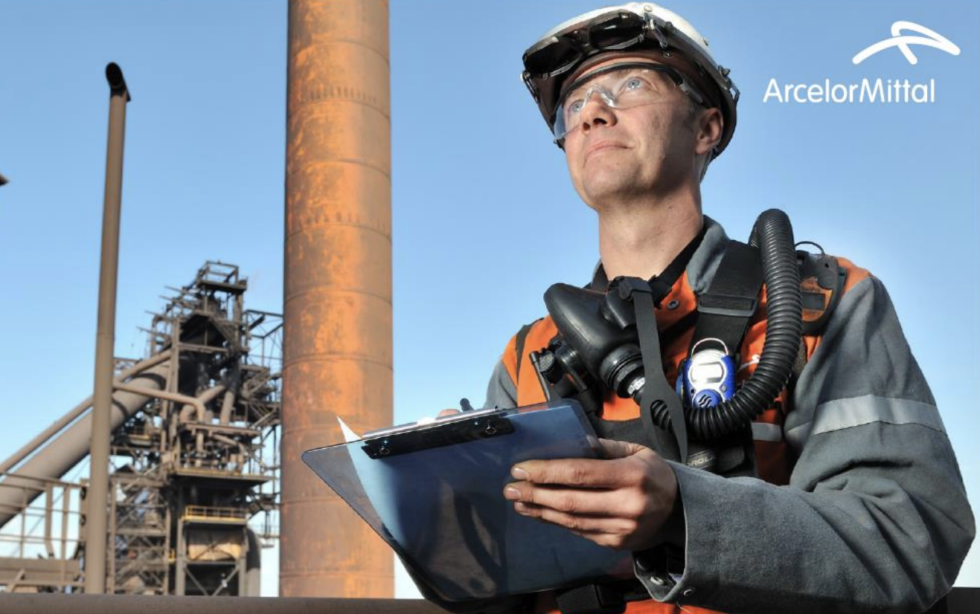

Timeline

Slide 3
safe.ly
Timeline
Notes:
Start the work with coffee but soon enough it turns into a reading excercise
Too many documents?
How to find what I really need in seconds (topic)?
What/where are related documents?
Go to work 5 minutes after I finish my coffee (not 1h)

Slide 4


safe.ly – the language of safety
type your question here…
Hello Worker!
How can I help you today?
safe.ly

Slide 5
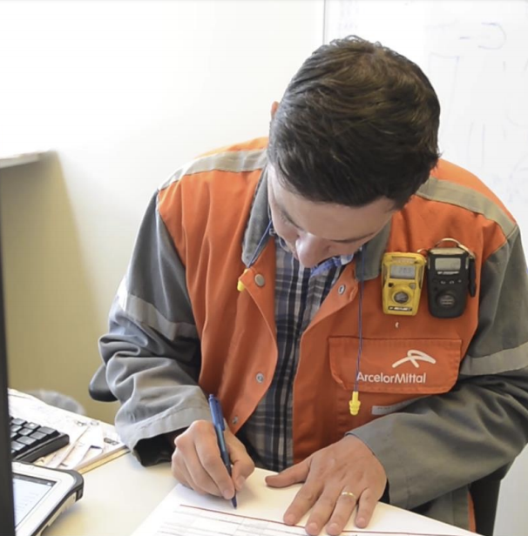
Our Magic Solution – safe.ly
What?
How?
Reinvents and facilitates the preparation process for workers…
Context recognizing engine to
search through big amounts of various documents and
find the appropriate topic the worker needs to focus on at that moment
safe.ly
safe.ly

Slide 6







Question
SEARCH
Hello Worker!
How can I help you today?
safe.ly

Slide 7

Search & find docs
Question
SEARCH
Search & find docs
Hello Worker!
How can I help you today?
safe.ly

Slide 8
Search & find docs
Find topics
Question
SEARCH
Search & find docs
Find topics
Hello Worker!
How can I help you today?
safe.ly

Slide 9
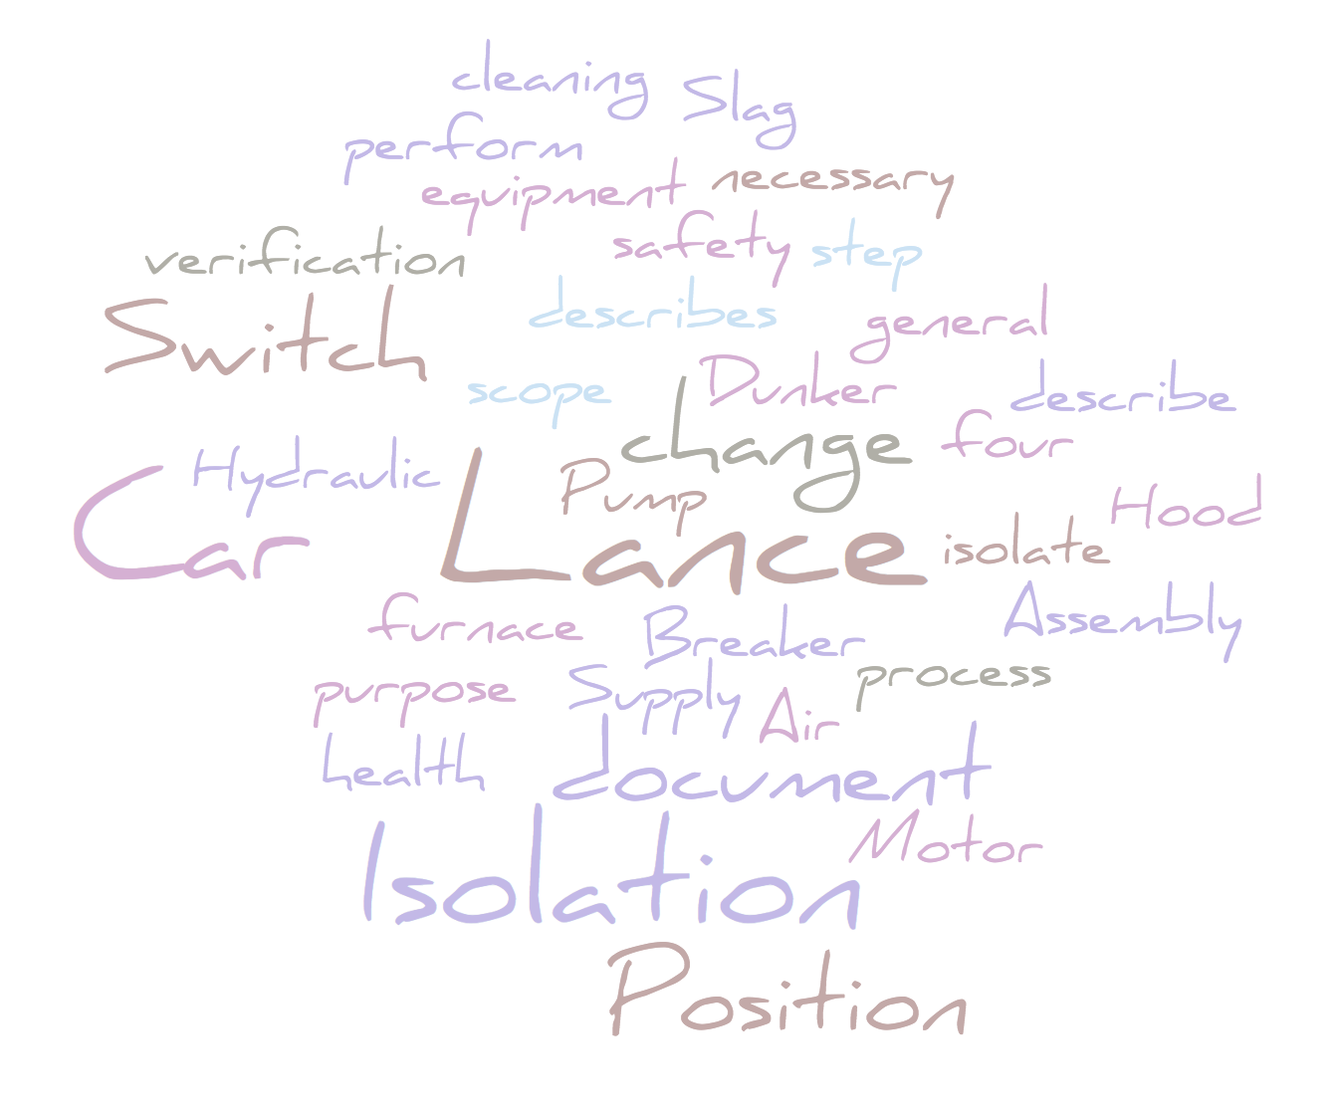
Search & find docs
Find topics
Question
Question
“lance car responsibilities”
Search & find docs
#1 Lance Car… #2 Lance Car… #3 Lance Car… | #1 Lance Car Responsibilities Understanding this work instruction and/or process. Providing input into improving this work instruction and/or process. Correct execution of this documented work instruction and/or process.
Find topics
Recent searches
safe.ly

Slide 10
Safety worker DEMO
Demo
Time
“What are the responsibilities to perform general cleaning of Lance Car?”
safe.ly

Slide 11






The team – B&D’s safe.ly members
in less than 48h we did what?
Recognize topics
Structure documents
(word and pdf)
Setup search engine
Setup NLP for topic recognition
… and
Wrote a bunch of python and R code
Prepared a simple
Shiny R app
…
Synapse
B&D’s Innovation Hub
Project kickstarter
Startup funder
Mind developer
Notes:
… Learned a lot about the steel making process!

Slide 12
safe.ly
saves time; lives
Notes:
Make us more productive
change the way workers execute their preparation process

Slide 13
Next up…
Robust end user application
Classify all types of documents
Create summaries per topic
More advanced text-mining capabilities per document section to allow for:
more relationship detection
identification of key points
cross-refecences with the industry standards (external data)
safe.ly

