Slide 1


SportyPal on Android
The real world of mobile applications
Tomche Delev
JUGMK technical presentation
03.04.2010

Slide 2
Agenda
Introduction to Android
What is SportyPal?
Application Features
The development process
Demo
Example Application
Questions

Slide 3
What is Android?
Android is a software stack for mobile devices that includes an operating system, middleware and key applications. The Android SDK provides the tools and APIs necessary to begin developing applications on the Android platform using the Java programming language.
http://developer.android.com
(Download and installation instruction)

Slide 4
Features
Application framework enabling reuse and replacement of components
Dalvik virtual machine optimized for mobile devices
Integrated browser based on the open source WebKit engine
Optimized graphics powered by a custom 2D graphics library; 3D graphics based on the OpenGL ES 1.0 specification (hardware acceleration optional)
SQLite for structured data storage
Media support for common audio, video, and still image formats (MPEG4, H.264, MP3, AAC, AMR, JPG, PNG, GIF)
GSM Telephony (hardware dependent)
Bluetooth, EDGE, 3G, and WiFi (hardware dependent)
Camera, GPS, compass, and accelerometer (hardware dependent)
Rich development environment including a device emulator, tools for debugging, memory and performance profiling, and a plugin for the Eclipse IDE

Slide 5

Android Architecture

Slide 6
Application Fundamentals and Building Blocks
Every application it's own process (own VM)
Building blocks
Activity – UI Correspondent typically corresponding to one screen
IntentReceiver – Responds to notifications or status changes. Can wake up your process.
Service – Faceless task that run in the background
ContentProvider – Enable application to share data.

Slide 7
What is SportyPal?
Multiplatform mobile application (J2ME, Android, WinMo, iPhone, Blackberry)
Workouts application
Mapping application
Trainer application
Sharing application

Slide 8
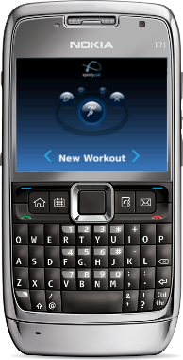
J2ME vs Android
First time developed as J2ME application
J2ME a small subset from J2SE
Not just simple porting

Slide 9
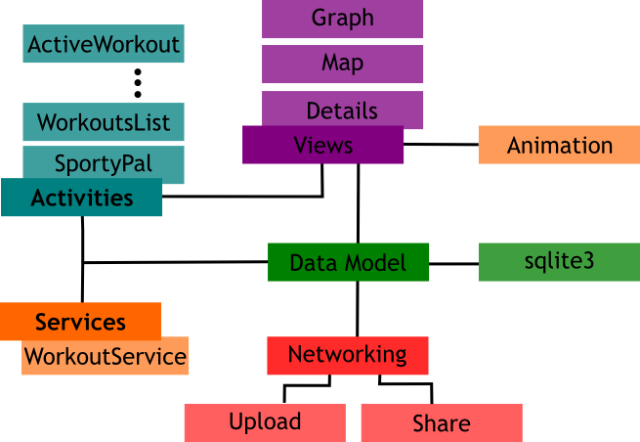
SportyPal Software Architecture

Slide 10
Development process
Activities and services as application blocks
SQLite database as persistence storage
Apache HTTP client for uploading and sharing
Efficient List Adapters for workouts list implementation
ContentProvider implementation, integration with upcoming SportyPalBike

Slide 11
Application features
Compelling UI
Long time stability and auto-saving
Web site integration (upload of workouts)
Integration with social networks (facebook, twitter)
Multiple resolutions support
  HTC Tattoo (240 x 320)
  HTC Magic (320 x 480)
  Motorola Milestone (480 x 854)
~40000 downloads from market up to date

Slide 12
Demo - www.sportypal.com

Slide 13
User Comments
Tried a few of these apps and this one hands down the best so far. Quick and accurate gps, all the necessary features, easy to use.

Slide 14
User Comments
I've tried them all!! Sportypal is THE BEST! I'm talking prime rib, everything else are side dishes. :)

Slide 15
User Comments
Developers thank you! Voice was only one missed. Sportypal with voice and 3D is unbeatable, GREAT

Slide 16
User Comments
Doesn't work on the treadmill.

Slide 17
Example Application
Take current location
Add some description
Persist to sqlite
Show on listView

Slide 18

Thank You for The Attention!
Questions???

