Slide 1
TCP Flow Behavior
TJ Dennis

Slide 2
Transmission Control Protocol
TCP is a standardized method of establishing and maintaining a connection to send data.
Packets are the base unit of data sent between connections
Built in data loss and error prevention
Manages flow control

Slide 3
Network Connections
TCP makes use of sockets that are used as end point instances for each connections
Handles one-to-one style connections with a specific corresponding socket at the other end of each connection
IP addresses are used to discover sockets and establish connections

Slide 4
Packages
Formatted unit of data carried over a network
Similar to a postal letter:
Header is like an envelop
Payload is like the content of the envelope
Footer is like the signature
Addresses of who its going to and where its from
Unlike a letter there is error detection and correction

Slide 5
Structure
TCP is connection oriented
3 Phases
Connection Establishment
Data Transfer
Connection Termination
Process to Process Communication
Transferring data to individual processes between hosts
Stream Oriented
Data is sent and received in a stream of bytes, but bundled into packets for encapsulation
Checksum Detection
Can detect when an error has been made or if a packet has lost data

Slide 6
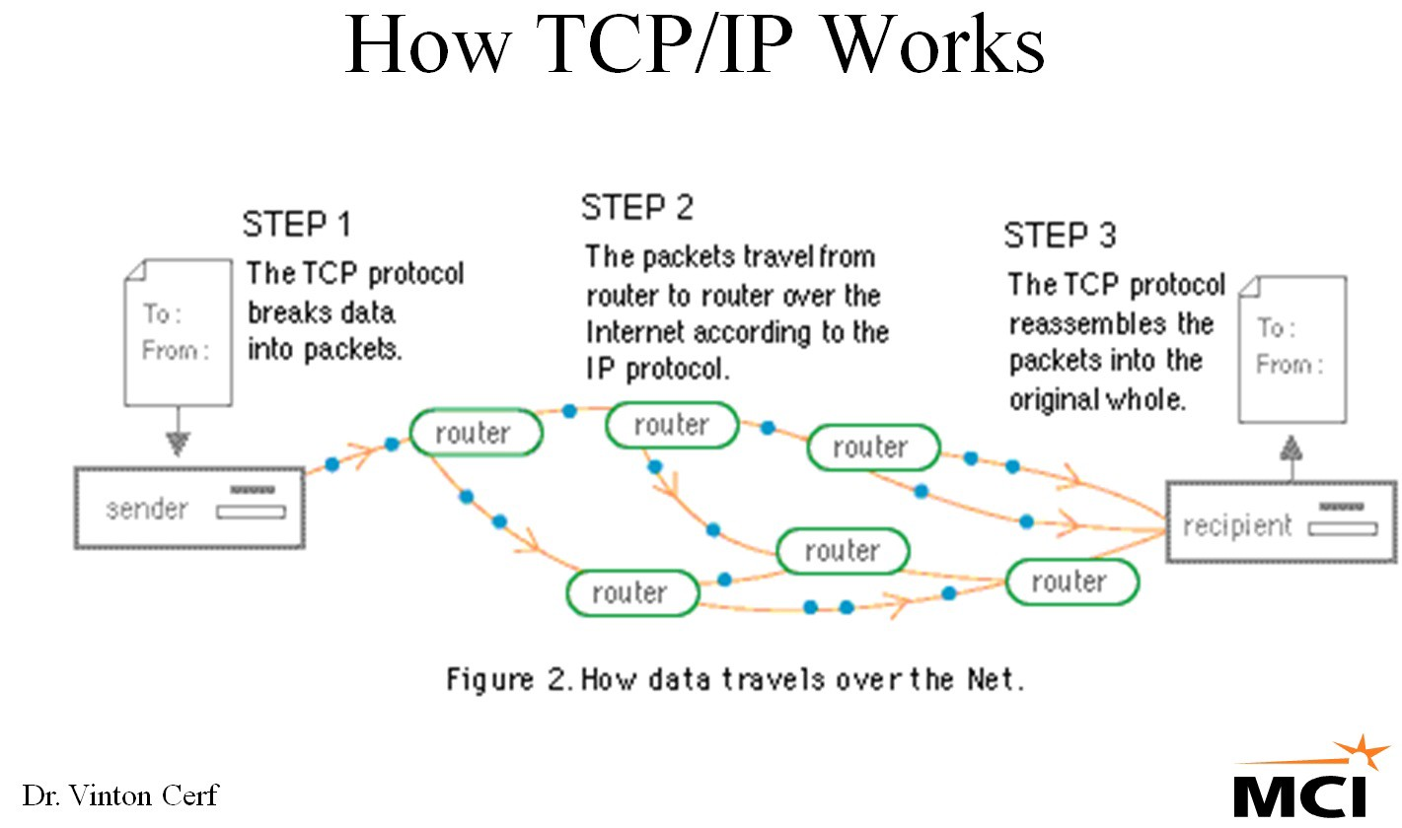

Slide 7
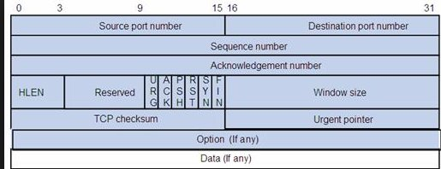
TCP Packet Header

Slide 8
Bandwidth
Allocation of total network throughput available to a given process
Determines how much data can be sent or received
Can cause errors if exceeded

Slide 9
TCP Window Scale
Changes the TCP window size in a packet to increase bandwidth of the connection
Managed by the Congestion Window (sender) and the receiving window (receiver)
Prevents traffic overload
Scaled on each packet based upon the previously accepted packet

Slide 10
Limitations
At maximum bandwidth, the window will go over the limit every other sent packet
If a packet is dropped the window returns to the smallest size
Isn’t a network, just a connection

Slide 11
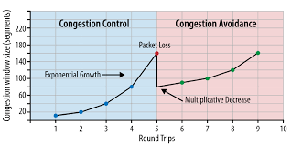
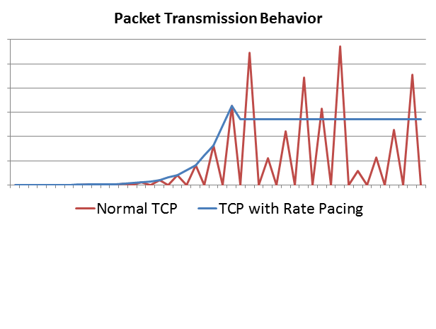
Flow

