Slide 1

Alleviating ecological bias in linking radon exposure to acute childhood leukaemia
De Smedt T, Simons K, Francart J, Poffijn A, Van Nieuwenhuyse A
Environmental Health Conference
Basel, 19-23 August 2013
Rue Juliette Wytsmanstraat 14 | 1050 Brussels | Belgium
T +32 2 642 51 11 | F +32 2 642 50 01 | email: info@iph.fgov.be | www.iph.fgov.be
Notes:
Today I am going to present our study that relates indoor radon concentrations to acute childhood leukaemia

Slide 2
Background
Previous studies regarding the relationship between radon and acute childhood leukaemia are inconclusive
Majority of previous studies used an ecological design
Due to privacy, data availability, cost, etc.
Assume a normally distributed radon exposure in each area
Environmental radon exposure and childhood leukemia, Tong J. et al, J Toxicol Environ Health B Crit Rev. 2012;15(5):332-47
Notes:
First of all a little bit of background, there have been numerous studies relating radon to childhood leukaemia, but not all of them are conclusive.
A second point is the ecological design of many of these studies, using the incidence in one area and relating it to the mean exposure in that area, which was done due reasons such as privacy, data availability, cost efficiency, etcetera. They also assume that the radon concentrations in each area is normally distributed.

Slide 3
Objectives
To incorporate the radon exposure distribution in the health impact assessment methodology
To cope with within-area variation that may lead to ecological bias
To validate the novel method against existing methods
Notes:
For our study, we wanted to develop a novel method and for this we have three objectives:
The first one is the incorporation of the exposure distribution, and not only the mean of each area
The second one is to take a look at the within-area variation and ecological bias
The thirth one is to validate our new method against the existing ones

Slide 4
Materials and methods
Incidence of acute childhood leukaemia (< 15 years)
by commune, Wallonia (2004-2010)
Data source: Belgian Cancer Registry
Measured indoor radon concentration
by commune, Wallonia (2004-2010)
Data source: Federal Agency Nuclear Control
Radon risk mapping in southern Belgium: an application of geostatistical and GIS techniques. Poffijn A. et al (2001), The Science of The Total Environment. 2001; 272(1-3): 203-210
Notes:
What was the data that was used in our study:
First of all we have the incidence of acute childhood leukaemia for each commune in Wallonia, which is the southern part of Belgium. We only have access to the total amount of cases for each commune, not to the individual cases.
Secondly, we have aggregate measures of the indoor radon concentrations for each commune in Wallonia, so we have for example the mean and standard deviation per area, but not individual cases. These radon measurements were done on a voluntarily basis.

Slide 5
Indoor radon exposure
Travel process from ground to indoors is highly dependant on: (multiplicative and additive factors)
Building type
Meteorological variables
Ground porosity
Etc.
Lognormal distribution of indoor radon concentration in different houses in each area
Possibility for significant within-area variance
Mapping variation in radon potential both between and within geological units, Miles J. & Appleton J., J. Radiol. Prot. 2005; 25 257-76
Notes:
Let us now take a look at the travel process of radon from the ground to indoors. This process is altered by the building and ventilation type of the house, by certain meteorological variables, by ground conditions, and by many more variables. All these factors have a multiplicative or additive effect on the total indoor radon concentration. If we take a look at the distribution of radon between houses in one area, this travel process gives rise to a lognormal distribution. There is also a possibility for significant within-area variation.

Slide 6
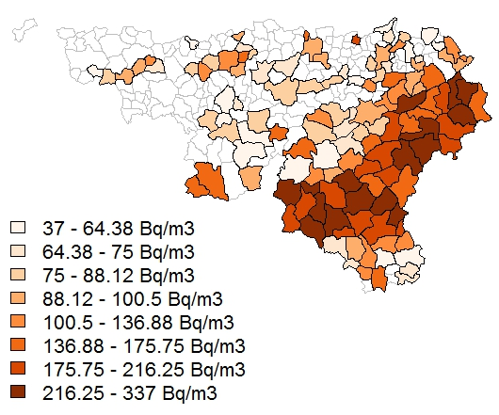
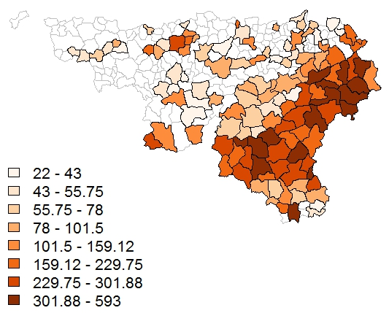
Within-area variation of radon
Fig. 1 Mean indoor radon concentrations, Wallonia,
Belgium
Fig. 2 Standard deviation of indoor radon concentrations, Wallonia, Belgium
Notes:
To give you an idea of this within-area variation, on this slide you can see the mean radon exposure on the left and the standard deviation per commune on the right.

Slide 7
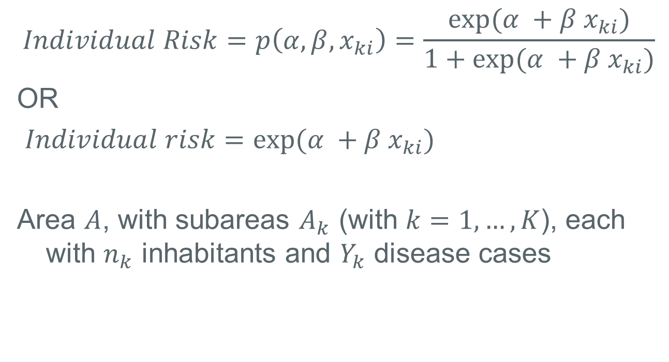
Ecological bias
$$Individual Risk=p\left(α,β,x_{ki}\right)=\frac{\exp{(α^{ }+β^{ }x_{ki})}}{1+\exp{(α^{ }+β^{ }x_{ki})}}$$
OR
$Individual risk=\exp{(α^{ }+β^{ }x_{ki})}$
Area $A$, with subareas $A_{k}$ (with $k=1,…,K$), each with $n_{k}$ inhabitants and $Y_{k}$ disease cases
Ecologic studies revisited, Wakefield J., Annual Review of Public Health(2008); 29 75-90
A statistical framework for ecological and aggregate studies, Wakefield J. & Salway R., J. R. Statist. Soc. A (2001); 1 119-137
Notes:
So let’s now take a look at the possible effect of this within-area variation. To do this, we must start from the individual risk model, which you will all be familiar with. So one of the most general risk models is the one with the logit link, which bounds the probability for an individual for becoming ill between 0 and 1. For statistically rare health outcomes it is also not unusual to use the log-link. So now let’s us consider we have an area A, with subareas Ak , each with nk inhabitants and Yk disease cases. Each individual has an exposure xki. Ofcourse in many studies with an ecological design, we have no access to the individual exposure values.
The main problem with this ecological design is ecological bias stemming from using aggregated (mean) exposure instead of the individual exposure per person: the mean radon concentration in an area is used as the actual concentration for the whole population in this area, neglecting the variability between different buildings and its inhabitants. This ecological bias has been thoroughly described in literature.
Aggregation over each individual in area $A_{k}$:
$$Ecologic risk=\frac{1}{n}\sum_{i=1}^{n}{\exp{(α^{ind}+β^{ind}x_{i})}}$$

Slide 8
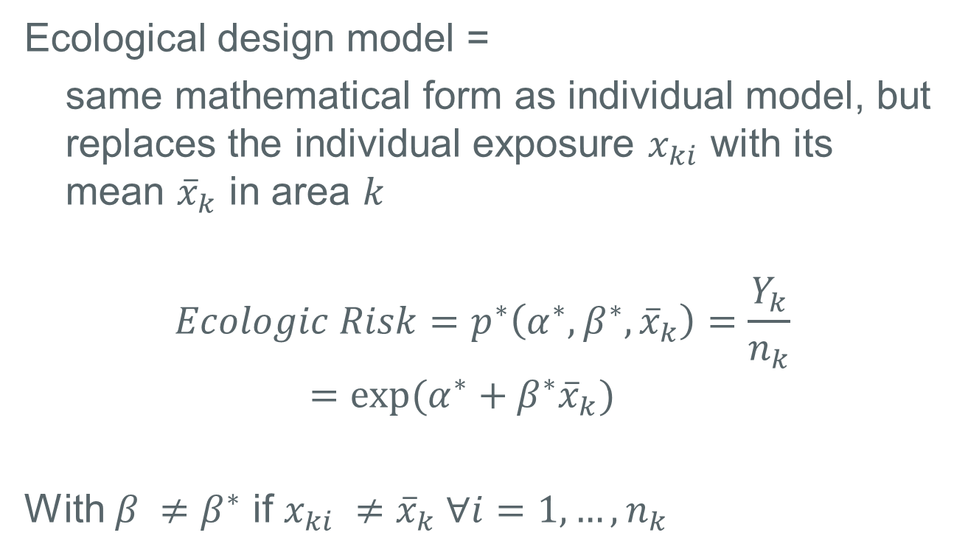
Ecological bias
Ecological design model =
same mathematical form as individual model, but replaces the individual exposure $x_{ki}$ with its mean ${\overline{x}}_{k}$ in area $k$
$$Ecologic Risk=p^{∗}\left(α^{∗},β^{∗},{\overline{x}}_{k}\right)=\frac{Y_{k}}{n_{k}}$$
$$=\exp{(α^{∗}+β^{∗}{\overline{x}}_{k})}$$
With $β^{ }≠β^{∗}$ if $x_{ki} ≠{\overline{x}}_{k} ∀i=1,…,n_{k}$
Notes:
Because of that we use aggregate exposure values, such as the mean for each area, denoted here by xbar. The normal setup is then to use a model with the same mathematical form as the individual risk model, but replacing the individual exposure xki by xbar. For example in the formula shown here, we have the log link, and usually we would continue by using this in a Poisson generalized linear model, to arrive at estimations for alpha and beta.
Something to keep in mind though, is that this betastar is not to same as the individual beta, when xki is not equal to xbar for every individual. This discrepancy is called the ecological bias.

Slide 9
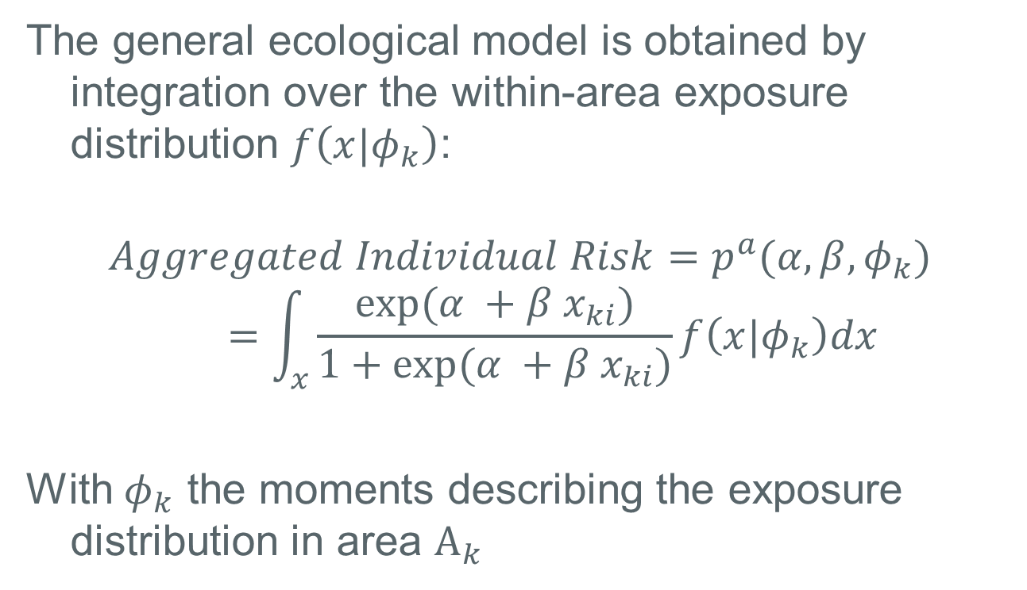
Proposed solution
The general ecological model is obtained by integration over the within-area exposure distribution $f\left(x|φ_{k}\right)$:
$$Aggregated Individual Risk=p^{a}(α,β,φ_{k})=\int_{x}{\frac{\exp{(α^{ }+β^{ }x_{ki})}}{1+\exp{(α^{ }+β^{ }x_{ki})}}}f\left(x|φ_{k}\right)dx$$
With $φ_{k}$ the moments describing the exposure distribution in area $A_{k}$
Notes:
The question now is how to arrive at a more general model for the ecologic risk, so the risk per area. Well this has been studied by Wakefield and Salway, among others, and the way to do this is by using the expectation value, which means here to integrate the individual risk together with the exposure distribution in the area. I have called it the aggregated individual risk. The within-area exposure distribution f, is characteriszed by its moments phi.
The problem with this formula, is that it is often very hard or impossible to know the actual within-area exposure distribution.

Slide 10
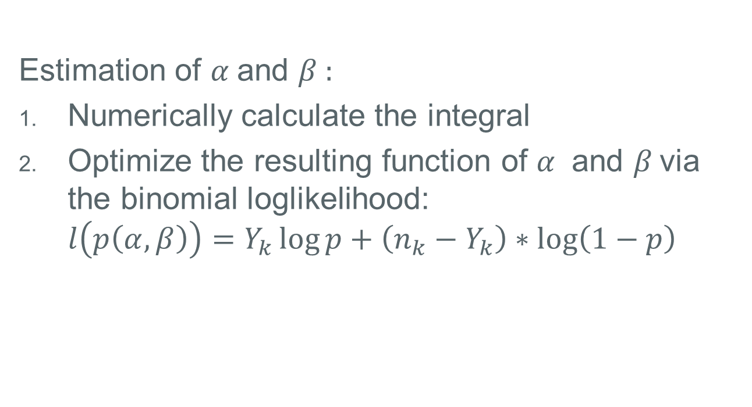
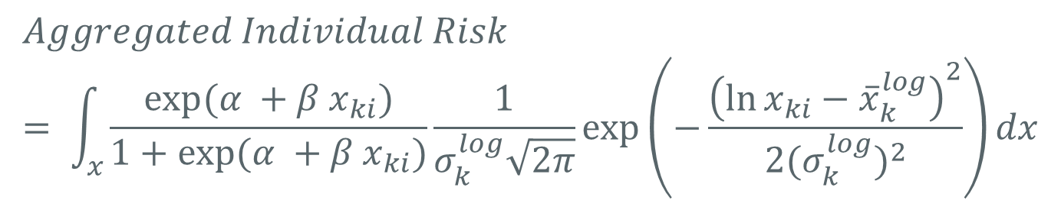
Proposed solution
$$Aggregated Individual Risk \\ = \int_{x}{\frac{\exp{(α^{ }+β^{ }x_{ki})}}{1+\exp{(α^{ }+β^{ }x_{ki})}}\frac{1}{σ_{k}^{log}\sqrt{2π}}\exp\left(−\frac{{\left(\ln{x_{ki}}−{\overline{x}}_{k}^{log}\right)}^{2}}{2{{(σ}_{k}^{log})}^{2}}\right)dx}$$
Estimation of $α^{ }$and $β^{ }:$
Numerically calculate the integral
Optimize the resulting function of $α^{ }$ and $β^{ }$via the binomial loglikelihood: $l\left(p\left(α,β\right)\right)=Y_{k}\log{p+\left(n_{k}−Y_{k}\right)∗\log\left(1−p\right)}$
Notes:
Althoud, as our nuclear agency does have the actual individual measurements, they were able to look at the within-area radon distribution. Which is lognormal. We can describe this distribution by using the logarithmic mean and the logarithmic standard deviation. Ofcourse, this integral is not of closed form, so we can not calculate it analytically. We can however calculate it numerically, via a computer. This results in a probability, which is a function of alpha and beta. We can then go on to estimate alpha and beta by optimizing the binomial loglikelihood (as the individual risk was a binomial probability). It should be stressed here that the resulting alpha and beta are the individual ones.

Slide 11
Practical implementation
SIMULATION STUDY
→ To compare the novel method and the ecological design
APPLICATION of the novel method
→ To assess the ecological relationship between indoor radon concentrations and acute childhood leukaemia in Wallonia, Belgium
Notes:
So we have now described our new method, let us first try to validate it against existing measures, and then use it to take a look at the relationship between acute childhood leukaemia and indoor radon concentrations in Wallonia.

Slide 12

Simulation study
Based on the population (<15 years) per commune of Wallonia we simulated the amount of disease cases in each commune by choosing an $α$ and $β$ and using these in the individual model with the actual indoor radon concentrations.
Notes:
So we did a simulation study where we started from the individual risk model and we choose an alpha and beta ourselves, combined this with the mean and standard deviation of the radon concentrations, to calculate a certain amount of disease cases for each area.

Slide 13
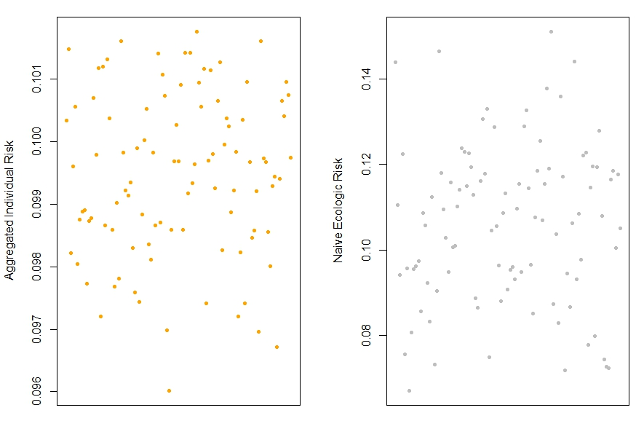
Results: 1. Simulation study
Figure 3: Plot of simulation study, novel method (left), GLM with log-exposure (right). $β=0.1$
Notes:
So if we then take a look at the results, we can see for each method how well it found the beta we gave as our simulation parameter, which was 0.1 here. We see that our method is slightly closer to 0.1 then on the other graphs, where we used a standard Poisson GLM with the logmean of the radon exposure.

Slide 14

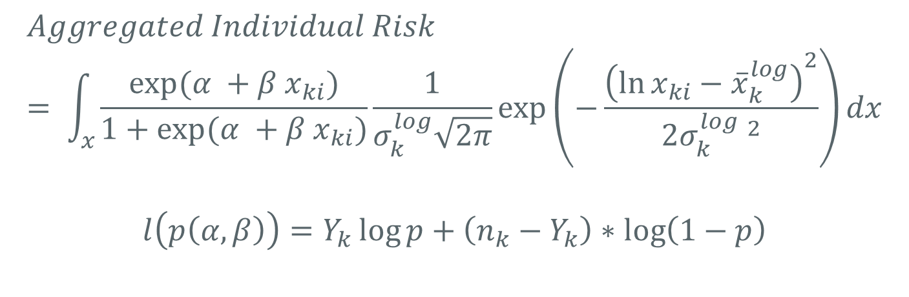
Results: 2. Application of the novel method on acute childhood leukaemia and radon in Wallonia
$α$: -8.2 (CI: -10.2 – -6.2 )
$β$: -0.033 (CI: -0.532 – 0.424)
$$Aggregated Individual Risk \\ = \int_{x}{\frac{\exp{(α^{ }+β^{ }x_{ki})}}{1+\exp{(α^{ }+β^{ }x_{ki})}}\frac{1}{σ_{k}^{log}\sqrt{2π}}\exp\left(−\frac{{\left(\ln{x_{ki}}−{\overline{x}}_{k}^{log}\right)}^{2}}{2{σ_{k}^{log} }^{2}}\right)dx}$$
$$l\left(p\left(α,β\right)\right)=Y_{k}\log{p+\left(n_{k}−Y_{k}\right)∗\log\left(1−p\right)}$$
Notes:
If we then use this method on the acute childhood leukaemia and indoor radon concentrations data, we get the following results. These are not significant, which we think is due to the very small amount of leukaemia cases (we only have 101 over all the years)

Slide 15
Conclusion
Advantages
Alleviate ecological bias
Incorporation of all available exposure information
Possibility of using the actual exposure distribution
Disadvantages
More complex than standard GLM
Harder to assess joint exposures and confounders
Notes:
So, in conclusion, we have the following advantages, mainly that we can alleviate part of the ecological bias. This method can also be used with other exposure distribution. The disadvantages are that it is more complex than a standard generalized linear model, especially in terms of computational power and in terms of finetuning the initial parameters for our optimization of the likelihood. Also it is harder to include joint exposures and confounder, as we then should use the joint distribution, which is almost never available.

