Slide 1

2009 Transitions
Students of Vision Opticianry Scholarship

Slide 2
Project Guidelines
Any length or format
Research paper, presentation, video, poster, community outreach, etc.
Explore or expand upon the healthy sight theme
Notes:
As we move through our course today, we will first take a look at the status of vision care worldwide. We will discuss the concept of Healthy Sight Counseling and what it means.
We will introduce an integrated approach necessary for healthy sight.
We will discuss the components for this approach and illustrate how an understanding of these and how they interrelate, is necessary to provide patients with the best possible visual health care.
In addition, this course will reinforce the importance of taking into consideration all the diverse factors that affect sight when evaluating a patient’s visual function and health, and offer you, the optician, an outline for utilizing Healthy Sight Counseling in assessing and promoting visual well-being.

Slide 3
Evaluation Areas
Creativity: Utilizes unique approach to topic and insightful language.
Understanding: Demonstrates understanding of Healthy Sight Counseling.
Role of Optician: Speaks to the importance of the optician in patient care, and shows how the optician can play a particular role in one aspect of HSC.

Slide 4
Students of Vision Scholarship
10 Ranked Scholarships
1st place $1,000
2nd place $750
3rd -10th place $500
Top five receive trip to September 2009 ABO-NCLE education Meeting in Cincinnati
Winning student’s class receives pizza party

Slide 5
Trip to 2009 ABO-NCLE Meeting
Airfare to Cincinnati, Ohio
Accommodations
Transportation
Meeting registration
Create poster of project
Poster session with faculty and fellow winners

Slide 6
Scholarship Program Timetable
Submit projects by March 1st 2009
Winners announced April 15th 2009
Pizza parties April 16th – June 30th 2009

Slide 7
Scholarship Program Timetable
Top five winners create PowerPoint poster of project using www.makesigns.com
Posters due August 1st 2009
ABO-NCLE Education Meeting September 10th-13th 2009

Slide 8
Application Instructions
Submit your project to:
  Transitions Students of Vision Opticianry Scholarship
  c/o Euro RSCG Worldwide PR
  4 PPG Place, 2nd Floor
  Pittsburgh, PA 15222
  Or e-mail:
  education@transitions.com

Slide 9
Application Instructions
Include:
  Name
  Phone Number
  E-Mail
  Mailing Address

Slide 10
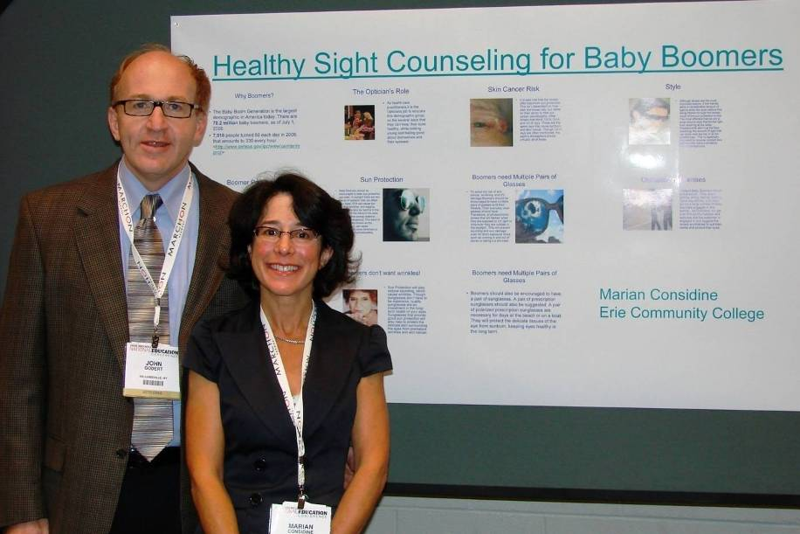
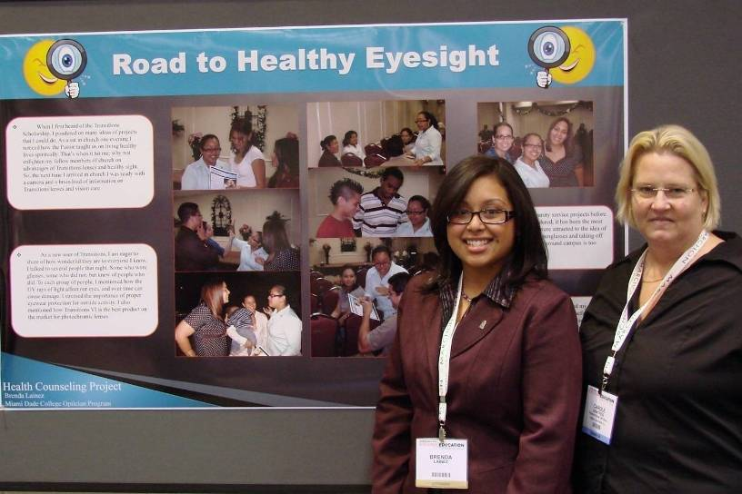
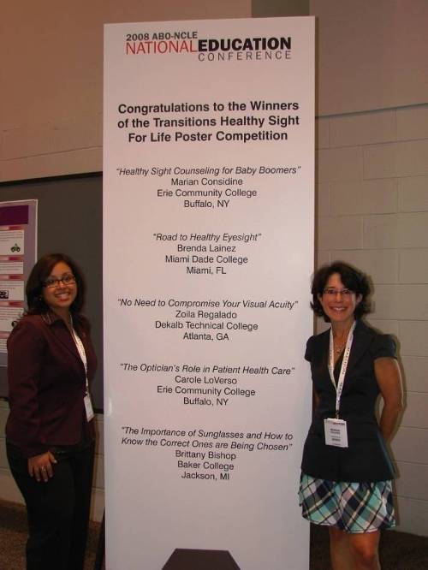
2008 Winners

Slide 11
Magnitude of visual impairment
161 million visually impaired:
  124 million low vision
  37 million blind
  90% in developing countries
  World Health Organization
Notes:
Visual impairment due to all causes is enormous, and growing with aging populations. Note that 90 percent of the visually impaired are in developing nations, where care is usually less accessible.

Slide 12
For More Information
To learn more about the Transitions Students of Vision Opticianry Scholarship Program, visit: www.HealthySightForLife.org
Notes:
To learn about the Healthy Sight For Life Fund and for more information about the Transitions Students of Vision Scholarship Program, visit www.HealthySightForLife.org.

Slide 13
Worldwide trends of ocular disease
Causes of Blindness:
  Cataract
  Glaucoma
  Age-related macular degeneration
    Number one in developed countries
  Trachoma, corneal opacities, diabetic retinopathy
75% to 80% are preventable or treatable
Notes:
Eye disease continues to run rampant across the globe, despite the fact that 75 to 80 percent are either preventable or treatable. If you look at cataract and macular degeneration alone, what might be the impact globally if we could reduce the ultraviolet radiation throughout the lifetime of every patient?

Slide 14
Prevention (delay)
Cataract
  UV Protection
  Safety Eyewear
Glaucoma
  Earlier diagnosis
  Surgical intervention vs. medication
Age-Related Macular Degeneration
  UV Protection
  Improved nutrition
Notes:
We can prevent, or at least delay, the incidence or progression of most conditions through better care.
In addition to UV protection, appropriate safety eyewear can prevent upwards of 90 percent of the cases of traumatic cataract.
The earlier that glaucoma is diagnosed, the more vision that may be saved. In many instances, surgery is a better glaucoma treatment option, because continued medications may not be accessible, and compliance is always questionable.
Educating patients about better nutrition, especially with foods that contain antioxidant vitamins, lutein and zeaxanthin, can reduce the impact of age-related macular degeneration.
Foods containing lutein and zeaxanthin are green vegetables, especially spinach, egg yolks, as well as kale and broccoli.

Slide 15
Quality of life issues
Blindness adds to individual, family, community, national poverty
Uncorrected refractive error or non-optimal correction reduces efficiency
Everyone deserves the opportunity to have the most appropriate care and visual correction
Notes:
How well a person sees has a dramatic influence on his or her quality of life.
Blindness, or even less-than-ideal refractive correction, limits a person’s contribution to society.
Everyone deserves the opportunity for the most appropriate care and visual correction!
This is where Healthy Sight Counseling comes in.

Slide 16
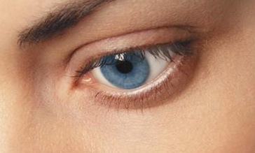
What Is Healthy Sight?
Healthy Sight is defined as the enhancement of the overall everyday quality of vision and the preservation of long-term ocular health—simply put, seeing well now and in the future.
Notes:
Basic to the discussion of Healthy Sight Counseling is the definition of healthy sight: the enhancement of the overall everyday quality of vision and the preservation of long-term ocular health — simply put, seeing well now and in the future.

Slide 17
What Is Healthy Sight Counseling (HSC)?
HSC provides the eyecare professional with an integrated approach to promoting healthy sight in the everyday office or clinic practice
The standard medical/primary care model is adopted to:
  expand on the refractive eye exam
  incorporate quality of vision and ocular health concerns
  generate a “customized” eyeglass prescription™
Notes:
Healthy Sight Counseling takes an integrated approach to eye care and adopts the standard medical/primary care model to expand on the refractive eye examination. It advocates incorporating quality of vision and ocular health concerns to generate a “customized” eyeglass prescription™.

Slide 18
What Is Healthy Sight Counseling?
HSC is based on the premise that healthy sight is something that can be achieved through a combination of:
  customized vision correction, and maintenance and preventive eye care
  increased professional and patient awareness of the importance of healthy sight and how to achieve it
Notes:
Healthy sight is something that opticians/ eyecare professional (ECPs) can promote to patients through a combination of customized vision correction, maintenance and preventive eye care, and increased professional and patient awareness.

Slide 19
Opticianry’s Role in HSC
HSC relies on an integrated three prong approach
  Vision Care, Vision Wear and Education
This presentation will show how the educated Optician is essential to the success of Healthy Sight Counseling.
Notes:
Every optician has an important role in Healthy Sight Counseling. The doctor’s focus is on vision care while opticians focus on vision wear. The overlap and reinforcement comes in the area of education which is everybody’s responsibility.

Slide 20
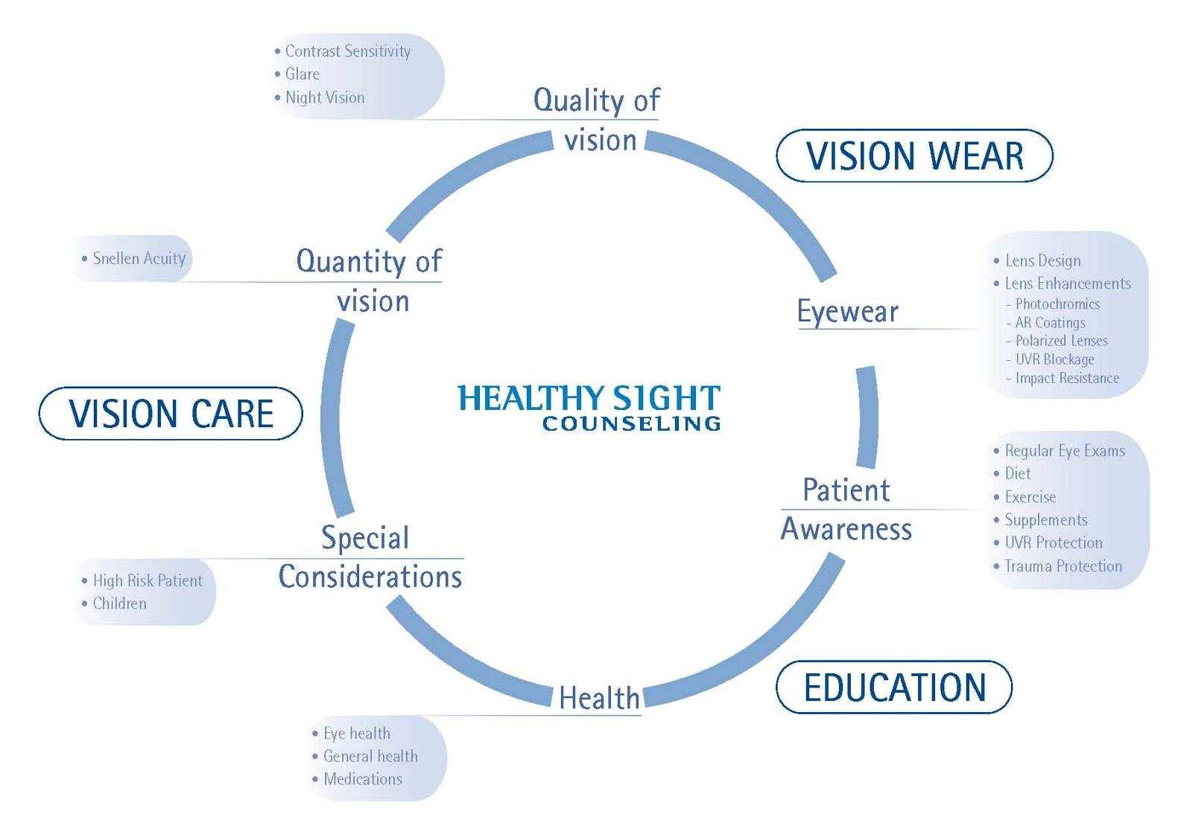
The Components of HSC
Notes:
The components of Healthy Sight Counseling

Slide 21


The Components of HSC
Vision Wear
Vision Care
Education
Notes:
To make things simple, we might think of Healthy Sight Counseling as having three essential components: vision care, vision wear and education. We’ll discuss each of these in greater detail.

Slide 22
The Components of HSC
Vision Care
Maintenance
Preventive eye care
Vision Wear
Education
Notes:
The first component of Healthy Sight Counseling is vision care. If the aim of Healthy Sight Counseling is healthy sight now and for the future, maintenance and preventive eye care must be a vital element of the Healthy Sight Counseling formula. It begins with a comprehensive patient history-taking and examination. It should reveal important information that enables the optician/ECP to have a broad view of the patients individual needs.

Slide 23
The Components of HSC
Vision Care
Vision Wear
Customized vision correction
Quantity and quality of vision
Education
Notes:
The second component of Healthy Sight Counseling is vision wear. For the majority of patients seen in the eyecare practice or clinic, satisfaction with the level of care rendered by the eyecare professional depends on how well they see with the vision wear prescribed. Healthy Sight Counseling seeks to expand the traditional function of vision wear beyond simply correcting vision in the less than 20/20 eye, to providing what we like to call “customized vision correction.” Both quantity and quality of vision become important and the potential role of vision wear in promoting healthy sight is recognized.

Slide 24
The Components of HSC
Vision Care
Vision Wear
Education
Customized vision correction
Quantity and quality of vision
Notes:
Finally, if Healthy Sight Counseling is to be successful, both professionals and patients must be educated about the elements of good vision and eye care, potential risks to healthy sight, and ways to help ensure both good ocular health and good general health. There is a special role for this third component of Healthy Sight Counseling in ECP training programs. Educating the optician is best started at the student level and will be most successful if integrated into the curriculum. However, incorporating Healthy Sight Counseling into the practice and during the consultation is equally critical.

Slide 25
Vision Care
Notes:
So, then, we have the three components of Healthy Sight Counseling: vision care, vision wear and education. Let’s start off with a discussion of Vision Care and see how this figures into the Healthy Sight Counseling equation for a lifetime of healthy sight.

Slide 26
Vision Care
To help your patient have Healthy sight it requires:
  Maintenance eye care
  Preventive eye care
Notes:
Healthy sight is the goal for now and for the future. Healthy sight depends on healthy eyes. Without healthy eyes, there can be no healthy sight and to help your patient have Healthy sight it requires both maintenance and preventive eye care.
That is ensuring we address issues that will affect sight today, but also providing means to help protect sight for the future.
The choice you make prescribing eyeglass lenses and lens treatments for your patients to meet their specific and unique needs, allows vision wear to do more than simply correct vision, serving to enhance sight and the overall visual experience and helping protect the eyes for a lifetime of healthy sight.

Slide 27
Elements Of A Prescription
Adopting the medical/primary care model
for eye care
History
Ocular Examination
Special Considerations
Notes:
Since Healthy Sight Counseling makes vision care a part of eye care, and both a part of overall medical/primary care care, it is recommended that ECPs adopt the medical/primary care model for vision and eye care. The patients customized prescription should take into account the patient’s history, the ophthalmic examination, and any special considerations that may adversely affect ocular health or sight.

Slide 28
Contemporary Examination
Patient History
Nature of presenting problem, including chief complaint
Visual and ocular history
General health history, which may include social history and review of systems
− American Optometric Association Optometric Clinical Practice Guideline: Comprehensive Adult Eye and Vision Examination
Notes:
Remember that the patient history should be very detailed.

Slide 29
Contemporary Examination
  Medication usage (including prescription and nonprescription drugs); mineral, herbal, and vitamin supplement usage; and medication allergies
  Family eye and medical histories
  Vocational and avocational vision requirements
  Identity of patient's other health care providers
− American Optometric Association Optometric Clinical Practice Guideline: Comprehensive Adult Eye and Vision Examination

Slide 30
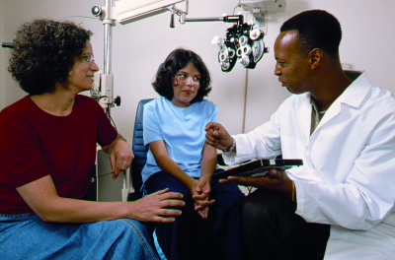
History
Presenting Complaint
  Ophthalmic
  Medical
  Social
Family
Special Consideration
  Occupational
  Recreational
  Medications
  Allergies
Notes:
The patient history is the initial component of the examination. The objective is to obtain specific information about the patient's eye and vision status and important background information on related medical issues. It helps the eyecare professional identify and assess problem areas.
Major components of the patient history include:
Nature of the presenting problem, including chief complaint
Visual and ocular history
General medical history, which may include a social history and review of systems
Family eye and medical histories
Any special risk factors or other considerations
Occupational and recreational vision requirements
Medication use and allergies

Slide 31
Special Considerations
Risk factors
Heredity
Pre-existing ocular disease
Pre-existing disease
Medications
Occupational hazards
Recreational pursuits
Age
Recent surgeries
Notes:
There are a number of special considerations for the eyecare professional in choosing the customized eyeglass prescription™ for a particular patient. These make the expanded ocular history an important part of Healthy Sight Counseling™.

Slide 32
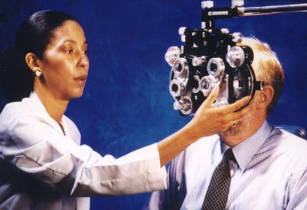
Ophthalmic Examination
Visual acuity
Refraction
Motility
External
Slit lamp biomicroscopy
Tonometry
Ophthalmoscopy
Special studies
Notes:
The medical/primary care model for Healthy Sight Counseling also involves an ophthalmic examination, including exams for visual acuity, refraction and motility. Special studies may be indicated for some patients.

Slide 33

Special Considerations: Children’s Eyes
Childhood and a lifetime of healthy sight
Protection from impact and injury
Ultraviolet radiation and (UVR) exposure
Refractive errors
Notes:
As part of the complete history-taking, we also need to take into account special considerations that may impact on a lifetime of healthy sight. Two in particular are children and exposure to ultraviolet radiation (UVR).
The best health care is preventive care, particularly in the case of children’s eyes. Preventive care — medical and ophthalmic — must start early in life to be effective. This makes children an important focus for Healthy Sight Counseling. There are certain threats to healthy eyes and healthy sight to which children are more susceptible than adults. Impact injury and UVR exposure are prime examples.

Slide 34
Ocular Trauma In Children
Nearly half of traumatic eye injuries related to ball sports
45% of these occur in children under age 14
90% are preventable
Notes:
Trauma — primarily sports-related ball trauma — is an important ocular risk factor for children. According to Prevent Blindness America, 90 percent of traumatic eye injuries in children are preventable with correct use of safety eyewear. This makes the use of eye protection during sports and impact-resistant lenses in children’s eyeglasses — polycarbonate or Trivex™ material — mandatory.

Slide 35
UVR And Children’s Eyes
80% lifetime UVR exposure prior to age 18
Increased UVR transmission through the young lens
Importance of cumulative effects of UVR on the eye
Most children do not wear eyeglasses
Most children do not wear prescription sunglasses
Notes:
The other important risk factor for damage to the young eye is UVR. A strong body of laboratory and epidemiologic data links UVR exposure to ocular disease. Both acute and chronic exposure are important. Children’s eyes are particularly susceptible to the adverse effects of UVR for three reasons:
An estimated 80 percent of cumulative lifetime exposure to UVR occurs prior to age 18.
The clear lens of the young child (10 years or younger) transmits 6.5 times more incident UVR than the adult lens.
While approximately half of adults in the Western world wear prescription eyeglasses (some of which provide good UVR protection for the eye), less than 20 percent of children under the age of 18 wear prescription eyeglasses. This means that while children stand to benefit the most from ocular UVR protection, they are the least likely to get it.

Slide 36
UVR And Ocular Disease: Acute
Sunburn of eyelids
Photokeratitis
Solar retinopathy
Notes:
Does UVR damage the eyes? What kind of damage does it do? UVR damage to the eyes — and the skin around the eyes — can occur with acute, high-level exposure or on a cumulative basis with less intense but prolonged, continued exposure. Acute and chronic exposure have different ocular manifestations. The main ocular sequelae of acute UVR exposure are sunburn, photokeratitis, and solar retinopathy.
Photokeratitis a burn of the cornea by ultraviolet B rays. Also called radiation keratitis or snow blindness.
Solar retinopathy is damage to the eye’s retina, particularly the macula, from prolonged exposure to solar radiation. It usually occurs due to staring at the sun or viewing a solar eclipse.

Slide 37
UVR And Ocular Disease: Chronic
Neoplasia of eyelids
Cataract
Macular degeneration
Neoplasia of conjunctiva
Pinguecula
Pterygium
Labrador keratopathy
Notes:
Chronic UVR exposure can lead to different clinical diseases or conditions. Of the greatest clinical importance are cutaneous neoplasia, cataract, and macular degeneration.
Neoplasia of eyelids; cancer of the eyelids
Labrador Keratopathy; clouding of the cornea – overexposure to UVR

Slide 38
UVR And Skin Cancer
More than 90% of all UVR-related skin cancers occur above the neckline
10% of all non-melanoma skin cancers occur on the eyelids
Notes:
Since the eyelids are a common site for UVR-related skin neoplasia, the role of eyeglasses in helping protect the delicate and susceptible skin of the eyelids is an important one. Sunglasses and photochromic lenses act as “sunblock for the eyes.”

Slide 39
UV Awareness Research Perceived Harmful Effects of Extended Sun Exposure
Spontaneous Awareness | Skin Cancer | Eye Damage
United Kingdom Study on awareness and attitudes concerning UVR, conducted on a sample of 1006 respondents, March 2006 | 86% | 7%
United States Study on awareness and attitudes concerning UVR, conducted on a sample of 1002 respondents, March 2006 | 82% | 9%
New Zealand Study on awareness and attitudes concerning UVR, conducted on a sample of 500 respondents, June 2003 | 90% | 7%
Australia Study on awareness and attitudes concerning UVR, conducted on a sample of 700 respondents, July 2006 | 82% | 6%
France Study on awareness and attitudes concerning UVR, conducted on a sample of 760 respondents, April 2006 | 84% | 6%
Notes:
As the chart shows, there is high awareness that UVR is harmful to the skin but little awareness that it is harmful to the eyes. It is therefore important to discuss this with patients to impress upon them the need to protect their eyes from extended exposure to UVR and to preserve their long-term eye health and eyesight, and especially to protect the eyes from extended exposure to UVR with protective eyewear.
Canada: February 2006 / 63 percent skin cancer / 3 percent damage to the eyes
Australia developed a campaign to assist in UV awareness called Slip-Slap-Slop; slip on a tee-shirt, slap on a hat and slop on some sunscreen. They have now started adding, “and wrap on some sunnies”.

Slide 40
UVR Absorption
All lenses should block UVR
Should meet internationally accepted standards
  ANSI: American National Standard Institute
  ISO: International Organization for Standardization
  AS/NZS: Australia – New Zealand Standards
  EN: European Standards
Notes:
Therefore, an important function of eyeglasses is UVR protection. While crown glass is not an efficient UVR absorber, more modern spectacle lens materials are available that generally offer excellent UVR protection for the eye. Transitions® lenses, for example, absorb 100 percent of both UVA and UVB radiation, and they were the first lenses to be awarded the World Council of Optometry’s Global Seal of Acceptance for UV Absorbers/Blockers.
ANSI: American National Standard Institute
ISO: International Organization for Standardization
AS/NZS: Australia – New Zealand Standards
EN: European Standards
International Standards of Performance
Block 100 percent UVA and UVB radiation (as calculated using ANSI Z80.3 and ISO 8980-3. Transitions Lenses also meet EN 1836 and AS/NZS 1067 standards).

Slide 41
Medical/Primary Care Model: Eyeglass Rx
HSC takes the refraction one step further
Applies the principles of medical/primary care to eye care
Combines the results of the patient history and ocular examination with the refraction
Generates a customized eyeglass prescription
Leads to healthy sight now, and for the future
Notes:
The most common procedure performed during the course of an eye examination is the refraction.
In a sense, the refraction is the basis for all eye care. Without a good refraction, vision will usually be compromised.
HSC though, takes the refraction one step further and applies the principles of the medical/primary care model for eye care.
HSC promotes combining the results of the refraction with the information gained during the history-taking and examination, to generate the customized eyeglass prescription™.
A specific set of instructions taking into account stage of life, their lifestyle and level of outdoor activity, existing medical and eye conditions, medications the patient may be taking, sensitivity to light or special considerations that promotes healthy eyes and healthy sight for the future.

Slide 42
Vision Wear
Notes:
The second component of Healthy Sight Counseling is vision wear.

Slide 43
The Role of Opticianry
Prescription analysis
Lifestyle analysis
Recommendations
Reinforce the doctor’s message
Notes:
The second component of Healthy Sight Counseling is vision wear.
It is critical for the optician to go beyond just filling the prescription to actually analyzing the prescription and their lifestyle so they can make a customized recommendation to promote Healthy Sight.

Slide 44



Lifestyle Dispensing
Visual lifestyle
Occupational requirements
Recreational requirements
Social requirements
Notes:
While the basic refraction remains the template for recommending vision correction to the patient, some attention has to be directed toward what the patient may want — or need — from prescribed eyeglasses. This has led to the concept of “lifestyle dispensing,” where the visual lifestyle of the patient is taken into account when corrective eyewear is dispensed.

Slide 45
Lifestyle Prescribing
Supersedes lifestyle dispensing
Visual lifestyle and visual health
“Customized eyeglass prescription”
Notes:
To truly begin a lifetime of healthy sight for the patient, and to help the patient get what he or she wants—and needs—from vision correction, lifestyle dispensing comes one step too late. What is really required for meaningful vision correction and vision wear is “lifestyle prescribing.” Here, both visual lifestyle and visual health are concerns in the prescription of vision correction, going beyond the numbers (i.e., the numbers on the Snellen chart and the sphere, cylinder, add on the prescription) so that vision wear becomes an element of vision care by providing the “customized eyeglass prescription™.”

Slide 46
Customized Vision Correction
Best possible vision
Long-term ocular health and well-being
Appropriate and compatible frame selection
Notes:
With customized vision correction, the opticians aim is to provide the best possible vision — in both quantity and quality — and to promote long-term ocular health and well-being.

Slide 47
Quantity and Quality of Vision
Quantity of vision
    Snellen acuity
Quality of vision
    Contrast sensitivity acuity
    Glare acuity
        Glare can diminish contrast
Notes:
As eyecare professionals, we are all aware that the elusive 20/20 vision most people seek is more a number than a goal. 20/20 (or 6/6) is an artificial construct—some might say an optical fantasy, measured in an artificial (not true-to-life) way to define what is normal. We all see 20/20 eyes that are not normal and normal eyes that don’t correct best at 20/20. And how often have you had the experience in your office or clinic of that 20/20 patient who is far from happy with his or her “normal” sight?
The problem with equating normalcy with quantity of vision is that quantity is not all that matters. We do need some standards to measure how well an eye sees, and for many eyes Snellen acuity is a reasonable measure. But think about how Snellen acuity is determined: at a strictly measured distance under controlled conditions of illumination, with none of those bothersome visual distractions of the real world that exist outside the refracting lane and removed from the boundaries of the phoropter.
Vision in the real world is not standardized. Variables such as light and glare make a difference, so Snellen acuity is not real-world acuity. And remember, our patients have to see — and function — n that real world under real-world conditions. This is when quality of vision becomes an important consideration. Snellen acuity has little to do with quality of vision; it is primarily a measure of quantity of vision. Contrast sensitivity and glare acuity are the true measures of quality of vision.

Slide 48
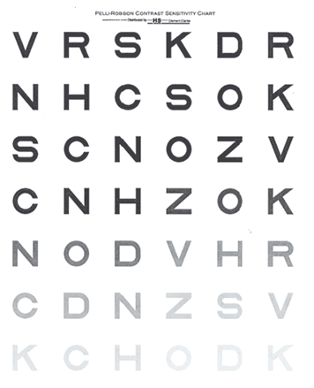
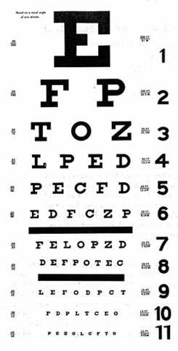
Snellen and Contrast Sensitivity Acuity
Notes:
This is a good illustration comparing visual acuity as measured by Snellen testing and visual acuity as measured by contrast sensitivity acuity testing.
To give you an example of how contrast impacts quality of vision take a look at this slide. Snellen acuity is measured on the left chart and contrast sensitivity is on the right. On the contrast chart which is easier to read the top line or the bottom? By Snellen standards you should see both the same, but quantity does not necessarily equal quality. The same is true with real life vision.

Slide 49

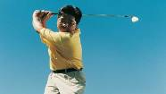


Four Types of Glare
Type of Glare
Source of Glare
Effect
Best Protection From Glare
Distracting Glare
Lens reflections
The light reflected off the front, back, or within lenses
Surface reflections
Light reflected off the front surface of lenses—obscuring view of wearer’s eyes
Ghost images
From headlights or streetlights at night via double reflection within lens
Backside reflections
Light source behind the wearer can obscure viewed scene
Eye fatigue
Reduced vision
Annoyance
Transitions® Lenses or clear lenses with AR coating
Discomforting Glare
Everyday bright light
Occurs in lighting situations in which the eye is unable to adapt naturally (e.g., moving from the shade into bright sunlight)
Squinting
Eye fatigue
Discomfort
Transitions Lenses with AR coating
Disabling Glare
Everyday bright light
Bright light outdoors
Blocked vision
Eye fatigue
Squinting
Contrast diminished
Fixed-tint,
fully-activated Transitions Lenses, or polarized lenses
Blinding Glare
Acute reflection glare
Light reflected off a surface such as water
Squinting
Blocked vision
Contrast diminished
Eye fatigue
Polarized lenses

Slide 50


Notes:
These paired photos demonstrate the effects of disabling glare on vision. The scene is the same. Notice, though, how the background is washed out and contrast diminished in the photo on your left. Glare is the reason and is responsible for some of the most common quality of vision complaints by patients.

Slide 51
Beyond 20/20
Quality vs. Quantity of vision
“Real world” vs. Snellen acuity
Notes:
To truly provide our patients with the best vision care and vision wear that they are really after, both quantity and quality of vision need to be addressed. Snellen acuity is still important — numbers do matter. The numbers on your prescription representing that combination of sphere and cylinder that give the best corrected acuity are also important.
But to consider both quality and quantity of vision in the prescription, you need to go beyond the numbers in the prescriptions and make specific recommendations on eyeglass lenses and lens enhancements that will address specific quality of vision issues for each particular patient. This then produces the customized eyeglass prescription that is integral to successful Healthy Sight Counseling. And this custom eyeglass prescription will also impact vision care by promoting not only healthy sight now, but also healthy eyes for a lifetime of healthy sight.

Slide 52
HSC: Lens Design and Lens Enhancements
Single vision or progressive lenses
High-index lenses
Polycarbonate lenses
Trivex™ lenses
Anti-reflective coatings
Tinted lenses
Photochromic lenses
Polarized lenses
Notes:
The prescription of specific lens designs and eyeglass lens treatments is an important part of Healthy Sight Counseling, allowing professionals not only to correct ametropias but also to enhance the quality of vision and to promote ocular health and safety for a lifetime of healthy sight. Polycarbonate and Trivex™ lens materials, for example, provide impact protection and safeguard the eye from trauma.
Anti-reflective coatings improve the quality of vision and promote visual comfort and efficiency by decreasing bothersome reflections and some types of glare. Fixed-tint lenses cut down on excessive light, while photochromic lenses go one step further by actually titrating light according to the level of illumination, offering the ideal in quality of vision and visual comfort and convenience under varying light conditions. Polarized lenses, by eliminating blinding glare off the surface of water or snow, are beneficial for outdoor activities such as skiing, fishing, or boating.
We’ve talked about vision care and vision wear and the importance of providing a customized eyeglass prescription™ that addresses the individual and specific needs of the patient. Let’s now look at the last component of Healthy Sight Counseling.

Slide 53
Education
Notes:
The final component of Healthy Sight Counseling is education.

Slide 54
Education
ECP awareness
Public awareness
Role of the optical industry
Role of training programs
Notes:
For healthy sight to become a priority, there needs to be increased professional and patient awareness of the importance of healthy sight; potential risks to healthy eyes and healthy sight and how to guard against them; and the value-added benefits of prescription eyewear that go above and beyond simple vision correction to promote a lifetime of healthy sight. In no sphere are these educational efforts more crucial than in training programs and their application to you as an optician.

Slide 55
HSC Needs Educated Opticians
Patients spend more time with their optician than the doctor.
Many patients feel more comfortable talking to their optician.
An educated optician can clarify the benefits of proper protection.
Notes:
Opticians have a great opportunity to educate patients. They tend to spend more time with the patient than the doctor. Many patients feel more comfortable talking to their optician. Knowledge and communication skills are necessary to deliver important messages to the patient.

Slide 56
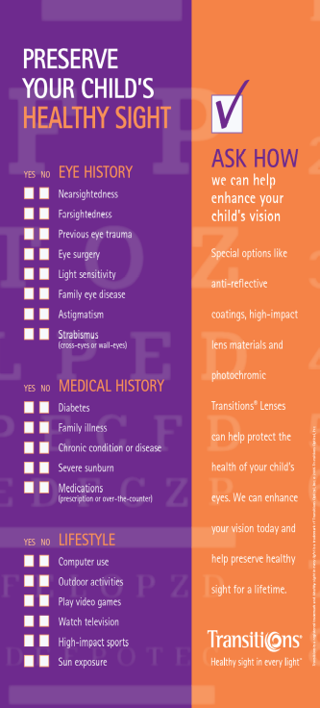
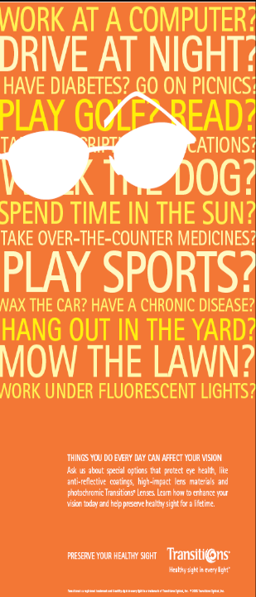
Education
UV Awareness
Glare Protection
Children
Special risk
  Medications
  Ocular disease
Notes:
There are a number of areas where it is important to educate your patients to help them not only with their daily visual needs, but also so they can help protect their eyes for a lifetime of healthy sight.
UV Awareness – Help reduce the risk of developing UV related eye conditions
Glare Protection – Improve your patients visual quality by recommending glare protection reducing eye fatigue and discomfort.
Children Remember to tell parents they need to protect their children’s eyes. It’s never too early to start.
Special risk – Medications, ocular disease
Many patients are at higher risk ensure they are aware of the added risk. Use posters and patient communication materials to help raise the awareness of the need to protect.

Slide 57
HSC and the Optician
Consider eyeglasses as a way to provide healthy sight now and to help safeguard and preserve vision for a lifetime of healthy sight.
Understand the difference between quantity and quality of vision.
Use spectacle lens enhancements to give patients the most in their eyewear.
Notes:
As you bring Healthy Sight Counseling into your role as a optician, you should:
Consider eyeglasses as a way to provide healthy sight now and to help safeguard and preserve vision for a lifetime of healthy sight.
Understand the difference between quantity and quality of vision.
Use spectacle lens enhancements to give patients the most in their eyewear.

Slide 58
HSC And Patient Satisfaction
The most tangible measure of patient satisfaction with the eye care they receive is how well they see.
Eyeglasses must meet the individual patient’s specific visual needs.
For most patients, how well they see depends on the eyeglasses prescribed.
For many patients, how well they see in the future might depend on the eyeglasses prescribed today.
Notes:
Your patients should be satisfied with the eyeglasses you dispense. And you should feel satisfied that you have provided the best in vision correction for your patient, now and for a lifetime of healthy sight.

Slide 59
The Components of HSC
Vision Care
Maintenance
Preventive eye care
Vision Wear
Customized vision correction
Quantity and quality of vision
Education
Customized vision correction
Quantity and quality of vision
Notes:
Remember, Healthy Sight Counseling is an integrated approach to seeing well for a lifetime. As the “gatekeepers,” we are responsible for ensuring that our patients see the best they can for a lifetime.

Slide 60
A Recommended Checklist:
10 Points for Healthy Sight
Have you identified and addressed the patient’s chief complaint?
Has a prior ophthalmic history been taken?
Has the patient’s medical history been reviewed?
Has the family history—ophthalmic and medical—been considered?
Has an individual patient lifestyle history been obtained?
Notes:
When incorporating Healthy Sight Counseling into the busy eyecare practice, the ECP and other members of the practice may want to review each patient encounter to ensure that the best possible vision care and vision wear has been provided and prescribed. Here is a simple ten-point checklist to make it easier to integrate the components of HSC into the exam and the entire practice.
1. Have you identified and addressed the patient’s chief complaint? Pay close attention to how your patient describes his/her vision problem. Remember that vision problems are often affected by lifestyle or existing medical conditions.
2. Has a prior ophthalmic history been taken? Did your patient mention any previous ocular disease, trauma, or surgery? Does she use contact lenses or eyeglasses? Has he had refractive surgery? Check to see if your patient has been using any topical eye medication—whether prescription or OTC products.
3. Has the patient’s medical history been reviewed? Does he/she suffer from any current systemic or chronic diseases? Has she had a prior surgery? Review all medications your patient is using—both prescription and OTC.
What about allergies?
4. Has the family history—ophthalmic and medical—been considered? Patients may not be aware of how the health of family members may relate to their personal health. By asking about this, you may uncover important information about potential or existing ocular conditions.
5. Has an individual patient lifestyle history been obtained? Occupation, recreation, computer use, and many other indoor and outdoor activities, can affect ocular health and daily vision needs. Remember to ask patients about their daily UVR exposure and the activities that subject them to glare.

Slide 61
A Recommended Checklist:
10 Points for Healthy Sight
6. Has a comprehensive ophthalmic examination been performed?
7. What are the special considerations identified for this patient?
8. Have the appropriate eyeglasses been prescribed?
9. Is the patient aware of his/her role in achieving healthy sight?
10. Are both you and your patient satisfied with the encounter?
Notes:
6. Has a comprehensive ophthalmic examination been performed? An “customized eyeglass prescription™” encompasses both the quantity of vision (measured by Snellen acuity), and quality of vision (contrast sensitivity and glare testing), which takes into account the many real-life issues that affect vision on a daily basis.
7. What are the special considerations you’ve identified for this patient? A wide range of history and lifestyle factors can affect visual health. Disease, medical and lifestyle issues, and risks that can have a negative effect ocular health are important. Also, remember children are more susceptible to the effects of UVR exposure.
8. Have the appropriate eyeglasses been prescribed for the patient’s eyes — and for the individual patient’s visual lifestyle? Not all lenses are right for all patients. It is imperative to prescribe eyeglasses that will help address each patient’s individual and specific needs based on his/her personal and demographic lifestyle. Remember to consider: single vision or progressive lens designs, impact-resistant lenses, photochromic lenses, Anti-Reflective coatings, and UVR blockage. Remember, too, that the patient may require multiple pairs for multiple needs.
9. Is the patient aware of his/her role in achieving healthy sight? Healthy Sight Counseling is a partnership between you and your patient. Make sure the patient is aware of how to maximize the quality of their everyday vision and how to help to preserve the health of their eyes. Also, be certain to explain the importance of preventive eye care, especially in children.
10. Are both you and your patient satisfied with the encounter? Quickly review the earlier points. Do both you and your patient feel comfortable with the encounter and confident that the visit has been as productive as possible? If the answer is yes, you can be assured that you are helping your patients achieve a lifetime of healthy sight.

Slide 62
For More Information:
Visit Transitions Optical at:
  http://www.Transitions.com
Visit the Healthy Sight For Life Fund at:
  http://www.HealthySightForLife.org
Visit the Healthy Sight Institute at:
  http://www.HealthySightInstitute.org
Notes:
That concludes our presentation.
For further information about Transitions Optical, visit www.Transitions.com.
To learn about the Healthy Sight For Life Fund and for more information about the Transitions Students of Vision Scholarship Program, visit www.HealthySightForLife.org.
And for more information about educational resources available, visit the Healthy Sight Institute at www.HealthySightInstitute.org.
Thank you.

