Slide 1
Artificial neural networks as analysis tool for predicting EEG data in auditory attention tasks
Tobias de Taillez¹
Bojana Mirkovic²
Birger Kollmeier¹
Bernd T. Meyer¹
University of Oldenburg, Germany, Department of Medical Physics and Cluster of Excellence Hearing4all
University of Oldenburg, Germany, Department of Psychology and Cluster of Excellence Hearing4all
Notes:
Question that drives my PHD thesis:
Neural Networks are powerful. How could they be used for research?

Slide 2
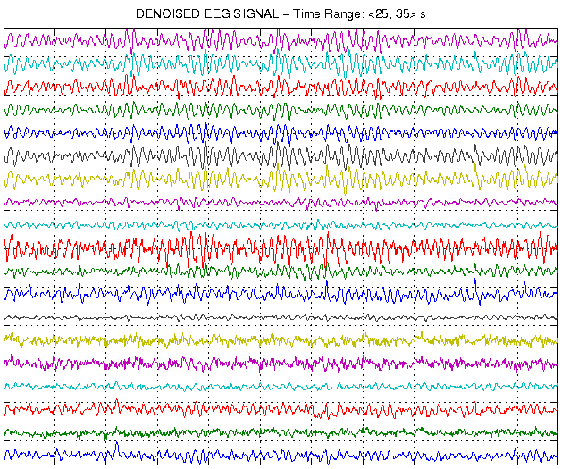
Alan J. Power et al. (2012): At what time is the cocktail party? A late locus of selective
attention to natural speech
Linear regression model
Edmund C. Lalor et al. (2009): Resolving Precise Temporal Processing Properties of the Auditory System Using Continuous Stimuli
X
ω(t)
x(t)
y(t)
+45°
!
-45°
Bojana Mirkovic et al. (2016): Target Speaker Detection with Concealed EEG Around the Ear

Slide 3
Deep Neural Network Encoding Model
X
ω(t)
x(t)
y(t)
+45°
!
-45°
Physical
Stimulus
Physiological Data

Slide 4
Deep Neural Networks
Powerful engineering tool
Work well in bad SNR situations
Can learn nearly any nonlinear transfer function
Powerful scientific tool also!
Contribution of input features can be calculated
This talk will show another way to learn from DNNs
S. Bach, A. Binder, G. Montavon, F. Klauschen, K.-R. Müller, W. Samek, On pixel-wise explanations for non-linear classifier decisions by layer-wise relevance propagation, PLOS ONE 10 (7) (2015) e0130140.
T. de Taillez et al. (2017): Machine learning for decoding listeners’ attention from electroencephalography evoked by continuous speech

Slide 5
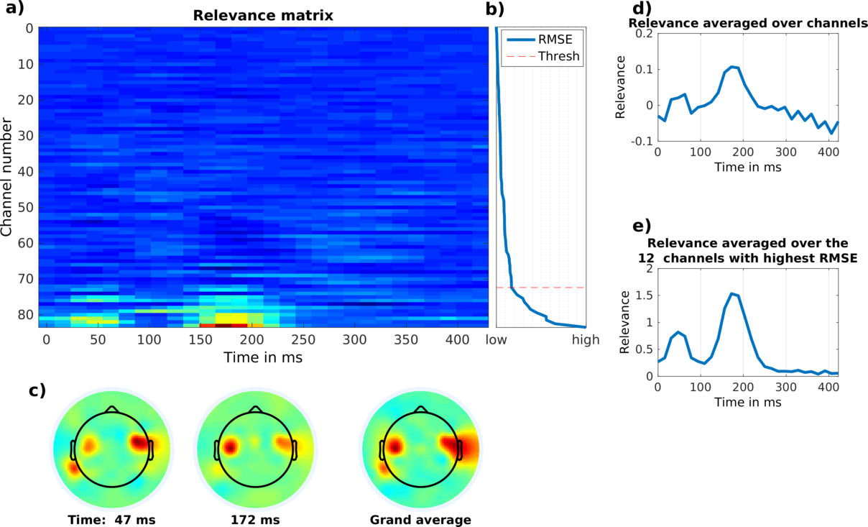
Deep Neural Networks
T. de Taillez et al. (2017): Machine learning for decoding listeners’ attention from electroencephalography evoked by continuous speech

Slide 6
Experimental setup
16 participants
8 attended left speaker
50 min EEG and audio data per participant
84 channel EEG
Speech preprocessing
Envelope calculation
Envelope down-sampled to 64 Hz
z-scored over complete length
EEG preprocessing
Automatic bad channel detection with EEGLAB and reconstruction by interpolation
Down-sampled to 64 Hz
Highpass filtered at 1 Hz
z-scored over time in 1 min blocks
X
+45°
!
-45°

Slide 7
Shifted across
Network Layout
2 input neurons
one attended channel
one unattended channel
3 hidden layer
4, 16 and 64 neurons
Output layer is a matrix
84 ∙ 32 =2688 neurons
for all EEG channels
500 ms time context
Attended
Unattended
4 neurons
16 neurons
64 neurons
Output matrix
84 neurons
channels
Shifted across
t₀
32 neurons
time context

Slide 8
Data split
Cross-validation step
2 min
50 min
Data of all 16 participants is pooled
16 * 50 min = 800 min data
32 min excluded from training set
16 min development set
16 min test set
DNN training until no improvement on development set for 10 training epochs
25 cross-validation steps
Left story
Right story
EEG data
EEG data
EEG data
EEG data
EEG data
Development set
Test set

Slide 9
Sanity Check
50 min
Cross-validation repeated
Misaligned stories
Same spectral properties of input features
DNN should not be able to learn any useful information from it!
Misalignment
Left story
Right story
EEG data
EEG data
EEG data
EEG data
EEG data

Slide 10
Model of Speech Processing
DNN is trained to model physiological speech processing
Model properties - calculating impulse response
Similar to ‚click‘ experiment
click-length would be below 64 Hz resolution
Picton, T. W., Hillyard, S. A., Krausz, H. I., & Galambos, R. (1974). Human auditory evoked potentials. I: Evaluation of components.
0 0 0 0 0 0 0 0 0 0 0 0 0 0
0 0 0 0 0 0 0 1 0 0 0 0 0 0
Simulated auditory evoked potential
for attended speech processing
0 0 0 0 0 0 0 1 0 0 0 0 0 0
0 0 0 0 0 0 0 0 0 0 0 0 0 0
Simulated auditory evoked potential
for unattended speech processing

Slide 11
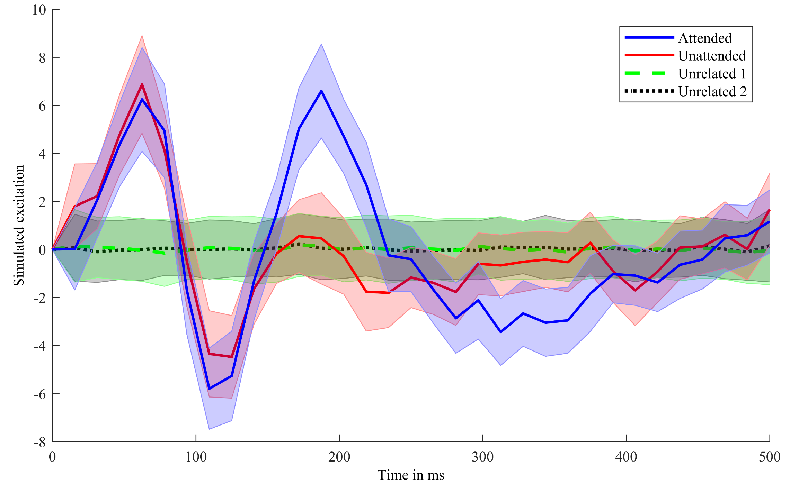

Slide 12
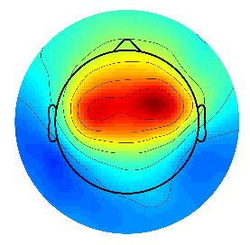
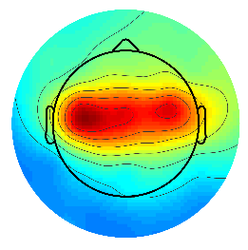

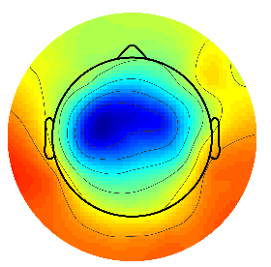
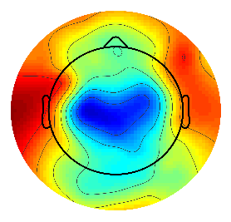
Impulse Response
Cz excitation resembles auditory evoked potentials
Even though trained on continuous speech!
Topological plot shows central activation
Attention effect
P₂ peak is not present in unattended processing
Attention related activity at 200 ms and after 250 ms

Slide 13
Spectral Aspects
EEG simulation of one input channel with complete story
Long term spectrum per channel
Averaging over channels
0 0 0 0 0 0 0 0 0 0 0 0 0 0
Complete story material
Long term spectrogram - attended speech processing
Complete story material
0 0 0 0 0 0 0 0 0 0 0 0 0 0
Long term spectrogram
- Unattended speech processing

Slide 14
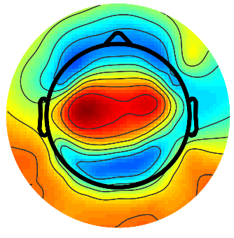
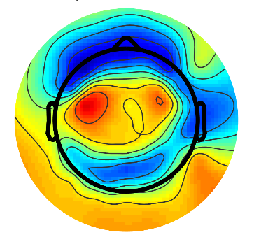
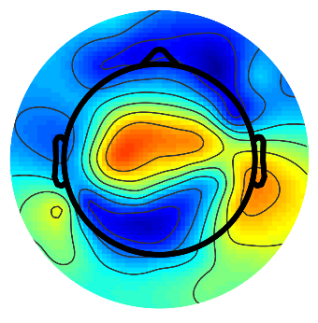
Spectral analysis
Comparable attended and unattended modeling
Difference between 4 and 6 Hz
Topologic view
Spectral power of each channel
Most power at 5 Hz is central
Attention related difference slightly lateral
Difference

Slide 15


Summary
Temporal
Spectral
Spectral and temporal analysis come to similar results
Auditory attention effects are encoded between the N₁ and P₂
DNNs can provide a model for attention-related speech processing
DNNs are no “black box” approaches
Additional training data would improve models further
Higher frequency resolution possible!
P₂

Slide 16
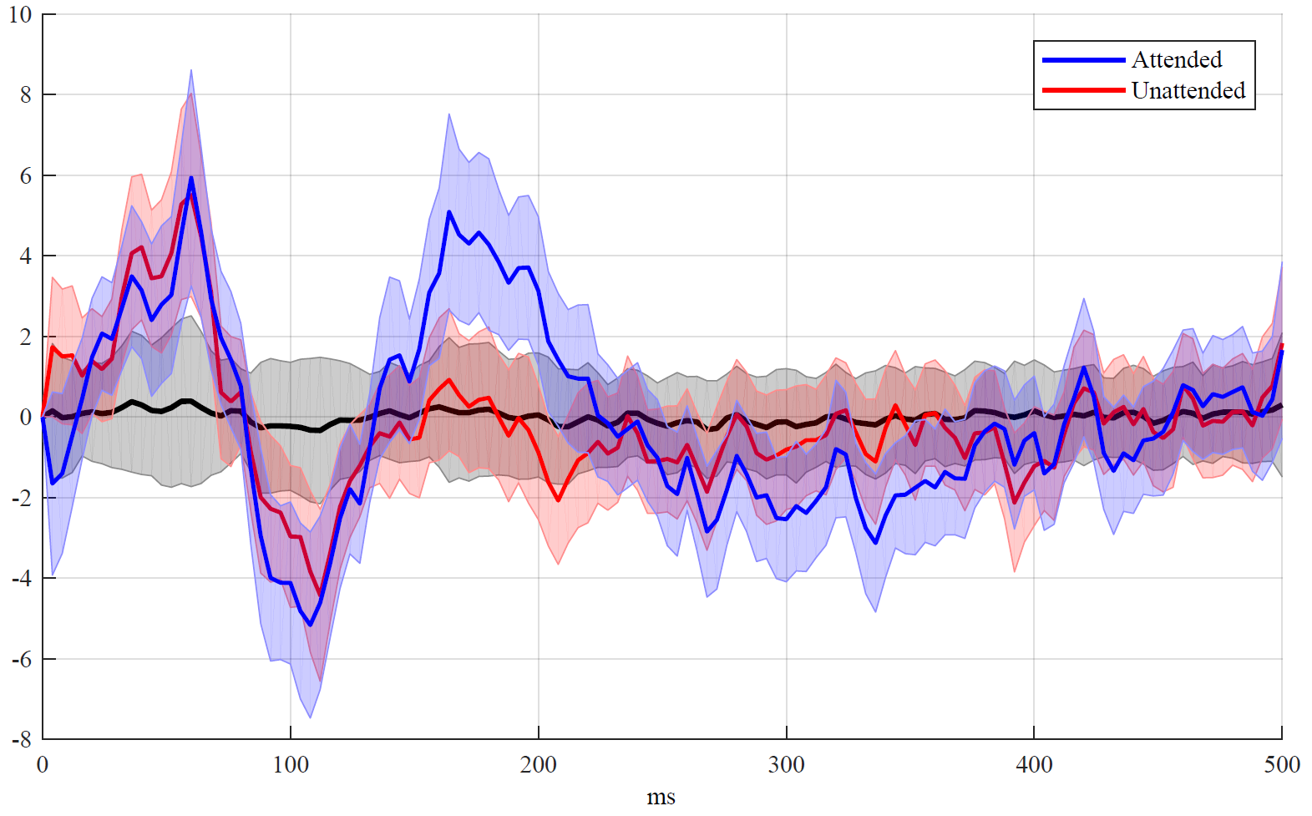
Lookout
?
?
?
?
?
?

Slide 17

Thank you for your auditory attention!
DNN code:

