Slide 1


ProfAI
Web App for AI-Generated Professional Instructor Content
L Dettling
CIS 641

Slide 2
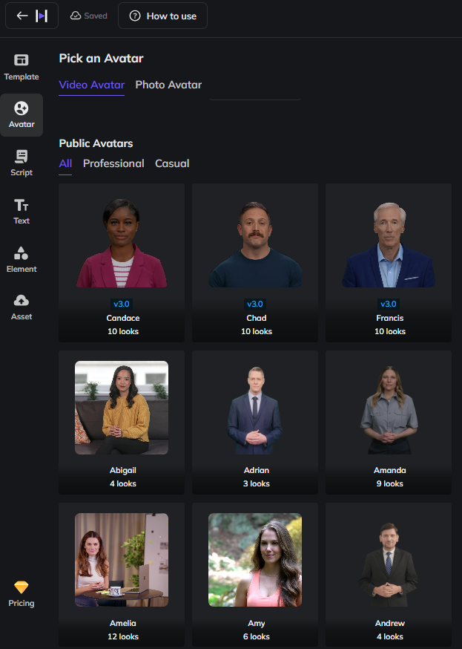
Motivation and Overview
Web App that takes a lifelike avatar of a professor and a content prompt, and generates a personalized 2-5 minute video describing content with a set of slides in the background.
Avatars created from HeyGen
Faculty: An accessible tool that is fast and easy to use
Students: Accessibility and active engagement
React and Django, SQLite
GVSU IT Innovation and Research funded
HeyGen’s Avatar page
Notes:
Describe your project at a high level. We should all know what each other is doing at this point, but it helps to "set the stage" for your presentation.

Slide 3
Steps for Faculty
Create an account, then generate an avatar and API key from HeyGen
2. Go to ProfAI, create an account, and connect your API key to import their avatar.
3. Pick a topic for your lecture video, and approve the generated script
4. Let ProfAI create the video, and export

Slide 4
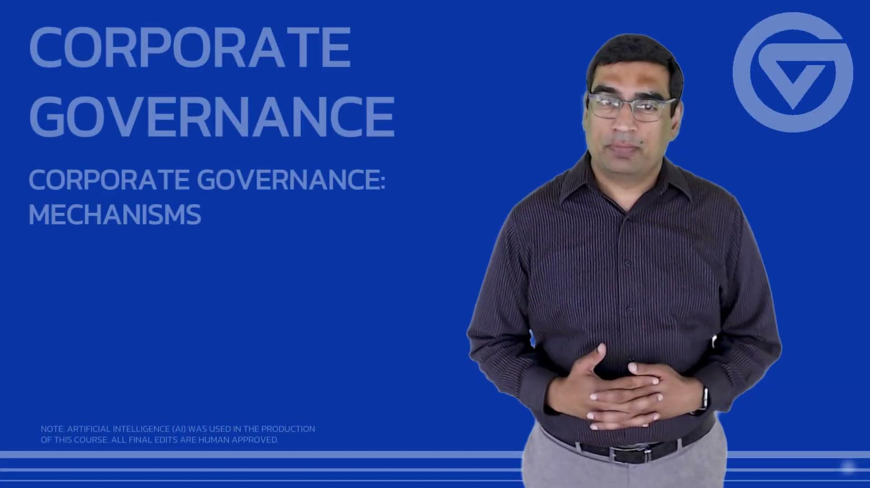
Our Goal

Slide 5
Overall Goals of the Project
Business Level:
Create downloadable videos
Create downloadable slides
Share an MVP for analysis
Technical Development:
Connect user accounts to HeyGen for integration
Create and manage secure data
Have slideshows dynamically flow through a video

Slide 6
Did we Meet the Goals of the Project?
Business Level:
Create downloadable videos - Yes
Create downloadable slides - Yes
Share an MVP for analysis - Coming up
Technical Development:
Connect user accounts to HeyGen for integration - Yes
Create and manage secure data - Yes, pending audit
Have slideshows dynamically flow through a video - No

Slide 7
Successes of ProfAI
Exposure to web development frameworks - React, Django, originally Node.js
Gained valuable professional experience
Future work is available

Slide 8
Pain Points of ProfAI
No program expert available for support
Minimal funding for MVP
Small development team

Slide 9

Demo

Slide 10
Future Work
UI Updates
Text box spacing
More ‘bubbly’ like homepage
More expressive instructions
Instructions for content generation and slideshow best practices
File uploads
For instructors to upload lecture notes, rather than a script content prompt.

