Slide 1
Mathematics of Gerrymandering
WXML Winter 2018
Notes:
Introduce Group.

Slide 2
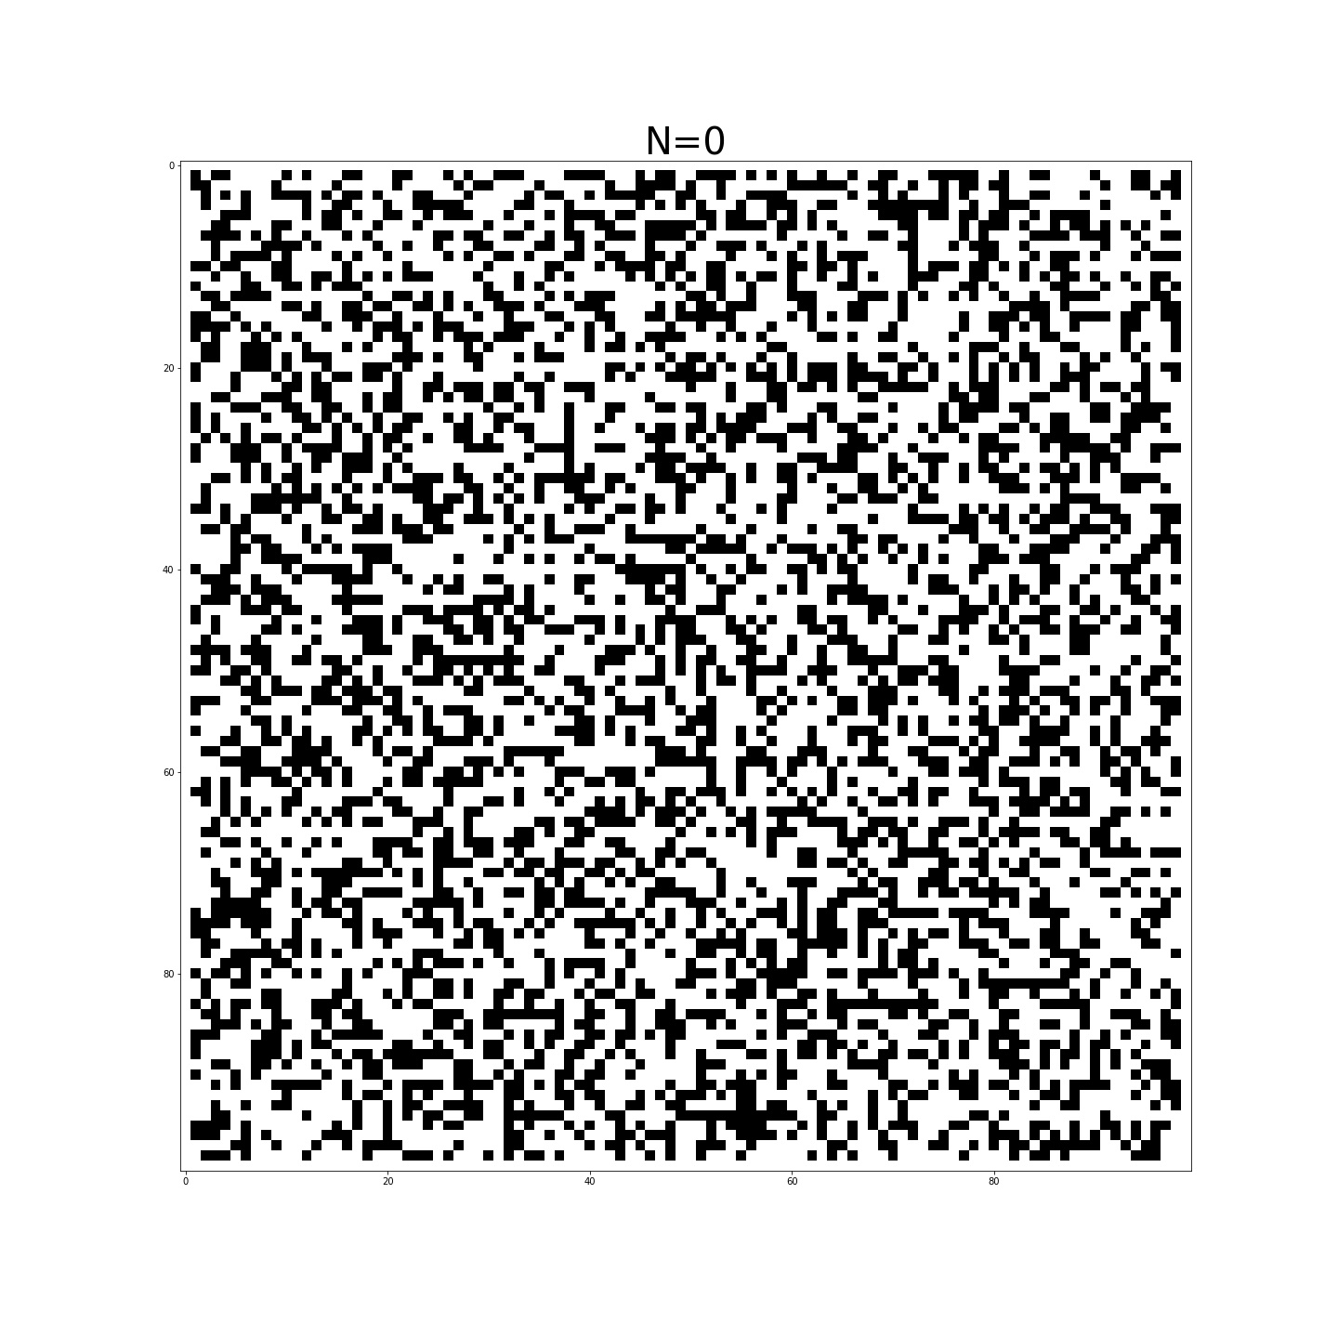
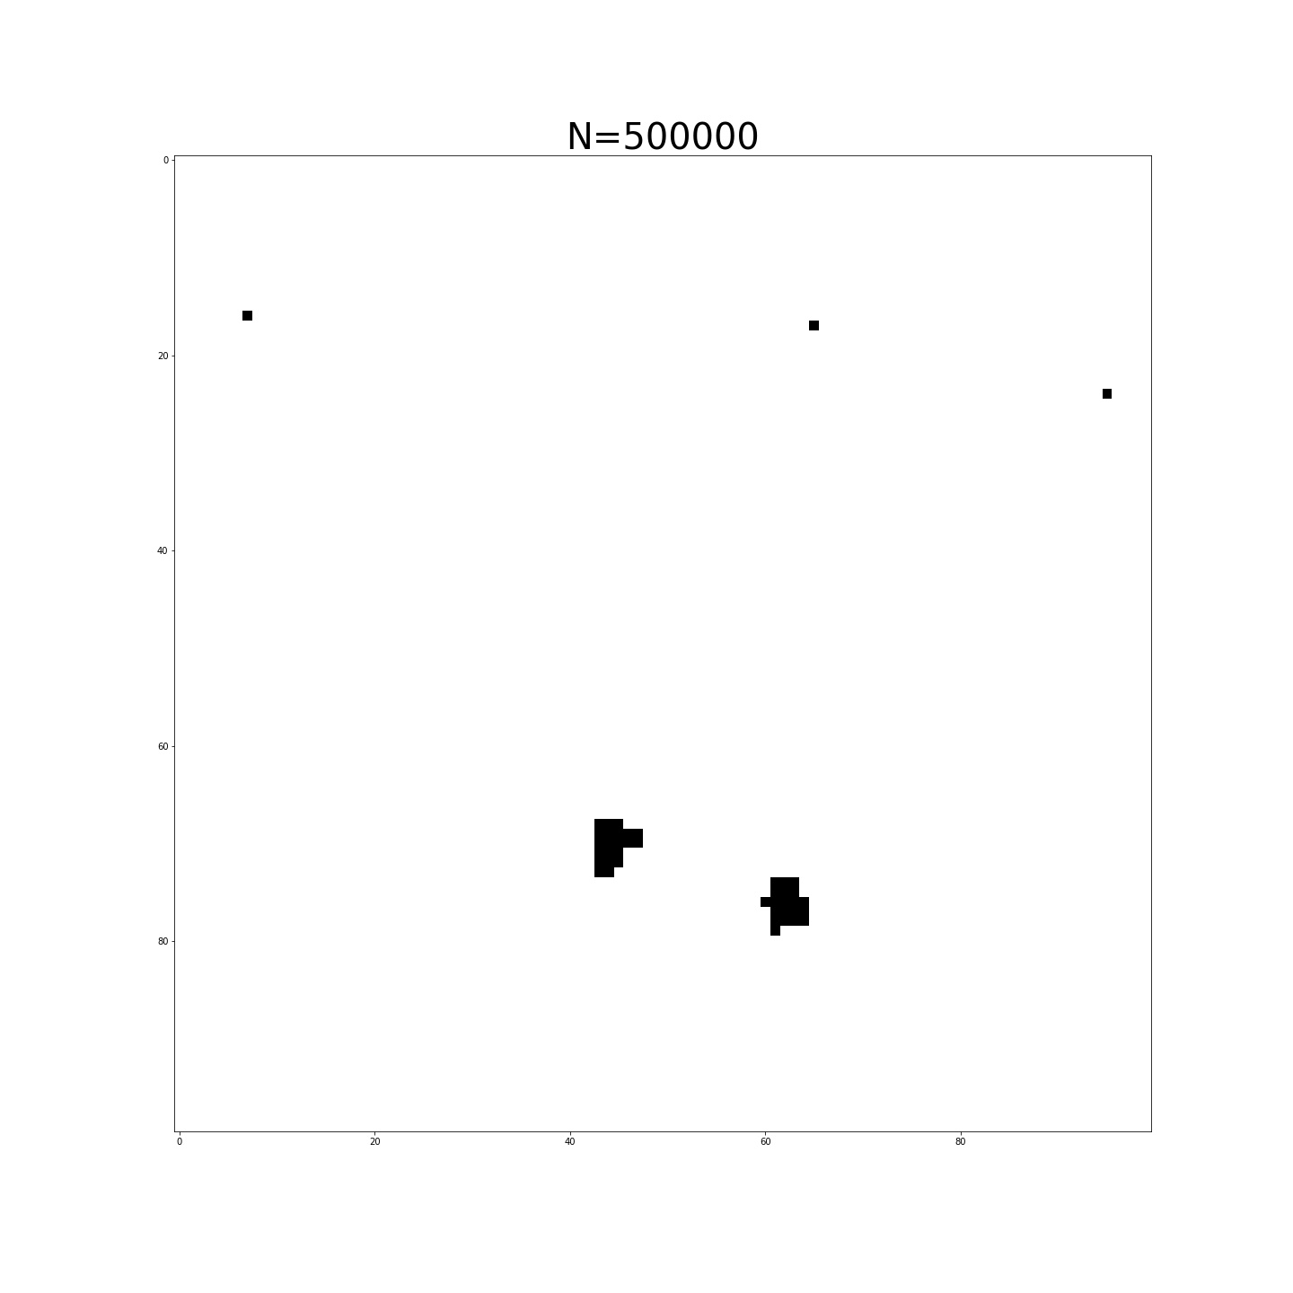
Recap
-We want to sample from a space of redistricting plans via random walk along a graph (using the Metropolis-Hastings Algorithm).
-Previously we developed our understanding of the algorithm by coding the Ising model.

Slide 3
Redistricting plans
States have varying types of requirements for redistricting plans. Common types include:
Contiguity
Population
Compactness
Voting Rights Act Compliance
These requirements will be important for our model.
Notes:
Talk about contiguity.

Slide 4
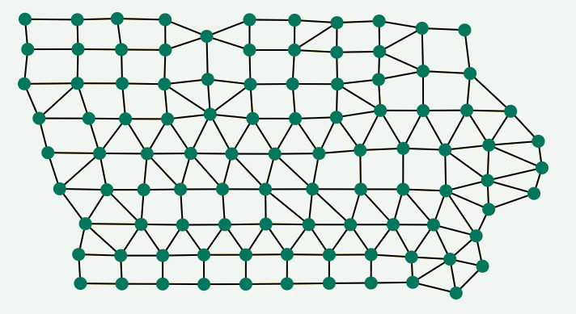
Iowa
We chose Iowa as our first state to model because counties must be kept together (reducing the complexity of our graph) and because its redistricting laws only require us to consider a few factors in our model (contiguity, population and compactness).
Image courtesy of Duke University
Notes:
The metropolis Hastings Algorithm produces a random walk who’s stationary distribution is the distribution we’re dealing with.

Slide 5
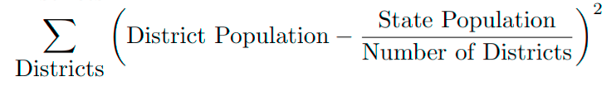
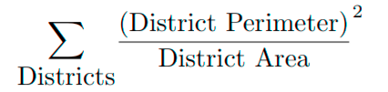
Iowa Redistricting Energies
Population energy:
Compactness energy:
We want to minimize these values.
Notes:
We reproduced Ising model to practice the algorithm because it is similar to planning congressional districts and much simpler. Ising model is a mathematical model of atoms of magnet with spins. Atoms represent precincts. Spins of atoms, which are only two, ups and downs, represent congressional districts which precincts belong to. And edges mean the precincts share a border. Also, the probability function of spin distribution of atoms are already given from physics, which we need to find out for redistricting distribution.

Slide 6

Implementing the algorithm
Use an undirected graph to represent the political map of Iowa.
Represent a possible redistricting plan by assigning each vertex a number from {1, 2, 3, 4}, indicating the Congressional district to which each precinct belongs.
Start with a random redistricting plan and proceed as follows:
Choose a similar redistricting plan which only differs from current plan by one precinct as candidate for next step of random walk.
Compute the following ratio:
Accept the candidate with probability min(ratio, 1)

Slide 7
Future works
Compare new congressional district map to the actual map using past presidential election data to simulate results.
Define majority-minority energy equation.
Ensure that minorities have an equal opportunity to elect representatives of their choice.
Define counties-split energy equation.
Division of boundaries of cities and counties should be minimized.
Apply this to Washington state.

Slide 8
Thank you.
Weifan Jiang
Namyoung Kim
Alex Robkin
Leo Segovia
Notes:
In Summary, by using the metropolis Hastings algorithm to approximate the Ising Model we gained insight into how we can use the Metropolis algorithm to sample from such a large space as that of all possible redistricting plans.

