Slide 1

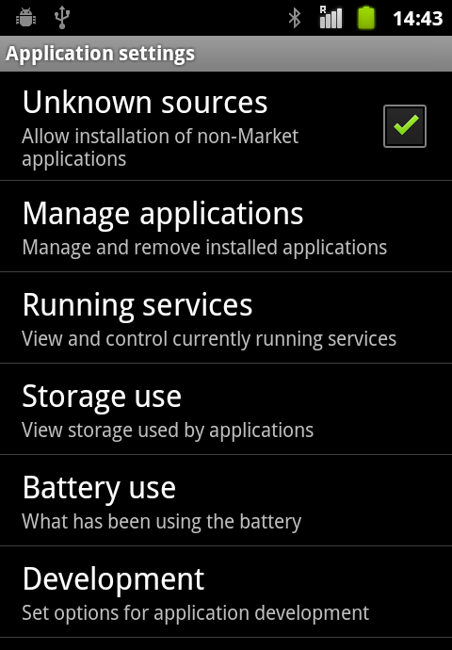
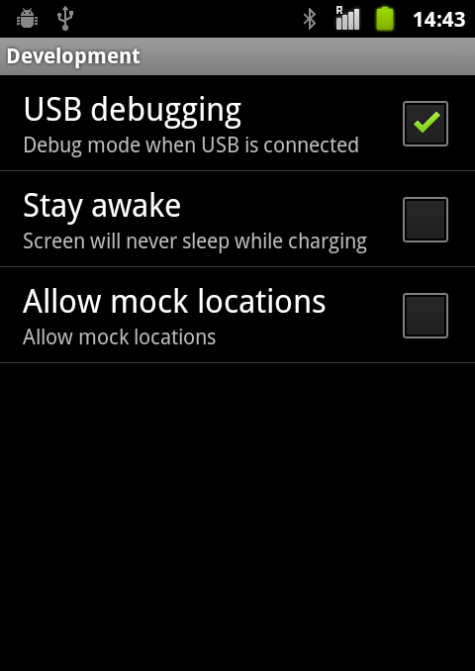
How to prepare for Debugging
Enable USB debugging on your device:

