Slide 1
Hack-a-Thon 2019
Harmonic Oxtel Control Suite
Dan Montz & Don Doyle

Slide 2
Background
Tools
Products
Automation
ChannelPort
FXTool
Spectrum X
Oxtel
effectstest.py
Electra X
Controls
Graphics/branding
DVE
Live Switching
Video over IP
VOS

Slide 3
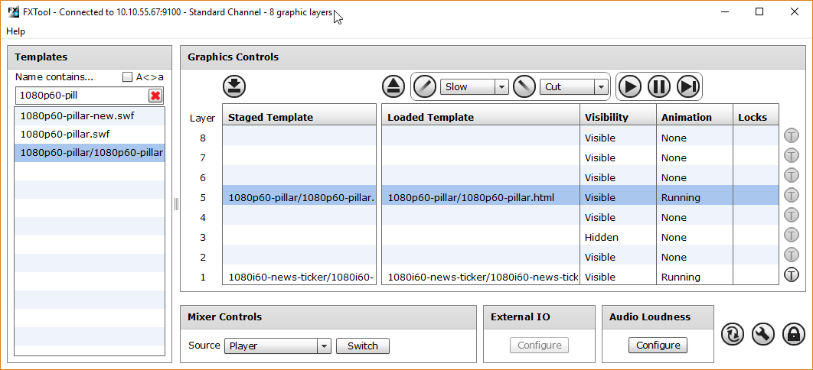
Our Tools
FXTool
Customers
Graphic Template Authors
Developers
Service
effectstest.py
Low-Level Developers
Service
QA automation
localhost:5007> load 0 1080i60-news-ticker.swf
localhost:5007> fade 0 1 10
localhost:5007> cut 0 0

Slide 4
The Problem
FXTool
Adobe AIR application
ActionScript 3.0
Macromedia MXML
Flash Builder 4.6
Cross Platform
Windows
OS X
Linux (discontinued 2011)
effectstest.py
Python Command Line Interface (CLI)
Python
IDE of choice
Cross Platform
Windows
OS X
Linux

Slide 5




Tool Architecture
FXTool
effectstest.py
Why so
Different?
User Interface
User Interface
Oxtel Protocol Client
Oxtel Protocol Client
ActionScript
MXML
python

Slide 6
Hack-a-thon Proof of Concept
Harmonic Oxtel Control Suite
CLI
Cross Platform
Application
ASCII
terminal
Mobile
Browser
High-Level Abstraction
Oxtel Protocol Client

Slide 7

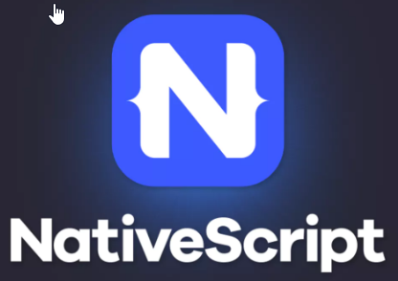




Hack-a-Thon Plan
Harmonic Oxtel Control Suite
CLI
Cross Platform
Application
ASCII
terminal
Mobile
(iOS & Android)
Browser
High-Level Abstraction
Oxtel Protocol Client

Slide 8
What We Accomplished
Harmonic Oxtel Control Suite
CLI
Cross Platform
Application
ASCII
terminal
Mobile
(iOS & Android)
Browser
High-Level Abstraction
Oxtel Protocol Client

Slide 9

Demo

Slide 10
Questions

Slide 11
Thank You

Slide 12
“Click to insert quote”
Person Quoted
Title, Date

Slide 13
Color palette (primary)
R: 0
G: 0
B: 0
R: 200
G: 200
B: 190
R: 5
G: 40
B: 70
R: 0
G: 157
B: 200
R: 135
G: 168
B: 33
R: 165
G: 14
B: 87
R: 110
G: 110
B: 105
R: 165
G: 165
B: 155

