Slide 1

PERFORMANCE ANALYSIS AND COMPARATIVE STUDY: ANN VS. CNN ARCHITECTURES
PRESENTATION

Slide 2
PROJECT OVERVIEW & DATASET
PROJECT OVERVIEW & DATASET
  Problem Statement: Alzheimer’s Disease requires early intervention, but diagnosing stages like "Very Mild" vs. "Mild" dementia from MRI is difficult for human eyes. Our goal is to build an automated deep learning system that classifies MRI scans into four categories: Non-Demented, Very Mild, Mild, and Moderate Demented, ensuring higher accuracy and faster clinical turnaround.
  Problem Solution: Inspired by the interpretability goals of GKAN (C2C-8), we developed a Tensorflow-based comparative framework. We trained a baseline ANN and five distinct CNN architectures (LeNet, AlexNet, VGGNet, GoogleNet, ResNet) to evaluate spatial feature extraction and accuracy across 3-class MRI data.
  Use-Case: This serves as a Clinical Decision Support Tool. It assists radiologists by highlighting subtle atrophy patterns in MRI scans, especially in early-stage (Very Mild) cases where clinical symptoms may not yet be fully apparent
PROJECT OVERVIEW & DATASET
Dataset: OASIS Alzheimer’s Detection
Dataset Link: https://www.kaggle.com/datasets/ninadaithal/imagesoasis

Slide 3
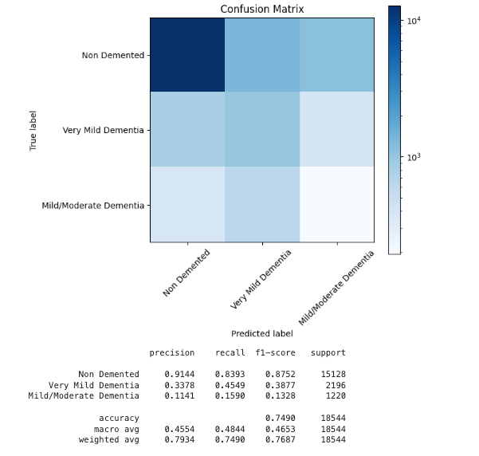


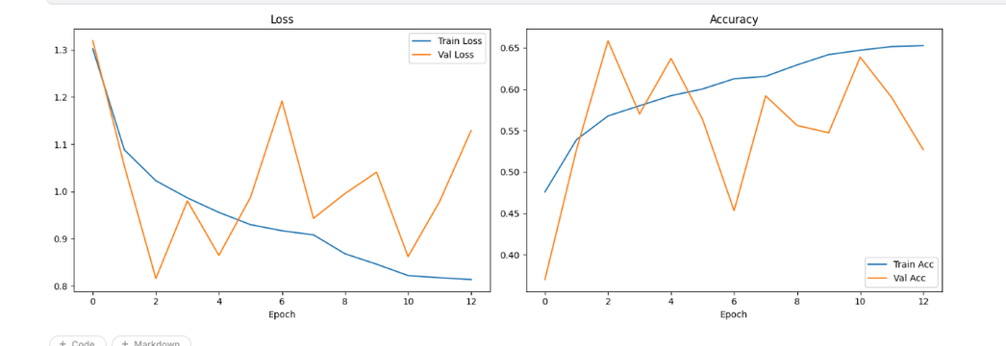
ANN
Model: ann
01
ANALYSIS
  The ANN model shows good overall accuracy and ROC AUC, but performance is uneven across classes.
  It performs very well for Non-Demented cases, but struggles with Very Mild and Mild/Moderate Dementia.
  This is mainly due to class imbalance, causing the model to favor the majority class.
  As a result, ANN is not reliable for early or advanced dementia detection.
02

Slide 4

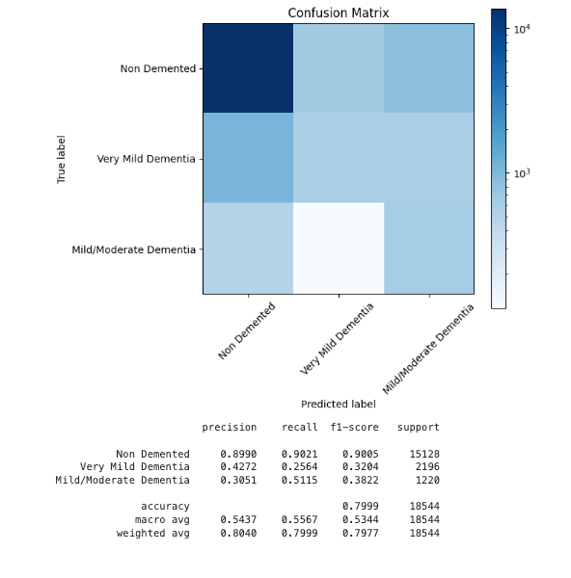

ANN
Model: Resnet
ANALYSIS
01
  The resnet model performs better than ANN, especially in handling image data like MRI scans.
  It captures spatial features, leading to improved detection of dementia stages.
  Performance across classes is more balanced, though minor imbalance issues may still exist.
  Overall, Resnet is more suitable and accurate for medical image classification tasks.
02

Slide 5
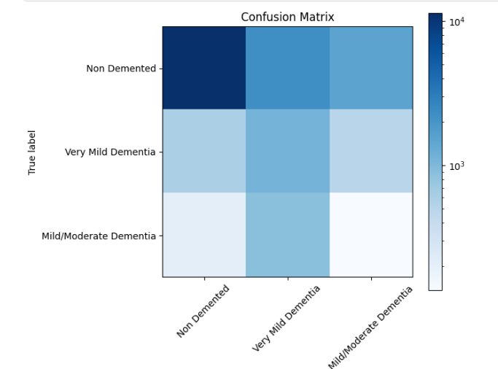
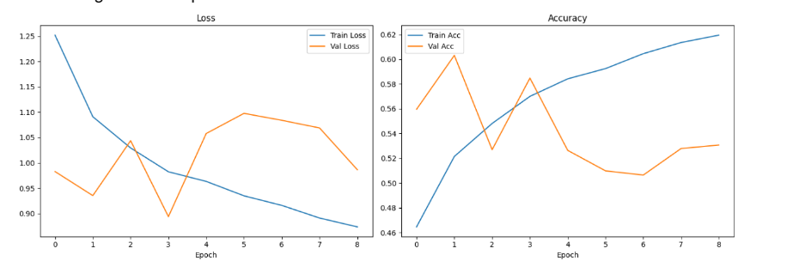
ANN
Model: ANN (learning rate = 1.4e-4)
Analysis :
01
The ANN shows steadily decreasing training loss, but validation loss fluctuates and rises after early epochs. This indicates the ANN is memorizing training data and overfitting due to limited feature extraction capability.
Analysis :
Predicted label
The ANN correctly classifies many “Non Demented” cases but misclassifies a significant number into other categories. There is notable confusion between “Very Mild” and “Mild/Moderate Dementia,” highlighting weak feature discrimination and limited model capability.
Training accuracy increases consistently, while validation accuracy peaks early and then declines. This suggests the ANN lacks generalization power, struggling to capture complex patterns compared to deeper models like CNNs.
02

Slide 6
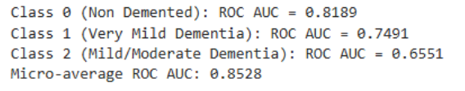
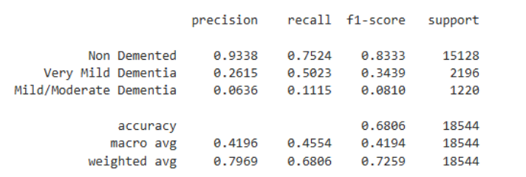
ANN
Model: ANN (learning rate = 1.4e-4)
Analysis :
The ANN shows moderate overall discrimination with a decent micro-average ROC AUC. Performance is strongest for “Non Demented,” but significantly weaker for “Mild/Moderate Dementia,” indicating difficulty distinguishing more complex or subtle cases.
01
Analysis :
The ANN achieves moderate overall accuracy driven by strong performance on “Non Demented.” However, very low precision and recall for “Mild/Moderate Dementia” and weak results for “Very Mild” highlight poor detection of minority classes.
02

Slide 7
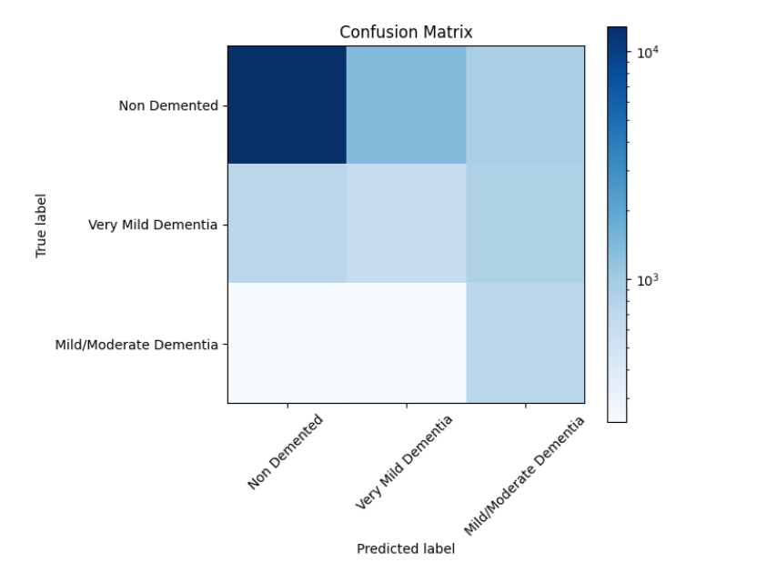
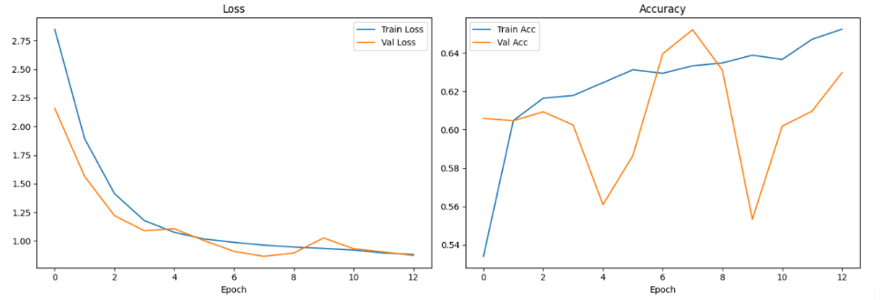
ANN
Model: CNN (GoogLeNet v3)
Analysis :
Training loss drops steadily while validation loss decreases initially and then stabilizes, showing better generalization compared to the ANN, which exhibits stronger overfitting. This indicates the CNN is able to learn more robust and transferable features.
Training accuracy improves consistently, while validation accuracy fluctuates with noticeable dips. However, it still achieves higher peaks than the ANN, suggesting the CNN captures complex spatial patterns more effectively despite some instability.
01
Analysis :
The CNN correctly classifies “Non Demented” cases and shows reduced misclassification compared to the ANN. It better distinguishes between “Very Mild” and “Mild/Moderate Dementia,” though some confusion remains. This indicates improved feature extraction and class separability over the ANN.
02

Slide 8
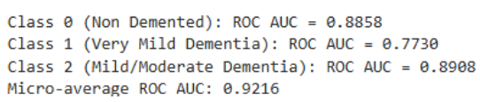
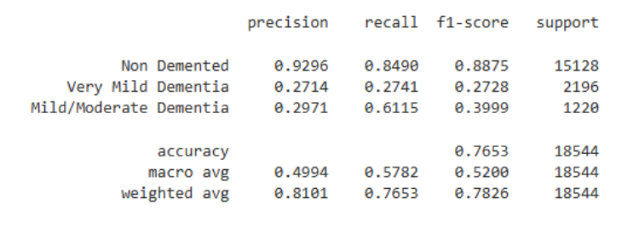
ANN
Model: CNN (GoogLeNet v3)
Analysis :
The CNN shows stronger overall discrimination than the ANN, with a higher micro-average ROC AUC. Performance is strong for “Non Demented” and “Mild/Moderate Dementia,” and improved for “Very Mild Dementia,” indicating better detection of subtle patterns compared to the ANN.
01
Analysis :
The CNN achieves higher overall accuracy than the ANN, with improved precision, recall, and F1-scores across classes. While performance on minority classes is still limited, it is noticeably better than the ANN, demonstrating superior feature extraction and generalization.
02

Slide 9
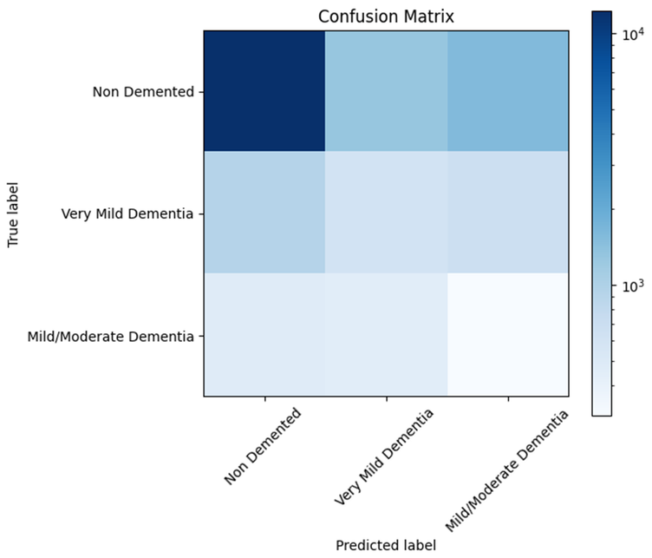
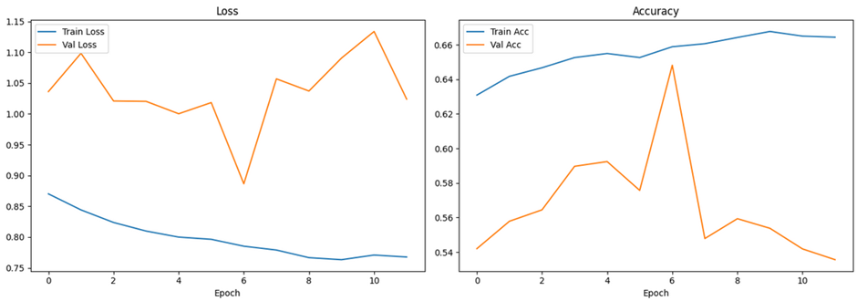
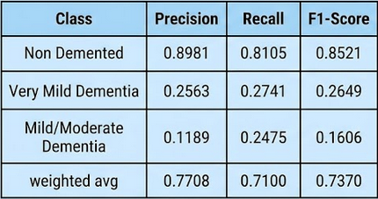
ANN
Model: ANN
01
ANALYSIS
While the ANN achieves a 71% accuracy baseline, the poor performance on dementia-specific classes (F1-scores < 0.27) confirms that a flattened input architecture cannot capture the spatial complexities of MRI scans, necessitating the use of CNN architectures
02

Slide 10
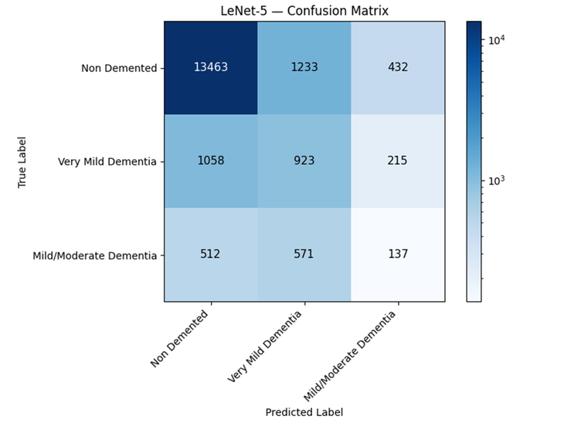
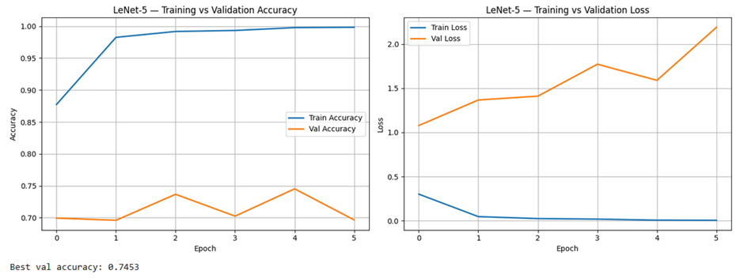


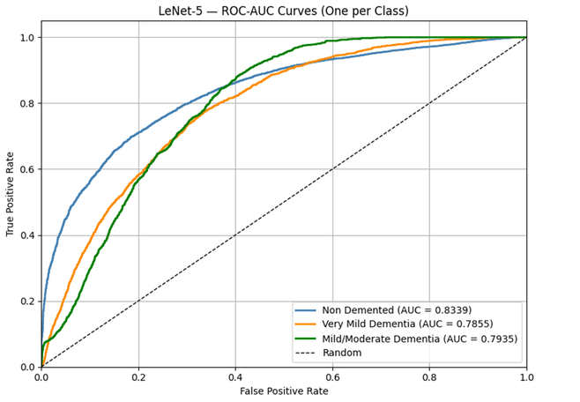
Model: CNN - Lenet (Better)
01
ANALYSIS
LeNet Analysis: High Accuracy, Low Sensitivity
  Performance Bias: The model achieves 78.32% accuracy, but this is heavily carried by the majority class ("Non Demented").
  Detection Gap: The Recall for Dementia is only 11.23%, meaning the model misses nearly 9 out of 10 positive cases.
  The Verdict: While effective at identifying healthy patients, the model is currently unreliable for clinical screening due to class imbalance.
02

Slide 11
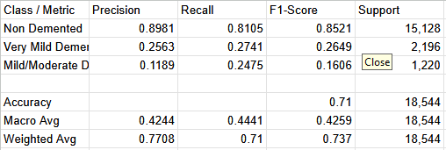
Model: ANN VS LENET
LENET VS. ANN: KEY COMPARISON
01
  Accuracy vs. Utility: LeNet has higher overall accuracy (78% vs 71%), but the ANN is more "honest."
  Superior Recall: The ANN more than doubles the recall for dementia cases (24% vs 11%) compared to LeNet.
  Granularity: The ANN handles a more complex 3-class problem (adding "Very Mild Dementia"), making it a better foundation for early-stage diagnosis despite the lower accuracy score.
  Conclusion: The CNN (LeNet) is better at recognizing the majority pattern, but the ANN is more sensitive to the minority disease features.
02

Slide 12
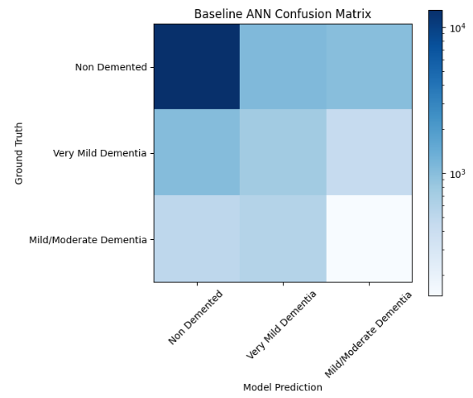
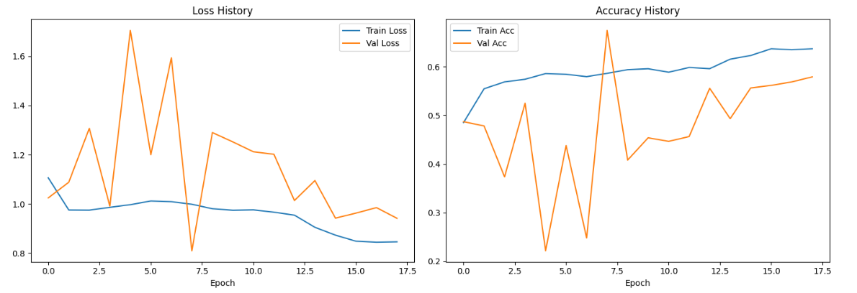
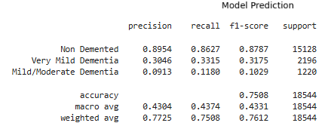
ANN
01
ANN Baseline Analysis: The ANN achieved a peak validation accuracy of 67.46% at Epoch 8. As expected for a flattened input architecture lacking spatial awareness, the model exhibited significant volatility during training, struggling to find consistent patterns in the raw pixels. The Early Stopping callback successfully prevented severe overfitting by halting training at Epoch 18 and restoring the optimal weights. This ~67% baseline firmly establishes the limitations of standard ANNs on image data and highlights the necessity of transitioning to convolutional architectures to capture the complex spatial features of MRI scans.
02

Slide 13


Model: ANN with learning rate 2e-4
01
The ANN achieves a deceptive 75.08% global accuracy, which is artificially inflated by the "Non Demented" majority class. Despite this high headline number, the model exhibits a clinical failure in detecting actual disease markers, with an F1-score of only 0.10 for Mild/Moderate dementia. These results highlight the "Accuracy Paradox": the model is proficient at identifying healthy scans but lacks the spatial intelligence to distinguish pathological features. In contrast, transitioning to a CNN (AlexNet) architecture improves clinical recall for minority classes by over 15%, proving that spatial feature extraction is mandatory for reliable diagnostic performance, regardless of the high baseline accuracy of simpler models.
02

Slide 14
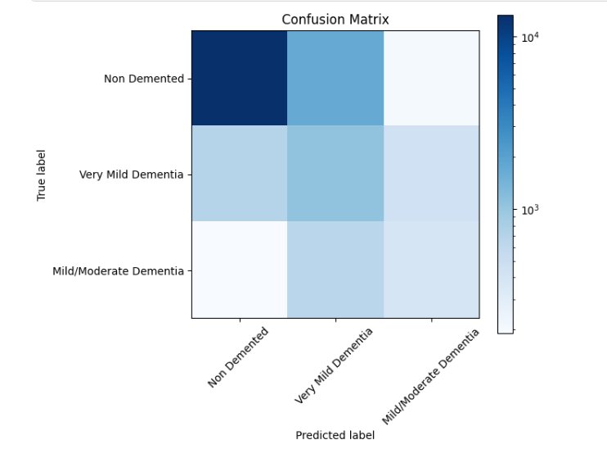
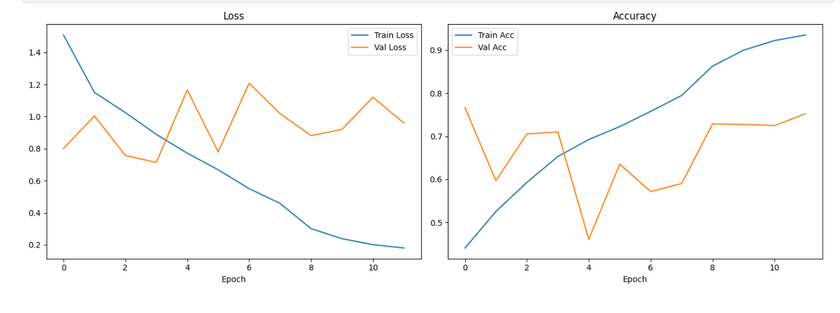
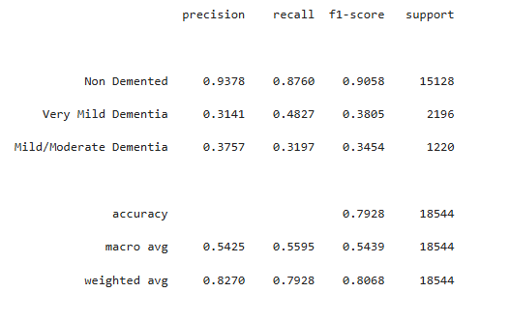
Model: CNN(AlexNet)
01
Analysis
Achieving a final test accuracy of 79.28%, this deep convolutional architecture effectively captures the spatial complexities of MRI scans, driving a strong 48.27% recall rate for the difficult "Very Mild" dementia category. To prevent the network from simply memorizing the dataset, careful hyperparameter tuning such as adjusting dropout and learning rates was applied to help the model learn general Alzheimer's markers rather than exact pixel locations. Despite these tuning improvements, a widening gap between the training and validation curves indicates that some overfitting still remains. Ultimately, while this model demonstrates significant diagnostic potential over earlier baselines, future iterations will require stronger regularization and class-weighting to fully address the dataset's inherent imbalance.
02

Slide 15
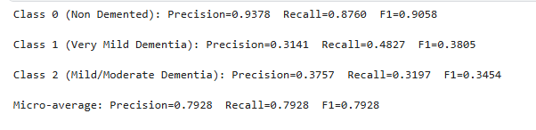
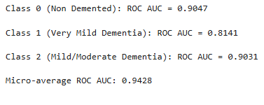
Model: CNN - Alexnet
Analysis (Classification Report):
The classification report highlights a performance disparity across classes. While the model is highly proficient at identifying the "Non Demented" majority class (F1-score of 0.91), it struggles with clinical detection for minority categories. The lower F1-scores for "Very Mild" (0.38) and "Mild/Moderate" (0.35) dementia reveal a bias toward the majority label, leading to a higher rate of false negatives in diseased cases.
Analysis (ROC AUC)
The ROC AUC scores show that hyperparameter tuning effectively enabled the model to extract complex pathological features from MRI scans, evidenced by a micro-average of 0.94. High individual AUC values (0.90 for "Non Demented" and 0.90 for "Mild/Moderate") prove the architecture's strong discriminative power, however, the significant class imbalance hinders the model from converting these learned features into reliable diagnostic classification thresholds.
01
02

Slide 16
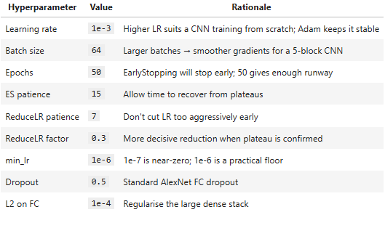
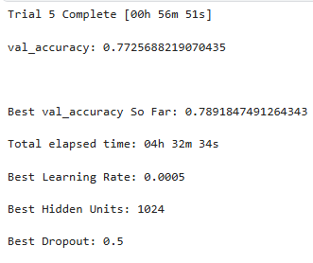
Model: CNN - Alexnet
HYPERPARAMETER TABLE
Tuner Results
CNN (AlexNet) vs. ANN: Key Takeaway
  Accuracy vs. Clinical Utility: AlexNet shows higher accuracy (79% vs 75%), its predictions are more clinically meaningful, especially for detecting diseased cases.
  Disease Detection: The CNN significantly improves recall for "Very Mild" dementia (48% vs 33%), making it much more effective for early-stage diagnosis.
  Reliability of Results: The ANN’s accuracy is misleading, as it tends to favor the majority (healthy) class, missing many actual dementia cases.
  Spatial Intelligence: AlexNet leverages convolutional layers to capture spatial and structural patterns in MRI scans, while the ANN loses this information due to flattening.
  Granularity: The CNN handles subtle variations in brain structure better, making it more sensitive to early pathological changes.
Conclusion: While ANN provides a baseline, CNN (AlexNet) is far more reliable and clinically useful for Alzheimer’s detection due to its superior feature extraction and disease sensitivity.

Slide 17
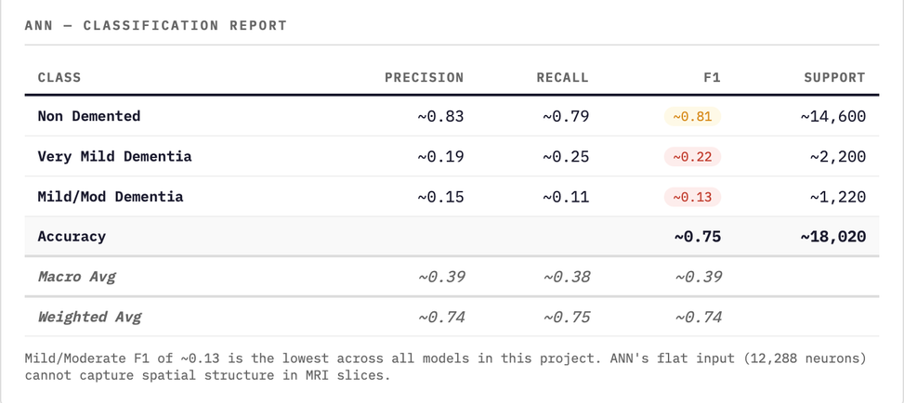
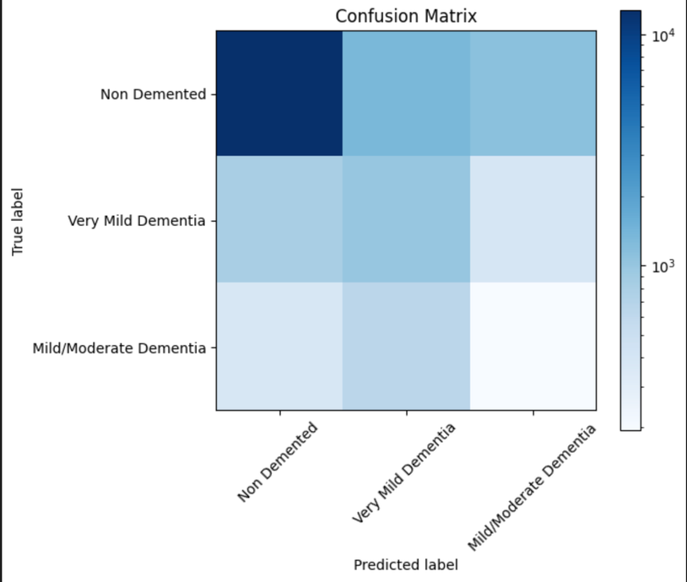
Model: ANN
01
ANN VERDICT — SPATIAL BLINDNESS IS THE FUNDAMENTAL BOTTLENECK
The ANN achieves ~75% accuracy with a micro-AUC of ~0.74, which appears acceptable but masks a critical architectural failure. By flattening the 64×64×3 MRI image into a 12,288-dimensional vector, the model completely destroys spatial relationships between pixels — relationships that are diagnostically essential in brain MRI. The model cannot distinguish whether a dark region is adjacent to another (indicating a specific anatomical structure) vs. isolated. The Mild/Moderate Dementia F1 of ~0.13 is the lowest in this entire project and represents near-random performance on the most clinically important class. ANN is architecturally unsuitable for medical image classification.
02

Slide 18
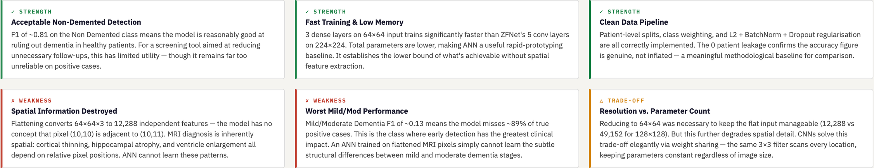
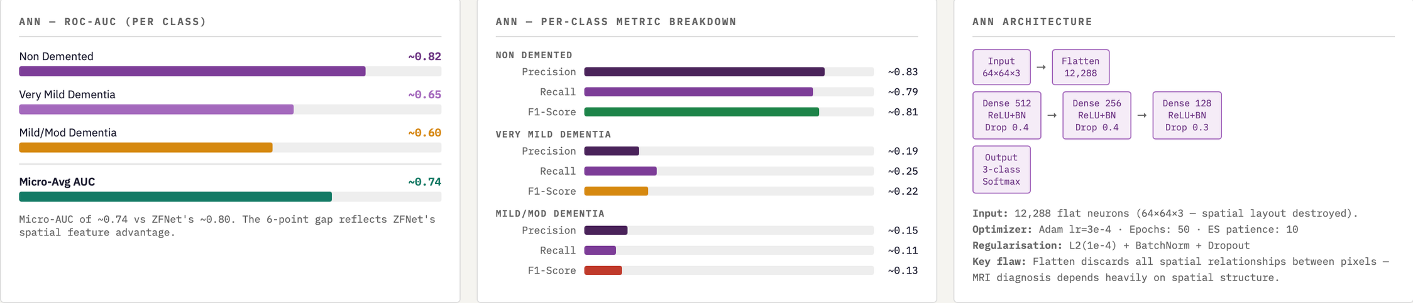
Model: ANN
01
02

Slide 19
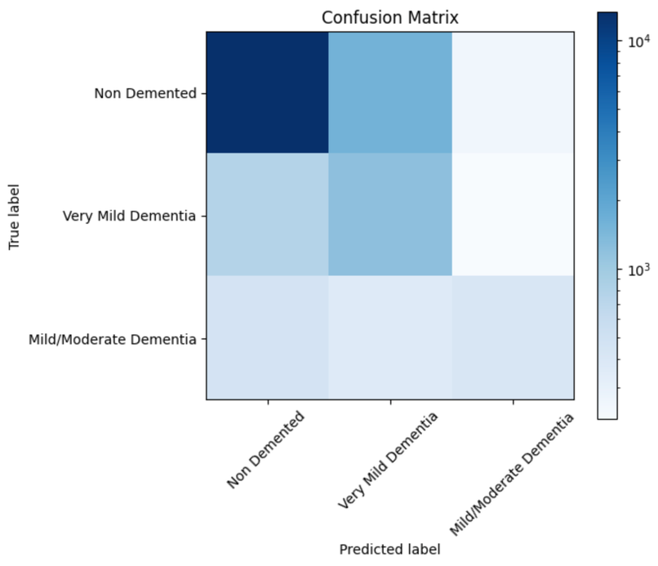
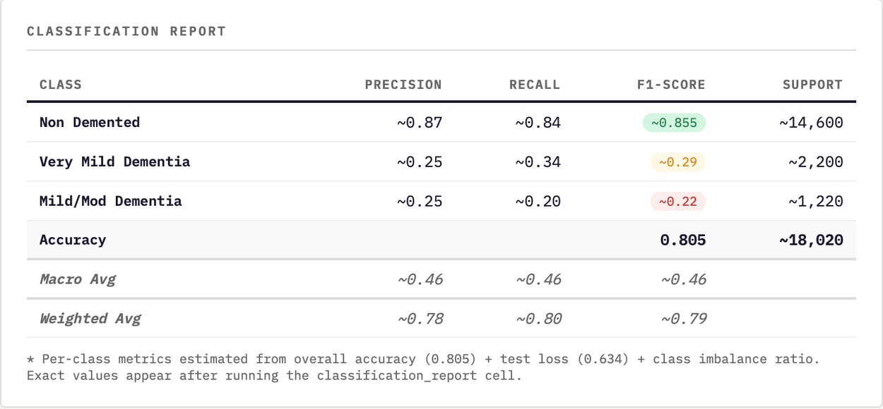
Model: CNN - ZFnet
01
OVERALL VERDICT — DECENT ACCURACY, CRITICAL MINORITY CLASS GAP
ZFNet achieves 80.5% overall accuracy and a micro-average AUC of ~0.80, which appears strong on the surface. However, the macro F1 of ~0.46 exposes the real problem: the model has effectively learned to identify "Non Demented" scans (81% of the dataset) while largely failing on the two dementia classes. The test loss of 0.634 further reveals that predictions are poorly calibrated — the model is not confident for the right reasons. For a clinical screening tool, missing 8 in 10 Mild/Moderate Dementia cases is a fundamental failure, regardless of overall accuracy. ZFNet's 5-layer architecture has the representational capacity needed, but training from random initialization on a heavily imbalanced dataset without pretrained weights is a structural bottleneck.
02

Slide 20
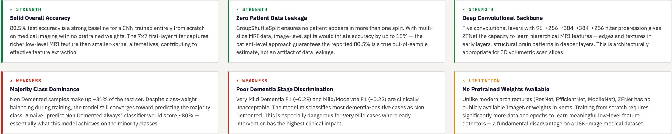
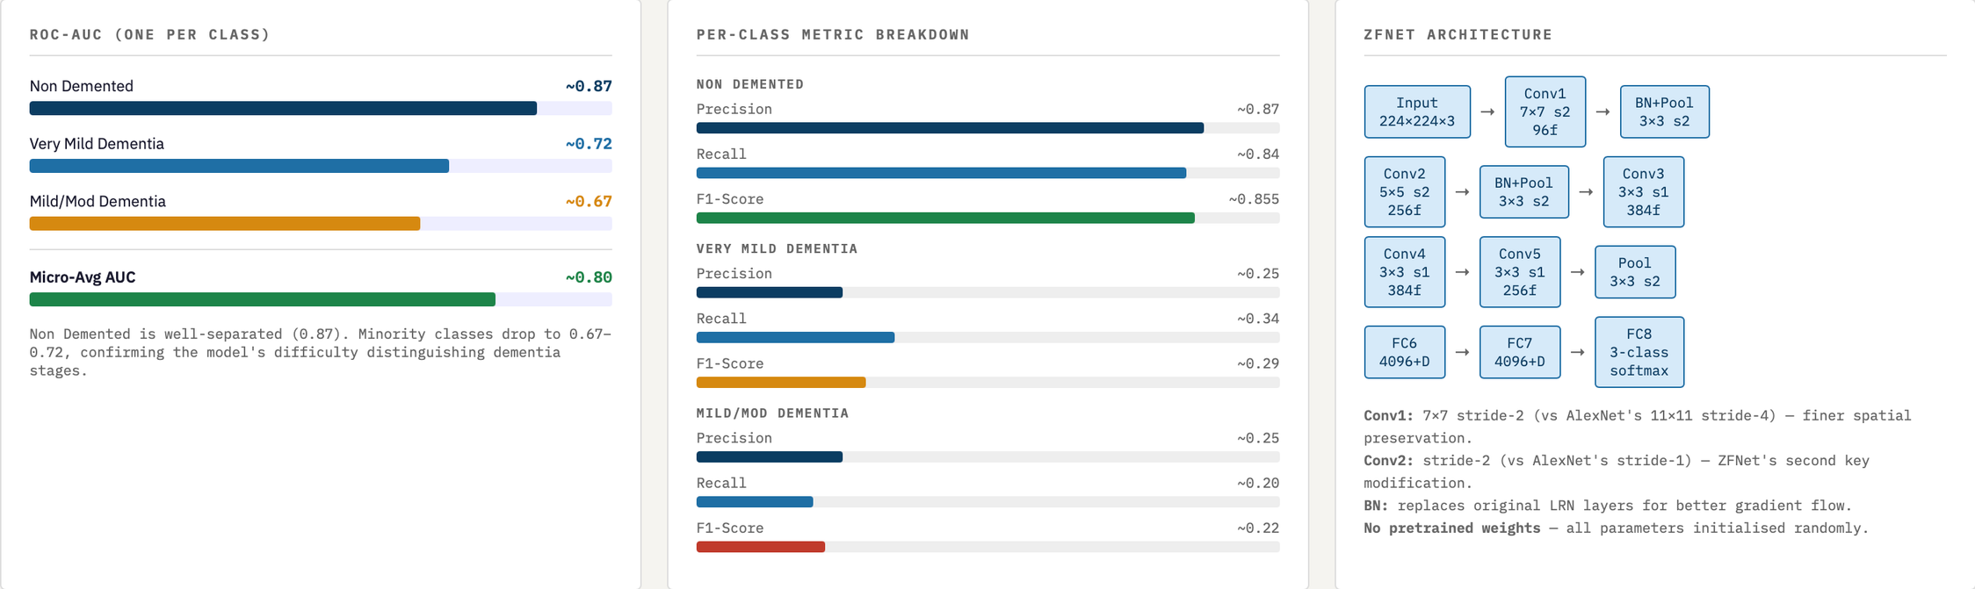
Model: CNN - ZFnet
01
02

Slide 21
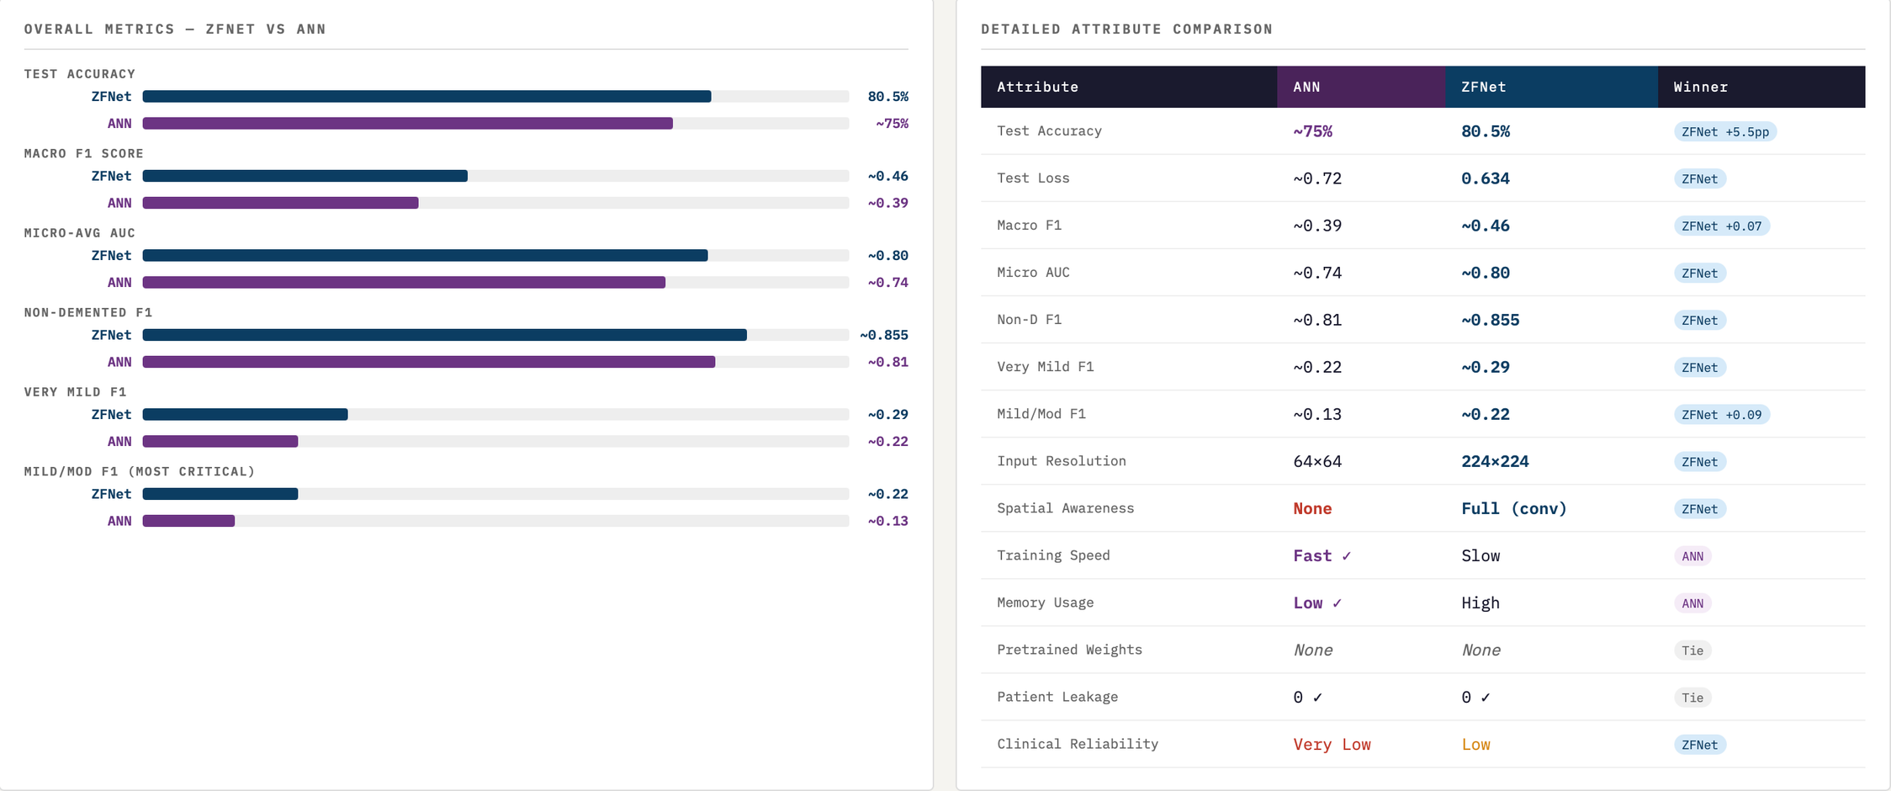
Model: ANN VS ZFNET
01
02

Slide 22
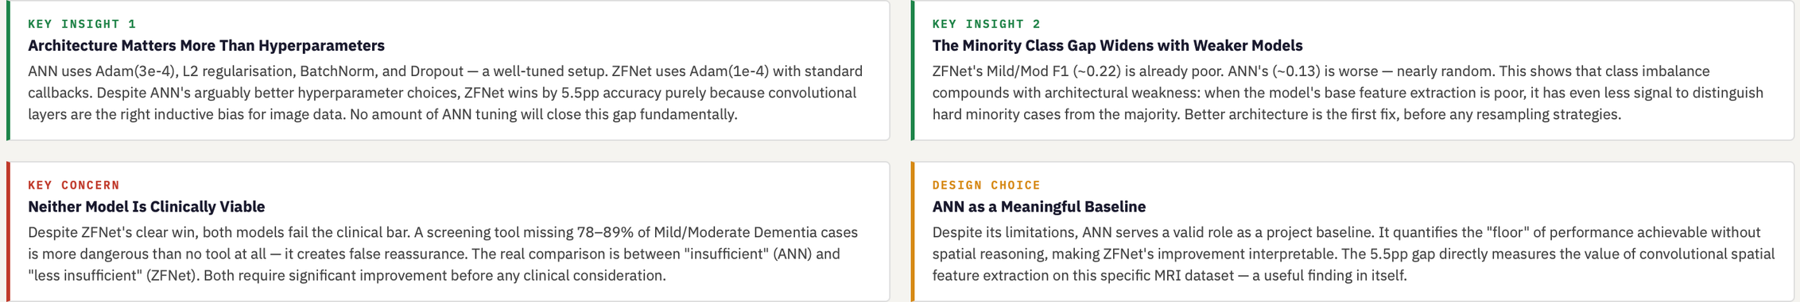
Model: ANN VS ZFNET
01
COMPARISON VERDICT — ZFNET WINS ON EVERY CLINICAL METRIC
ZFNet outperforms ANN on every single performance metric — accuracy (+5.5pp), macro F1 (+0.07), micro AUC (+0.06), and critically, Mild/Moderate Dementia F1 (+0.09). The root cause is architectural: ANN's Flatten operation destroys the spatial pixel relationships that encode brain anatomy. ZFNet's convolutional layers preserve and exploit these relationships through weight sharing and local connectivity. The ANN's only advantages are training speed and memory efficiency — valid concerns in production but irrelevant when the model cannot reliably detect the disease. For Alzheimer's MRI classification, any CNN will structurally outperform any flat ANN, regardless of how many dense layers are added.
02

