Slide 1
Problem solving and search
Chapter 3
(Adapted from Eck Doerry, Stuart Russel, Dan Klein, and others. Thanks guys!)
Chapter 3
<number>

Slide 2
Outline
♦ Problem-solving agents
♦ Problem types
♦ Problem formulation
♦ Example problems
♦ Basic search algorithms (the meat, 90%)
Chapter 3
<number>

Slide 3
Problem-solving agents
Simplified form of general agent:
function Simple-Problem-Solving-Agent( percept) returns an action
static: seq, an action sequence, initially empty
state, some description of the current world state
goal, a goal, initially null
problem, a problem formulation
state ← Update-State(state, percept)
if seq is empty then
goal ← Formulate-Goal(state)
problem ← Formulate-Problem(state, goal)
seq ← Search( problem)
action ← Recommendation(seq, state) seq ← Remainder(seq, state)
return action
Note: this is offline problem solving; solution executed “eyes closed.”
Online problem solving different: uncertainty, incomplete knowledge, etc
Chapter 3
<number>

Slide 4
Classic example: route-finding (in Romania)
Oradea
71
Neamt
Zerind
151
87
75
Iasi
Arad
140
Sibiu
92
99
Fagaras
118
Vaslui
80
Rimnicu Vilcea
Timisoara
111
211
142
Lugoj
97
Pitesti
70
98
Hirsova
Mehadia
146
101
85
Urziceni
75
138
86
120
Bucharest
Dobreta
90
Giurgiu
Craiova
Eforie
Chapter 3
<number>

Slide 5
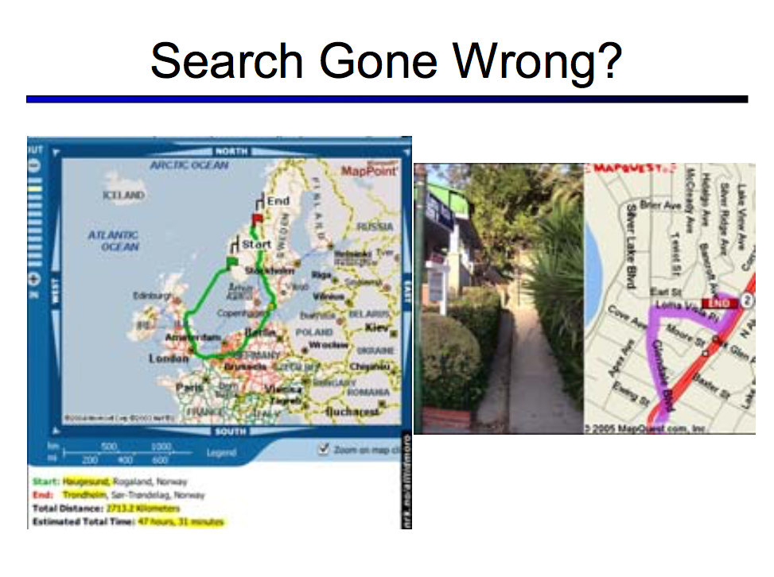

Slide 6
Problem types
Deterministic, fully observable =⇒ single-state problem
Agent knows exactly which state it will be in
Solution is a simple sequence of actions
Non-observable =⇒ conformant problem
Also known as “sensorless search”
Agent may have no idea where it really is
Solution (if any) is a sequence
Surprisingly useful in many situations (simplifies state space for computing a “likely” solution quickly...which is adjusted during action)
Nondeterministic and/or partially observable =⇒ contingency problem
percepts provide new information about current state
solution is a contingent plan or a policy
often interleave search, execution
Unknown state space =⇒ exploration problem
“Online” planning/re-planning
Chapter 3
<number>

Slide 7






Example: vacuum world
Single-state, start in #5. Solution??
Move right, suck.
Conformant, start in: ?
Solution?? move right, suck,
Move left, suck.
What if the suck action is not guaranteed
To work? With some probability p?
Contingency, start in #5
Murphy’s Law: Suck can dirty a clean carpet
Local sensing: dirt sensed in current location only.
Solution??
move right, while current square is dirty: suck,
Move left, while current square is dirty: suck.
1
2
3
4
5
6
7
8
Chapter 3
<number>

Slide 8
Single-state problem formulation
A problem is defined by four items:
1. initial state e.g., “at Arad”, vacuum state 5
2. successor function S(state) = set of action–state pairs
e.g., S(Arad) = {(Arad → Zerind, Zerind), . . .}
S([(0,0)]) = {(down,[(0,0),(0,1)]), (right,[(0,0),(1,0)]), (down-right,[(0,0),(1,1)])}
3. goal test, can be
explicit, e.g., state = “at Bucharest”
implicit, e.g., NoDirt(state), Checkmate(board)
Marker for each board position, state needs to track which ones we have already explored
4. path cost (additive)
e.g., sum of distances, number of actions executed, etc.
c(state_before, action, state_after) is the step cost, assumed to be ≥ 0
A solution is a sequence of actions leading from the initial state to a goal state
Chapter 3
<number>

Slide 9
Selecting a state space
Real world is absurdly complex !!
⇒ state space must be abstracted for problem solving
(Abstract) state = set of real states
(Abstract) action = complex combination of real actions
e.g., “Arad → Zerind” represents a complex set of possible routes, detours, rest stops, etc.
For guaranteed realizability, any real state “in Arad” must get to some real state “in Zerind”
(Abstract) solution = set of simplified paths that can be translated to solutions in the real world
Leads to several definitions for quality of abstractions chosen:
Useful abstraction: Each abstract action should be “easier” than the original problem!
Valid abstraction: any abstract solution can be expanded to solution in real world
Chapter 3
<number>
Notes:
Hi
<number>

Slide 10

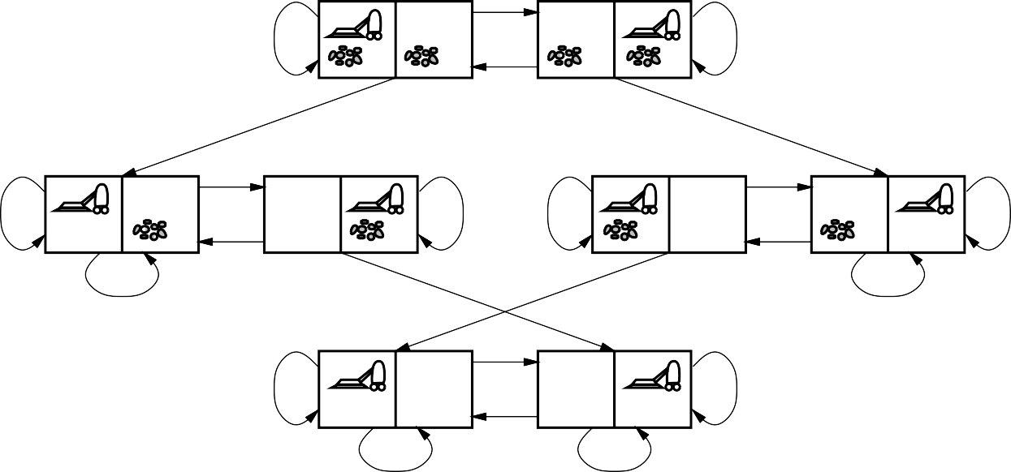
Example:vacuum world state space graph
R
L
R
L
S
S
R
R
L
R
L
R
L
L
S
S
S
S
R
L
R
L
S
S
states?? see above. Initial is one of these.
x = ( where is the vacuum, [set of squares with dirt])
actions?? L, S, R. successor function? S(state) = {R if state on left, L if state on right, S if dirt in current square state}
goal test?? G(position, set) = set is empty. len(set)==0.
path cost?? sum of step costs, c(state1, action, state2) = {
Pos2, set2 = state2
Return len(set2)
}.
Chapter 3
<number>

Slide 11
Example: The 8-puzzle
7
2
4
1
2
3
5
6
4
5
6
8
3
1
7
8
Start State
Goal State
States?? [ [7,2,4], [5, None, 6], [8,3,1] ] list of list of int/None.
actions/successor function?? [ (slide down, [ [7,None,4], [5,2,6], [8,3,1] ]) (slide left, ) (slide right,) (slide up,)]
goal test?? if state = [ [1,2,3], [4,5,6], [7,8,None] ]
path cost?? c(before_state, action, after_state) = 1
Chapter 3
<number>

Slide 12
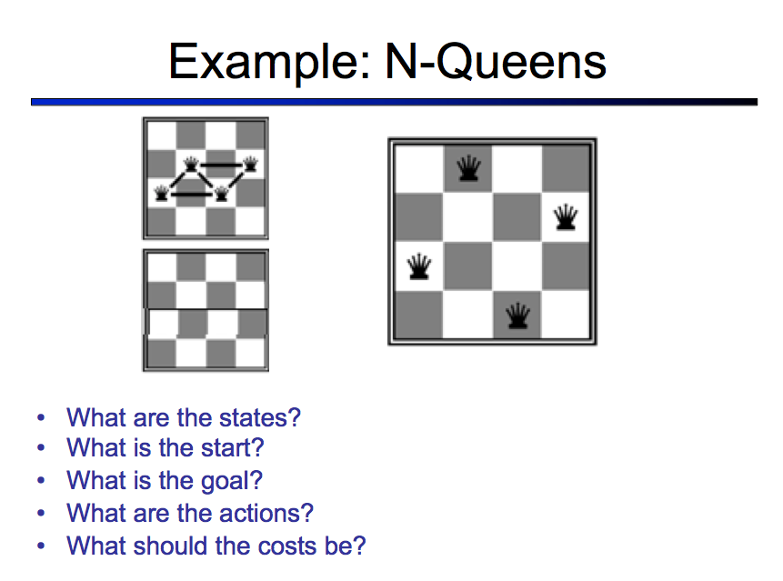
State = list of positions of queens on board.
Initial = empty list
[ (2,0) ]
[ (2,0), (0,1) ]
Successor function, S(list_of_positions) = list of all xy_tuples which are not possible to attack from list_of_positions
Goal = have N items in list.
Cost??
State = list of row numbers for each column.
Initial = empty list
[ 2 ]
[ 2, 0 ]

Slide 13
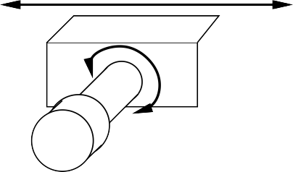


Example: robotic assembly
P
R
R
R
R
R
states??:
real-valued coordinates of robot joint angles
parts of the object to be assembled (location, orientation)
actions??: continuous motions of robot joints
goal test??: complete assembly with no robot included!
path cost??: time to execute? Number of joints motions (wear and tear)?
Chapter 3
<number>

Slide 14
Tree search algorithms
Basic idea:
offline, simulated exploration of state space
by generating successors of already-explored states (a.k.a. expanding states)
function Tree-Search( problem, strategy) returns a solution, or failure
initialize the search tree using the initial state of problem
loop do
if there are no candidates for expansion then
return failure
choose a leaf node for expansion according to strategy
if the node contains a goal state then
return the corresponding solution
else expand the node and add the resulting nodes to the search tree
end
Chapter 3
<number>

Slide 15
Tree search example
Arad
Sibiu
Timisoara
Zerind
Arad
Fagaras
Oradea
Rimnicu Vilcea
Arad
Lugoj
Arad
Oradea
Chapter 3
<number>

Slide 16
Concepts: states vs. nodes
A state is a (representation of) a physical configuration
A node is a data structure constituting part of a search tree
includes parent, children, depth, path cost -> known as g(state)
States do not have parents, children, depth, or path cost!
parent, action
5
depth = 6
g(x) = 6
5
4
State
4
Node
6
6
1
1
8
8
7
state
7
3
3
2
2
The Expand function creates new nodes, filling in the various fields and using the SuccessorFn of the problem to create the corresponding states.
Chapter 3
<number>

Slide 17
Implementation: general tree search
function Tree-Search( problem, frontier) returns a solution, or failure
frontier ← Insert(Make-Node(Initial-State[problem]), frontier)
loop do
if frontier is empty then return failure
node ← Remove-Front(frontier)
if Goal-Test(problem, State(node)) then return node
frontier ← InsertAll(Expand(node, problem), frontier)
function Expand( node, problem) returns a set of nodes
successors ← the empty set
for each action, result in Successor-Fn(problem, State[node]) do
s ← a new Node
Parent-Node[s] ← node; Action[s] ← action; State[s] ← result
Path-Cost[s] ← Path-Cost[node] + Step-Cost(node, action, s)
Depth[s] ← Depth[node] + 1 add s to successors
return successors
Chapter 3
<number>

Slide 18
Graph search
Q: What will happen is the search space is not a DAG? (a strict tree)
Bi-directional arcs? (road can be driven both ways!)
Cycles in the directional graph
function Graph-Search( problem, frontier) returns a solution, or failure
closed ← an empty set
frontier ← Insert(Make-Node(Initial-State[problem]), frontier)
loop do
if frontier is empty then return failure
node ← Remove-Front(frontier)
if Goal-Test(problem, State[node]) then return node
if State[node] is not in closed then
add State[node] to closed
frontier ← InsertAll(Expand(node, problem), frontier)
end
Chapter 3
<number>

Slide 19
Search strategies
A strategy is defined by picking the order of node expansion
Specifically: exact action of InsertAll() fn
Strategies are evaluated along the following dimensions:
Completeness—returns a solution if there is one, returns failure if there is no solution.
time complexity— the amount of time/operations required.
space complexity— the amount of memory/disk space required.
Optimality—any solution returns is an optimal one.
Time and space complexity are measured in terms of
b—number of sucessors / tree breadth.
d— depth of solution.
m— max depth.
Chapter 3
<number>

Slide 20
Uninformed search strategies
Uninformed strategies use only the information available in the problem definition:
Breadth-first search
Uniform-cost search
Depth-first search
Depth-limited search
Iterative deepening search
Chapter 3
<number>

Slide 21
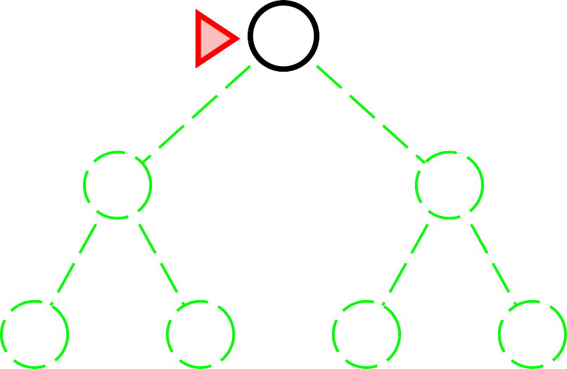
Breadth-first search
Plan: Always expand shallowest unexpanded node
Shallowest = shortest path from root
Implementation:
frontier is a FIFO queue, i.e., new successors go at end
Python list: new successors at end of list, always expand first item in list.
Frontier = [A], [B,C], [C, D, E], [F, G, D, E]
A
B
C
D
E
F
G
Chapter 3
<number>

Slide 22
Properties of breadth-first search
Complete?? yes.
Time?? O(b^d) = 1 + b + b^2 + … + b^d
Space?? O(b^d)
Optimal?? only if actions have uniform/equal cost.
Chapter 3
<number>

Slide 23
Uniform-cost search
Plan: Expand least-cost unexpanded node
“least cost” = Having the lowest path cost
Equivalent to breadth-first if step costs all equal
Implementation:
frontier = queue ordered by path cost, lowest first
Complete??
Time??
Space??
Optimal??
Chapter 3
<number>

Slide 24
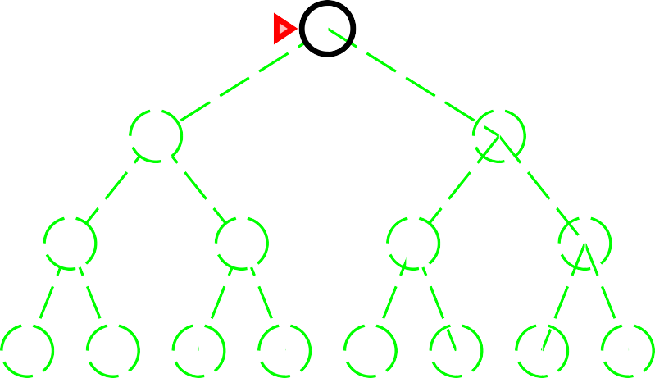
Depth-first search
Plan: Expand deepest unexpanded node
Deepest= longest path from root
Implementation:
frontier = LIFO queue, i.e., put successors at front
Frontier = [A], [B,C], [D,E,C], [H, I, E, C]
A
B
C
D
E
F
G
H
I
J K L M N O
Chapter 3
<number>

Slide 25
Properties of depth-first search
Complete?? only if finite state space (no cycles).
Time?? O(b^m)
Space?? O(mb)
Optimal?? NO!
Chapter 3
<number>

Slide 26
Depth-limited search
Plan: depth-first search with depth limit l,
i.e., nodes at depth l have no successors
Recursive implementation:
function Depth-Limited-Search( problem, limit) returns soln/fail/cutoff
Recursive-DLS(Make-Node(Initial-State[problem]), problem, limit)
function Recursive-DLS(node, problem, limit) returns soln/fail/cutoff
cutoff-occurred? ← false
if Goal-Test(problem, State[node]) then return node
else if Depth[node] = limit then return cutoff
else for each successor in Expand(node, problem) do result ← Recursive-DLS(successor, problem, limit) if result = cutoff then cutoff-occurred? ← true
else if result /= failure then return result
if cutoff-occurred? then return cutoff else return failure
Chapter 3
<number>

Slide 27
Iterative deepening search
function Iterative-Deepening-Search( problem) returns a solution
inputs: problem, a problem
for depth ← 0 to ∞ do
result ← Depth-Limited-Search( problem, depth)
if result /= cutoff then return result
end
Chapter 3
<number>

Slide 28
Iterative deepening search l = 0
Limit = 0
A
Chapter 3
<number>

Slide 29
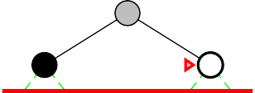
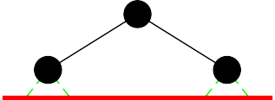
Iterative deepening search l = 1
Limit = 1
A
A
A
B
C
B
C
C
Chapter 3
<number>

Slide 30
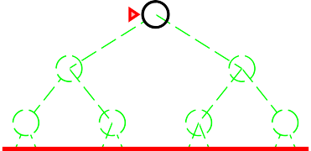
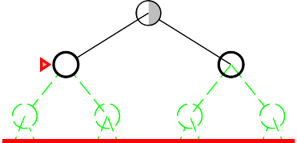
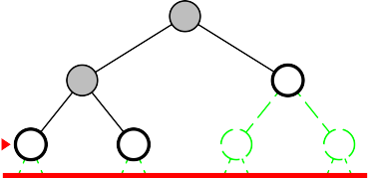
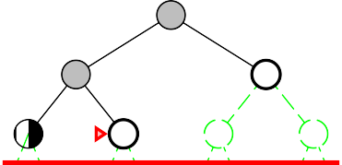
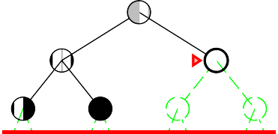
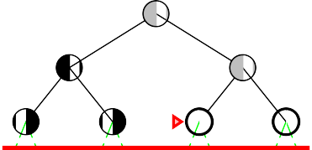
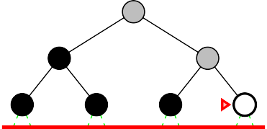
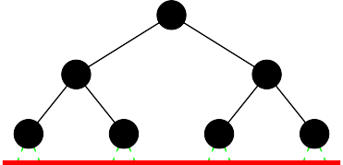
Iterative deepening search l = 2
Limit = 2
A
A
A
A
B
C
B
C
B
C
B
C
D
E
F
G
D
E
F
G
D
E
F
G
E
F
G
A
A
A
C
C
C
F
G
F
G
G
Chapter 3
<number>

Slide 31
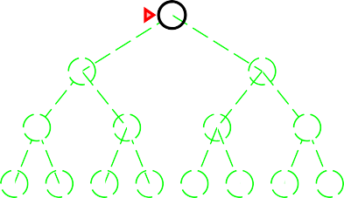
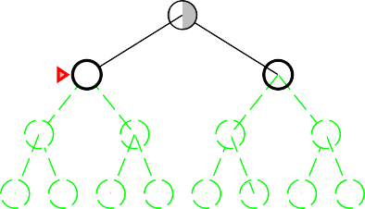
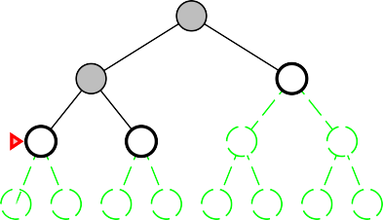
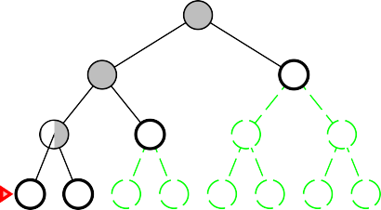
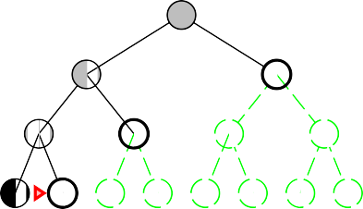
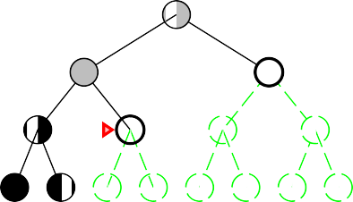
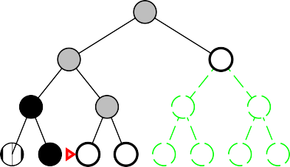
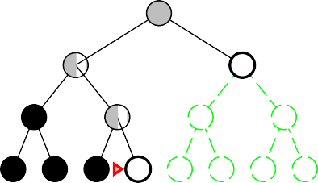
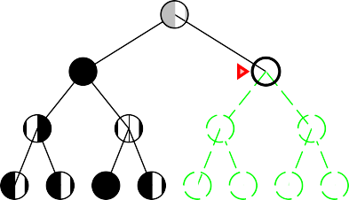
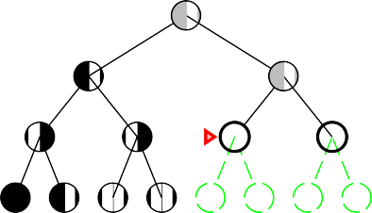
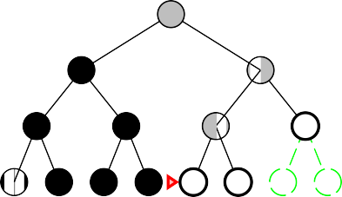
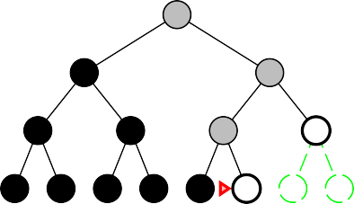
Iterative deepening search l = 3
Limit = 3
A
A
A
A
B
C
B
C
B
C
B
C
D
E
F
G
D
E
F
G
D
E
F
G
D
E
F
G
H
I
J K L M N O
H
I
J K L M N O
H
I
J K L M N O
H
I
J K L M N O
A
A
A
A
B
C
B
C
B
C
B
C
D
E
F
G
E
F
G
E
F
G
E
F
G
I
J K L M N O
J K L M N O
J K L M N O
K L M N O
A
A
A
A
C
C
C
C
F
G
F
G
F
G
F
G
L M N O
L M N O
L M N O
M N O
Chapter 3
<number>

Slide 32
Properties of iterative deepening search
Complete??
Time??
Space??
Optimal??
Numerical comparison for b = 10 and d = 5, solution at far right leaf:
N (IDS) = 50 + 400 + 3,000 + 20,000 + 100,000 = 123,450
N (BFS) = 10 + 100 + 1,000 + 10,000 + 100,000 + 999,990 = 1,111,100
Chapter 3
<number>

Slide 33
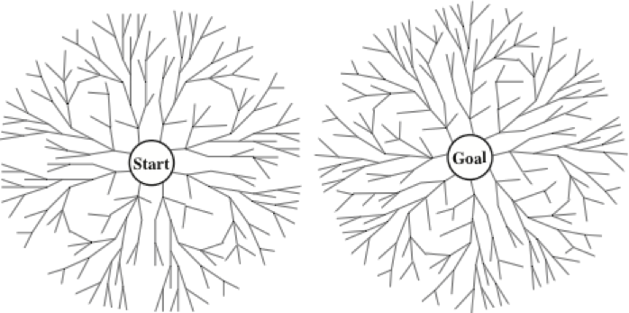
Bi-Directional Search
Plan: Standard BFS…but search from both start and goal state
Goal test: success when they meet (intersect of frontiers)
Advantages:
Concerns:
Chapter 3
<number>

Slide 34
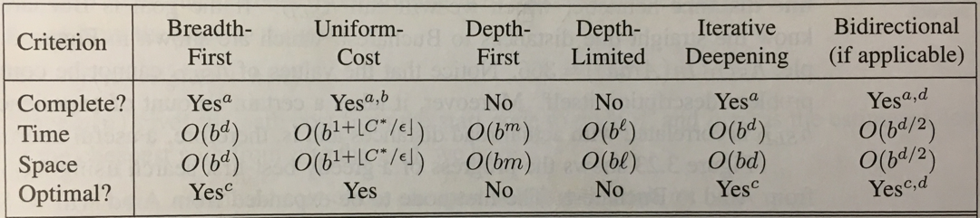
Summary of uninformed algorithms
Legend:
b = branching factor
d= depth of shallowest solution
m = maximum depth of tree
l = depth limit
Superscripts:
a = complete if b is finite
b = complete if step costs > 0
c = optimal if step costs all identical
d = if both directions use breadth-first
Chapter 3
<number>

Slide 35


