Slide 1
Bayesian networks
Chapter 14.1–3

Slide 2
Outline
♦ Syntax
♦ Semantics
♦ Parameterized distributions

Slide 3
Bayesian networks
A simple, graphical notation for conditional independence assertions and hence for compact specification of full joint distributions
Syntax:
a set of nodes, one per variable
a directed, acyclic graph (link ≈ “directly influences”)
a conditional distribution for each node given its parents:
P(X_{i}|P arents(X_{i}))
In the simplest case, conditional distribution represented as a conditional probability table (CPT) giving the distribution over X_{i} for each combination of parent values

Slide 4
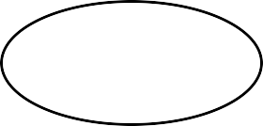
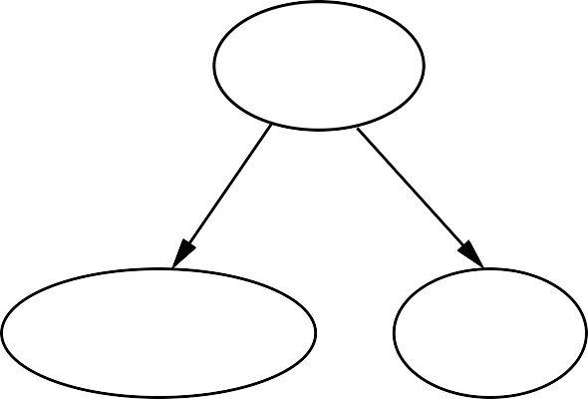
Example
Topology of network encodes conditional independence assertions:
Weather
Cavity
Toothache
Catch
W eather is independent of the other variables
T oothache and Catch are conditionally independent given Cavity

Slide 5
Example
I’m at work, neighbor John calls to say my alarm is ringing, but neighbor Mary doesn’t call. Sometimes it’s set off by minor earthquakes. Is there a burglar?
Variables: Burglar, Earthquake, Alarm, JohnCalls, MaryCalls
Network topology reflects “causal” knowledge:
A burglar can set the alarm off
An earthquake can set the alarm off
The alarm can cause Mary to call
The alarm can cause John to call

Slide 6
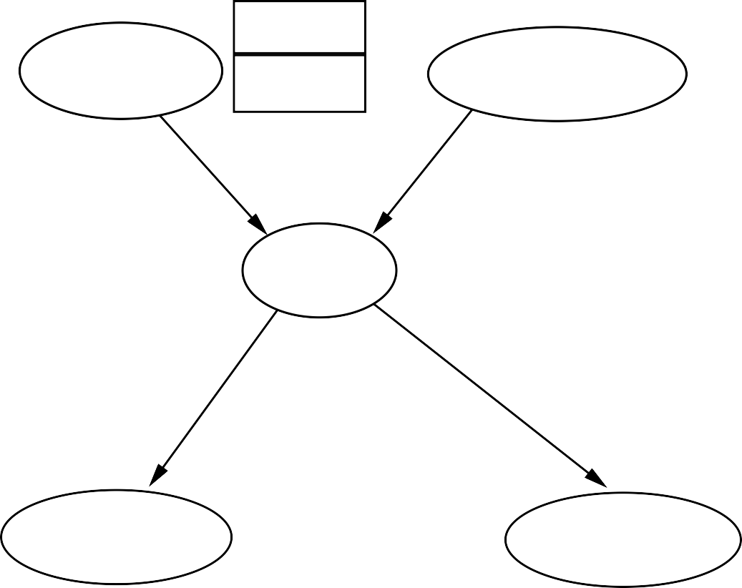
Example contd.
P(B)
.001
P(E)
Burglary
Earthquake
.002
B | E | P(A|B,E)
T | T | .95
T | F | .94
F | T | .29
F | F | .001
Alarm
A | P(J|A)
T F | .90 .05
A | P(M|A)
T F | .70 .01
JohnCalls
MaryCalls

Slide 7
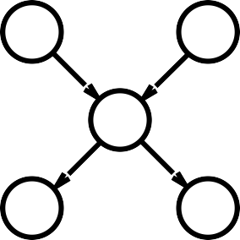
Compactness
A CPT for Boolean X_{i} with k Boolean parents has
2^{k} rows for the combinations of parent values
Each row requires one number p for X_{i} = true
(the number for X_{i} = false is just 1 − p)
If each variable has no more than k parents,
the complete network requires O(n · 2^{k}) numbers
I.e., grows linearly with n, vs. O(2^{n}) for the full joint distribution
B
E
A
J
M
For burglary net, 1 + 1 + 4 + 2 + 2 = 10 numbers (vs. 2⁵ − 1 = 31)

Slide 8
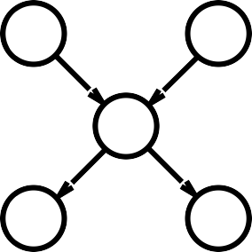
Global semantics
Global semantics defines the full joint distribution as the product of the local conditional distributions:
n
B
E
P (x , . . . , x ) = Π
P (x |parents(X ))
A
1 n
i = 1
i i
e.g., P (j ∧ m ∧ a ∧ ¬b ∧ ¬e)
=
J
M

Slide 9

Global semantics
“Global” semantics defines the full joint distribution as the product of the local conditional distributions:
n
B
E
P (x , . . . , x ) = Π
P (x |parents(X ))
A
1 n
i = 1
i i
e.g., P (j ∧ m ∧ a ∧ ¬b ∧ ¬e)
= P (j|a)P (m|a)P (a|¬b, ¬e)P (¬b)P (¬e)
= 0.9 × 0.7 × 0.001 × 0.999 × 0.998
≈ 0.00063
J
M

Slide 10
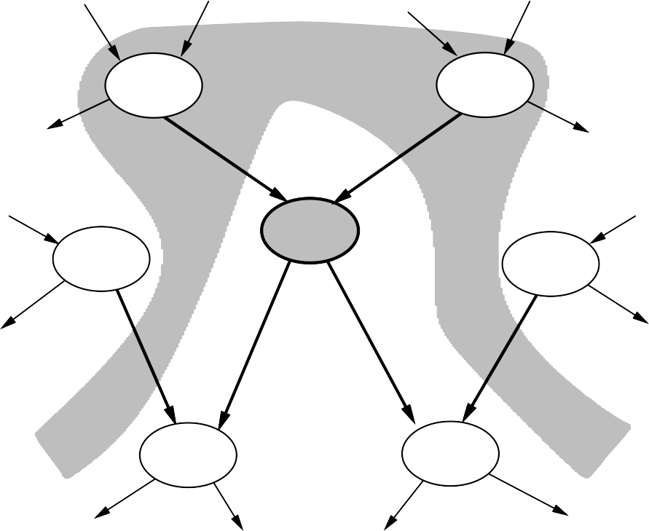
Local semantics
Local semantics: each node is conditionally independent of its nondescendants given its parents
U₁
. . .
U_{m}
X
^{Z} 1j
^{Z}nj
Y₁
. . .
Y_{n}
Theorem: Local semantics
⇔ global semantics

Slide 11
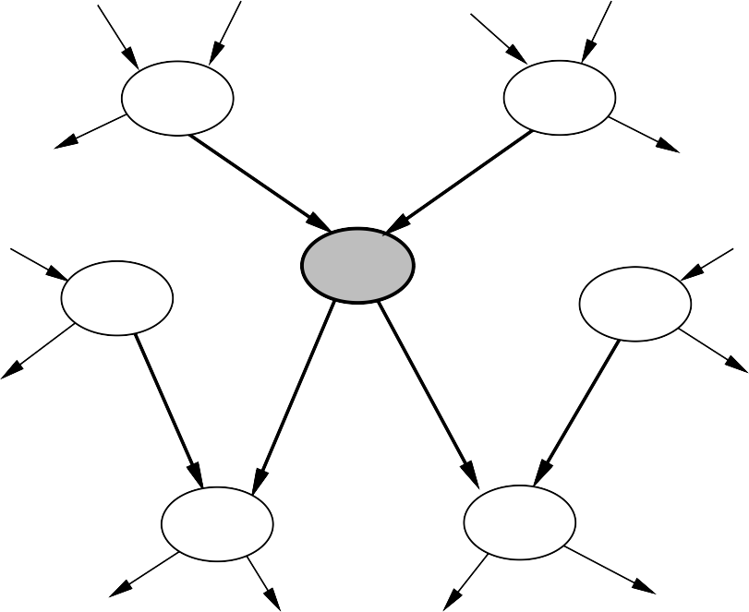
Markov blanket
Each node is conditionally independent of all others given its Markov blanket: parents + children + children’s parents
U₁
. . .
U_{m}
X
^{Z} 1j
^{Z}nj
Y₁
. . .
Y_{n}

Slide 12
Constructing Bayesian networks
Need a method such that a series of locally testable assertions of conditional independence guarantees the required global semantics
Choose an ordering of variables X₁, . . . , X_{n}
For i = 1 to n
add X_{i} to the network
select parents from X₁, . . . , X_{i−1} such that
P(X_{i}|P arents(X_{i})) = P(X_{i}|X₁, . . . , X_{i−1})
This choice of parents guarantees the global semantics:
n
P(X , . . . , X ) = Π
P(X |
X , . . . , X )
(chain rule)
(by construction)
1
n
i = 1
i 1
i−1
= Π^{n} P(X |P arents(X ))
i = 1
i i

Slide 13
Example
Suppose we choose the ordering M , J, A, B, E
MaryCalls
JohnCalls
P (J|M ) = P (J)?

Slide 14

Example
Suppose we choose the ordering M , J, A, B, E
MaryCalls
JohnCalls
Alarm
P (J|M ) = P (J)? No
P (A|J, M ) = P (A|J)? P (A|J, M ) = P (A)?

Slide 15
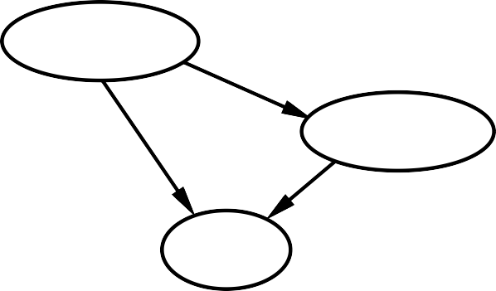

Example
Suppose we choose the ordering M , J, A, B, E
MaryCalls
JohnCalls
Alarm
Burglary
P (J|M ) = P (J)? No
P (A|J, M ) = P (A|J)? P (A|J, M ) = P (A)? No
P (B|A, J, M ) = P (B|A)?
P (B|A, J, M ) = P (B)?

Slide 16
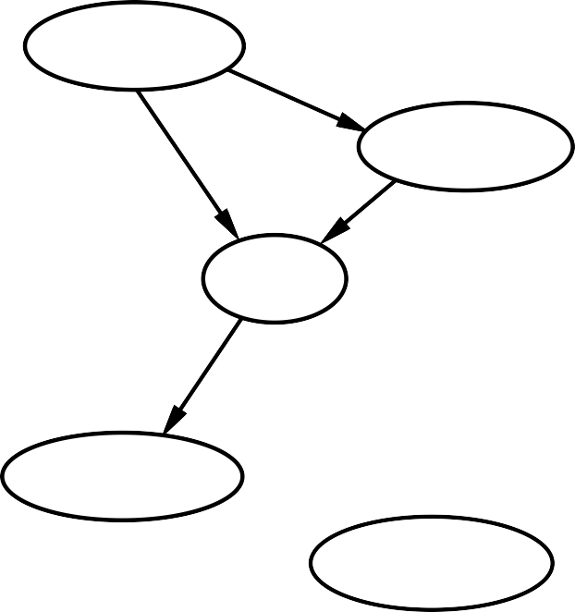
Example
Suppose we choose the ordering M , J, A, B, E
MaryCalls
JohnCalls
Alarm
Burglary
Earthquake
P (J|M ) = P (J)? No
P (A|J, M ) = P (A|J)? P (A|J, M ) = P (A)? No
P (B|A, J, M ) = P (B|A)? Yes
P (B|A, J, M ) = P (B)? No
P (E|B, A, J, M ) = P (E|A)?
P (E|B, A, J, M ) = P (E|A, B)?

Slide 17
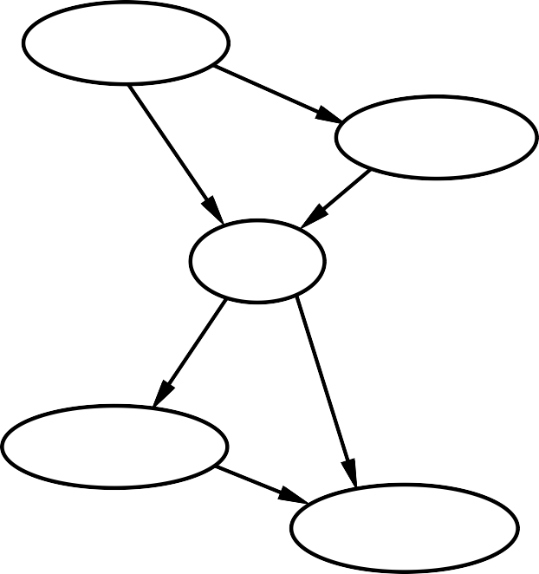
Example
Suppose we choose the ordering M , J, A, B, E
MaryCalls
JohnCalls
Alarm
Burglary
Earthquake
P (J|M ) = P (J)? No
P (A|J, M ) = P (A|J)? P (A|J, M ) = P (A)? No
P (B|A, J, M ) = P (B|A)? Yes
P (B|A, J, M ) = P (B)? No
P (E|B, A, J, M ) = P (E|A)? No
P (E|B, A, J, M ) = P (E|A, B)?
Yes

Slide 18

Example contd.
MaryCalls
JohnCalls
Alarm
Burglary
Earthquake
Deciding conditional independence is hard in noncausal directions
(Causal models and conditional independence seem hardwired for humans!) Assessing conditional probabilities is hard in noncausal directions
Network is less compact: 1 + 2 + 4 + 2 + 4 = 13 numbers needed

Slide 19
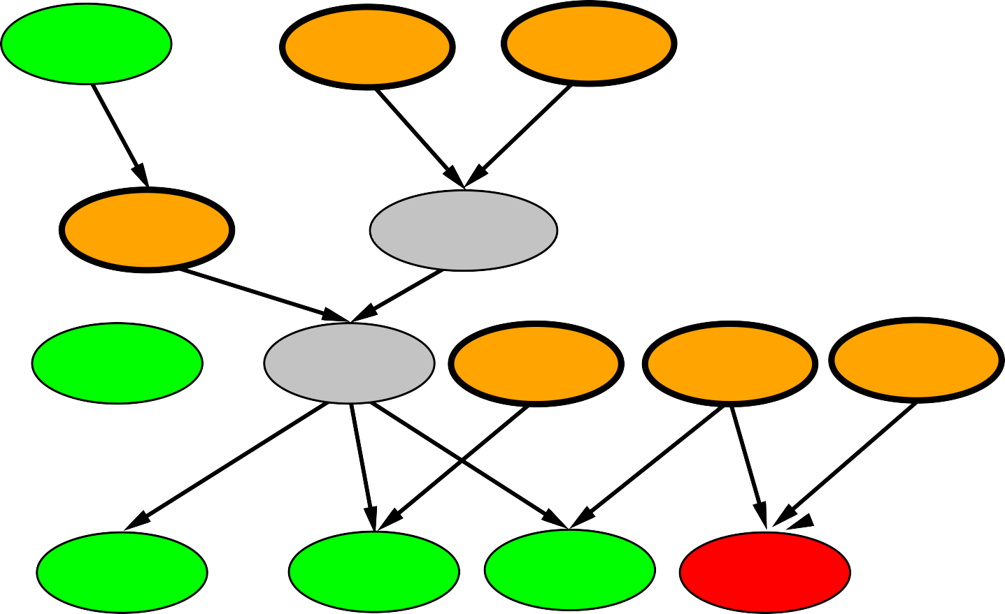

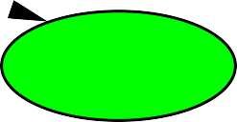
Example: Car diagnosis
Initial evidence: car won’t start
Testable variables (green), “broken, so fix it” variables (orange) Hidden variables (gray) ensure sparse structure, reduce parameters
battery age
alternator broken
fanbelt broken
battery dead
no charging
battery meter
battery flat
no oil
no gas
fuel line blocked
starter broken
lights
oil light
gas gauge
car won’t start
dipstick

Slide 20

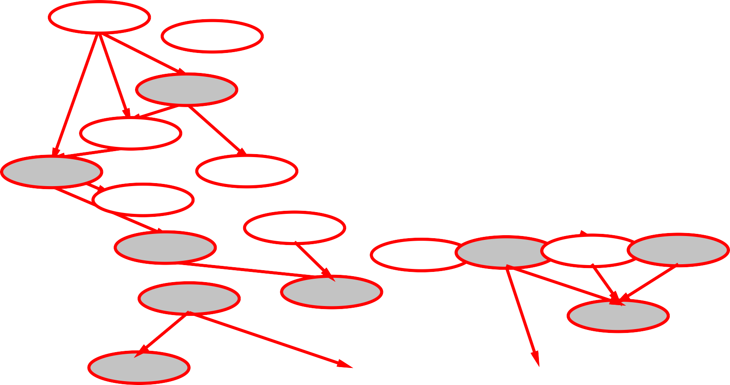



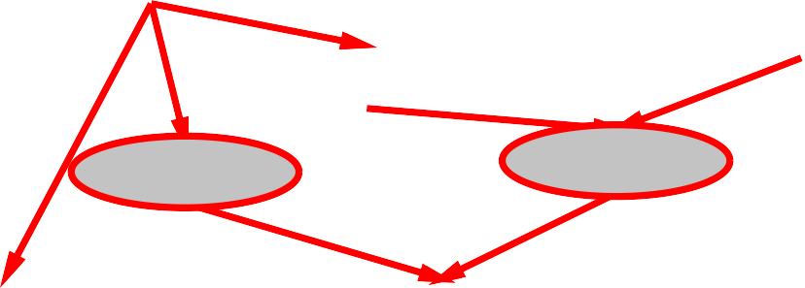


Example: Car insurance
SocioEcon
Age
GoodStudent
ExtraCar
Mileage
RiskAversion
VehicleYear
SeniorTrain
DrivingSkill
MakeModel
DrivingHist
Antilock
DrivQuality
Airbag
CarValue
HomeBase
AntiTheft
Ruggedness
Accident
Theft
OwnDamage
Cushioning
OtherCost
OwnCost
MedicalCost
LiabilityCost
PropertyCost

Slide 21
Compact conditional distributions
CPT grows exponentially with number of parents
CPT becomes infinite with continuous-valued parent or child
Solution: canonical distributions that are defined compactly Deterministic nodes are the simplest case:
X = f (P arents(X)) for some function f
E.g., Boolean functions
N orthAmerican ⇔ Canadian ∨ US ∨ M exican
E.g., numerical relationships among continuous variables
∂Level
∂t
= inflow + precipitation - outflow - evaporation

Slide 22

Compact conditional distributions contd.
Noisy-OR distributions model multiple noninteracting causes
Parents U₁ . . . U_{k} include all causes (can add leak node)
Independent failure probability q_{i} for each cause alone
j
⇒ P (X|U . . . U , ¬U . . . ¬
U ) = 1 − Π q
1 j j+1
k
i = 1
i
Cold F | Flu F | Malaria F | P (F ever) 0.0 | P (¬F ever) 1.0
F | F | T | 0.9 | 0.1
F | T | F | 0.8 | 0.2
F | T | T | 0.98 | 0.02 = 0.2 × 0.1
T | F | F | 0.4 | 0.6
T | F | T | 0.94 | 0.06 = 0.6 × 0.1
T | T | F | 0.88 | 0.12 = 0.6 × 0.2
T | T | T | 0.988 | 0.012 = 0.6 × 0.2 × 0.1
Number of parameters linear in number of parents

Slide 23
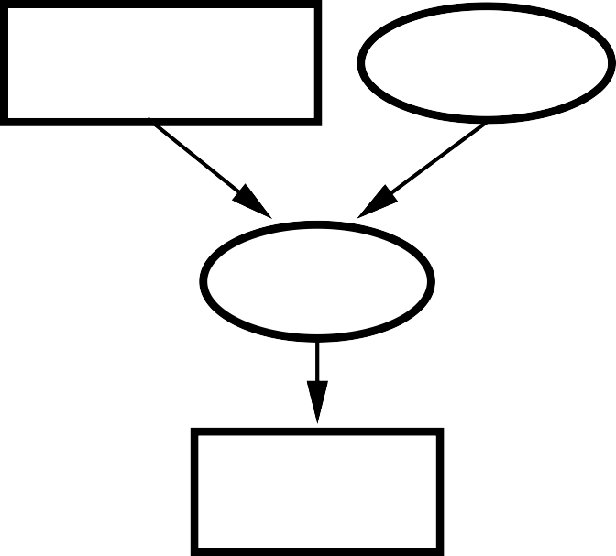
Hybrid (discrete+continuous) networks
Discrete (Subsidy? and Buys?); continuous (Harvest and Cost)
Subsidy? Harvest
Cost Buys?
Option 1: discretization—possibly large errors, large CPTs Option 2: finitely parameterized canonical families
Continuous variable, discrete+continuous parents (e.g., Cost)
Discrete variable, continuous parents (e.g., Buys?)

Slide 24
Continuous child variables
Need one conditional density function for child variable given continuous parents, for each possible assignment to discrete parents
Most common is the linear Gaussian model, e.g.,:
P (Cost = c|Harvest = h, Subsidy? = true)
= N (a_{t}h + b_{t}, σ_{t})(c)


_{2}
1
 1 c − (a_{t}h + b_{t}) 
=
_{σt}√
exp −








σ_{t}


2π 2


Mean Cost varies linearly with Harvest, variance is fixed Linear variation is unreasonable over the full range
but works OK if the likely range of Harvest is narrow

Slide 25
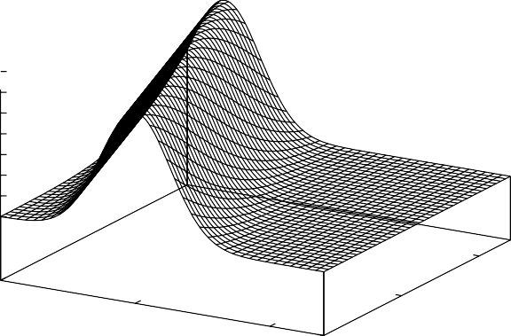
Continuous child variables
P(Cost|Harvest,Subsidy?=true)
0.35
0.3
0.25
0.2
0.15
0.1
0.05
0
10
Harvest
0
5
Cost
5
10
0
All-continuous network with LG distributions
⇒ full joint distribution is a multivariate Gaussian
Discrete+continuous LG network is a conditional Gaussian network i.e., a multivariate Gaussian over all continuous variables for each combination of discrete variable values

Slide 26
Discrete variable w/ continuous parents
Probability of Buys? given Cost should be a “soft” threshold:
1
0.8
0.6
0.4
0.2
0
P(Buys?=false|Cost=c)
0
2
4
6
Cost c
8
10
12
Probit distribution uses integral of Gaussian:
Φ(x) = ^{[ x}
−∞
N (0, 1)(x)dx
P (Buys? = true | Cost = c) = Φ((−c + µ)/σ)

Slide 27
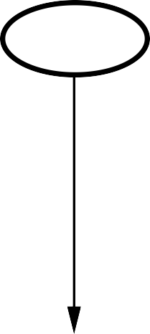
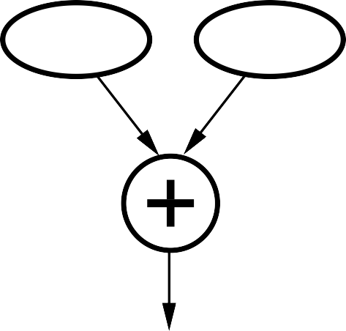
Why the probit?
It’s sort of the right shape
Can view as hard threshold whose location is subject to noise
Cost
Cost
Noise
Buys?

Slide 28
Discrete variable contd.
Sigmoid (or logit) distribution also used in neural networks:
1
P (Buys? = true | Cost = c) =
−c+µ
1 + exp(−2
)
σ
Sigmoid has similar shape to probit but much longer tails:
1
0.9
0.8
0.7
0.6
0.5
0.4
0.3
0.2
0.1
0
P(Buys?=false|Cost=c)
0
2
4
6
Cost c
8
10
12

Slide 29
Summary
Bayes nets provide a natural representation for (causally induced) conditional independence
Topology + CPTs = compact representation of joint distribution Generally easy for (non)experts to construct
Canonical distributions (e.g., noisy-OR) = compact representation of CPTs
Continuous variables
⇒ parameterized distributions (e.g., linear Gaussian)

