Slide 1
Learning from Examples
Chapter 18

Slide 2
Outline
Learning agents
Kinds of Learning
Supervised learning (our main focus)
Inductive learning
Decision tree learning (easy, to learn the basics)
Measuring learning performance
Choosing the best hypothesis
Model selection
Going from error to “loss”
Brief survey of other approaches
Regression, with linear models
Neural Nets
Non-Parametric models
Support Vector Machines
Ensemble Learning

Slide 3
Learning
Learning is essential for unknown environments
Motivations: Why learn?
Why not just program it “right/complete” in the first place?
Software designers are not omniscient !
Cannot anticipate all possible situations agent might encounter
Can not anticipate changes in world’s behavior over time
Designer has no strong idea of how a particular world works!
Learning is useful as a system construction method
expose the agent to reality rather than trying to write it down!
Learning modifies the agent’s decision mechanisms to improve performance
Any component of a learning agents can be improved by learning

Slide 4
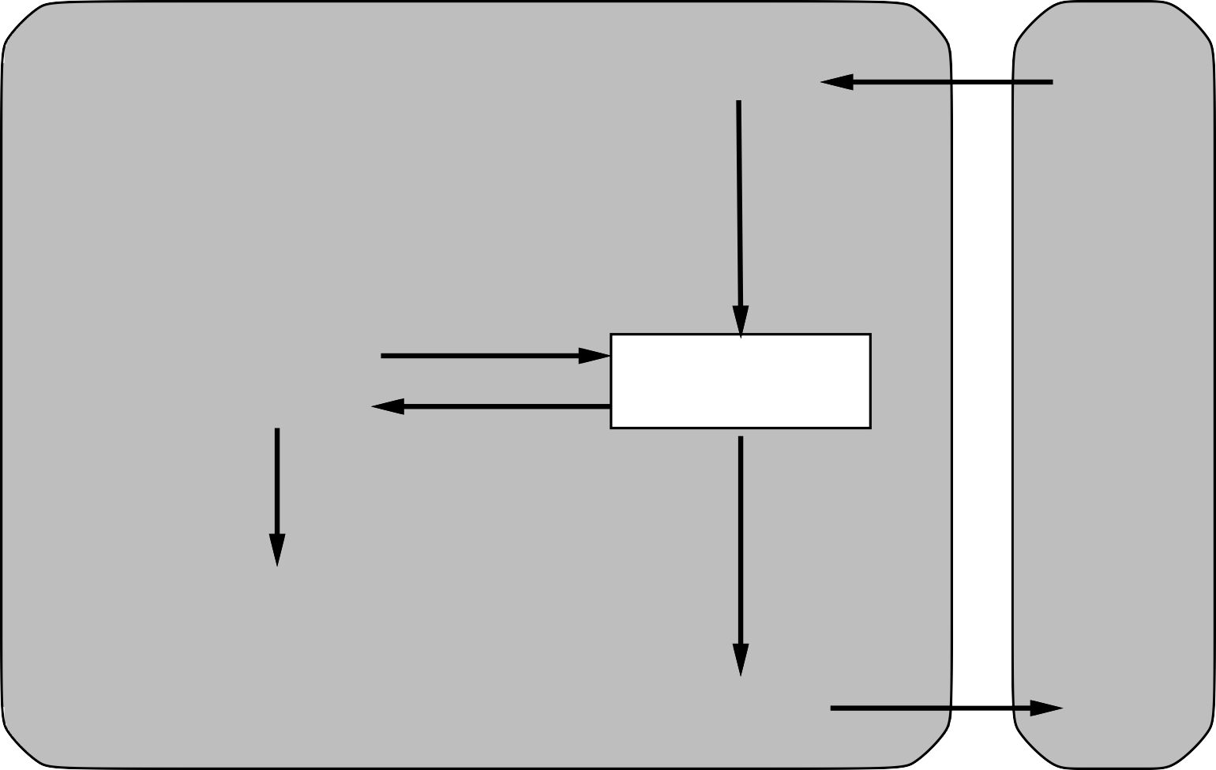
Review: Learning agents
Performance standard
Critic
Sensors
feedback
changes
Environment
Learning element
Performance element
knowledge
learning goals
Problem generator
experiments
Agent
Effectors

Slide 5
Possible Learning Elements
Kind of learning is desired/applicable depends on:
Which component targeted for improvement
What prior knowledge is available
The representation used for data and within the component
What feedback is available to learn from
Example scenarios:
Key factors: Representation and Feedback
Let’s examine more closely…
Performance element | Component | Representation | Feedback
Alpha−beta search | Eval. fn. | Weighted linear function | Win/loss
Logical agent | Transition model | Successor−state axioms | Outcome
Utility−based agent | Transition model | Dynamic Bayes net | Outcome
Simple reflex agent | Percept−action fn | Neural net | Correct action

Slide 6
Representations and Feedback
Representation of what the agents knows about world is key
Learning = Observe performance, assign credit/blame, change knowledge
Internal representation of world affects efficacy of process!
Atomic representation of world state:
Chess board, an input/output function, a picture: “knowledge” is intrinsic
Situation is rated by evaluation fn.
But what “parts” of world are good/bad? Hard to pick apart…hard to improve…
Factored representation of world state:
A world is represented by a whole set of (semi-) independent facts
Logics, Rule-based systems, etc.
Chess board = (king positioning)+(queen mobility)+(rook-bishop position)+etc.
Rules for how the world works + importance weightings for rule selection
Learning = Learn relevant factors to performance + adjust weightings on them

Slide 7
Representations and Feedback
Feedback available to agent determines type of learning
An sample is just a vector of random variables and their values
{weather=sunny, tooth_pain=3, mood=5, traffic=medium, etc etc}
Represents one situation observed in the world…could be a percept.
Unsupervised learning: No feedback at all
Given reams of samples , but no feedback on what is “good” and “bad”
Learning = discern significant patterns in the input
The central component of data mining
Reinforcement learning: Feedback by experience
Given lots of samples, plus (at least occasionally) a utility function value.
An sample + “how successful I was/felt” in that situation
E.g.: A finishing board in a game, plus how many points you scored
Supervised learning: Learning by training
Given a set of positive samples + set of negative samples
Learn to classify any new sample as positive/negative
Most info-rich = most powerful. We will focus here…

Slide 8

Inductive Learning
Simplest form of supervised learning
Given (sample, outcome) pairs, learn a function that connects the two.
E.g. All of science, experiential learning in real life, etc.
Differentiate from deductive learning
have some rules/facts see what new facts can be derived
F(x) is the target function
The underlying “rule for world behavior” I’m trying to discover
Assumption: the world behaves in (semi-) deterministic ways
A example is a (sample, outcome pair), i.e., (x, f(x)) like:
Learning problem:
Given a training set, find a hypothesis h(x), such that h(x) ≈ f(x)
Classification: output= discrete options, e.g., image → is it happy, angry, sad, calm)
Regression: output= real value, e.g., meteo stats → predict tomorrow’s temperature
Note: Very simplified model of real learning
Ignores prior knowledge of agent
Assumes a deterministic, observable “environment”
Assumes examples are given (nice clean training set)
Assumes that the agent wants to learn f —why?)

Slide 9
Inductive learning method
Construct/adjust h to agree with f on training set
h is consistent if it agrees with f on all examples)
E.g., curve fitting:
Note that red line is not consistent → clearly best h(x) is not linear fn!
f(x)
f(x)
x
x

Slide 10
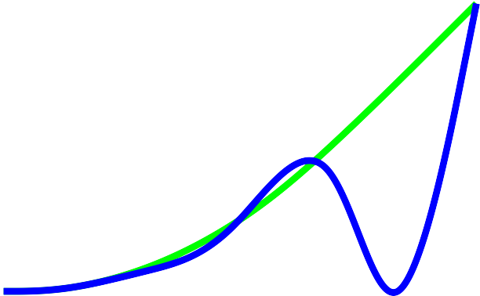
Inductive learning method
Construct/adjust h to agree with f on training set
Might need to explore higher order models for h(x)
A hypothesis space: A possible h(x) functions being considered
Learning = search through hypothesis space for h(x)= f(x)
Hypothesis space is usually HUGE. Settle for best h(x) ≈ f(x)
Higher order h(x) is found to be consistent
But just because it fits training set, doesn’t mean it’s the truth
i.e., the targeted f(x) that is accurate for whole world (all samples)
f(x)
f(x)
Or maybe…???
x
x

Slide 11
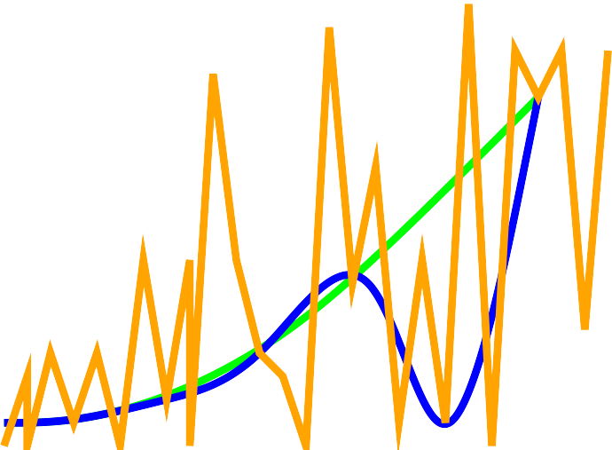
Inductive learning method
Construct/adjust h to agree with f on training set
But where to stop?
Could always hypothesize more and more higher order fns, all consistent!
Which h(x) among all possible (infinite?) consistent h(x) should I choose?!?!
Or maybe even this?
f(x)
x
Ockham’s razor: balance of accuracy and simplicity
Choose the simplest possible explanation consistent for observations so far.
f(x)
So we would choose this
… until further samples say otherwise
x

Slide 12
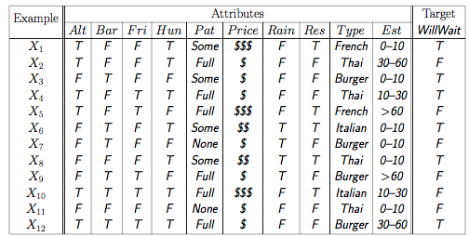
Attribute-based Representations
So with this concept of learning, what does that mean in practice?
Need to take a closer look at what an example really is:
Examples are describes as (sample, output) pairs
Sample is set of (attribute,values). Whole thing can be seen as table.
Example: When will Dr. D wait for a restaurant table?
Sample attributes describe the possible factors
Patrons=(none, some, full); Price=($$$,$$,$); Type=(French, Thai, Italian, Burger), EstimateWait=(0-10,10-30, 30-60, >60)
Boolean variables: Alternatives close by, Bar area available, Raining?, Did I reserve?, am I hungry?
Each sample in training set classified as positive (will wait) or not.

Slide 13
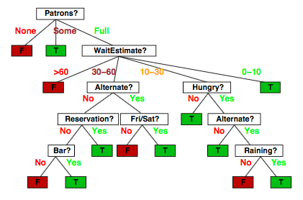
Decision Trees
Any classification problem can be represented as a decision tree
Shows:
the factors that play into a classification decision
The priority ordering, i.e., order in which factors considered (more important ones at root)
Example: the “true” decision tree for restaurant decisions
Learning with decision trees=
Given some sample set, discover the underlying decision tree that drives outcomes
Goal: Could then classify any future sample accurately!

Slide 14
Expressiveness
Decision trees can express any function of the input attributes.
E.g., for Boolean functions, truth table row → path to leaf:
Obviously: There exists a consistent decision tree for any training set
w/ one path to leaf for each example (unless f nondeterministic in x)
but even a consistent tree may not generalize to new examples…
New samples effectively increase training set → rebuild tree, keep learning
Learning = given a training set, find a consistent decision tree for it
Analyze what factors influence output
Analyze what factors influence the output the most (highest in tree)
Prefer to find most compact decision trees (Ockham’s razor at work)
Learning is directed search through space of possible trees!
A B Out
A
F
T
F | F | F
F | T | T
T | F | T
T | T | F
B
B
F
T
F
T
F
T
T
F

Slide 15
Hypothesis spaces
So how big is the space of possible hypotheses (decision trees, in this case)
If learning is search, how big is search space? Helps us know what search approach…
How many distinct decision trees possible given n boolean attributes
Note: gets much worse for multi-value or continuous attributes
Really: What is the number of possible boolean functions?
→ how many rows are in the truth table for one function? → 2^{n}
Then how many such truth tables with 2n rows are there →
Ack!
So with 6 Boolean attributes, there are 18,446,744,073,709,551,616 trees!
Ok, simplify: How many purely conjunctive hypotheses (decision trees)?
E.g. ( Hungry ∧¬Rain ) ?
Each attribute can be present/positive, present/negative, or not present
→ 3^{n} distinct conjunctive hypotheses
More expressive hypothesis spaces (e.g. no “conjunctive” restriction):
Good: Increases chances that hypothesis h could express true target function f
Bad: Dramatic increases in the hypothesis space
Ugly: Increases # of hypotheses consistent with training set
May get worse predictions…

Slide 16
Algorithm: Decision tree learning
Aim: find a small tree consistent with the training examples
Idea: (recursively) choose “most significant” attribute as root of (sub)tree
Notice: training set examples crucial for *building* tree…but don’t actually appear anywhere in finished tree.
function DTL(examples, attributes, parent-examples) returns a decision tree
if examples is empty then return Plurality-Value(parent-examples)
else if all examples have the same classification then return the classification
else if attributes is empty then return Plurality-Value(examples)
else
A ← argmax_{a∈attributes} Importance(attributes, examples) ;; choose best splitter!
tree ← a new decision tree with root test A
for each value v_{k} of A do
exs ← {e: e∈examples and e.A=v_{k} }
subtree ← DTL(exs, attributes −A, examples)
add a branch to tree with label (A=v_{k}) and subtree subtree
return tree

Slide 17
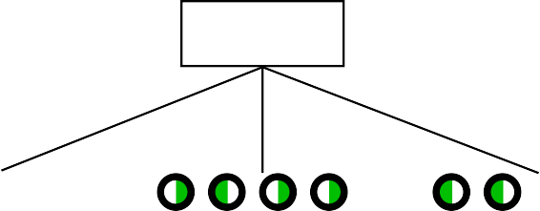
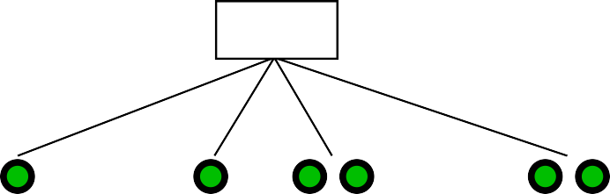
Decision Tree learning
Decision Tree Learning = build a decision tree consistent with training set
Can rebuild tree (re-run algo) when new percepts show bad classification
Greedy algo: want to build smallest possible tree consistent with examples
Importance function in algo is crucial: must choose “best” attribute. But how?
Guaranteeing the smallest possible tree → search through trees. Ack!
Practically: use heuristics from information theory to get close.
Choosing the “best” attribute
Idea: a good attribute is one that most effectively splits remaining choices
Splits remaining examples into subsets that are (ideally) all positive, all negative
So “patron?” is better choice: gives more information about classification
Patrons?
Type?
None
Some
Full
French
Italian
Thai
Burger

Slide 18

Information Theory (briefly)
Information answers questions, reduces uncertainty
Entropy measures the uncertainty of some random variable
The fundamental quantity in information theory
Perfect knowledge = I know for sure = entropy is zero.
Information theory: mathematical basis for calculating entropy
i.e., calculating the amount of information gained by some statement
Idea: the more clueless I am about outcome, the more information some answer has
So: based on prior probabilities of each variable < P₁,P₂,…P_{k}> for k variable world
So then: Entropy of a fair (50-50) coin flip = -(0.5log₂0.5 + 0.5log₂0.5) = 1 bit
Entropy of loaded coin (heads 99%) = -(0.99log₂0.99 + 0.01log₂0.01) = .08 bits
First case: gain more information = reduce uncertainty more = more bits of info gained.
In learning context: choose attribute that maximally reduces entropy
Can use simple math (see book) to calculate information gain of attributes
Gain(Patrons?) = 0.541 bits versus Gain(Type)= 0 bits
Provides the needed foundation for the Importance function in algo

Slide 19
Decision Tree learning
From applying the DTL algo to our 12-sample training set:
Note that this h-function (tree) is considerable smaller than the “true” tree (see earlier)
A more complex hypothesis was simply not justified by the (limited 12 sample) data
Would likely rebuild tree after get more samples (and failed classifications!)
Patrons?
None
Some
Full
F
T
Hungry?
Yes No
Type?
F
French
Italian
Thai
Burger
T
F
Fri/Sat?
T
No Yes
F
T
Notes:
http://machinelearningmastery.com/implement-decision-tree-algorithm-scratch-python/

Slide 20
Decision Tree learning: Challenges
For some training sets, DTL may erroneously generate large tree
Given some training set, finds a “pattern” when there really is none.
When there are many irrelevant variables, and smallish training set.
DTL infers relevance in the values of irrelevant vars in the training set.
Called overfitting the model to the data
General phenomenon, can occur in all learning techniques
Solution: use decision tree pruning techniques
Idea: prune away irrelevant nodes
Question: How to determine “irrelevant” nodes?
Use probabilistic statistics: run a significance test on all nodes
Idea: Calculate probability that there is no underlying pattern
Compare number of positive/negative examples in the subsets produced by the node split to the number one would normally expect.
If no significant difference → node is really useless and can be pruned.
Most common: Chi-squared pruning (remember Chi-squared test? From stats class?)
Notes:
http://machinelearningmastery.com/implement-decision-tree-algorithm-scratch-python/

Slide 21
Decision Trees in the real world
Decision Tree learning: very popular machine learning technique
Fast, effective, and (!!) allows humans to examine/understand results
Actually required by law in dangerous domain like medical diagnosis
Must address some real world issues to get practical utility:
Missing data: Attribute values not known for every sample
Wonky sensor, un-recorded data, too expensive to gather each time, etc.
Building tree: how to account for missing vars in entropy calculation?
Using tree: how to classify a sample that is missing a test attribute for tree?
Multi-valued attributes: Info gain calculation gets confused
Ex: Exact_temp attribute has infinite values → every subset is a singleton
Since only one member of subset → info gain measure goes to maximum
Erroneous! Must develop a concept of info gain ratio, or other strategy
Continuous value attributes: Have infinite possible values
Dumb DTL would generate infinitely many branches…
Most DTL algos divide into ranges by finding split points with highest info gain
So exact_temp → temp<30, 31<temp<60, 61<temp<95, temp>95
Continuous output values: predict a specific value rather than classify
Ex: Given training set of recent rentals, predict price of apartment
Requires a regression tree: each leaf is a linear function (rather than class)
Notes:
http://machinelearningmastery.com/implement-decision-tree-algorithm-scratch-python/

Slide 22
Measuring Learning Performance
$10M question: how do we know that h ≈ f (in any learning algorithm)?
Need a way to compute/compare performance!
Need some concepts first:
Stationarity assumption: there is some stable “truth” to be found
A probability distribution over all possible samples (mostly) stable over time
Error rate of a hypothesis: proportion of mistakes it makes
Proportion of h(x)≠y over some set of (x,y) examples.
Performance = use theorems of computational/statistical learning theory
See Section 18.5 in book for mathematical detail
Plan: Try h on a new “test set” of examples.
Different from training set, but has same probability distribution over example space
Learning curve = error rate on test set as a function of training set size
Learning effectiveness of learning algorithm: Indicated by the overall shape of learning curves produced across many training sets
Hypothesis correctness: whether or not is converges on an error rate of zero as training set size grows.
Notes:
http://machinelearningmastery.com/implement-decision-tree-algorithm-scratch-python/

Slide 23
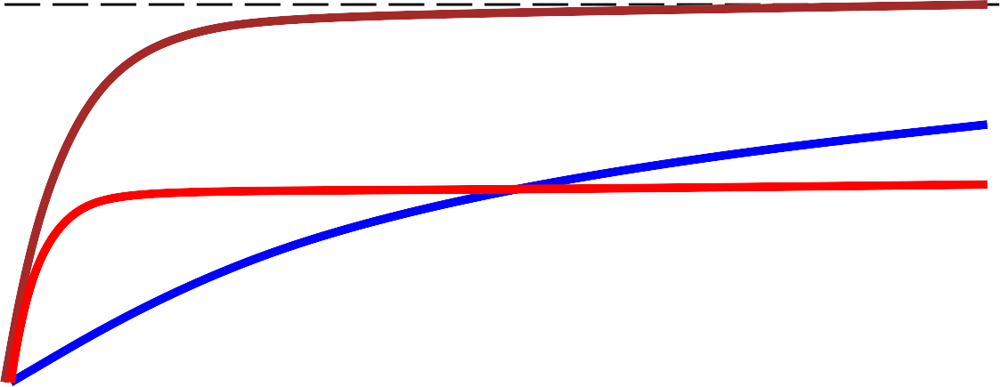
Measuring Learning Performance
1
0.9
0.8
0.7
0.6
0.5
0.4
% correct
% correct on test set
1
realizable
redundant nonrealizable
# of examples
0 10 20 30 40 50 60 70 80 90 100
Training set size
Learning curves provide a way to measure/compare performance
Can see how fast a hypothesis converges on f (shape of curve)
Convergence = error rate asymtotically approaches zero.
Can see whether a hypothesis ever converges on f
Realizable vs. non-realizable
Non-realizable: missing attributes; or wrong hypothesis space (e.g. only linear fns)
Overfitting → redundant expressiveness
Loads of irrelevant attributes confuse things, blunt convergence rate.
Notes:
http://machinelearningmastery.com/implement-decision-tree-algorithm-scratch-python/

Slide 24

α β ⊆ ¬ ⇒ |= ∧ ∨ ⇔ ∈

Slide 25
Learning using Linear Models
Decision Tree Learning is just one of many learning techniques
Many others exist, often chosen depending on exact needs or domain characteristics
Let’s take a quick look at a few:
Learning using Linear models
Notes:
http://machinelearningmastery.com/implement-decision-tree-algorithm-scratch-python/

Slide 26
Learning using Neural Networks

Slide 27
Learning with Non-parametric models

Slide 28
Learning with Support Vectors Machines (SVM)

Slide 29
Ensemble Learning

Slide 30
Which learning algorithm is best?
It depends!
On complexity of the domain
How many variables must be represented to get halfway accurate?
Are there stochastic effects in the domain?
What is the nature of output required: classification vs. regression
Your knowledge representation approach
What are the “factors” in your factored representation
Accuracy vs. speed trade-off you are targeting
Does quick convergence matter more than absolute accuracy?
Is the domain real-time, i.e., new percepts coming in all the time that need to be evaluated…and then added to the training set to re-learn in real time?
What is your access to training sets?
Are larger training sets even available? How good/accurate are they?
Do you have new test examples (percepts) arriving in real-time?
Does learning have to happen in real-time?
Or can I save my test examples and re-learn from them during some pause?
Machine learning is a huge active area of AI research!
Needs a separate course to examine techniques in detail
Machine learning experts: assess a domain/need, choose an appropriate method

Slide 31
Summary
Learning needed for unknown environments, lazy designers Learning agent = performance element + learning element
Learning method depends on type of performance element, available feedback, type of component to be improved, and its representation
For supervised learning, the aim is to find a simple hypothesis that is approximately consistent with training examples
Decision tree learning using information gain
Learning performance = prediction accuracy measured on test set

