Slide 1
Adversarial Search (a.k.a. Game Playing)
Chapter 5
(Adapted from Stuart Russell, Dan Klein, and others. Thanks guys!)

Slide 2
Outline
Games
Perfect play: principles of adversarial search
minimax decisions
α–β pruning
Move ordering
Imperfect play: dealing with resource limits
Cutting of search and approximate evaluation
Stochastic games (games of chance)
Partially Observable games
Card Games
<number>

Slide 3
Games vs. search problems
Search in Ch3&4: Single actor!
“single player” scenario or game, e.g., Boggle.
Brain teasers: one player against “the game”.
Could be adversarial, but not directly as part of game
e.g. “I can find more words than you”
Adversarial game: “Unpredictable” opponent shares control of state
solution is a strategy → specifying a move for every possible opponent response
Time limits ⇒ unlikely to find goal, must find optimal move with incomplete search
Major penalty for inefficiency (you get your clock cleaned)
Most commonly: “zero-sum” games. My gain is your loss = Adversarial
Gaming has a deep history in computational thinking
Computer considers possible lines of play (Babbage, 1846)
Algorithm for perfect play (Zermelo, 1912; Von Neumann, 1944)
Finite horizon, approximate evaluation (Zuse, 1945; Wiener, 1948; Shannon, 1950)
First chess program (Turing, 1951)
Machine learning to improve evaluation accuracy (Samuel, 1952–57)
Pruning to allow deeper search (McCarthy, 1956)
Plus explosion of more modern results...
<number>

Slide 4
Types of Games
deterministic
chance
perfect information
chess, checkers, go, othello, connect-4, tic-tac-toe | Backgammon, Monopoly, Chutes-n-ladders
Battleship, Blind tic-tac-toe, Kriegspiel | Bridge, Poker, Scrabble Nuclear war
imperfect information
Access to Information
Perfect Info. Fully observable. Both player see whole board, all of the time
Imperfect Info. Not/partially-observable. Blind or partial knowledge of board.
Determinism:
Deterministic: No element of chance. Players have 100% control over actions taken in game
Chance: Some element of chance: die rolls, cards dealing, etc.
<number>

Slide 5
Game tree (2-player, deterministic, turns)
MAX (X)
X
X | O
X | O |  | X
 | X
 |  | X
X
 |  | X
X
 | X
 |  | X
MIN (O)
X
X |  | O
X
O
. . .
MAX (X)
X | O
X
X | O
 | X
. . .
MIN (O)
Pondering Game Tree Size...
Tic-tac-toe (3x3)
“Small” = 9! = 362,880 terminal nodes
Chess
10⁴⁰ terminal nodes!
Never could generate whole tree!
. . .
. . .
. . .
. . .
X | O |  | X
 | O |  | X
 | O
X | O |  | X
O | O |  | X
X | X |  | O
X | O |  | X
 | X
X | O |  | O
. . .
TERMINAL
Utility
−1
0
+1
<number>

Slide 6
Minimax Search
Normal Search: Solution = seq. of actions leading to goal.
Adversarial Search: Opponent interfering at every step!
Solution= Contingent plan of action
Finds optimal solution to goal, assuming that opponent makes optimal counter-plays.
Essentially an AND-OR tree (Ch4): opponent provides “non-determinism”
Perfect play for deterministic, perfect-information games:
Idea: choose move to position with highest minimax value
E.g., 2-ply game:
3
MAX
A
1
A
2
A
3
MIN
3
2
2
^{A} 11 ^{A} 12 ^{A} 13
^{A} 21 ^{A} 22
^{A} 23
^{A} 31 ^{A} 32 ^{A} 33
3
12
8 2
4 6
14
5
2
<number>

Slide 7
Minimax algorithm
function Minimax-Decision(state) returns an action
inputs: state, current state in game
return the a in Actions(state) maximizing Min-Value(Result(a, state))
function Max-Value(state) returns a utility value
if Terminal-Test(state) then return Utility(state)
v ← −∞
for a, s in Successors(state) do v ← Max(v, Min-Value(s))
return v
function Min-Value(state) returns a utility value
if Terminal-Test(state) then return Utility(state)
v ← ∞
for a, s in Successors(state) do v ← Min(v, Max-Value(s))
return v
<number>

Slide 8
Minimax: Reflection
Need to understand how minimax works!
Recursive depth-first algorithm
Max-Value at one level...calls Min-Value at next...calls Max-Value at next.
Base case: Hits a terminal state = game is over -> has known score (for max)
Scores “backed up” through the tree on recursive return
As each node fully explores its children, it can pass its value back
Score arriving back at root shows which move current player (max) should make
Makes move that maximizes outcome, assuming optimal play by opponent.
Multi-player games?
Don’t have just Max & Min. Have whole set of players A,B,C, etc.
Calculate utility vector of scores at each level/node
Contains node (board position) value for each player
Value of node = utility vector that maximizes benefit for player whose move it is
<number>

Slide 9
Properties of minimax search
Complete??
Yes, if tree is finite (chess has specific rules for this)
Minimax performs complete depth-first exploration of game tree
Optimal??
Yes, against an optimal opponent. Otherwise??
Time complexity??
O(b^m), b=breadth of tree (number of actions/successors), m=max depth
Space complexity??
O(bm) (depth-first exploration) (m is max depth)
Practical Analysis:
For chess, b ≈ 35, m ≈ 100 (moves) for “reasonable” games
Time cost gets out of range of “3 minute per move” standard fast!
⇒ exact solution completely infeasible!
Engage cleverness: do we really need to explore every path in tree?
<number>
Notes:
<number>

Slide 10
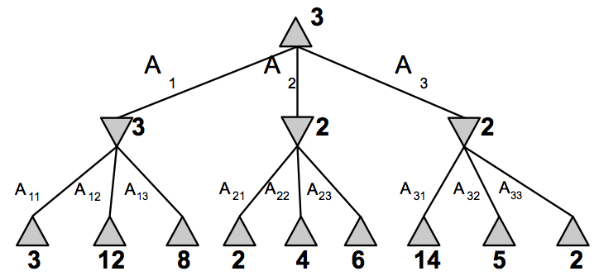
Alpha-Beta (α–β) pruning
DFS plunges down tree to a terminal state fast!
Knows about one complete branch first...
Can we use this to avoid searching later branches?
Alpha-Beta pruning:
MAX
3
MIN
3
Reference: whole tree
3
12
8
<number>

Slide 11
α–β pruning example
MAX
3
MIN
3
2
X X
3
12
8 2
Reference: whole tree
<number>

Slide 12
α–β pruning example
MAX
3
MIN
3
2
14
X X
3
12
8 2
14
Reference: whole tree
<number>

Slide 13
α–β pruning example
MAX
3
MIN
3
2
14 5
X X
3
12
8 2
14
5
Reference: whole tree
<number>

Slide 14
α–β pruning example
MAX
3 3
MIN
3
2
14 5 2
X X
3
12
8 2
14
5
2
Reference: whole tree
<number>

Slide 15
α–β: Reflection on behavior
MAX
α
α
α is set/updated as first branch is explored…then sent down subsequent branches to prune with.
MIN
..
..
..
MAX-n
α
MIN-n
V
α-β maintains two boundary values as it moves up/down tree
α is the best value (to max) found so far off the current path
β is the best value found so far at choice points for min
Example: If V is worse than α, Max-n will avoid it
⇒ prune that branch
β works similarly for min
<number>

Slide 16

The α–β algorithm
function Alpha-Beta-Decision(state) returns an action
return the a in Actions(state) maximizing Min-Value(Result(a, state))
function Max-Value(state, α, β) returns a utility value
inputs: state, current state in game
α, the value of the best alternative for max along the path to state
β, the value of the best alternative for min along the path to state
if Terminal-Test(state) then return Utility(state)
v ← −∞
for a, s in Successors(state) do
v ← Max(v, Min-Value(s, α, β))
if v ≥ β then return v
α ← Max(α, v)
return v
function Min-Value(state, α, β) returns a utility value
same as Max-Value but with roles of α, β reversed
<number>

Slide 19
Properties of α–β
α–β observations:
Pruning is zero-loss.
Final outcome same as without pruning.
Great example of “meta-reasoning”= reasoning about computational process.
Here: reasoning about which computations could possibly be relevant (or not)
Key to high efficiency in AI programming.
Effectiveness depends hugely which path (moves) you examine first.
Slide 14: why prune in middle subtree…but not in rightmost one.
Middle subtree: examines highest value (for max) nodes first!
Analysis:
Chess has average branching factor around 35
Pruning removes branches (whole subtrees)
-> effective branching factor = 28. Substantial reduction.
Unfortunately, 28⁵⁰ is still impossible to search in reasonable time!
<number>

Slide 20
Move ordering to improve α–β efficacy
Plan: at any ply: examine higher value (to max) siblings first.
Sets the α value tightly -> more likely to prune subsequent branches.
Strategies:
Static: Prioritize higher value moves like captures, forward moves, etc.
Dynamic: prioritize moves that have been good in the past
Use IDS: searches to depth=n reveal high values moves for subsequent re-searches at depth > n.
Stats:
Minimax search = O(b^{m})
α–β with random ordering = about O(b^{3m/4}) -> nice reduction
α–β with strong move ordering = about O(b^{m/2})
Effectively reduced b-factor from 35 to 6 in chess! Can ply twice as deep, same time!
More power: transpositions
Some move chains are transpositions of each other. (a->b, then d->e) gives same board as (d->e, then b->a).
Identify and only compute once: can double reachable depth again!
<number>

Slide 21
Imperfect Game Play
Reality check:
Thus far: minimax assumes we can search down to “bottom” of tree
Not realistic: minimax is O(b^{m})
Chess = of 50 moves/game, b about 35
O(35⁵⁰)….or, with theoretical best α–β move ordering: O(6⁵⁰). Huge!
Plan: Search as deep as time allows
Terminal-test() -> Cutoff-test()
Cut-off-test(s) decides if we should stop searching at that state/level.
If true: apply evaluation function and return value of that board.
When to cut off search?
Fred Flintstone static approach = just always cut off search at some depth d.
Problem: leaves valuable time on the table
Reachable depth within t-limit varies depending on board/# pieces/etc.
Solution: Use IDS.
Search until time is up -> return result from latest completed search
Bonus: Use info from previous IDS runs to optimize α–β move ordering
Problem: horizon effect = something bad could happen just beyond search limit
Solution: Add quiescence metric. Never cut off search in middle of heavy action.
<number>

Slide 22
Advanced Techniques: when winning matters
Idea 1: Find ways to search deeper.
Efficiency: efficient board representation, faster eval functions, etc.
Better pruning: maximize efficacy of move ordering subsystem
Forward pruning: cut off “un-interesting” branches of search tree early
α–β prunes nodes that are provably useless -> loss-less
Forward pruning “guesses” -> prunes nodes that are probably useless.
Danger: could prune away moves that ultimately lead to wins!
Strategy: shallow search gets rough node value. Stored info estimates likely utility
Idea 2: More sophisticated evaluation function
Linear weighted function assume independence of features…statically
But often it’s the combo of pieces that count…more at some points in game than others
E.g., pair of bishops > two knights…but more so in the end-game
Non-linear weighted functions allow more subtle tuning
Machine learning can also be used to adjust weights from experience
<number>

Slide 23
Advanced Techniques: when winning matters
Idea 3: Avoid search completely when you can
In many games, there are certain rote phases
e.g. Chess: whole libraries of books about standard openings/end games
Why search down through billions of boards? Look it up!
Can just store and look-up moves for “standard” situations
Enter from books and other “human knowledge”
Calculate stats on DB of previously played games -> which openings won most?
Computers can have advantage of humans here!
Human: has general strategy for certain endgames
King-rook-king (KRK) endgame, king-bishop-knight-king (KBNK), etc.
Computer: with so few pieces, can literally compute winning move sequence!
For all possible KRK endings, etc.
Computer recognizes a pre-computed sequence -> plays perfect deterministic endgame!
<number>

Slide 24
History: Deterministic Games in practice…
Checkers:
Chinook ended 40-year-reign of human world champion Marion Tinsley in 1994.
Used an endgame database defining perfect play for all positions involving 8 or fewer pieces on the board, a total of 443,748,401,247 positions.
Chess:
Deep Blue defeated human world champion Gary Kasparov in a six-game match in 1997.
Deep Blue searches 200 million positions per second, uses very sophisticated evaluation, and undisclosed methods for extending some lines of search up to 40 ply.
Othello:
human champions refuse to compete against computers, who are too good.
Go:
2005: human champions refuse to compete against computers, who are too bad.
In go, b > 300, so most programs use pattern knowledge bases to suggest plausible moves.
2017: IBM reveals it has been secretly entering its Go agent in online tournaments. And winning. Beats reigning Go champion four in a row…
<number>

Slide 25
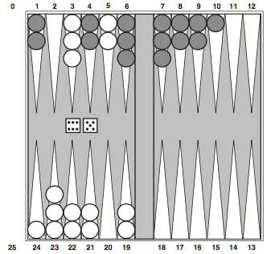
Stochastic (non-deterministic games)
Player-at-turn rolls dice:
Can now move one piece 5 places, and another piece 6 places
Combination of luck and skill
Strategy must account for roll of dice = random chance. Plus other player!
Backgammon: Dice determine possible moves
Can’t construct a standard game tree!
<number>

Slide 26
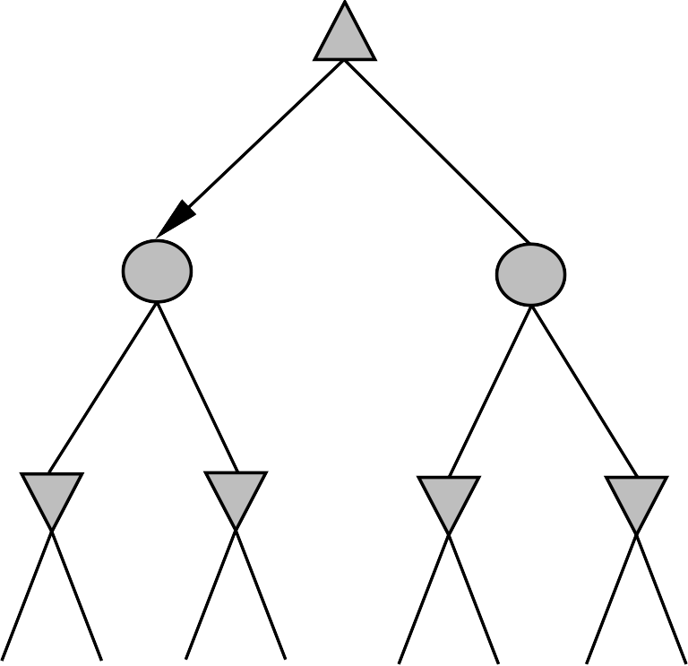
Non-deterministic Games
Chance introduced by: dice, card-shuffling/dealing, drawing cards
Minimax → Expectiminimax
Chance essentially acts as another “player”
Chance level= sum of expected outcomes, weighted by probability of happening.
Simplified example with coin-flipping “move” inserted into some game:
MAX
CHANCE
3
−1
0.5
0.5
0.5
0.5
MIN
2
4
0
−2
2 4 7 4 6 0 5 −2
<number>

Slide 27
Expectiminimax Algorithm
Expectiminimax produces perfect play
Meaning: best possible play, given the stochastic probabilities involved.
Just like Minimax, except we must also handle chance nodes:
. . .
If terminal-test(s)=true
return Evaluation-fn(s)
if state is a Max node then
return the highest ExpectiMinimax-Value of Successors(state)
if state is a Min node then
return the lowest ExpectiMinimax-Value of Successors(state)
if state is a chance node then
return SUM of probability-weighted(ExpectiMinimax-Value of Successors(state))
. . .
Dice rolls increase b:
21 possible rolls with 2 dice Backgammon ≈ 20 legal moves (can be 6,000 with 1-1 roll)
depth 4 = 20 × (21 × 20)³ ≈ 1.2 × 10⁹
Thus: As depth increases, probability of reaching a given node shrinks
⇒ value of lookahead is diminished
α–β pruning is much less effective (because chance makes pruning less common)
TDGammon: uses depth-2 search + very good Eval≈ world-champion level
<number>

Slide 28
Partially Observable Games
So far: Fully observable games
All player can see all functional pieces (state) of the game at all times
Many games are fun because of imperfect information
Players see only none/part of opponents state.
E.g. Poker and similar card games, Battleship, etc.
Example: Kriegspiel: Blind chess!
White and Black see only a board containing their pieces.
On turn: player proposes a move.
Referee announced: legal/illegal. If legal: “Capture on square X”, “Check by <direction>”, “checkmate” or “stalemate”.
Plan: Use belief states developed in Ch4!
Referee feedback = percepts that update/prune belief states.
All believe states NOT equally likely: can calculate probabilities on believe states based predicting optimum play by opponent.
Implication: Best to add some randomness to your play: be unpredictable!
<number>

Slide 29
Card Games
Stochastic partial observability
Cards dealt randomly at the beginning of game. Deterministic after that.
Odds (probability) of possible hands easily calculated.
E.g. Bridge, Whist, Hearts, some forms of poker.
Plan: Probabilistic weighted search
Generate all possible deals of the (missing) cards
Solve each one just like a fully observable games (Minimax)
Weight each outcome with probability of that hand being dealt
Chose move that has the best outcome, averaged over all possible deals.
Reality check:
In Bridge there are 10+ million possible visible hands. Can’t explore all!
Idea: Monte Carlo approach: solve random sample of deals
Choice of sample set is weighted to include more likely hands.
Bidding may add valuable info on hands → changes probabilities.
GIB, leading bridge program: generates 100 deals consistent with bidding
<number>

Slide 30
Summary
Games are just specialized search problems. Modifications:
Minimax (plus α–β pruning) to model opponent player
Stochastic “choice” layers in tree to model chance
Belief state management to model partial observability
Games illustrate several important points about AI
perfection is unattainable in reality ⇒ must approximate
good idea to think about what to think about
Meta-level analysis, as in considerations leading to α–β pruning
Uncertainty constrains the assignment of values to states
Increases effective branching factor, could make pruning less effective
Optimal decisions depend on information state, not real state
As illustrated in partially observable games, when belief state is what matters
Games are to AI as grand prix racing is to automobile design
Proving ground for hardware, data structures, algorithms…and cleverness
<number>

Slide 31

<number>

