Slide 1
Logical agents
Chapter 7
(Some slides adapted from Stuart Russell, Dan Klein, and many others. Thanks guys!)

Slide 2
Outline
Knowledge-based agents
Wumpus world
Logic in general—models and entailment
Propositional (Boolean) logic
Equivalence, validity, satisfiability
Inference rules and theorem proving
forward chaining
backward chaining
resolution

Slide 3
Knowledge-based Agents
Previously: Solved problems by search
Basically brute force. Clever...but is it “intelligent”?
“Knowledge” about how world works hidden...embodied in successor fn.
Knowledge-based agents:
Have internal representations of the world...and reason about them.
Based on formal symbolic logics: propositional, first-order predicate, etc.
Advantages:
Can combine and recombine base knowledge for many purposes
Can accept new tasks anytime, explicitly states as goals
Q: Could Boggle do any task except...well...boggle search boards?
Can achieve competence quickly
Being told new facts about the world
Learning new knowledge by deduction + percepts
Can adapt to changes in environment by updating knowledge

Slide 4
Knowledge Bases
Knowledge base is basis for all KB-agent reasoning and action
Consists of: set of sentences in a formal language
Inference engine
domain−independent algorithms
Knowledge base
domain−specific content
Declarative approach to building an agent (or other system):
Idea:
Tell it what it needs to know
Then it can Ask itself what to do (autonomous agent) or you Ask it goal.
answers should follow from the KB
KB-Agents can be viewed at the knowledge level
i.e., what they know, regardless of how implemented
Or at the implementation level
i.e., data structures in KB and algorithms that manipulate them

Slide 5
A simple knowledge-based agent
function KB-Agent( percept) returns an action
static: KB, a knowledge base
t, a counter, initially 0, indicating time
Tell(KB, Make-Percept-Sentence( percept, t))
action ← Ask(KB, Make-Action-Query(t))
Tell(KB, Make-Action-Sentence(action, t))
t ← t + 1
return action
KB-agent function centered around on:
Tell: Adding new information to the KB
Ask: Posing a query (goal) to be resolved using the KB and universal algorithms
The agent must be able to:
Represent states, actions, etc.
Incorporate new percepts
Update internal representations of the world
Deduce hidden properties of the world
Things it has not been told explicitly...but arise from evolving facts
Deduce appropriate actions (given tacit or explicit goal)

Slide 6



Wumpus World: A classic example
Simple game of logical deduction
Dark cave with deadly pits and voracious wumpus monster
Goal: Find hidden pile of gold, avoid dying, return safely
PEAS Description:
Performance measure:
gold +1000, death -1000
-1 per step, -10 for using the arrow
Environment:
Squares adjacent to wumpus are smelly
Squares adjacent to pit are breezy
Glitter iff gold is in the same square
Shooting kills wumpus if you are facing it. Shooting uses up the only arrow
Grabbing picks up gold if in same square
Releasing drops the gold in same square
Actuators:
Left turn, Right turn, Forward, Grab, Release, Shoot
Sensors:
Breeze, Glitter, Smell
Stench |  | Breeze | PIT
 | Breeze Stench Gold | PIT | Breeze
Stench |  | Breeze
START | Breeze | PIT | Breeze
4
3
2
1
1
2
3
4

Slide 7
Wumpus World: problem characterization
Observable??
No—only local perception
Deterministic??
Yes—outcomes exactly specified
Episodic??
No—sequential at the level of actions
Static??
Yes—Wumpus and Pits do not move
Discrete??
Yes. Actions are discrete and limited. States are definite and finite.
Single-agent??
Yes—Wumpus is essentially a natural feature

Slide 8
Exploring a wumpus world
4
3
OK
2
OK
OK
A
1
1
2
3
4
Start in [1,1]. Cave entry/exit. Guaranteed safe.
Note: No smells, no breezes → adjacent squares ok.

Slide 9
Exploring a wumpus world
B
OK
A
OK
OK
A
Move to [2,1]. Sensor detects breeze (B)

Slide 10
Exploring a wumpus world
P?
B
OK
P?
A
OK
OK
A
Deduce possible pits in adjacent squares.

Slide 11
Exploring a wumpus world
P?
B
OK
P?
A
OK
S
OK
A
A
Better go explore a safer place...maybe gather more info...
Detect smell (S) in [1,2]... But no breeze!

Slide 12
Exploring a wumpus world
P
P?
B
OK
P? OK
A
OK
S
OK
W
A
A
Can deduce W in [1,3] (can’t be in [2,2] because was no smell in [2,1]! )
Can definitely place the Pit in [3,1]

Slide 13
Exploring a wumpus world
P
P?
B
OK
P? OK
A
A
OK
S
OK
W
A
A

Slide 14
Exploring a wumpus world
P
P?
OK
B
OK
P? OK
OK
A
A
OK
S
OK
W
A
A
Now that [2,2] determined OK, can go there.
Nothing sensed → deductions about adjacent

Slide 15
Exploring a wumpus world
P
P?
OK
B
OK
P? BGS OK OK
A
A
A
OK
S
OK
W
A
A
And then on to [2,3]. Detect Glitter! Grab Gold!
Then head back out to exit.

Slide 16
Tight spots: Can’t always reason safely
Breeze in (1,2) and (2,1)
⇒ no safe actions!
Make educated guess:
Assuming pits uniformly distributed, (2,2) has pit w/ prob 0.86, vs. 0.31
P?
B
OK
P?
P?
A
OK B
OK
A
A
P?
Smell in (1,1)
⇒ cannot move!
Can use a strategy of coercion:
Act: shoot straight ahead
Wumpus was there → dead
Wumpus not there → safe
S
A

Slide 17
Introduction to Logic
Let’s start with some basics: definitions
Logics are formal languages for representing information
such that conclusions can be drawn
Syntax defines the format of legal sentences in the language
Semantics define the “meaning” of sentences
i.e., define truth of a sentence with respect to a particular world (state)
Example: The language of arithmetic
Syntax: x + 2 ≥ y is a legal sentence; x2 + y > is not
Semantics:
x + 2 ≥ y is true iff the number x + 2 is no less than the number y
x + 2 ≥ y is true in a world where x = 7, y = 1
x + 2 ≥ y is false in a world where x = 0, y = 6

Slide 18
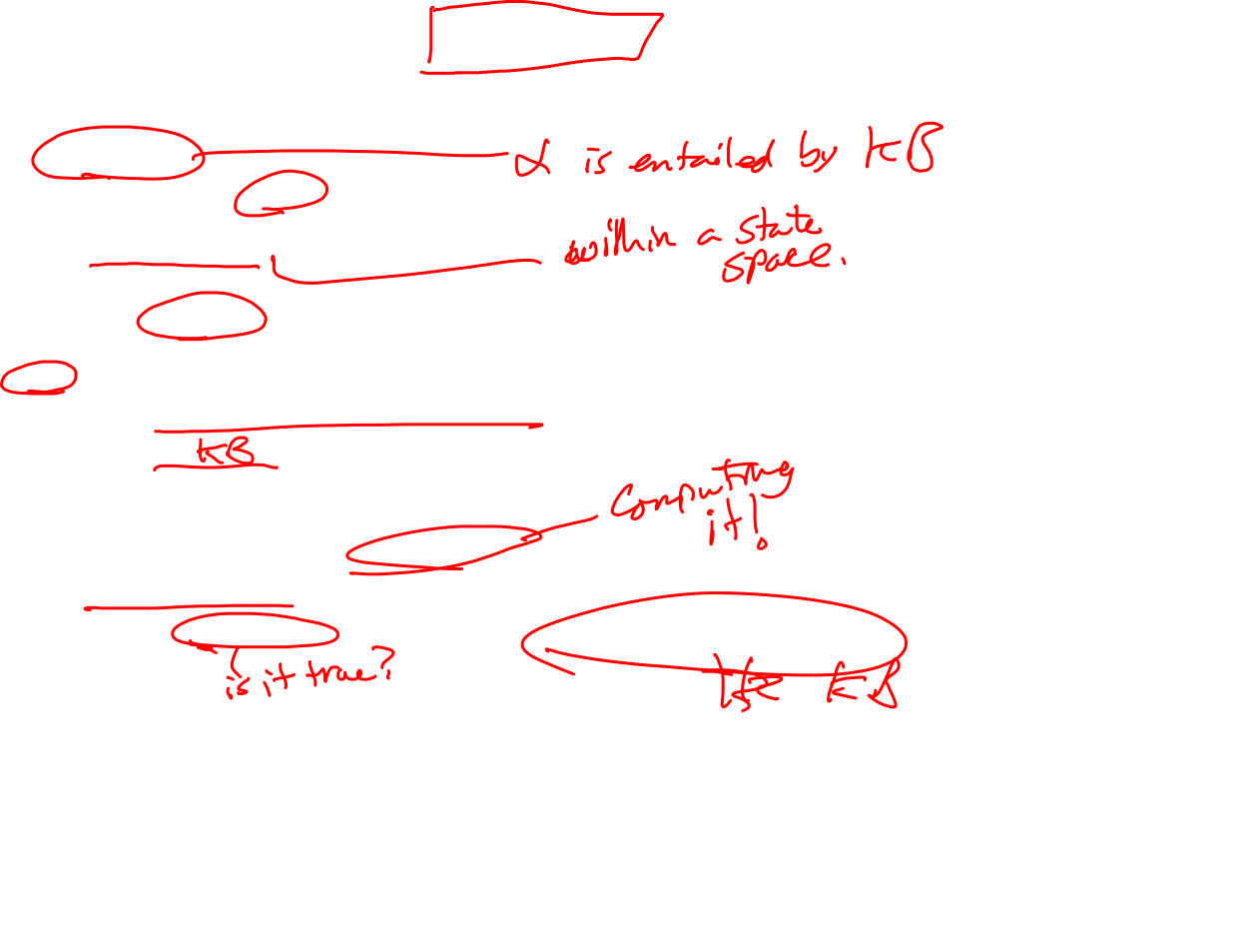
Logical Entailment
Entailment means that one thing follows from another:
KB |= α
Knowledge base KB entails sentence α if and only if α is true in all worlds where KB is true
Example: the KB containing “the Giants won” and “the Reds won” entails α =“Either the Giants won or the Reds won”
→ α is true in all worlds in which KB is true.
Example: x + y = 4 entails 4 = x + y
Entailment our first element of reasoning!
is a relationship between sentences (i.e., syntax)
Idea that one sentence (logical fact) follows logically from another sentence

Slide 19
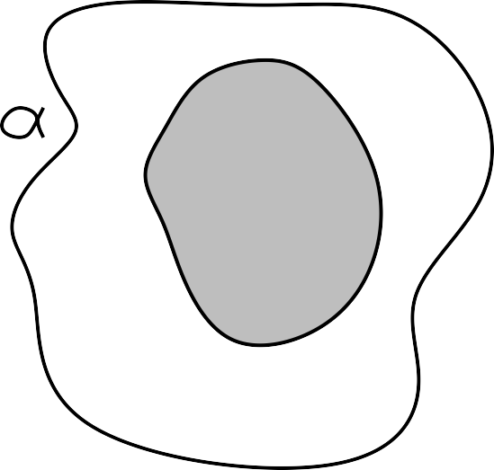
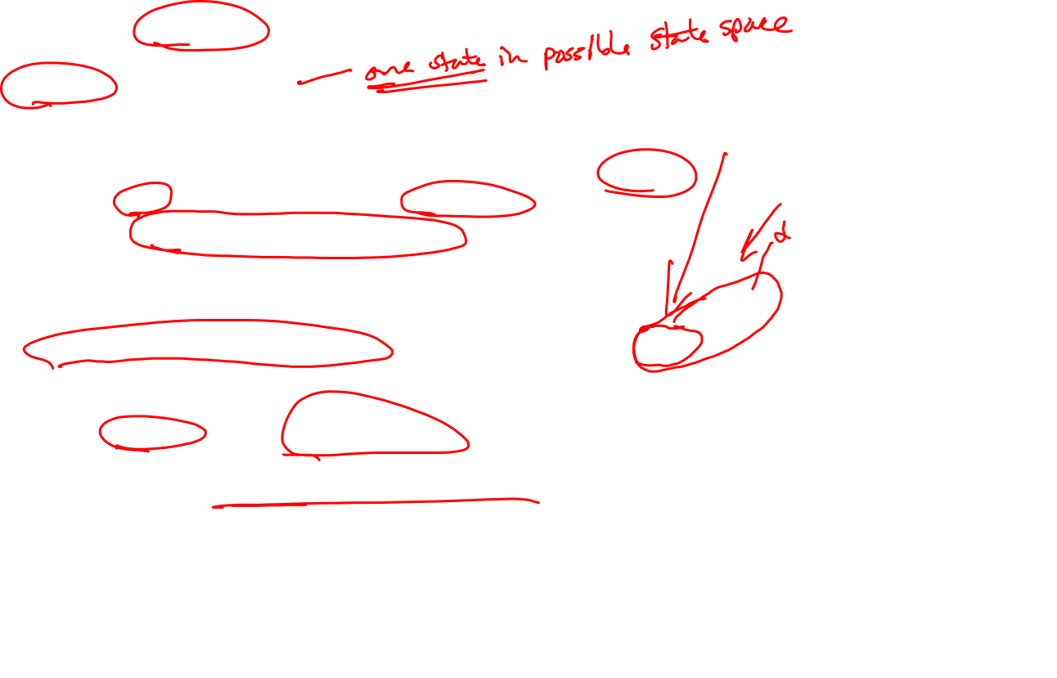
Models
What about “in a world where x is true”? A “world”? What’s that?
Model = a possible “world”.
Formally structured expression of world state with respect to which truth can be evaluated
Basically a collection of logical sentences describing a world or state
We say m is a model of a sentence α if α is true in m
Notation: M (α) is the set of all models of α
Example:
KB = Giants won and Reds won
α = Giants won
Then KB |= α if and only if M (KB) ⊆ M (α)
KB entails α iff, in every model where α is true, KB is also true.
Note that KB is the stronger statement here: the “tighter” set of possible models.
x
x x
x
x
x
_{x} x
M(α)
x
x_{x}
x
x
x
x x
x
x
x
x
x
x
x
x
x
x
x
x
x
xx
x
x xx
x x
x
M(KB)
x
x
x
x
x
x
x
x
x

Slide 20
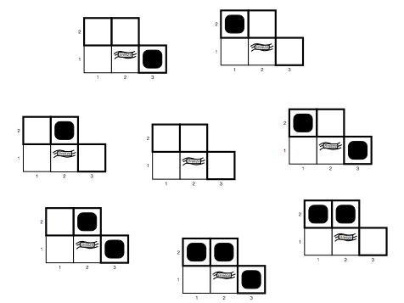
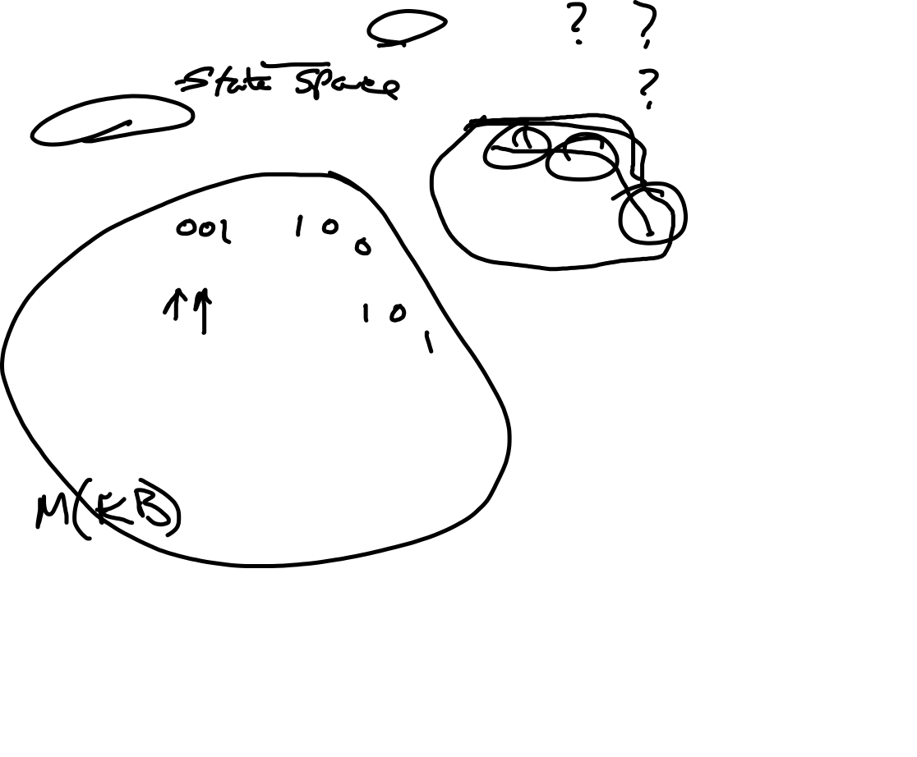
Example: Entailment in the wumpus world
Situation after detecting nothing in [1,1], moving right, breeze in [1,2]
Consider possible models for ?s assuming only pits:
Each square could contain a pit...or not
→ 3 Boolean choices
→ 8 possible models
? ?
B
?
A
A
Note:
The full model set for this world is large!
→ contains all possible combinations of possible contents for every square on board.
We are just looking at the subset dealing with the squares at the frontier of our exploration. Efficient!

Slide 21
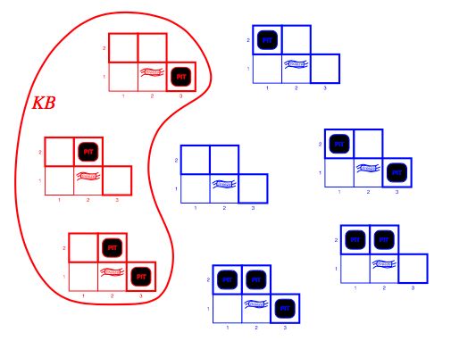
Wumpus models
KB = wumpus world rules + observations (percepts)
Percepts = breeze([1,2]) , nothing([1,1])
Solid red line = all of the models in which KB is true = M(KB)
The state of the world represented by KB is consistent with the model

Slide 22
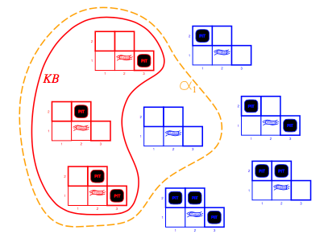
Wumpus models
α1
KB = wumpus-world rules + percepts
Assertion α1 = “[2,1] is safe”
Dotted line is M(α1) = Set of all models in which α1 holds true.
Then we can say that KB |= α1
In every model in which KB is true, α1 is also true. ➔ Proof by model checking
Thus: α1 is consistent with KB → “α1 is derivable from KB via model checking”

Slide 23
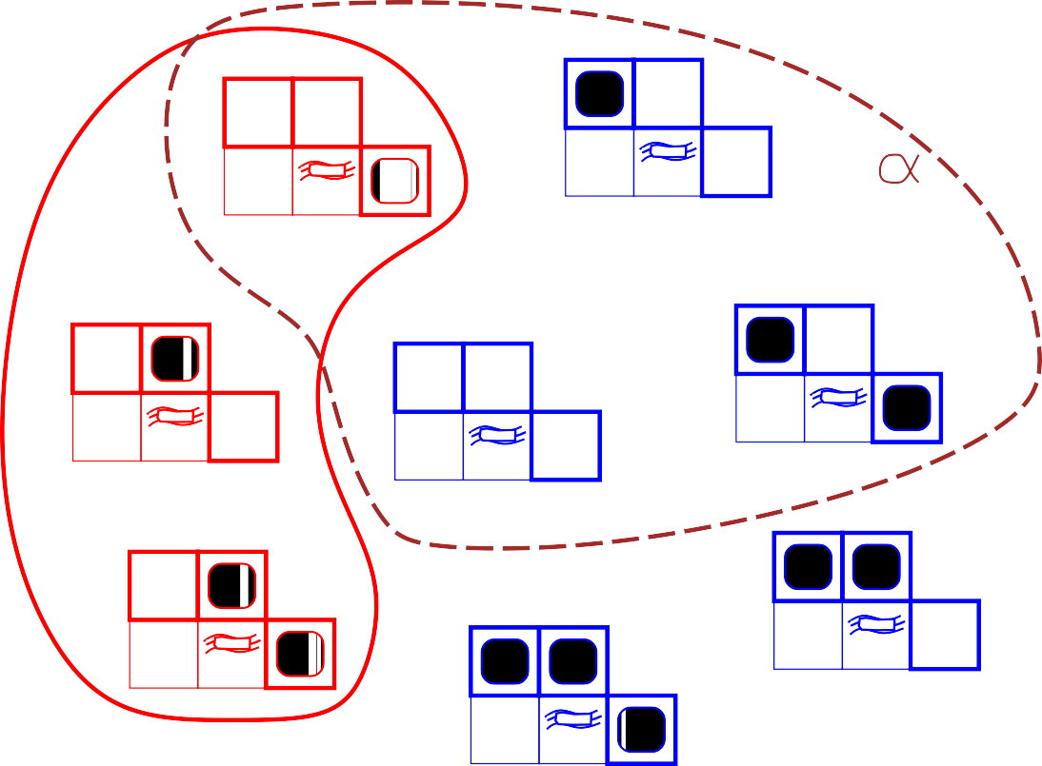
Wumpus models
2
2
PIT
1
Breeze
PIT
1
Breeze
α2
KB
1
2
3
1
2
3
2
PIT
2
PIT
2
1
Breeze
PIT
1
Breeze
1
Breeze
1
2
3
1
2
3
1 2
3
2
PIT
2
PIT
PIT
1
Breeze
PIT
1
Breeze
2
PIT
PIT
1
2
3
1
2
3
1
Breeze
PIT
1
2
3
Now let’s consider another case:
KB = wumpus-world rules + observations again, same as before
α2 = “[2,2] is safe”
Model checking shows that KB does not entail α2
Can not conclude there is no pit in [2,2]
But also doesn’t prove that there is one. Logical facts are simply inconclusive.

Slide 24
Logical Inference
Model checking is one possible algorithm for logical inference
Plan: generate and test. Brute force.
Generate all possible models that could exist
Check that goal proposition (i.e. α) is true in all models in which KB is true
KB |– _{i} α → “sentence α can be derived from KB by procedure i”
KB |– _{mc} α1 = “goal fact α1 can be derived from KB by model checking”
Metaphor: “Logical consequences” of KB are a haystack; α is a needle.
Entailment = needle is in haystack: KB |= α (it’s in there somewhere)
inference = finding the needle, i.e., proving the entailment
Soundness: Inference algorithm i is sound if
whenever KB |– _{i} α, it is also true that KB |= α
Desirable! Unsound inference algo shows things entailed that aren’t!
Completeness: i is complete if
whenever KB |= α, it is also true that KB |– _{i} α
Desirable! A complete inference algo can derive any sentence (goal fact) that is entailed.

Slide 25
Propositional logic: Syntax
Thus far: General logical concepts. Let’s get concrete...
Propositional logic is the simplest logic
Very basic, illustrates foundational ideas
So simple → also quite limiting. We’ll need more power eventually...
The proposition symbols P1, P2 simplest possible atomic sentences
The basic building blocks of propositional logic
Each represent a specific fact (e.g. W_{1,2}) that can be true or false
Can be combined to form more complex sentences:
If S is a sentence, ¬S is a sentence (negation)
If S1 and S2 are sentences, S1 ∧ S2 is a sentence (conjunction)
If S1 and S2 are sentences, S1 ∨ S2 is a sentence (disjunction)
If S1 and S2 are sentences, S1 ⇒S2 is a sentence (implication)
If S1 and S2 are sentences, S1 ⇔S2 is a sentence (biconditional)

Slide 26
Propositional Logic: Semantics
Each model specifies true/false for each proposition symbol
Ex: ← Pit in [3,1]. No pit in [2,2] and [1,2]
With these three symbols: 8 possible models. Easily enumerated.
Semantics: Rules for evaluating truth with respect to some model m
For logical sentences S_{i}:
Simple recursive process evaluates arbitrary sentence
E.g.: ¬P_{1,2} ∧ (P_{2,2} ∨ P_{3,1}) = true ∧ (false ∨ true) = true ∧ true = true
P_{1,2} P_{2,2} P_{3,1}
False False True
¬S | is true iff | S |  | is false
S₁ ∧ S₂ | is true iff | S₁ |  | is true and | S₂ |  | is true
S₁ ∨ S₂ | is true iff | S₁ |  | is true or | S₂ |  | is true
S₁ ⇒ S₂ | is true iff | S₁ |  | is false or | S₂ |  | is true
i.e., | is false iff | S₁ |  | is true and | S₂ |  | is false
(!!) i.e., | is true if | S₁ |  | is false and | S₂ |  | T or F
S₁ ⇔ S₂ | is true iff | S₁ ⇒ | S₂ | is true and | S₂⇒ | S₁ | is true

Slide 27

Complete truth tables for connectives
P false | Q false | ¬P true | P ∧ Q false | P ∨ Q false | P ⇒Q true | P ⇔Q
false | true | true | false | true | true | false
true | false | false | false | true | false | false
true | true | false | true | true | true | true
true
Interesting to note:
Implication (⇒). Non-intuitive: False only when P is true and Q is false.
Biconditional (⇔). “co-variance”: True when both have same truth state.
Wumpus world sentences:
Let P_{i,j} be true if there is a pit in [i, j].
Let B_{i,j} be true if there is a breeze in [i, j].
Then: ¬P_{1,1} ∧ ¬B_{1,1} ∧ B_{2,1} ➔ “no pit or breeze in [1,1], breeze in [2,2]
How about: “Pits cause breezes in adjacent squares”?
Not possible in propositional logic. Can only state specific facts.
B_{1,1} ⇔ (P_{1,2} ∨ P_{2,1}) , B_{2,1} ⇔ (P_{1,1} ∨ P_{2,2} ∨ P_{3,1}), etc. etc.
“A square is breezy if and only if there is an adjacent pit” – stated for each square!

Slide 28
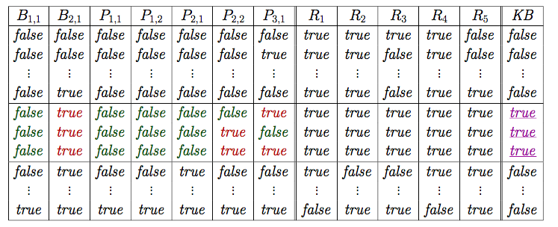
Truth tables for inference
Proposition Symbols
Models
Wumpus KB (what we know):
R1: ¬P_{1,1} no pit in [1,1]
R2: B_{1,1} ⇔ (P_{2,1} ∨ P_{1,2}) B[1,1] only if pit in...
R3: B_{2,1} ⇔ (P_{1,1} ∨ P_{2,2} ∨ P_{3,1})
R4: ¬B_{1,1} no breeze in [1,1]
R5: B_{2,1} breeze in [2,1]
Model Checking for entailment:
KB is true if all rules (Rs) are true
True in just three models
Some α is true if consistent across all true KB models
α=P_{2,1} → false in all three → deduce no pit [2,1]
α=P_{2,2} → Inconclusive...

Slide 29
Inference by enumeration
Depth-first enumeration of all models is sound and complete
function TT-Entails?(KB, α) returns true or false
inputs: KB, the knowledge base, a sentence in propositional logic
α, the query, a sentence in propositional logic
symbols ← a list of the proposition symbols in KB and α
return TT-Check-All(KB, α, symbols, [ ])
function TT-Check-All(KB, α, symbols, model) returns true or false
if Empty?(symbols) then
if PL-True?(KB, model) then return PL-True?(α, model)
else return true
else do
P ← First(symbols); rest ← Rest(symbols)
return TT-Check-All(KB, α, rest, Extend(P , true, model )) and
TT-Check-All(KB, α, rest, Extend(P , false , model ))
O(2^{n}) for n symbols; problem is co-NP-complete

Slide 30
Propositional Theorem Proving
So far: The only algorithm for proving entailment is model-checking
Have set of logical sentences KB, want to know if α= P_{1,2} is entailed
→ generated 2^{Pi} models, check M(KB) ⊆ M(α)
Gets expensive fast as the number logical facts (P_{i}) grows!
Propositional Theorem Proving
Construct a proof of a sentence without consulting models
Search through a space of possible symbols transformations to connect KB with α.
Need three key concepts first:
Validity. A sentence is valid only if true in all models (tautology).
Ex. True, A ∨¬A, A⇒A, (A ∧ (A⇒B))⇒B
Gives us deduction theorem: A |= B if and only if A⇒B is valid.
Can decide if A |= B by checking the A⇒B true in all models!
Satisfiability. A sentence satisfiable if it’s true in some model.
Earlier KB (R₁ through R₅) was satisfiable because true in 3 models.

Slide 31
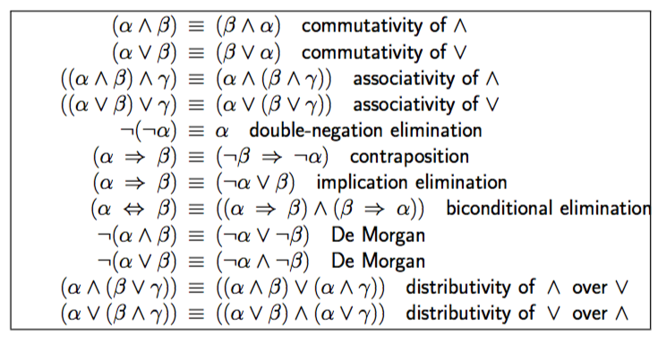
Propositional Theorem Proving
Last concept: Logical equivalence
To logical sentences A and B are equivalent if M(A)=M(b).
Meaning: A equivalent to B iff each entails the other → A |= B and B |= A
There are many equivalences established by standard rules of logic:

Slide 32
Propositional Theorem Proving
Validity and satisfiability are connected. Useful:
A is valid iff ¬A is unsatisfiable; A is satisfiable iff ¬A is not valid.
Thus: KB |= α if and only if (KB ∧ ¬α) is unsatisfiable
Basis for proof by contradiction! → Assume α false, show unsatisfiable
Plus we have a number of standard logical inference rules:
Modus Ponens: – And Elimination:
Plus: all of the logical equivalences can be used as inference rules
(α ⇒ β) Ξ (¬α ∨ β) (implication elimination)
becomes
α ⇒ β, α β
α ∧ β β
(α ⇒ β)
(¬α ∨ β)
and
(¬α ∨ β)
(α ⇒ β)

Slide 33
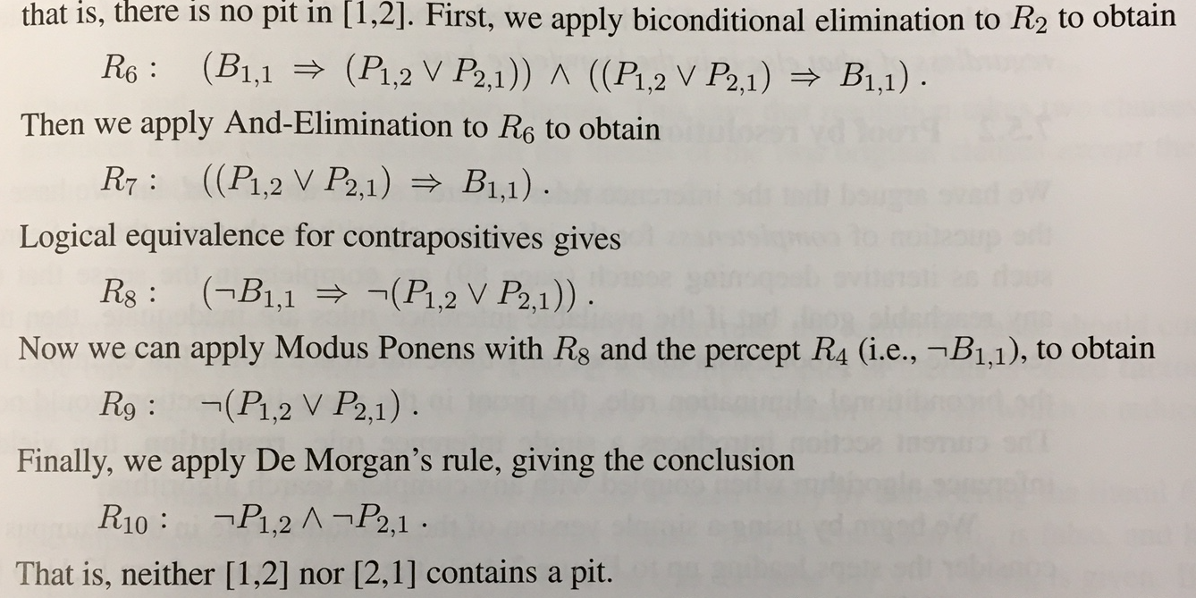
Propositional Theorem Proving Example:
Wumpus KB
R1: ¬P_{1,1}
R2: B_{1,1} ⇔ (P_{2,1} ∨ P_{1,2})
R3: B_{2,1} ⇔ (P_{1,1} ∨ P_{2,2} ∨ P_{3,1})
R4: ¬B_{1,1}
R5: B_{2,1}
Found this proof “manually”, by hand
Needed cleverness and insight to find goal in directed manner.
Could apply any search algo! Brute force!
Initial state: initial KB
Actions: applying all inference rules to all sentences → new Kb_{i}
Result: Add bottom half of inference rule to KB_{i} to get Kb_{i+1}
Goal: goal state is when some KB_{i} generated contains target fact/query

Slide 34
Propositional Theorem Proving
Searching for proofs in inference space is alternative to model checking
Often much more efficient: ignores facts (P_{i}’s) irrelevant to target goal
Especially useful when the model space is complex (lots of P_{i}’s)
Searching for proofs is sound ... but is it complete?
Search algorithms like IDS are complete...if a goal is reachable.
Highly dependent on completeness of set of inference rules
Missing some critical inference rule → proof will not succeed.
Resolution Theorem Proving solves this problem
Proof with a single inference rule (resolution)
Guaranteed complete algorithm if used with any complete search algorithm
But: requires all of KB to be conjunctions of clauses (see book disc.)
Clause = a disjunction of literals, e.g. P₁ ∨ P₂ ∨ P₃ ∨ P₄
Luckily: any set of propositional logic can be turned into conjunctive normal form
For any sentences A and B in propositional logic, a resolution theorem prover can decide if A |= B.

Slide 35
Conversion to CNF
Plan: Apply various equivalences to “massage” into CNF
Example:
B1,1 ⇔ (P1,2 ∨ P2,1)
1. Eliminate ⇔, replacing α ⇔ β with (α ⇒β) ∧ (β ⇒ α).
(B1,1
⇒(P_{1,2} ∨ P_{2,1})) ∧ ((P_{1,2} ∨ P_{2,1}) ⇒ B_{1,1})
Eliminate ⇒, replacing α ⇒ β with ¬α ∨ β.
(¬B_{1,1} ∨ P_{1,2} ∨ P_{2,1}) ∧ (¬(P_{1,2} ∨ P_{2,1}) ∨ B_{1,1})
Move ¬ inwards using de Morgan’s rules and double-negation:
(¬B_{1,1} ∨ P_{1,2} ∨ P_{2,1}) ∧ ((¬P_{1,2} ∧ ¬P_{2,1}) ∨ B_{1,1})
Apply distributivity law (∨ over ∧) and flatten:
(¬B_{1,1} ∨ P_{1,2} ∨ P_{2,1}) ∧ (¬P_{1,2} ∨ B_{1,1}) ∧ (¬P_{2,1} ∨ B_{1,1})
Not always super easy! But can be brute-forced with search!

Slide 36
Resolution Theorem Proving
Basically: works by removing (resolving) contradictory literals.
Example: Given KB:
R1: ¬P_{1,1}
R2: ¬P_{1,3}
R3: ¬P_{2,2}
R4: P_{1,1} ∨ P_{3,1} ∨ P_{2,2}
Then:
R1 resolves with R4 to give R5: (¬P_{1,1}∨ P_{1,1}) ∨ P_{3,1} ∨ P_{2,2} = P_{3,1} ∨ P_{2,2}
R2 resolves with R5 to give R6: P_{3,1}
At end of resolution we have inferred a specific fact!
Full Resolution inference rule:
where a₂ and m₂ are complementary literals.
So each resolution step:
Considers a logical sentence in CNF (i.e. two OR’d clauses in your KB)
Resolves to a new clause → with complementary literals removed.
(a₁∨ a₂ ∨ a₃.. ∨a_{n}) ∧ (m₁∨ m₂∨ m₃ ∨... ∨ m_{n})
(a₁∨ a₃.. ∨a_{n}) ∧ (m₁∨ m₃ ∨... ∨ m_{n})

Slide 37
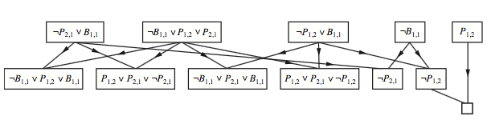
Algorithm: Resolution Theorem Proving
Idea: Proof by contradiction
Want to show that KB |= α → so show that (KB ∧ ¬α) is unsatisfiable
Plan:
Convert (KB ∧ ¬α) into CNF
Exhaustively apply resolution to all pairs of clauses with complementary literals
Continue process until:
There are no new resolutions to make…but some clauses remain
Could not show unsatisfiability → KB does not entail α
Two clauses resolve to empty clause
a₁∨ a₁ resolves to { } = essentially “false”
Unsatisfiability is shown → KB |= α
Example:
Notes:
Here is another example: http://www.ai.mit.edu/courses/6.825/fall02/pdf/6.825-lecture-07.pdf

Slide 38
Inference with Horn Clauses
Resolution theorem is complete ... but also complex
Many practical cases: Don’t need all this power (and complexity!)
Inference with Horn clauses
If your KB can be expressed within a restricted rule format
Horn clause: Disjunction in which at most one element is positive
Ex: (¬L_{1,1} ∨ ¬Breeze ∨ B_{1,1}) ; ¬B_{2,2}
No positive literals = turns into a fact or goal clause
One positive: Can be rewritten as implications: (L_{1,1} ∧ Breeze) ⇒ B_{1,1}
LHS= premise (body); RHS = consequent (head)
Can be use in forward/backward chaining proof algorithm
These algorithms are very natural and run in linear time !

Slide 39
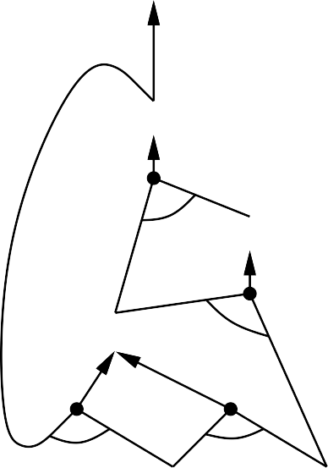
Forward Chaining
Idea: Work forward from the known facts to try to reach the target goal
Start with known facts → true by definition
Repeat:
fire any rule whose premises are satisfied in the KB,
add its conclusion to the KB
Until: query is found (proved!); or no more facts added to KB (stalled, failed)
Visually: Can represent the H-clauses in the KB as a directed graph.
Forward chaining: start with facts and traverse the graph
P ⇒Q
Q
L ∧ M ⇒ P
P
B ∧ L ⇒ M
A ∧ P ⇒ L
M
A ∧ B ⇒ L A
B
L
A
B

Slide 40
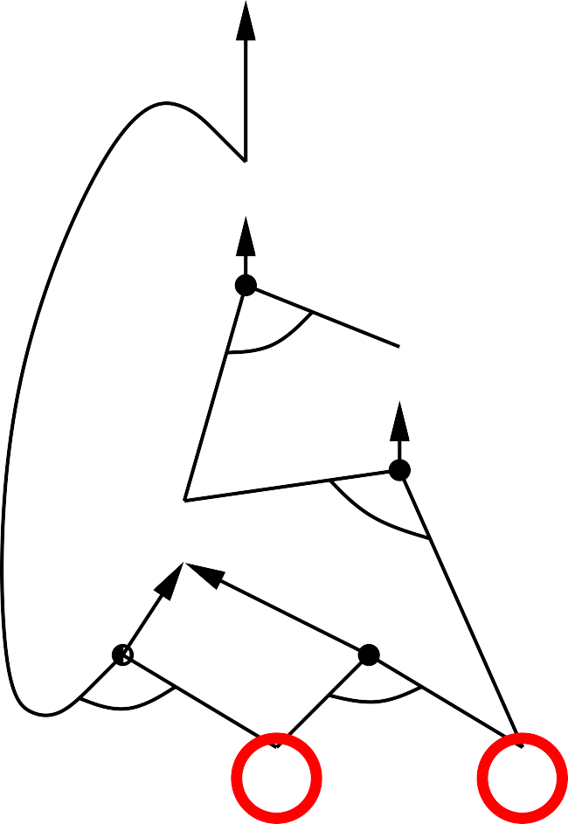
Forward chaining example
P ⇒Q
Q
P
M
L
L ∧ M ⇒ P
B ∧ L ⇒ M
A ∧ P ⇒ L
A ∧ B ⇒ L A
B
A
B

Slide 41
Backward Chaining
Idea: work backwards from the query q:
The Plan: A simple (recursive!) algorithm
Initialize: Push q on the “proof stack” = things to be proven
Repeat:
Pop next fact q_{i} to prove off proof stack
Check if q_{i} is known to be true (fact in KB). If so, continue
Else search KB for rule R_{j} with head = q_{i} (a way to prove q_{i} )
Add premises of R_{j} to the proof stack
Until:
Proof stack is empty (success); or
no change in proof stack
Avoid loops: check if new subgoal is already on the goal stack
Avoid repeated work: check if new subgoal
has already been proved true, or
has already failed
Visually: Can represent the H-clauses in the KB as a directed graph.
Backward chaining: start with target goal and traverse the graph
Done if/when all leaves of search are facts

Slide 42
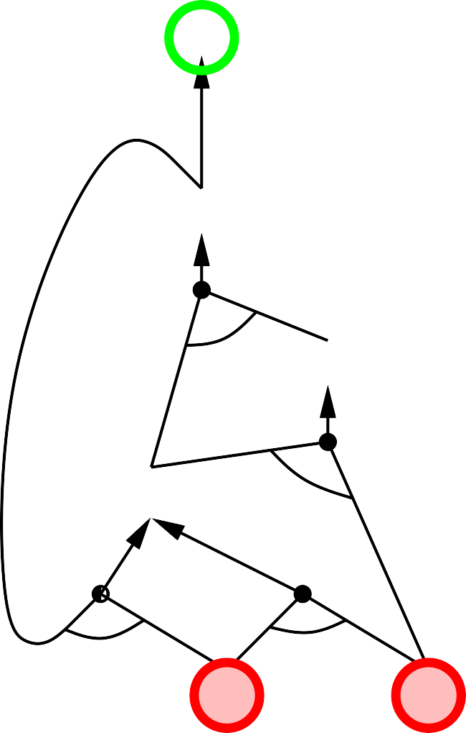
Backward chaining example
P ⇒Q
Q
P
M
L
L ∧ M ⇒ P
Stack:
B ∧ L ⇒ M
A ∧ P ⇒ L
A ∧ B ⇒ L A
B
A
B

Slide 43
Summary: Inference Approaches
Model Checking
Simple, complete ... But exponential in number of symbols (features) in KB
Proposition Theorem proving by inference rules (Modus Ponens, etc.)
Implemented as search though proof space to find goal
Could be incomplete!
Resolution theorem proving
Universal and guaranteed complete
... but also arduous and complex
Forward/Backward Chaining with Horn clauses
Possible in contexts where rules can be massaged in to Horn-clause form
Complete, straightforward, and efficient (linear time in size of KB)
FC: data-driven. Good for routine, automatic, continuous processing
Non-goal directed, e.g., dynamic facial recognition, routine decision-making
May do lots of inferring that is irrelevant to proving some goal
BC: goal-driven. Good for answering specific questions (posed as goals)
Complexity often much less than linear in size of KB
Basis for Prolog language

Slide 44
Summary: Intro to Logical Agents
Logical agents apply inference to a knowledge base to derive new information and make decisions
Basic concepts of logic:
syntax: formal structure of sentences
semantics: truth of sentences wrt models
entailment: necessary truth of one sentence given another
inference: deriving sentences from other sentences
soundness: derivations produce only entailed sentences
completeness: derivations can produce all entailed sentences
Wumpus world requires the ability to represent partial and negated information, reason by cases, etc.
Propositional logic: Great to intro concepts…but lacks expressive power
Recall difficulty of “Any square with a breeze has a pit in it’s neighbor”
Need something that can express these broad, general truths!

Slide 45

α β ⊆ ¬ ⇒ |= ∧ ∨ ⇔

