Slide 1
Inference in first-order logic
Chapter 9

Slide 2
Outline
♦ Reducing first-order inference to propositional inference
♦ Unification
♦ Generalized Modus Ponens
♦ Forward and backward chaining
♦ Logic programming
♦ Resolution

Slide 3
Reasoning in FOL
We know how to efficiently represent complex worlds in FOL
Quantification + variables → FOL much more flexible, compact
We know how to do inference in propositional logics
Model-checking OR inference rules OR resolution
Can be arduous, but it’s fairly mechanical. Sound and complete
Size of problem becomes impossible as complexity of world grows.
Would like to use FOL...and do inference in FOL.
Quantification + variables → make things much more complex.
Question: How can we reason in FOL?
We can convert FOL to propositional → use propositional inferencing
We can develop new ideas to deal with instantiation/variables
Reasoning directly in FOL!

Slide 4
Universal Instantiation (UI)
Goal: Get rid of universal quantifiers
Plan: Logically equivalent replacement
Consider all facts that a universally quantified sentence could imply.
Replace the quantified sentence by all implied facts.
Example. Consider:
∀x King(x) ∧ Greedy(x) ⇒ Evil(x)
What are all the literal facts that this could imply?
King(John) ∧ Greedy(John) ⇒ Evil(John)
King(Richard) ∧ Greedy(Richard) ⇒ Evil(Richard)
King(Father(John)) ∧ Greedy(Father(John)) ⇒ Evil(Father(John))
Etc. etc. etc. → “∀x” means “true for every possible literal substitution
Every possible instantiation of a universally quantified sentence is entailed by it:
So: for a given FOL fact base: substitute all ∀x with literal facts implied.
∀ v α
Subst({v/g}, α)
for any variable v and ground term g

Slide 5
Existential Instantiation (EI)
Goal: Get rid of existential quantifiers
Plan: Logically equivalent replacement
Example. Consider:
∃x Crown(x) ∧ OnHead(x, John)
What exactly does this mean?
There is some literal in the world for which this is true.
But for which literal? What if we don’t know it yet? Or anonymous: mom(Kate)
Answer: create a special unique anonymous literal: Skolem Constant
So: Crown(C1) ∧ OnHead(C1, John), where C1 is a new Skolem symbol
So, to get rid of quantification:
UI can be applied several times to add new sentences
the new KB is logically equivalent to the old
EI can be applied once to replace the existential sentence
the new KB is not strictly equivalent to the old...but is satisfiable iff the old KB was satisfiable
∃ v α
Subst({v/k}, α)
For any sentence α, variable v, and constant symbol k
that does not appear elsewhere in the knowledge base

Slide 6
Example: Reduction to Propositional Inference
Suppose the KB contains just the following:
∀x King(x) ∧ Greedy(x) ⇒ Evil(x)
King(John)
Greedy(John)
Brother(Richard, John)
Instantiating the universal sentence in all possible ways, we have
King(John) ∧ Greedy(John) ⇒ Evil(John)
King(Richard) ∧ Greedy(Richard) ⇒ Evil(Richard)
King(John)
Greedy(John)
Brother(Richard, John)
The new KB is propositionalized:
proposition symbols: King(John), Greedy(John), Evil(John), King(Richard) etc.
Note: not predicates! Consider them monolithic symbols like B_{1,1} and W_{3,2}

Slide 7
Analysis: Reducing FOL to Propositional Inference
Claim: a sentence α is entailed by new KB iff entailed by original KB
Claim: every FOL KB can be propositionalized so as to preserve entailment
Idea! Do inference in FOL KB by:
Propositionalize KB and query
apply propositional resolution, return result
Problem: function symbols: for any input, yield an output entity
Can refer to infinitely many entities, e.g., Father(Father(Father(John)))
Propositionalized KB is essentially infinite!
Theorem: Herbrand (1930):
If a sentence α is entailed by an FOL KB, it is entailed by a finite subset of the propositional KB
Yields new Idea: For n = 0 to ∞ do
create a propositional KB by instantiating with depth-n terms
see if α is entailed by this KB
Basically the IDS concept applied to proving entailment
Problem: works if α is entailed... But never stop looking if α is not entailed
Theorem: Turing (1936), Church (1936), entailment in FOL is semidecidable

Slide 8
Other practical problems with propositionalization
Another problem: Propositionalization generates lots of irrelevant sentences.
E.g., from:
∀x King(x) ∧ Greedy(x) ⇒ Evil(x)
King(John), Prince(Andrew), Lady(Di), Stodgy(Mum)
∀y Greedy(y)
Brother(Richard, John)
it seems instantly obvious to human readers that Evil(John),
...but propositionalization produces lots of facts that are irrelevant:
Greedy(Richard), Greedy(Andrew), Greedy(Di), Greedy(Mum), etc
With p k-ary predicates and n constants, there are p·n^{k} instantiations!
And with function symbols, it gets much much worse!
We need a more straightforward way to inference directly in FOL !!!

Slide 9
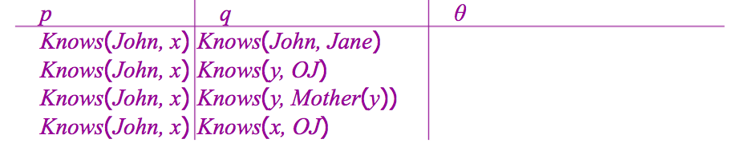
Unification
Observation:
Given previous KB, we can get the inference Evil(John) immediately... if we can find a substitution θ such that King(x) and Greedy(x) match King(John) and Greedy(y)
θ = {x/John, y/John} works!
Definition: Unify(α, β) = θ if subst(θ, α) = subst(θ, β)
Two terms α and β unify, if you can find a variable binding θ that, when substituted in, makes the terms identical
Example: Unify the following sentences:
The last one fails...but shouldn’t. What’s going on?
The ‘x’ in Knows(John,x) is not necessarily same as ‘x’ in Knows(x,OJ)
Both are just variables...could be bound to anything.
Standardize apart: Variables in each clause made unique: Knows(John, x₂₁₇)

Slide 10
Generalized Modus Ponens (GMP)
We can leverage unification to generalize Modus Ponens Inference!
Reminder: Modus ponens was
But now suppose that p_{i} and q are all parameterized by variables
If there is some set of bindings θ that makes all sentences in the premise of an implication identical to sentences already in the KB, then we can assert the conclusion.
Or formally:
So then:
Note that GMP is used with:
KB of definite clauses (exactly one positive term)
All variables are assumed to be universally quantified
α ⇒ β, α β
Or, more generally:
p₁, p₂, p₃...p_{n}, (p₁ ∧ p₂ ∧ ... ∧p_{n}) ⇒ q)
q
p’₁, p’₂, p’₃...p’_{n}, (p₁ ∧ p₂ ∧ ... ∧p_{n}) ⇒ q)
subst(θ,q)
where subst(θ,p_{i}’) = subst(θ,p_{i}) for all i
King(John), Greedy(y), (King(x) ∧Greedy(y)) ⇒ Evil(x))
Evil(John)
for θ={x/John, y/John}

Slide 11
Example: Putting it together
The law says that it is a crime for an American to sell weapons to hostile nations. The country Nono, an enemy of America, has some missiles, and all of its missiles were sold to it by Colonel West, who is American.
Prove that Col. West is a criminal

Slide 12
Example: Putting it together (cont.)
The law says that it is a crime for an American to sell weapons to hostile nations. The country Nono, an enemy of America, has some missiles, and all of its missiles were sold to it by Colonel West, who is American.
Prove that Col. West is a criminal
. . . it is a crime for an American to sell weapons to hostile nations:

Slide 13
Example: Putting it together (cont.)
The law says that it is a crime for an American to sell weapons to hostile nations. The country Nono, an enemy of America, has some missiles, and all of its missiles were sold to it by Colonel West, who is American.
Prove that Col. West is a criminal
. . . it is a crime for an American to sell weapons to hostile nations:
American(x)∧Weapon(y)∧Sells(x, y, z)∧Hostile(z) ⇒ Criminal(x)
Nono . . . has some missiles

Slide 14
Example: Putting it together (cont.)
. . . it is a crime for an American to sell weapons to hostile nations:
American(x)∧W eapon(y)∧Sells(x, y, z)∧Hostile(z) ⇒ Criminal(x)
Nono . . . has some missiles, i.e., ∃ x Owns(Nono, x) ∧ Missile(x): Owns(Nono, M₁) and Missile(M₁)
. . . all of its missiles were sold to it by Colonel West
The law says that it is a crime for an American to sell weapons to hostile nations. The country Nono, an enemy of America, has some missiles, and all of its missiles were sold to it by Colonel West, who is American.
Prove that Col. West is a criminal

Slide 15
Example: Putting it together (cont.)
. . . it is a crime for an American to sell weapons to hostile nations:
American(x)∧W eapon(y)∧Sells(x, y, z)∧Hostile(z) ⇒ Criminal(x)
Nono . . . has some missiles,
i.e., ∃ x Owns(Nono, x) ∧ Missile(x)...and applying EI
Owns(Nono, M₁) and Missile(M₁)
. . . all of its missiles were sold to it by Colonel West
∀x Missile(x) ∧ Owns(Nono, x) ⇒ Sells(West, x, Nono)
Missiles are weapons:
The law says that it is a crime for an American to sell weapons to hostile nations. The country Nono, an enemy of America, has some missiles, and all of its missiles were sold to it by Colonel West, who is American.
Prove that Col. West is a criminal

Slide 16
Example: Putting it together (cont.)
. . . it is a crime for an American to sell weapons to hostile nations:
American(x)∧W eapon(y)∧Sells(x, y, z)∧Hostile(z) ⇒ Criminal(x)
Nono . . . has some missiles, i.e.,
∃ x Owns(Nono, x) ∧ Missile(x):
Owns(Nono, M₁) and Missile(M₁)
. . . all of its missiles were sold to it by Colonel West
∀ x Missile(x) ∧ Owns(Nono, x) ⇒ Sells(West, x, Nono)
Missiles are weapons:
Missile(x) ⇒ Weapon(x)
An enemy of America counts as “hostile”:
The law says that it is a crime for an American to sell weapons to hostile nations. The country Nono, an enemy of America, has some missiles, and all of its missiles were sold to it by Colonel West, who is American.
Prove that Col. West is a criminal

Slide 17
Example: Putting it together (cont.)
. . . it is a crime for an American to sell weapons to hostile nations:
American(x)∧W eapon(y)∧Sells(x, y, z)∧Hostile(z) ⇒ Criminal(x)
Nono . . . has some missiles,
i.e., ∃ x Owns(Nono, x) ∧ Missile(x):
Owns(Nono, M₁) and Missile(M₁)
. . . all of its missiles were sold to it by Colonel West
∀x Missile(x) ∧ Owns(Nono, x) ⇒ Sells(West, x, Nono)
Missiles are weapons:
Missile(x) ⇒ Weapon(x)
An enemy of America counts as “hostile”:
Enemy(x, America) ⇒ Hostile(x)
West, who is American . . .
American(West)
The country Nono, an enemy of America . . .
Enemy(Nono, America)
The law says that it is a crime for an American to sell weapons to hostile nations. The country Nono, an enemy of America, has some missiles, and all of its missiles were sold to it by Colonel West, who is American.
Prove that Col. West is a criminal

Slide 18
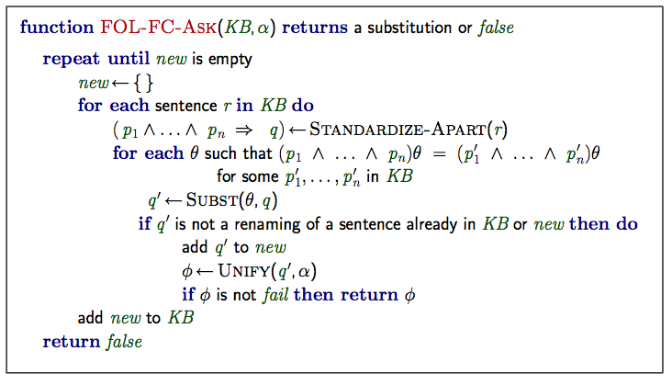
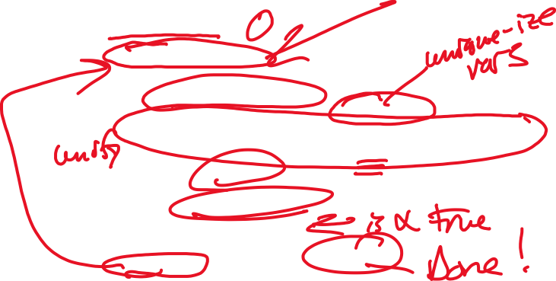
Inference algorithms: Forward chaining
Similar to propositional logic, we can infer new facts using forward chaining

Slide 19
Forward chaining proof
First we have the known facts...
American(West)
Missile(M1)
Owns(Nono,M1)
Enemy(Nono,America)

Slide 20
Forward chaining proof
Forward chaining with:
∀x Missile(x) ∧ Owns(Nono, x) ⇒ Sells(West, x, Nono)
Missile(x) ⇒ Weapon(x)
Enemy(x, America) ⇒ Hostile(x)
Weapon(M1)
Sells(West,M1,Nono)
Hostile(Nono)
American(West)
Missile(M1)
Owns(Nono,M1)
Enemy(Nono,America)

Slide 21
Forward chaining proof
Criminal(West)
Weapon(M1)
Sells(West,M1,Nono)
Hostile(Nono)
American(West)
Missile(M1)
Owns(Nono,M1)
Enemy(Nono,America)
Continuing to infer with:
American(x)∧W eapon(y)∧Sells(x, y, z)∧Hostile(z) ⇒ Criminal(x)

Slide 22
Forward Chaining Proof
Properties of Forward-chaining proof
Sound and complete for first-order definite clauses
Proof similar to propositional proof.
For Datalog (first-order definite clauses + no functions), FC terminates for Datalog in poly iterations
There at most p · n^{k} literals = upper bound on number of iterations.
May not terminate in general if α is not entailed. Fn’s generate infinite new facts.
This is unavoidable: entailment with definite clauses is semi-decidable
Efficiency of forward chaining proof. Sources of inefficiency
Matching conjunctive premises to all possible literals
Can often order conjunctive clauses to quickly constrain literals.
Redundant matching of all rules on each cycle
Simple observation: no need to match a rule on iteration k if a premise wasn’t added on iteration k − 1 ⇒ match only those rules whose premise contains a newly added literal
Waste time generating facts irrelevant to goal
Inherent to forward chaining. Backward chaining more efficient for goal-directed.
Magic sets: Can dynamically rewrite rules to “specialize” them toward desired goal

Slide 23
Backward chaining algorithm
For query-oriented (goal-directed) proofs, backward chaining is more natural
Note that the algorithm is depth-first, recursive.
function FOL-BC-Ask(KB, goals, θ) returns a set of substitutions
inputs: KB, a knowledge base
goals, a list of conjuncts forming a query (θ already applied)
θ, the current substitution, initially the empty substitution { }
local variables: answers, a set of substitutions, initially empty
if goals is empty then return {θ} ;; if I’ve proven everything, I’m done
q ^{t} ← Subst(θ, First(goals)) ;; else grab the first goal in list and try to prove
for each sentence r in KB
where Standardize-Apart(r) = ( p₁ ∧ . . . ∧ p_{n} ⇒ q)
and θ^{t} ← Unify(q, q ^{t}) succeeds ;; unify goal with head of rule
new goals ← [ p₁, . . . , p_{n}|Rest(goals)] ;; add RHS of rule to goal stack
;; now plug latest bindings made into goal stack and call recursively...
answers ← FOL-BC-Ask(KB, new goals, Compose(θ^{t}, θ)) ∪ answers
return answers
Returns a set of substitutions
All possible sets of bindings for which entailment holds
Could also return an “iterator”: new set of bindings each time you ask

Slide 24
Backward chaining example
“Prove that Colonel West is a criminal”
Criminal(West)
American(x)∧W eapon(y)∧Sells(x, y, z)∧Hostile(z) ⇒ Criminal(x)
Owns(Nono, M₁) and Missile(M₁)
∀x Missile(x) ∧ Owns(Nono, x) ⇒ Sells(West, x, Nono)
Missile(x) ⇒ Weapon(x)
Enemy(x, America) ⇒ Hostile(x)
American(West)
Enemy(Nono, America)

Slide 25
Backward chaining example
Criminal(West)
{x/West}
American(x)
Weapon(y)
Sells(x,y,z)
Hostile(z)
American(x)∧W eapon(y)∧Sells(x, y, z)∧Hostile(z) ⇒ Criminal(x)
Owns(Nono, M₁) and Missile(M₁)
∀x Missile(x) ∧ Owns(Nono, x) ⇒ Sells(West, x, Nono)
Missile(x) ⇒ Weapon(x)
Enemy(x, America) ⇒ Hostile(x)
American(West)
Enemy(Nono, America)

Slide 26
Backward chaining example
Criminal(West)
{x/West}
American(West)
Weapon(y)
Sells(x,y,z)
Hostile(z)
{ }
American(x)∧W eapon(y)∧Sells(x, y, z)∧Hostile(z) ⇒ Criminal(x)
Owns(Nono, M₁) and Missile(M₁)
∀x Missile(x) ∧ Owns(Nono, x) ⇒ Sells(West, x, Nono)
Missile(x) ⇒ Weapon(x)
Enemy(x, America) ⇒ Hostile(x)
American(West)
Enemy(Nono, America)

Slide 27
Backward chaining example
Criminal(West)
{x/West}
American(West)
Weapon(y)
Missile(y)
Hostile(Nono)
Sells(West,M1,z)
Hostile(z)
Sells(x,y,z)
{ }
American(x)∧W eapon(y)∧Sells(x, y, z)∧Hostile(z) ⇒ Criminal(x)
Owns(Nono, M₁) and Missile(M₁)
∀x Missile(x) ∧ Owns(Nono, x) ⇒ Sells(West, x, Nono)
Missile(x) ⇒ Weapon(x)
Enemy(x, America) ⇒ Hostile(x)
American(West)
Enemy(Nono, America)

Slide 28
Backward chaining example
Criminal(West)
{x/West, y/M1}
American(West)
Weapon(y)
Missile(y)
Hostile(Nono)
Sells(West,M1,z)
Hostile(z)
Sells(x,y,z)
{ }
{ y/M1}
American(x)∧W eapon(y)∧Sells(x, y, z)∧Hostile(z) ⇒ Criminal(x)
Owns(Nono, M₁) and Missile(M₁)
∀x Missile(x) ∧ Owns(Nono, x) ⇒ Sells(West, x, Nono)
Missile(x) ⇒ Weapon(x)
Enemy(x, America) ⇒ Hostile(x)
American(West)
Enemy(Nono, America)

Slide 29
Backward chaining example
Criminal(West)
{x/West, y/M1, z/Nono}
American(West)
Weapon(y)
Missile(y)
Sells(West,M1,z)
z/Nono }
Hostile(z)
{ }
{
Missile(M1)
Owns(Nono,M1)
{ y/M1}
American(x)∧W eapon(y)∧Sells(x, y, z)∧Hostile(z) ⇒ Criminal(x)
Owns(Nono, M₁) and Missile(M₁)
∀x Missile(x) ∧ Owns(Nono, x) ⇒ Sells(West, x, Nono)
Missile(x) ⇒ Weapon(x)
Enemy(x, America) ⇒ Hostile(x)
American(West)
Enemy(Nono, America)

Slide 30
Backward chaining example
Criminal(West)
{x/West, y/M1, z/Nono}
American(West)
Weapon(y)
Missile(y)
Sells(West,M1,z)
z/Nono }
 | Hostile(Nono)
Enemy(Nono,America)
{ }
{
Missile(M1)
Owns(Nono,M1)
{ y/M1}
{ }
{ }
{ }
American(x)∧W eapon(y)∧Sells(x, y, z)∧Hostile(z) ⇒ Criminal(x)
Owns(Nono, M₁) and Missile(M₁)
∀x Missile(x) ∧ Owns(Nono, x) ⇒ Sells(West, x, Nono)
Missile(x) ⇒ Weapon(x)
Enemy(x, America) ⇒ Hostile(x)
American(West)
Enemy(Nono, America)

Slide 31
Backward Chaining Proof
Properties of Backward chaining proof
Depth-first recursive proof search
space is linear in size of proof
Incomplete due to infinite loops
⇒ fix by checking current goal against every goal on stack
Breaks loop...but may not solve incompleteness problem (inherent to DFS)
Inefficient due to repeated subgoals (both success and failure)
fix using caching of previous results (extra space!)
Widely used (with improvements!) for logic programming

Slide 32
Logic programming
Logic programming:
is a way to solve problems declaratively
Based directly on FOL... (using datalog semantics)
Conceptually: computation as inference on logical KBs
Logic programming
Identify problem
Assemble information
Tea break
Encode information in KB
Encode problem instance as facts
Ask queries
Find false facts
Ordinary Procedural Programming
Identify problem
Assemble information
Figure out solution
Program solution
Encode problem instance as data
Apply program to data
Debug procedural errors
Should be easier to debug Capital(NewYork, US) than x := x + 2 !

Slide 33
Prolog systems
Basis: backward chaining with Horn clauses + bells & whistles
Widely used in Europe, Japan (basis of 5th Generation project)
Compilation techniques ⇒ approaching a billion LIPS
Program = set of clauses = head :- literal₁, . . . literal_{n}.
e.g.: criminal(X) :- american(X), weapon(Y), sells(X,Y,Z), hostile(Z).
Depth-first, left-to-right backward chaining
Built-in predicates for arithmetic etc.
e.g.: X is Y*Z+3
Closed-world assumption (“negation as failure”)
e.g.: given alive(X) :- not dead(X).
alive(joe) succeeds if dead(joe) fails

Slide 34

Prolog examples
Depth-first search from a start state X:
dfs(base). % base case, known fact.
dfs(X) :- successor(X,S), dfs(S).
No need to loop over S: successor succeeds for each
Appending two lists to produce a third:
append([],Y,Y).
append([X|L],Y,[X|Z]) :- append(L,Y,Z).
Query: append([2],[4,6,8],Z).
Yields (yawn): [2,4,6,8]
query: append(A,B,[1,2]) ?
WOW!! Much more powerful than procedural functions!
Provides all possible bindings of A, B that could (when appended) yield [1,2]
A=[] B=[1,2] ; A=[1] B=[2] ; A=[1,2] B=[]

Slide 35
FOL Resolution: Brief summary
Principle: Identical to propositional resolution
Full first-order version:
where Unify(l_{i} , ¬m_{j}) = θ.
So same as before: match complemented predicates
But now: that unify with some set of bindings to be identical
For example,
with θ = {x/Ken}
To show entailment of α : Apply resolution steps to CNF (KB ∧ ¬α)
Is complete for FOL
l₁ ∨...∨ l_{k}, m₁ ∨... ∨ m_{n}
Subst(θ, (l₁ ∨...∨ l_{i−1} ∨ l_{i+1} ∨ ... ∨ l_{k} ∨ m₁ ∨ ... ∨ m_{j−1} ∨ m_{j+1} ∨ ... ∨ m_{n})
¬Rich(x) ∨ Unhappy(x) Rich(Ken)
Unhappy(Ken)

Slide 36
Conversion to CNF
Everyone who loves all animals is loved by someone:
∀ x [∀ y Animal(y) ⇒ Loves(x, y)] ⇒ [∃ y
1. Eliminate biconditionals and implications
Loves(y, x)]
∀ x [¬∀ y
¬Animal(y) ∨ Loves(x, y)] ∨ [∃ y Loves(y, x)]
2. Move ¬ inwards:
Note that: ¬∀x, p ≡ ∃ x ¬p
And that: ¬∃ x, p ≡ ∀x ¬p
So:
∀ x ∀ x | [∃ y [∃ y | ¬(¬Animal(y) ∨ Loves(x, y))] ∨ [∃ y Loves(y, x)] ¬¬Animal(y) ∧ ¬Loves(x, y)] ∨ [∃ y Loves(y, x)]
∀ x | [∃ y | Animal(y) ∧ ¬Loves(x, y)] ∨ [∃ y Loves(y, x)]

Slide 37
Conversion to CNF (contd.)
Standardize variables: each quantifier should use a different one
∀x [∃ y Animal(y) ∧ ¬Loves(x, y)] ∨ [∃ z Loves(z, x)]
Skolemize:
a more general form of existential instantiation.
Each existential variable is replaced by a Skolem function of the enclosing universally quantified variables:
Could generate any possible literal as the one that “exists”
∀x [Animal(F (x)) ∧ ¬Loves(x, F (x))] ∨ Loves(G(x), x)
Drop universal quantifiers:
[Animal(F (x)) ∧ ¬Loves(x, F (x))] ∨ Loves(G(x), x)
Distribute ∧ over ∨:
[Animal(F (x)) ∨ Loves(G(x), x)] ∧ [¬Loves(x, F (x)) ∨ Loves(G(x), x)]

Slide 38
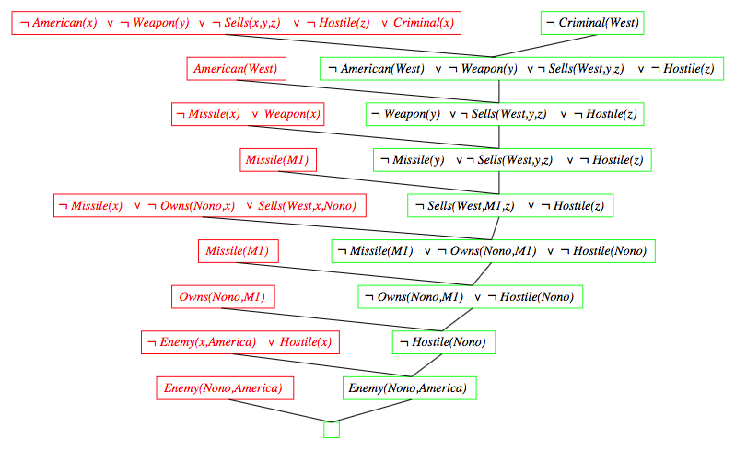
Example: Resolution proof
Notes:
Another great example of FOL resolution proof: http://www.cs.toronto.edu/~edelisle/384/f14/Lectures/LogicExample.pdf
And another: https://www.google.com/url?sa=t&rct=j&q=&esrc=s&source=web&cd=4&ved=0ahUKEwjz2pKJpsLTAhVjllQKHXELCWMQFgg1MAM&url=http%3A%2F%2Fwww.cs.cmu.edu%2Fafs%2Fcs%2Facademic%2Fclass%2F15780-s13%2Fwww%2Flec%2FResolutionExample.pptx&usg=AFQjCNGAFTbdPoUro6NAcQR8emBAcmxrGQ
And another: https://www.cs.utexas.edu/users/novak/reso.html
And another: https://www.csee.umbc.edu/courses/graduate/691/spring12/03/notes/19resolution.pdf

Slide 39
Summary: Inference in FOL
Fred Flintstone: Turn FOL into propositional logic; find entailments
Use of Universal Instantiation and Existential Instantiation
Works...but is slow for all but the smallest domains.
Better plan: Use unification to identify possible bindings of variables!
Can be seen as a “goal-focused instantiation”
Then can just use generalized Modus Ponens for inference
Forward and Backward chaining algorithms implement this approach in two different ways
Forward chaining is used in production systems (expert systems)
Forward chaining is complete for datalog → runs in polynomial time
Backward chaining is best for query-oriented proof
Used in logic programming systems like Prolog
Suffers from typical DFS issues: infinite loops and incompleteness
Prolog uses database semantics to implement a subset of FOL
Generalized resolution proof provides a complete proof system for FOL

Slide 40

α β ⊆ ¬ ⇒ |= ∧ ∨ ⇔

